Slide 1
Ordre Mondial des Gourmets Dégustateurs
OMGD

Slide 2
Index
History
Goal & Objectives
Membership
Management
Vision & Mission
Action Plan : Siége Mondial
Action Plan : International Committe
Action Plan : Baillis Délégués
Action Plan : National Echansons
Key Statistical Information

Slide 3
History
Ordre Mondial des Gourmet Dégustateurs (OMGD) is a specific section of the Chaîne des Rôtisseurs, which specializes and concentrates on wines, spirits, liqueurs, and crafted beverages.
It was founded in Paris in September 1963, and is an integral part of the Chaîne des Rôtisseurs.

Slide 4
Goal & Objectives
The goal of OMGD is to promote the enjoyment, appreciation and the knowledge of fine wines, spirits, liqueurs, beers and crafted beverages from around the world.
The main objectives and tasks of OMGD is to organize dinners, tastings, meetings, field trips, and other events focusing on wine and other crafted beverages, and pairing them with the appropriate dishes, thus encouraging and fostering an understanding and appreciation of wines and spirits which is valued by OMGD members and their guests.

Slide 5
Membership
The members of OMGD also include professionals working in the drinks sector, such as producers & distributors, and amateurs who simply have love or passion for fine wines, and quality spirits.
Any member of the Chaîne des Rôtisseurs can become a member of l’Ordre Mondial des Gourmet Dégustateurs provided that they are proposed and sponsored by an OMGD member.
Members of OMGD require a separate membership and a subscription payment.

Slide 6
L’Ordre Mondial des Gourmet Dégustateurs is managed by an international committee comprising the following members:
MANAGEMENT
Mohamed HAMMAM Chairman Commandeur Bailli Délégué deTurquie Membre des Conseils d’Administration et Magistral
Benoît FRAGNIÉRE Member Chancelier de Suisse Membre des Conseils d’Administration et Magistral
Harold S. SMALL Member Bailli Délégué des États-Unis Membre des Conseils d’Administration et Magistral
Tal GAL-COHEN Member Bailli Délégué d’ Israel Member du Conseil Magistral

Slide 7
Vision & Misson
The vision of the International Committee is to widen the presence of, and further expand l’Ordre Mondial des Gourmet Dégustateurs membership globally, and to provide its members with the desired added value, in line with its defined goal and objectives, with the commitment of the worldwide president and the international committee, and further motivation and encouragement of the Baillis Délégués and National Echansons, through the implementation of a realistic action plan.

Slide 8
Action Plan - Siège Mondial
Ensure the commitment of the worldwide President to promote OMGD.
The President to introduce the new OMGD Committee to all Baillis Délégués & Echansons.
The President to encourage all Baillis Délégués to introduce and develop the OMGD in their respective countries.
The President to assist the International Committee when needed, to provide credibility and generate the support of the Baillis Délégués.

Slide 9
Action Plan – The International Committee 1/3
Revive the brand & image of OMGD
Change the current OMGD logo
Re-introduce the OMGD plaque distribution to the OMGD professional members
Introduce OMGD International Committee members to the Baillis Délégués & Echansons, and inform them about the vision for the future OMGD, and the intention to further develop and increase its membership and activities globally
Ask the Baillis Délégués and Echansons of their expectations from the OMGD Committee
Request all Baillis Délégués of countries with no current OMGD structure, to appoint a national Echanson to their respective National Boards whose main duty would be recruiting OMGD members, and organizing OMGD events, and other related activities

Slide 10
Action Plan – The International Committee 2/3
Request all Bailli Délégués to provide to the Committee, a list of OMGD events that have been held in their respective countries over the past three years
Request all Baillis Délégués & Echansons to organize at least two or more OMGD events annually. Such events shall include, but not be limited to the following:
Wine, spirits, and other crafted beverage tastings
Wine, spirits, and other crafted Beverage pairing dinners
Winemakers dinners
Vineyard harvest & winery visits
Provide guidance to the Baillis Délégués and their national Echansons on the type of events, and how to organize such events
Request all the national Echansons to regularly report all their OMGD events and activities held in their respective countries, to the Committee

Slide 11
Action Plan – The International Committee 3/3
The Siége Mondial shall maintain a historical list of OMGD events held in each respective country in the past three years. The list shall be provided by the Siége Mondial to the Committee, and it shall then be made available to all Baillis Délégués and national Echansons, in order to provide them with ideas of similar events that they may want to organize in their respective bailliages.
The International Committee shall organize an annual international OMGD Grand Chapitre, to be held in a different wine country/region every year. The event shall be announced to all members, and be featured on the international website, and be included in the Siége Mondial Grand Chapitre Calendar well in advance.

Slide 12
Action Plan - Baillis Délégués
Introduce OMGD structure in their respective countries
Appoint an Echanson to their National Boards. Vice-Echansons may also be introduced in countries where regional structure exists
Offer OMGD membership parallel to the Chaîne membership, for all new candidates joining the Chaîne des Rôtisseurs
Encourage the non-OMGD members to enroll themselves as OMGD members
Support the International Committee in realizing its vision and mission
Support and encourage their National Echansons to promote OMGD, and to organize OMGD events and other activities

Slide 13
Action Plan - National Echansons
Promote OMGD in their respective countries
Encourage the increase in number of members
Encourage more hospitality and wine professionals to join OMGD
Organize and hold at least two OMGD events annually. In countries with regional structure, the same should apply to each Regional Bailliage
Regularly report on all the events held in their respective countries to the OMGD Committee

Slide 14
Key Statistical Information 1/8
Total OMGD Members 2015 per Bailliage
Total: 2591

Slide 15
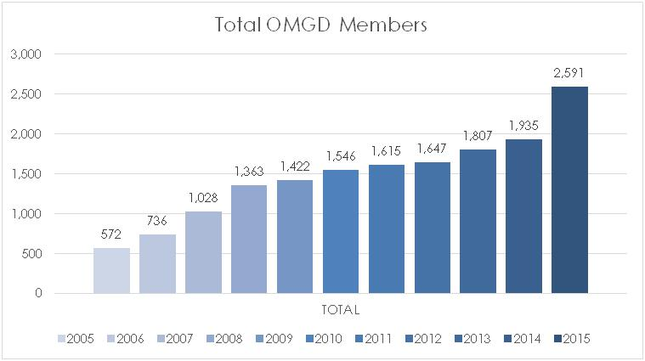
Key Statistical Information 2/8

Slide 16
Key Statistical Information 3/8
Bailliages > 5 OMGD Members in 2015 Bailliages 1 < 5 OMGD Members in 2015
BAILLIAGES | TOT 2015
Turquie | 506
Suisse | 447
Finlande | 273
Norvège | 236
Grande-Bretagne | 180
Israël | 159
Afrique du Sud | 115
Canada | 105
Autriche | 95
Philippines | 94
Portugal | 85
Guyane | 47
Danemark | 46
Bermudes | 35
Corée | 33
Australie | 31
France | 23
Chine | 17
Guadeloupe | 11
Costa Rica | 9
Italie | 8
Cambodge | 7
BAILLIAGES | TOT 2015
Allemagne | 5
Singapour | 5
Thaïlande | 4
Mexique | 3
Belgique | 2
At Large | 2
Emirats Arabes Unis | 1
Liban | 1
Japon | 1
Suède | 1
Indonésie | 1
Russie | 1
Sultanat d'Oman | 1
Sint Maarten | 1

Slide 17
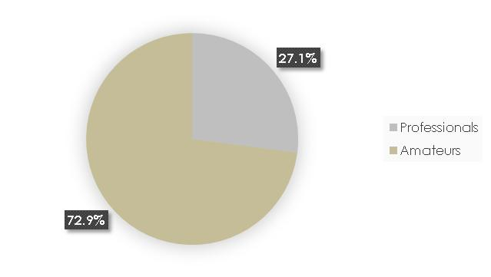
Key Statistical Information 4/8
Professional / Non Professional OMGD Members 2015

Slide 18
Key Statistical Information 5/8

Slide 19
Key Statistical Information 6/8

Slide 20
Key Statistical Information 7/8
OMGD Age Structure 2015

Slide 21
Key Statistical Information 8/8
Average Age 2015
Lowest to the highest
Bailliage National | AV. AGE
Afrique du Sud | 47
Chine | 47
Turquie | 49
Cambodge | 51
Philippines | 52
Israël | 53
Guadeloupe | 53
Australie | 54
Corée | 55
Costa Rica | 55
Canada | 56
Bailliage National | AV. AGE
Bermudes | 57
Finlande | 58
Grande-Bretagne | 58
France | 58
Suisse | 59
Autriche | 59
Italie | 60
Norvège | 61
Portugal | 61
Danemark | 62
Guyane | 63

