Slide 1
MONALIIKU - MONIKANSALLISTEN NAISTEN HYVINVOINTI JA LIIKUNTA RY
SPORTS + NETWORKING = SOCIAL INCLUSION

Slide 2
Monaliiku- monikansallisten hyvinvointi ja liikunta ry
About us
Monaliiku- Well-Being and Sports for Multicultural Women is a unique non-governmental organization revolutionizing multicultural women’s social inclusion by providing them with opportunities to take more active role in the society.
We work for the enhanced wellbeing for women and girls regardless of their background, religion or nationality.
Based on our values we aim to enhance the equality of sexes, equal opportunities of women, health and well-being. Moreover, we strive against discrimination in the society.

Slide 3
Monaliiku values
The core values of the organization include:
trust
sports and exercise
respect
knowledge and professionalism
networking
support
change
communication skills

Slide 4
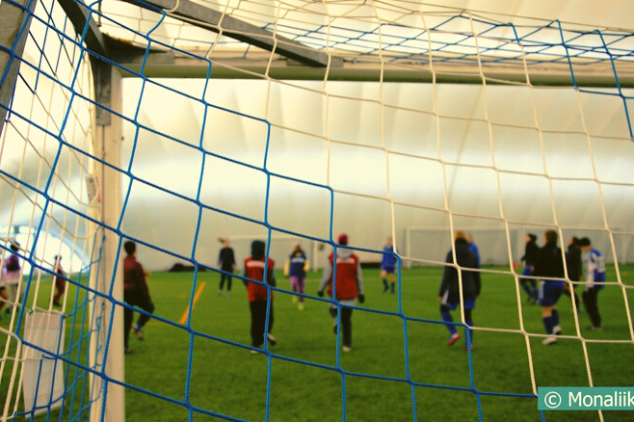
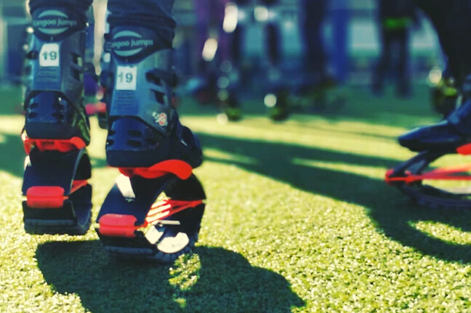
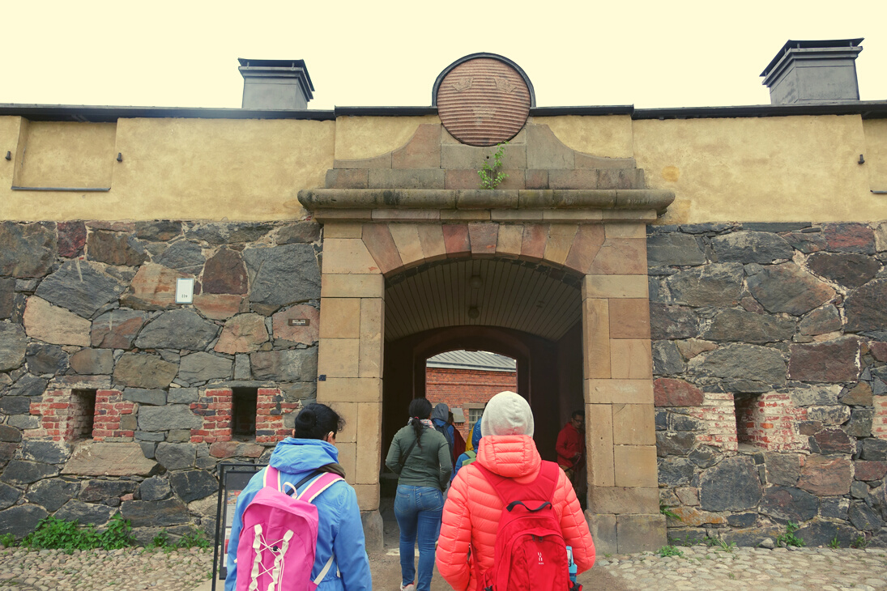
Projects
FIT4LIFE (Elämäni Kunnossa)
Sports and events
Small projects
Enhancing health and well-being of migrant women
Preventing exclusion
Enhancing the quality of life
Sports and exercise
Discussions about health and well-being led by professionals
Health checks
Food courses
.
Walk to museums
Kamuset
Different sports groups from dance to football
Multicultural sports events bringing together people from different backgrounds

Slide 5
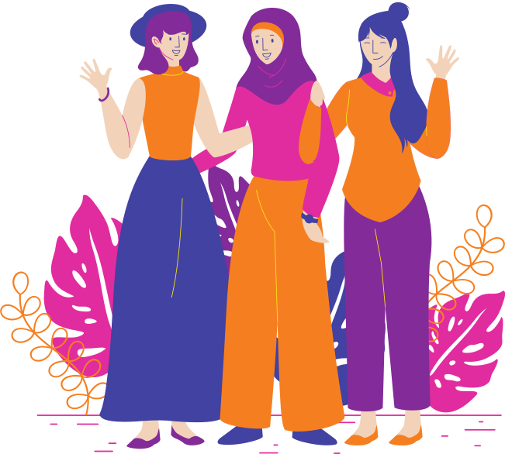
Projects
Mentor on the Move
Pilot project developing an active mentoring program (2018-2020)
Concept follows the core ideology of Monaliiku
” Bringing people together and enhancing well-being
with sports and exercise”
Funded by the Ministry of Health and Social Affairs with the support of Veikkaus (STEA)

Slide 6
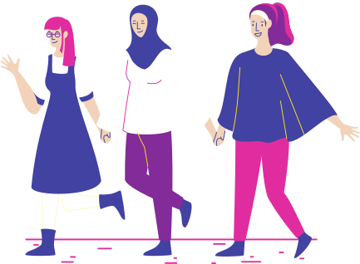
Mentor on the Move
Aim of the project
Social well-being
Sports and exercise
The program integrates sports and exercise to mentoring meetings and thus enhances their well-being
Mentoring can promote the social well-being and add social networks of the mentee
Working life skills
Social inclusion
Mentoring provides the mentee beneficial working life skills and opportunities. In addition, the program provides workshops for professional networking.
The project provides migrant women with opportunities to take part in the finnish society and to feel included

Slide 7
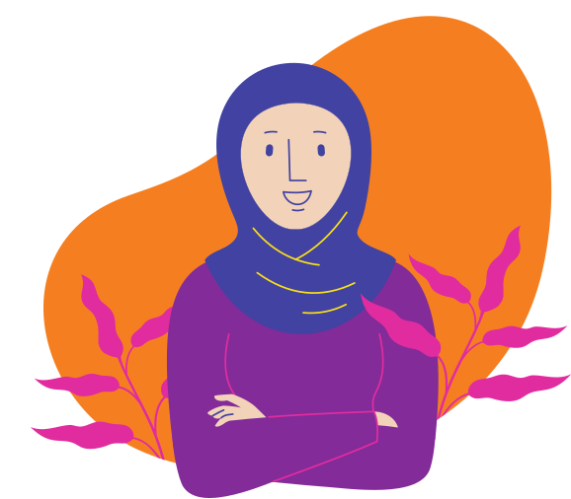
Mentor on the Move
Mentor + Actor (Mentee) = mentoring pair
Mentor
Actor
Finnish women who want to share their knowledge and expertise with migrant women
Migrant women who are motivated to add sports in their life, learn about Finnish society/ sports culture or who want to enhance their social network

Slide 8
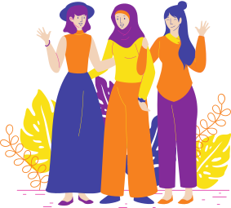
Mentor on the Move
Timetable
Kick Off- event
Mid term meeting
Graduation seremony
5.9.2020 @ZOOM
Networking
Joulukuu 2020
Self care
6.3.2021
What is Mentor on the Move?
What is mentoring?
What are the roles of mentor and actor?
What is networking and how it is done.
Updating plans
It is time to celebrate the journey of our wonderful mentoring pairs and learn about means of self care and mental well-being. What is it that keeps you going?
Goals!- workshop
Mentors round table
16.9.2020 klo 17-19
23.9.2020 klo 17-19
24.9.2020 klo 17-19
29.9.2020 klo 17-19
January 2021
Mentor’s support meeting
Mentor on the Move is a goal orientated mentoring program. Goals help us focus on what we want to achieve. Here, we make plans and learn new tools for making progress.
Max number of participants is 5 pairs/ group. Register at:https://www.monaliiku.fi/hankkeet-projects/mentor-on-the-move-liikunnalline/tapahtumat-ja-tyopajat/

Slide 9
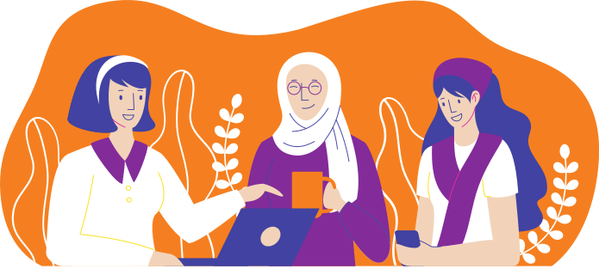
Mentoring meetings are the most important part of the program. The aim of the meeting is to have an open and relaxed, prepared and consultative discussion. Every actor is responsible for their own progress; thus it is important that she is the one making the initiative for the. What is it that the actor wants to establish?
The discussion stems from situations where the actor feels like she needs support. The topics often relate to subjects, which are not traditionally covered with instructors, such as personal relationships, feelings or opinions. Mentoring requires accepting emotions as empowering factor in one’s life.
Mentor on the Move
Mentoring meetings

Slide 10
Mentor on the Move
Sports, exercise and resources
Mentoring meetings incorporate sports/ exercise in different forms and the mentoring pairs are encouraged to try new things and attend different events (i.e. hockey game, yoga festival)
Exercising together provides and informal platform for mentoring, and it is often easier to discuss even difficult topics.
The program offers each pair 160€ to cover the cost of sports/ exercise. In addition, they are entitled to 10€ cashback to cover the cost of “post-sports cuppa”, if they like to sit down after doing sports and discuss subjects arising from the actor's goals.
e.g. going swimming + having a cup of tea afterwards ☺

Slide 11
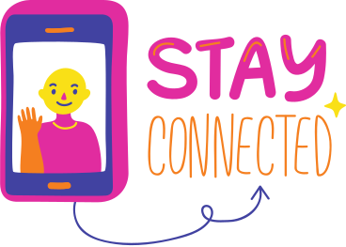
Mentor on the Move
COVID-19
3. Make rules with your partner
People have different mindsets when it comes to the pandemic. One may follow the recommendations very strictly, one may not. You have the right to do what is best for you as long as you don’t harm anyone else.
Make sure you communicate clearly with your partner and decide upon the rules for you two and for your meetings.
1. Follow the recommendations by the government
https://valtioneuvosto.fi/tietoa-koronaviruksesta
2. Don’t take risks!
4. Always follow the rules of the venue
If you or someone from you’r family is having any of the Covi-19 symptoms, please take the test at omaolo.fi and follow the instructions
www.omaolo.fi

