Slide 1
MONALIIKU - MONIKANSALLISTEN NAISTEN HYVINVOINTI JA LIIKUNTA RY
Good mentee

Slide 2
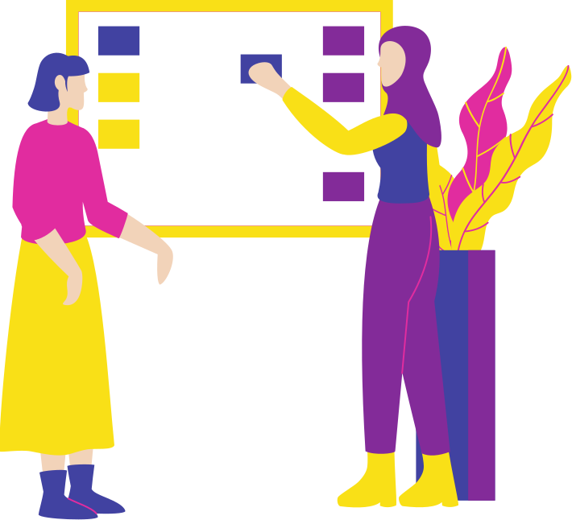
What is mentoring?
Effective and popular way to learn different personal and professional skills
One of the oldest means of influencing
A person acts as a role model, teacher and a friend to another
The “elderly” and “wise” professional teach young people different skills beneficial in life
By opening doors (new opportunities)
Sharing networks, ideas and suggestions for future
Influencing positively on the self-esteem and confidence of the mentee (I am skilled and capable)

Slide 3
The goals of mentoring
Helping with career and education decisions
Sharing knowledge and experience
Goals and creativity
Accepting differences and adding cooperation skills
Acknowledging your own and other people’s feeling
Learning new things

Slide 4
Who is your mentor?
We all have had people in our life, who have had an impact in our life and growth. Take a moment to reflect on important changes in your thoughts, attitudes, or situations where someone made you feel good about yourself. Someone has helped you to find a new skill or talent that you didn’t know existed. It was someone, who said something, that changed the way you think or act- the phrase is still there.

Slide 5
According to mentees with mentoring you can
Provides an opportunity to learn new things and get positive feelings
Have the support of the active and skilled mentor, who can provide you the knowledge and share experiences
Get your hands on the type of information that you can’t find otherwise
Get a “shortcut” to the right career path
Get feedback; ideas are tested, and you can find a solution together
Have stronger self-esteem; dare to take risks, make decisions
get courage to face tought situations
Expand your network

Slide 6
The ABC of a good mentoring relationship
Goal orientation
Agree upon goals for the whole process and every meeting. The goals can change during the program.
It’s a two way road
Both parties give and receive
Flexibility
Mentoring is a learning process, which cannot be set on stone. You just have to go with the flow.
It’s all about US
Mentoring relationship is for both of you; the mentee and the mentor. You trust the mentor and the mentor trusts you- and that’s worth holding on to. You can only break the trust once.
Engage
It is important that both of you are motivated to give your time and share skills

Slide 7
Framing the relationship
What is it that i want to learn from my mentor?
What can I offer my mentor? (What can she learn from me)
What are the things that we want to engage in/ do not want to engage in?
Are there subjects that are off limits? (i.e. you don’t feel comfortable sharing)
Are we ready to take feedback and become critical friends?
How formal/ unformal do we want our meetings to be?

Slide 8
Good mentee
Mentees are usually less experienced and seek for guidance, support or knowledge with the help of a mentor
Mentees benefit from mentoring:
Learning new things
Mentor teacher new things and shares information about her experiences, what has been successful and what has not
The mentee gets information that might be difficult to find on your own
Networks expand, faster career development
Feedback and ideas
Support for problem solving
Better self-esteem; I am capable, and I will
Gourage to take risks, make decisions and face difficult situations
Mentee
Learner, actor, who has the motivation to grow and evolve. Someone who is ready to take responsibility for theirself and their actions. Ability to take in feedback, coaching and questions.

Slide 9
Good mentee
Motivated and committed to the process
Open and fearless
Takes responsibility for her own development and growth
Willing to receive feedback and coaching
Knows how to reflect upon her own learning and development
Knows how to express her own expectations (oral and written)
Is active when it comes to arranging the mentoring meetings

