Slide 1
Product Family Project

Slide 2
What is a product family?
A product family is a group of related goods produced by the same company under the same brand.
Products are identifiable as a member of the same product family on the basis of design, materials, colours, print pattern etc.

Slide 3
Some examples about the product families

Slide 4
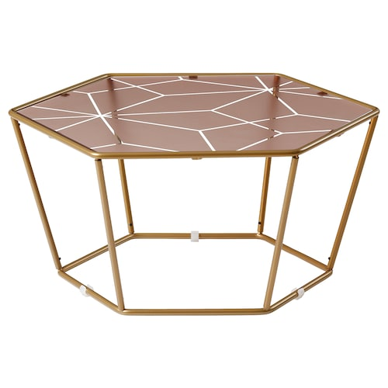
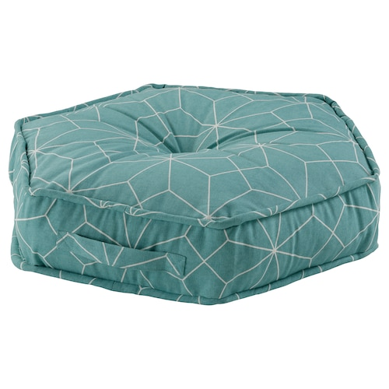
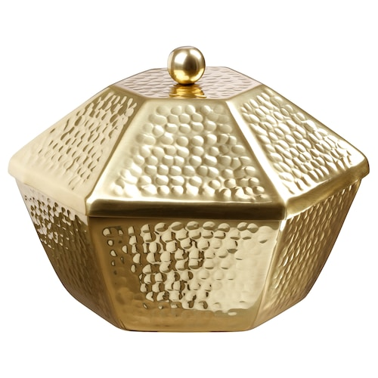
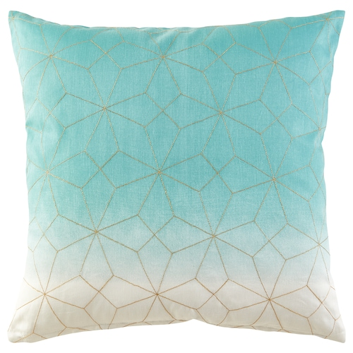
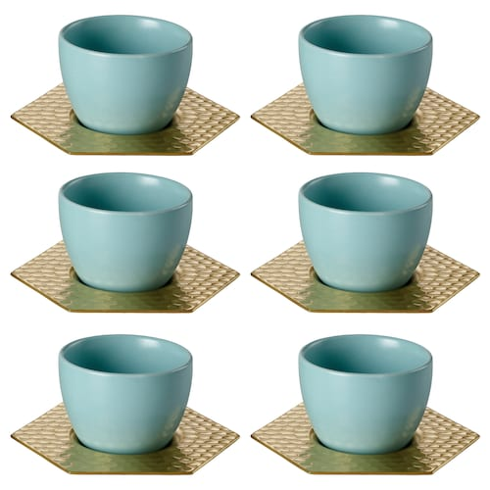
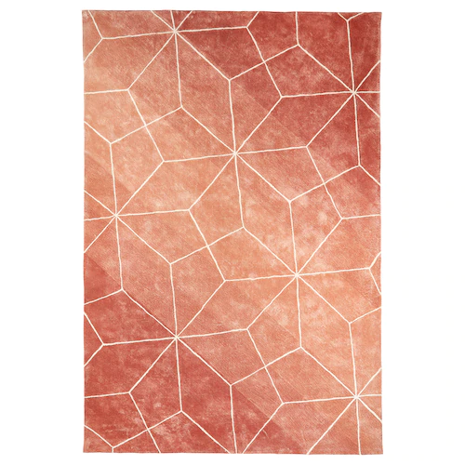
What is the common
factor with
these products?
All of these belong
to the Ikea’s "Ljuv"
product family.
Are the products
similar in their design,
colours or materials?

Slide 5
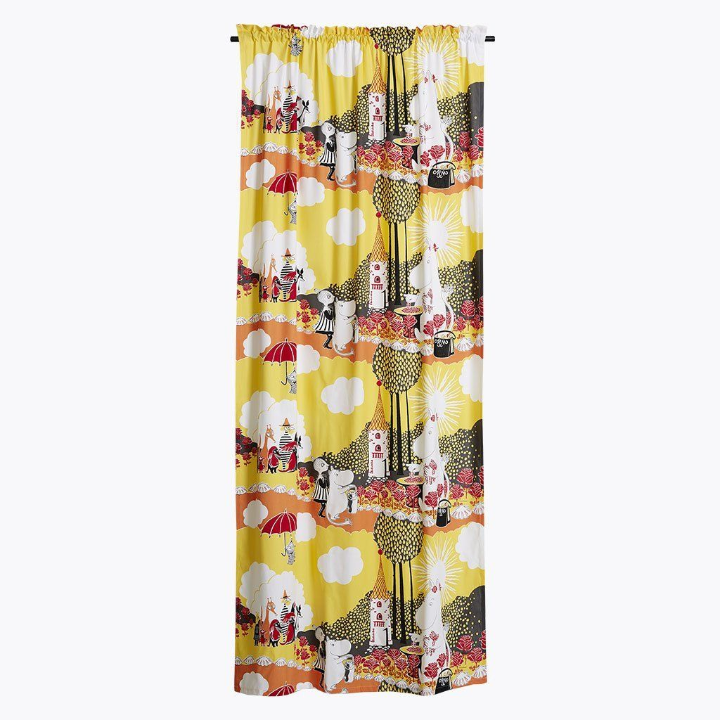
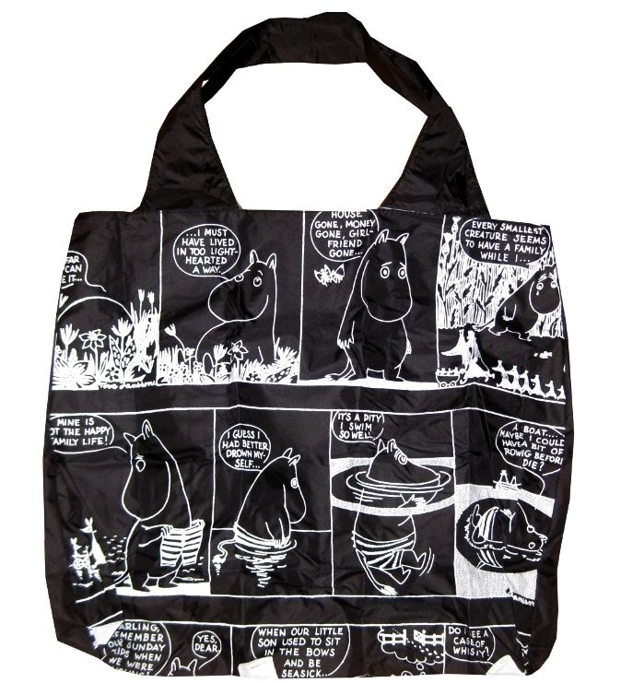
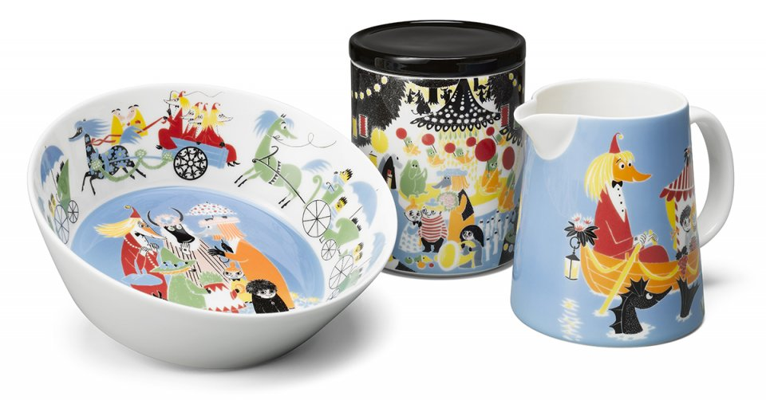
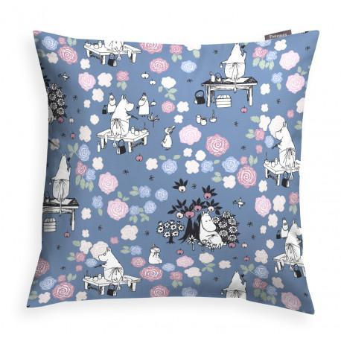
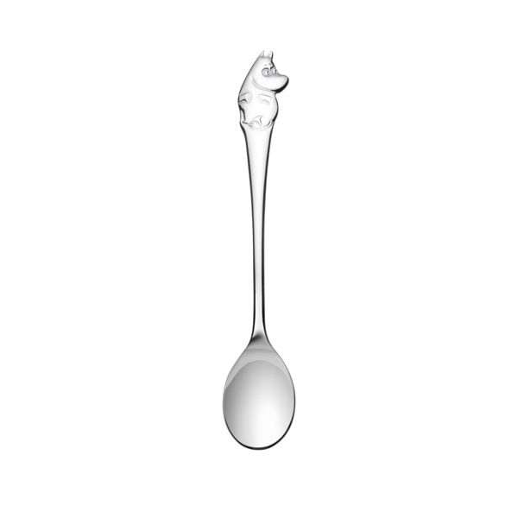
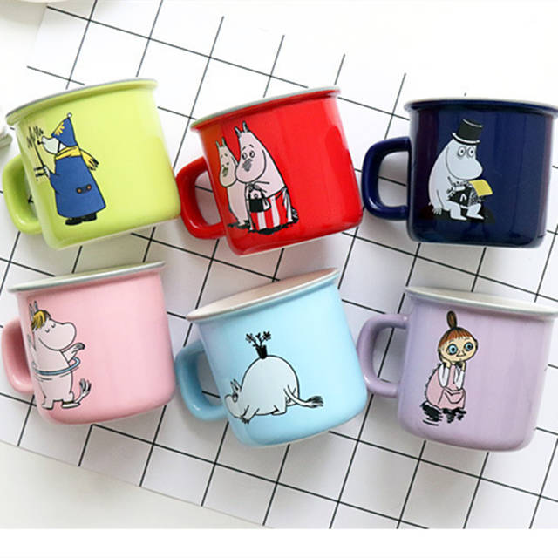
Moomin Character© series

Slide 6
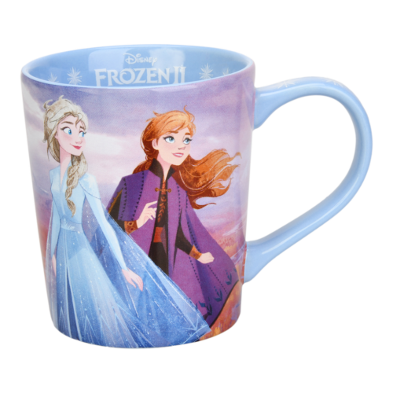
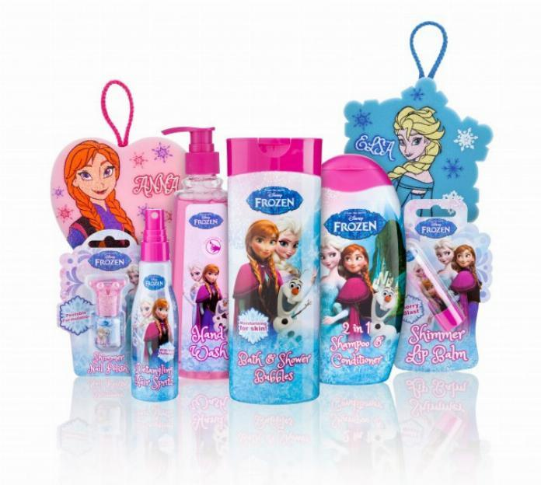
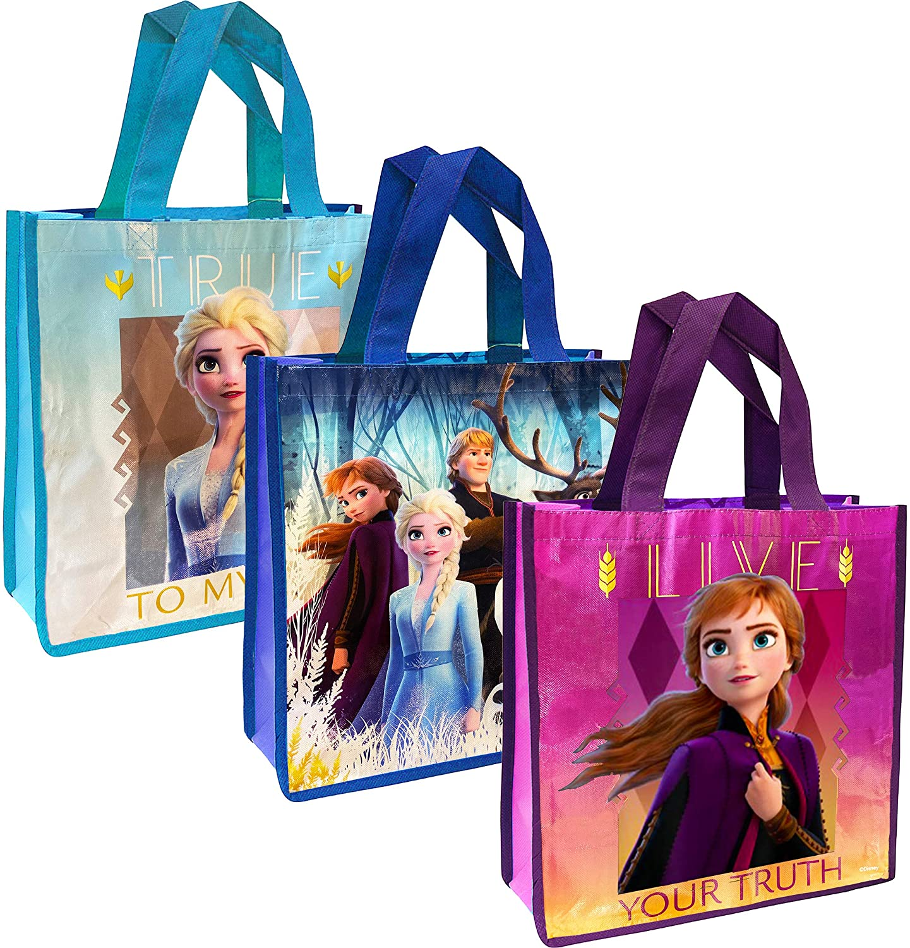
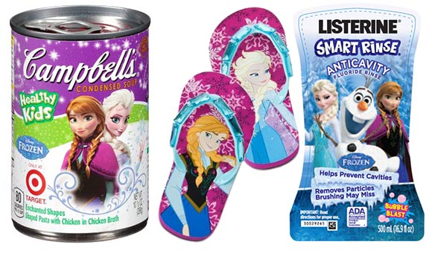
Frozen Product Family

Slide 7
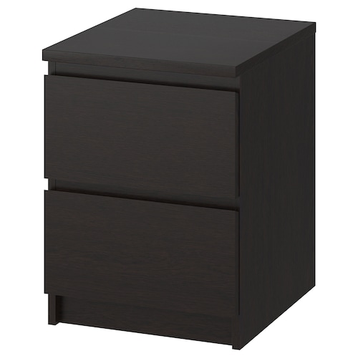
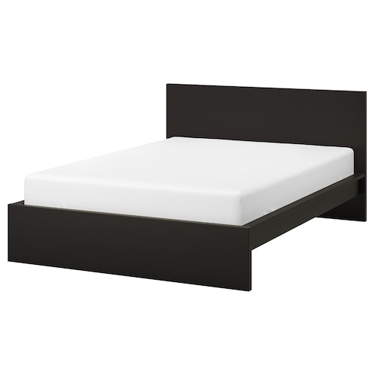
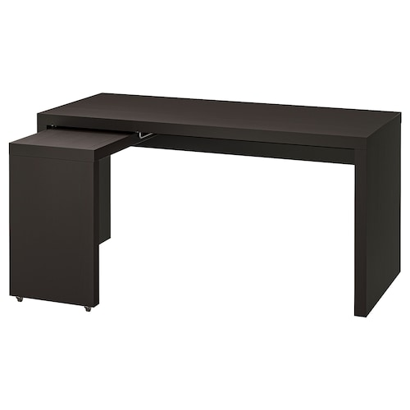
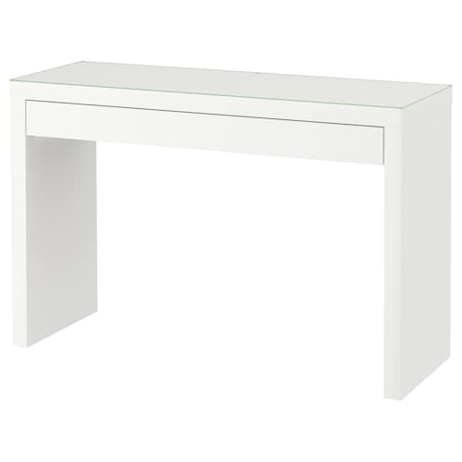
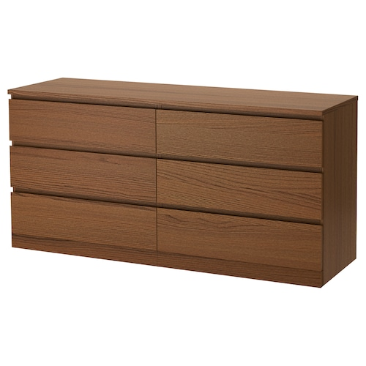
All of these belong
to the Ikea’s “Malm"
product family.

Slide 8
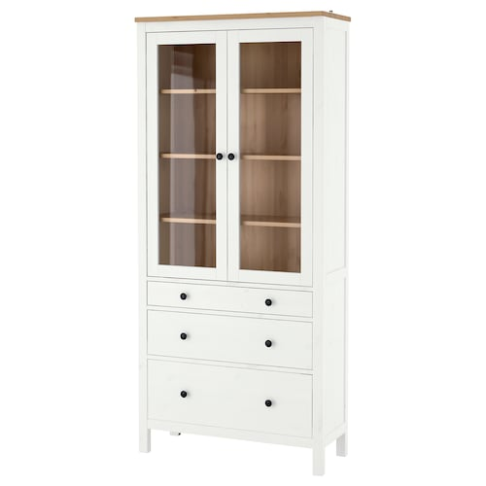
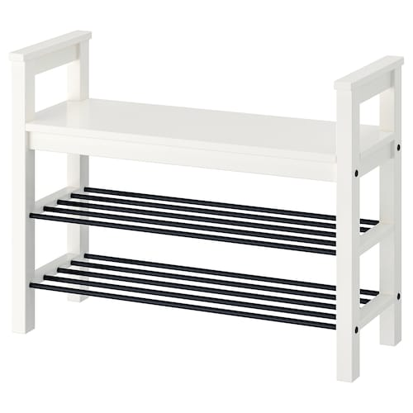
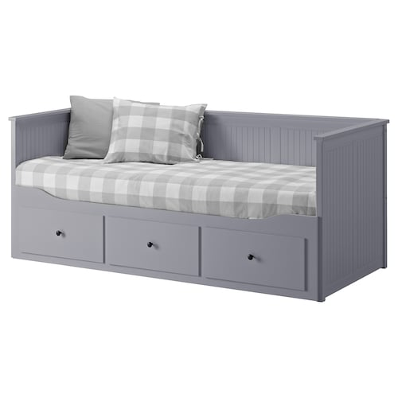
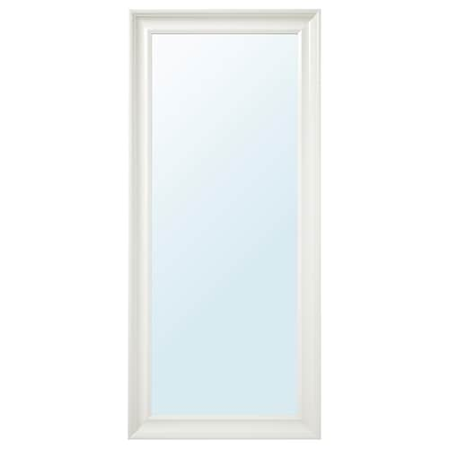
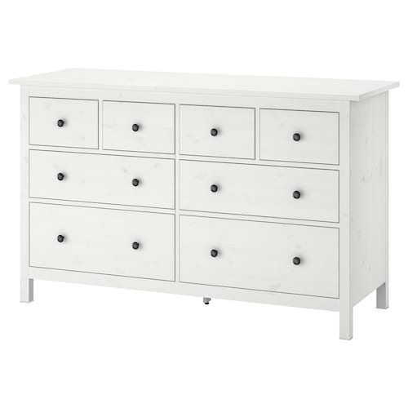
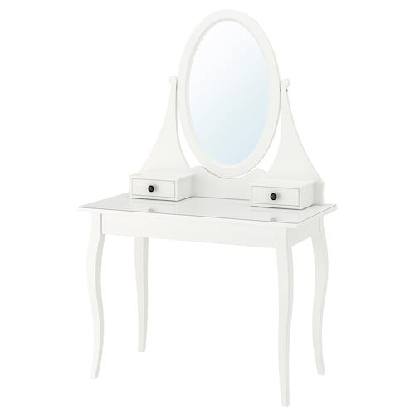
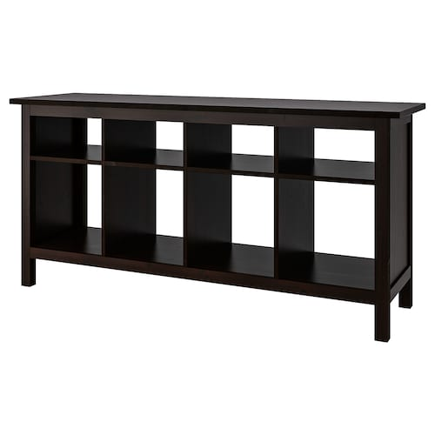
All of these belong
to the Ikea’s “Hemnes"
product family.

Slide 9
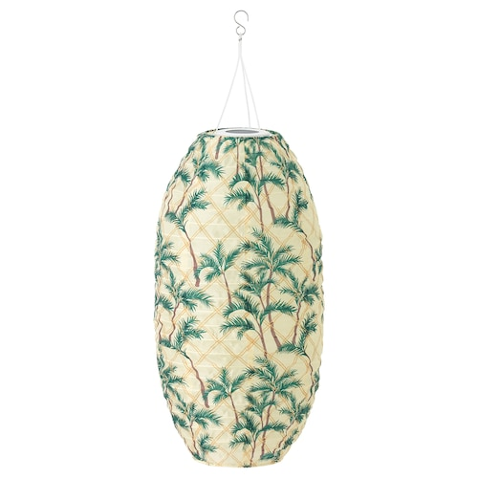
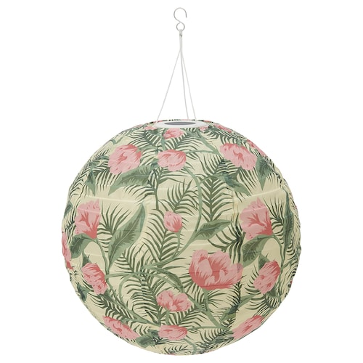
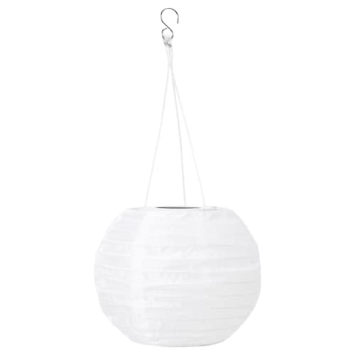
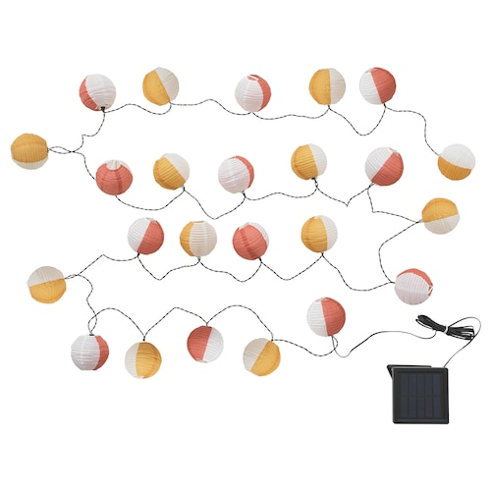
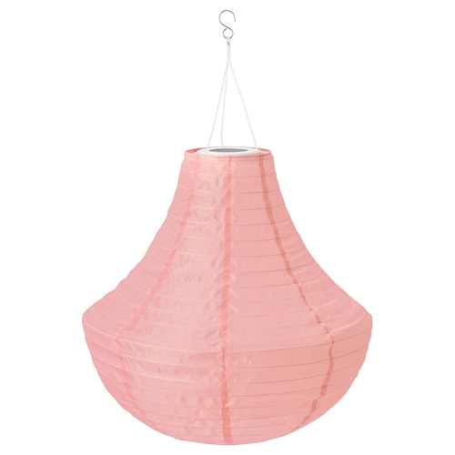
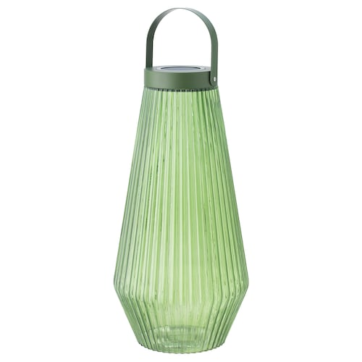
All of these belong to the Ikea’s “Solvinden" product family.

Slide 10
What do you have to do?
Plan and design your own small product family (minimum 3 products)
Plan products to kitchen, bedroom or living room
Draw your plan of the products on a paper.
If you want to use some digital planning/drawing tool (example Paint 3D) you can do so.
Your plan must show the measurements (in centimetres) of the products, materials and colours.

Slide 11
Presentation of your work
Make a PowerPoint or Sway presentation of your Product family
Give you product family a name and write the name on the title slide
Introduce one product on each slide
You can take a photo of your plans and attach into your presentation
Return your presentation into Class Notebook
Deadline xx.xx.2020

Slide 12
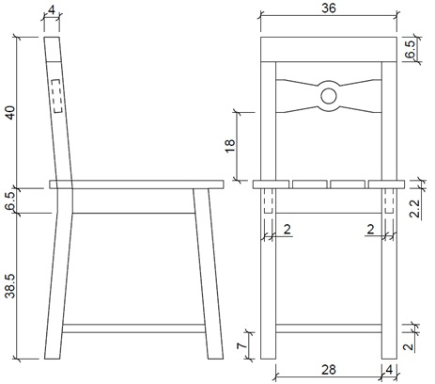
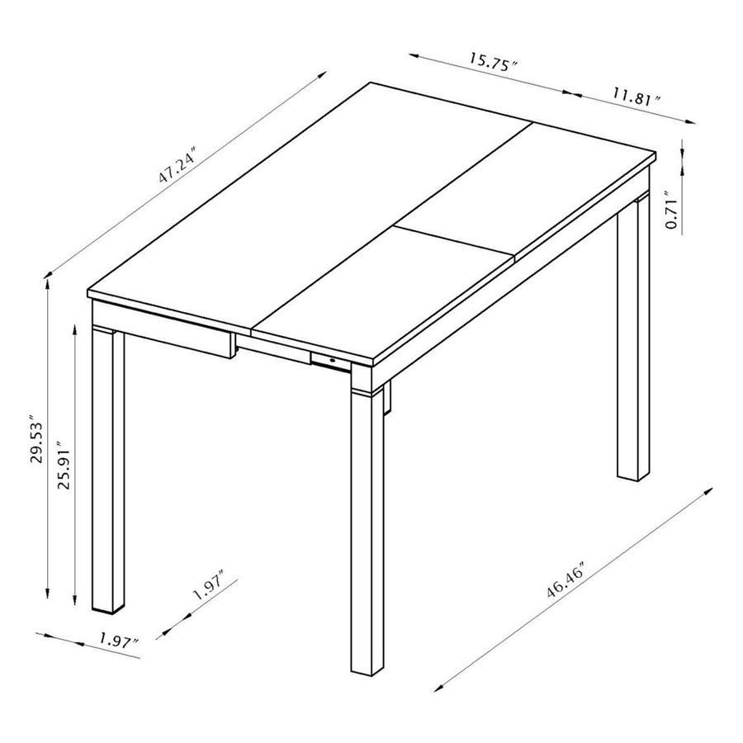
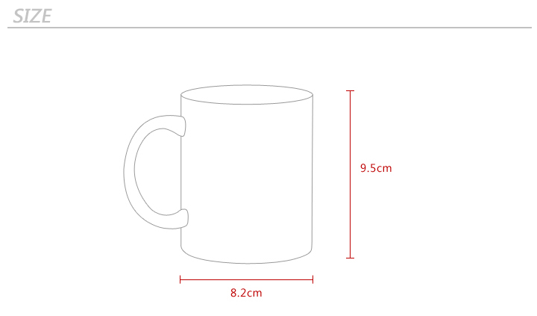
Ideas how to
draw your plan

Slide 13
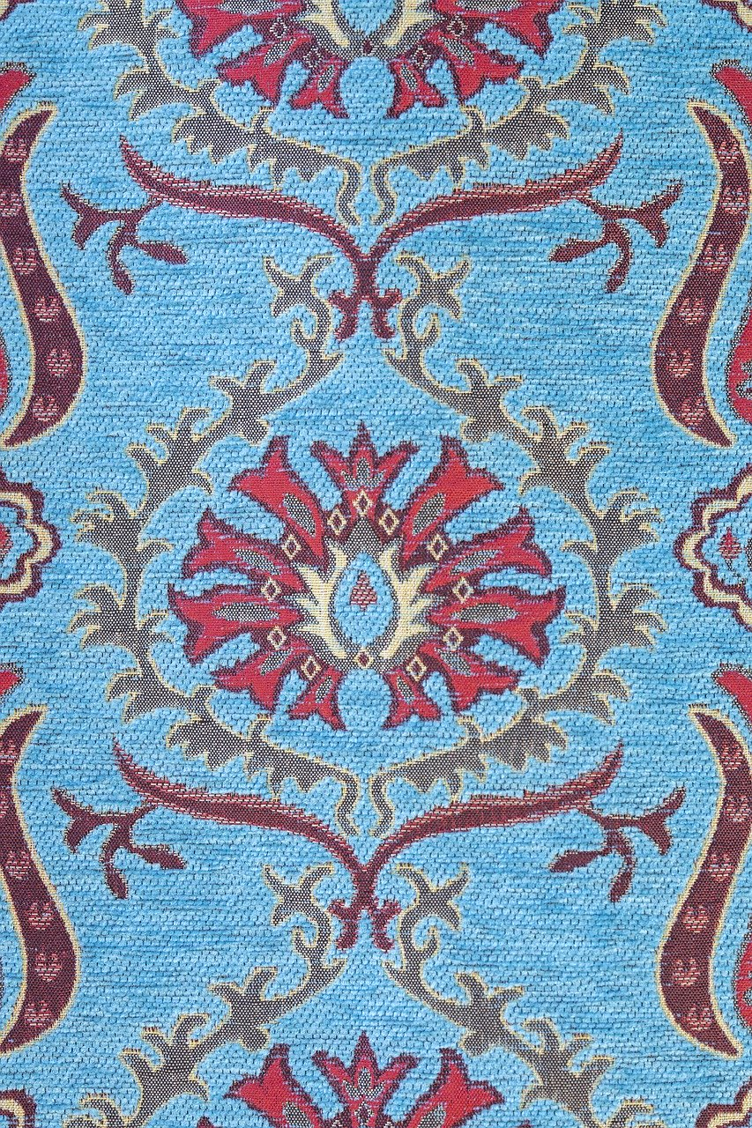
Example slide of
one product
Thickness 7 cm
The first product for my
Product family is cushion.
This product family is recognizable
by its Arabic pattern and pentagonal shape.
20 cm
Upper material: Printed 100% cotton
Sides and back side: Dark blue 100% cotton

