Slide 1
Recycle crafts from plastic
Think outside the box

Slide 2
What to do?
Just sit back and look at the pictures in this slide show
Think about the answers to the questions in the slides, but no need to write anything down.
And don’t worry you don’t have to make any of them yourself
This is just to get your creativity going

Slide 3
Where would you get the bottles?

Slide 4
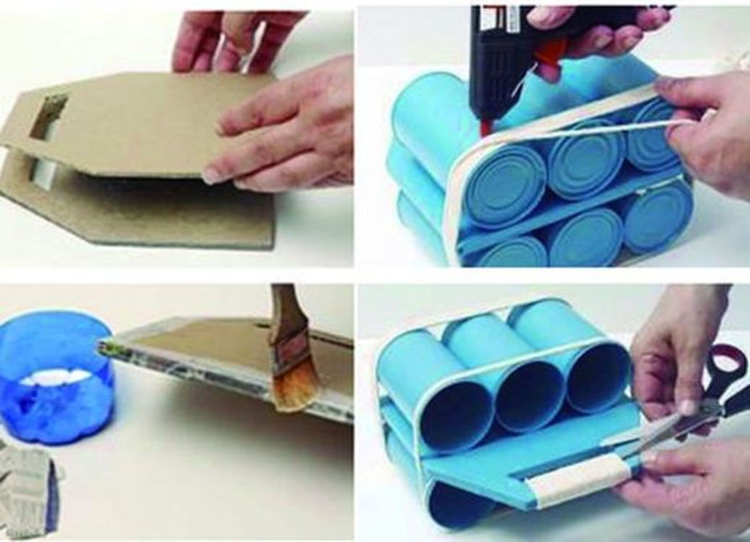
What materials are needed for this?

Slide 5
What is the placemat made out of?

Slide 6
Who could live here?

Slide 7
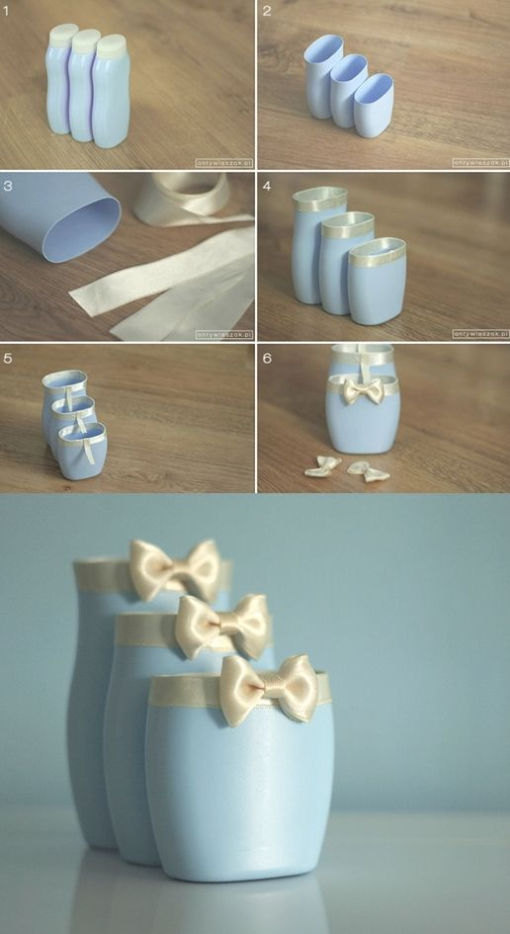
Can you find bottles similar to ones in the picture at your house?

Slide 8
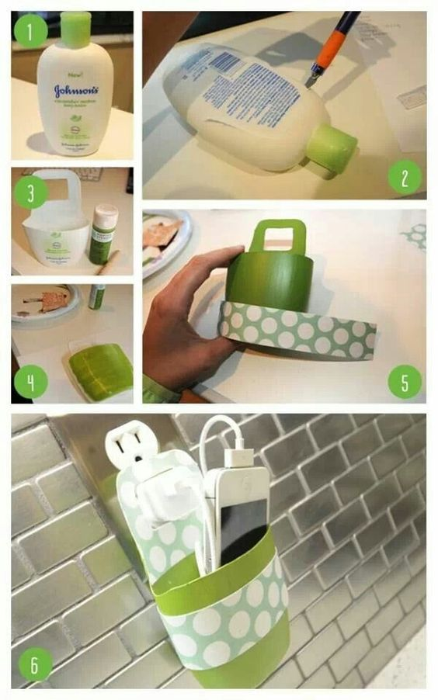
Do you need one of these?

Slide 9
Would this be possible to make yourself?

Slide 10
Some inspirational videos to watch:
https://fi.pinterest.com/pin/338121884523140991/
https://fi.pinterest.com/pin/315392780153879651/
If the links do not work you can search with recycle+plastic+crafts for more ideas

Slide 11
The assignment for crafts for 3 weeks
Try to make your own product from plastic (or other) waste.
What to do?
1. collect all kind of waste you can find from your house
2. remember to wash the plastic containers
3. use your creativity and test what you can do with the materials
4. take pictures of everything you do
5. when you are finished make a power point or sway to present your project stages
Important to remember: This assignment is not about the product you make, but about the process. So spend time to test and try different things and make as many prototypes as needed.
Be careful with sharp tools. Use scissors and ask an adult to assist you with cutting if needed.

