Slide 1
Mirror Coatings for Spray and brush application

Slide 2
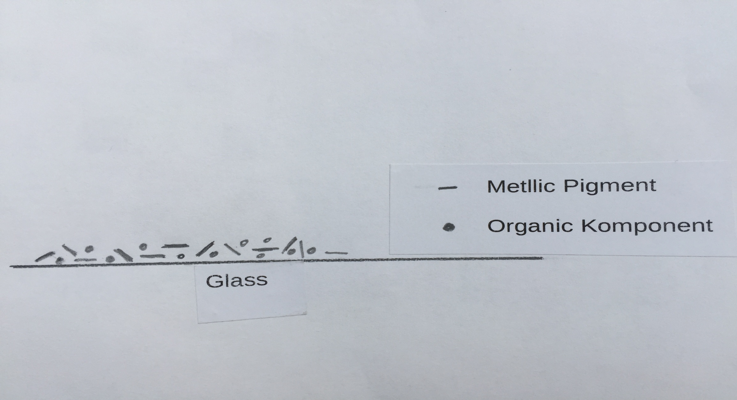
Metallic Pigment with Organic Particels
(No mirror effect)

Slide 3
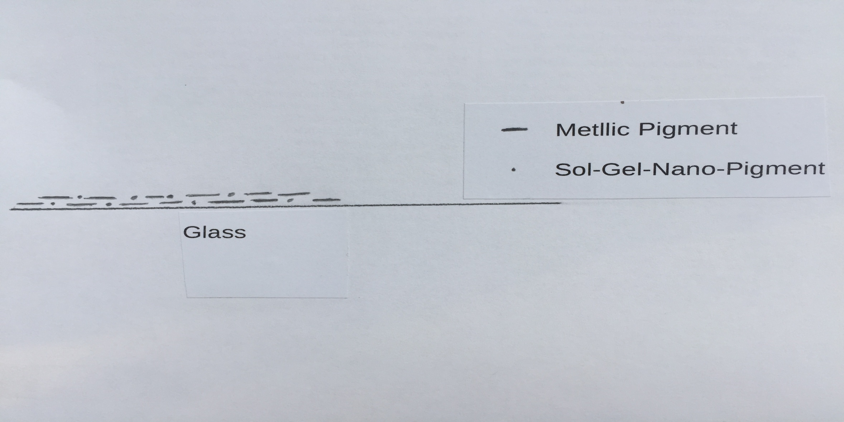
Metallic Coating with Special Nano Particles
(The Coating has now a Mirror-like surface)

Slide 4
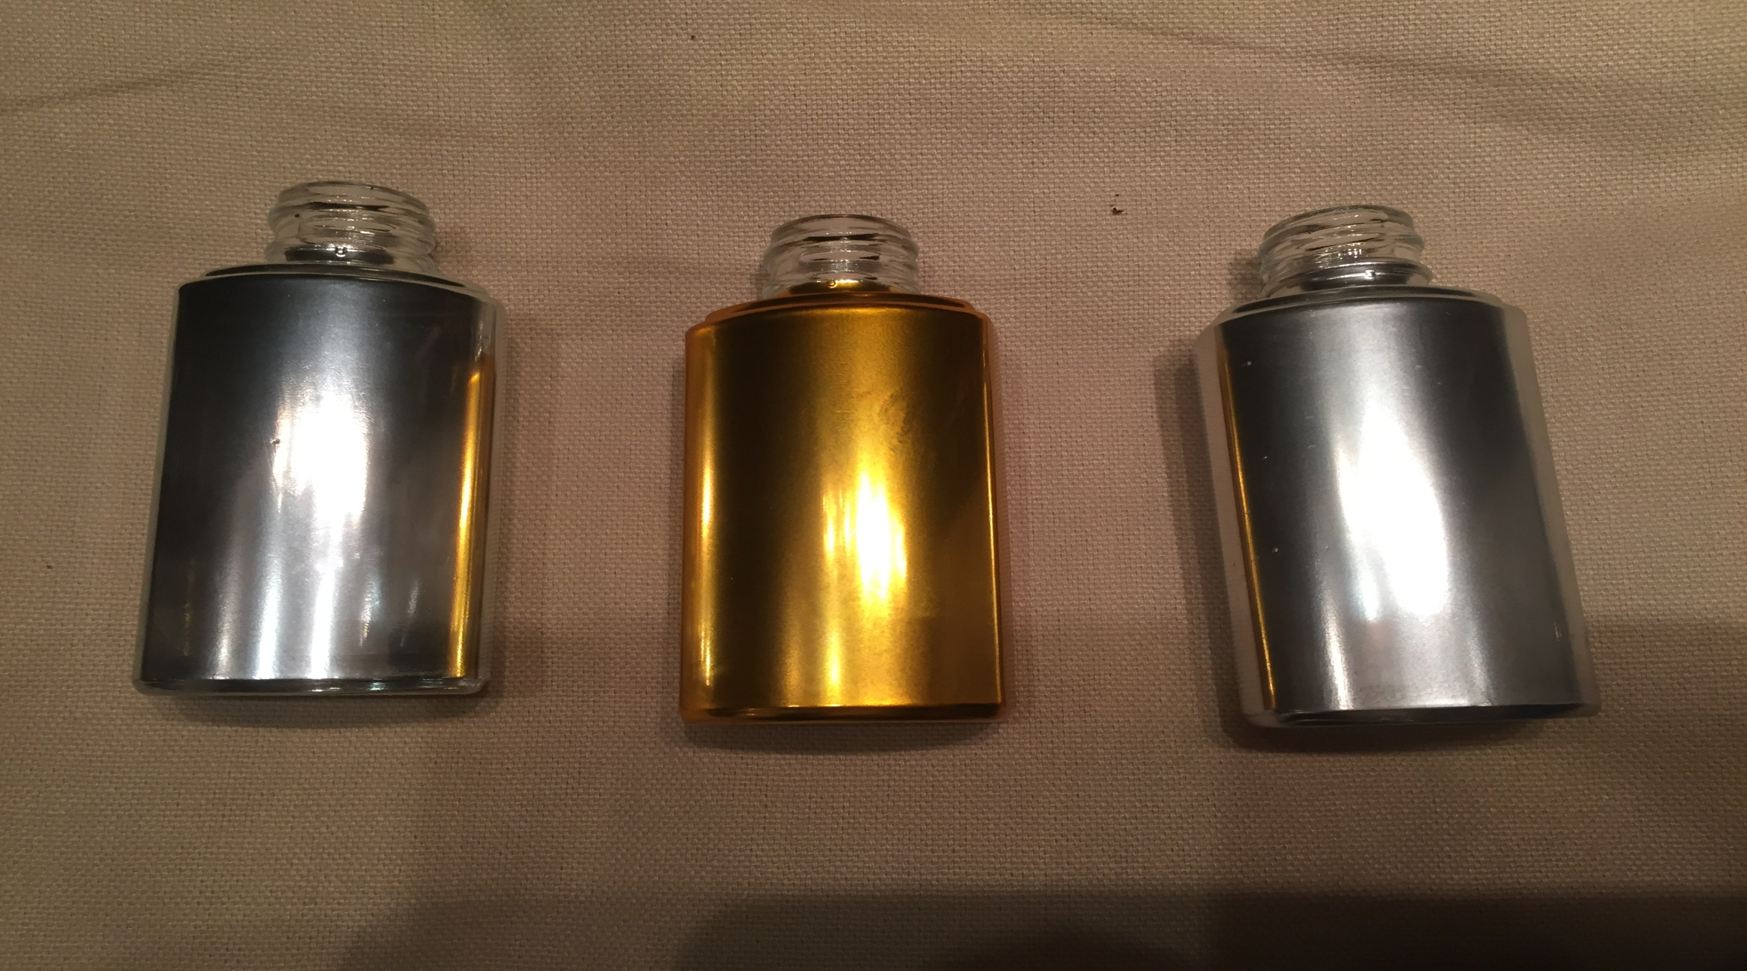
Samples coated with ORMO-Chrome

Slide 5
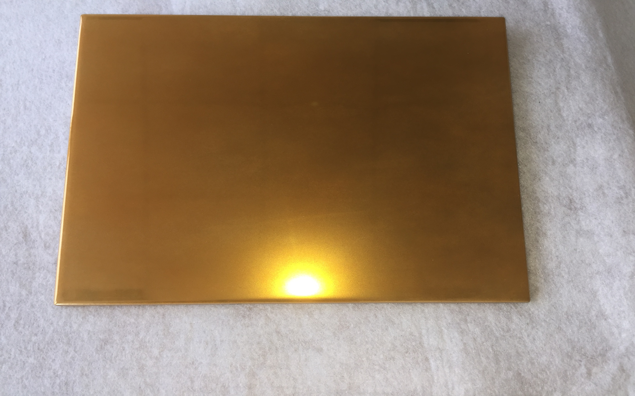
Maximilian Trier Fa. ORMO Print GmbH
Ferdinand Trier Fa. ORMO Print GmbH
Ceramic Tile with Gold Coating
( ORMO-Chrome + ORMOGLASS Yellow )

Slide 6
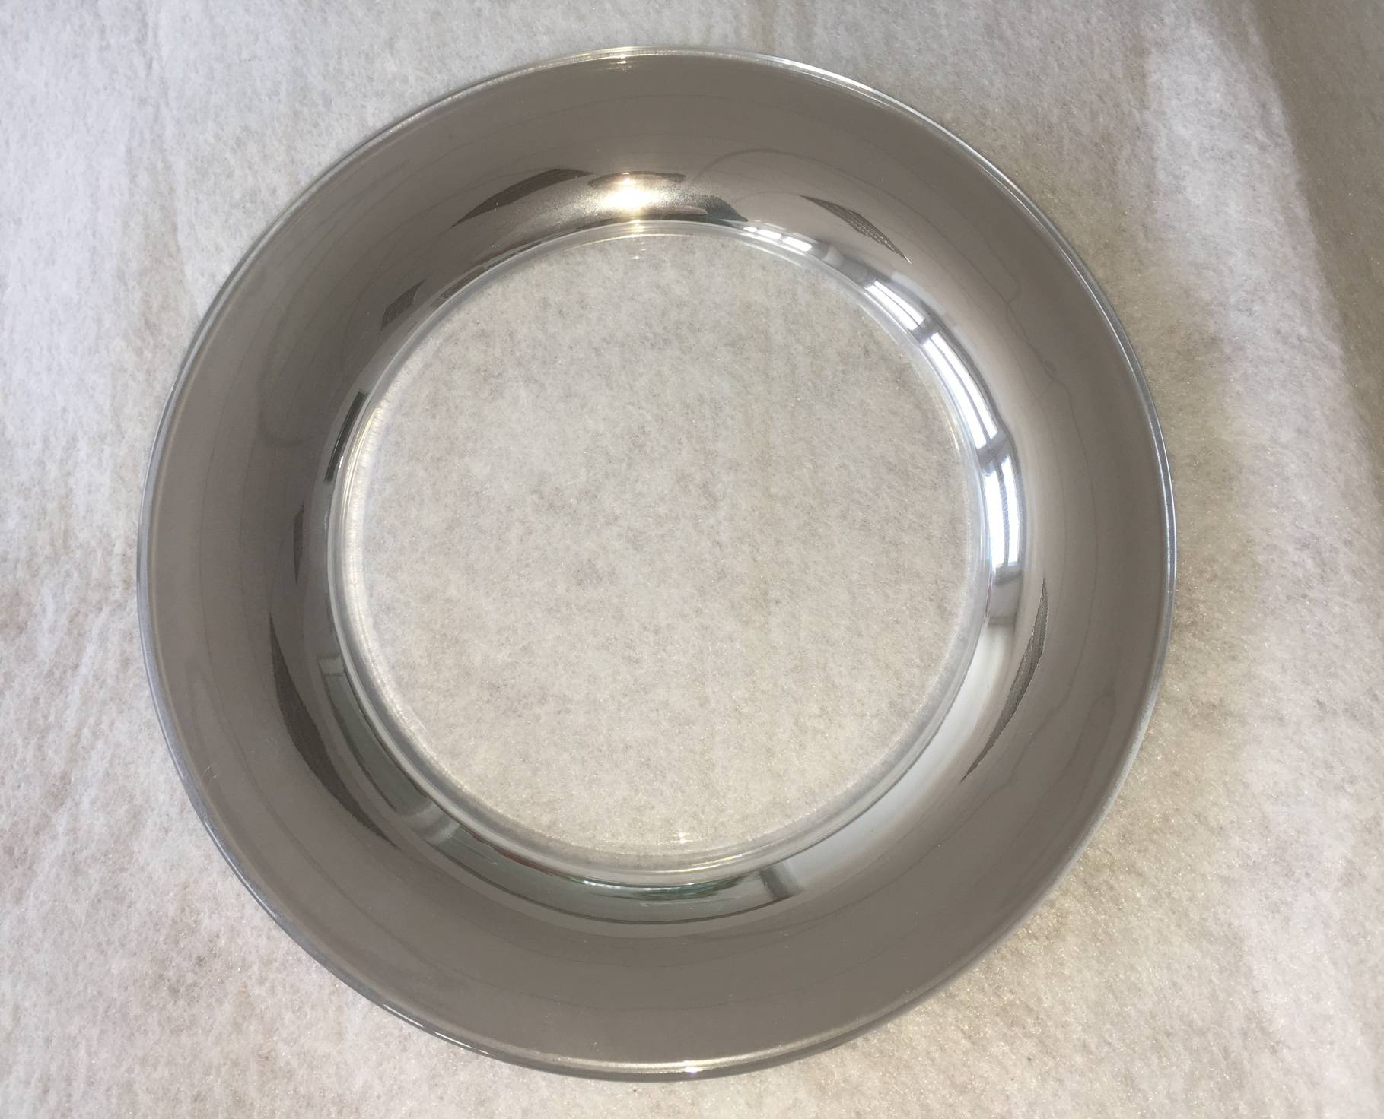
Rim of a Glass-plate with Silver Coating (ORMO-Chrome)

Slide 7
Conclusion
The first samples show that ORMO-Chrome really allows to produce
Mirror like coating on glass.
There is still some work to get the coating more stabil especially in
the dishwasher.

