Slide 1
The Summary Presentation of GPD Finland 2015 Jorma Vitkala GPD Chairman

Slide 2
GPD 2015 Summary Presentation is compiled from over 140 presentations
and from over 8000 slides.

Slide 3
GPD 25 Years In Brief 1992 – 2017
GPD is an independent forum dedicated to the development of the global glass industry supply chain through education.
Gpd history in numbers 1992-2016:
Over 1000 spekers
Over 12000 specialists visitors
Over 100 different countries
Over 40 media partners
Over 8000 pages publish articles
Conferences & seminars to the entire glass industry supply chain:
Finland, China, Brazil ,India, Turkey, Azerbaijan, Singapore ,UK and Cuba

Slide 4
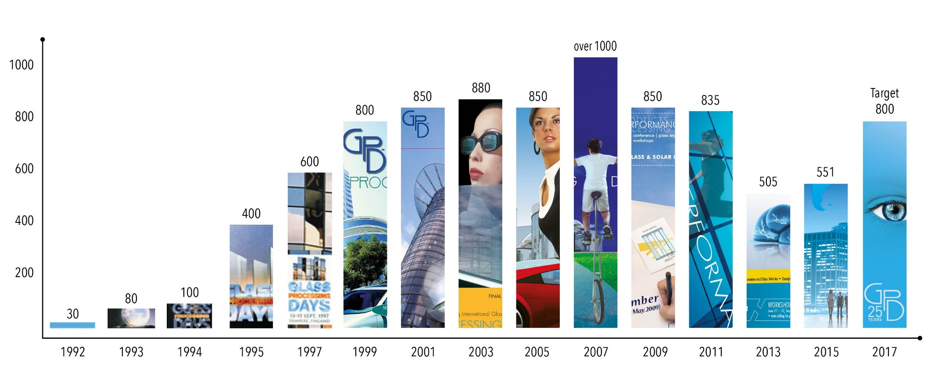
Participant History
Since 1992
  Over 12 000 participants since 1992
  Over 1 000 speakers
  Over 10 000 pages of technical papers published
In 2017, the target is to get around 800 participants to attend, since GPD will be celebration its 25th anniversary

Slide 5
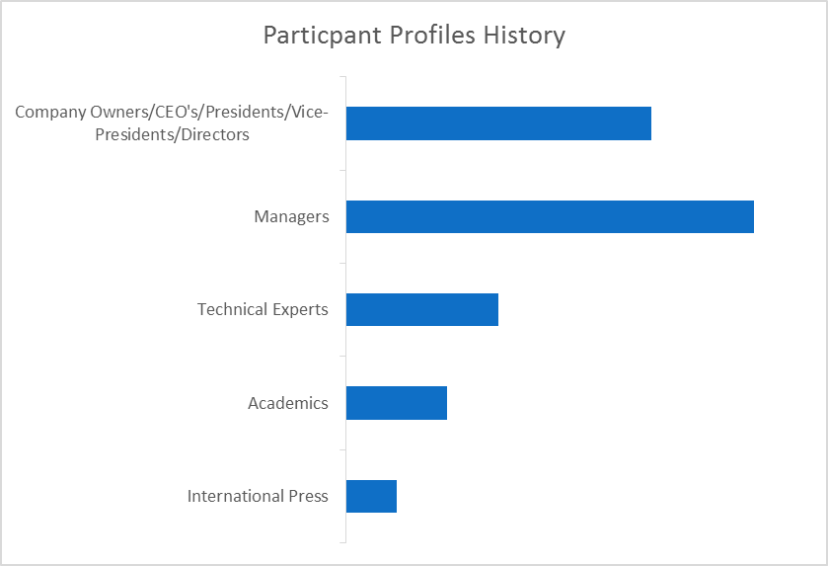
Participant Seniority Profiles
35-40%
35-45%
20-25%
5-10%
2-5%

Slide 6
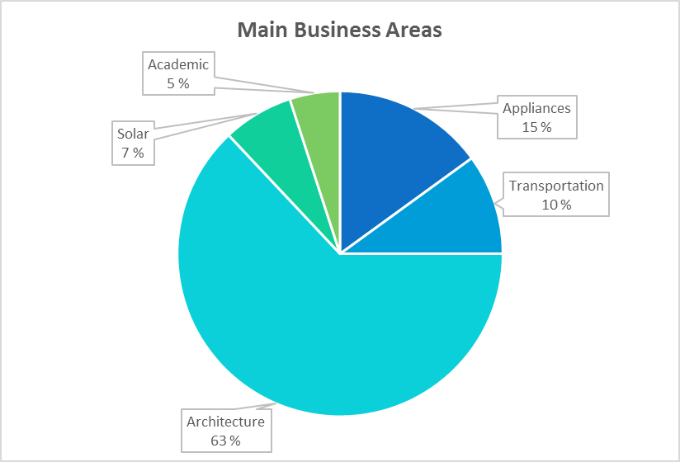
Participant Main Business Area

Slide 7
Participant Company Activities

Slide 8
A Summary Presentation of GPD Finland 2015: Market and Trends

Slide 9
Some key figures flat glass products
Global market | Figures
Flat glass | 70 million tons per year
 | 7000 million m² (equivalent 4 mm)
Low-e glass | 450 million m² per year
Laminated glass | 300 million m² per year
Coaters lines | Several hundred
Tempering lines | 7 to 10 thousand
Summary of GPD – 2015, J.Vitkala | Source: www.gpd.fi ©Bernard Savaëte JS.Différences

Slide 10
 | Flat Glass | Container Glass
Yearly production (world) | 70 million tons | 50 million tons
Business | 80 billion US$ | 55 billion US$
Summary of GPD – 2015, J.Vitkala | Source: www.gpd.fi ©Bernard Savaëte JS.Différences

Slide 11
New comers in the flat glass business
Extra thin glass for portable devices and LCD did bring new comers inside the flat glass business, such as:
  Corning
  LG Chem
  Avanstrate
Summary of GPD – 2015, J.Vitkala | Source: www.gpd.fi ©Bernard Savaëte JS.Différences

Slide 12
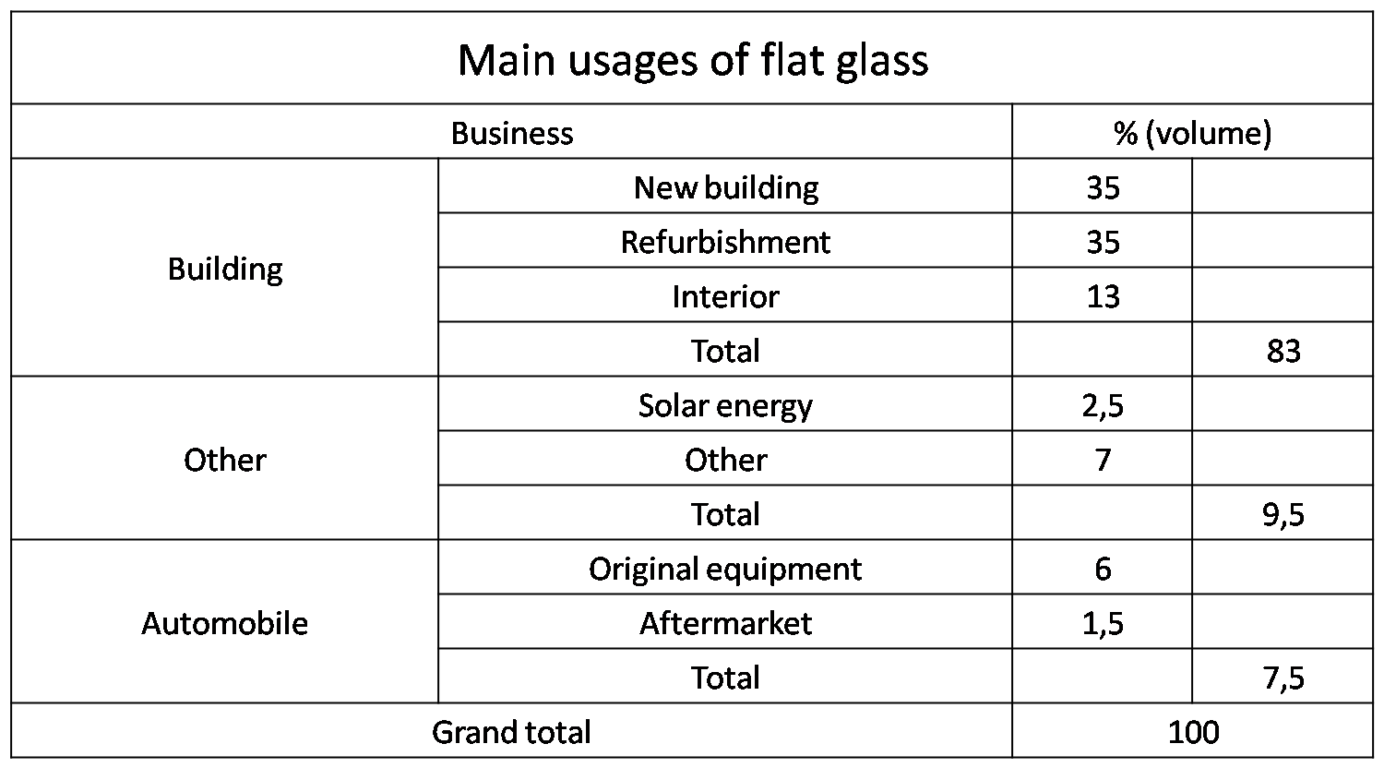
Summary of GPD – 2015, J.Vitkala | Source: www.gpd.fi ©Bernard Savaëte BJS.Différences

Slide 13
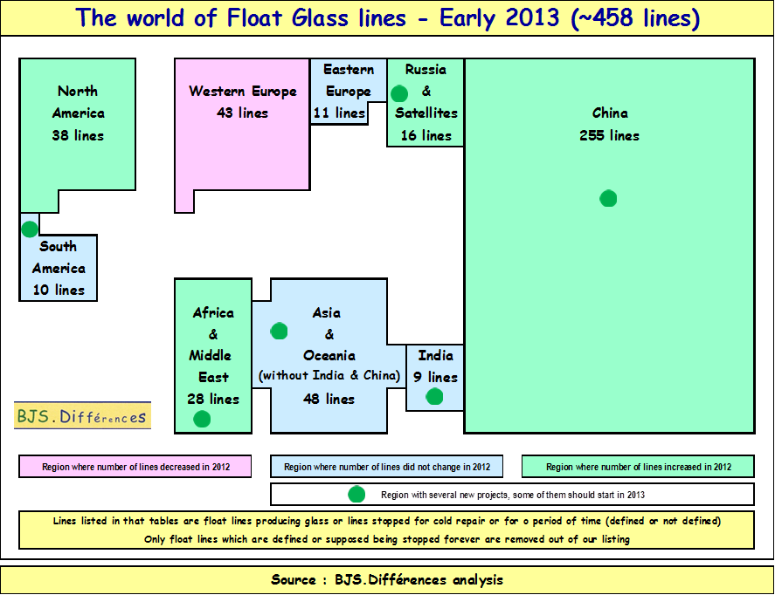
World map of float glass lines - status early 2013
Summary of GPD – 2015, J.Vitkala | Source: www.gpd.fi ©Bernard Savaëte BJS.Différences

Slide 14
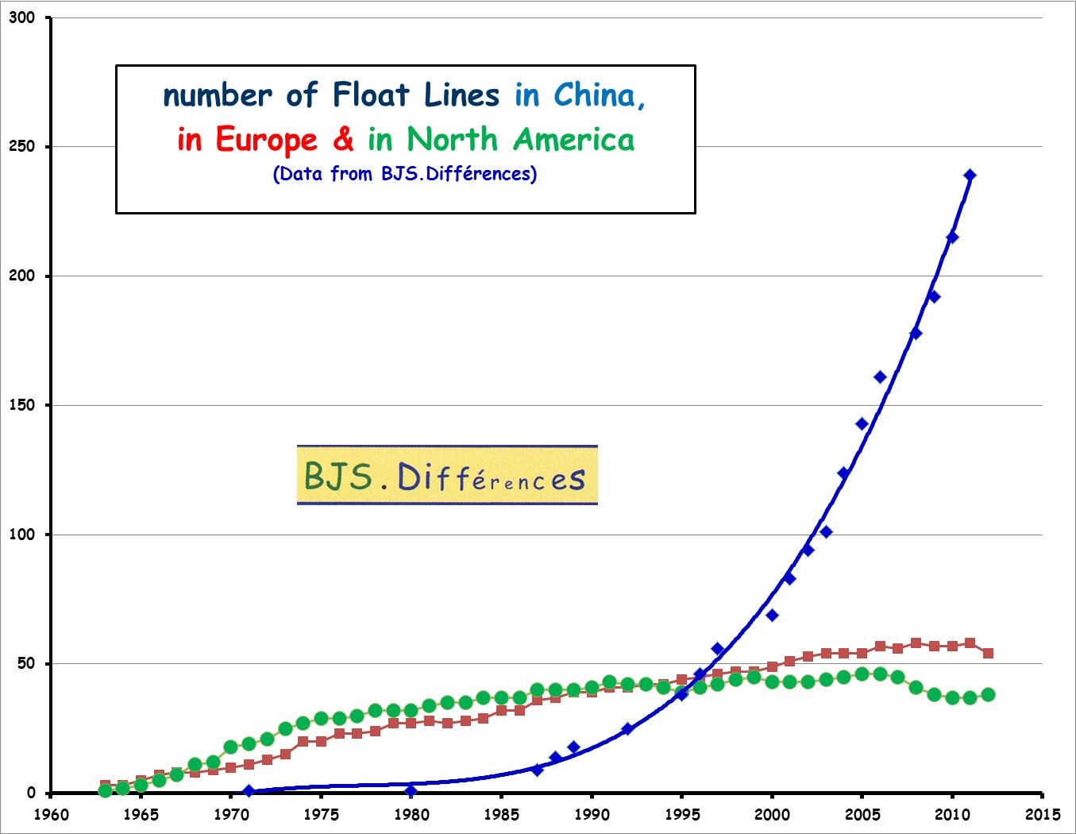
Evolution of number of float lines vs. time (up to 2012)
Summary of GPD – 2015, J.Vitkala | Source: www.gpd.fi ©Bernard Savaëte BJS.Différences

Slide 15
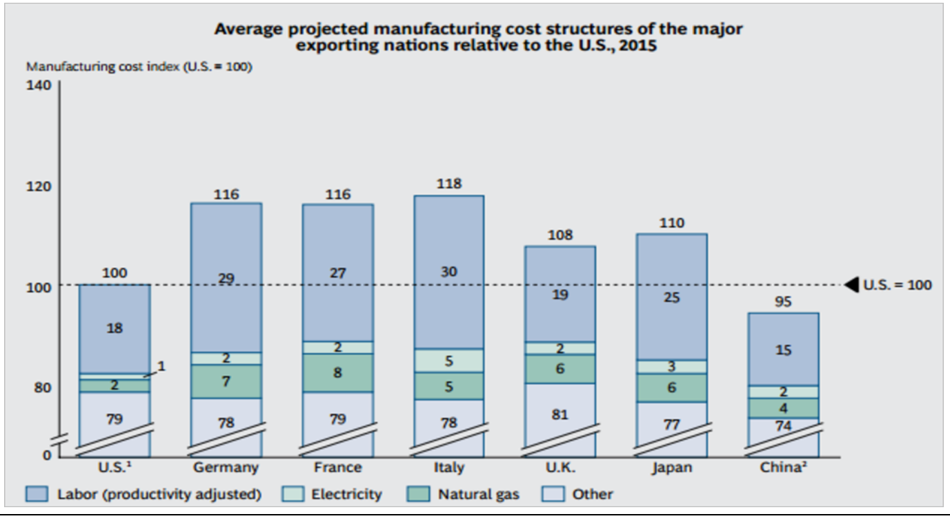
The US as one of the developed world's lowest-cost manufacturers
Selected 2013 & 2014 facts (24/31). Boston Consulting Group (08/2013)
Summary of GPD – 2015, J.Vitkala | Source: www.gpd.fi ©Bernard Savaëte JS.Différences

Slide 16
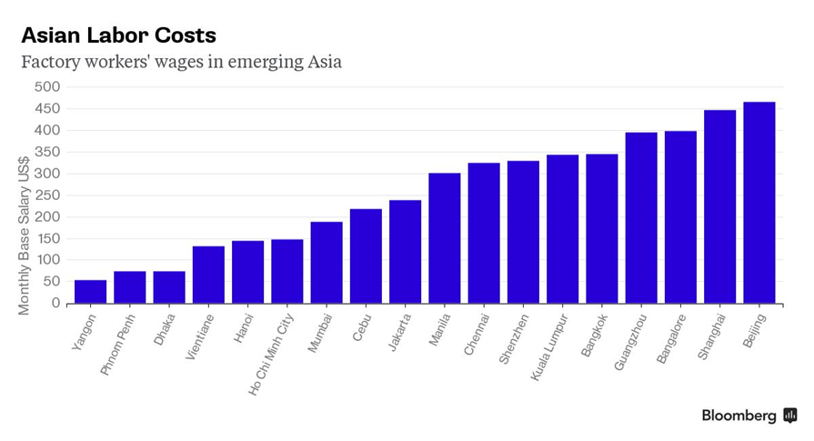
From http://www.bloomberg.com/news/articles/2015-04-29/china-is-set-to-lose-manufacturing-crown
29 April 2015
Summary of GPD – 2015, J.Vitkala | Source: www.gpd.fi ©Bernard Savaëte JS.Différences

Slide 17
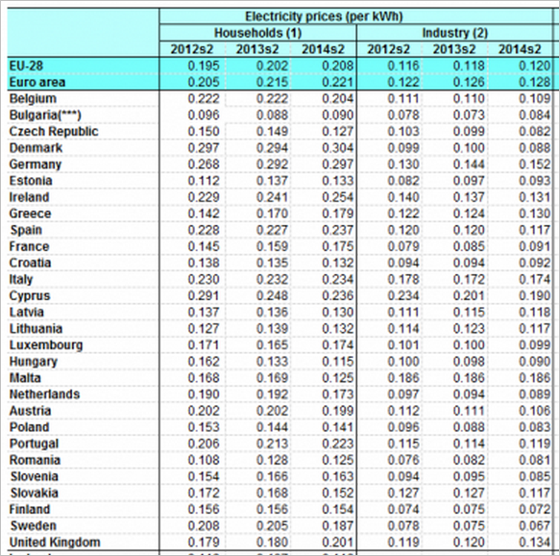
Electricity prices in Europe
(Euros per Kwh)
Source : Eurostat
Summary of GPD – 2015, J.Vitkala | Source: www.gpd.fi ©Bernard Savaëte JS.Différences

Slide 18
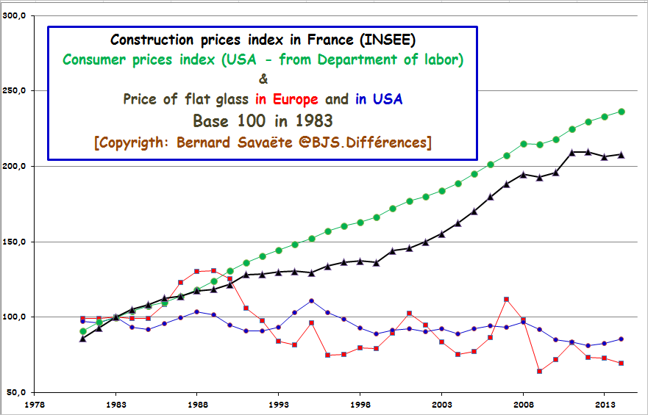

Selling prices of clear glass in USA & Europe (1981-2015) vs. consumer prices & construction index prices
Summary of GPD – 2015, J.Vitkala | Source: www.gpd.fi ©Bernard Savaëte JS.Différences

Slide 19
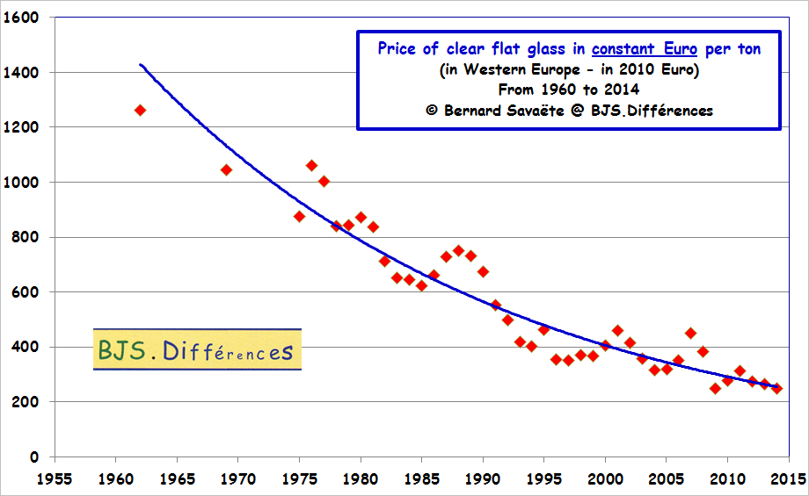
Selling prices of clear glass in Europe (1960-2015)
Summary of GPD – 2015, J.Vitkala | Source: www.gpd.fi ©Bernard Savaëte JS.Différences

Slide 20
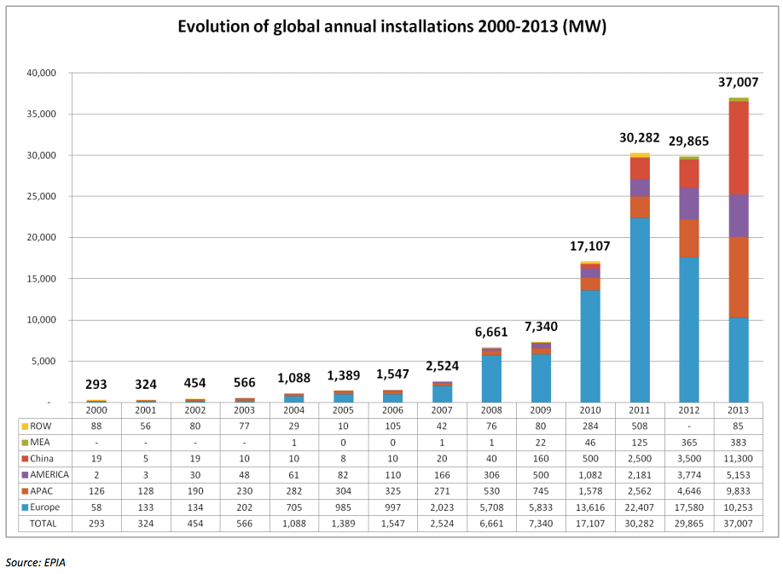
World solar capacity
Selected 2013 & 2014 facts (23/31).
Summary of GPD – 2015, J.Vitkala | Source: www.gpd.fi ©Bernard Savaëte JS.Différences

Slide 21
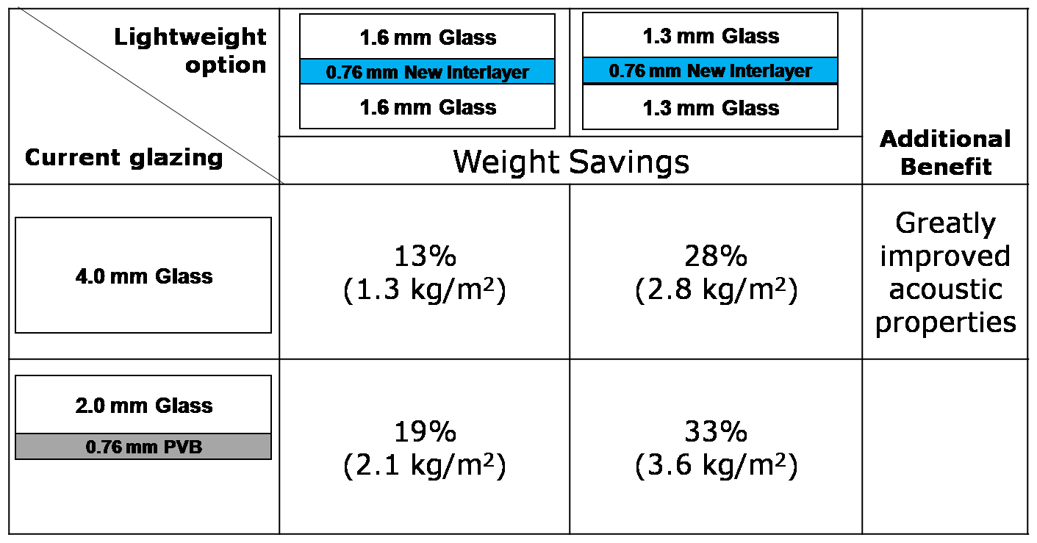
Potential weight savings
2.0 mm Glass
Summary of GPD – 2015, J.Vitkala | Source: www.gpd.fi ©Chuck Butler Kuraray America, Inc

Slide 22
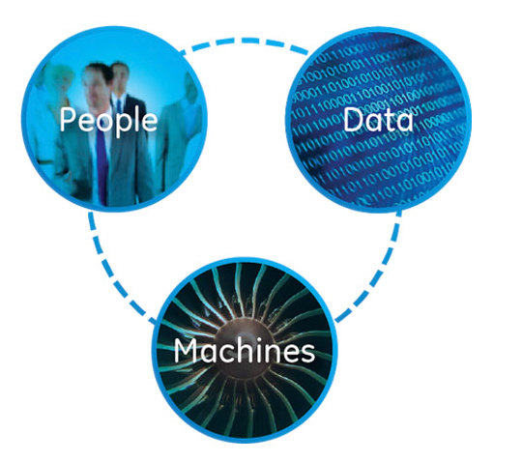
Internet of Things – What is it?
Tieto Corporation defines IoT following way:
Internet of Things will put customer demand, production and supplier data in context at a rate that is faster and more accessible. This in turn will lead to lower costs, increased efficiency and faster response times.
Summary of GPD – 2015, J.Vitkala | Source: www.gpd.fi ©Kimmo Kuusela Glaston

Slide 23
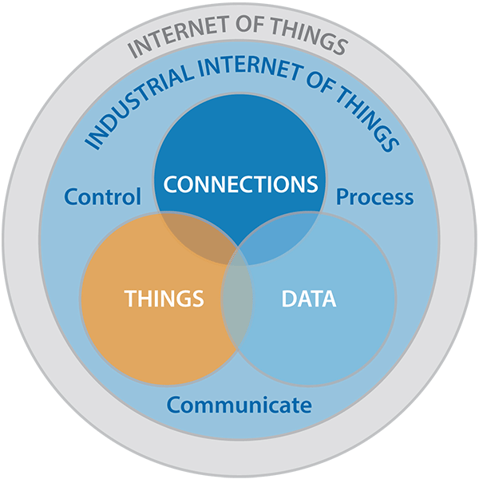
Internet of Things – Future
In the next generation glass processing factory:
All machines from cutting all the way to final shipment are connected together (Also to ERP system)
Machines can automatically schedule “their” maintenance brakes and spares
Machines can inform ERP systems to reserve production breaks accordingly
ERP system can automatically inform CRM system to modify lead times accordingly
Summary of GPD – 2015, J.Vitkala | Source: www.gpd.fi ©Kimmo Kuusela Glaston

Slide 24
NEW DESIGN
Notes:
CLOSING SLIDE

Slide 25

“Treat each and every project as if it the last one you will ever do. The project should respond to its use, respect its climate, achieve the highest level of craft possible, utilize innovative and appropriate technology and reflect how you want to be remembered”
C. Keith Boswell
Summary of GPD – 2015, J.Vitkala
Source: www.gpd.fi © C. Keith Boswell Skidmore, Ownings & Merrill LLP
Notes:
CLOSING SLIDE

Slide 26


HIGH PERFORMANCE DESIGN - An Architects Perspective
perfor-
mance
performance
cost
cost
Summary of GPD – 2015, J.Vitkala
Source: www.gpd.fi © C. Keith Boswell Skidmore, Ownings & Merrill LLP

Slide 27
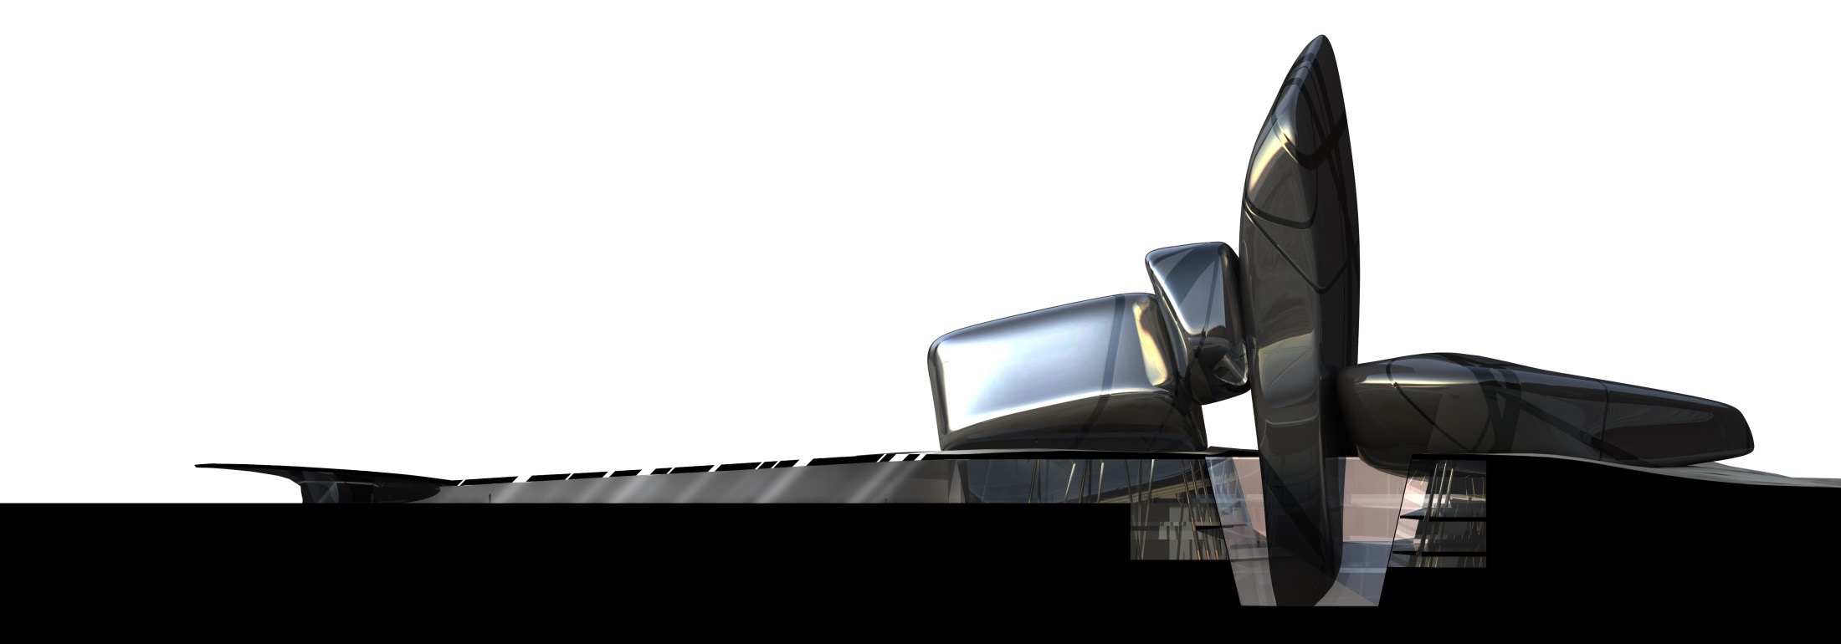
  Summary of GPD – 2015, J.Vitkala
  Source: www.gpd.fi ©Peter French, Snohetta
Notes:
Divided vertically into
Past
Present
Future
Linked by the plaza
Entrance
Pebbles
Source
Past present future

Slide 28
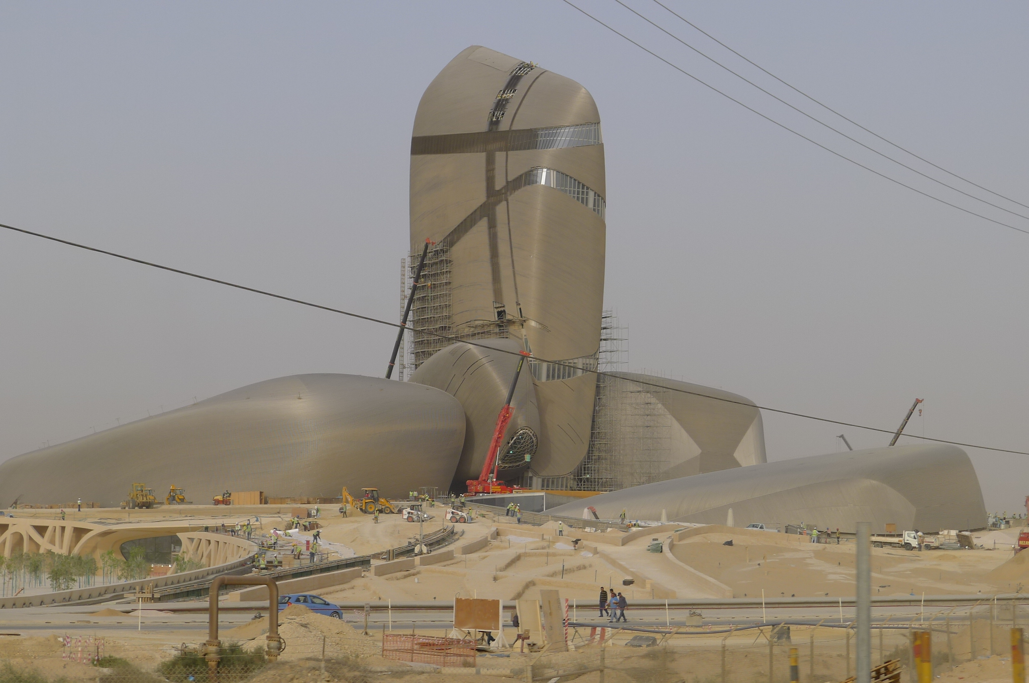
Summary of GPD – 2015, J.Vitkala
Source: www.gpd.fi ©Peter French, Snohetta

Slide 29
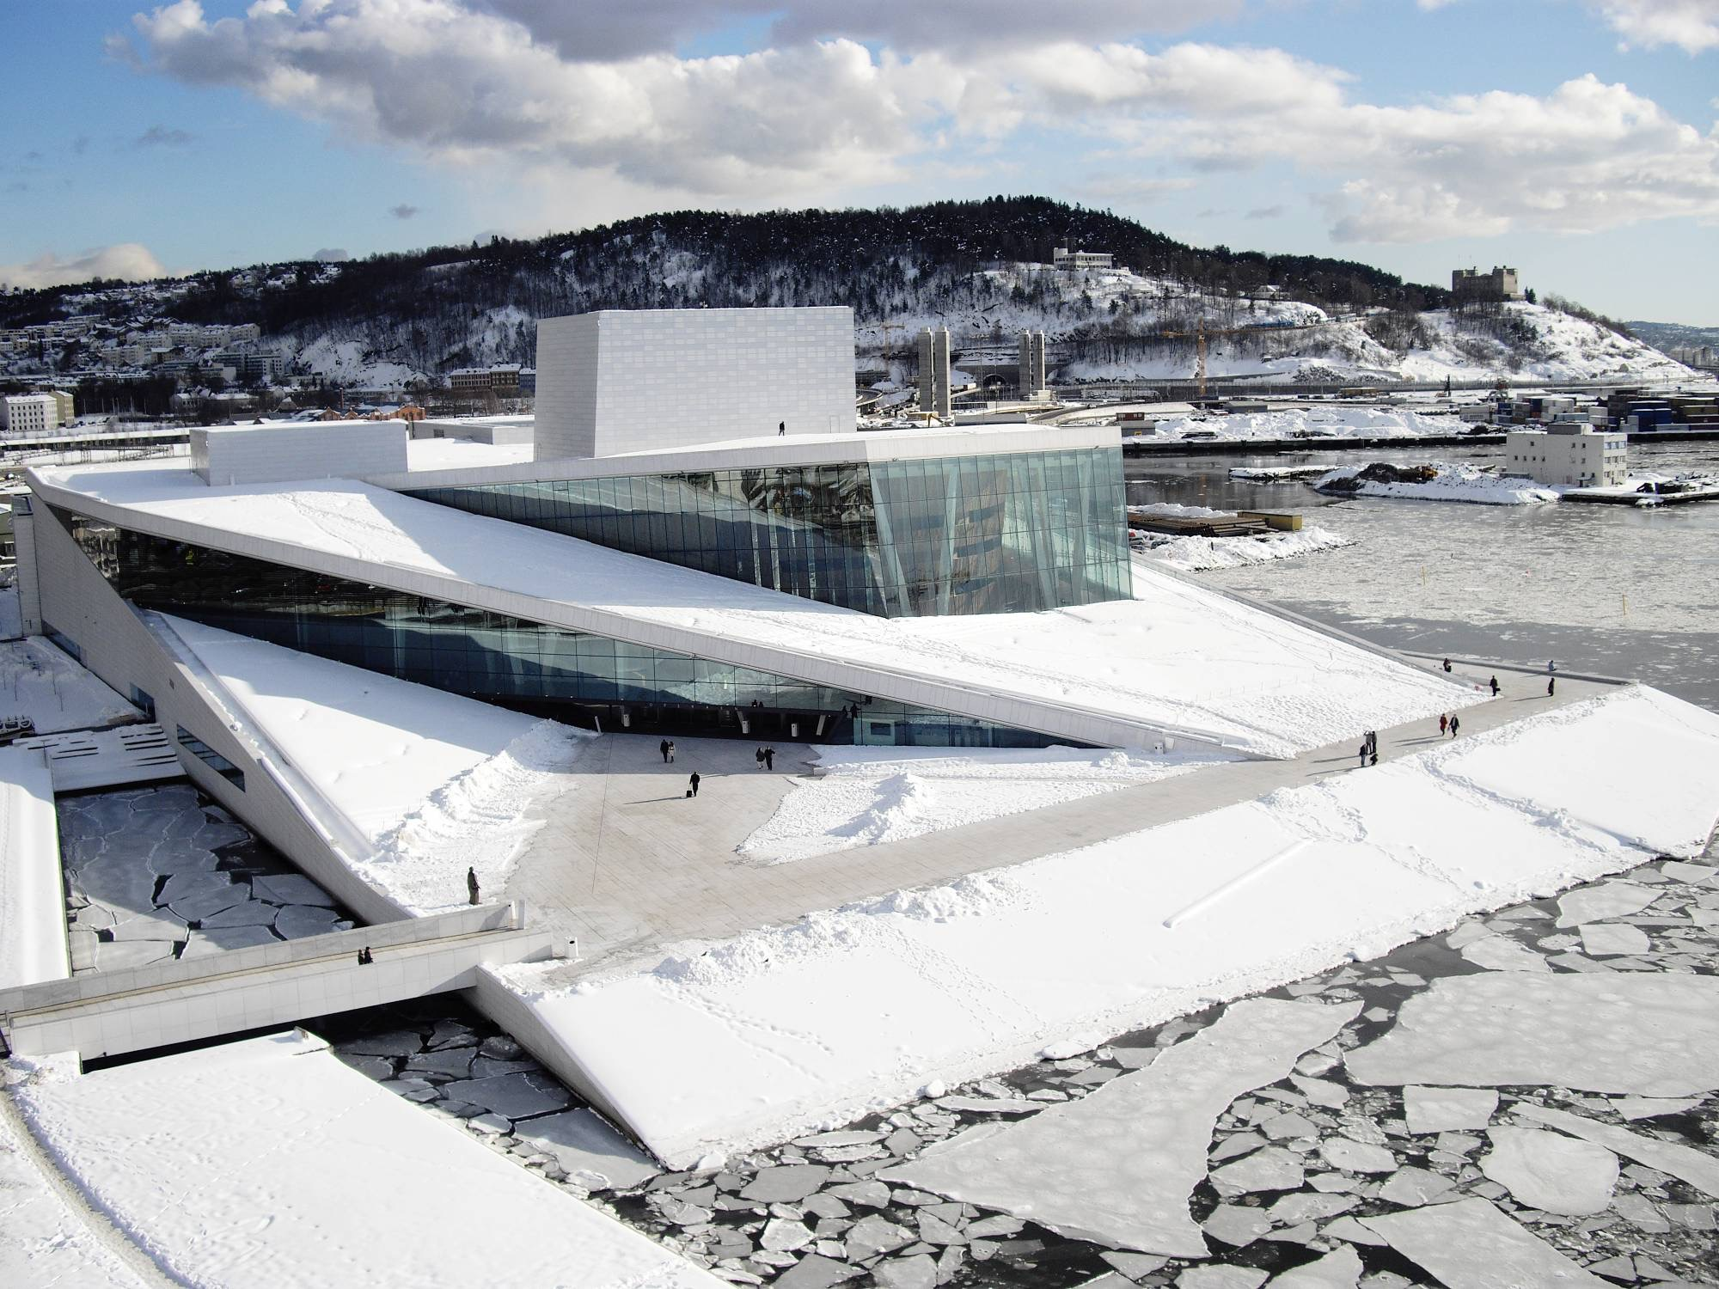
Summary of GPD – 2015, J.Vitkala
Source: www.gpd.fi ©Peter French, Snohetta
Notes:
New Norwegian National Opera and Ballet
Completed 2008

Slide 30
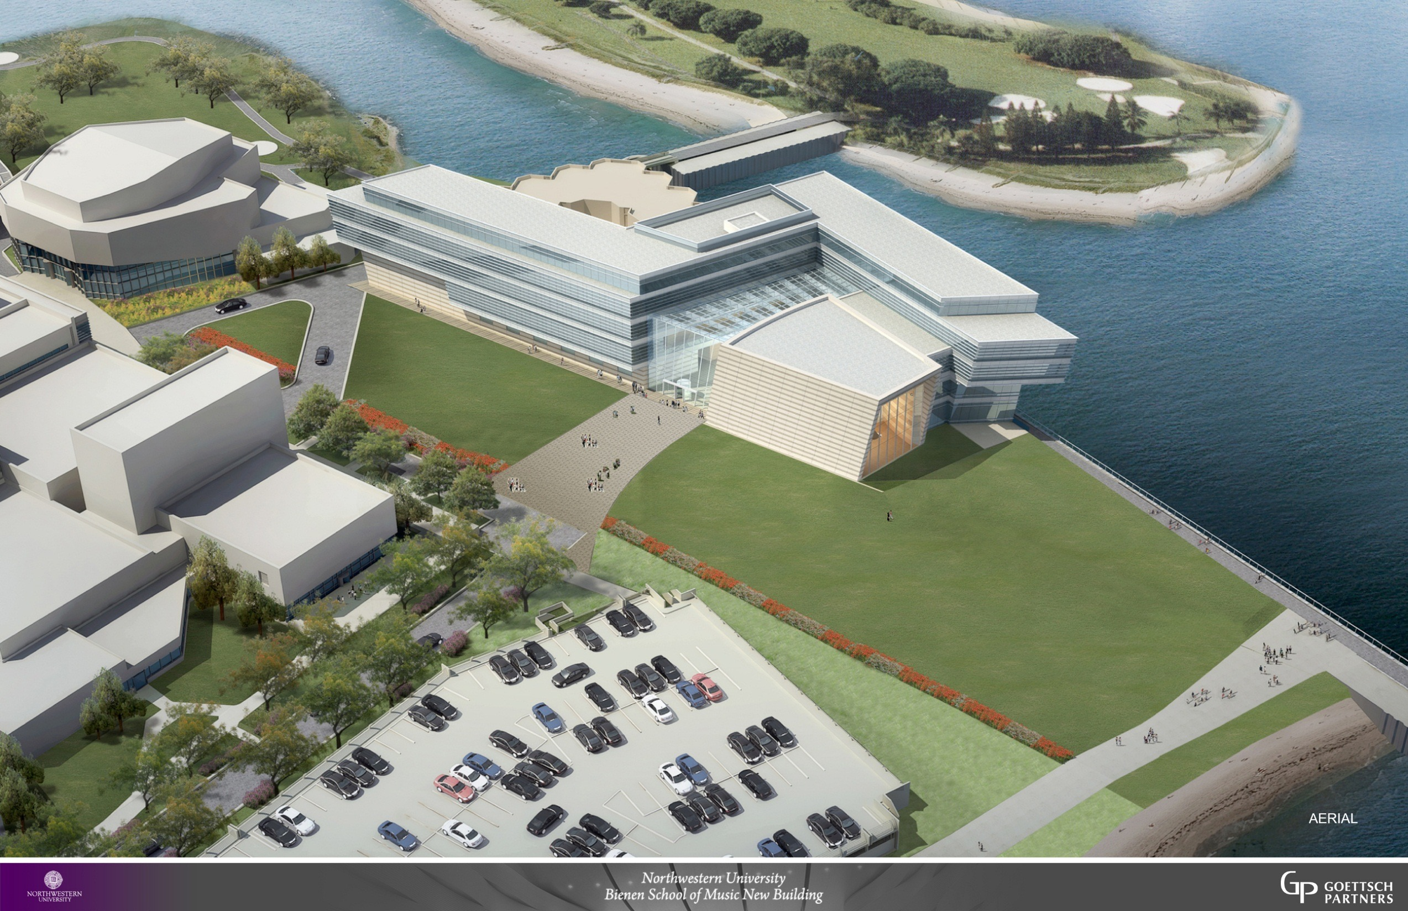
Summary of GPD – 2015, J.Vitkala
Source: www.gpd.fi ©Patrick Loughran, Goettsch Partners

Slide 31
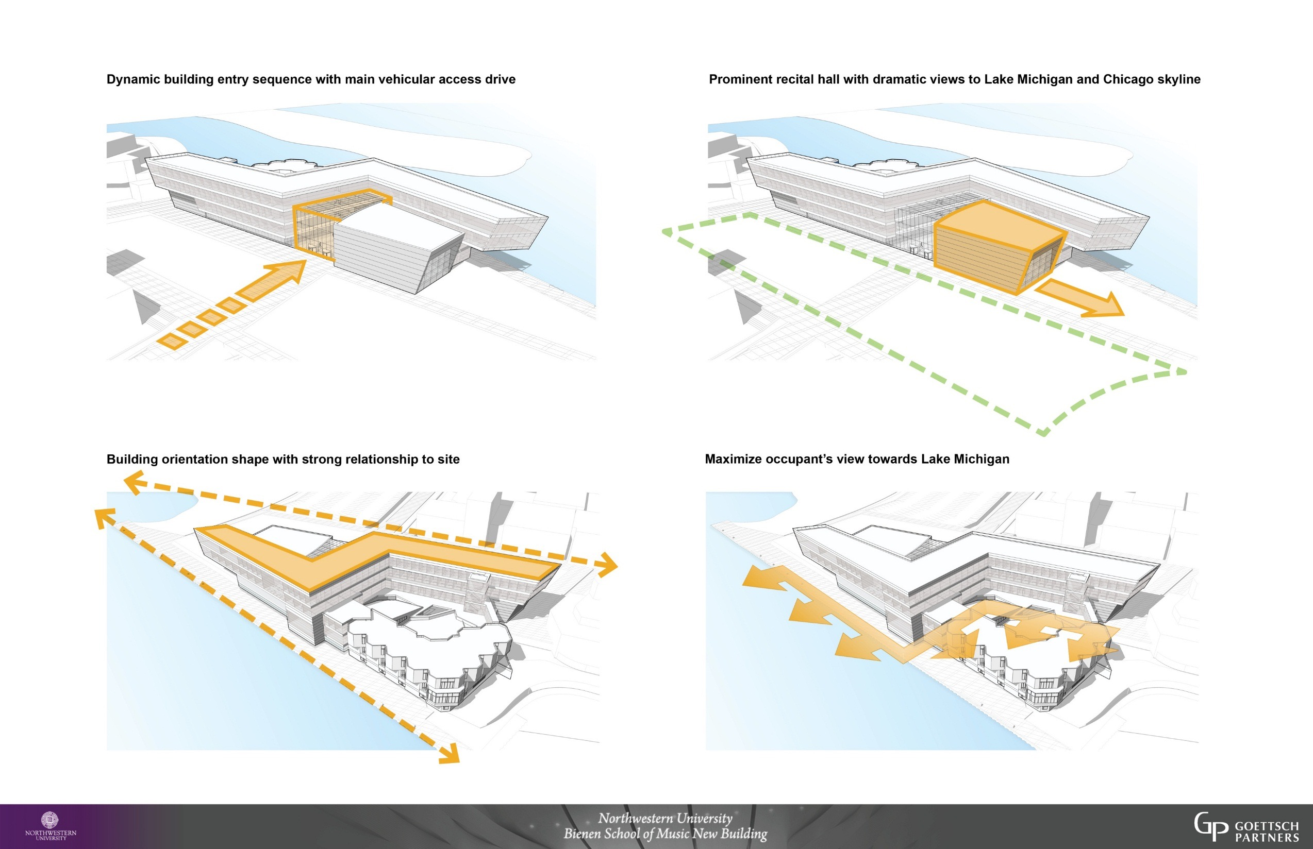
Summary of GPD – 2015, J.Vitkala
Source: www.gpd.fi ©Patrick Loughran, Goettsch Partners

Slide 32
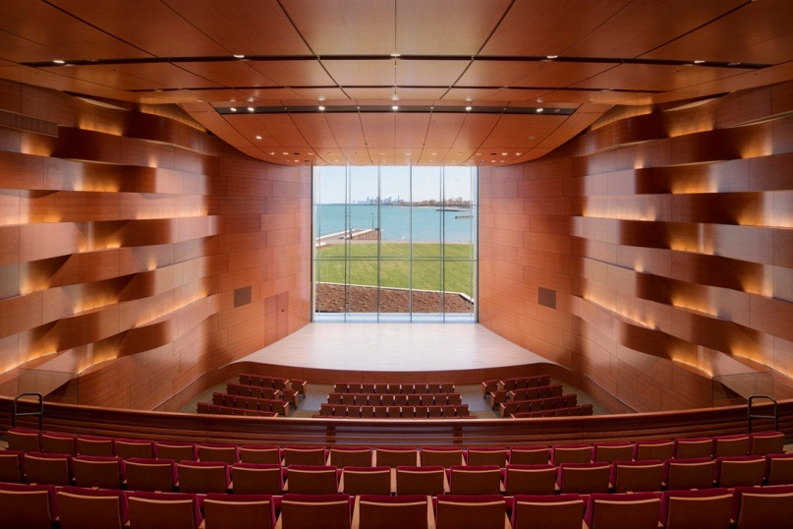
Summary of GPD – 2015, J.Vitkala
Source: www.gpd.fi ©Patrick Loughran, Goettsch Partners

Slide 33
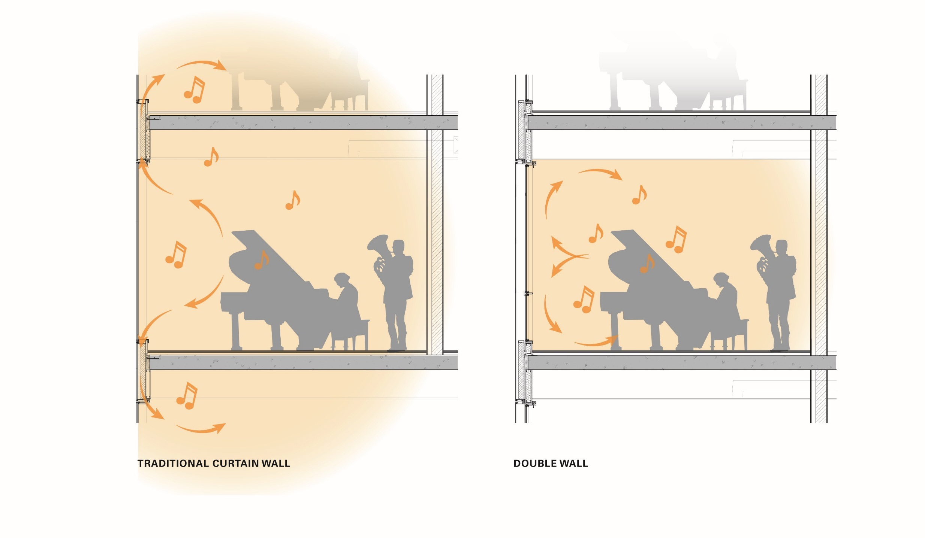
Summary of GPD – 2015, J.Vitkala
Source: www.gpd.fi ©Patrick Loughran, Goettsch Partners

Slide 34
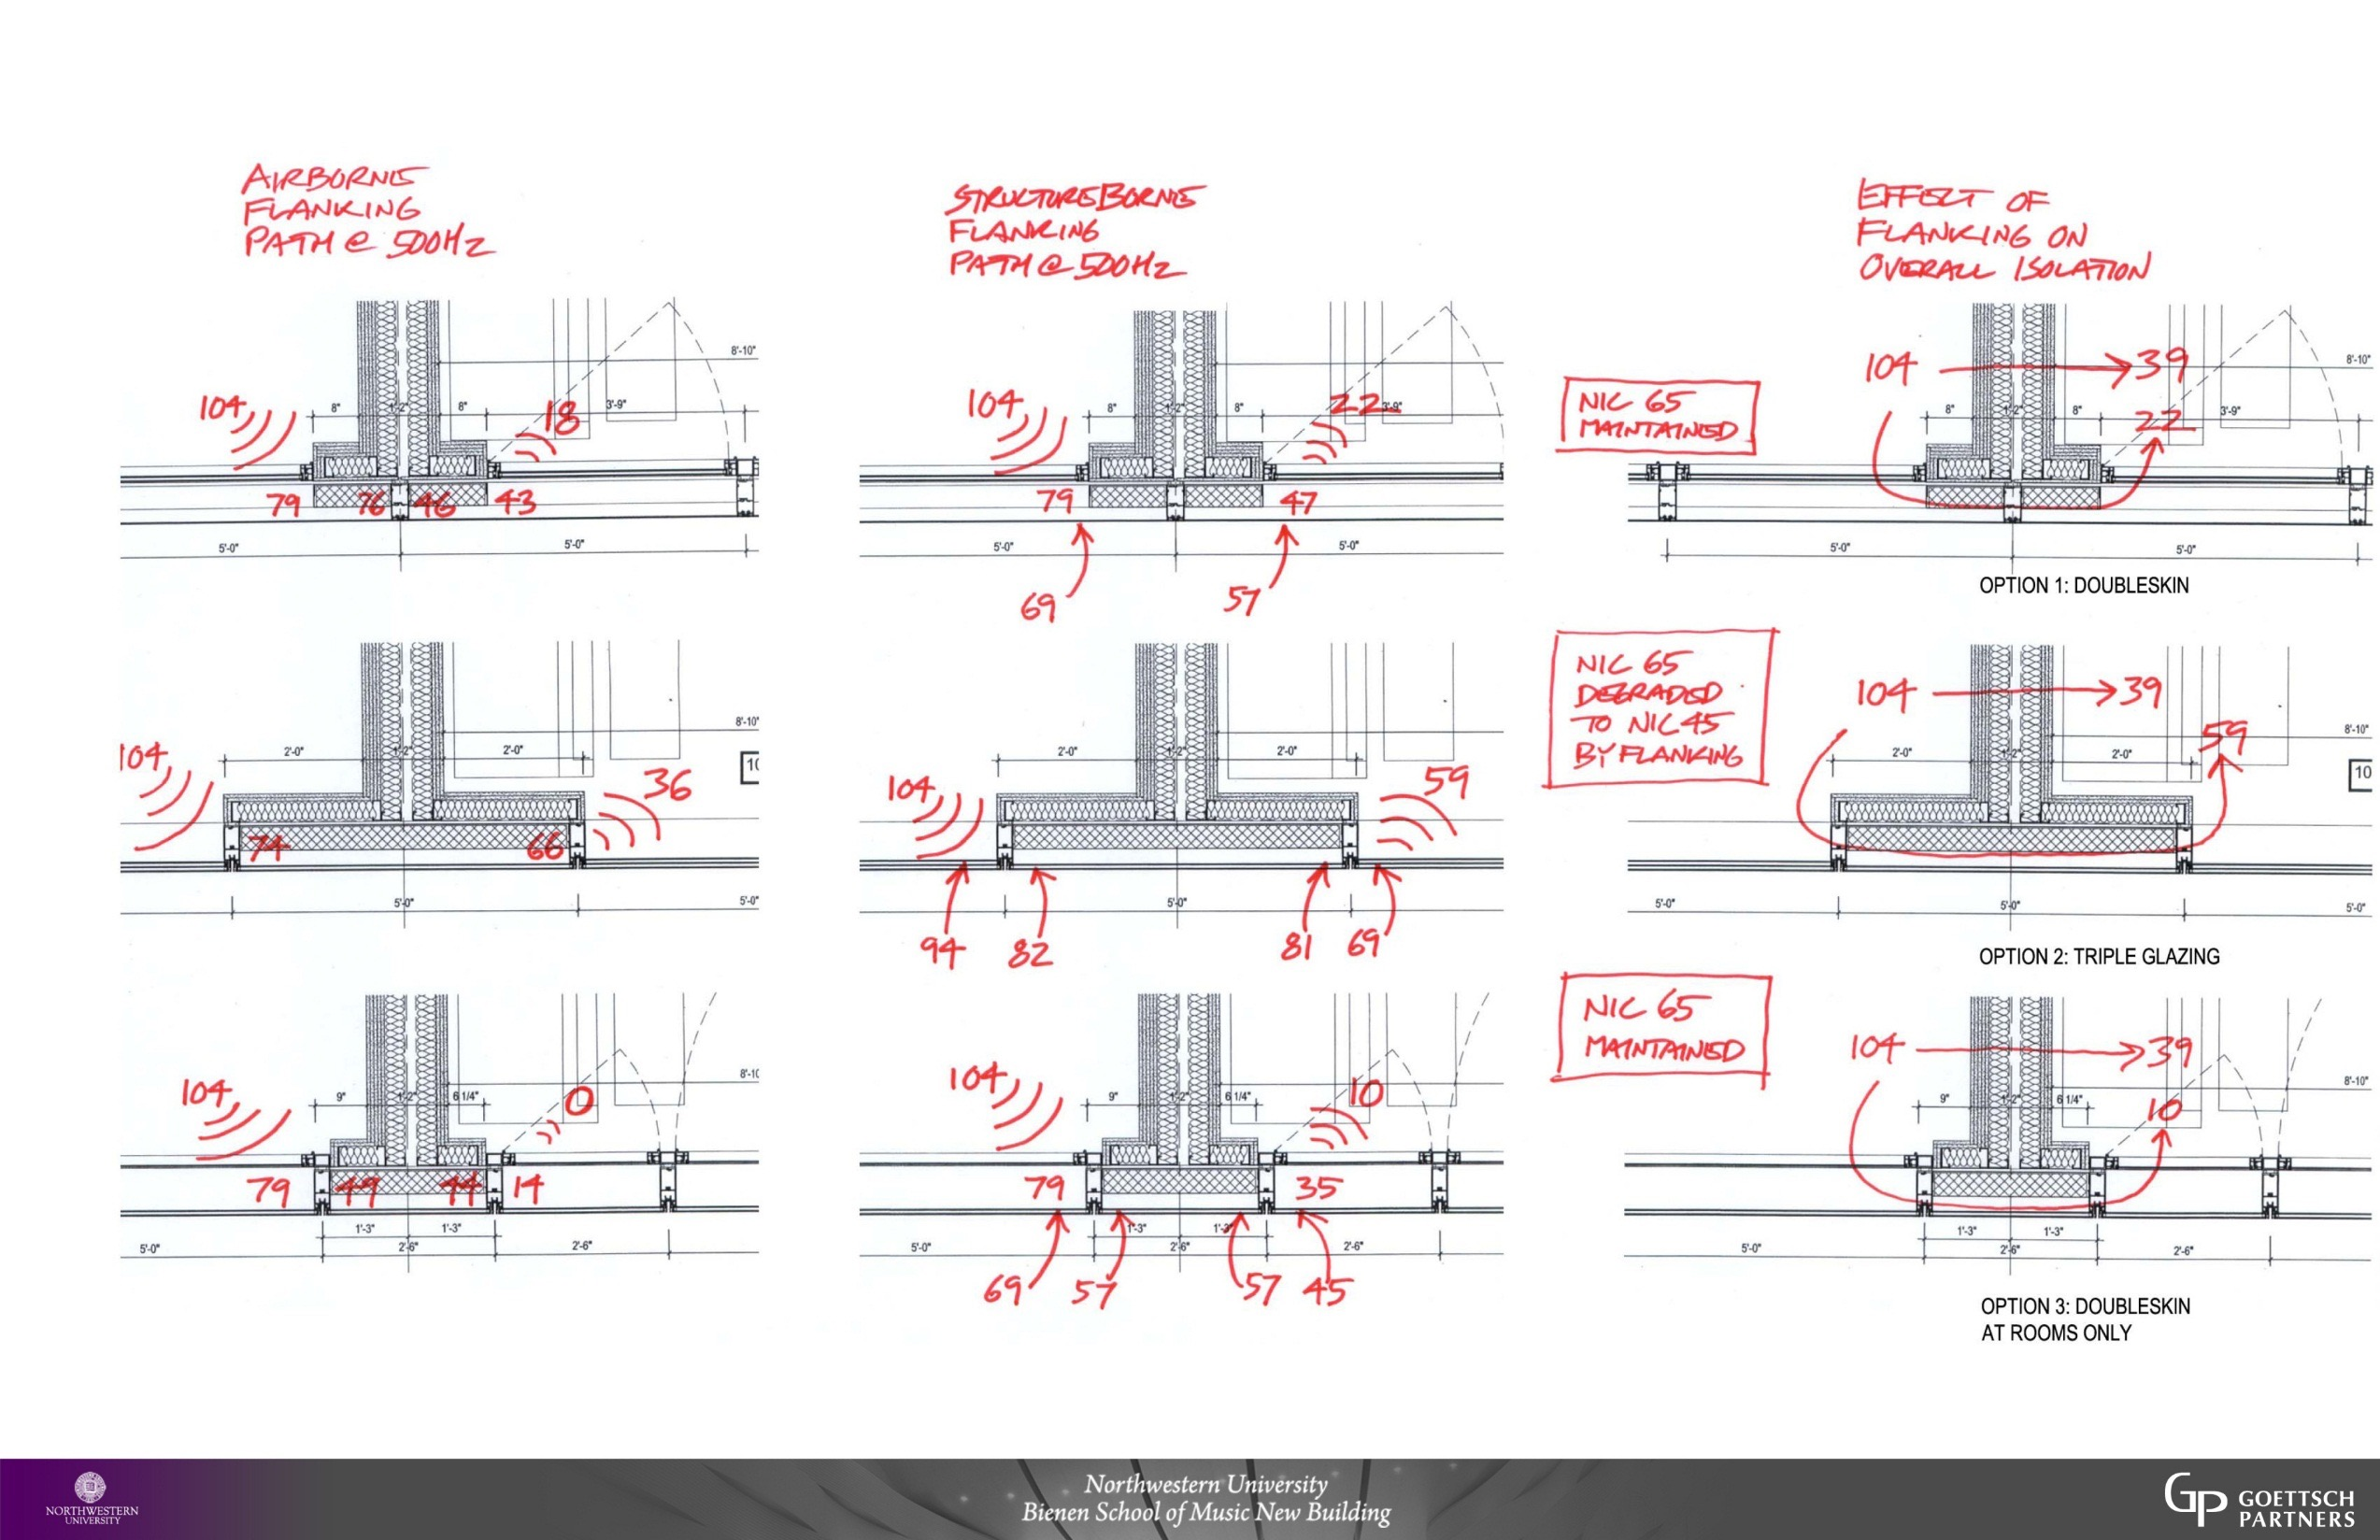
NIC Design Goals = 75 faculty teaching, 65 practice room, 50 office
Summary of GPD – 2015, J.Vitkala
Source: www.gpd.fi ©Patrick Loughran, Goettsch Partners

Slide 35
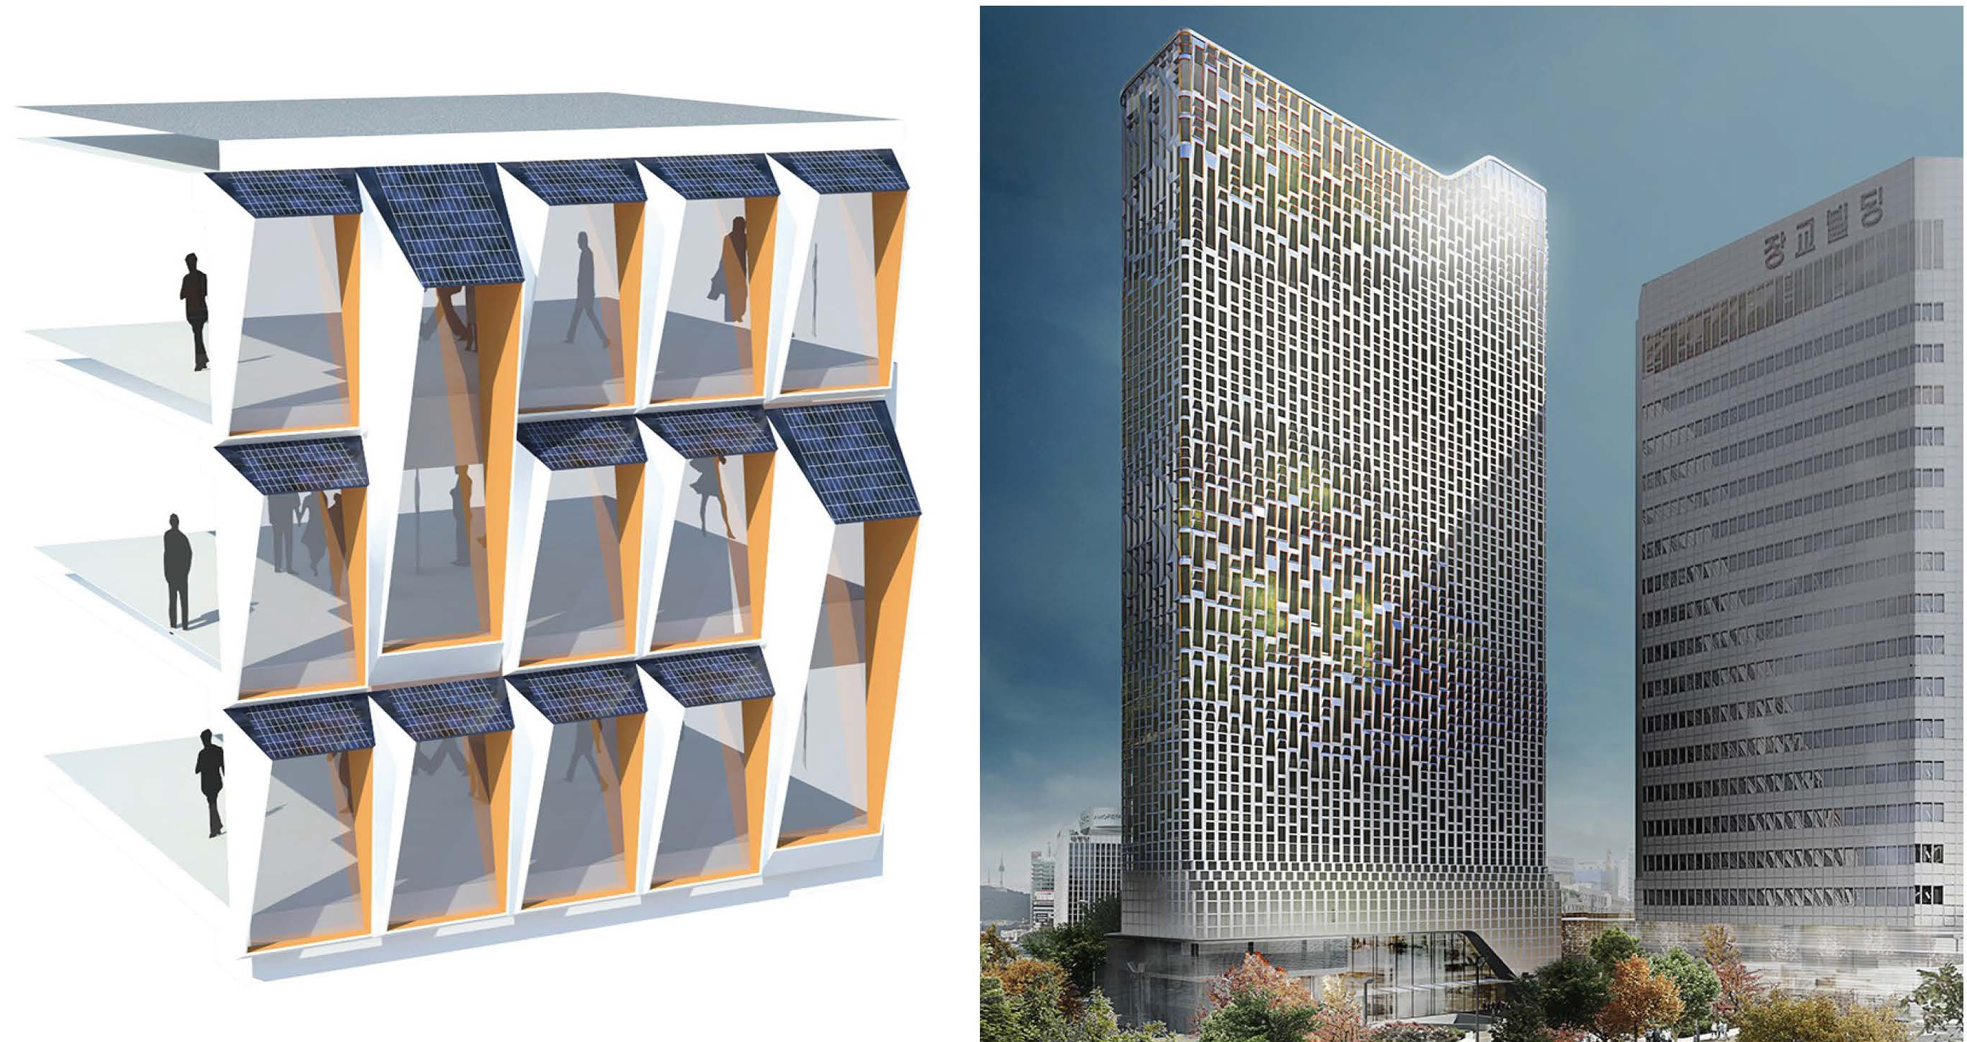
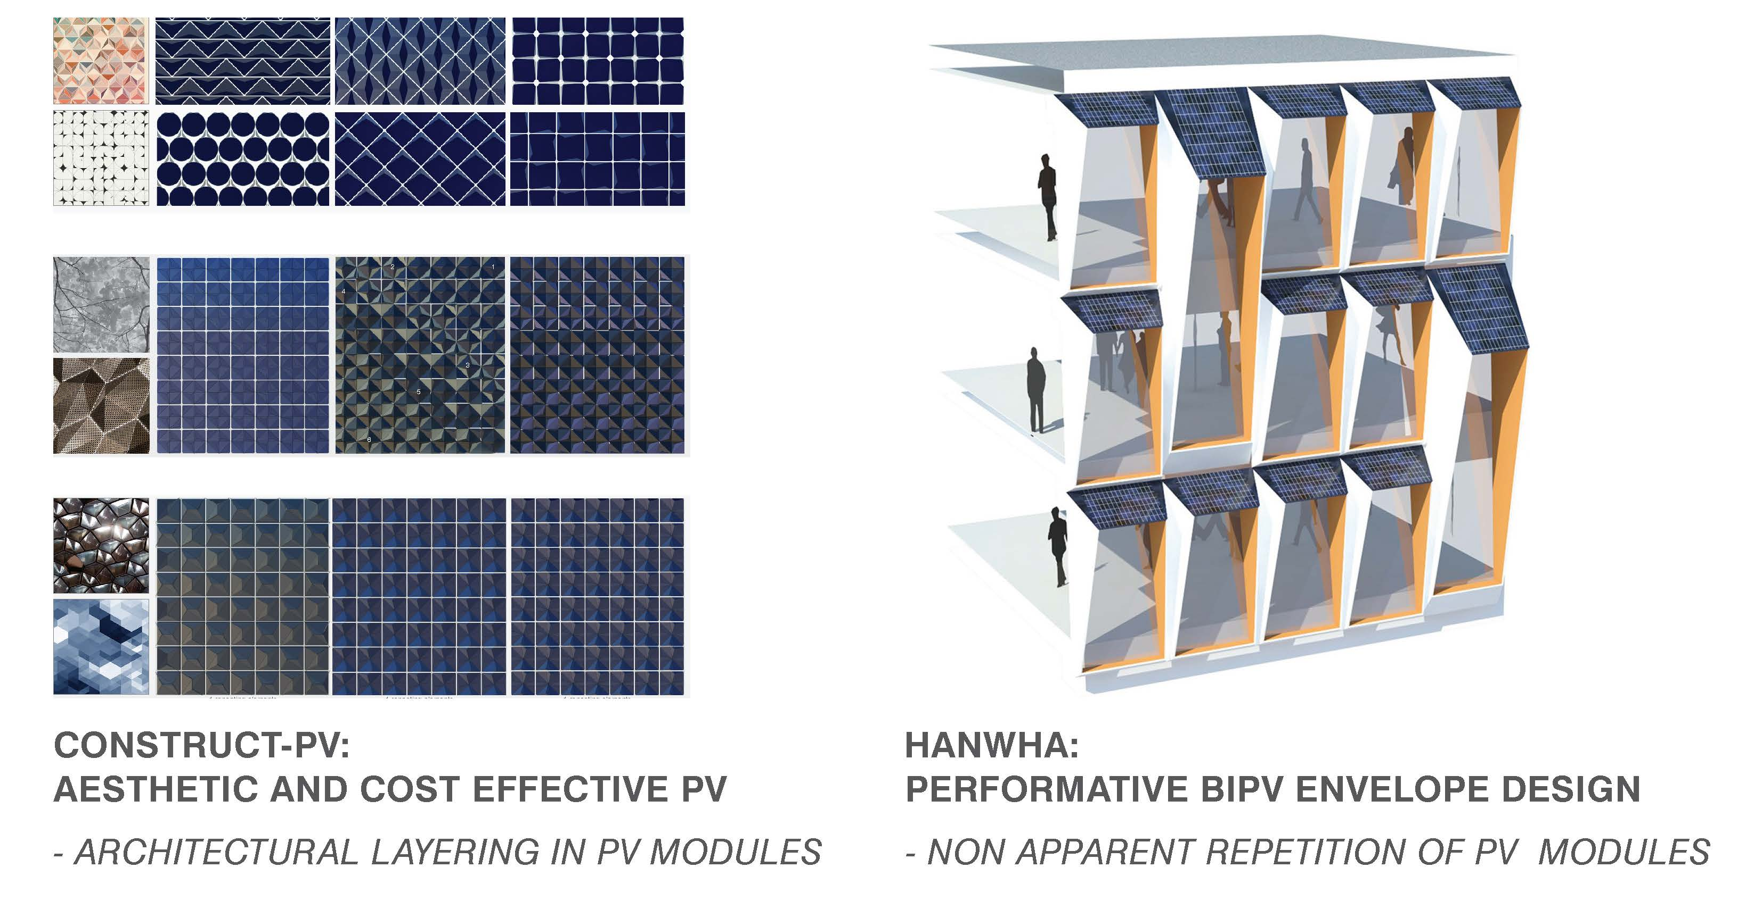
ConstructPV slide
Summary of GPD – 2015, J.Vitkala
Source: www.gpd.fi Hanwha Headquarters: ©UNStudio

Slide 36
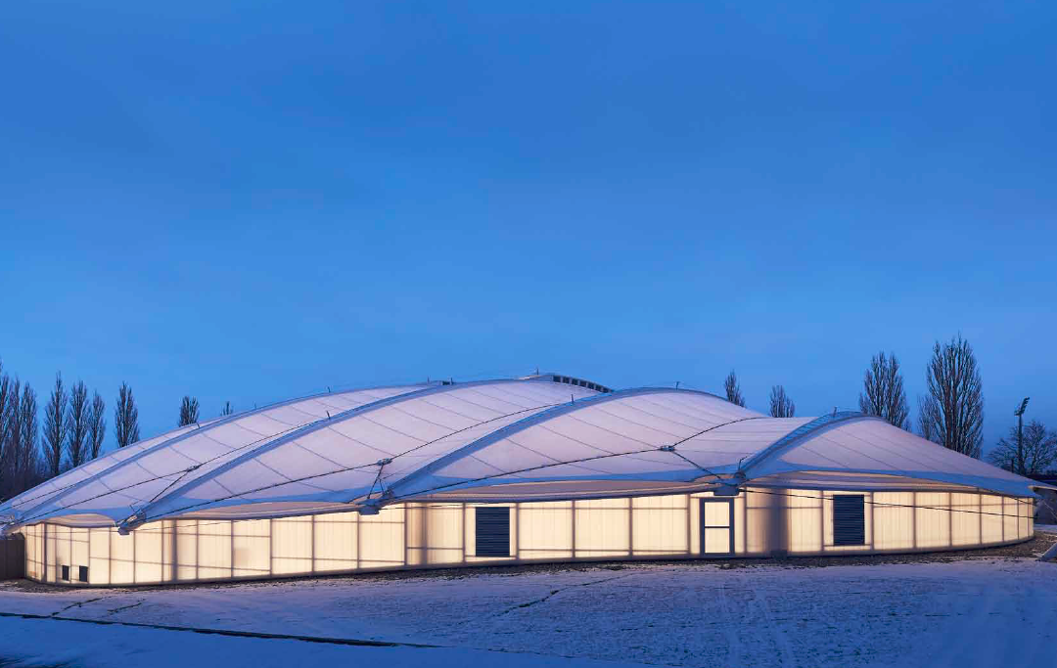
Summary of GPD – 2015, J.Vitkala
Source: www.gpd.fi ©Stig Mikkelsen, MIKKELSEN Architects
Thorvald Ellegaard Arena, Odense

Slide 37
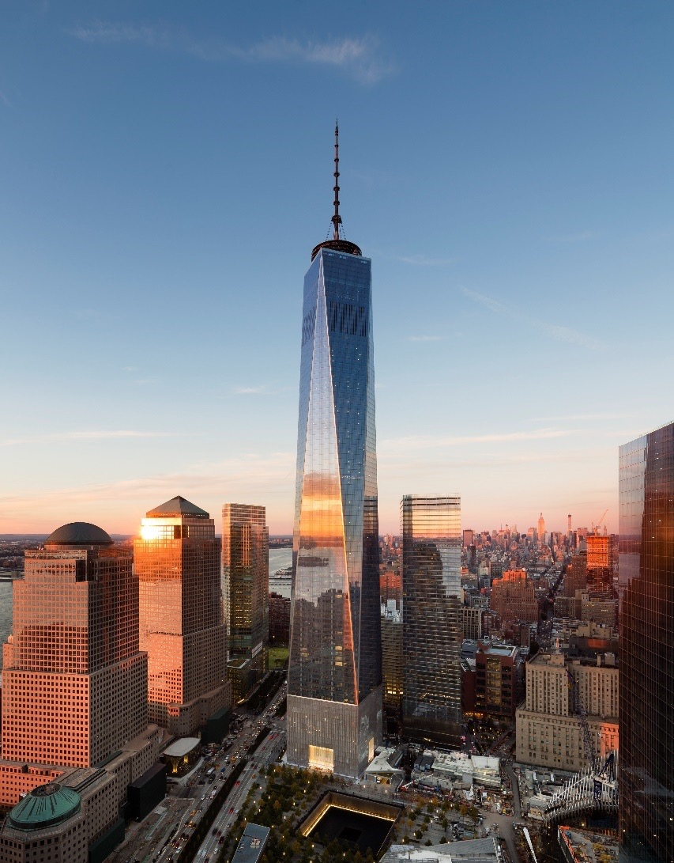
325,160 m² (3.5 million gsf) Class A office tower with Concourse retail, Observation Deck, Digital Broadcast Antenna, Parking, Plazas and Public Space
Over 1800 construction workers on site at peak times
Enhanced security and life safety
LEED CS Gold
1.2 MW fuel cell plant
Below grade concourse with direct access to subways, PATH, retail, and World Financial Center
104 floors, office floors 20-90
422m (1386’) to top of parapet, 541m (1776’) to top of spire
Approximately 122m (448’) spire
First Move-ins fall 2014
Summary of GPD – 2015, J.Vitkala
Source: www.gpd.fi ©Christoph Timm, SOM Architects
Photo by James Ewing
Notes:
The building shape changes as it rises from a square to octogon. eight isosceles triangles

Slide 38
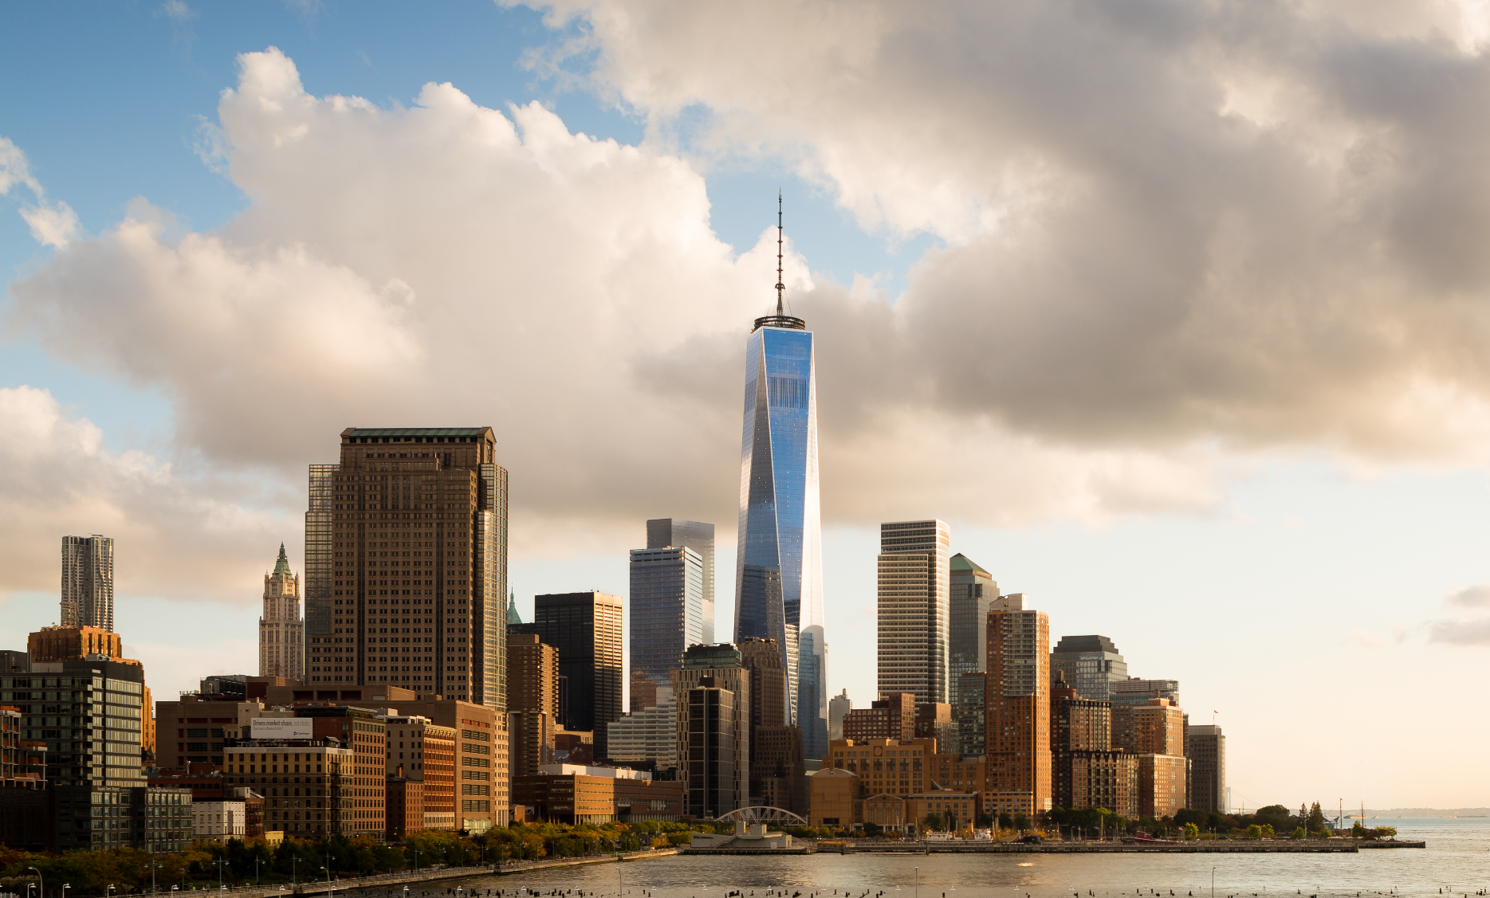
Summary of GPD – 2015, J.Vitkala
Source: www.gpd.fi ©Christoph Timm, SOM Architects
Photo by James Ewing
Notes:
450’

Slide 39
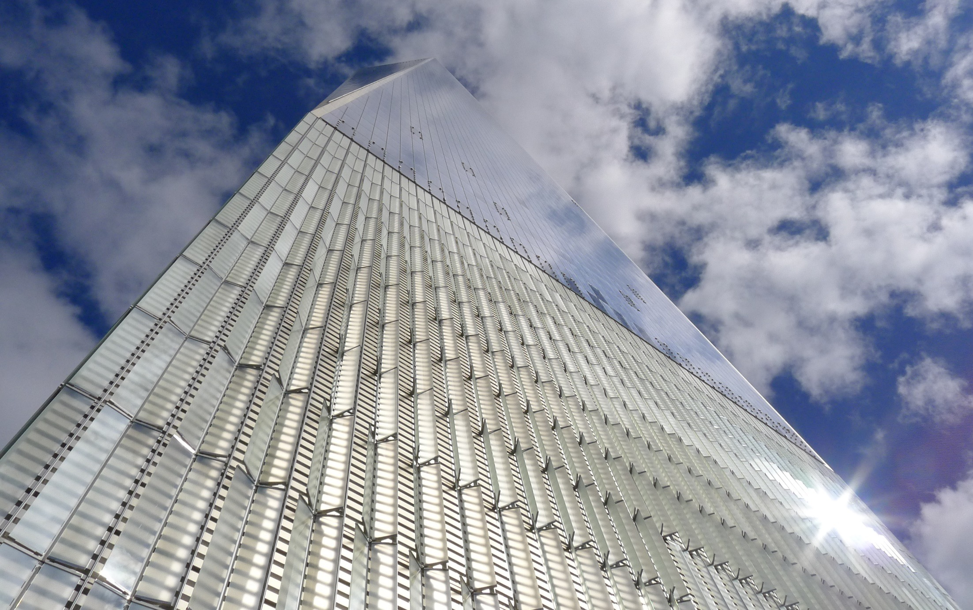
Summary of GPD – 2015, J.Vitkala
Source: www.gpd.fi ©Christoph Timm, SOM Architects

Slide 40
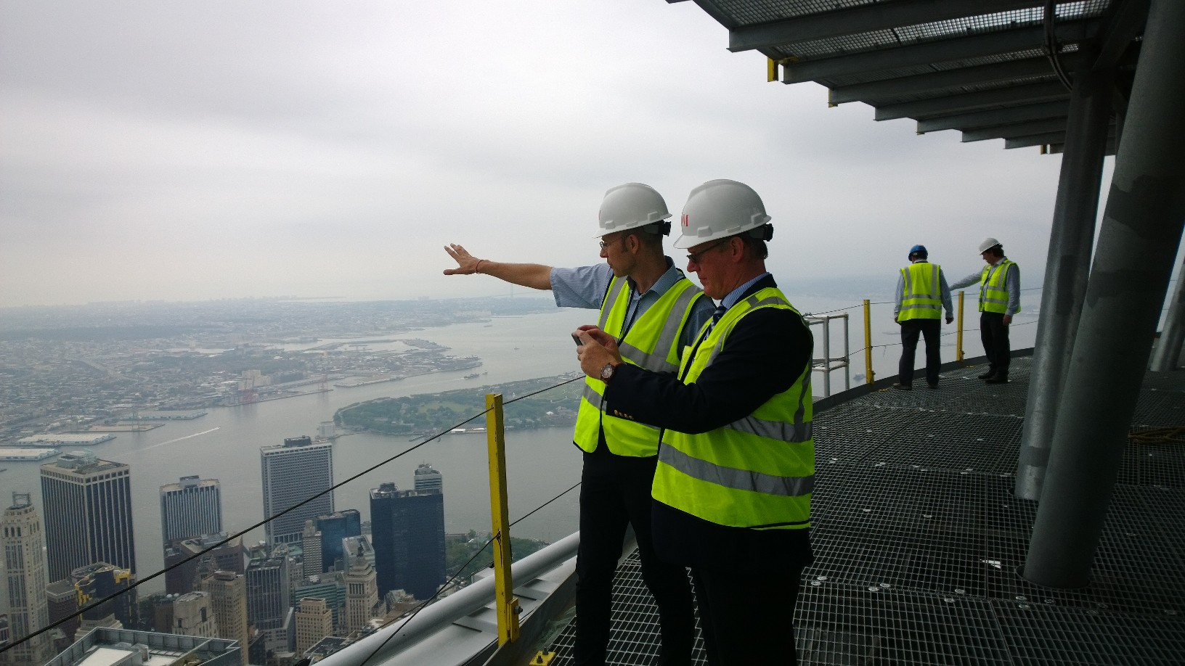

Slide 41
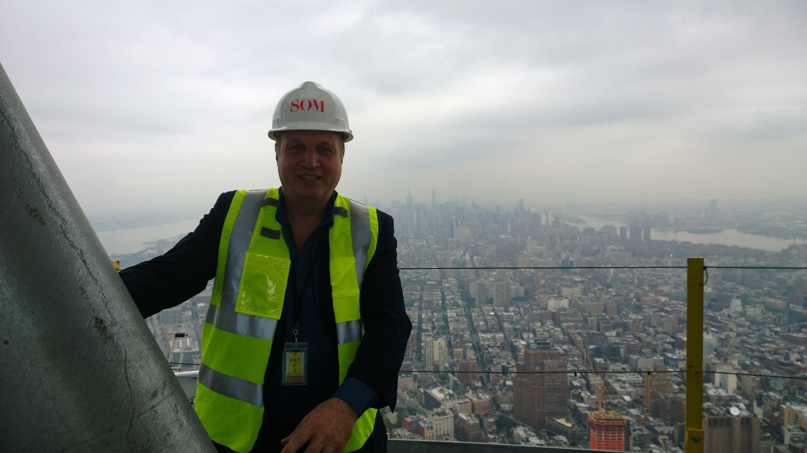

Slide 42
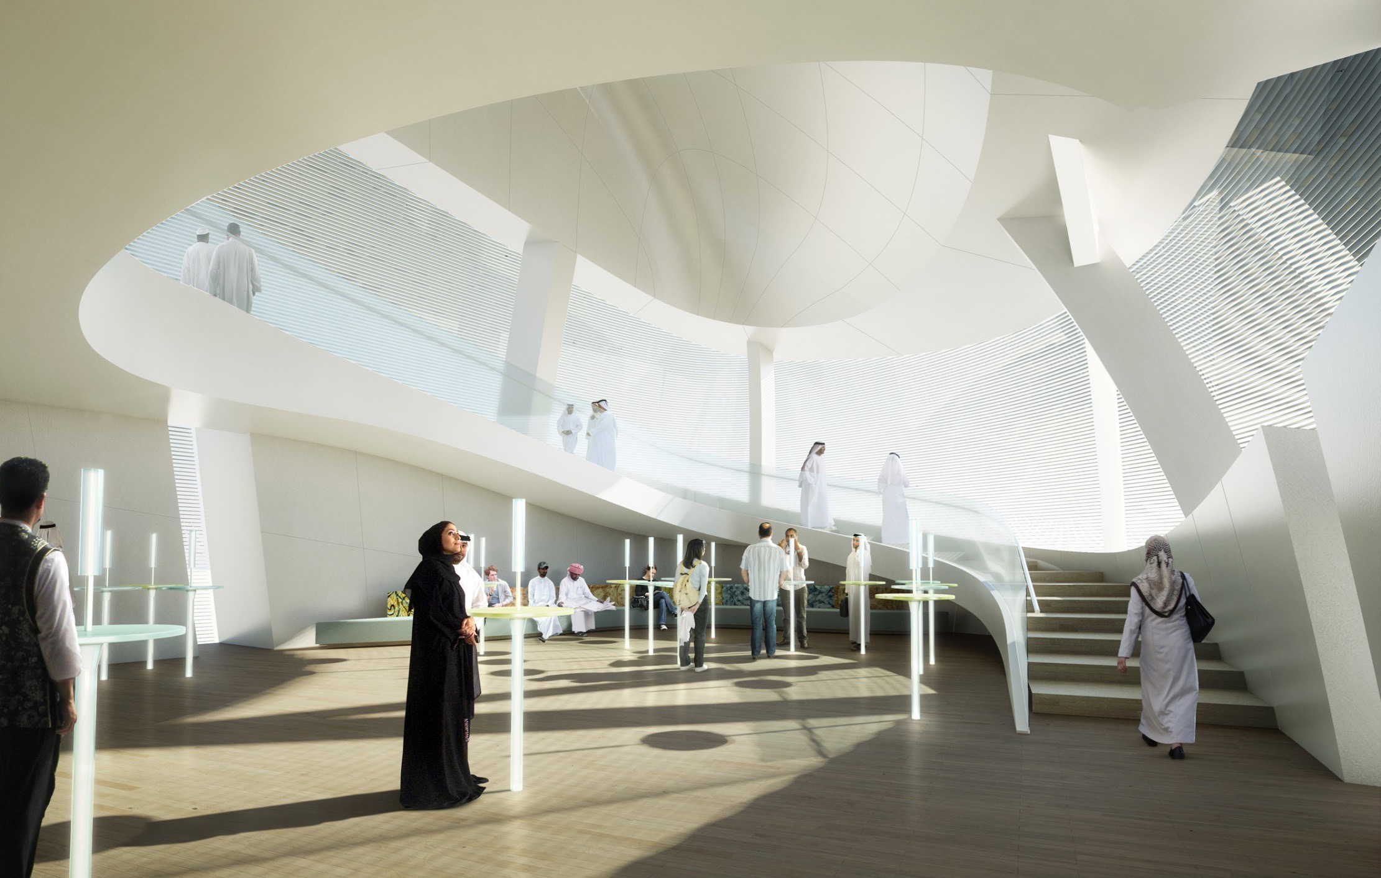
Summary of GPD – 2015, J.Vitkala
Source: www.gpd.fi ©Peter French, Snohetta

Slide 43
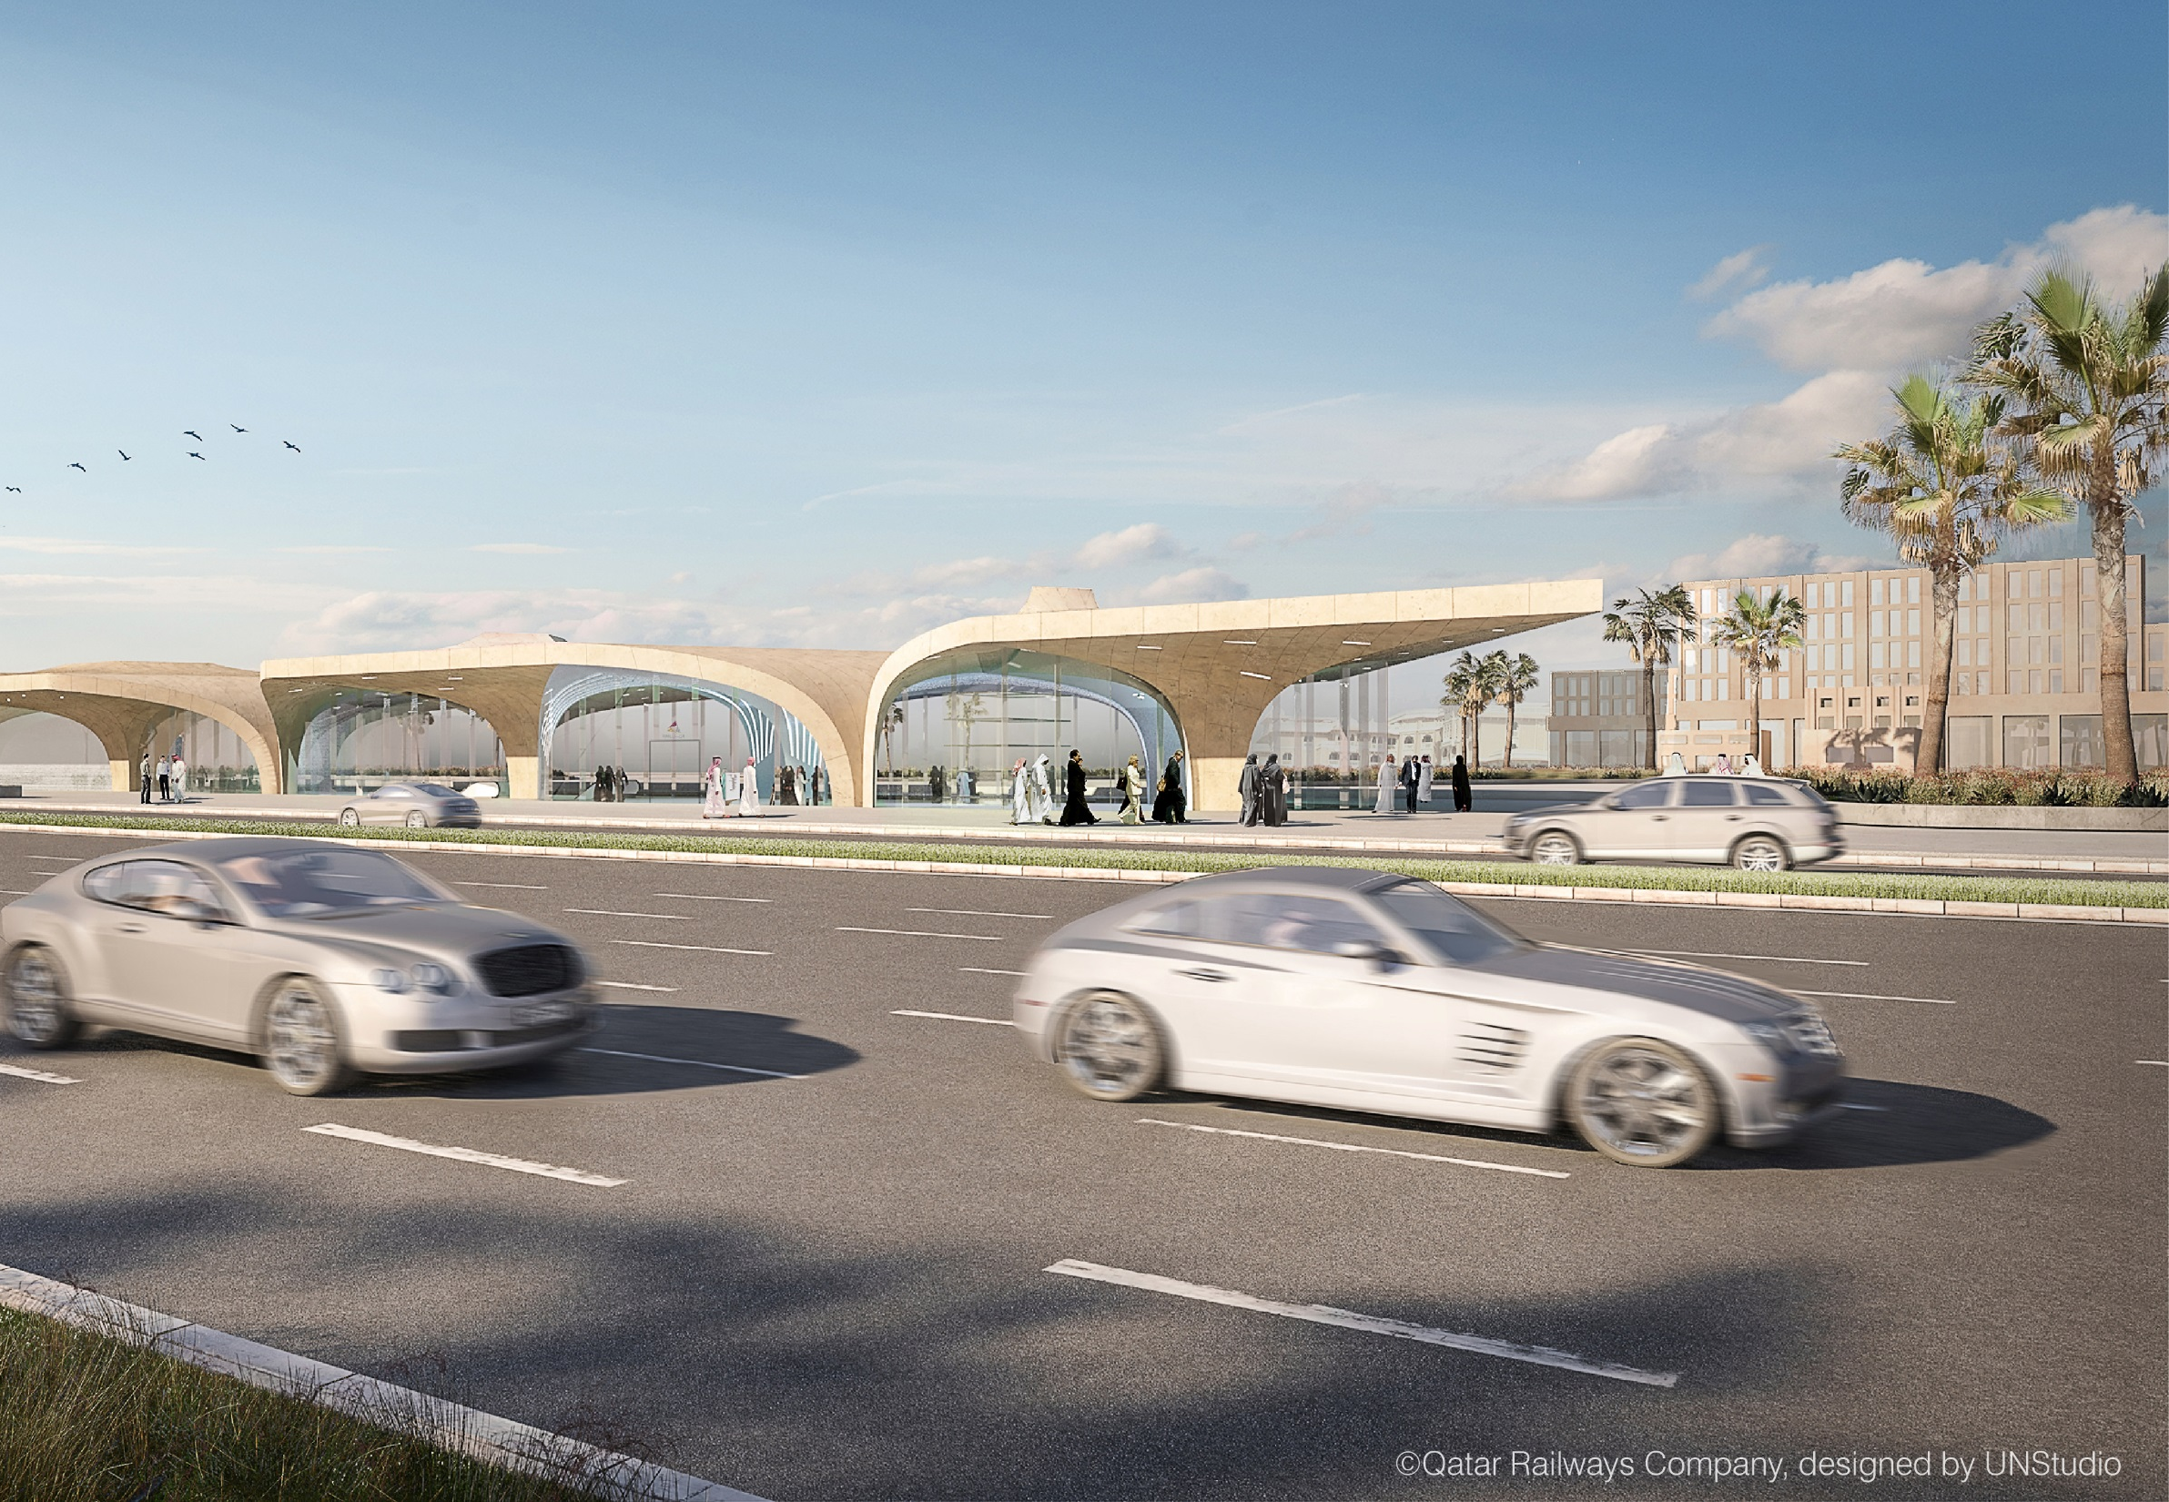
Summary of GPD – 2015, J.Vitkala
Source: www.gpd.fi ©Qatar Railways Company, designed by UNStudio
Notes:
Qatar Rail project
Where we are the branding architect on 36 stations in Doha
…a massive design project in which all custom components can be developed at an industrial scale
…take-offs and quantities come in the 50-100k range
…this is the main station in the city at the Msheireb development

Slide 44
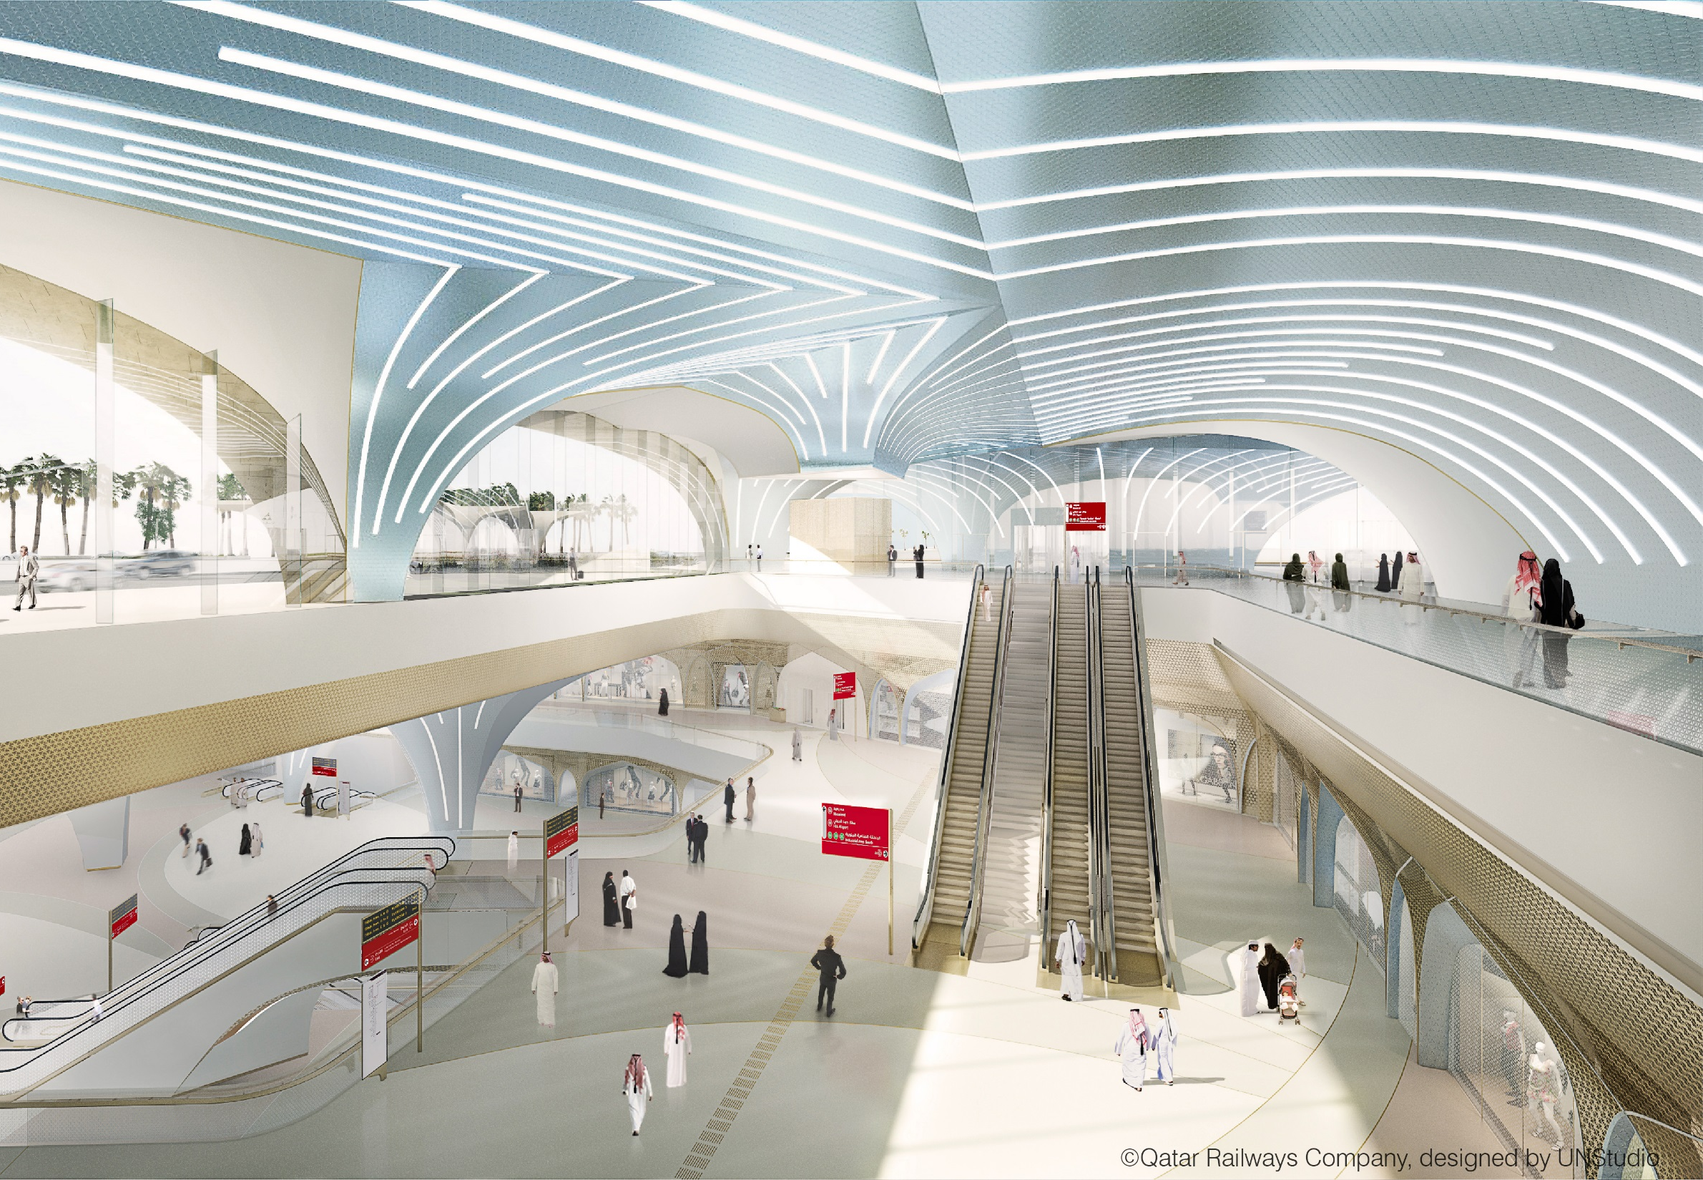
Summary of GPD – 2015, J.Vitkala
Source: www.gpd.fi ©Qatar Railways Company, designed by UNStudio

Slide 45
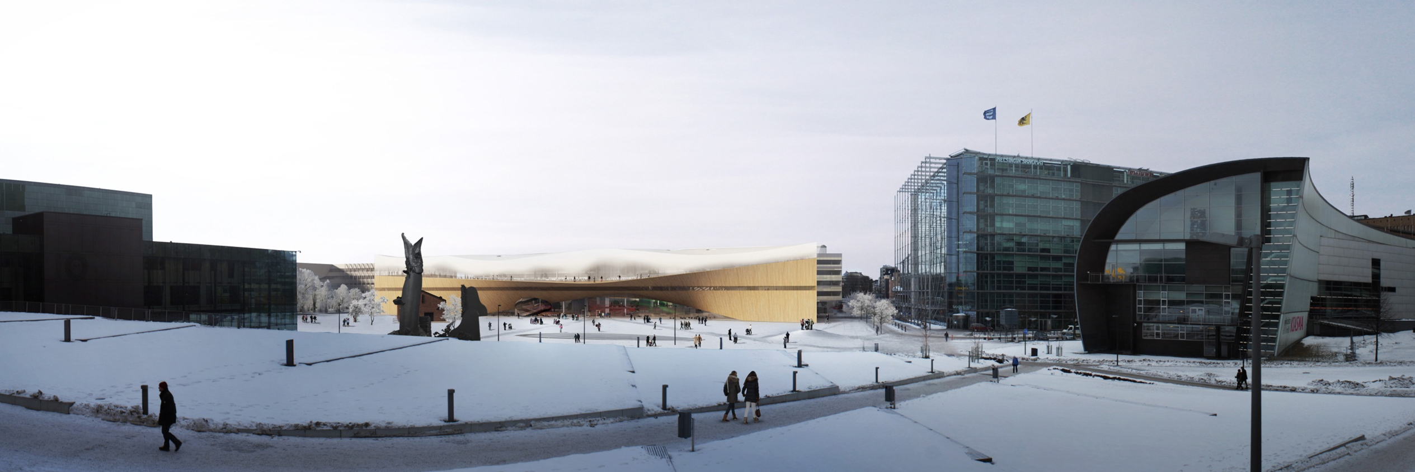
Summary of GPD – 2015, J.Vitkala
Source: www.gpd.fi © Juho Grönholm, Arkkitehtitoimisto ALA

Slide 46
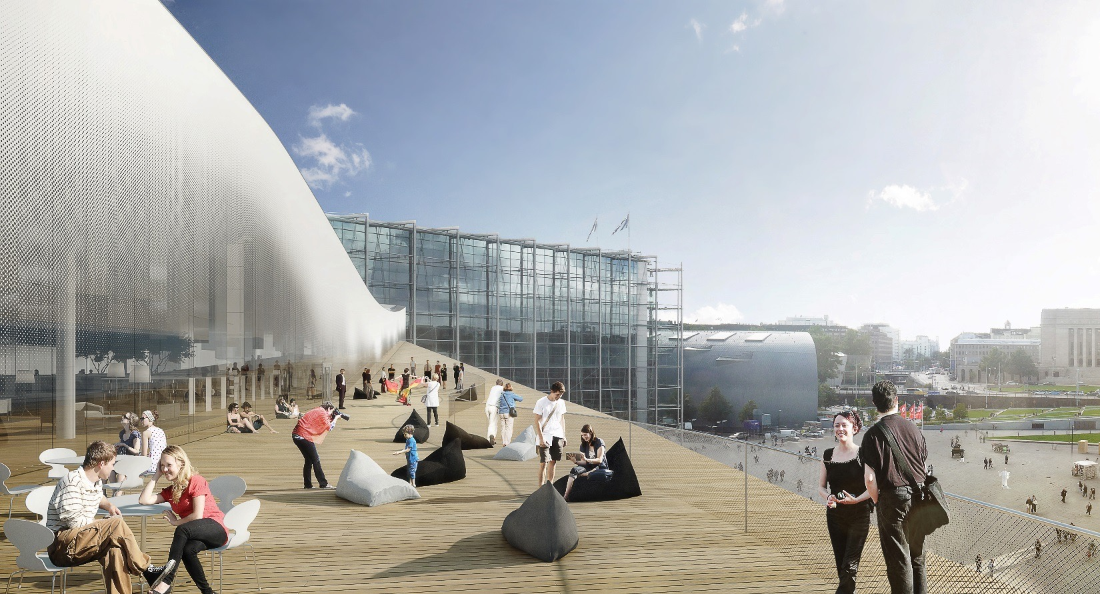
  Summary of GPD – 2015, J.Vitkala
  Source: www.gpd.fi © Juho Grönholm, Arkkitehtitoimisto ALA

Slide 47
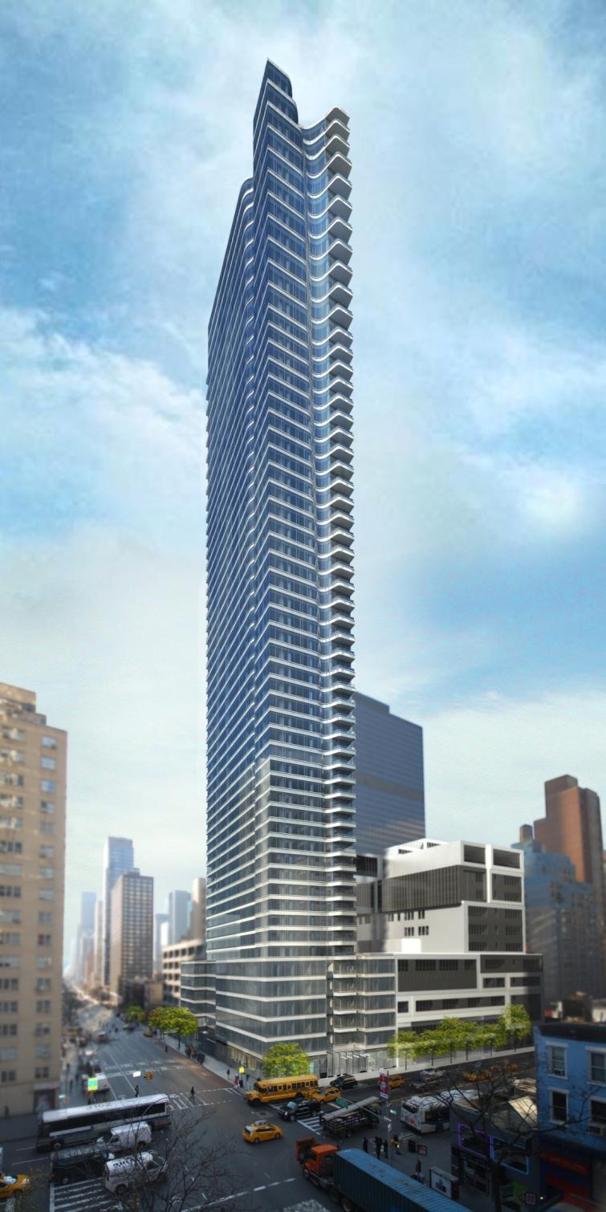
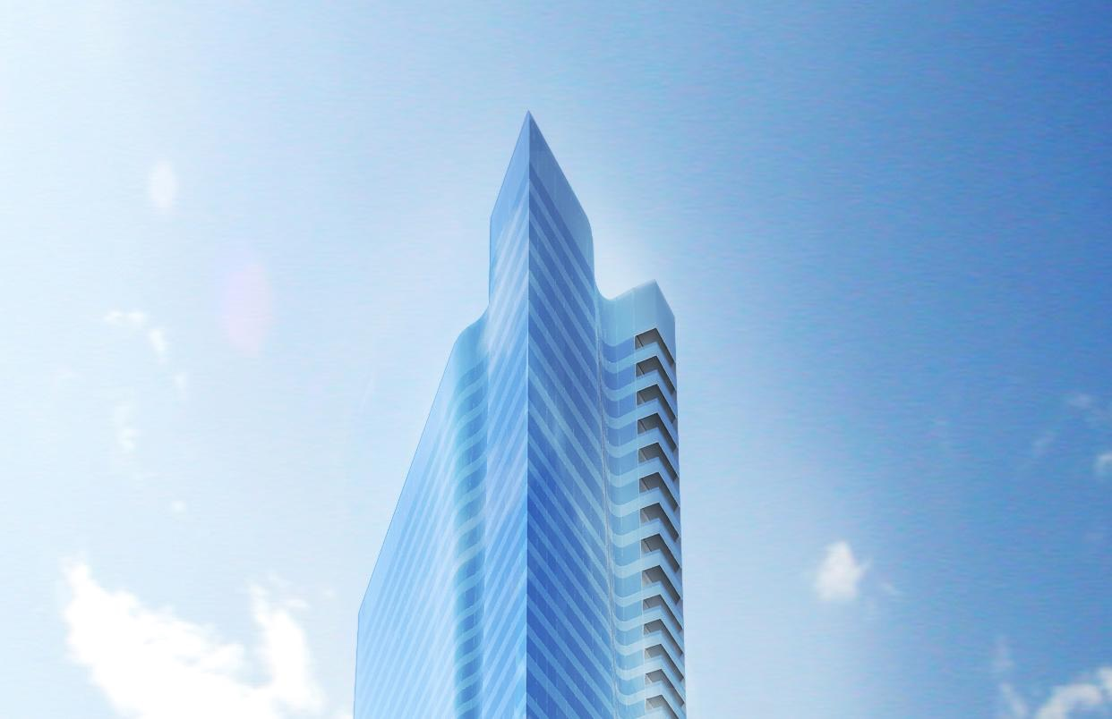
Summary of GPD – 2015, J.Vitkala
Source: www.gpd.fi ©Christoph Timm, SOM Architects

Slide 48
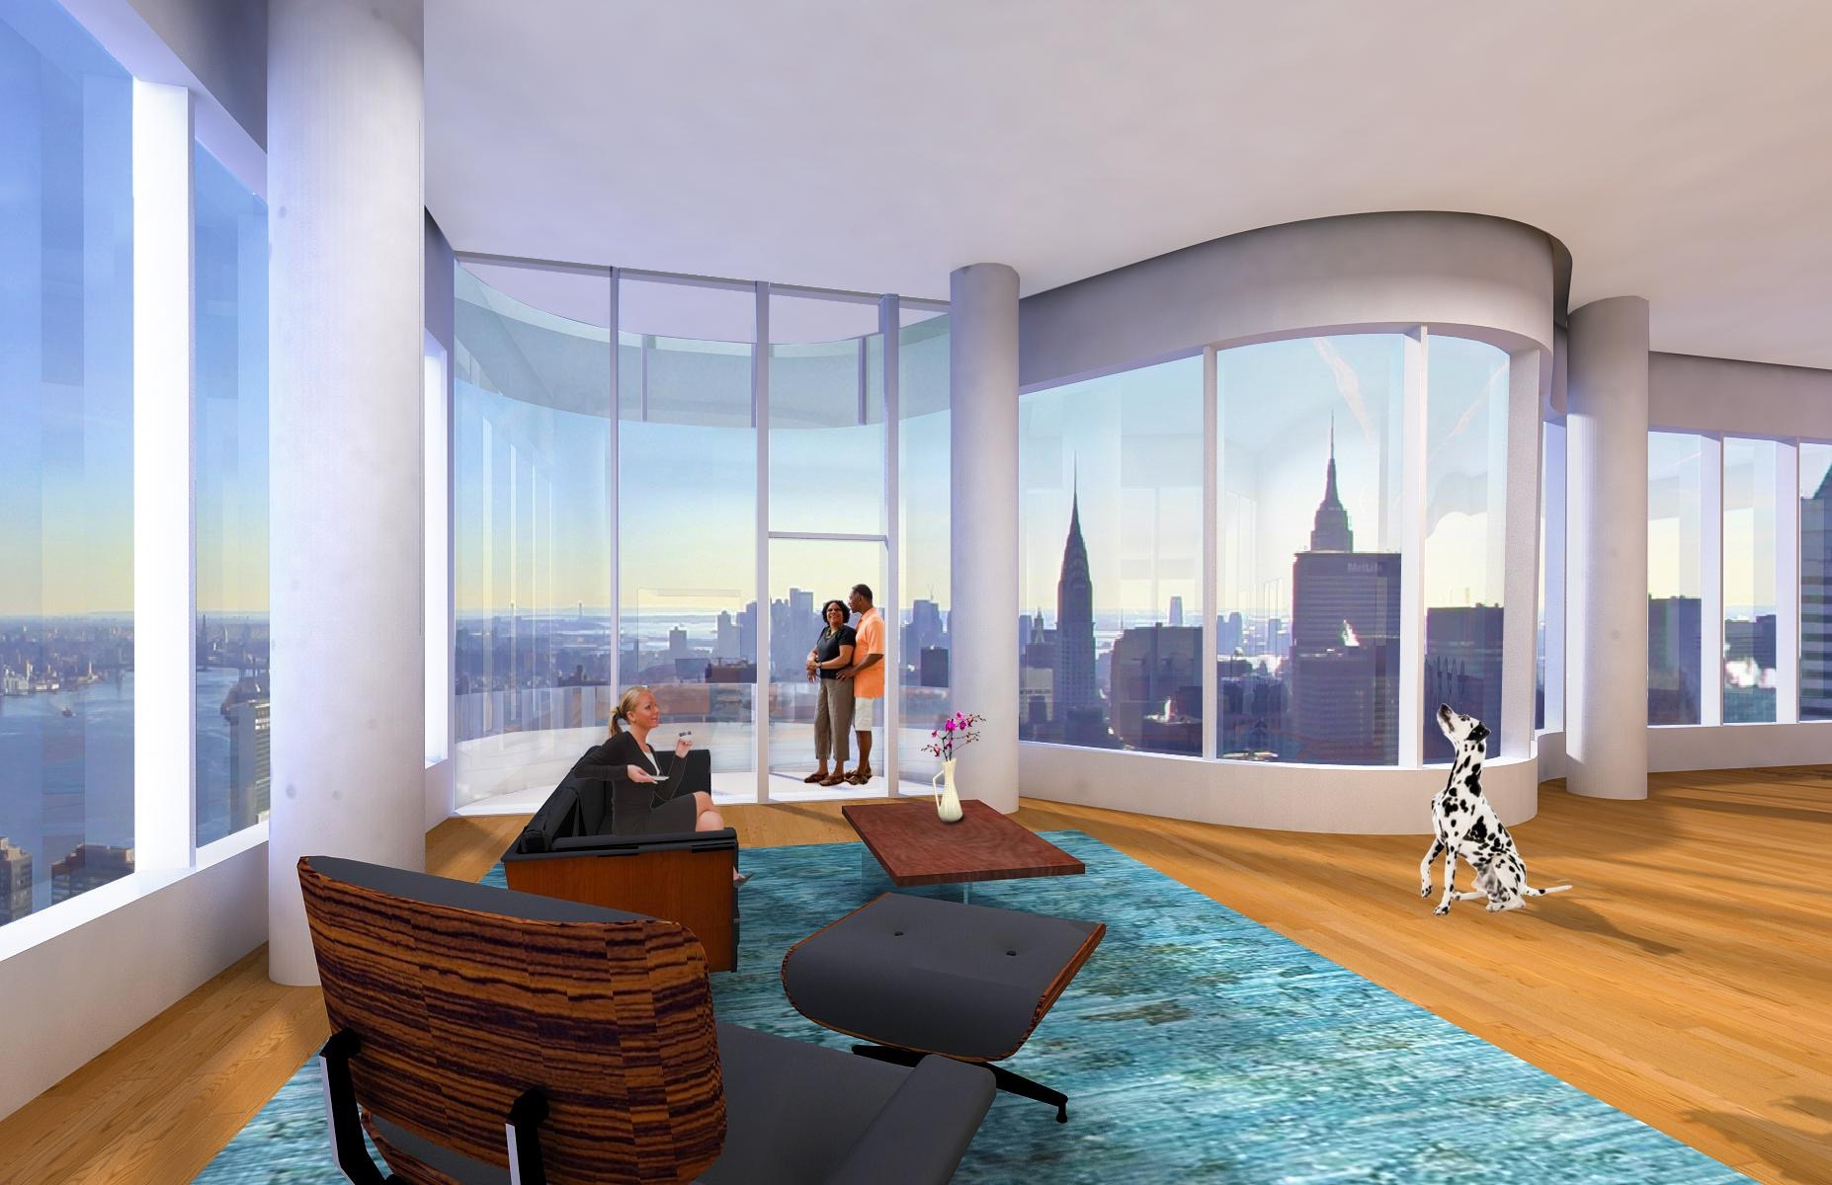
``
Summary of GPD – 2015, J.Vitkala
Source: www.gpd.fi ©Christoph Timm, SOM Architects
Notes:
Upper Condo Dining Room Facing South

Slide 49
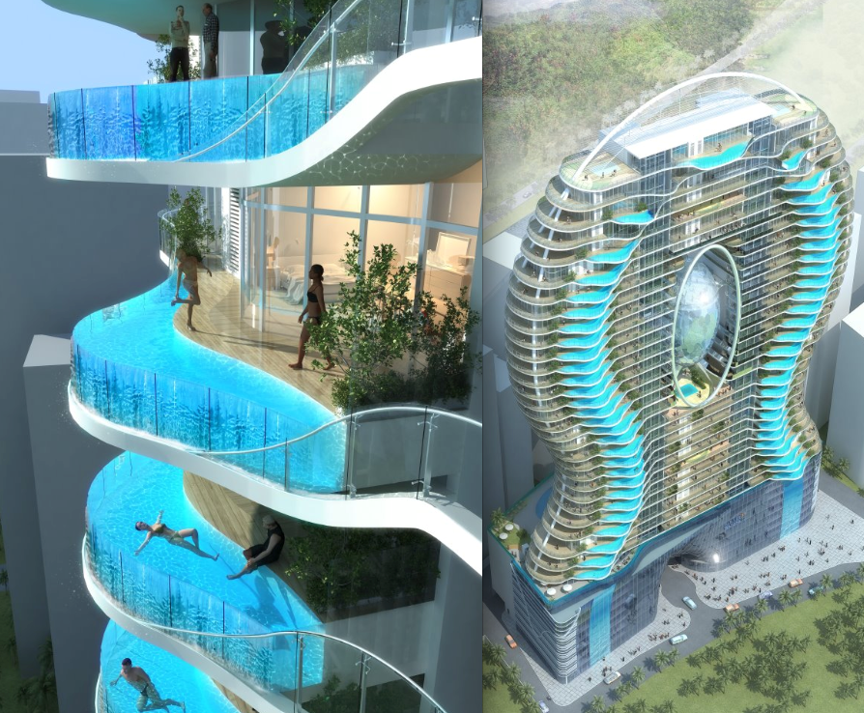
Aquaria Grande residential tower Mumbai India
Summary of GPD – 2015, J.Vitkala
Source: www.gpd.fi ©Urmilla Jokhu-Sowell, GANA

Slide 50
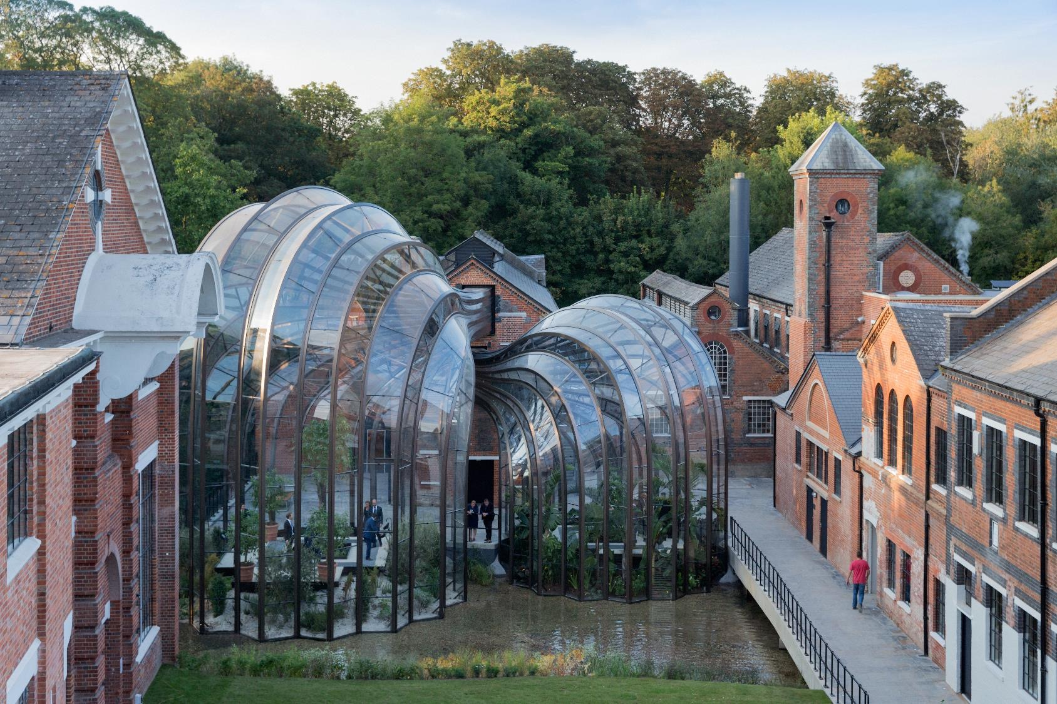
Summary of GPD – 2015, J.Vitkala
Source: www.gpd.fi © Felix Weber, Aprup

Slide 51
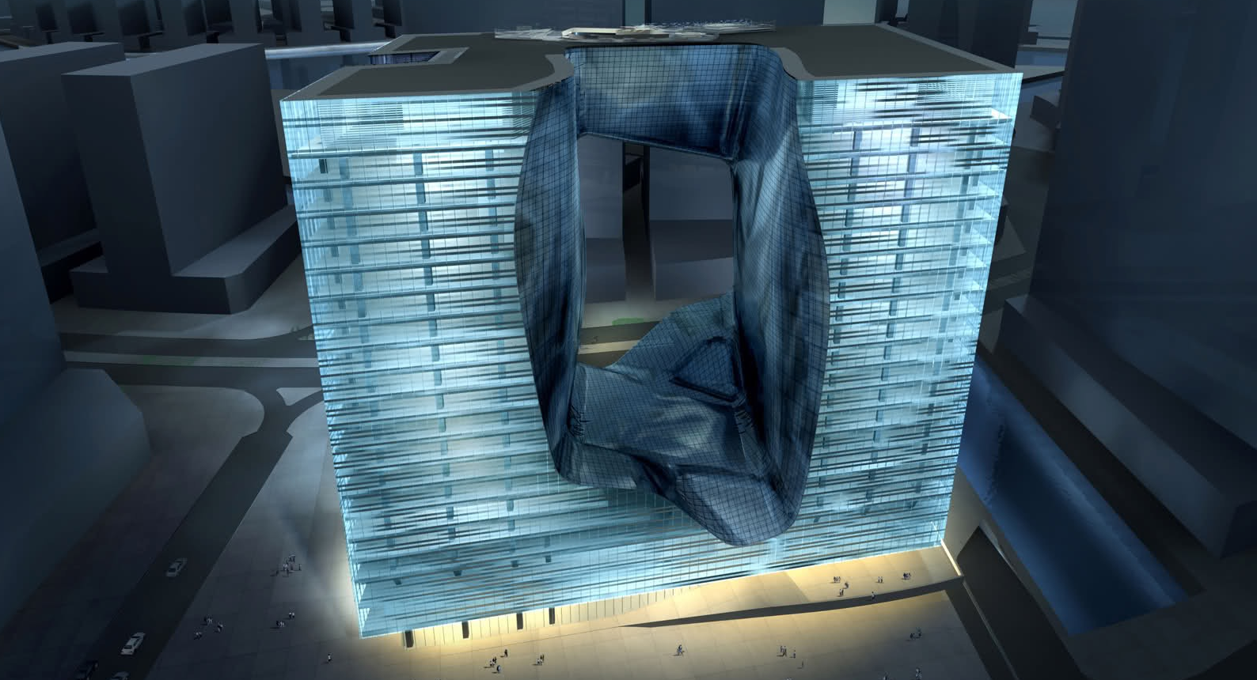
Summary of GPD – 2015, J.Vitkala
Source: www.gpd.fi © Agnes Koltay, Kotlay Facades

Slide 52
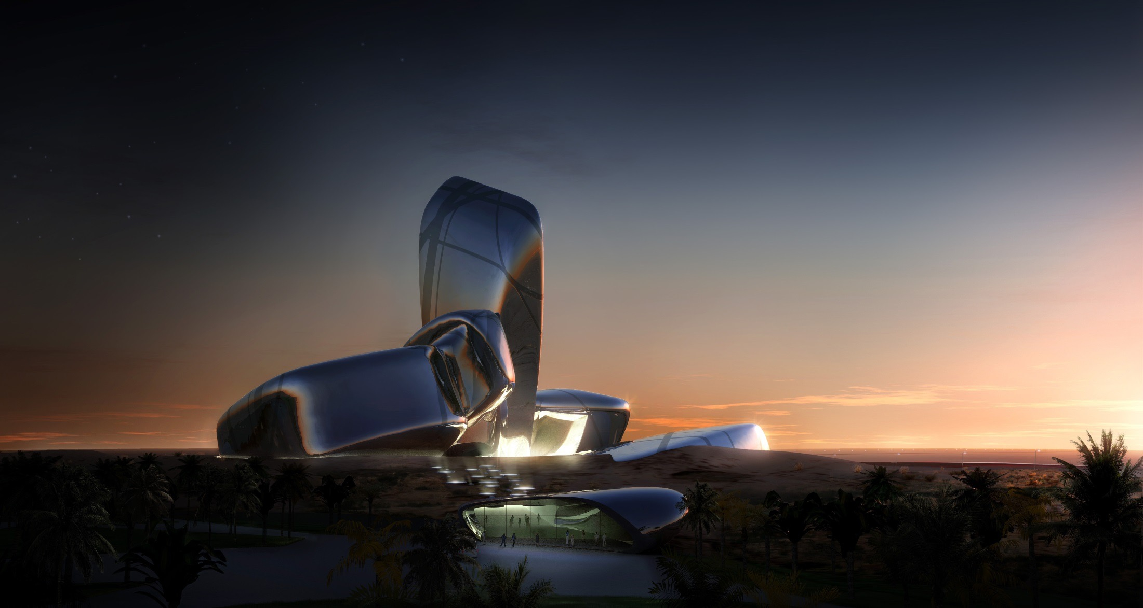
Summary of GPD – 2015, J.Vitkala
Source: www.gpd.fi ©Peter French, Snohetta
Notes:
Design comeption over 2 months in 2007
We won, beating ZAHA and OMA and 3x Neilson
Feb 2008 team started schematic design and about 1 year later we issued IFC docs.
Aramco representatives moved into our offices offering input in planning process and also to give an understanding of the cultural context. Those Aramconians not only became highly valued members within the design team but also friends
At the height of design process 53 archs, ints and lands were involved in project
Extremely complex- once in a lifetime chance to build
Challenge from client for iconic building
Bag of archietctural tricks weel and truly used. Just about every element was designed.

Slide 53
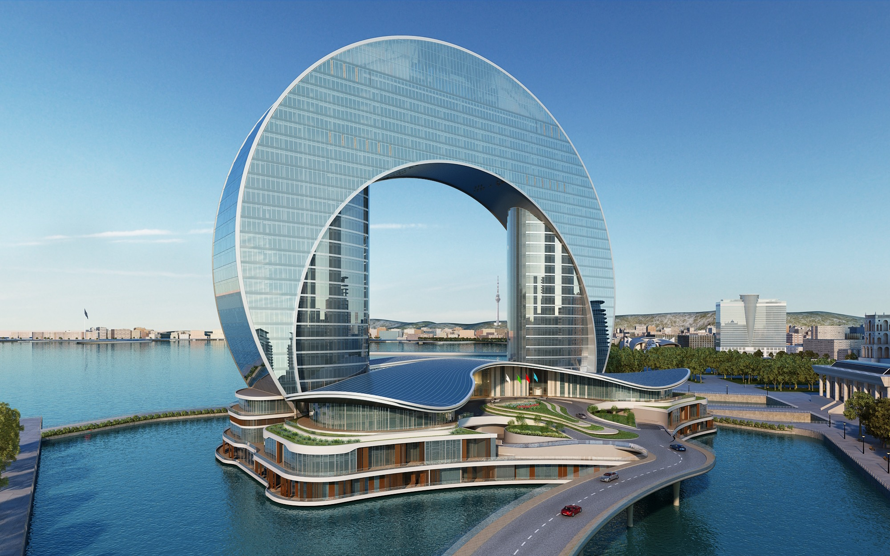
Summary of GPD – 2015, J.Vitkala
Source: www.gpd.fi © Agnes Koltay, Kotlay Facades

Slide 54
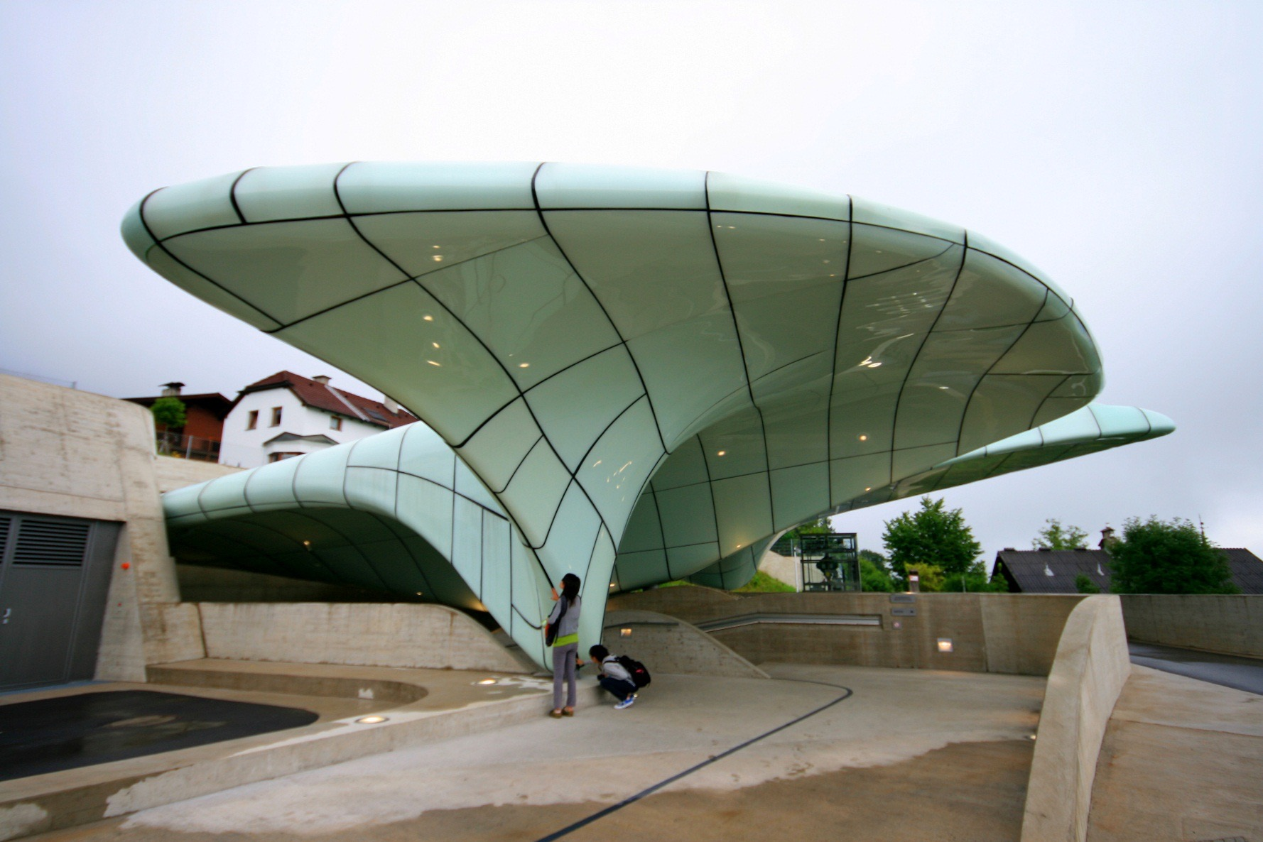
Summary of GPD – 2015, J.Vitkala
Source: www.gpd.fi ©Christian Raun, Adapa ApS

