Slide 1

“High Rise Buildings Design Considerations – A short Course for Finnish Architects”
Organised & Presented by
Mr. Jorma Vitkala
On Behalf of
GPD Finland

Slide 2
Todays Presenters
Dr Leon Jacob Principal J & Associates
Mr Keith Boswell Partner SOM
Mr Peter Smithson Principal BG&E Facades
Mr Thomas Henriksen
& Mr Dan Mollgren .

Slide 3
Topics to be discussed in this Session
Development of windows
Use of glass in windows
Function of windows
Development of curtain wall systems
Double skin curtain walls
Performance based windows – Curtain walls
What is Glass ?

Slide 4
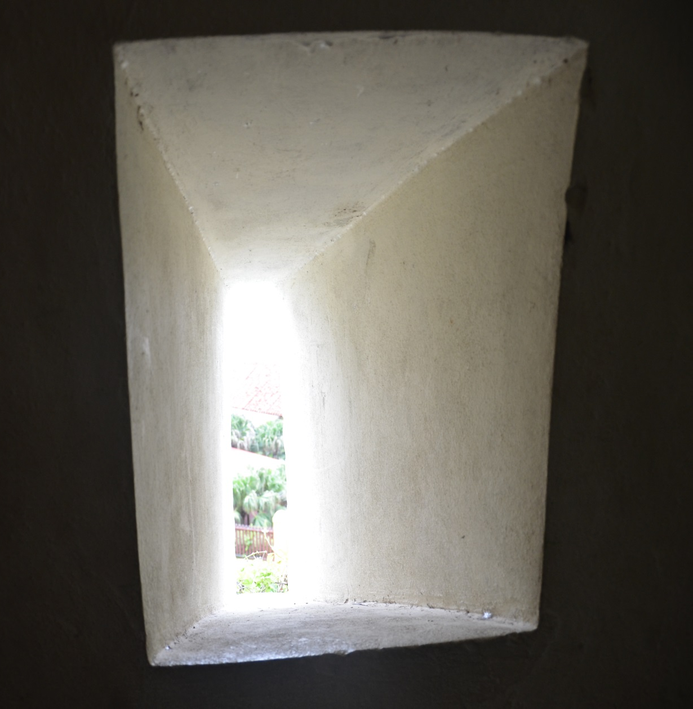
Window opening in a Fort - Cuba

Slide 5
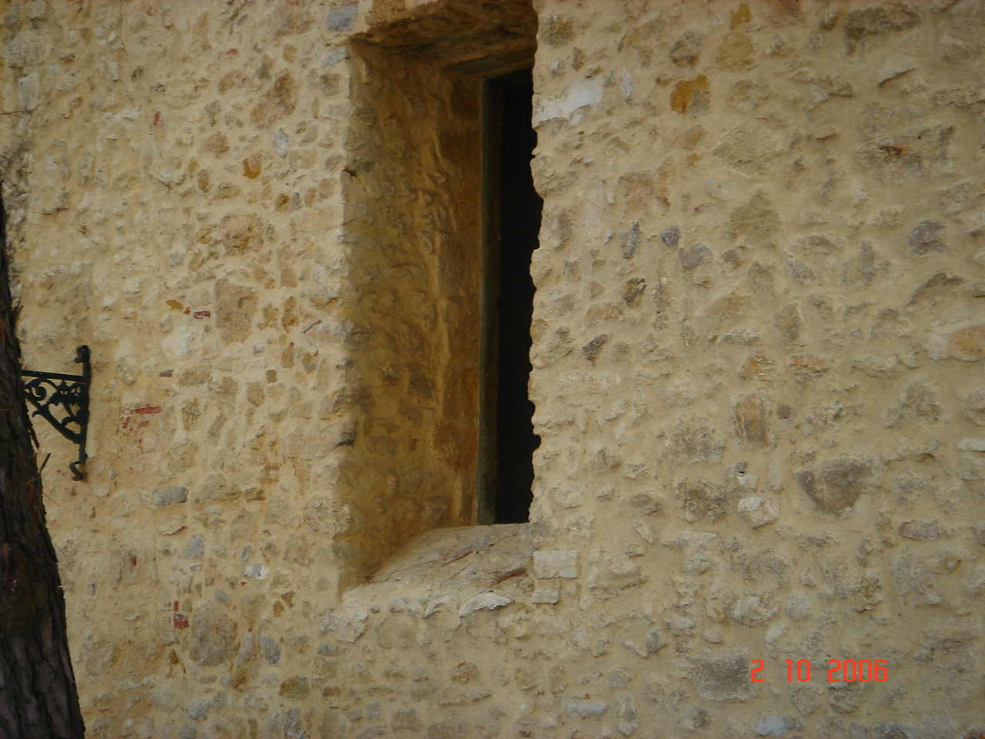
Old building (castle) Portugal

Slide 6
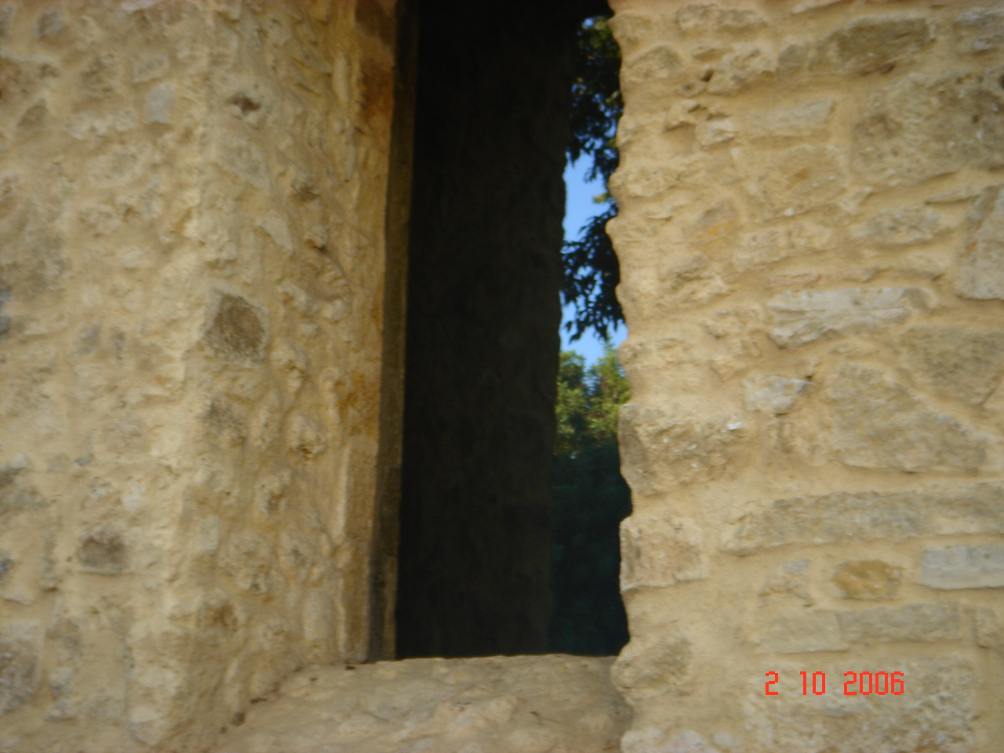
Glass window to old opening in the building

Slide 7
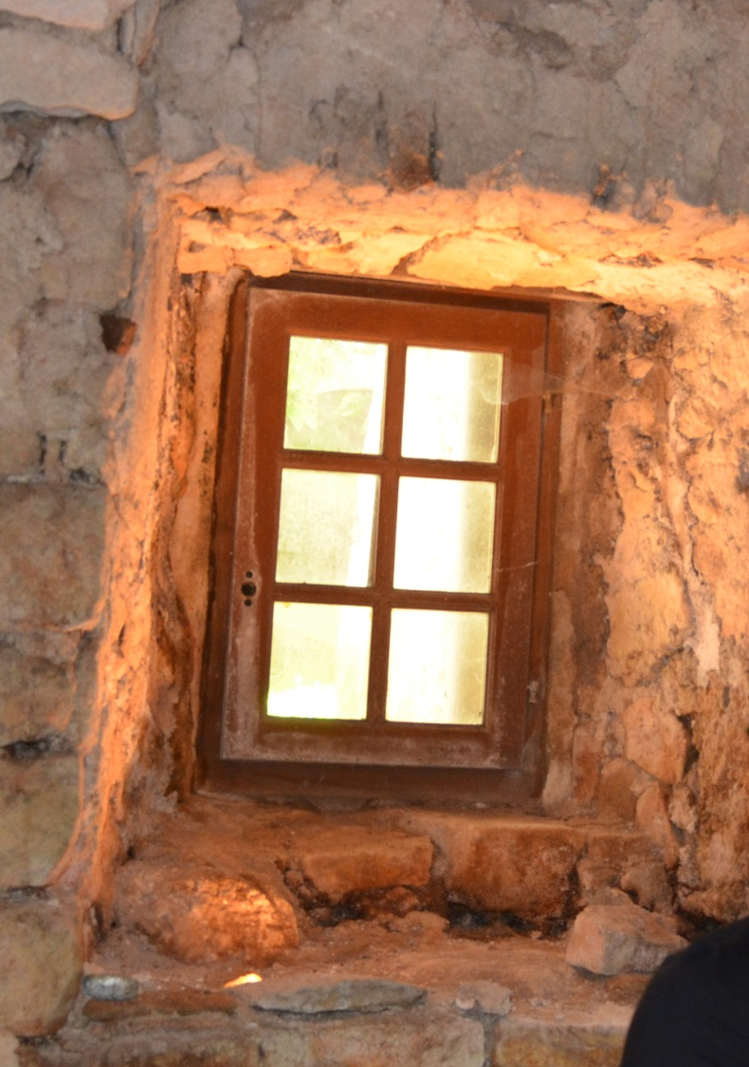
Window fitted to the opening

Slide 8

Old fort with openings

Slide 9
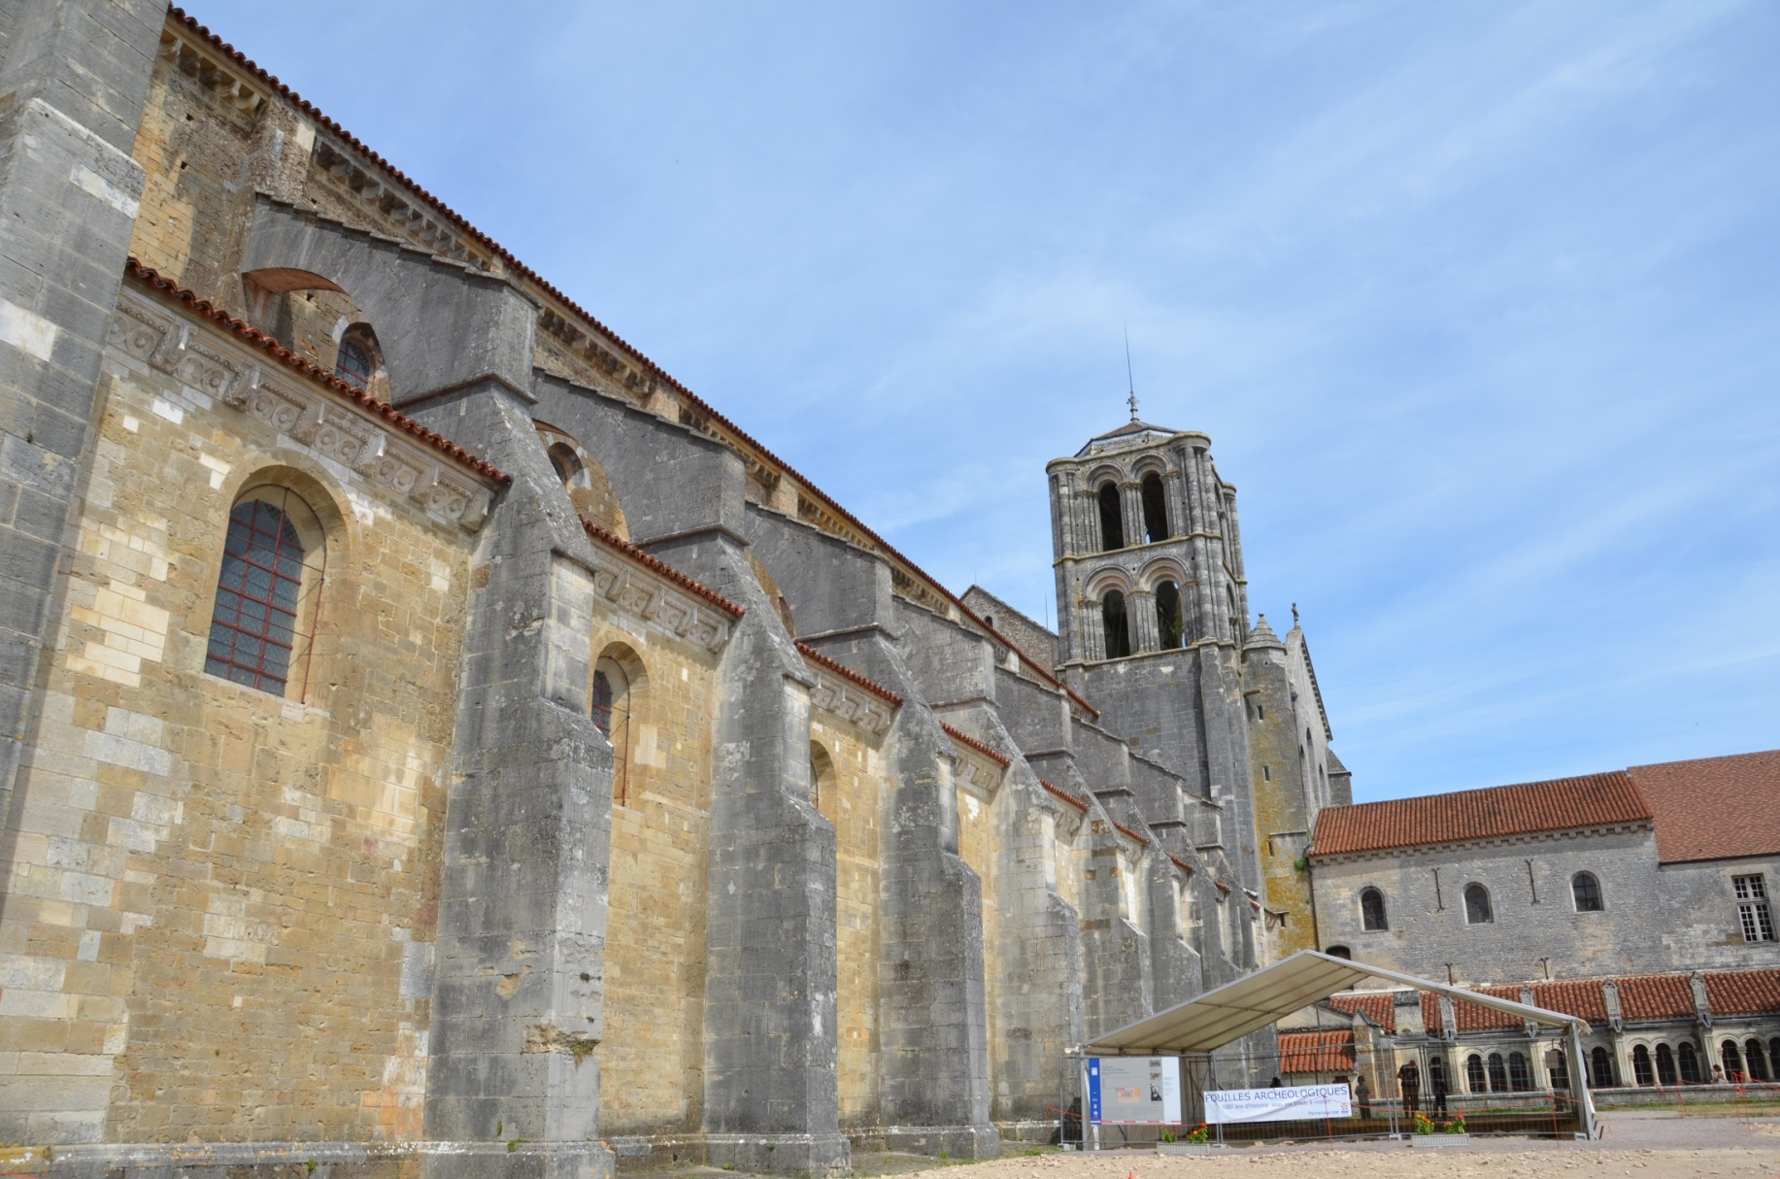
Old Monastery with windows

Slide 10
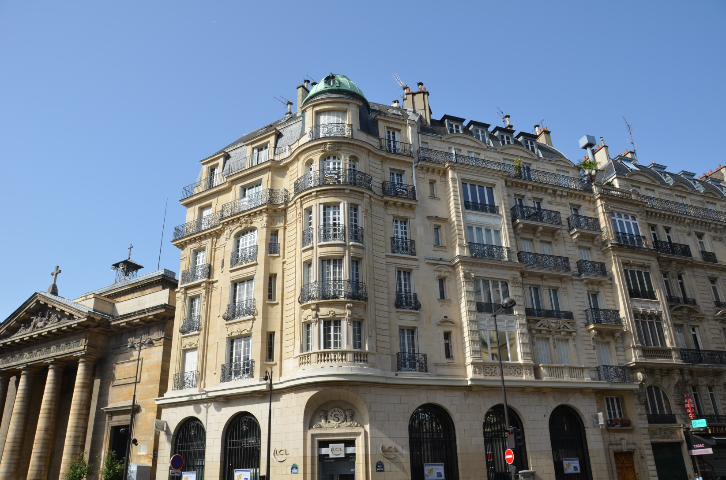
Other examples of high rise building

Slide 11
Glass Facades
Facades are the first aesthetical feature of a building that distinguishes one building from another
Facades are the most important feature that quantifies & qualifies the performance of the building
Facades must ensure occupant comfort and performance

Slide 12
Brief History – High Rise Buildings
Development of high rise buildings is generally attributed to
  The availability of steel framing
  The development of internal lifts
  The development of air conditioning systems
  The development of high spectral performance glasses
This brought on a change of design criteria:
  Building weight not supported by the external skin
  Availability of steel for building construction

Slide 13
What Caused this Building Growth
Availability of glass in large sizes
This created new problems like:
  excessive heat, light, comfort, breakage and
  consequent occupant safety etc
Industry had to recognise these issues and respond

Slide 14
Glass
Extremely Versatile
Comes in various thickness & sizes
Can be modified to develop special characteristics -
Safety, security, solar control, retain heat in cold countries, bullet resistance etc.

Slide 15
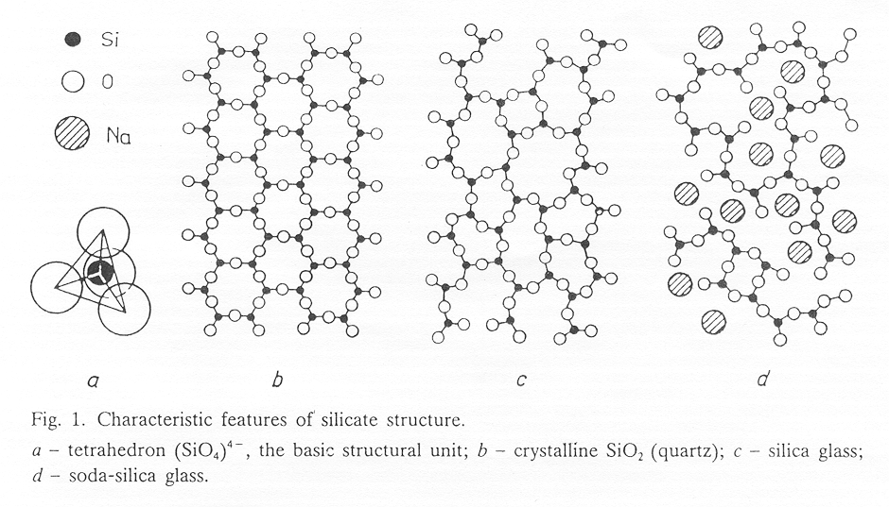
Glass Structure.

Slide 16
The Nature of Glass Strength
Theoretically glass strength is very high - 16 GPa
In practice glass is approximately - 45MPa
Glass exhibits a very high variability in strength.
Strength decreases with increasing size.
Strength decreases with increasing load duration.
Weathered glass has lower strength

Slide 17
THEORETICAL STRENGTH.
Can Be Estimated From The Strength of The Atomic Bonds
Or From The Energy Of The Newly Formed Surfaces Of The Ruptured Sample
Theoretical Strength Has Been Estimated To Be Approximately 16 GPa

Slide 18
PRACTICAL STRENGTH OF GLASS.
Studied By Various Investigators
Large Scatter Found
Values Are A Function Of The Test Methods
Difficult To Assign A Value Like Density Etc
Strength Is Concerned With Point to Point Separation
Hence The Statistical Nature of Strength

Slide 19
Stresses Developed in Glass Panels
Pressure-stress relationship is linear only at low load or particular panel geometry.
For typical window designs, the pressure-stress relationship is non-linear at the design wind loads.
The pressure-stress relationship is different at different points on the same panel.

Slide 20
Glass Properties

Slide 21
Physical Properties of Glass
Density - 2500 kg/m³
Specific gravity - 2.5
Coeft. Linear Thermal expansion - 75 - 80 x 10⁻⁷/deg C
Thermal Conductivity - 1.05 W/mºc
Modulus of Elasticity - 69 GPa
Poisson’s Ratio - 0.22 to 0.23
Compressive Strength - 25 mm cube - 248 MPa
Tensile Strength - Sustained Load - 19.3 to 28.4 MPa
Refractive Index - 1.52
Thermal Transmittance - 6.02 W/m^{2o}C
Visible light Transmission - 85%

Slide 22
Strength
Is the resistance to fracture
Is that value of stress at which failure occurs
It is not a material property

Slide 23
THE STRENGTH OF GLASS
Failure due to tensile stress
The compressive strength - 10 times > tensile strength
Fracture generally begins at the surface
Strength is impaired by surface flaws
Strength is dependant on -
  Duration of Load
  Temperature &
  Environmental Conditions
  Panel size

Slide 24
Fatigue
Loss of Strength with Time
Glass will support a higher load for a short period of time than under a prolonged loading
The faster the load is applied the stronger is the glass

Slide 25
Types of Strength
Dynamic vs Static
Short term vs Long term
Tensile vs Bending / Shear / Compressive
Annealed vs Un annealed

Slide 26
Glass Fracture
Failure is Always Due to Tensile Stress
Compressive Strength is Several Times Higher Than the Tensile strength
Strength of Identical Samples show Large Scatter (C.O.V - 22% to 25%)
Glass Failure Always Starts at the surface
Strength is impaired by Surface flaws
Strength is Dependent on the Duration of Loading

Slide 27
Theoretical Strength of Glass
σ_{t} = {Eγ/a_{o}}^{1/2} = 16 GPa
E - Youngs Modulus - 70GPa
γ - Fracture Surface Energy - 4.5J/m²
a_{o} - Inter Atomic distance - 2x10⁻¹⁰ m

Slide 28
PRACTICAL STRENGTH OF GLASS
Studied By Various Investigators
Large Scatter Found
Values Are A Function Of The Test Methods
Difficult To Assign A Value Like Density Etc
Strength Is Concerned With Point to Point Separation
Hence The Statistical Nature of Strength
Weathered Glass has Reduced Strength

Slide 29
FACTORS AFFECTING MEASURED STRENGTH
Size Of Specimen
Surface Quality
Load Duration
Rate Of Loading
Test Environment
Temperature
Relative Humidity

Slide 30
The Nature of Glass Strength
Theoretically has very high strength.
In practice has very low tensile strength.
Has very high variability of strength.
Strength decreases with increasing size.
Strength decreases with increasing load duration.
Weathered glass has lower strength.

Slide 31
Stresses Developed in Glass Panels
Pressure-stress relationship is linear only at low load or particular panel geometry.
For typical window designs, the pressure-stress relationship is non-linear at the design wind loads.
The pressure-stress relationship is different at different points on the same panel.

Slide 32
Spectral Issues with Glass in Facades
Glass is transparent to Short Wave radiation & opaque to long wave radiation
Glass is a brittle material – Behaviour must be understood
Glass provides light to the building occupants
Glass provides an improved environment for the occupants
Glass can be designed and selected to suit all needs

Slide 33
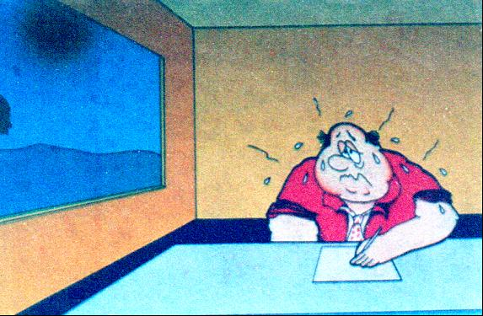
Effect of Hot Glass or Direct Solar Radiation

Slide 34
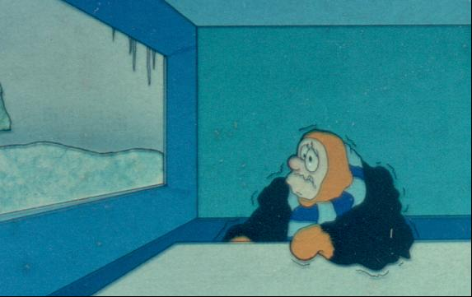
Effect of Cold on Glass

Slide 37
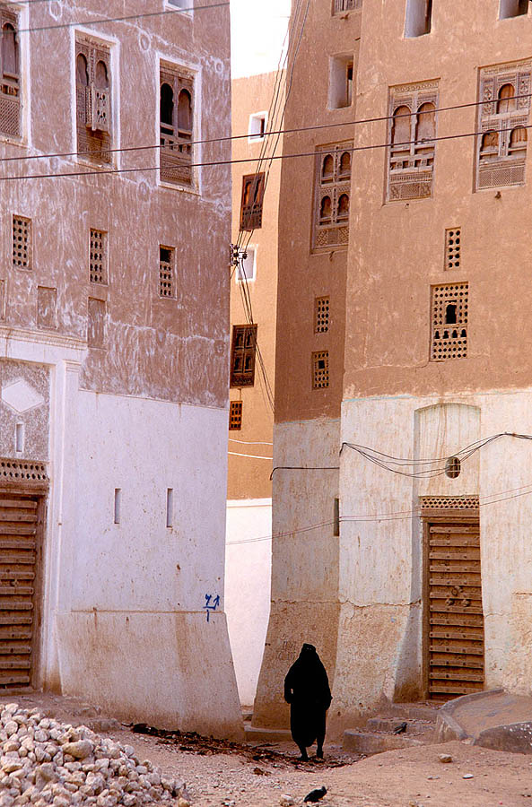
Mud High Rise Building 16th Centaury

Slide 38
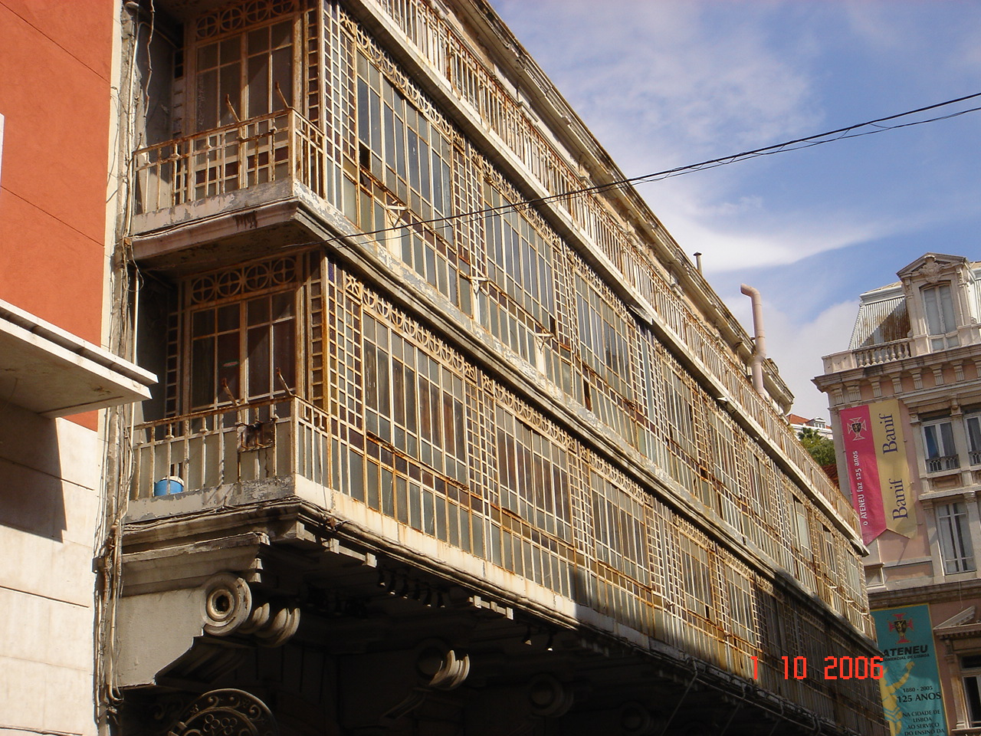
Old Balconies filled with steel framed glass

Slide 39
Brief Look at Various Cities
Generally the growth of Curtain wall systems in various countries can be seen as exciting and on going with the building height a critical factor
It appears that the height of buildings (curtain wall systems) was the driving mechanism- Countries are competing for the tallest building
Consequently we are developing systems and structures that can accommodate all issues relating to comfort, sustainability and function

Slide 40
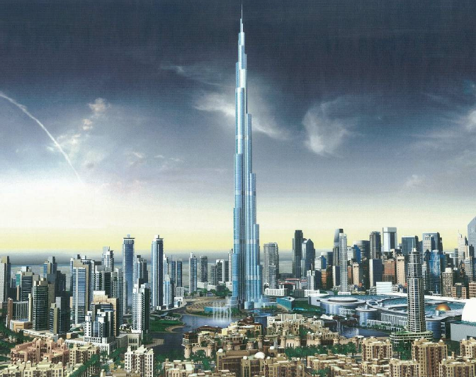
Dubai – Currently the Worlds Tallest Glass Clad Building

Slide 41

Hong Kong

Slide 42
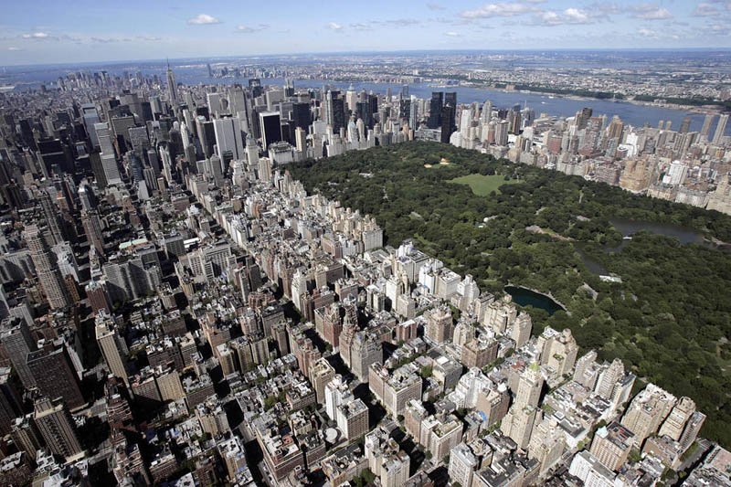
New York

Slide 43
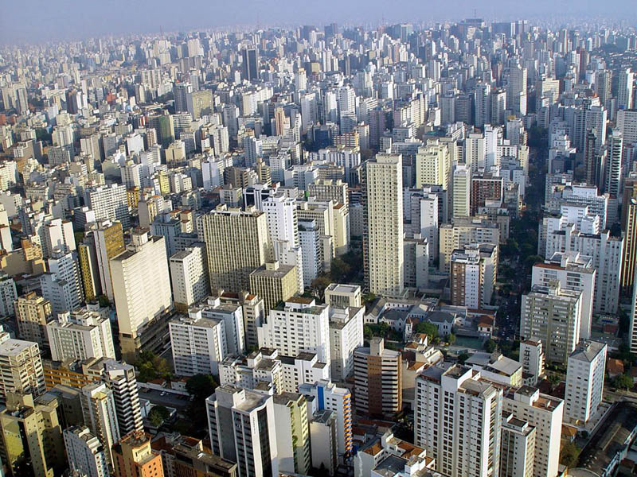
Sao Paulo

Slide 44

Singapore

Slide 45

Seoul S Korea

Slide 46
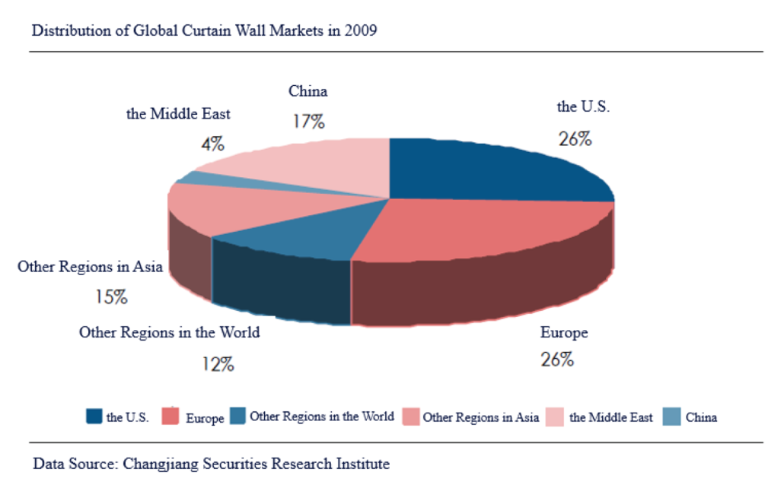
Global Curtain Wall Markets - 2009

Slide 47
Curtain Wall Systems
A curtain Wall – a glass and framing covering the external façade of a building
  Not load bearing
  Only supports lateral loads
  External loads transmitted at every floor
  Provides protection against the elements
    Wind loading / acoustics protection / light and solar control within the building environment

Slide 48
Development of high rise systems
Simple exposed frame
Semi exposed frame
Full glass façade using
  Glass (spandrel panels)
  Stone panels
  Artificial panels etc.
Unitised curtain wall
Point supported &
Double skin facades
Intelligent facades

Slide 49
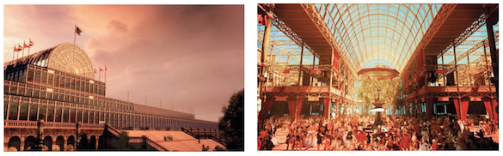
First Curtain Wall Building
First curtain wall Building. Crystal Palace - the Great Exhibition - London in 1851.

Slide 50
Development of the Curtain Wall
Steel Glass Facades – Beginning of 1950’s -
  Skeletal building method
  Necessity of controlling the interior climate
  Generate a higher incidence of light in the building
  The development of lifts to transfer people
  Development of air conditioning
  Artificial lighting
Other influences
  Development of synthetic sealants
  Development of IG units
  Types of façade construction – using prefabricated components
Systems
  Stick
  Unitised curtain wall

Slide 51
Curtain wall
Defined as thin, aluminium-framed wall, containing
  Infills of glass, metal panels, or thin stone.
  The framing is attached to the building structure – does not carry the floor or roof loads of the building.
  The wind and gravity loads of the curtain wall are transferred to the building structure, typically at the floor line.
  Aluminium framed wall systems date back to the 1930's, and developed rapidly after World War II when the supply of aluminium became available for non-military use.

Slide 52
Classification
By Fabrication and installation
  Stick System
  Unitised system
  Double skin System
  Point fixed facades
  Smart systems
Energy Efficient Facades
Smart Buildings

Slide 53
Façade Design Technology Growth
The façade fabrication has developed from
  a simple frame
  a unitized,
  point-supported,
  double-skinned
In addition
  more energy-efficient,
  ecological façade panels,
  photoelectric façade, and
  intelligent façade are gathering momentum.
The Architectural envelope market is mainly driven by the development of the global economy and building industry

Slide 54
Curtain Wall
Generally
    Aluminium Framing
    Glass Vision Panels
    Spandrel - Metal, Stone, & Composite Panels
Facades
    Represents up to 25% of Total Building Costs
    Exposed to a range of Environmental Conditions
    Required to perform a multitude of tasks - Physical, Visual & Environmental
Complex Structure

Slide 55
Curtain Wall Fundamentals
A thin, usually aluminium-framed wall, containing:
  in-fills of glass,
  metal panels, or
  thin stone.
The framing is attached to the building structure and does not carry the floor or roof loads of the building.
The wind and gravity loads of the curtain wall are transferred to the building structure, typically at the floor line.
Aluminium framed wall systems date back to the 1930's, and developed rapidly after World War II when the supply of aluminium became available for non-military use.

Slide 56
Curtain Wall Design Fundamentals
Resistance to wind pressure
Water leakage
Environmental control
  Reduction of solar heat gain (warm climates0
  Reduction of heat loss in cold countries
  Seismic control
Noise reduction and control
Thermal movement
Fire control

Slide 57
Curtain Walls - Unitised.
Totally Independent Structure encapsulating glass Panels & Spandrels suspended from the main building structure.
Not built between floors.
An exterior wall system capable of supporting it’s own dead weight. ( It transfers all other loads to the structure)

Slide 58
Examples of High Rise Buildings
Stick systems
Unitised Glazing systems
Point fixed facades
All glass facades

Slide 59
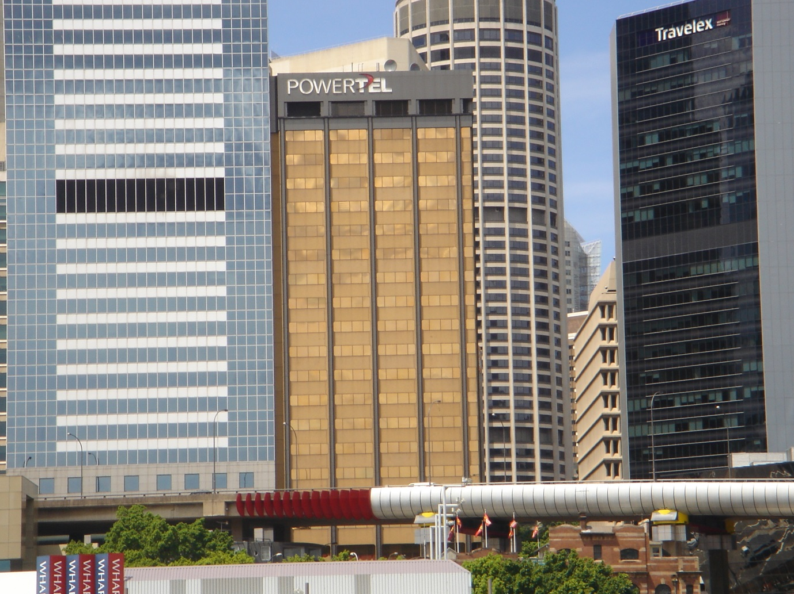
High Rise Building – Stick System
Curtain wall glazing system utilised 4 different sealants –
Front seal - silicone,
Heal and toe beads
Internal seal - gasket.
No pressure equalisation
Stick system –
Externally glazed
IG unit for vision
Toughened glass for spandrels

Slide 60
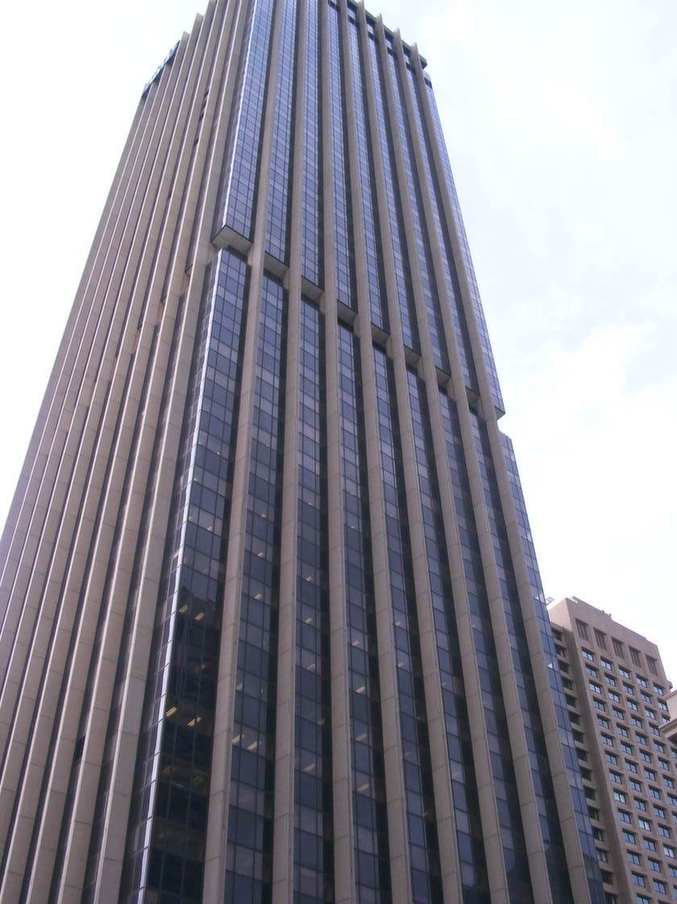
Stick System
4 edge supported

Slide 61
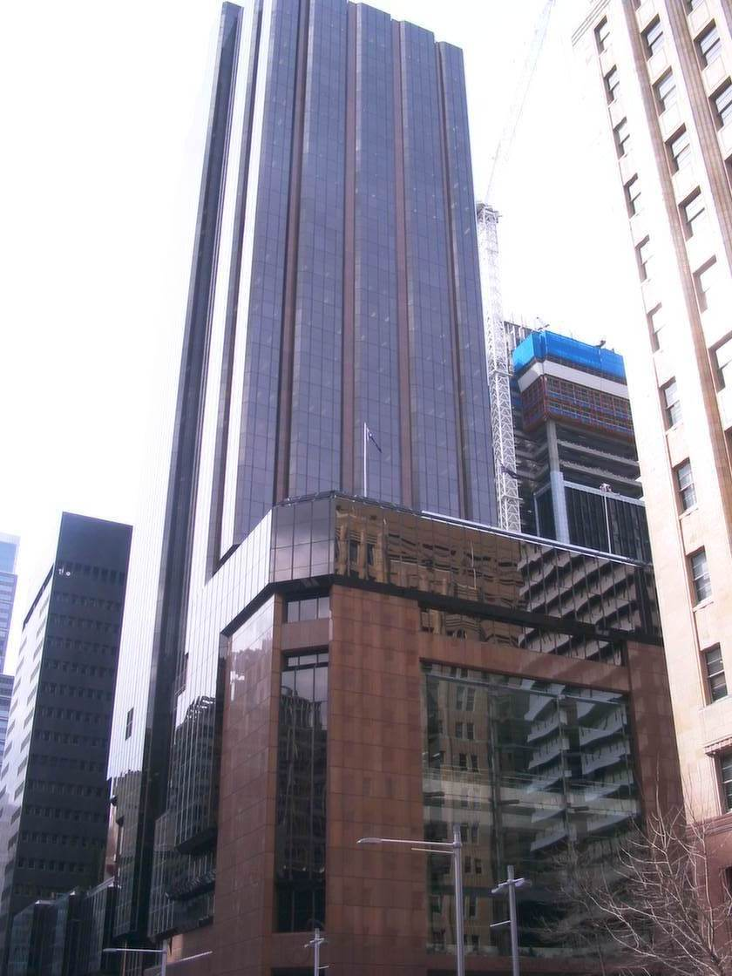
Two Sided Curtain Wall – Structurally Glazed

Slide 62
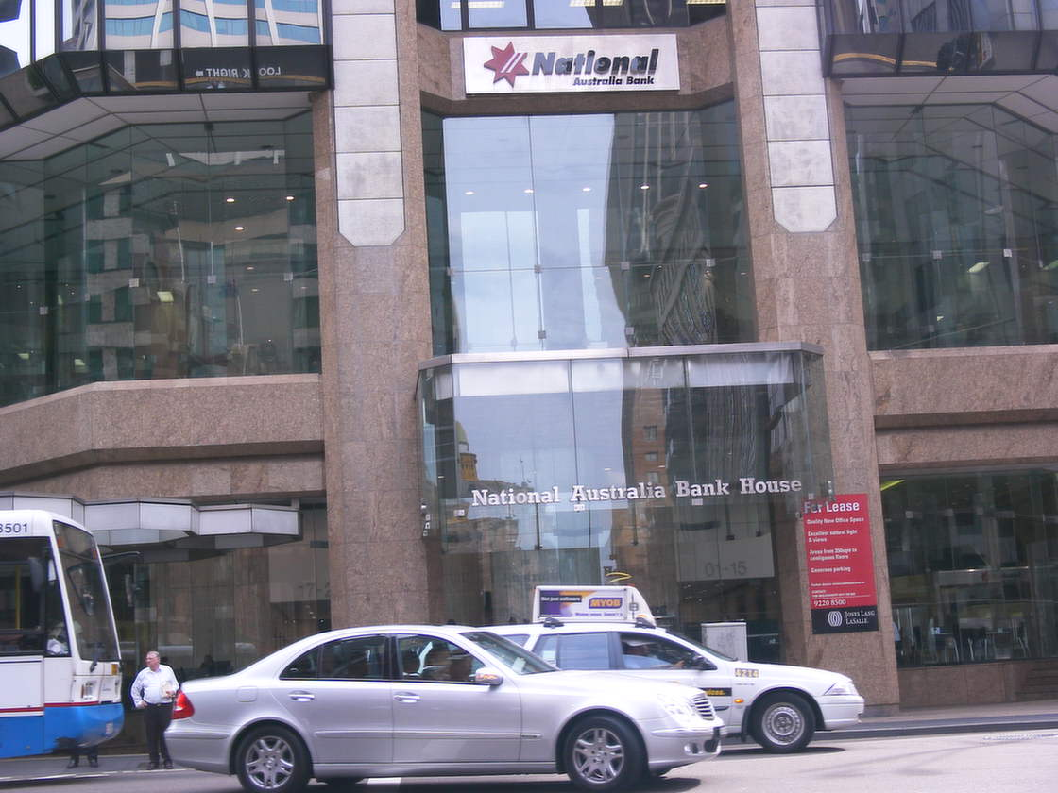
Toughened Glass Foyer Glazing

Slide 63
Unitised Glazing systems

Slide 64
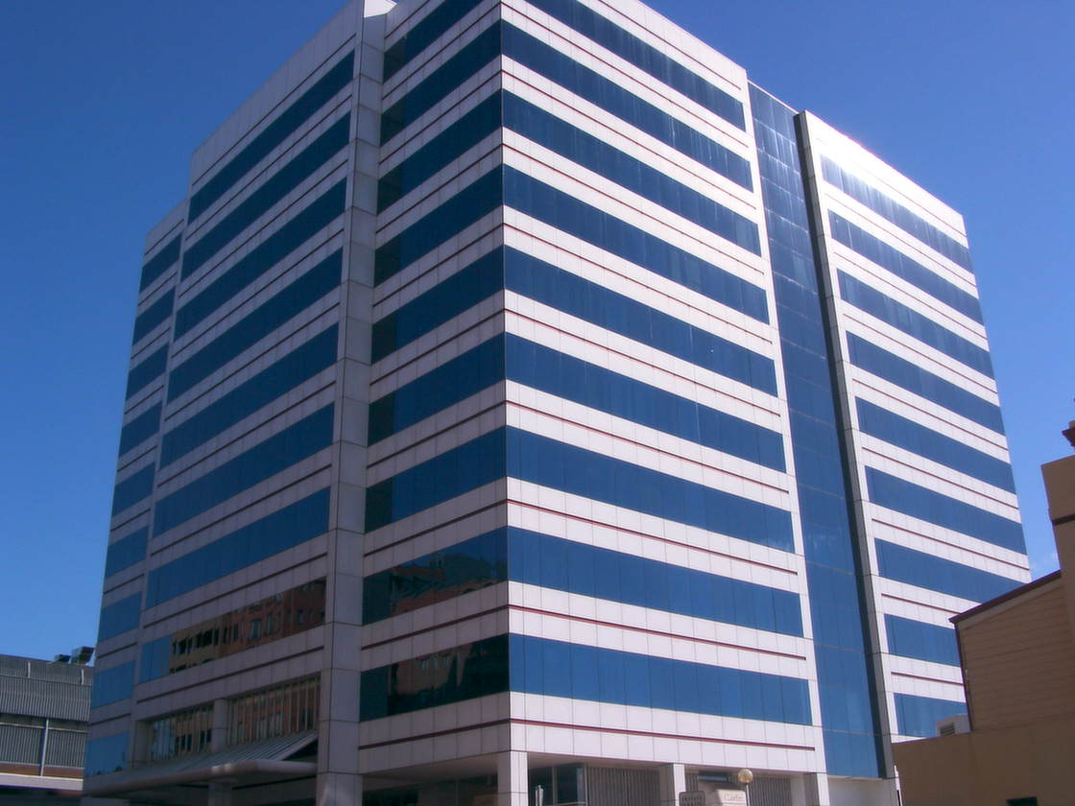
4 edge unitised glazing

Slide 65
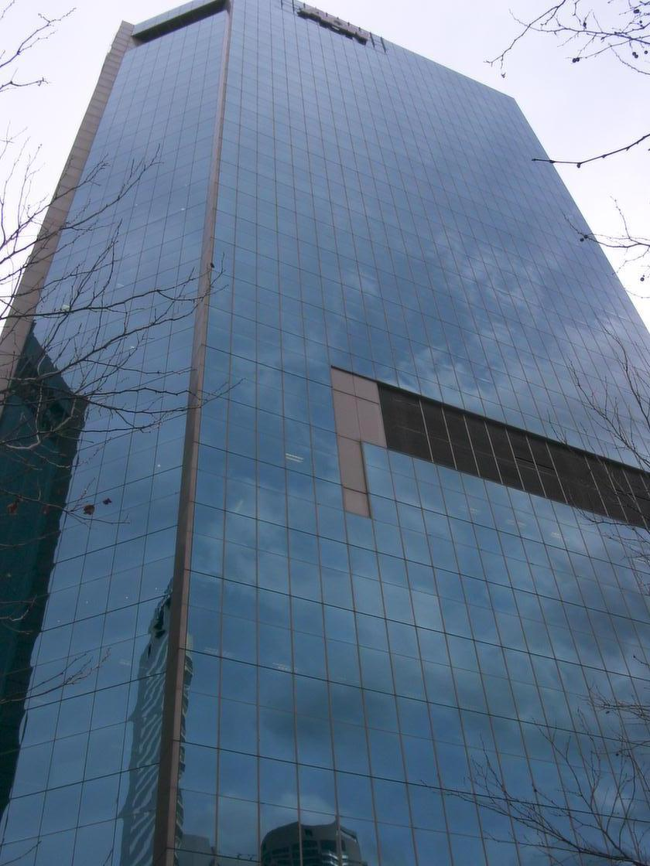
MSB twin tower 4 sided structurally glazed facade

Slide 66
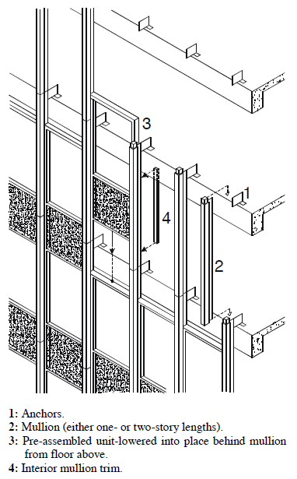
Unit & Mullion (stick) System

Slide 67
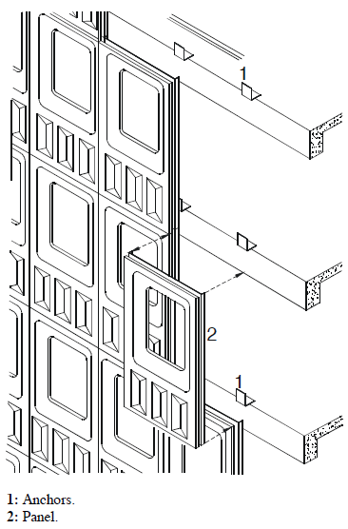
Panel System

Slide 68
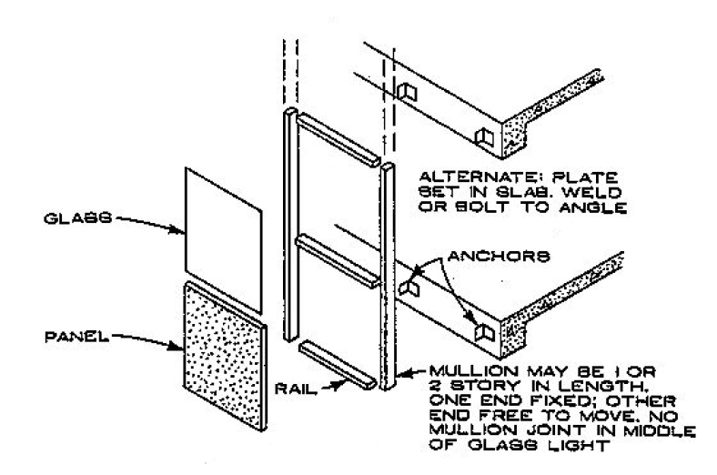
Typical Stick wall system

Slide 69
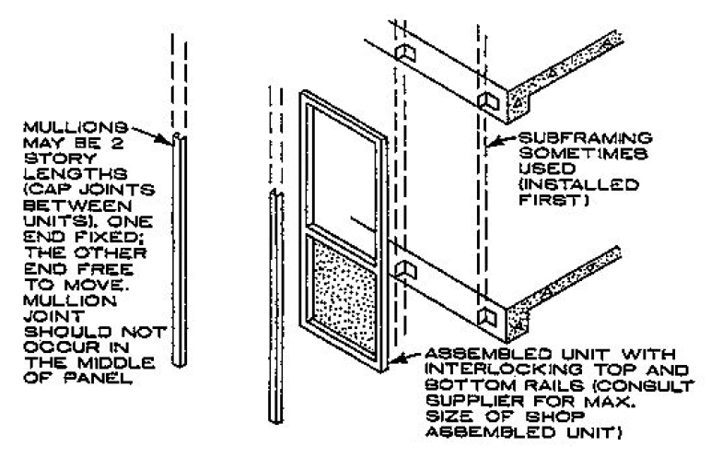
Semi Unitised Curtain Wall System

Slide 70
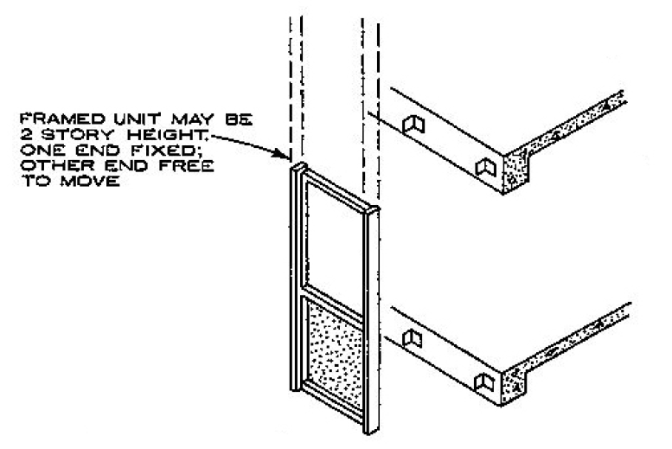
Unitised Curtain wall system

Slide 71
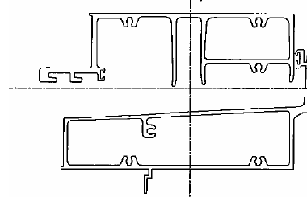
Typical stack joint – Unitised System

Slide 72
Typical Mullion – Male & Female

Slide 73
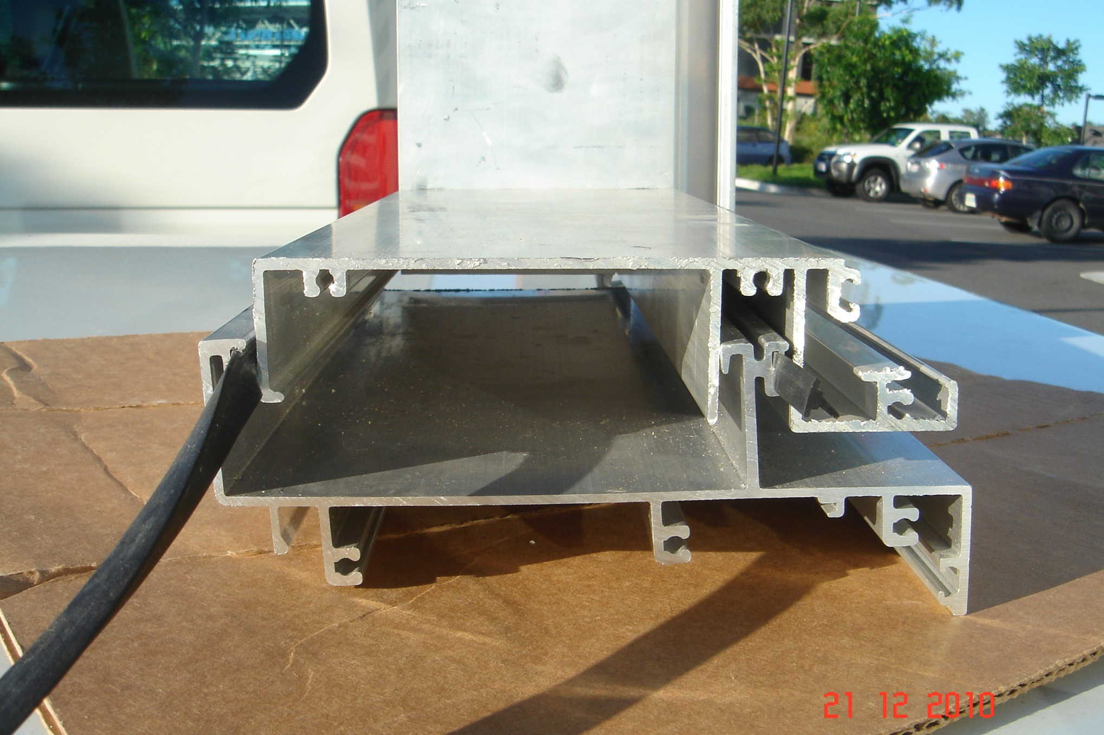
Stack Head Joint

Slide 74
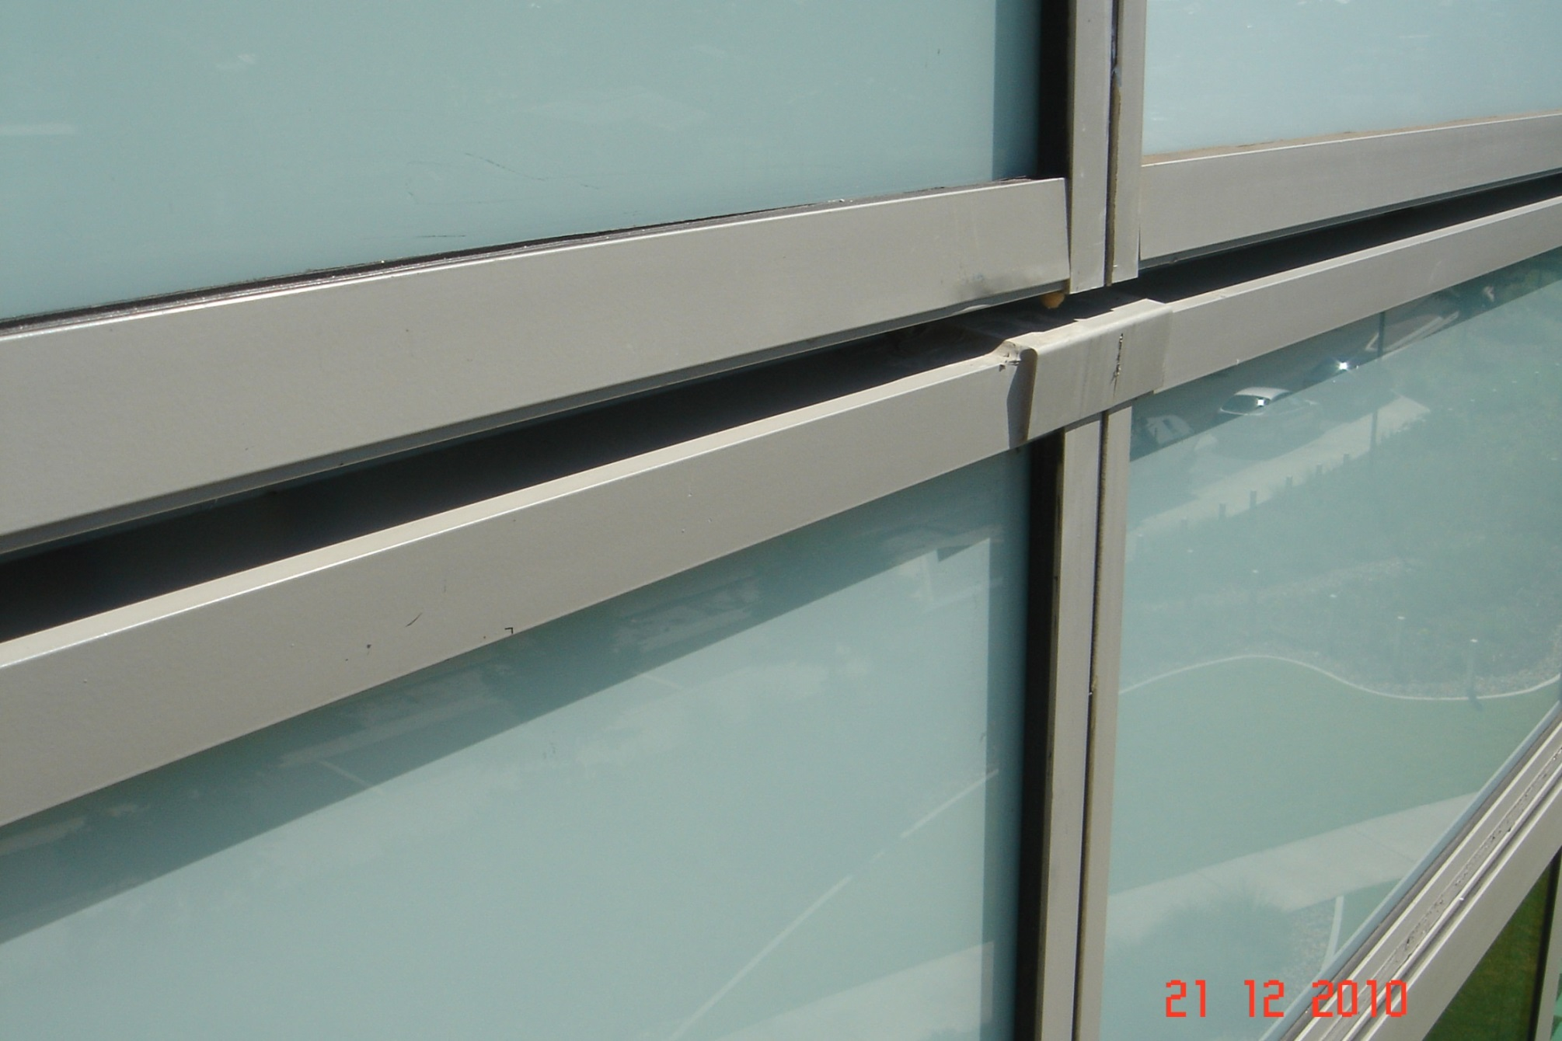
External View of Stack Head Joint

Slide 75
Pressure equalisation – unitised curtain wall

Slide 76
Installation of insulation - spandrel

Slide 77
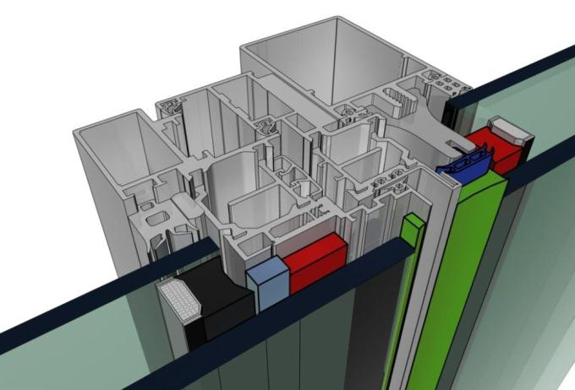
Aluminium Framing System

Slide 78
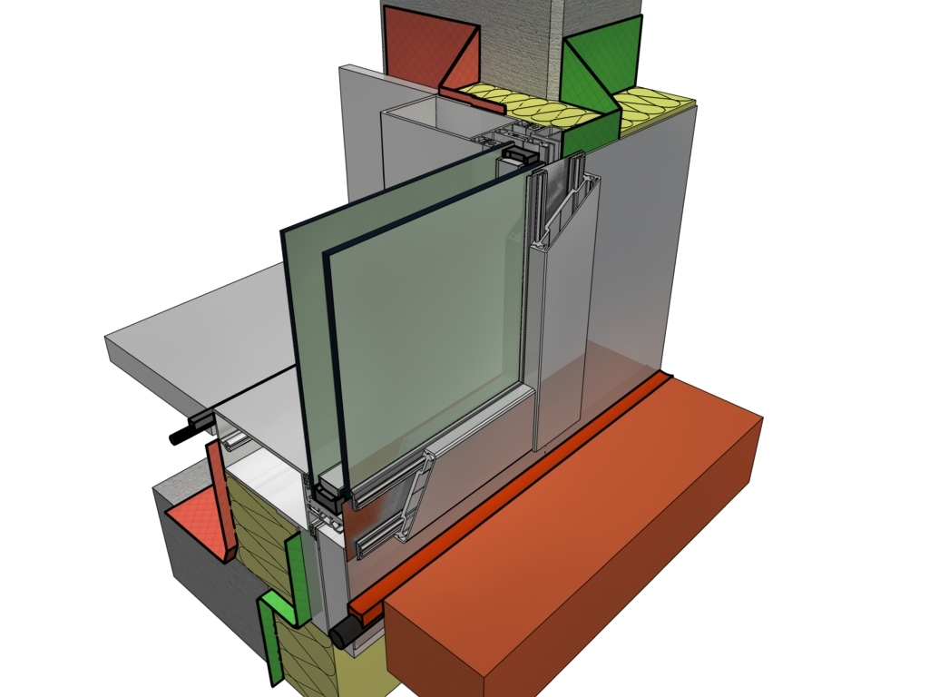
Isometric View of Glass – Aluminium

Slide 79
Special Purpose Design Facades
Security buildings
Aesthetic shading devices
Passive design High rise façade
Point Supported Facade

Slide 80
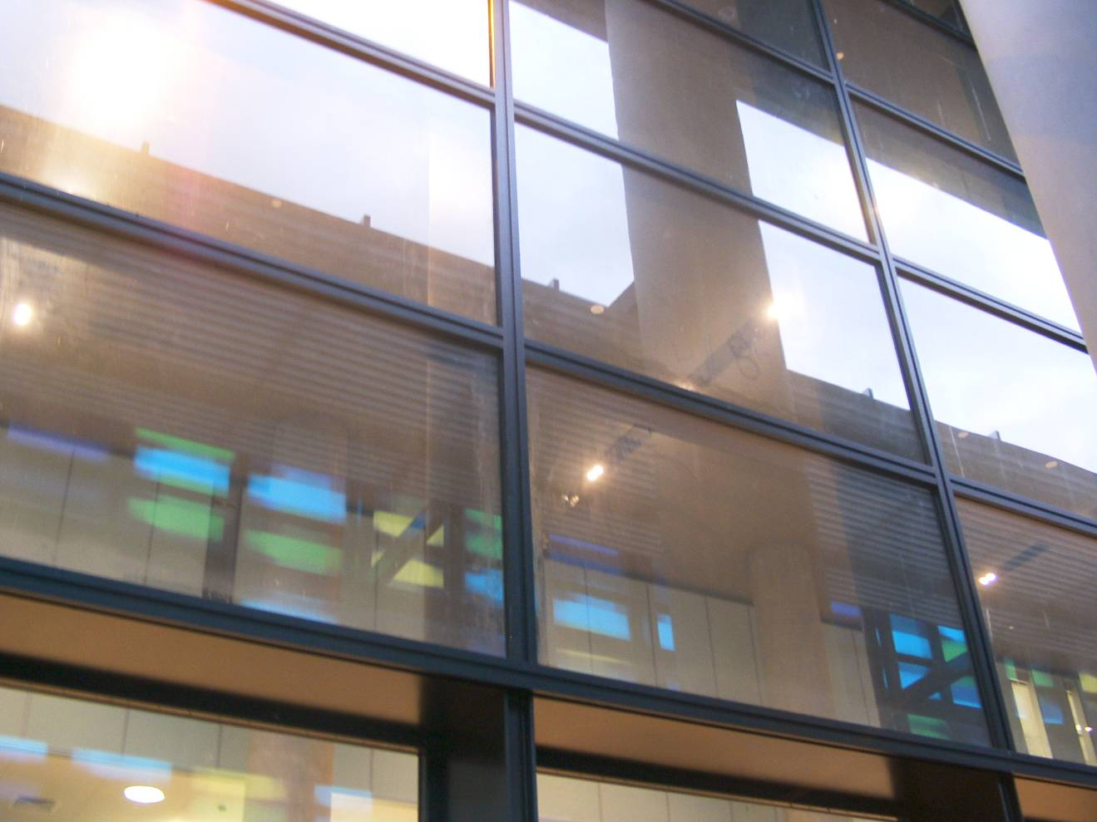
Special Bomb Resistant Screen Using SG interlayers

Slide 81
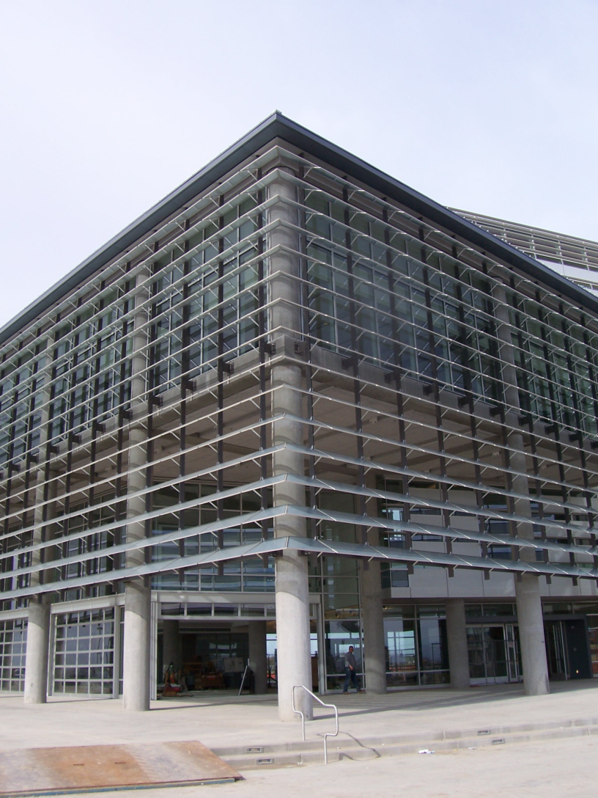
Special external screen with glass louvres

Slide 82
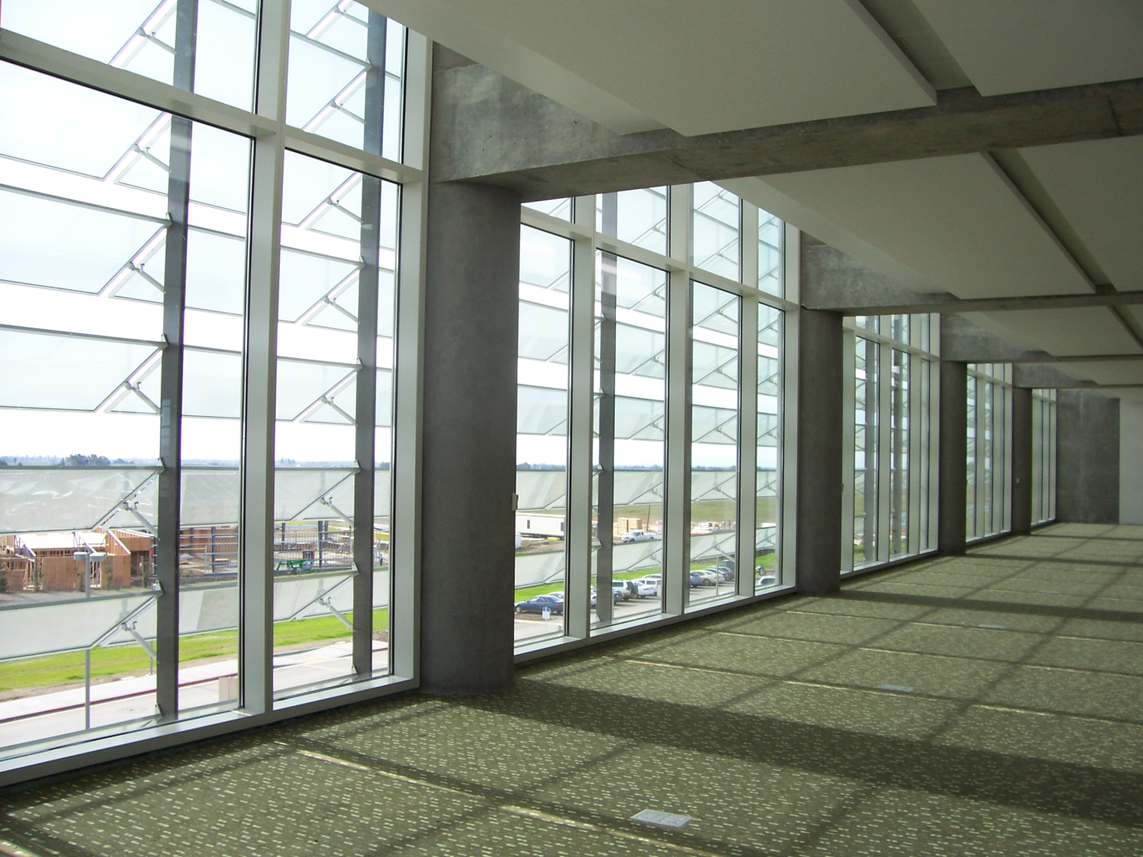
Special Glass Louvres
Span 2.0 m – no bow in the 2 edge supported panel

Slide 83
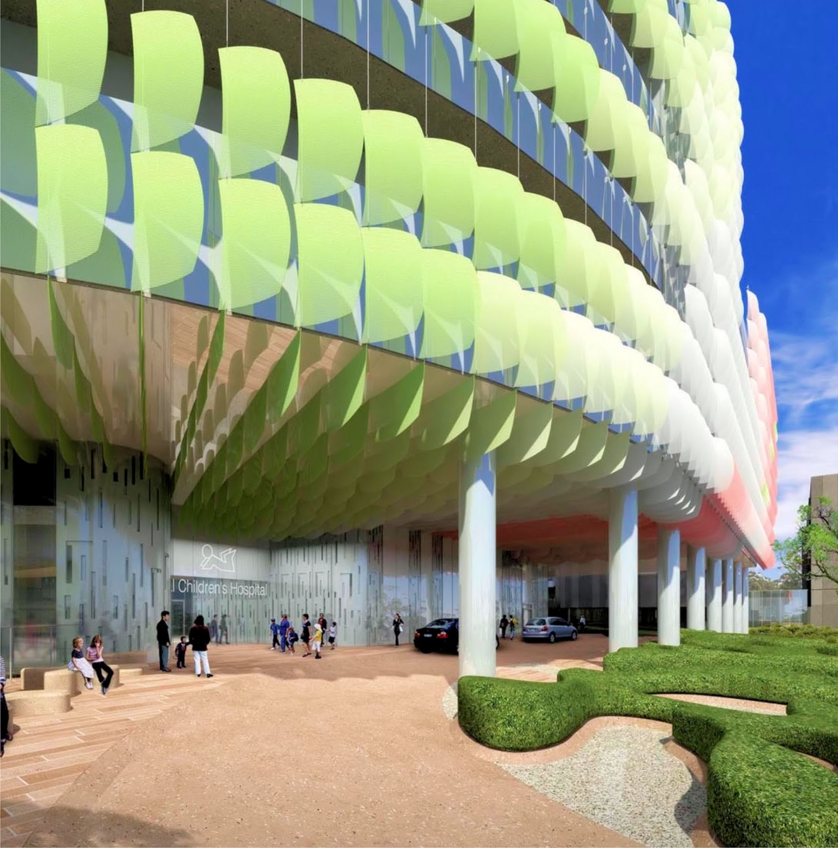
Children’s Hospital Melbourne

Slide 84
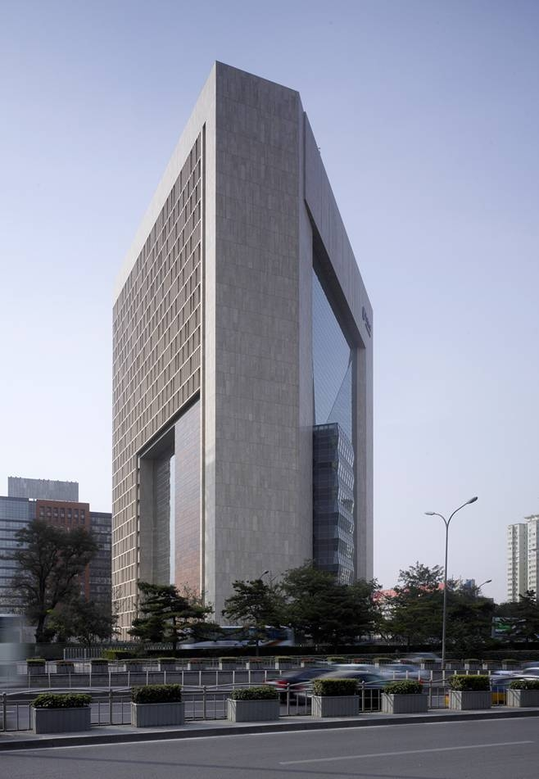
Toughened glass wall – point supported

Slide 85
Point Supported façades & Double Skin Facades

Slide 86
Double Skin Facades
The reduction of energy use during the occupation
The aesthetic desire for a fully glazed façade that leads to increased transparency
The practical need for improved indoor environment, lesser reliance on artificial plant
The need for improving the acoustic performance of buildings located in noise polluted areas

Slide 87
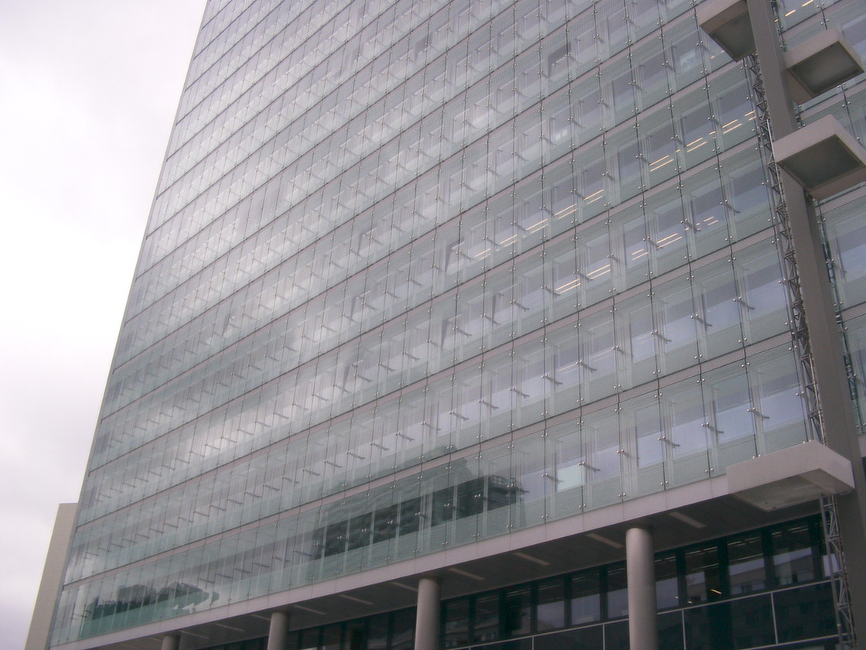
Double Skin Wall

Slide 88
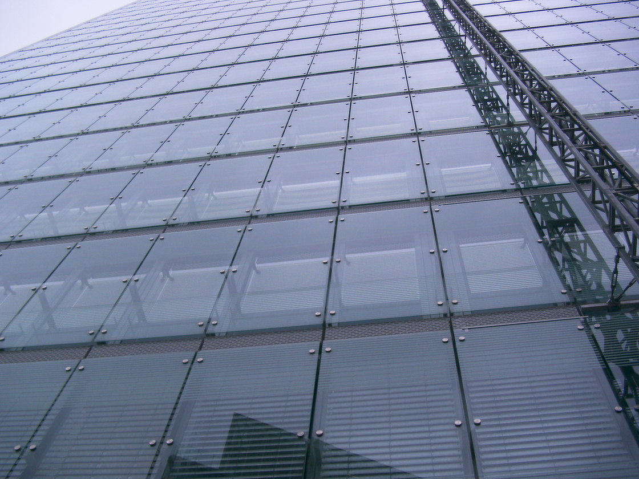
Double Skin – Point Supported Facade

Slide 89
Double Skin Facade

Slide 90
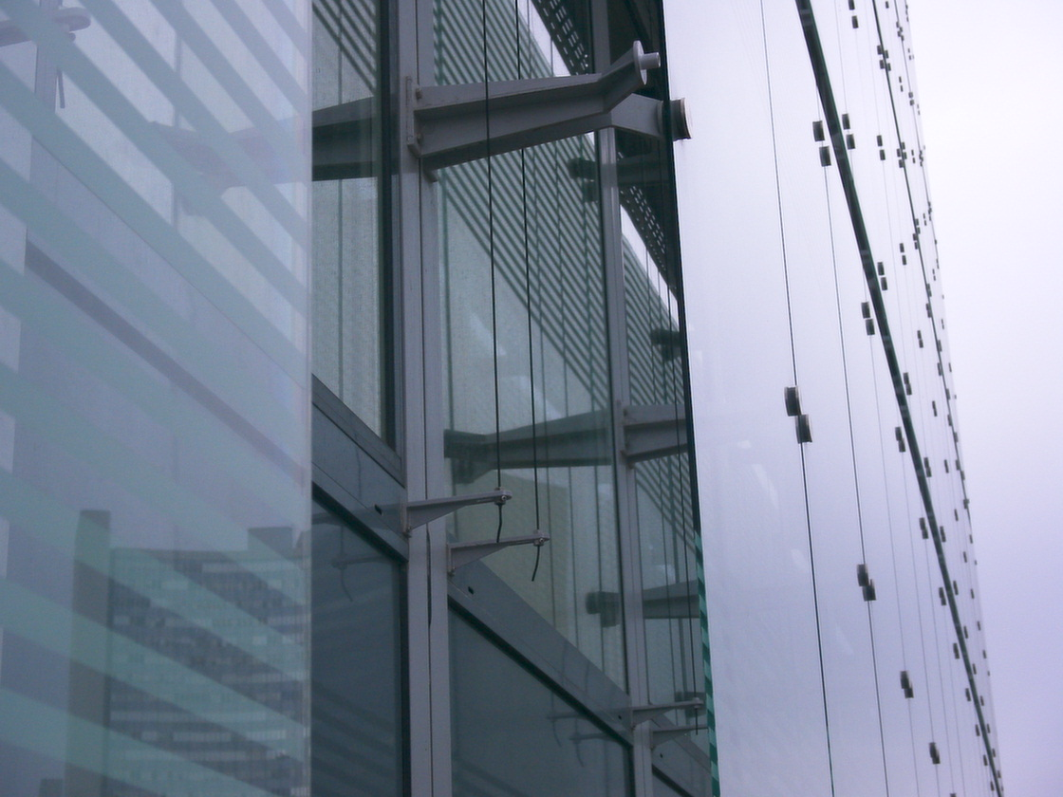
Double skin wall – illustrating internal glass wall

Slide 91
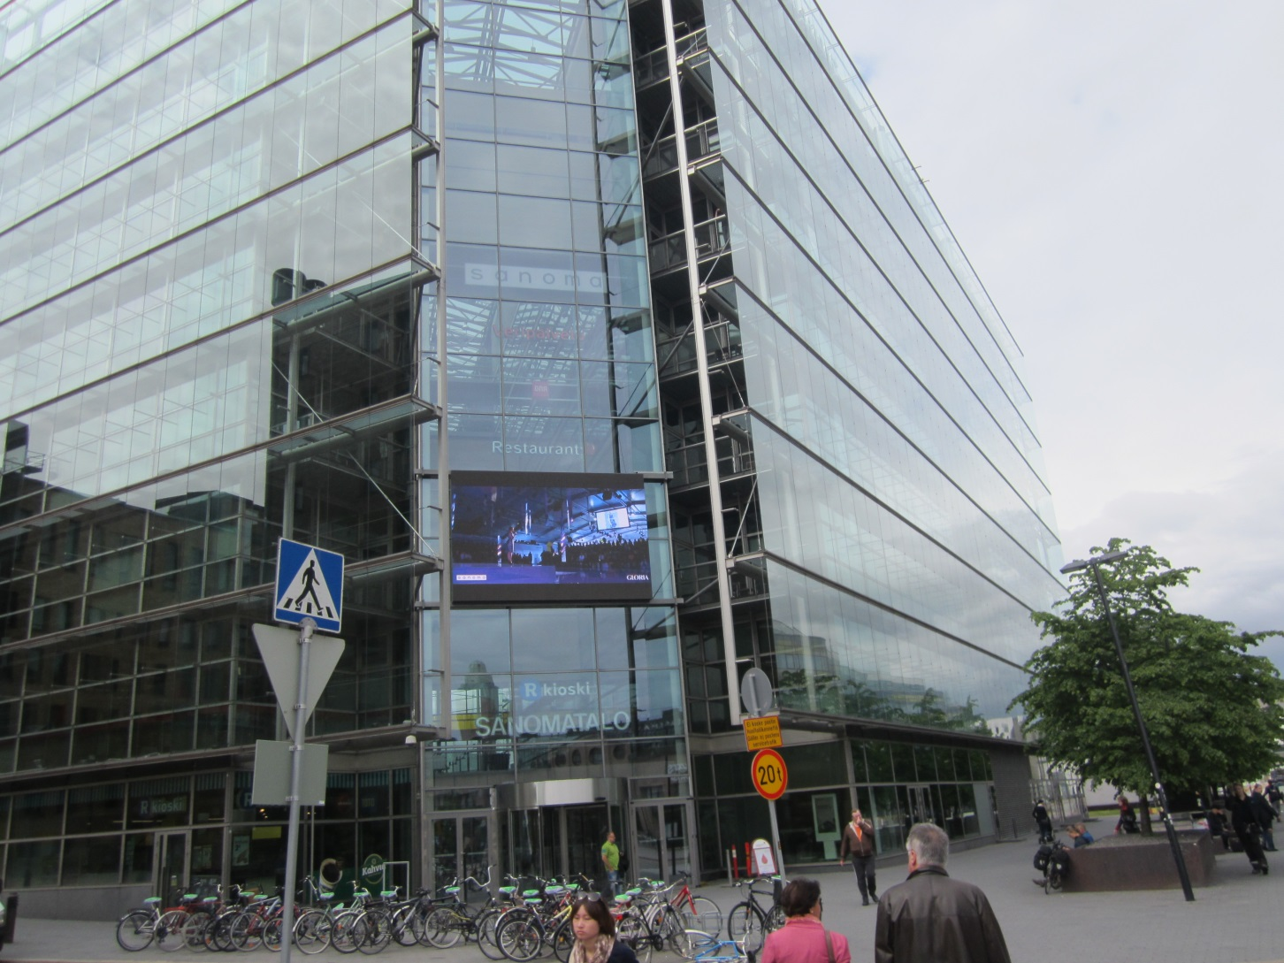
Double Skin Curtain Wall

Slide 92
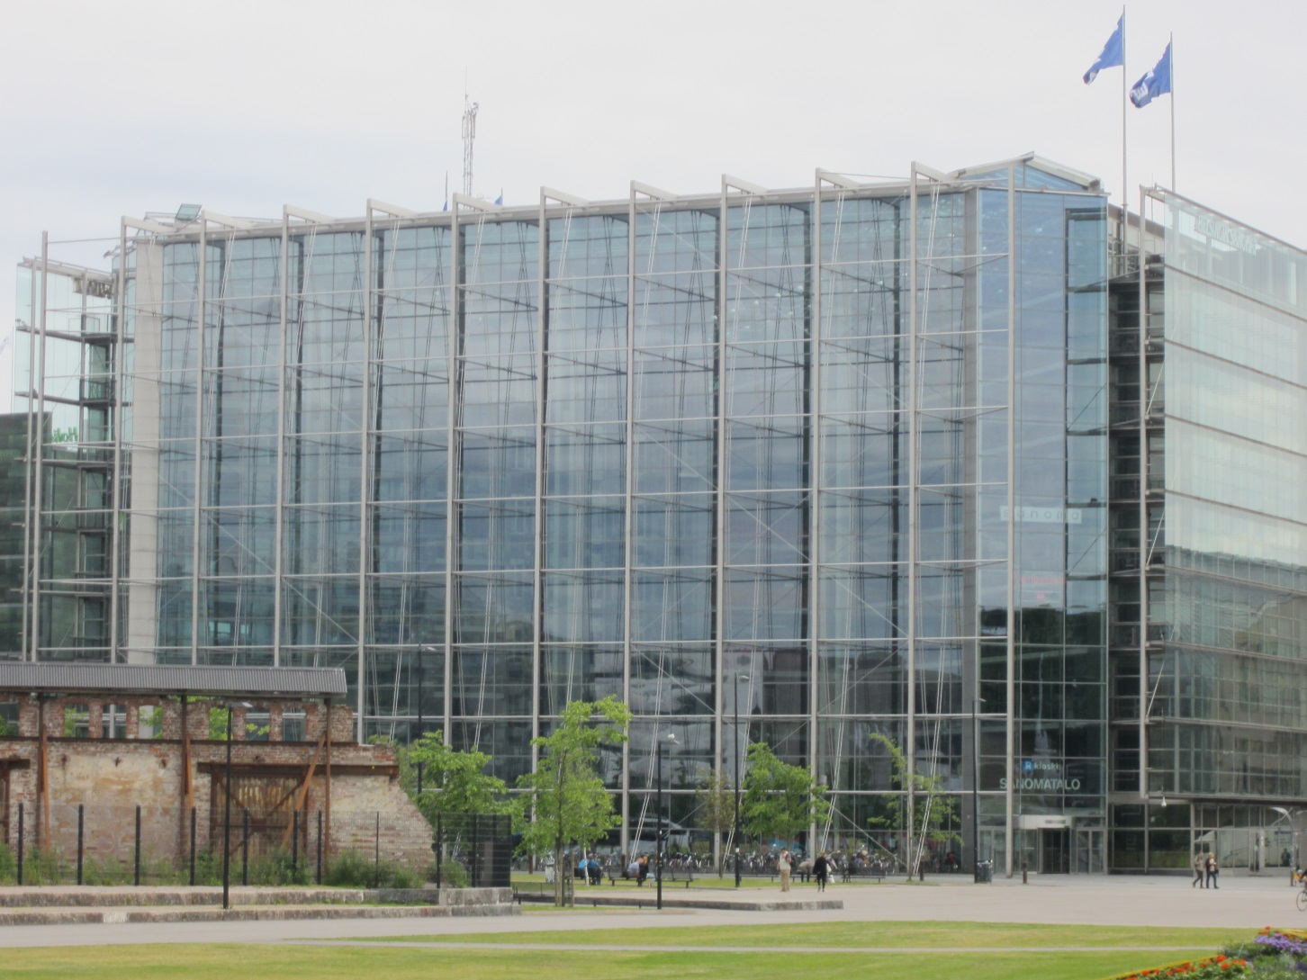
Double Skin Façade - Helsinki

Slide 93
Point Supported Facades

Slide 94
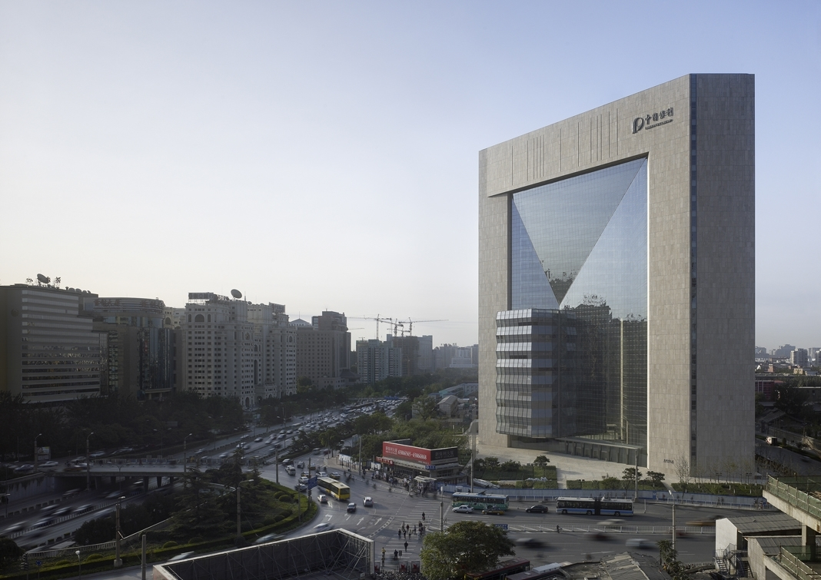
Point Supported Facade

Slide 95
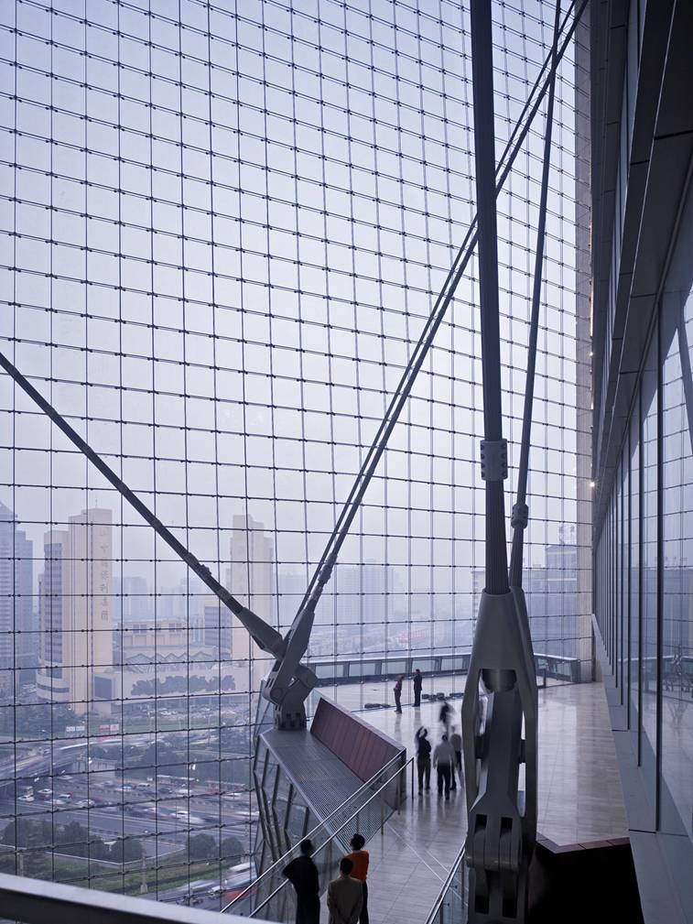
Internal view

Slide 96
Intelligent and Reactive Facades
1 Bligh St Sydney
Blinds work automatically
Lights come on automatically
Air conditioning works automatically

Slide 97
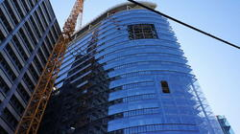
Passive Design
A 20-story office building in Vienna recently became the world’s first high-rise building to be certified under the international Passive House standard. With a glass façade 262 feet (80 m) high and office spaces for 900, the RHW.2 building—home to the Austrian Raiffeisen-Holding Group—could be a counterpoint to those arguing that all-glass buildings popular with developers are inherently wasteful

Slide 98
Double Skin Facades
The passive design strategies of double skin façade bring
  natural ventilation,
  day lighting and
  solar heat gain into the fabric of the high-rise building,
  Resulting in energy efficiency and comfort to the inhabitant.

Slide 99
Issues Requiring attention
Building and façade performance criteria,
Water ingress problems
Glass breakage
Glass deflection
Frame and glass design criteria
Building movement – wind loading/ earth quake loading (resistance)
Testing of curtain wall systems

Slide 100
Performance Criteria
Desired Life Span
Environment - External / Internal
Loading - Wind & Dead Loads, Seismic Loads etc
Thermal & Acoustic Performance
Reflectivity & Shading - Cooling / Heating Loads
Weather & air Infiltration
Building - Structure / Tolerance / Movement
Maintenance

Slide 101
Design Techniques
Framing
    Manual / Finite Element
    Deflection & Stress Criteria
    Joint Details
    Movement Capability - Structural, Joint & Thermal
Glass
    Codes - US / British / Australian / German / Other
    Influence of Membrane Stresses
Sealant
    Structural Silicone - Joint Design
Pressure Equalisation Principle

Slide 102
Water Resistance
Three elements required for water permeation
  Water
  Path
  Force
Methods of controlling water ingress
  Cannot control water and path
  Use of sealants alone has been proven to be ineffective
  Current technologies –
    Minimise the force available to drive the water through the joint –
    Pressure equalisation (rain screen principal)

Slide 103
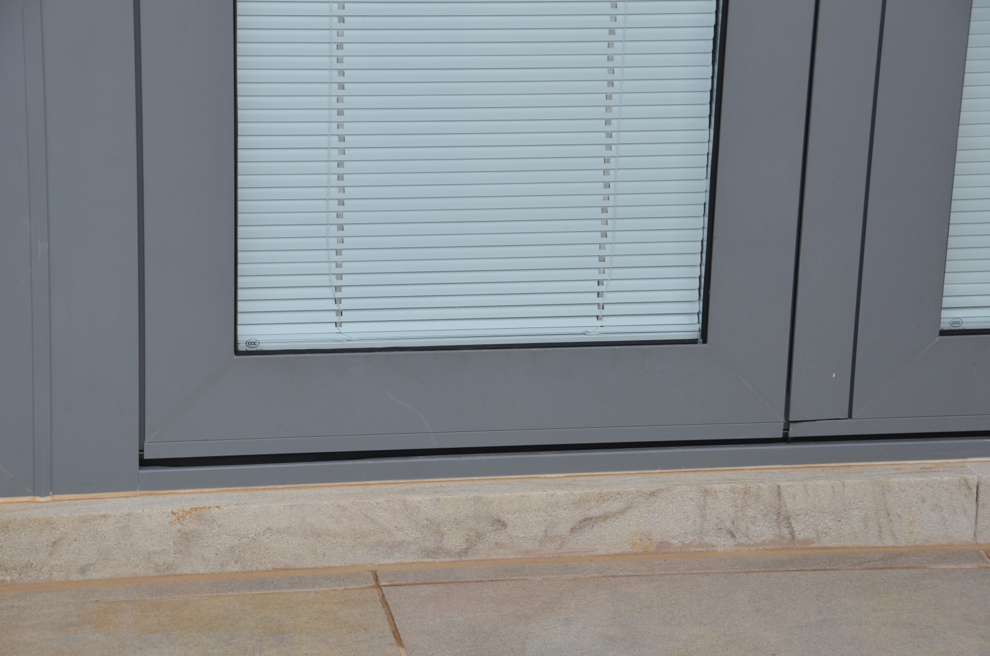
Drainage - Missing

Slide 104
Pressure Equalisation Systems
3 Factors for water ingress
  water
  path
  force
Air seal
Pressure equalisation chamber
Water head
    Critical for the chamber
    Function of Rain intensity

Slide 105
Testing Of Curtain Walls
Air Infiltration
Water Infiltration
Structural Design Loads
Allowable Deflection
Structural Load Safety Factor
ASTM - Aircraft Engine (Dynamic)
Sirowet - Stepped load Application
Field Water Test - AAMA 501.

Slide 106
Sealants
Structural Silicones
    Primary - 2 Component & 1 part
    Secondary - Small Joint Sealants & weather Seals
    Compatability - Between Sealants & Substrates
Example
  Aluminium
    Anodised / Alodyne / PVF2 / Fluorocarbon etc.
  Glass
    Coated - Hard / Soft
    IG Unit - Secondary Seal

Slide 107
New Technology
Switchable Glass
Electrochromics
Thermochromics
Selective coatings – Sol gel process
Vacuum systems
Glass shelves
Laminated reflective + Low E + Asymmetric

Slide 108
Need for glass in Buildings
Technology exists that can accommodate all the strengths of weaknesses of glass in Buildings
Improved communication between the Architect and the glass industry will ensure improved building performance and comfort
Better design will minimise the problems with glass used in buildings

Slide 109
Thank You

Slide 110
ALWAYS DO IT RIGHT
THIS WILL GRATIFY SOME PEOPLE
&
ASTONISH THE REST.
Mark Twain
(1835 - 1910)

Slide 114
MAN HAS KNOWN GLASS LONGER THAN IT HAS BEEN USED,
AND USED IT LONGER THAN HE HAS KNOWN HOW TO MAKE IT.

Slide 115
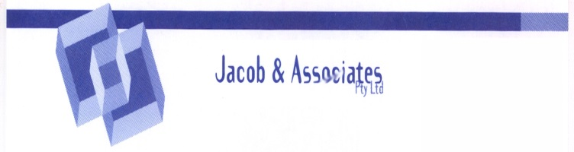
Water Permeation

Slide 116
Force
Pressure differential
Gravity
Capillary action

Slide 117
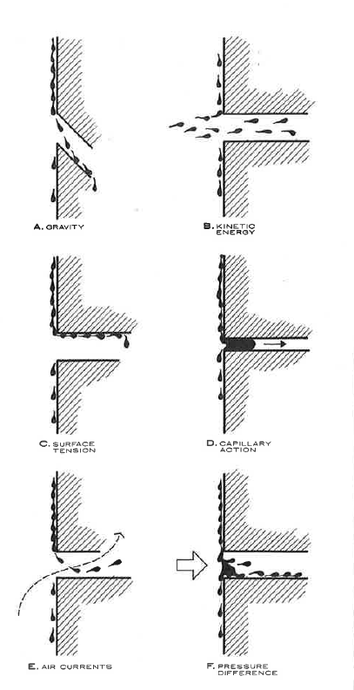
Forces – for water ingress

Slide 118
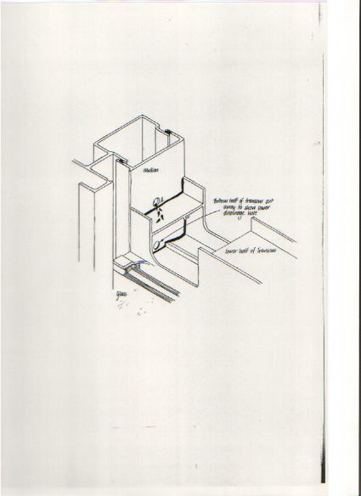
Typical Pressure Equalisation

Slide 119
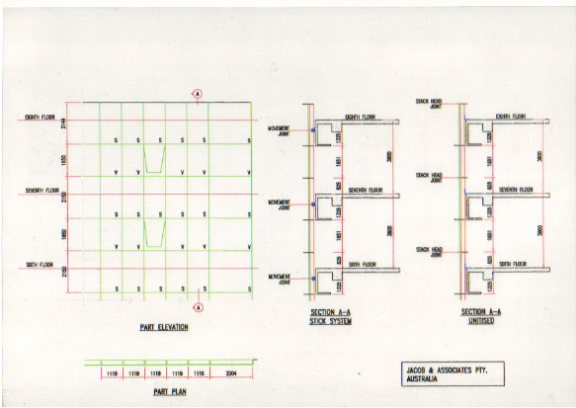
Typical Curtain Wall

Slide 120
FAILURE MECHANISM
Poor Workmanship (manual production)
Horizontal Assembly
Inadequate Adhesion
Sealant Degradation
    UV Exposure
    Standing in Water
Loss of Bond
    Wind Loading
    Changes in Pressure
Poor MVT
Condensation of Chemical Fog.

Slide 121
Testing Of Curtain Walls
Air Infiltration
Water Infiltration
Structural Design Loads
Allowable Deflection
Structural Load Safety Factor
ASTM - Aircraft Engine (Dynamic)
Sirowet - Stepped load Application
Field Water Test - AAMA 501.

Slide 124
Architectural Specification

Slide 125
Architectural Specifications
Referenced Standards
  Complimentary standards must be referenced
  Glass strength – EN / BS / US / Aust. etc different & could result in a compromise
Ensure the spec details what is required
Tolerances – be specific in what is required
Design Loads
  Ensure correct standards specified
  Ensure correct loads and deflection limits are specified
  Example – Brisbane – deflection limits not specified – result water leakage

Slide 126
Façade Failure
Common Causes
Segmented Design
    Architect / Builder / Façade Consultant / Fabricator
Tender Practice
    Lowest Price - Best Quality
Adversarial Construction
    No team Work - Win / Lose Ethic
Poor Planning
    Specialist Skills Not Considered at Design Stage
Material Selection - Ad Hoc
Warranty
    False Sense of Security - Sub Contractor Responsible

Slide 127
Other Issues
Limitations of specifications
  Incorrect standards referenced
  Too many standards referenced
  Insufficient details in the specifications
  Glass composition
  Limits for deformation in framing systems
Roller wave limits
Deformation limits
Incompatible sealants
Colour and reflective limits for glass must be specified
Test criteria must also be carefully specified and controlled

Slide 128
Roller wave distortion
Ensure roller wave – horizontal not vertical
Prescribe a limit for roller wave – 0.125 mm/ 300 mm

Slide 129

Coating Issues

Slide 130
Damage to Curtain Wall Glass
SURFACE
EDGES
Mechanical - Impact
Cleaning - Scratches
B M Units - Scratches & Impact

Slide 131

Edge Damage

Slide 132

Deep Shell - Glass Edge

Slide 133

Typical Edge Damage

Slide 134

No drainage at sub sill

Slide 135
Condensation

Slide 136
Frame Deflection
Test data – for system performance – structural, water, air infiltration, etc
Specify stress and deflection limits
Specify building movement
Water criteria – ensure gutter is suitable for expected rain

Slide 137
Glass Specifications
Strength – Stress and deflection criteria
Spectral Performance –
  Require test data confirming performance
  Uniformity of colour
Glass quality –
  roller wave magnitude and direction/
  Bow & warp
Impurities – Nickel sulphide _ EN 14179 ensure Oven records are maintained and provided for review
  Cycle times
  Duration
  Number of failures per batch recorded etc

Slide 138
Roller wave distortion
Ensure roller wave – horizontal not vertical
Prescribe a limit for roller wave – 0.125 mm/ 300 mm

Slide 139
Glass Selection - Issues
Direction & Magnitude of roller wave
Laminated glass
  different thickness
IG Units
  different thickness
Sloped Facades
  Reflective glass
  Colour specifications

Slide 140
Thank You

