Slide 1
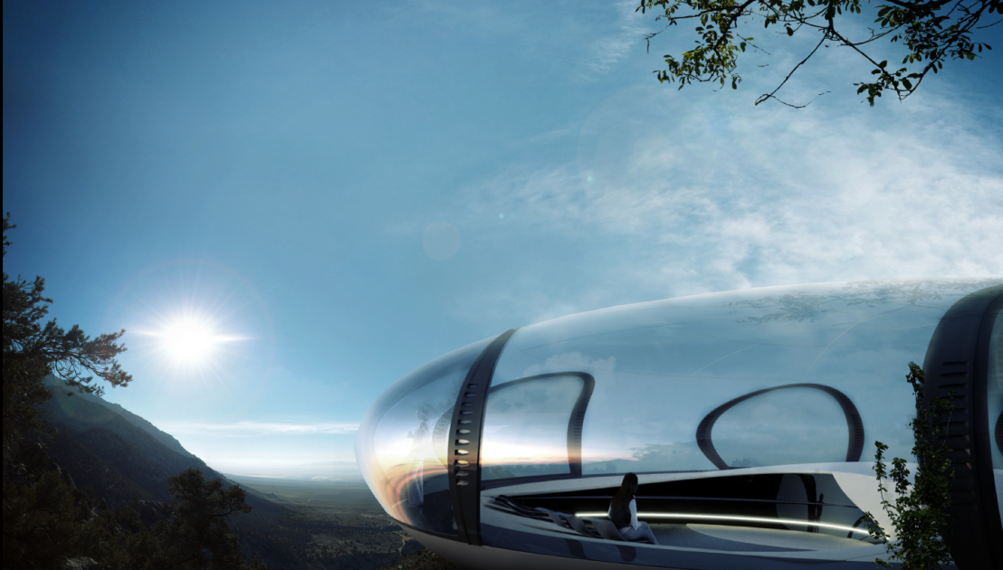
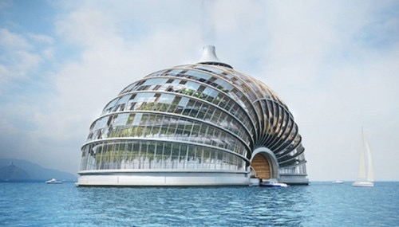
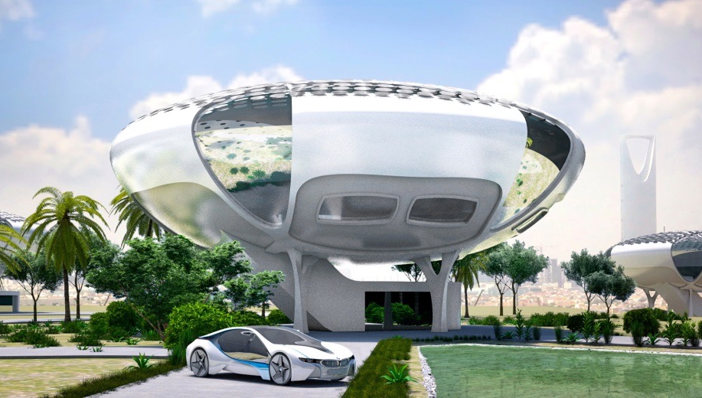
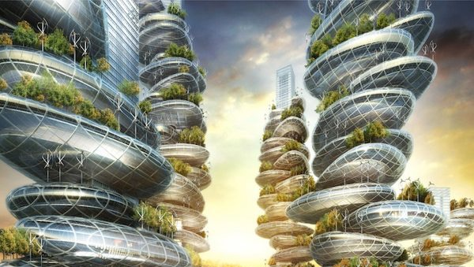
R129 Future Housing Concept
Prof. Werner Sobek
Floating Housing Project Concept For Uncertain Climate Future
Alexander Remizov
White Sky iHouse
Lindemann Architects
Farmscrapers – Housing of the Future
Vincent Callebaut Architectures
Summary of GPD – 2015, J.Vitkala
Source: www.gpd.fi ©Benjamin Beer, Meinhardt Façade Technology

Slide 2

“YOU ARE ONLY AS GOOD AS
WHAT YOU DID TODAY!”
C. Keith Boswell
Summary of GPD – 2015, J.Vitkala
Source: www.gpd.fi © C. Keith Boswell Skidmore, Ownings & Merrill LLP
Notes:
CLOSING SLIDE

Slide 3
TRANSPARENCY
Notes:
CLOSING SLIDE

Slide 4
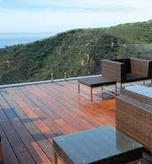
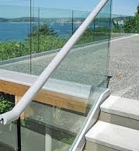
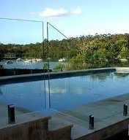
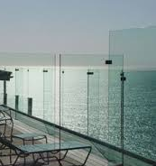
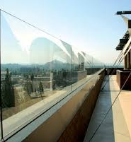
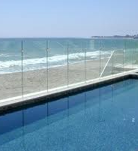
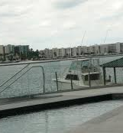
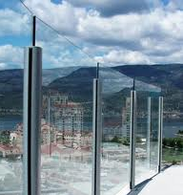
Glass Railing Systems - Examples
Summary of GPD – 2015, J.Vitkala
Source: www.gpd.fi ©Vicente Montes-Amoros, CDC, Inc.

Slide 5
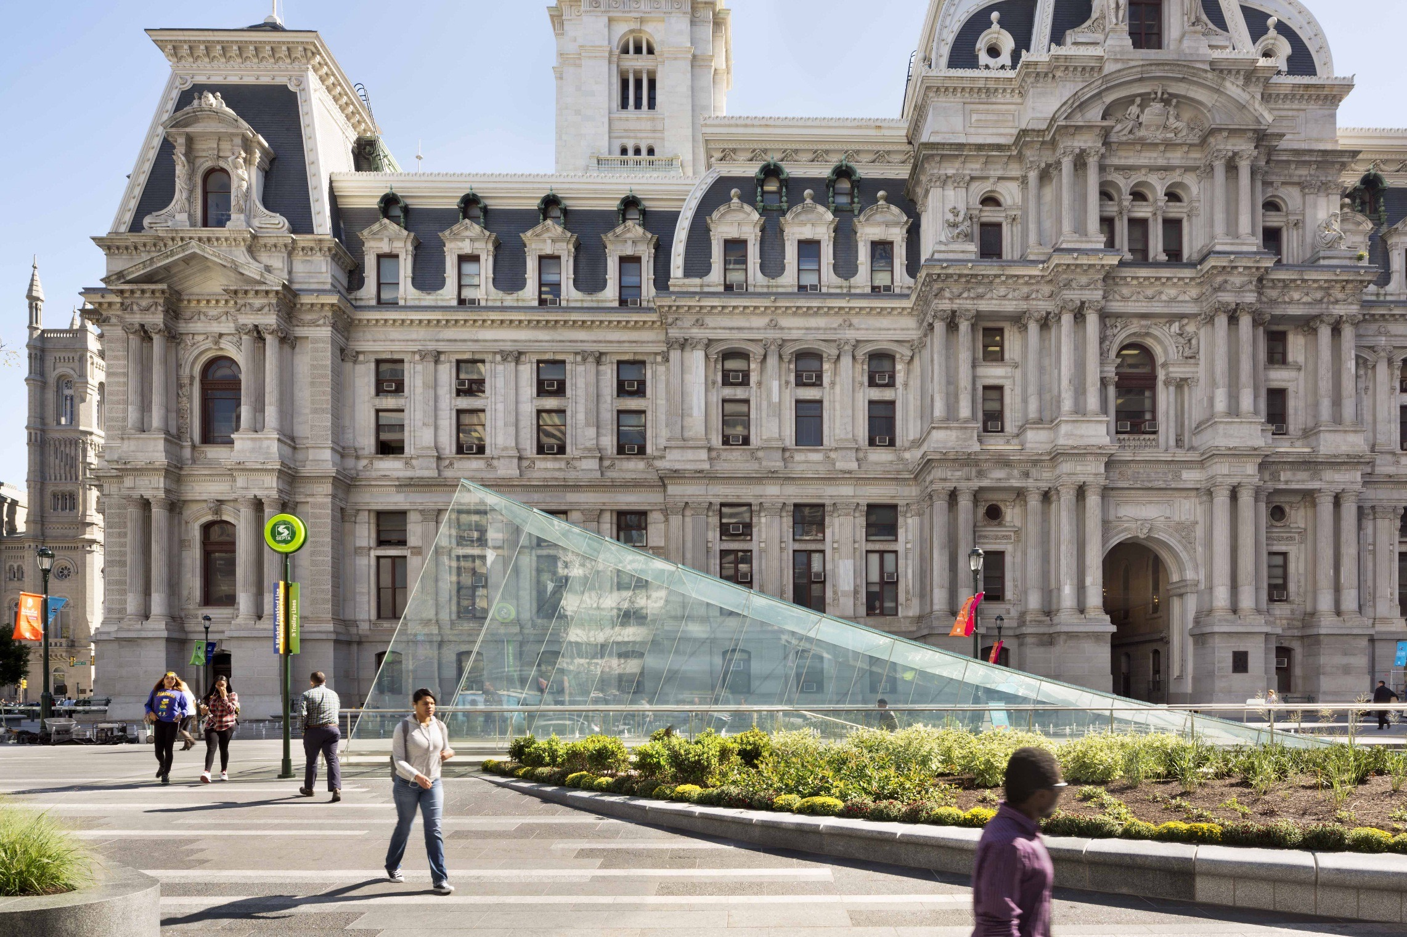
Summary of GPD – 2015, J.Vitkala
Source: www.gpd.fi ©James Ocallaghan, Eckersley O’Callaghan

Slide 6
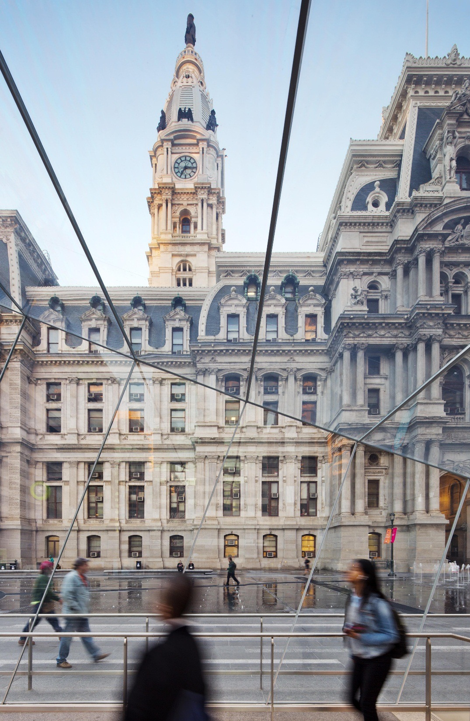
Summary of GPD – 2015, J.Vitkala
Source: www.gpd.fi ©James Ocallaghan, Eckersley O’Callaghan

Slide 7
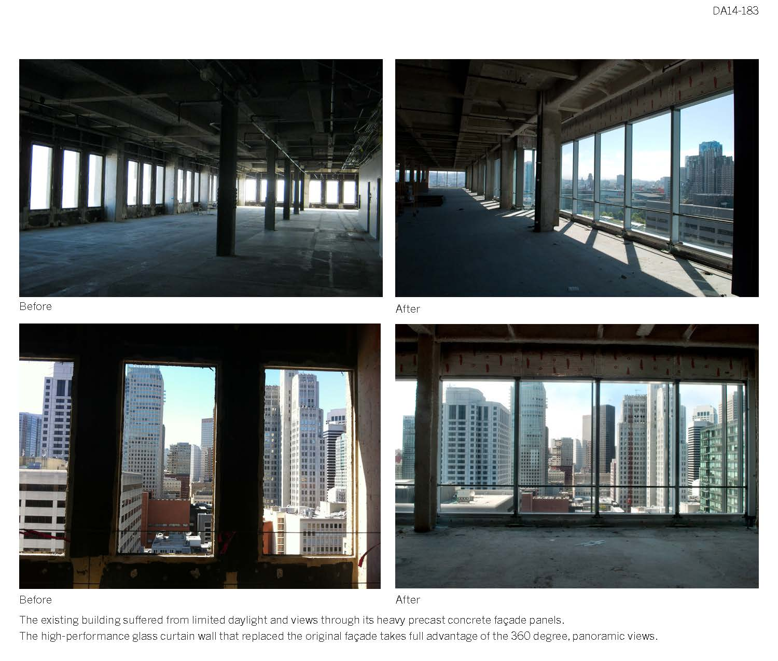
Renovate / transparency
San Francisco, California
680 Folsom
Summary of GPD – 2015, J.Vitkala
Source: www.gpd.fi © C. Keith Boswell Skidmore, Ownings & Merrill LLP

Slide 8
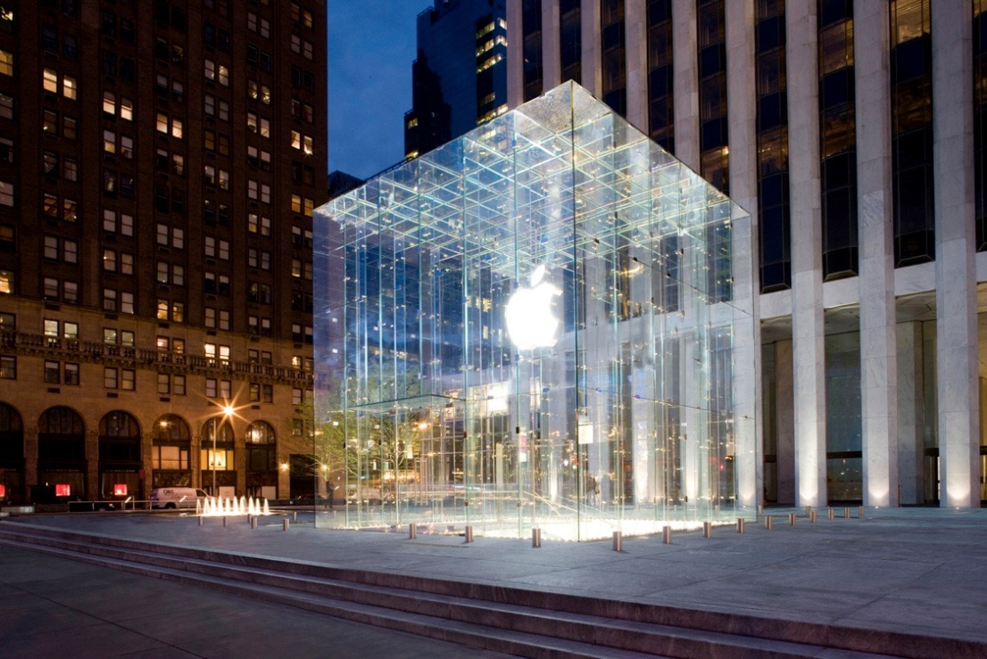
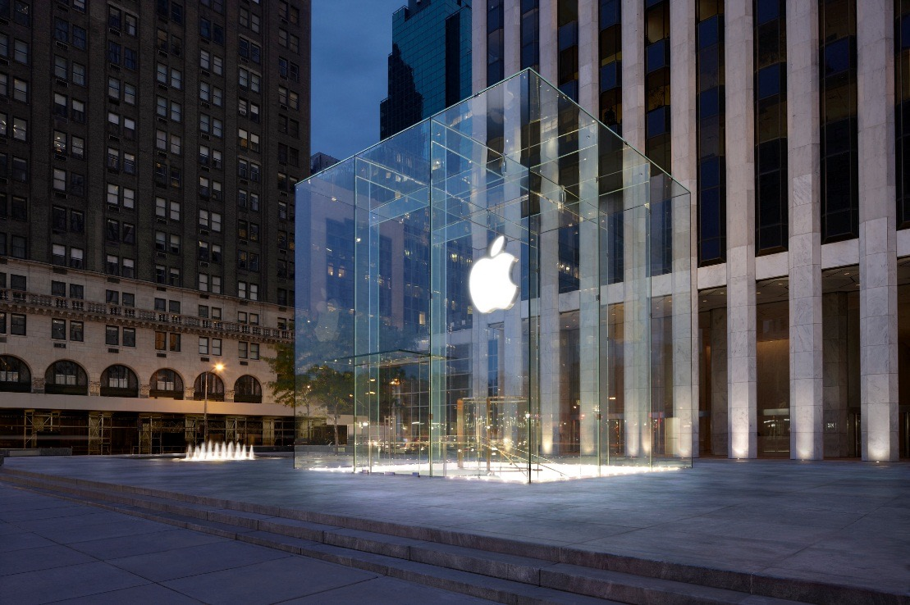
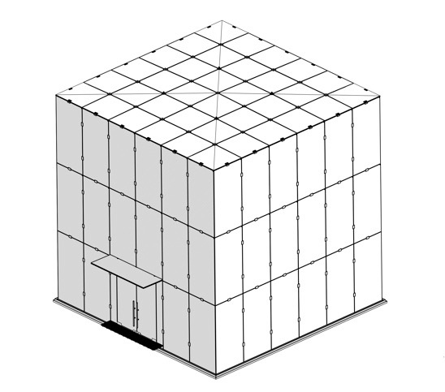
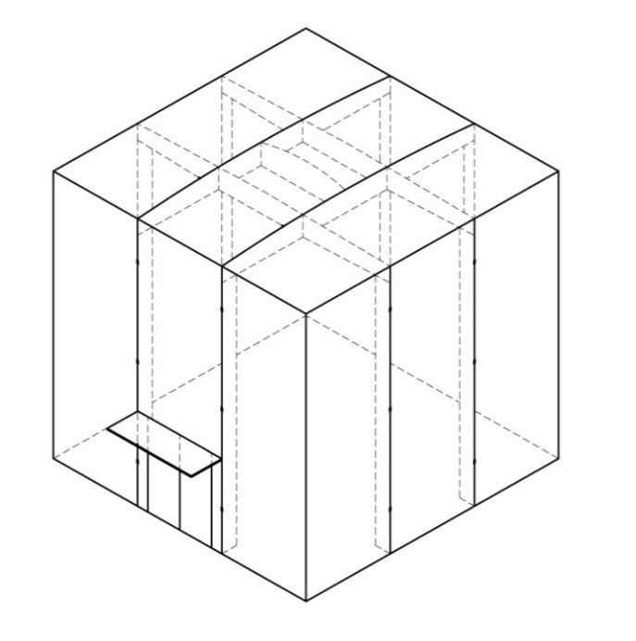
2006
2011
Summary of GPD – 2015, J.Vitkala
Source: www.gpd.fi ©James Ocallaghan, Eckersley O’Callaghan
Notes:
Led to desire from Steve Jobs to re construct Apple’s most iconic glass structure in the most minimal way currently achievable
Cube to be re-opened today
18 façade panels reduced to just 3
36 roof panels reduced to just 3

Slide 9
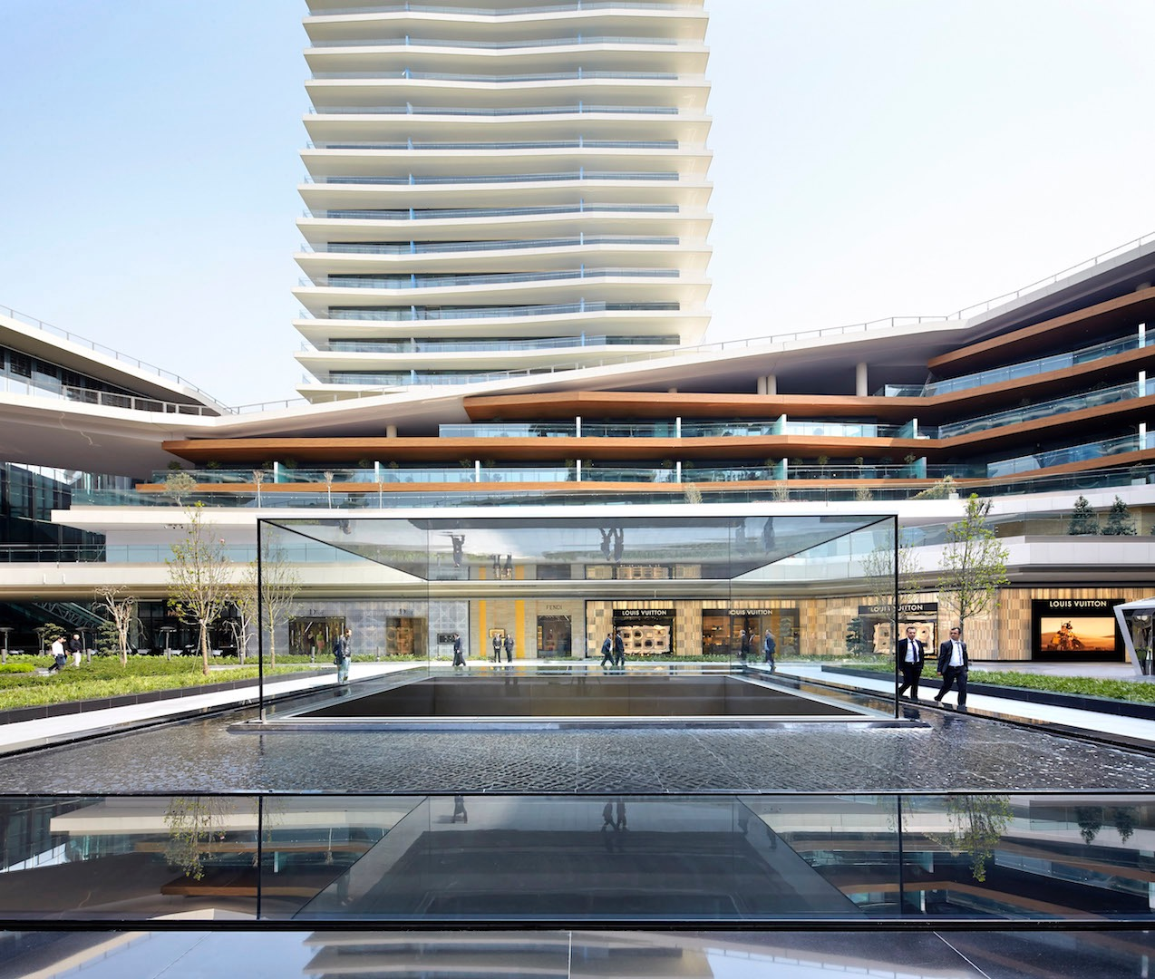
Summary of GPD – 2015, J.Vitkala
Source: www.gpd.fi ©James Ocallaghan, Eckersley O’Callaghan

Slide 10
STRUCTURAL GLASS
Notes:
CLOSING SLIDE

Slide 11
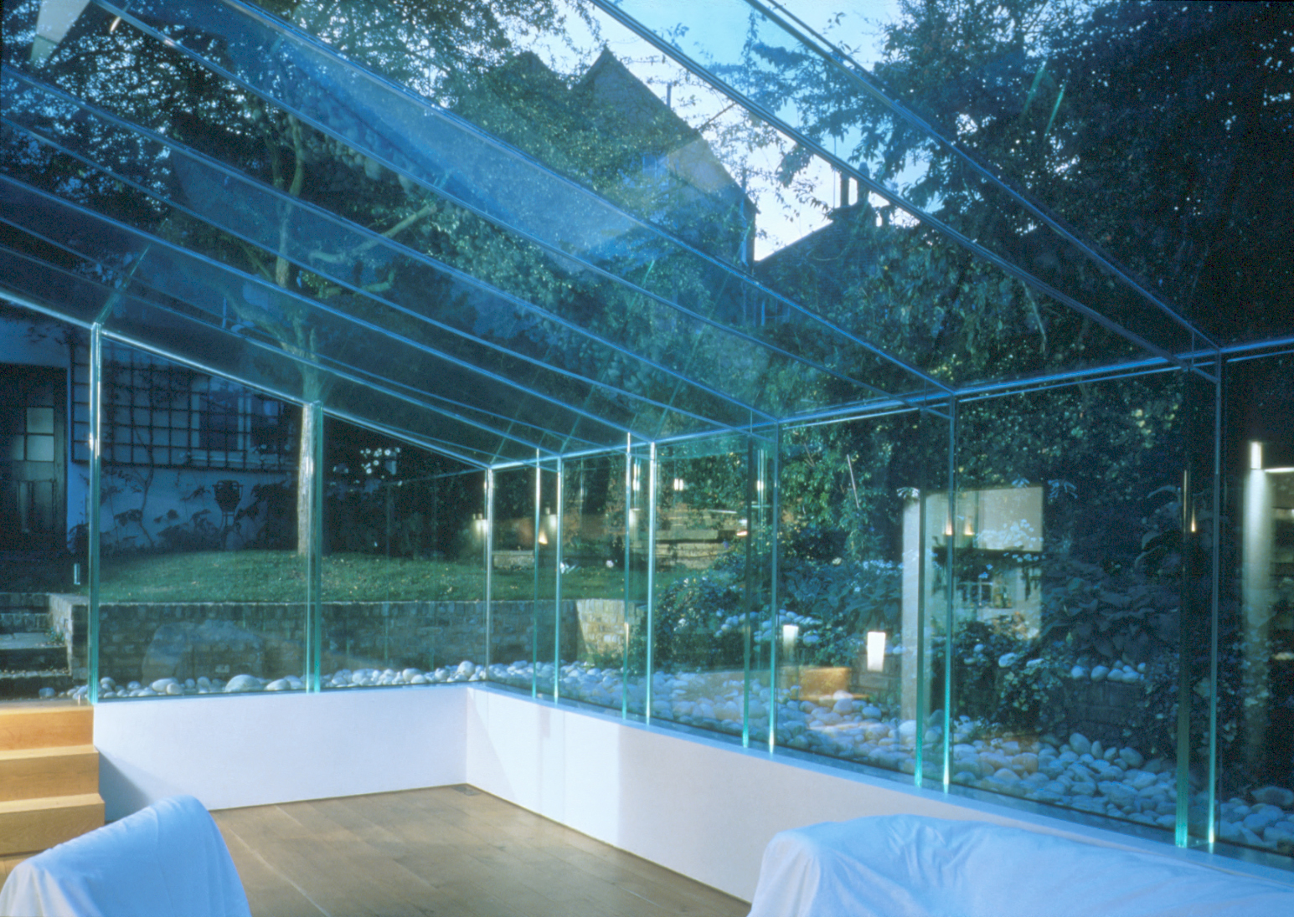
Summary of GPD – 2015, J.Vitkala
Source: www.gpd.fi ©Tim Macfarlane,
Glass Light and Special Structures Limited

Slide 12
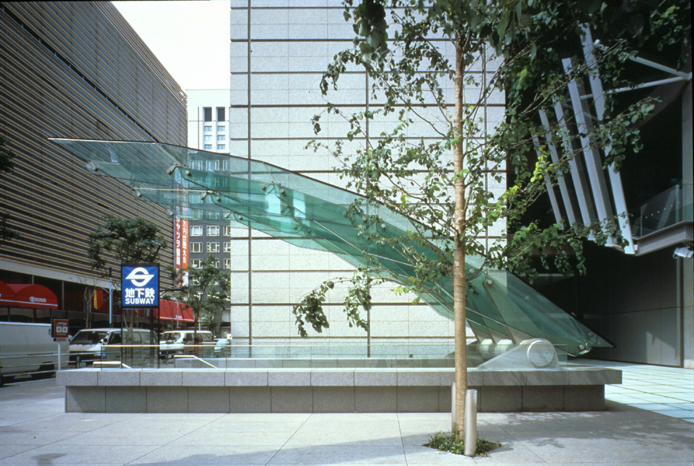
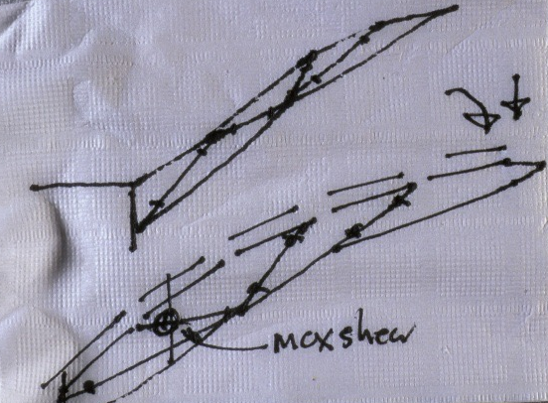
Summary of GPD – 2015, J.Vitkala
Source: www.gpd.fi ©Tim Macfarlane,
Glass Light and Special Structures Limited

Slide 13
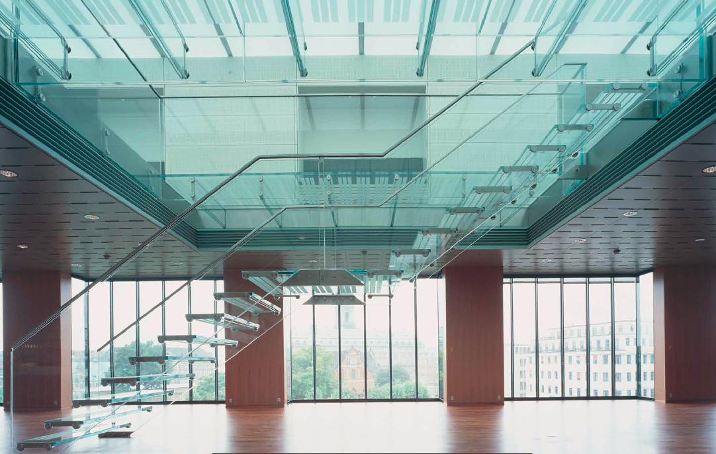
Summary of GPD – 2015, J.Vitkala
Source: www.gpd.fi ©Stig Mikkelsen, MIKKELSEN Architects
National Bank
of Denmark

Slide 14
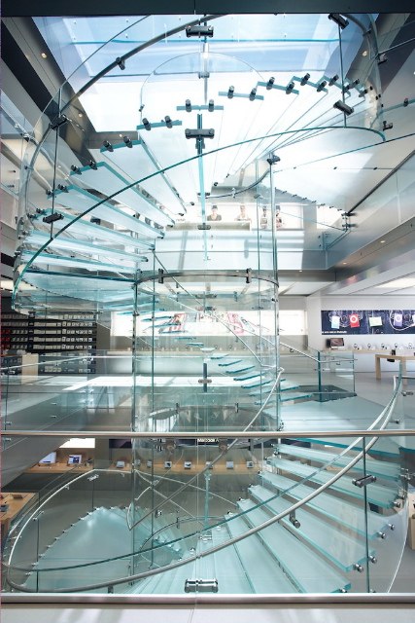
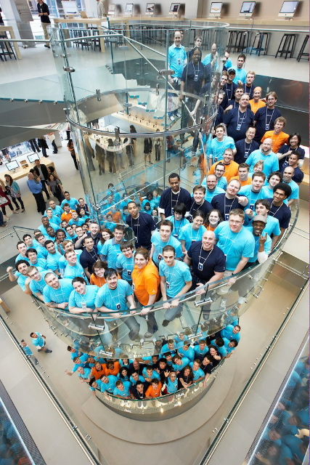
Summary of GPD – 2015, J.Vitkala
Source: www.gpd.fi ©James Ocallaghan, Eckersley O’Callaghan

Slide 15
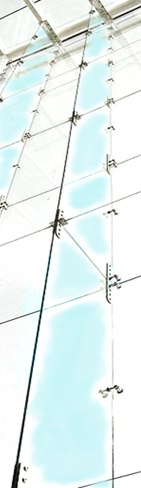
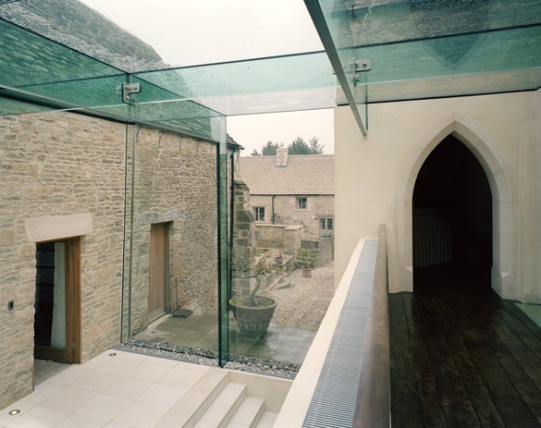
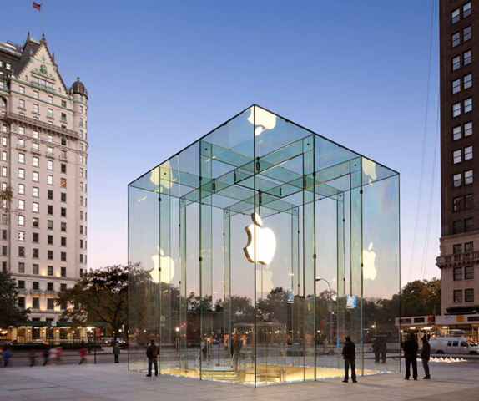
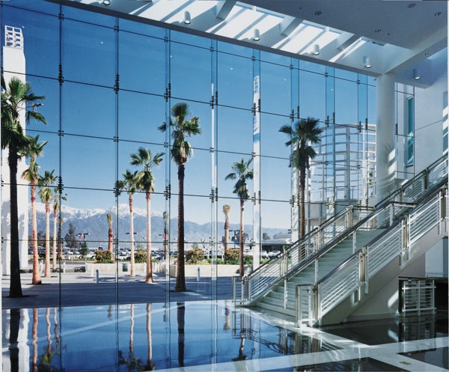
Glass beams as structural elements
Supporting floors/roofs
Glass frames
Fins for glazed façades
Summary of GPD – 2015, J.Vitkala
Source: www.gpd.fi © Kenny Martens, Ghent University

Slide 16
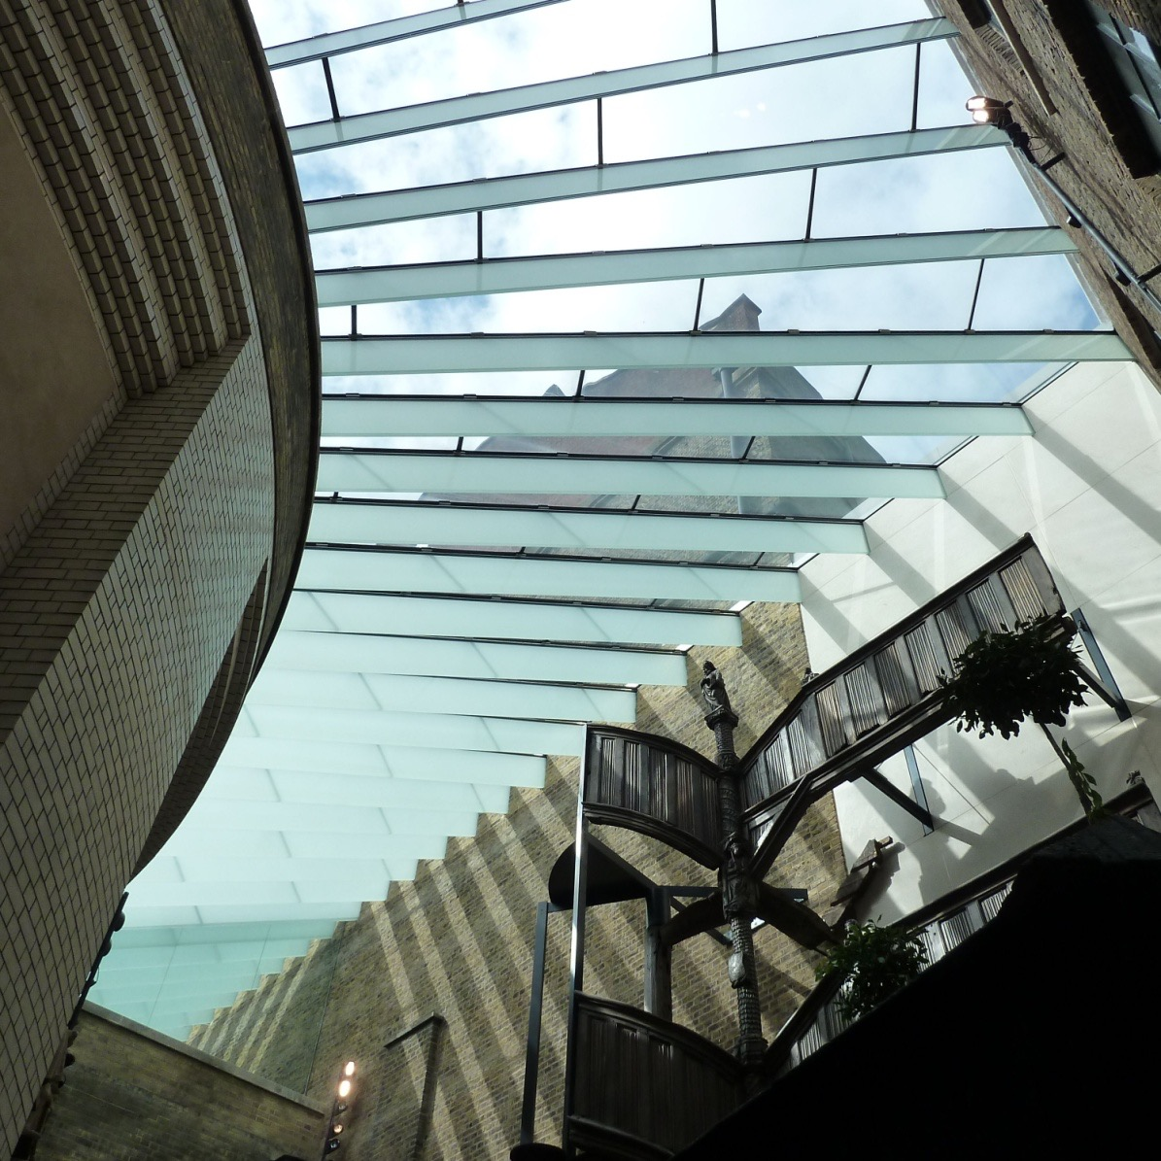
Laminated glass panels
Victoria & Albert Museum, London
Summary of GPD – 2015, J.Vitkala
Source: www.gpd.fi ©Mick Eekhout, TU Delft

Slide 17
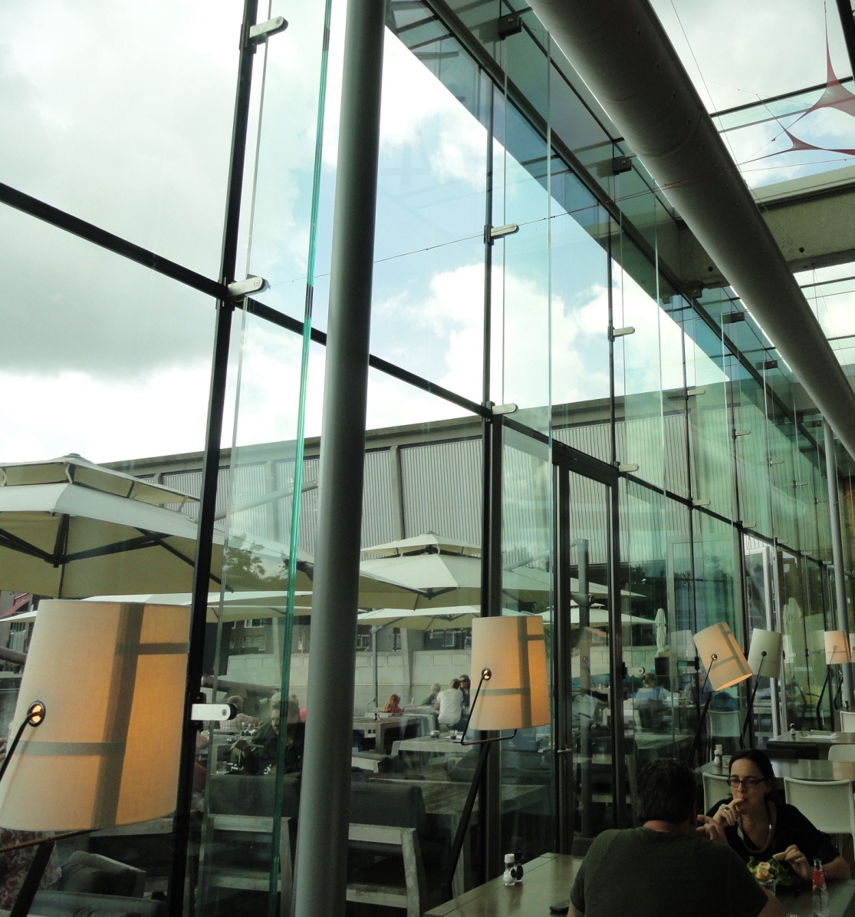
Glass finns 2010 after extension
Summary of GPD – 2015, J.Vitkala
Source: www.gpd.fi ©Mick Eekhout, TU Delft

Slide 18
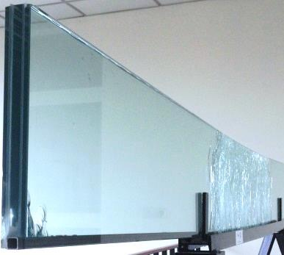
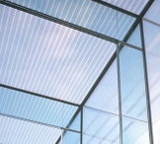
Solution: connected glass beams
New connection prototype
Reinforced laminated glass beams
Adhesively transparent connection
Summary of GPD – 2015, J.Vitkala
Source: www.gpd.fi © Kenny Martens, Ghent University
Notes:
Combination of reinforcement connection & adhesive connection
Result: Tranparency + post-breakage behaviour

Slide 19
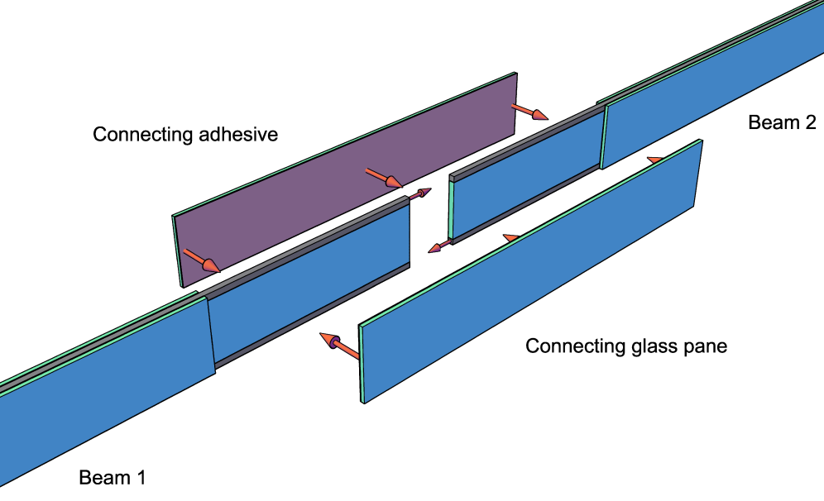
Solution: connected glass beams
New connection prototype
Summary of GPD – 2015, J.Vitkala
Source: www.gpd.fi © Kenny Martens, Ghent University
Notes:
Combination of reinforcement connection & adhesive connection
Result: Tranparency + post-breakage behaviour

Slide 20
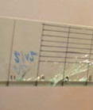
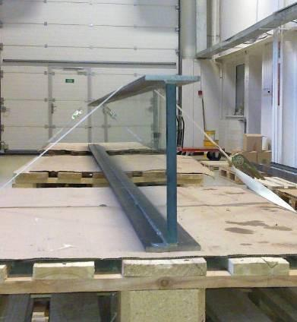
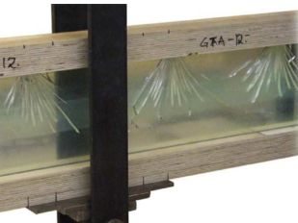
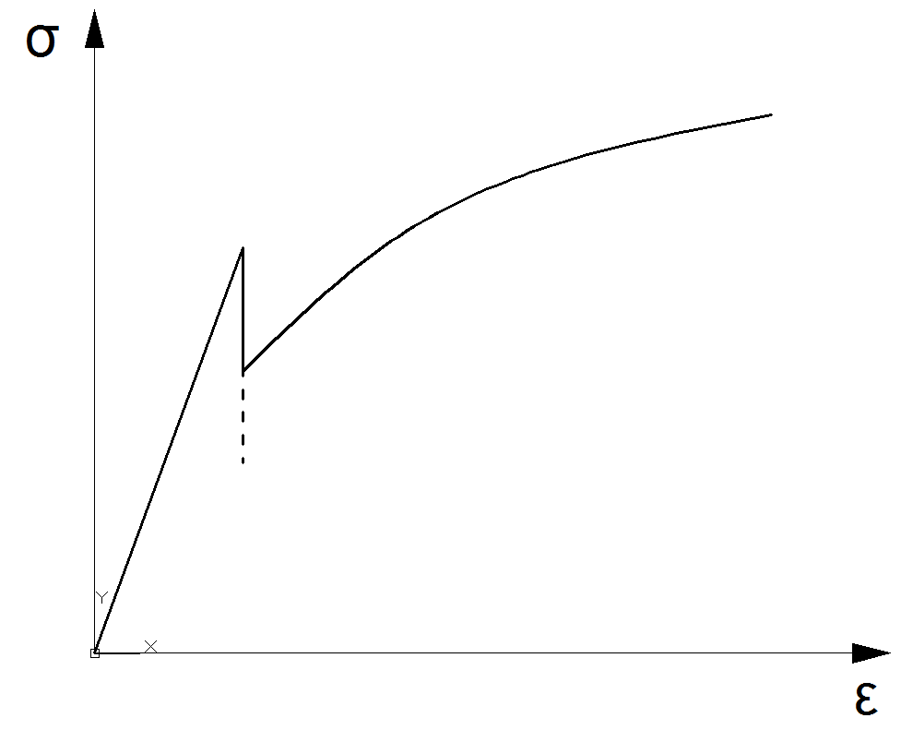
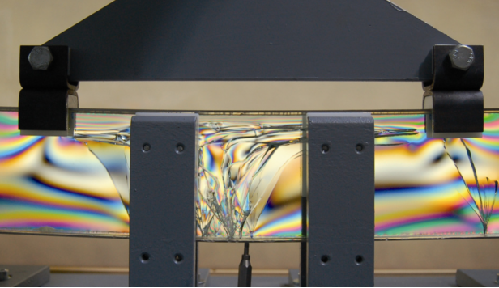
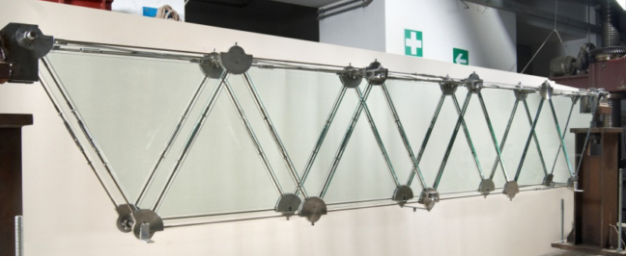
What about safety?
Hybrid glass beams → Safe failure behaviour
Ductility
Regular glass beam
Initial glass failure
Post-breakage strength
Hybrid glass beam
Summary of GPD – 2015, J.Vitkala
Source: www.gpd.fi © Kenny Martens, Ghent University
Notes:
Solution: hybrid glass beams, combination of glass with other elements
Many different types were developed using steel, timber, GFRP, concrete
Result: post-breakage capacity & ductility

Slide 21
Summary of GPD – 2015, J.Vitkala
Source: www.gpd.fi ©James Ocallaghan
Eckersley O’Callaghan

Slide 22
COLD BENDING
Notes:
CLOSING SLIDE

Slide 23
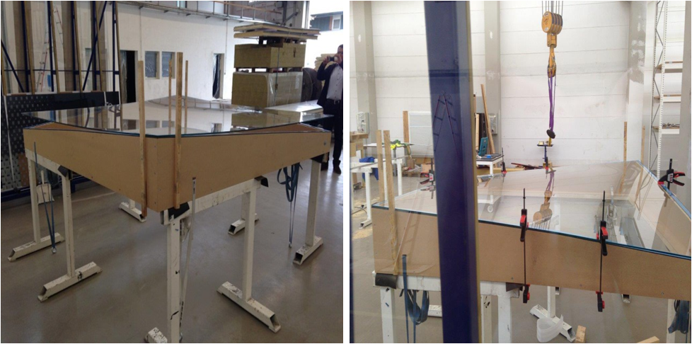
Transparent elements
©LEICHT
Summary of GPD – 2015, J.Vitkala
Source: www.gpd.fi © Lutz Schöne, LEICHT
Structural Engineering & Specialist Consulting

Slide 24
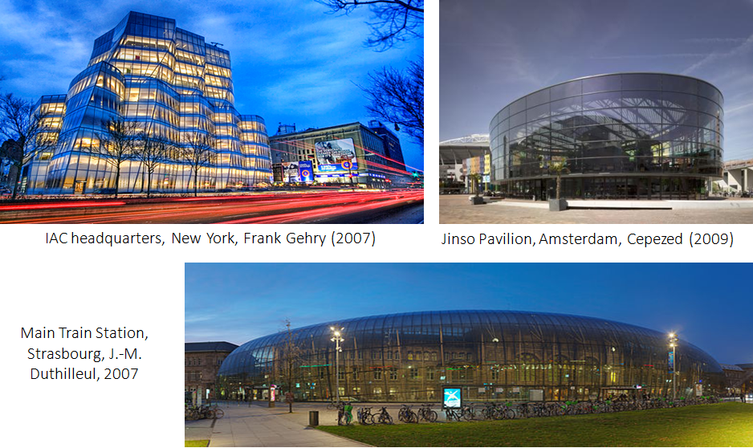
Cold bent glass in architecture
Summary of GPD – 2015, J.Vitkala
Source: www.gpd.fi ©Gianni Royer-Carfagni
Univesity of Parma, Italy

Slide 25
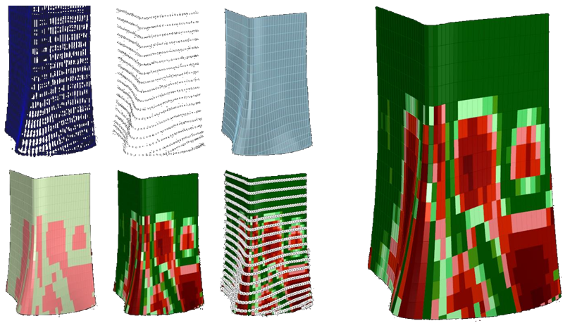
Parametric modeling. Freeform facade
Insulated glass panel. Cold bending assessment (gradient) according to established criteria
Summary of GPD – 2015, J.Vitkala
Source: www.gpd.fi ©Benjamin Beer Meinhardt Façade Technology

Slide 26
GLAZING
Notes:
CLOSING SLIDE

Slide 27
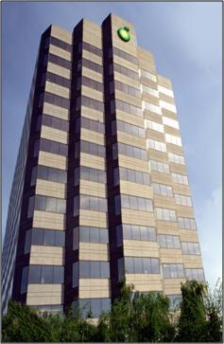
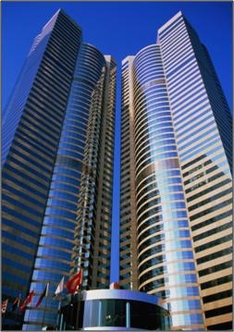
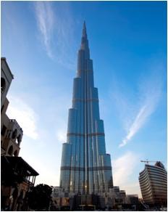
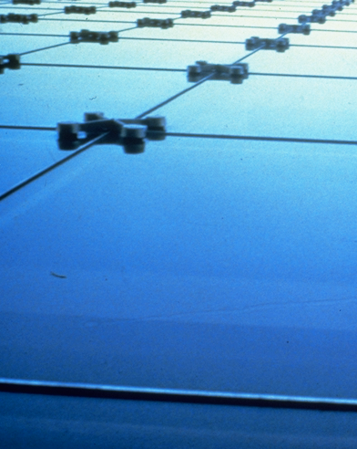
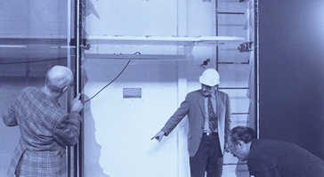
History
Origins of Structural Glazing
  1971: First 4-sided SG – Detroit 1971
  1980: Use of 1K neutral silicone
  1984: In factory glazing with 2K silicone sealants
1983_Alaska
1984_Hong Kong
2009_Dubai
Summary of GPD – 2015, J.Vitkala
Source: www.gpd.fi © P. Vandereecken, Dow Corning

Slide 28
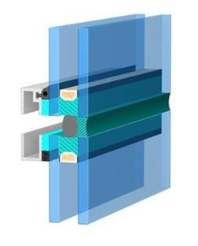
Structural Glazing
Bonding of glass onto a metallic frame
  Frameless façade
  Improved aesthetics
  Increase design possibilities
  Air & water permeable
  Energy efficient
SG sealant
Glass to metal bonding
Weathersealant
(air & water tightness)
IG sealant
Glass to glass bonding
Summary of GPD – 2015, J.Vitkala
Source: www.gpd.fi © P. Vandereecken, Dow Corning

Slide 29


Bolted point-fixings to increase transparency
In facades and in canopies
Summary of GPD – 2015, J.Vitkala
Source: www.gpd.fi © Kenny Martens, Ghent University

Slide 30


Point Fixing Condensation
Summary of GPD – 2015, J.Vitkala
Source: www.gpd.fi ©David Appelfeld & Valarie Hayez, Dow Corning Europe SA
Notes:
The energy benefit of using TSSA compare to traditional point fixing by fixing bolts is illustrated here. The heat flow through this specific detail was reduced from 62.0 W/m to 25.3 W/m for traditional point fixing to TSSA. The condensation on glass and fixing bolds, indicated by thick read line, was completely eliminated due to removing the thermal bridge.

Slide 31






However stress-concentrations arise
Adhesive
point-fixings
Tension
Compression
Solution
Mocibob, D., & Belis, J. (2010). Coupled experimental and numerical investigation of structural glass panels
with small slenderness subjected to locally introduced axial compression. Engineering Structures, 32(3), 753–761.
Summary of GPD – 2015, J.Vitkala
Source: www.gpd.fi © Kenny Martens, Ghent University

Slide 32
DESIGN PROBLEMS
Notes:
CLOSING SLIDE

Slide 33

Glass Surface Corrosion
  Summary of GPD – 2015, J.Vitkala
  Source: www.gpd.fi © Peter Hartog, Building Diagnostics Asia Pacific,
  Chris Barry, Glass Consultant

Slide 34

Distortion of reflected sunlight from wrinkles and areas of non-uniform thickness in combinations of PVB and PET laminating films
Summary of GPD – 2015, J.Vitkala
Source: www.gpd.fi © Peter Hartog, Building Diagnostics Asia Pacific,
Chris Barry, Glass Consultant

Slide 35

The number and visibility of moiré fringes are functions of the magnitude of thermal deformation of sheet metal back-panels
Summary of GPD – 2015, J.Vitkala
Source: www.gpd.fi © Peter Hartog, Building Diagnostics Asia Pacific,
Chris Barry, Glass Consultant

Slide 36

32nd floor of office building
(Melbourne)
Summary of GPD – 2015, J.Vitkala
Source: www.gpd.fi © Peter Hartog, Building Diagnostics Asia Pacific,
Chris Barry, Glass Consultant

Slide 37





When Buildings Attack Their Neighbors
Summary of GPD – 2015, J.Vitkala
Source: www.gpd.fi ©Vicente Montes-Amoros, CDC Inc

Slide 38


The Death Ray Strikes Back
Summary of GPD – 2015, J.Vitkala
Source: www.gpd.fi ©Vicente Montes-Amoros, CDC Inc

Slide 39






The Death Ray Strikes Back
Summary of GPD – 2015, J.Vitkala
Source: www.gpd.fi ©Vicente Montes-Amoros, CDC Inc

Slide 40




The Death Ray Strikes Back
Summary of GPD – 2015, J.Vitkala
Source: www.gpd.fi ©Vicente Montes-Amoros, CDC Inc

Slide 41


What Is Anisotropy?
Source: Vehmas, J., Glaston
Summary of GPD – 2015, J.Vitkala
Source: www.gpd.fi ©Saverio Pasetto, Skanska UK
Notes:
Darker/lighter areas or multicolour patterns on glass plate
leopard spots – strain patterns – iridescence – polarization fields - quench marks

Slide 42




What causes anisotropy?
Stresses in glass plate due to heat treatment
Polarised light: reflection & scattering
Viewing Angle & Conditions
Controllable?
Source: Schweitzer, A. - Arcon Flachglas-Veredlung
Summary of GPD – 2015, J.Vitkala
Source: www.gpd.fi ©Saverio Pasetto, Skanska UK
Notes:
STRESSES ALTER BEHAVIOUR OF LIGHT
POLARISED LIGHT: BUILDINGS, WATER, ASPHALT, BLUE SKY,HUMAN EYE
ISOTROPIC MATERIALS AND FLOAT, DIRECTIONALLY DEPENDANT PROPERTIES
OPTICAL ANISOTROPY, ANISOTROPY OF REFRACTIVE INDEX,
STRESSES?

Slide 43
What causes anisotropy?
No
issues
Annealed float glass
Need for
Heat treatment
Heat treatment
Stresses + viewing conditions
Big issues
No anisotropy
Potential for anisotropy
Introduces anisotropy
Affect visibility of anisotropy
Summary of GPD – 2015, J.Vitkala
Source: www.gpd.fi ©Saverio Pasetto, Skanska UK
Notes:
STRESSES ALTER BEHAVIOUR OF LIGHT
POLARISED LIGHT: BUILDINGS, WATER, ASPHALT, BLUE SKY,HUMAN EYE
ISOTROPIC MATERIALS AND FLOAT, DIRECTIONALLY DEPENDANT PROPERTIES
OPTICAL ANISOTROPY, ANISOTROPY OF REFRACTIVE INDEX,
STRESSES?

Slide 44

State of the art: Acceptance/Rejection
Area with non-critical
Anisotropy level
Source: Schweitzer, A. - Arcon Flachglas-Veredlung
Area with critical
Anisotropy level
Summary of GPD – 2015, J.Vitkala
Source: www.gpd.fi ©Saverio Pasetto, Skanska UK
Notes:
Importance of SOTA
Need for objectivity: importance of measurement
Specifications

Slide 45

State of the art: Acceptance/Rejection
Isotropy-value:
Percentage of the surface of the glass which does not show critical
Anisotropy level
Source: Schweitzer, A. - Arcon Flachglas-Veredlung
Source: Vehmas, J., Glaston
Summary of GPD – 2015, J.Vitkala
Source: www.gpd.fi ©Saverio Pasetto, Skanska UK
Notes:
Importance of SOTA
Need for objectivity: importance of measurement
Specifications

Slide 46

Standards vs. specifications
Do agreed specifications clearly address anisotropy acceptance and rejection criteria?
Summary of GPD – 2015, J.Vitkala
Source: www.gpd.fi ©Saverio Pasetto, Skanska UK

Slide 47

Standards vs. specifications
… a glass supply chain problem?
Are clients prepared to pay more to avoid issues associated with anisotropy or to take the risk?
Summary of GPD – 2015, J.Vitkala
Source: www.gpd.fi ©Saverio Pasetto, Skanska UK

Slide 48
A Summary Presentation of GPD Finland 2015:
ENERGY

Slide 49




Tapping into the potential of the building sector
’Energy efficiency first’ principle
Buildings (and transport) as priority sectors where energy efficiency gains must be reaped
Focus of financial and regulatory efforts in these sectors
Need to empower consumers in the energy transition
Over 40% of EU energy consumption from buildings
Summary of GPD – 2015, J.Vitkala
Source: www.gpd.fi ©Bertrand Cazes & Niels Schreuder, Glass for Europe

Slide 50

Building Energy Performance Needs to Improve
41.5% of Energy Consumption goes to Buildings
Total 2009 US Energy Consumption by Sector (Source: US Energy Information Administration)
Summary of GPD – 2015, J.Vitkala
Source: www.gpd.fi ©Patrica R. Athey, PPG Industries Inc

Slide 51

Energy Loss in Buildings
US buildings account for:
71% of electricity
39% of total energy
  Energy Loss Through the Windows has the Largest Impact of Any Building Envelope
Summary of GPD – 2015, J.Vitkala
Source: www.gpd.fi © Damoder Reddy, Argil, Inc

Slide 52



An energy efficiency tool for consumers
EU energy labelling:
  To inform consumers about the energy-efficiency of products
  Support the market uptake of best-in-class solutions
  Be condusive for innovation
The EU challenge:
  From energy-using products to energy-related products
  Can it work for building products?
Updated regulatory framework in place to make it happen:
  Revised Energy Labelling Directive (2010)
  Working Plan for 2012-2014: Windows in the “priority product groups”
  New Methodology for the Ecodesign of Energy related Products (MEErP)
Summary of GPD – 2015, J.Vitkala
Source: www.gpd.fi ©Bertrand Cazes & Niels Schreuder, Glass for Europe

Slide 53
BUILDING ORIENTATION -
Energy Management
Notes:
CLOSING SLIDE

Slide 54

News Building, Danish Broadcasting Corporation
Climate Strategy
Summary of GPD – 2015, J.Vitkala
Source: www.gpd.fi ©Stig Mikkelsen, MIKKELSEN Architects

