Slide 1
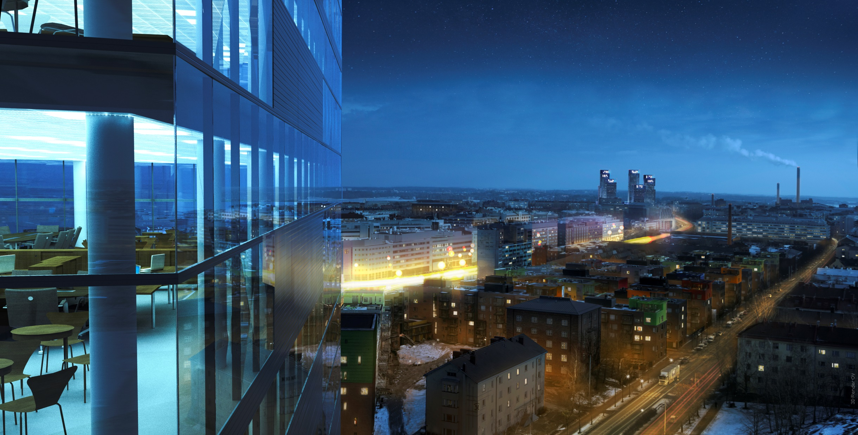


AN INTERNATIONAL DESIGN-BUILD COMPETITION
GPD 2015/Helsinki
Dan Mollgren, Architect, Head of Project

Slide 2
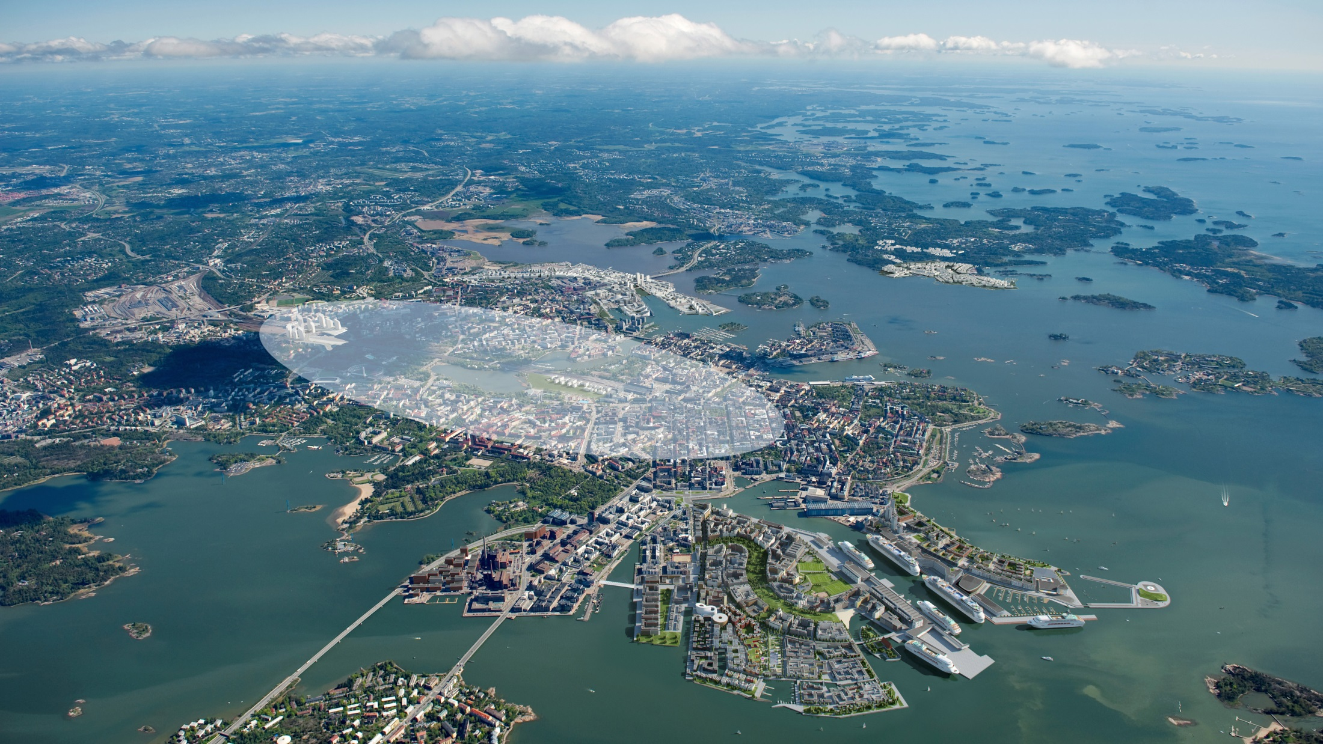
Helsinki is envisioned to grow
Expansion of City Core

Slide 3
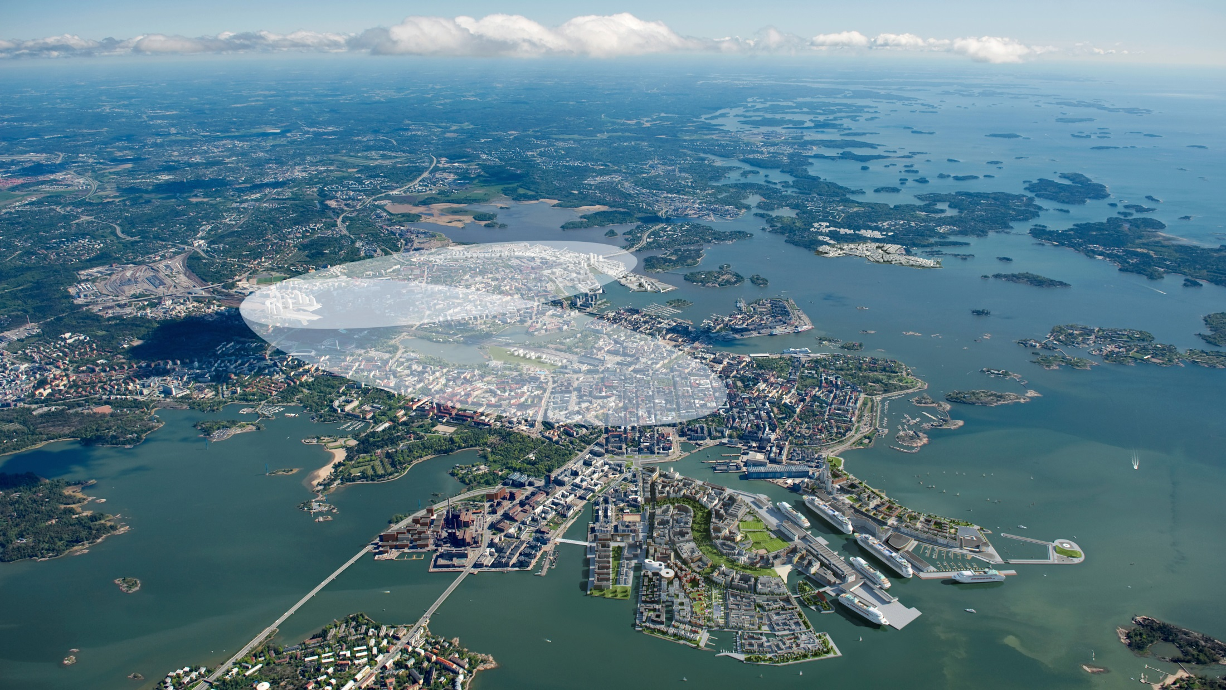
“We will need more space for enterprises near the city centre and more housing to meet the increased demand for urban housing.”
Innovation District
Expansion of City Core

Slide 4
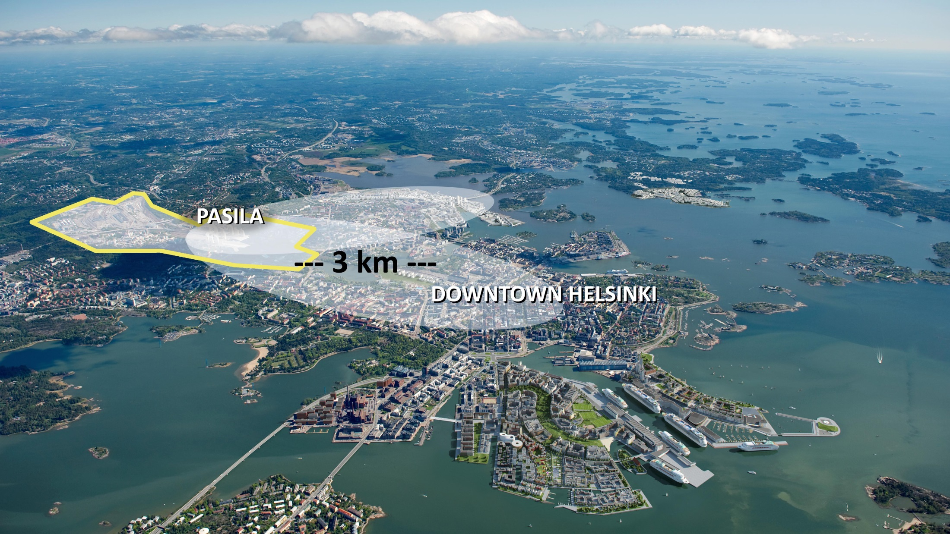
Pasila is a growing CBD with 50 000 jobs by 2050

Slide 5
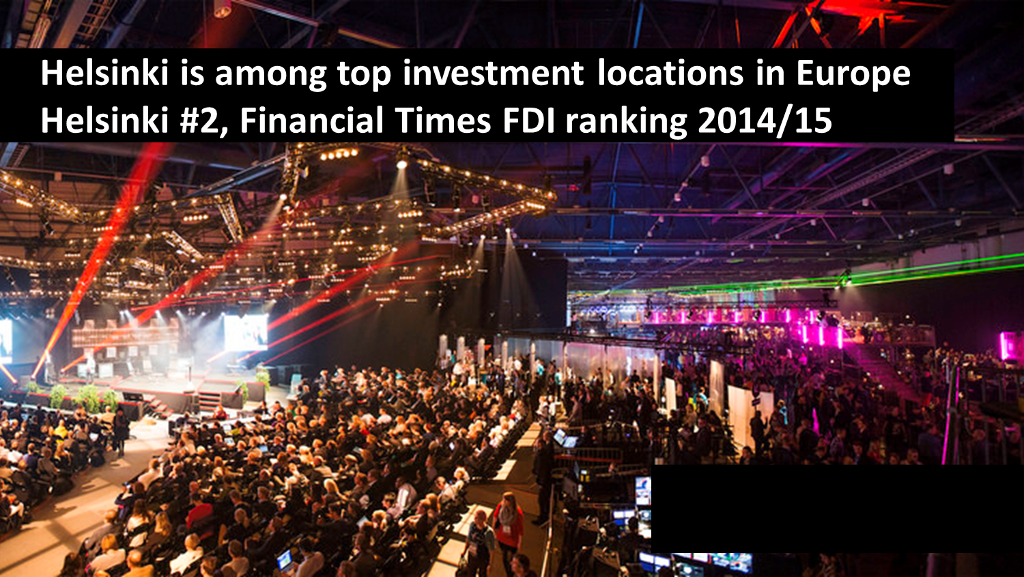
SLUSH –Event
PHOTO: SLUSH

Slide 6
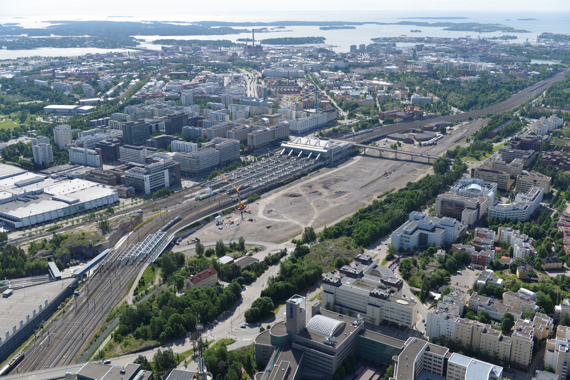

Slide 7
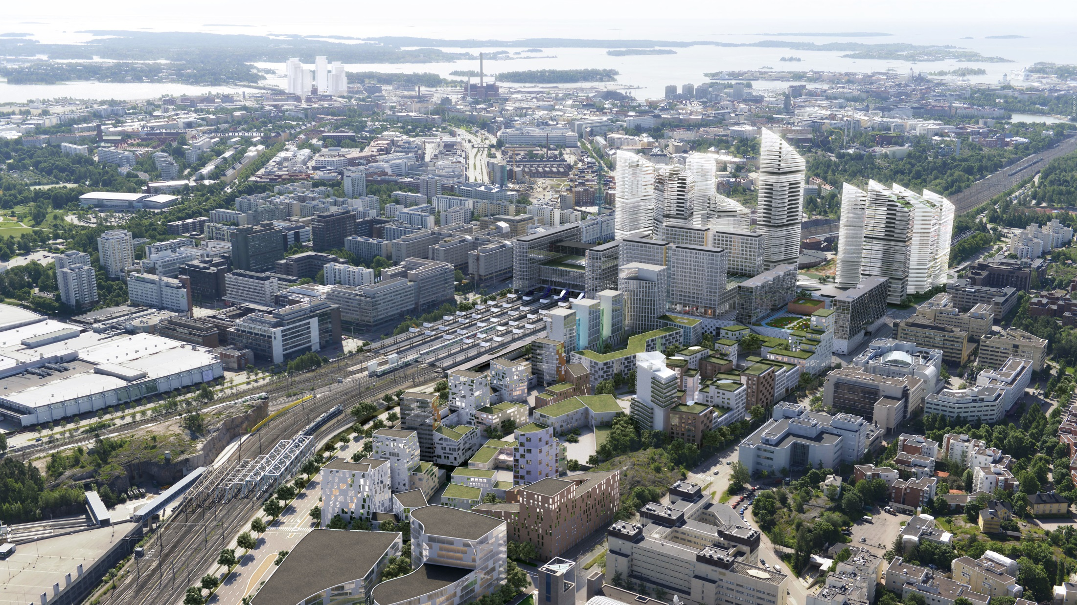

Slide 8
Central Pasila

Slide 9
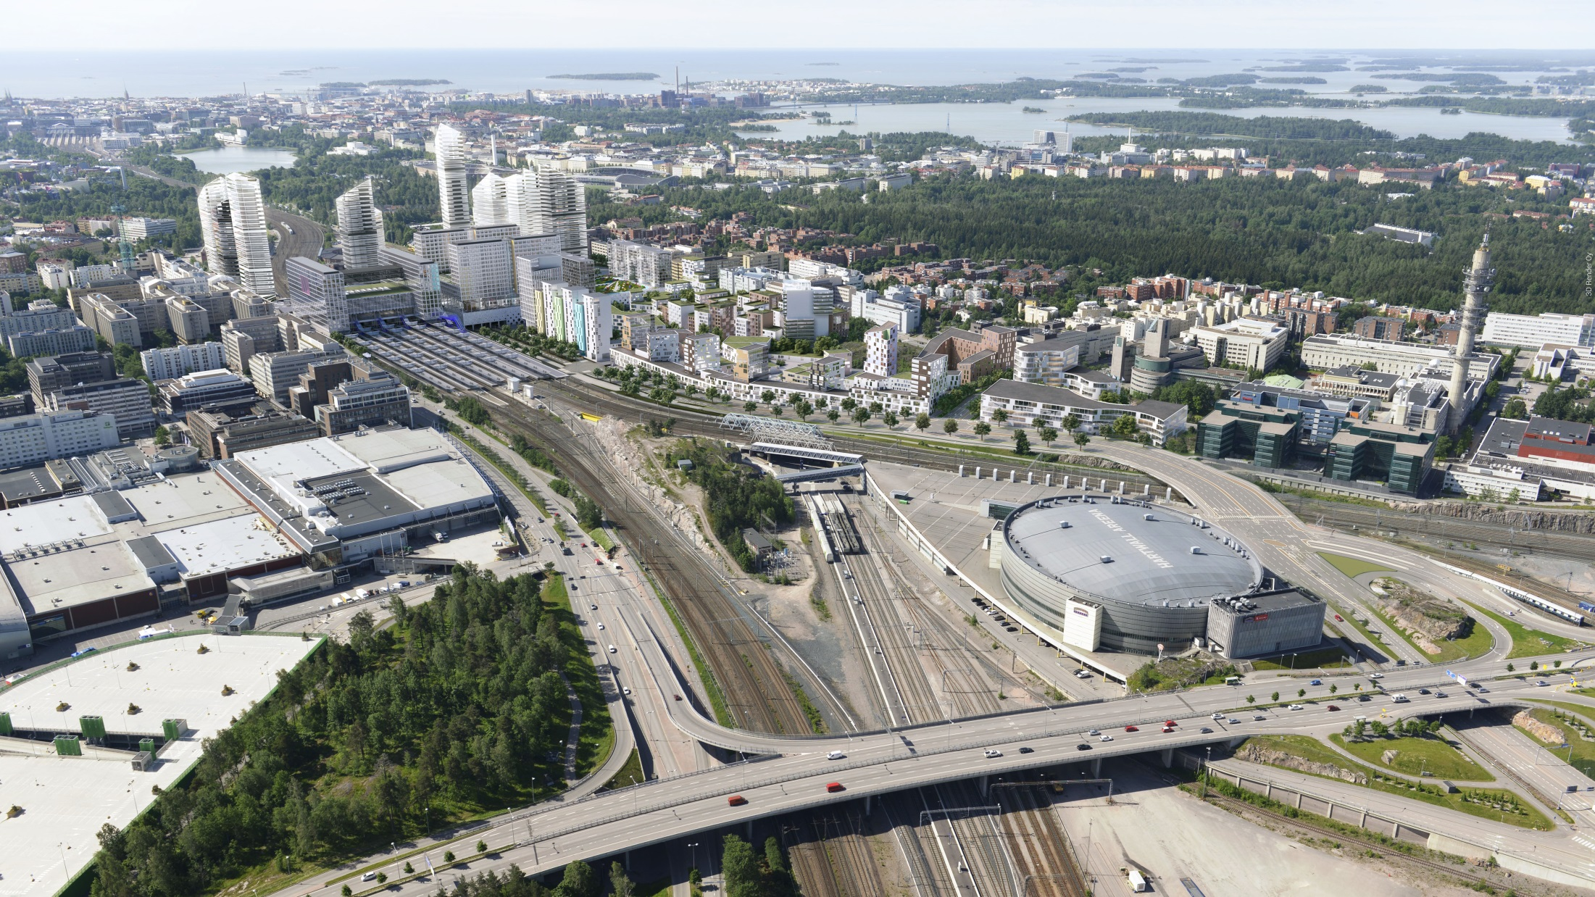

Slide 10
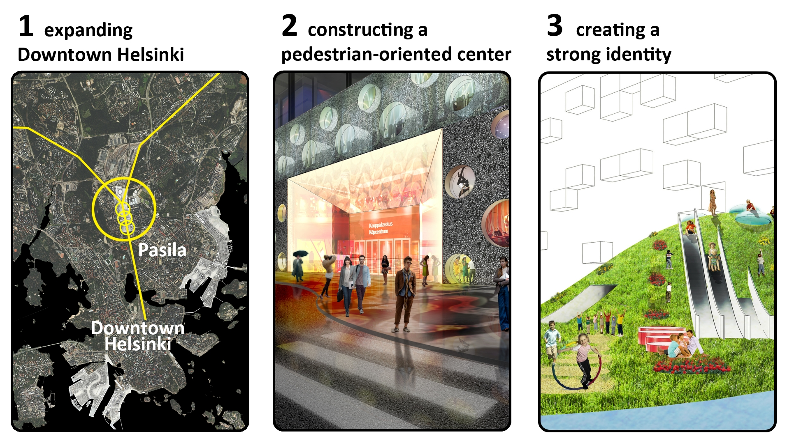

Slide 11
Pasila Station

Slide 12
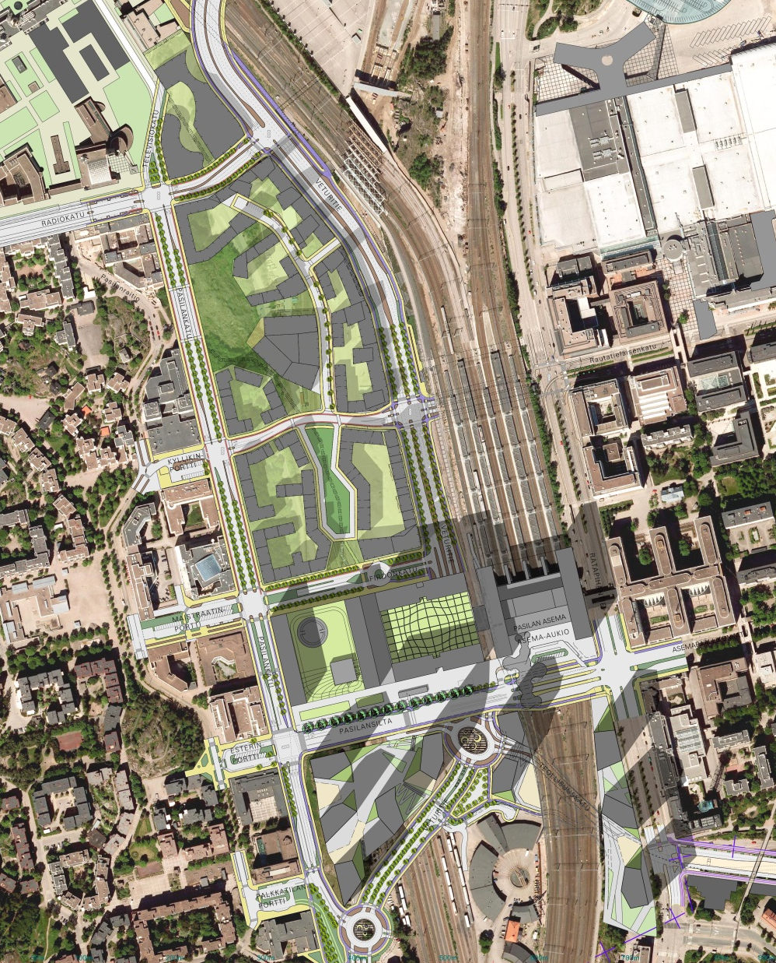
PASILA STATION
AN INTERMODAL
TRANSPORT COMPONENT
100 000
PASSENGERS/DAY

Slide 13
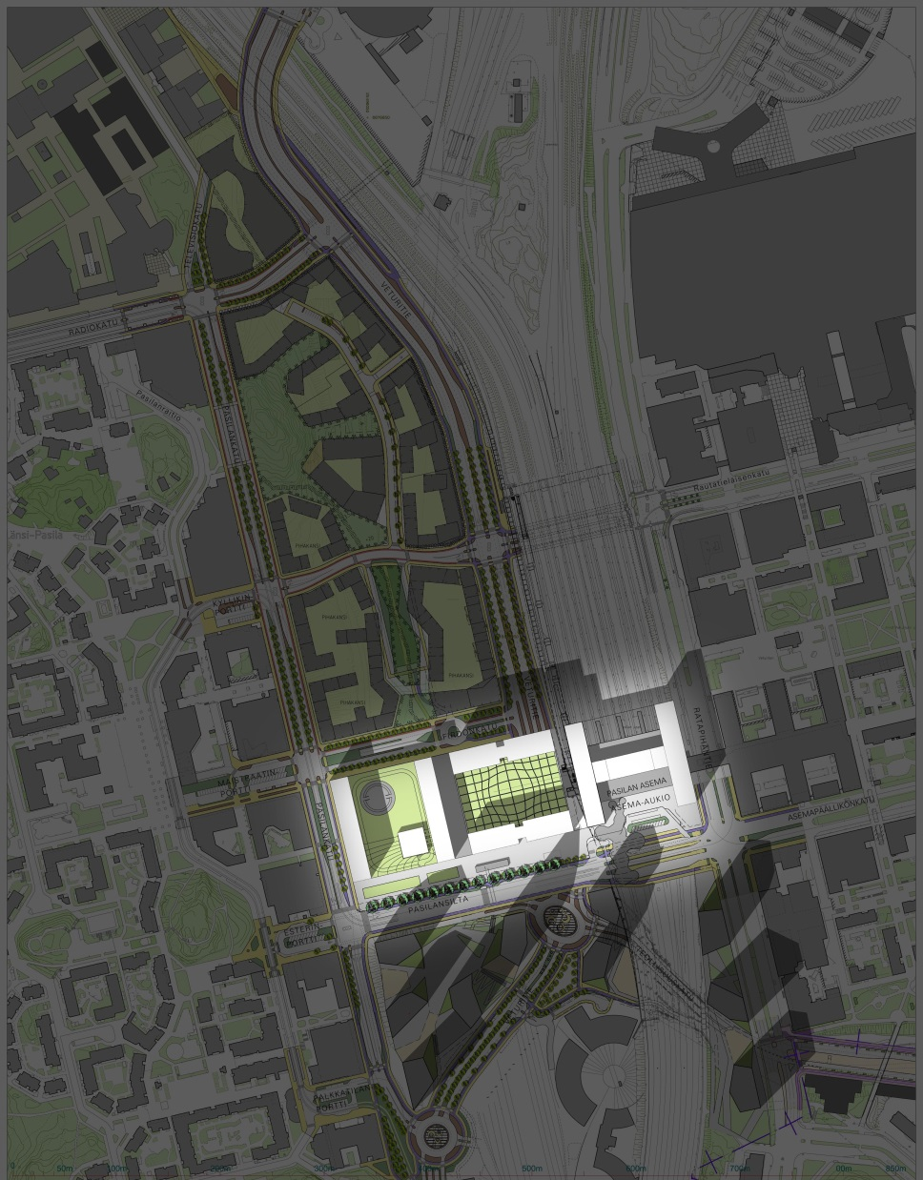
TRIPLA
MIXED-USE 190 000 sq m²
MEETING POINT!
CONSTR. START 2015

Slide 14
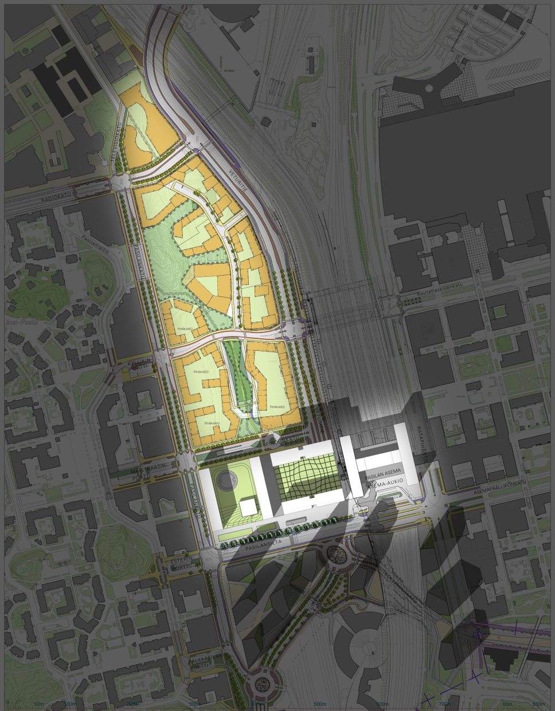
RAILYARD
APARTMENTS
A NEW HOME
FOR 3000 INHABITANTS
CONSTR. START 2017

Slide 15
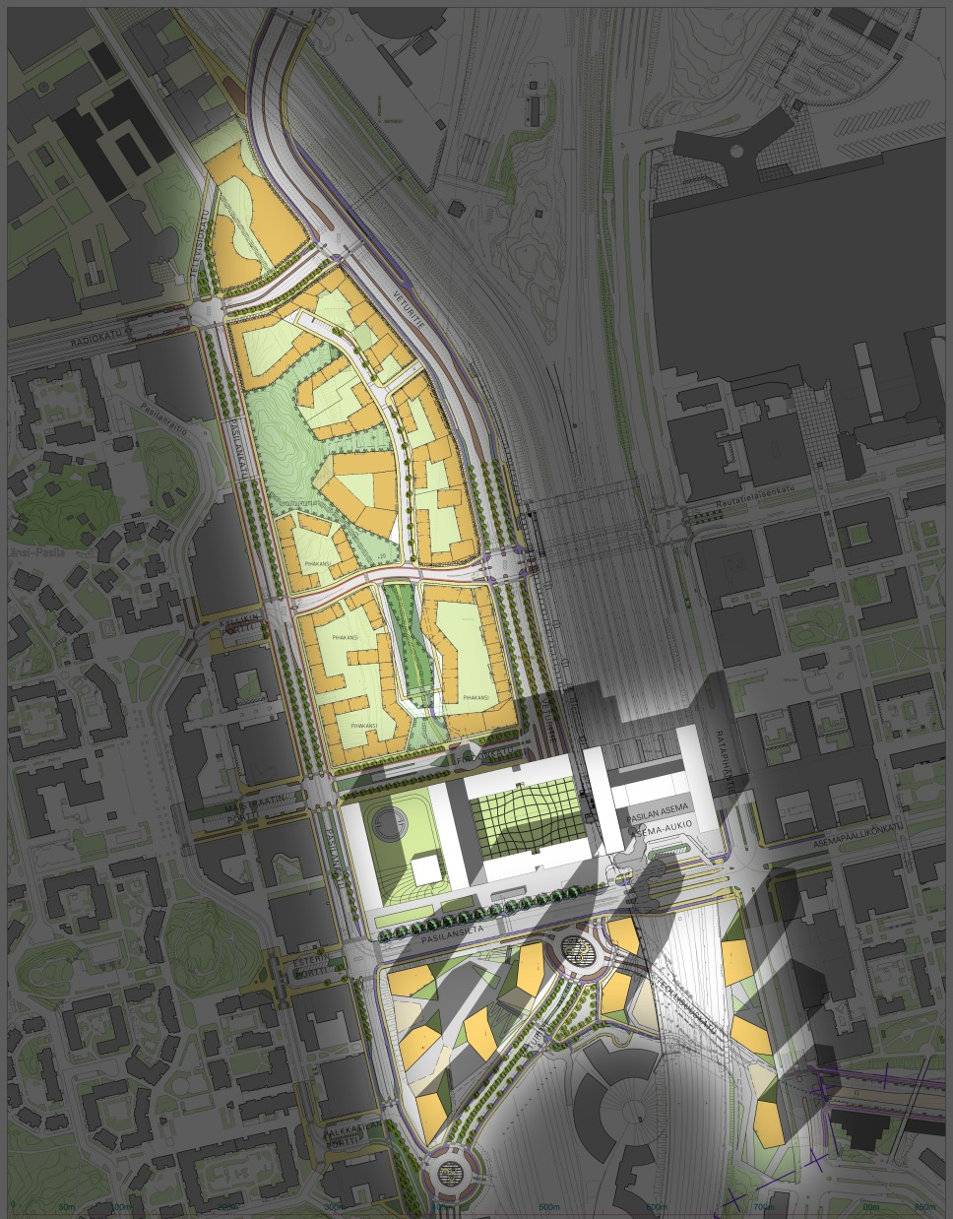
TOWER AREA
OFFICES AND
APARTMENTS
COMPETITION
2015-2016

Slide 16
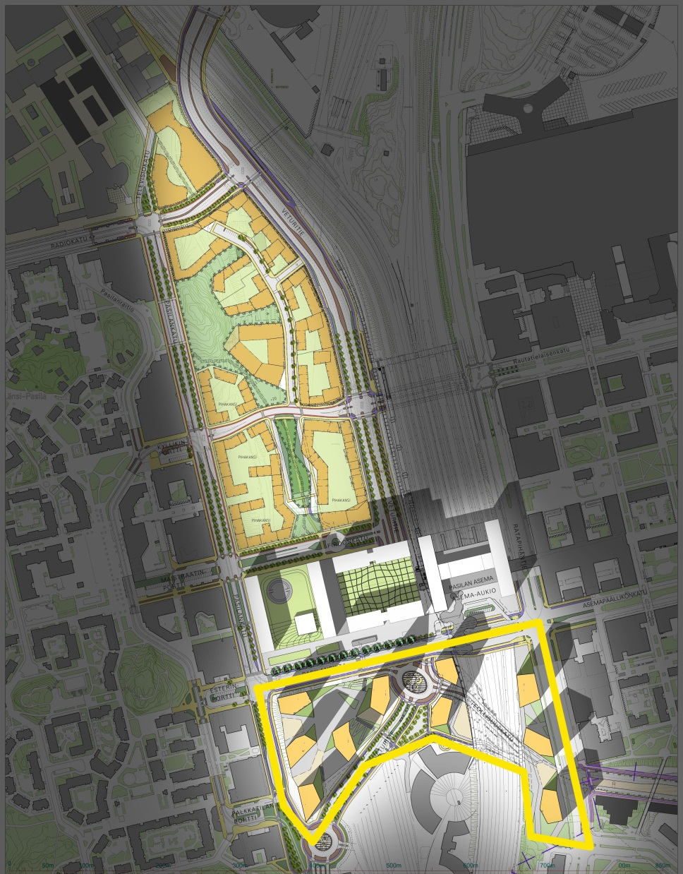

150-200 000 m²
DESIGN-BUILD

Slide 17
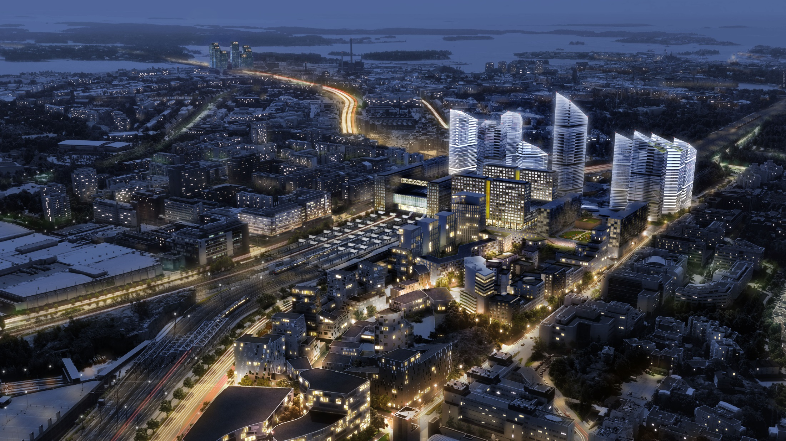
24/7

Slide 18

A New Dimension of Downtown Helsinki
COMPETITION START: FALL 2015
www.helsinkihighrise.fi

Slide 19
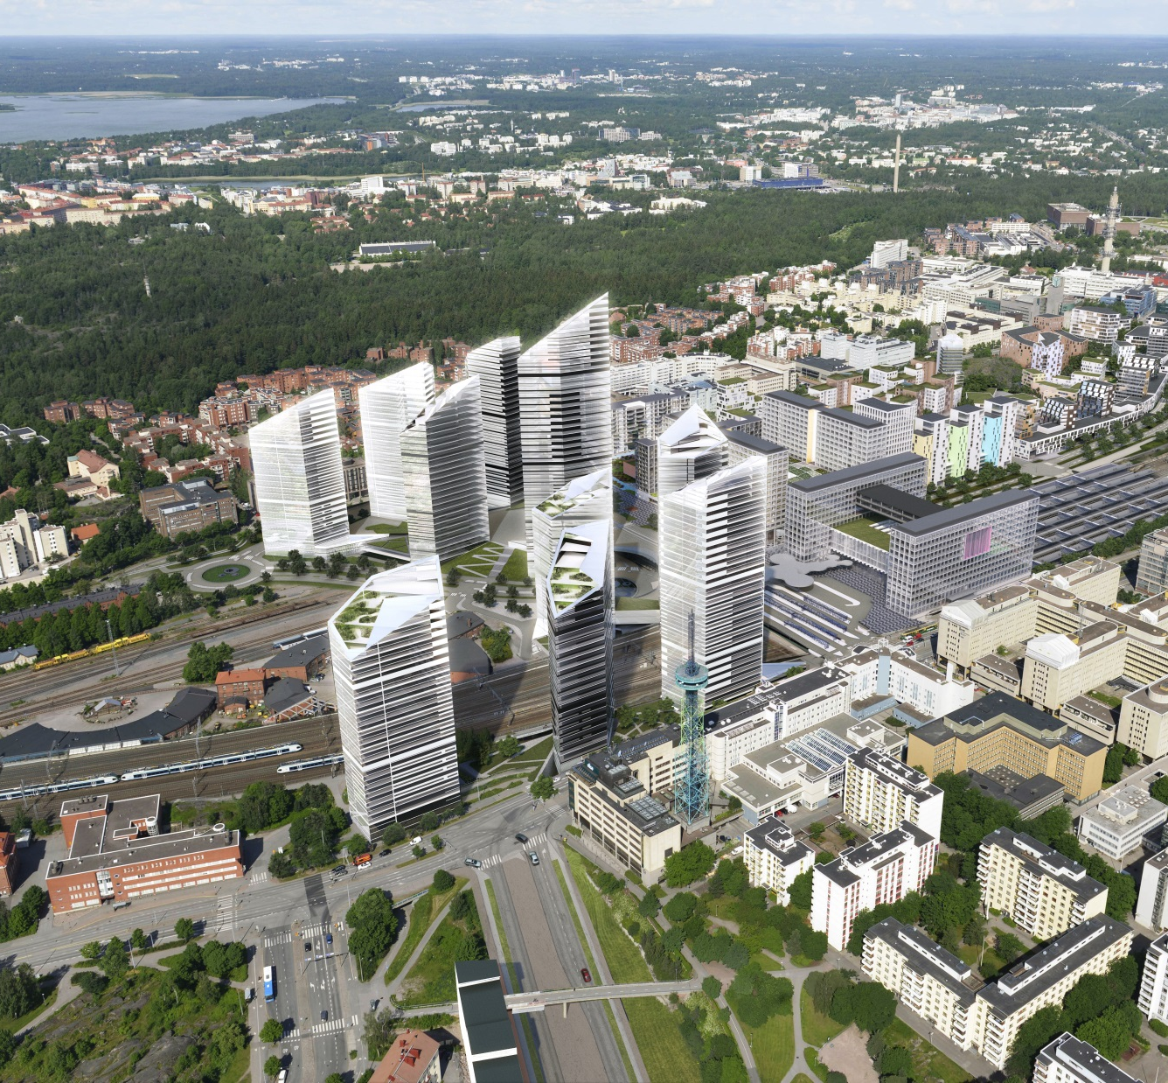
www.helsinkihighrise.fi

