Slide 1
BUILDING ORIENTATION -
Energy Management
Notes:
CLOSING SLIDE

Slide 2
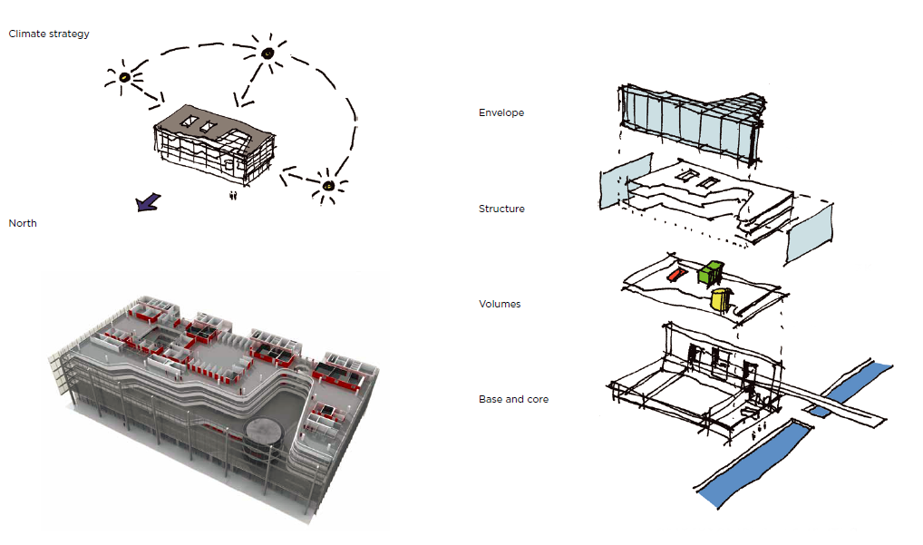
News Building, Danish Broadcasting Corporation
Climate Strategy
Summary of GPD – 2015, J.Vitkala
Source: www.gpd.fi ©Stig Mikkelsen, MIKKELSEN Architects

Slide 3

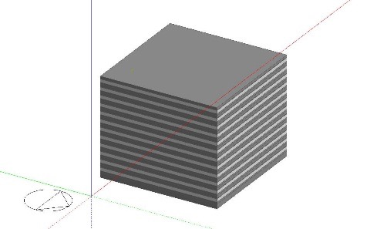
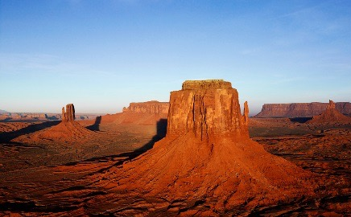

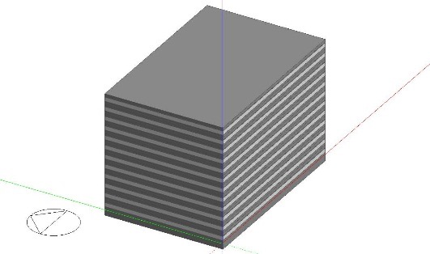
Optimize Commercial Building Energy Usage
Design Building Energy Perf. & Aesthetics by Climate Zone
Orientation
Window to Wall Ratio (WWR)
Shape
SQUARE
Floor to Floor Wall Area
(13’ x 20’)
N
SQUARE
0
45
90
135
Floor to Floor Wall Area
(13’ x 20’)
RECTANGULAR
RECTANGULAR
0
45
90
135
Summary of GPD – 2015, J.Vitkala
Source: www.gpd.fi ©Patrica R. Athey, PPG Industries Inc

Slide 4
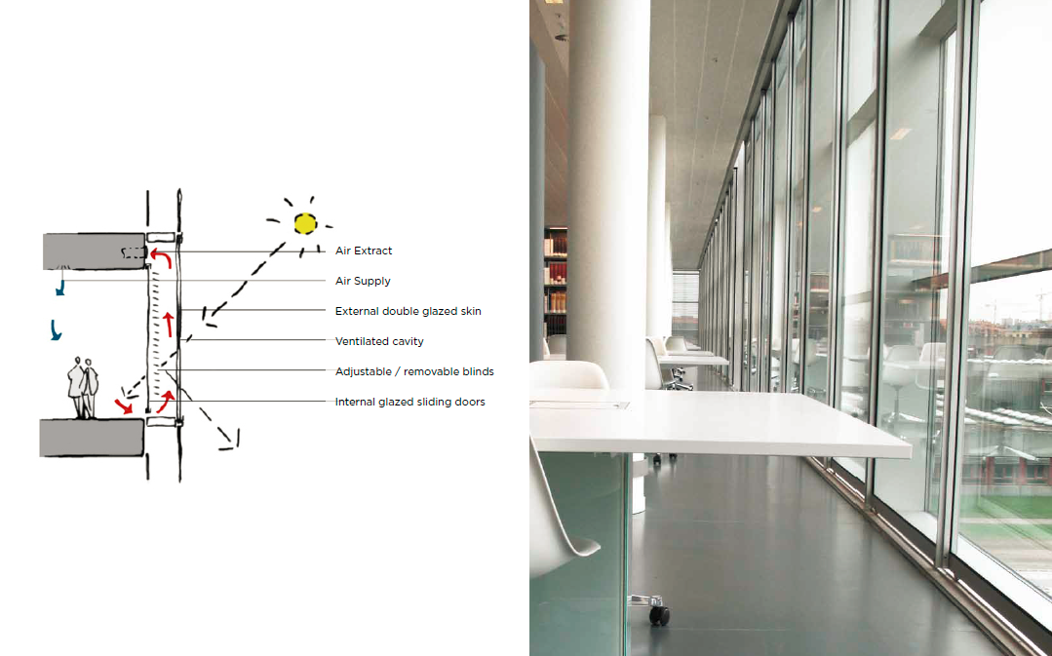
University of Copenhagen Royal Library Amager
Summary of GPD – 2015, J.Vitkala
Source: www.gpd.fi ©Stig Mikkelsen, MIKKELSEN Architects

Slide 5
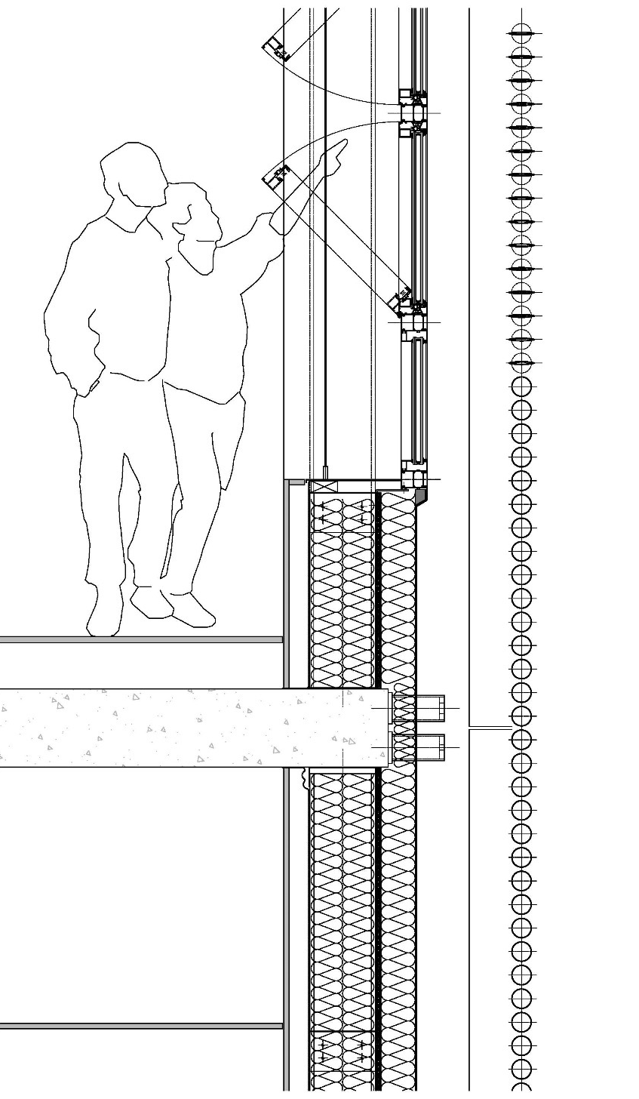
Sun radiation
Sand
Summary of GPD – 2015, J.Vitkala
Source: www.gpd.fi ©Peter French, Snohetta
Notes:
Shade varjostaa shading device

Slide 6
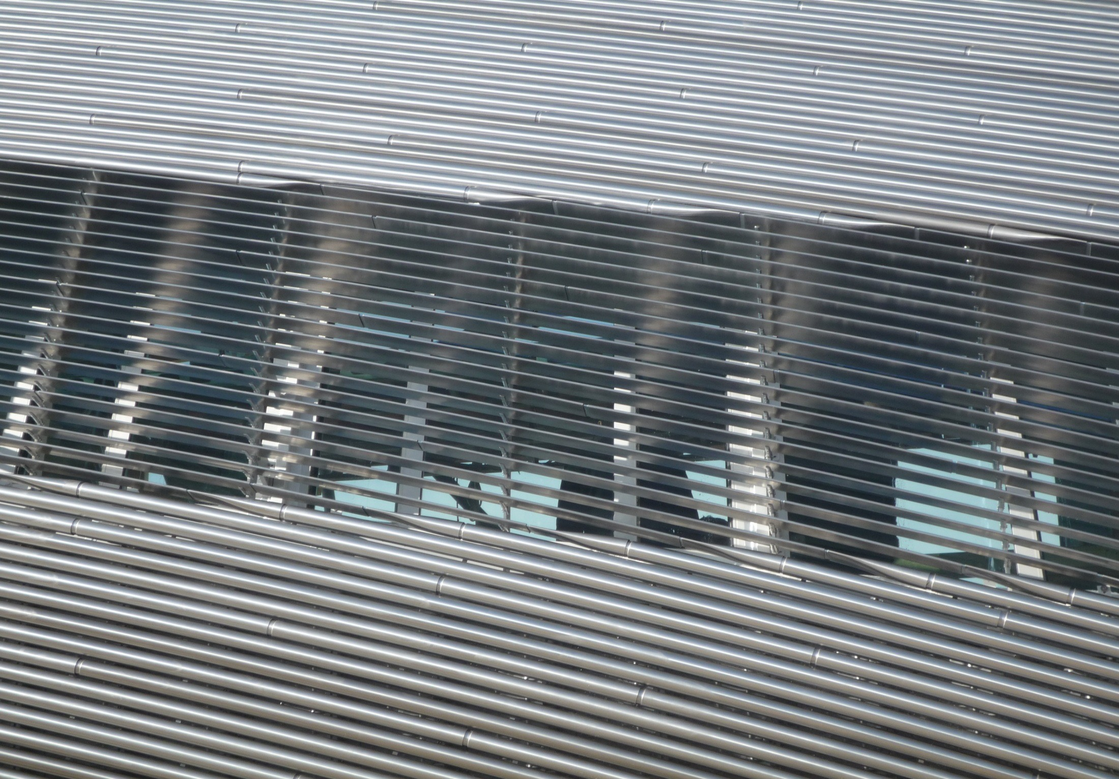
Summary of GPD – 2015, J.Vitkala
Source: www.gpd.fi ©Peter French, Snohetta

Slide 7
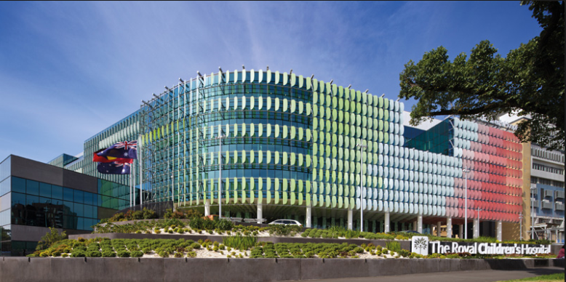
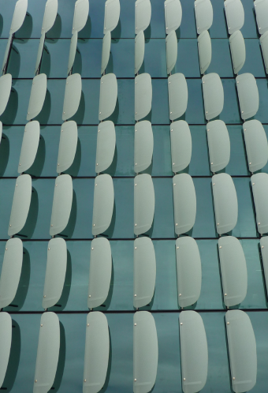
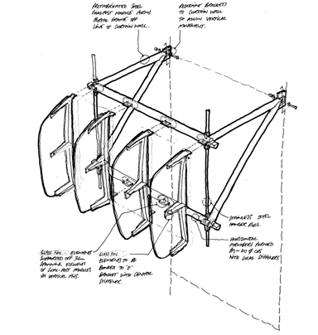
Summary of GPD – 2015, J.Vitkala
Source: www.gpd.fi ©Oliver Ng, BG&E
Notes:
Did the RCH

Slide 8
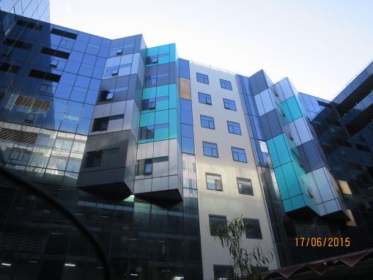
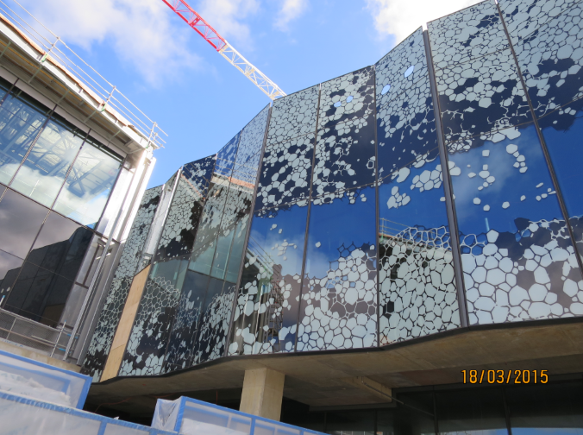
Summary of GPD – 2015, J.Vitkala
Source: www.gpd.fi ©Oliver Ng, BG&E

Slide 9
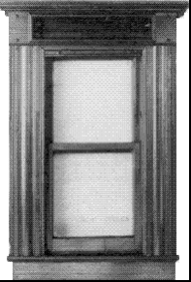
Criteria for Selecting Optimal Facades
Energy / Carbon
Comfort
View/Privacy
Security
Acoustics
Structure
Recycled Materials
Daylight
Aesthetics
Weatherproof
Cleaning
Maintenance
Durability
Summary of GPD – 2015, J.Vitkala
Source: www.gpd.fi ©Stephen Selkowitz, Lawrence Berkeley National Laboratory
Notes:
There are many important criteria and relative importance may vary with the job.
For this discussion the initial focus is “Energy- related” but the approach provides many other measurable benefits

Slide 10
Annual Energy Costs in Perspective:
Occupancy Costs = 100 x Energy Cost
Check: Where is the Real Cost in Buildings?
Cost / Sq. M. Floor -Year
Energy Cost: $50.00
Rent: $500.00
“Productivity” $5000.00+
Smart Integrated Systems will Improve Comfort!
Summary of GPD – 2015, J.Vitkala
Source: www.gpd.fi ©Stephen Selkowitz, Lawrence Berkeley National Laboratory
Notes:
You know this slide… productivity = salary x2 (for overheades) / floor area…
Well designed facades can deliver value here even if we cant yet fully quantify health, performance , etc My view is these are real but hard to quantify, hard to relate to specific design variables

Slide 11
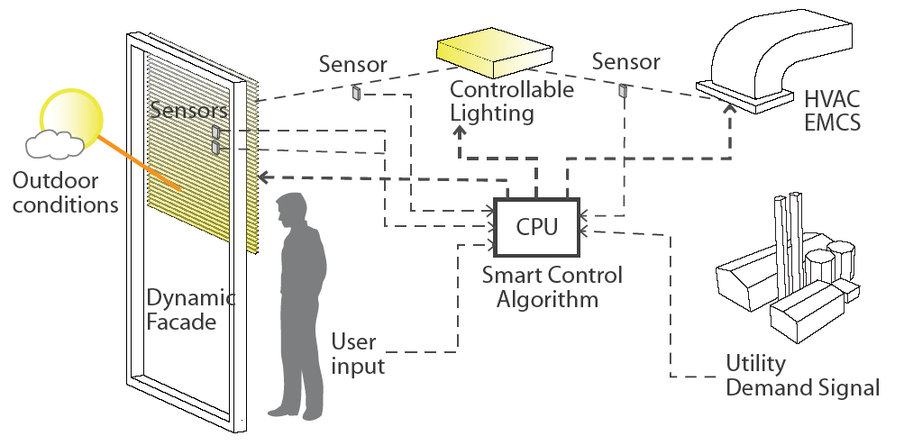
The Integrated Façade/Lighting System “Challenge”
BIPV
Facade
Solar intensity
Daylight, glare
Shade position
Lighting
Occupancy
Illuminance level
Energy use
HVAC
Outdoor and indoor temp
Heat/ cool/ econ mode
COP
Summary of GPD – 2015, J.Vitkala
Source: www.gpd.fi ©Stephen Selkowitz, Lawrence Berkeley National Laboratory
Notes:
Challenge- many moving parts- all combinations possible- too many choices, too many interactions
AEC will never master all this- result- too costly, will not specify

Slide 12
VIG VACUUM INSULATING GLASS -
Glass Of The Future?
Notes:
CLOSING SLIDE

Slide 13
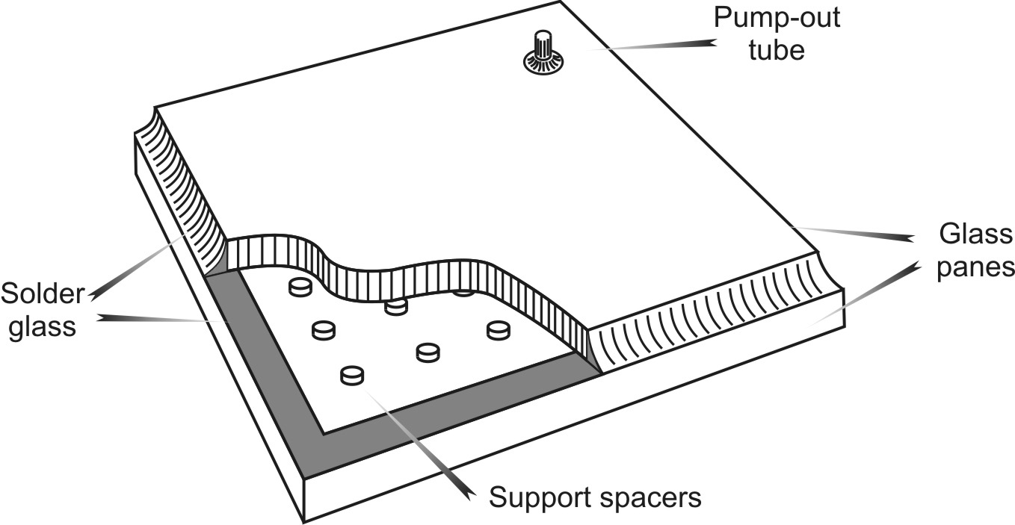
highly thermally insulating glazing –
VIG – vacuum insulating glaizing
two panes of glass hermetically sealed at the edges and separated by an evacuated gap, maintained under the influence of atmospheric pressure by an array of spacers
Summary of GPD – 2015, J.Vitkala
Source: www.gpd.fi ©Cenk Kocer, University of Sydney

Slide 14
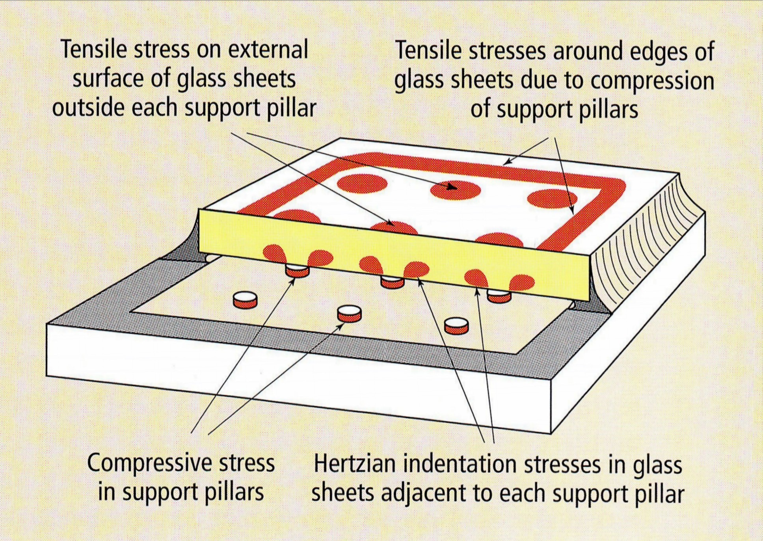
VIC - The mechanical performance
Image reproduced from the work of, and with the permission of, Prof. (emeritus) Richard E. Collins
Summary of GPD – 2015, J.Vitkala
Source: www.gpd.fi ©Cenk Kocer, University of Sydney

Slide 15
Multiple-pane insulating glass
Energy required to manufacture the additional chamber
Outlook from 3-pane to 4-pane glass
Ug-value improvement when changing from 3-pane to 4-pane glass
0.6 to 0.3 = ∆ - 0.3 W/(m²K)
Calculations: University of Kassel – CESR
Ug value of quadruple glazing: IFT calculation
* Room temperature 20°C (standard climate D according to PHPP)
**Assumption: central heating with a gas condensing boiler.
The primary energy analysis includes all energy costs and conversion losses for supplying the fuel from the source to the furnace room ("cumulated energy demand" CED).
Summary of GPD – 2015, J.Vitkala | Source: www.gpd.fi ©Markus Jandl, LiSEC Austria GmbH

Slide 16
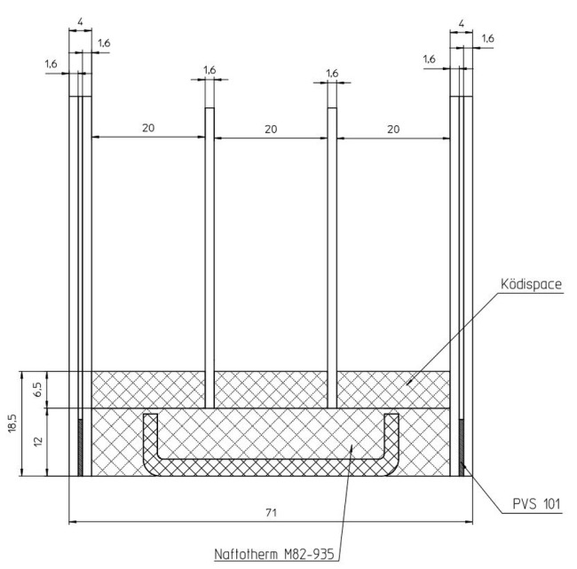
Targets for the insulating glass of the future
Which technologies can we use to meet these targets?
The following technologies:
Quadruple-glazed insulating glass
Thin glass technology
New edge bond
Facilitate:
U value of 0.3 W/m²K (with argon)
Lowering the primary energy requirement for manufacturing
Reducing weight and costs
Frameless, self-supporting structure
Summary of GPD – 2015, J.Vitkala
Source: www.gpd.fi ©Markus Jandl, LiSEC Austria GmbH

Slide 17
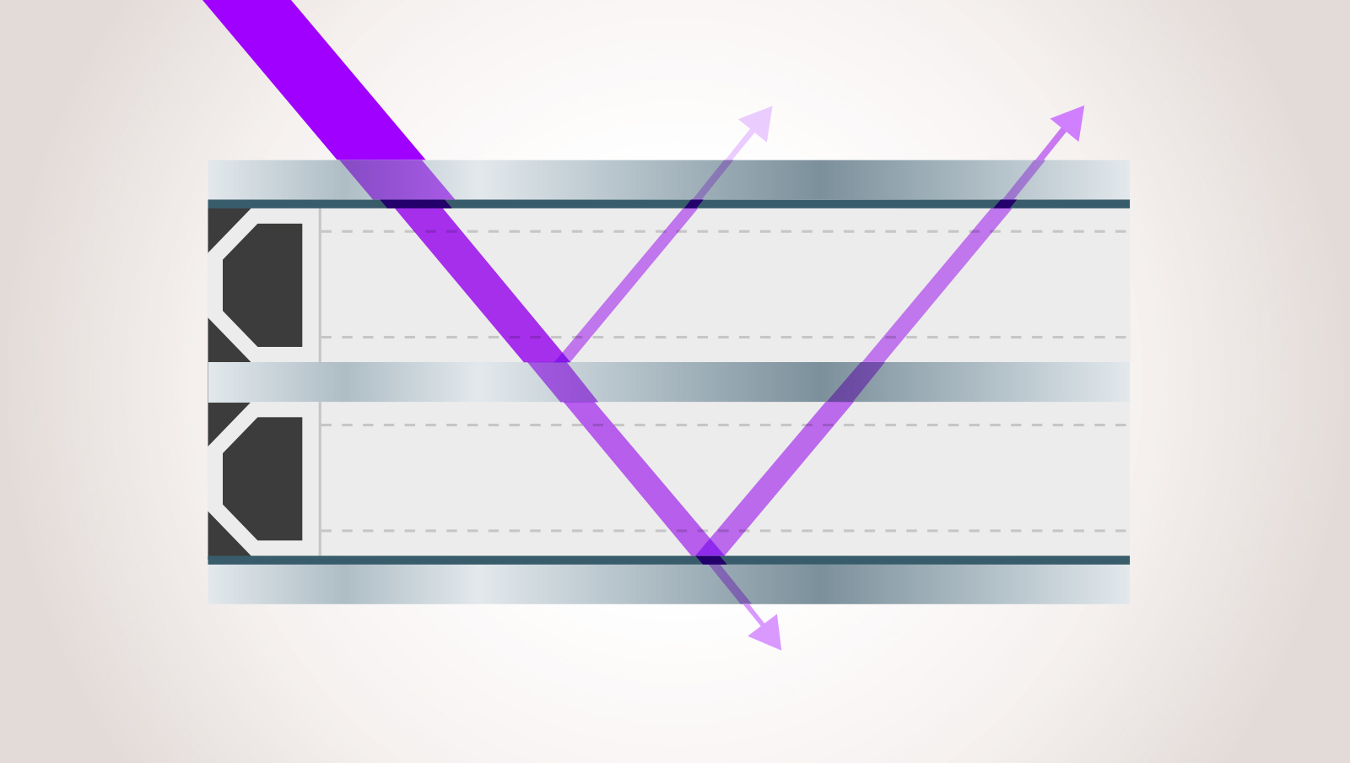

Measuring gas concentration without breaking the IGU – even on triples
Coating
1
02
Placement of
the coated surfaces
makes a difference
in measurement
2
02
Coating
Summary of GPD – 2015, J. Vitkala
Source: www.gpd.fi © Miikkael Niemi, Sparklike
Notes:
Here is a standard triple glazed structure, where the purple line visualizes the laser beam entering the IG from the upper left.
Laser is focused into the IG, and then reflected back from the IG surfaces and DETECTED
We are measuring changes in laser signal caused by oxygen – not only the signal intensity
However, we are dealing with signal budget. So stronger signal equals to higher measuring accuracy, and vice versa.
Laser penetrates float glass well, but has low reflection
Coatings are cutting off the laser power, but reflect amazingly well, like mirror
This all makes the coating transmission and location important feature when considering the measurement
On triple, actually two measurements are made, and from these the results on different cavities can be separated
As a side product, very accurate thickness information on glass and spacers is received

Slide 18
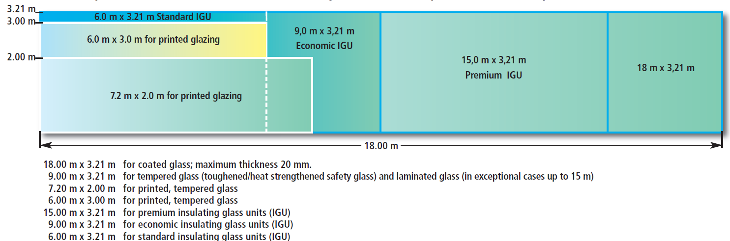
IGU – for standard to premium sizes
Summary of GPD – 2015, J.Vitkala
Source: www.gpd.fi © Michael Elstner, AGC Interpane

Slide 19
FUTURE ENERGY MANAGEMENT
SMART WINDOW
Notes:
CLOSING SLIDE

Slide 20
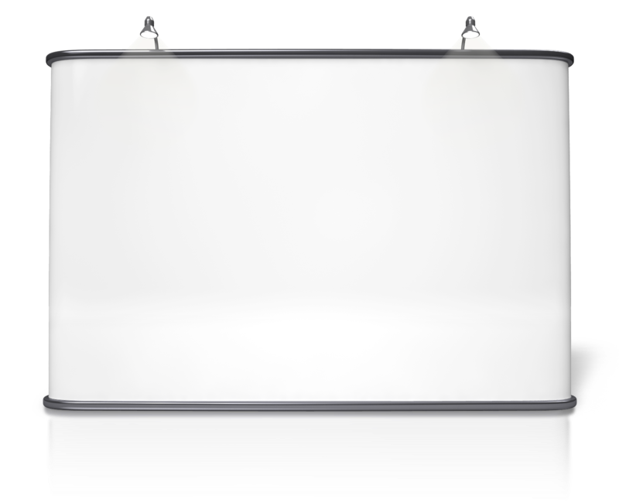
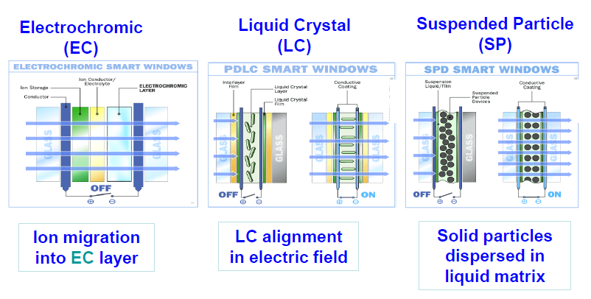
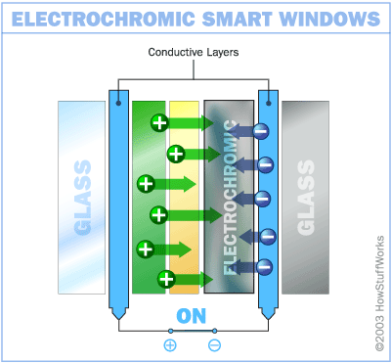
Smart Window Technologies
Suspended Particle Device (SPD)
Liquid-Crystal (LC)
Electrochromie (EC)
Summary of GPD – 2015, J.Vitkala
Source: www.gpd.fi © Damoder Reddy, Argil, Inc

Slide 21
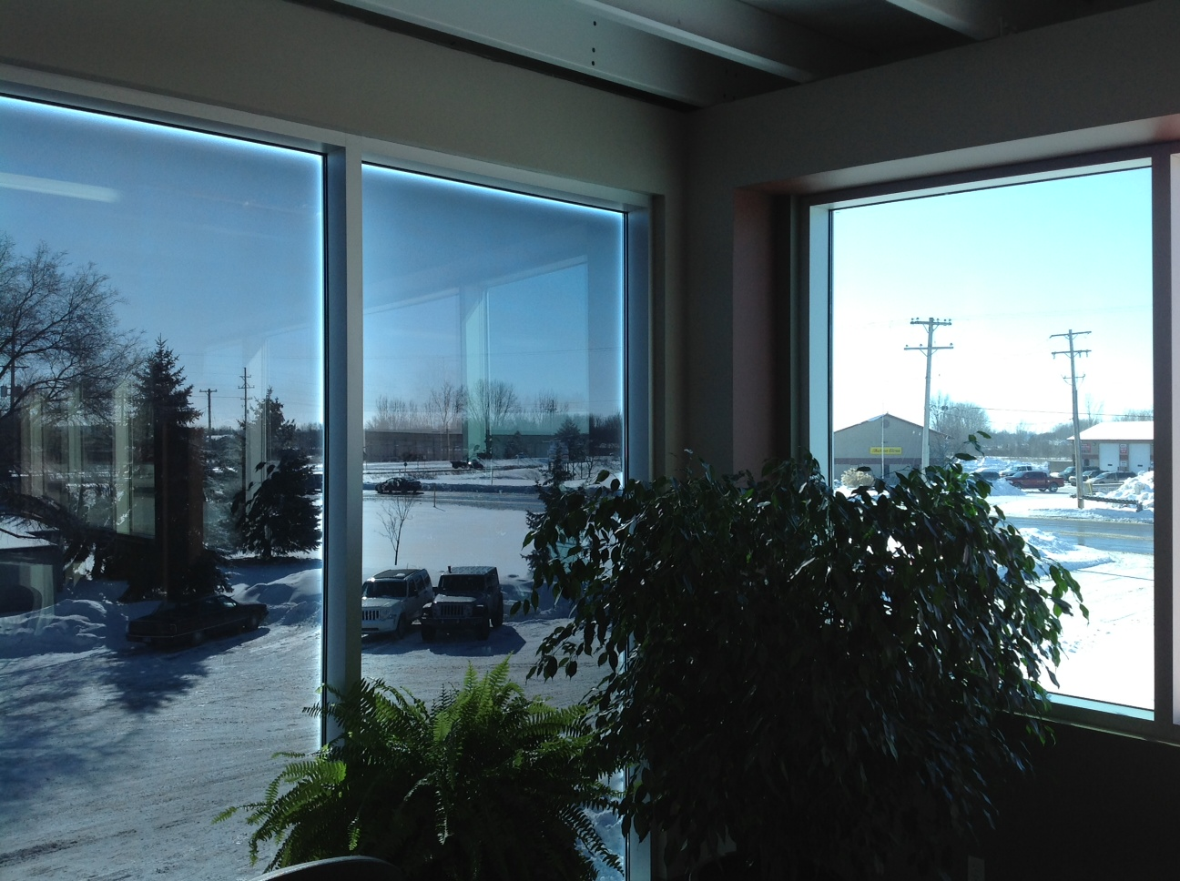
Thermochromic Tinting Effect at mid-day
West facing windows
South facing windows
Summary of GPD – 2015, J.Vitkala
Source: www.gpd.fi © Curtis Liposcak, Pleotint ,LLC
Office Building in Michigan

Slide 22
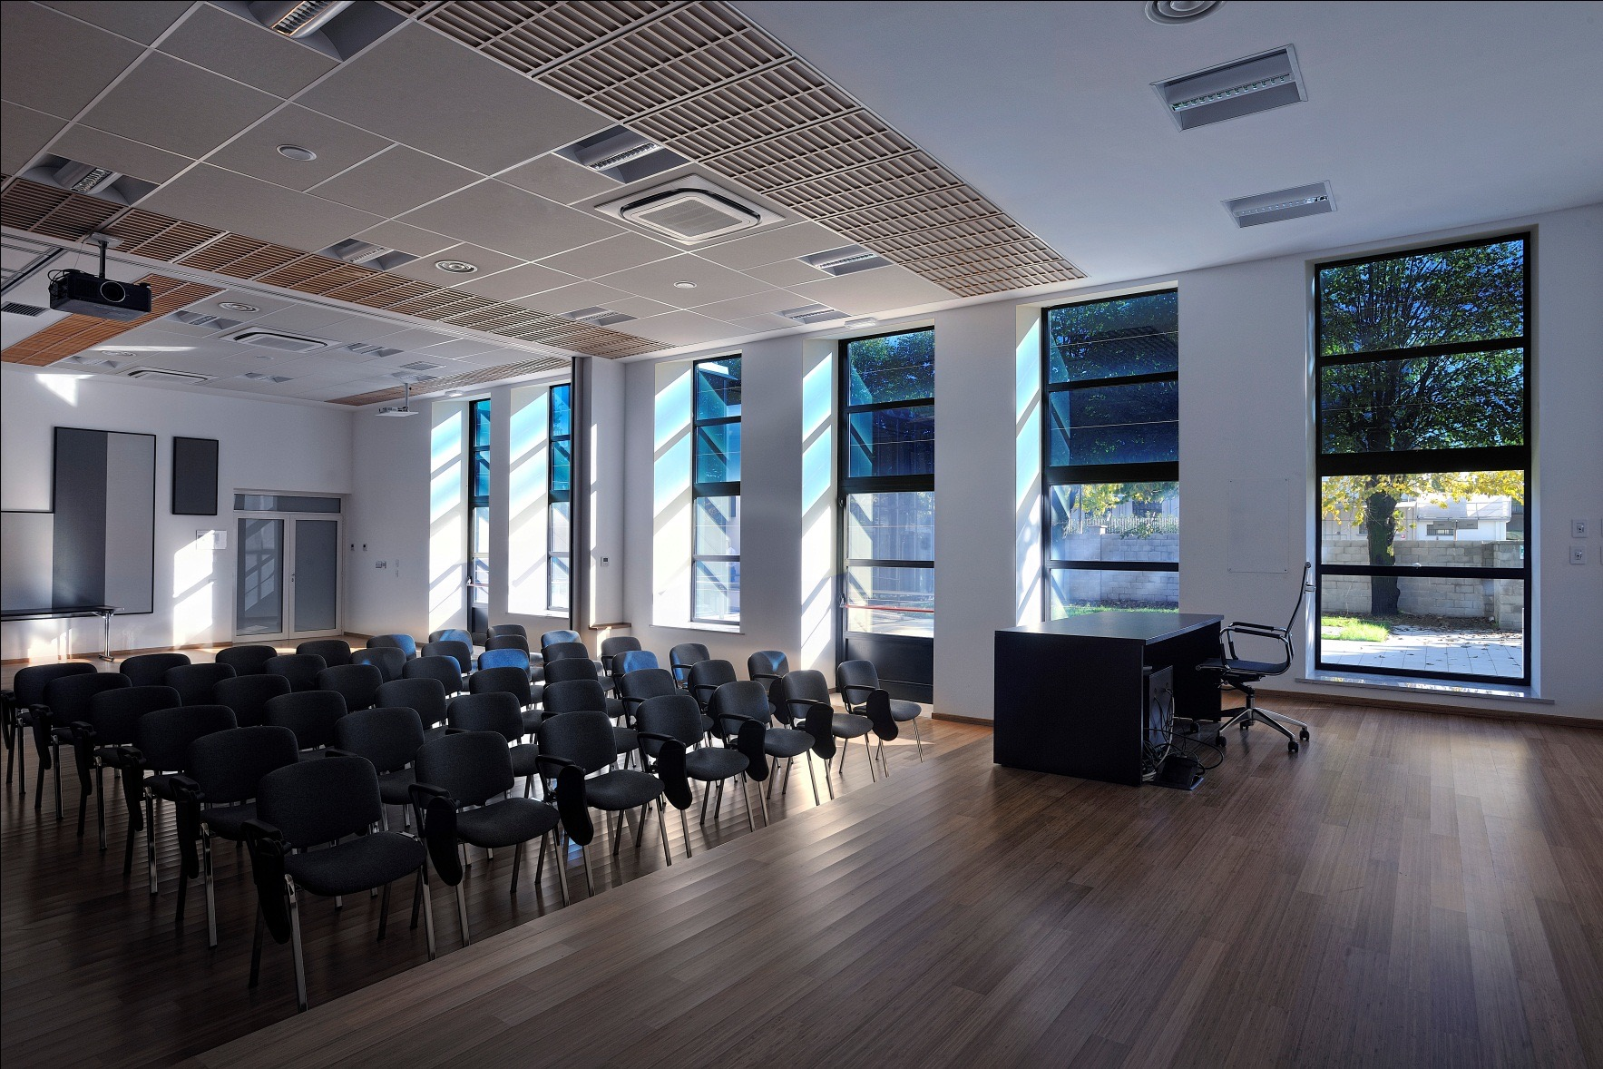
STEP 1
Dynamic Glare & Solar Control: Electrochromic glass
Summary of GPD – 2015, J.Vitkala
Source: www.gpd.fi ©Helen Sanders, SAGE & Pekka Hakkarainen, Lutron Electronics

Slide 23
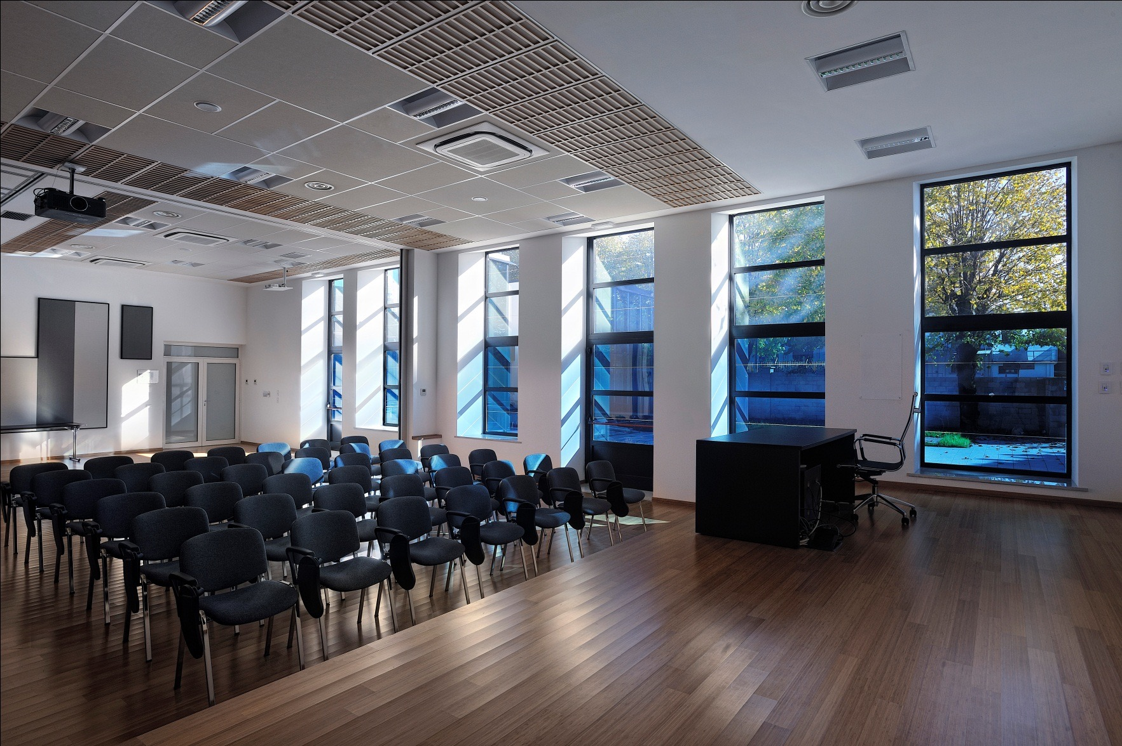
STEP 2
Dynamic Glare & Solar Control: Electrochromic glass
Summary of GPD – 2015, J.Vitkala
Source: www.gpd.fi ©Helen Sanders, SAGE & Pekka Hakkarainen, Lutron Electronics

Slide 24
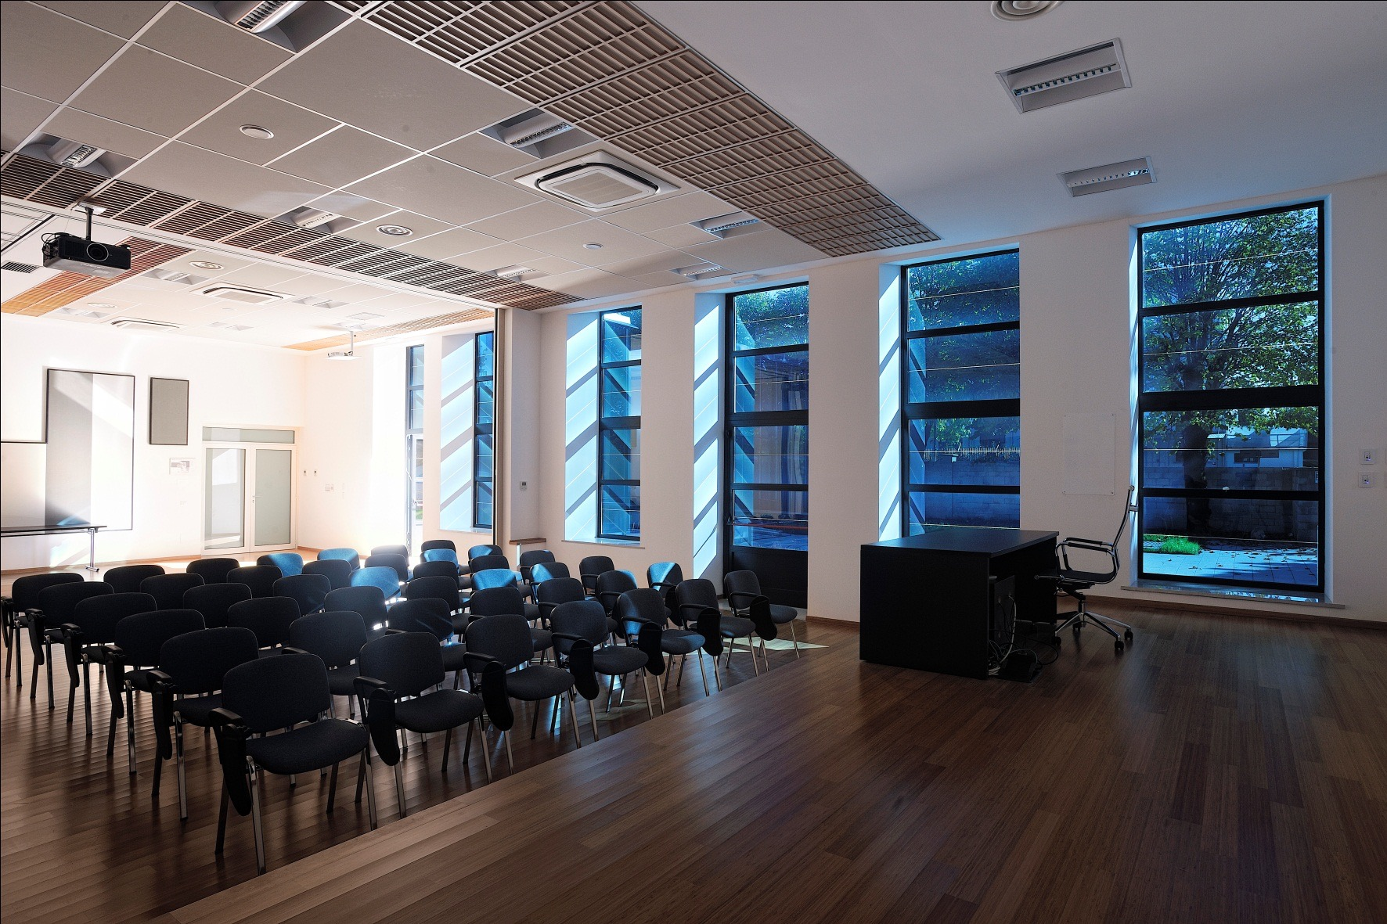
STEP 3
Dynamic Glare & Solar Control: Electrochromic glass
Summary of GPD – 2015, J.Vitkala
Source: www.gpd.fi ©Helen Sanders, SAGE & Pekka Hakkarainen, Lutron Electronics

Slide 25
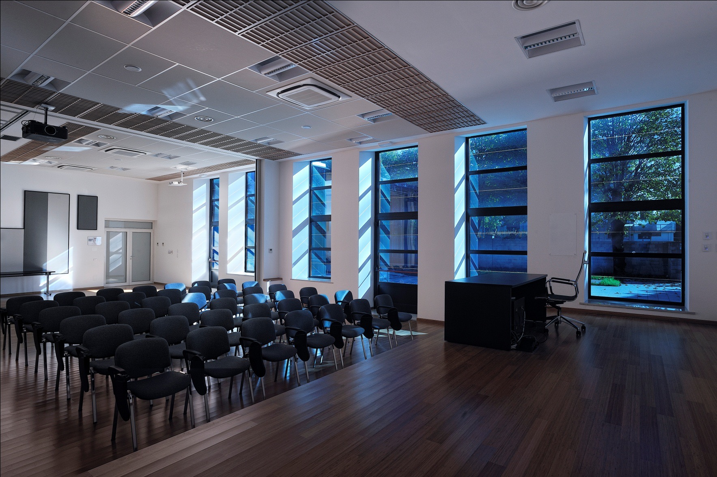
STEP 4
Dynamic Glare & Solar Control: Electrochromic glass
Summary of GPD – 2015, J.Vitkala
Source: www.gpd.fi ©Helen Sanders, SAGE & Pekka Hakkarainen, Lutron Electronics

Slide 26
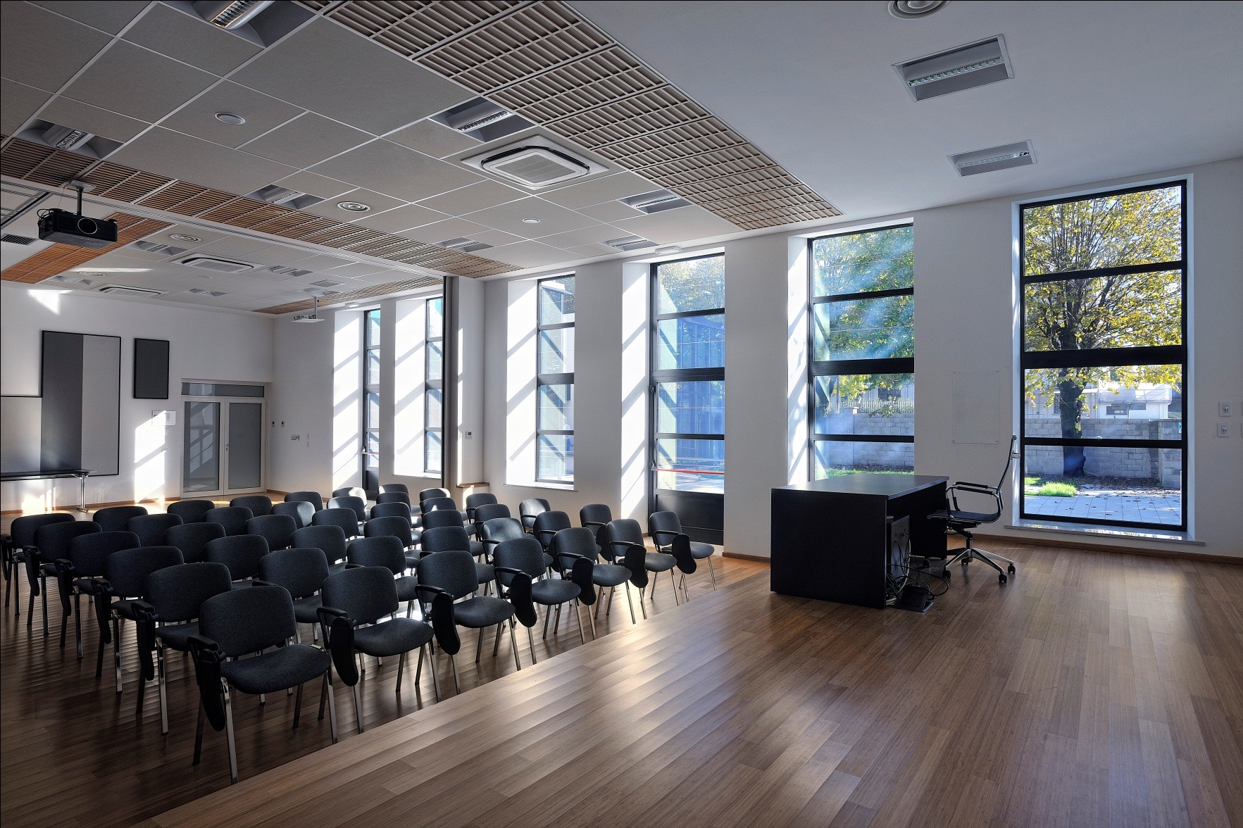
STEP 5
Dynamic Glare & Solar Control: Electrochromic glass
Summary of GPD – 2015, J.Vitkala
Source: www.gpd.fi ©Helen Sanders, SAGE & Pekka Hakkarainen, Lutron Electronics

Slide 27
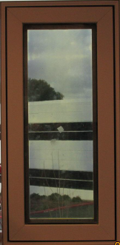
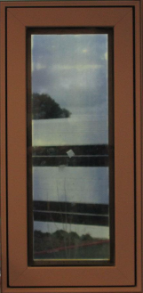
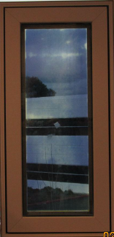
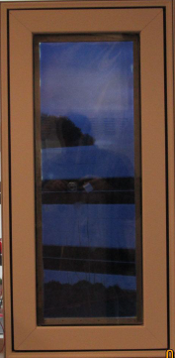
LCD Switchable Glass
Transmission can be varied by changing voltage
>60%
Transmission
50%
Transmission
40%
Transmission
<10%
Transmission
Summary of GPD – 2015, J.Vitkala
Source: www.gpd.fi © Damoder Reddy, Argil, Inc

Slide 28
Measuring gas concentration without breaking the IGU – even on triples
Coating
1
02
Placement of
the coated surfaces
makes a difference
in measurement
2
02
Coating
Summary of GPD – 2015, J. Vitkala
Source: www.gpd.fi © Miikkael Niemi, Sparklike
Notes:
Here is a standard triple glazed structure, where the purple line visualizes the laser beam entering the IG from the upper left.
Laser is focused into the IG, and then reflected back from the IG surfaces and DETECTED
We are measuring changes in laser signal caused by oxygen – not only the signal intensity
However, we are dealing with signal budget. So stronger signal equals to higher measuring accuracy, and vice versa.
Laser penetrates float glass well, but has low reflection
Coatings are cutting off the laser power, but reflect amazingly well, like mirror
This all makes the coating transmission and location important feature when considering the measurement
On triple, actually two measurements are made, and from these the results on different cavities can be separated
As a side product, very accurate thickness information on glass and spacers is received

Slide 29
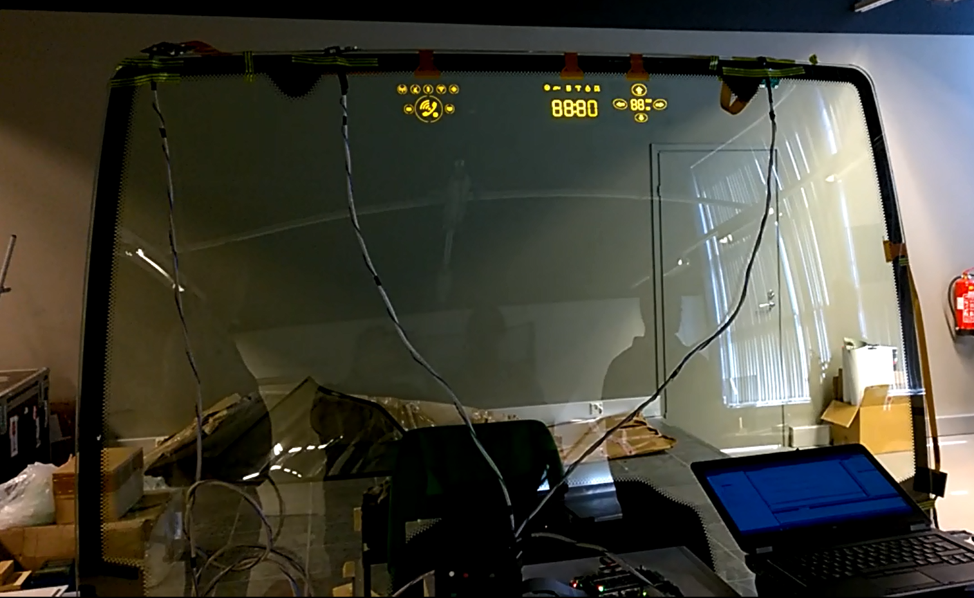
Picture from Pilkington
Summary of GPD – 2015, J.Vitkala
Source: www.gpd.fi © Gerald Smid
Beneq Products Oy

Slide 30
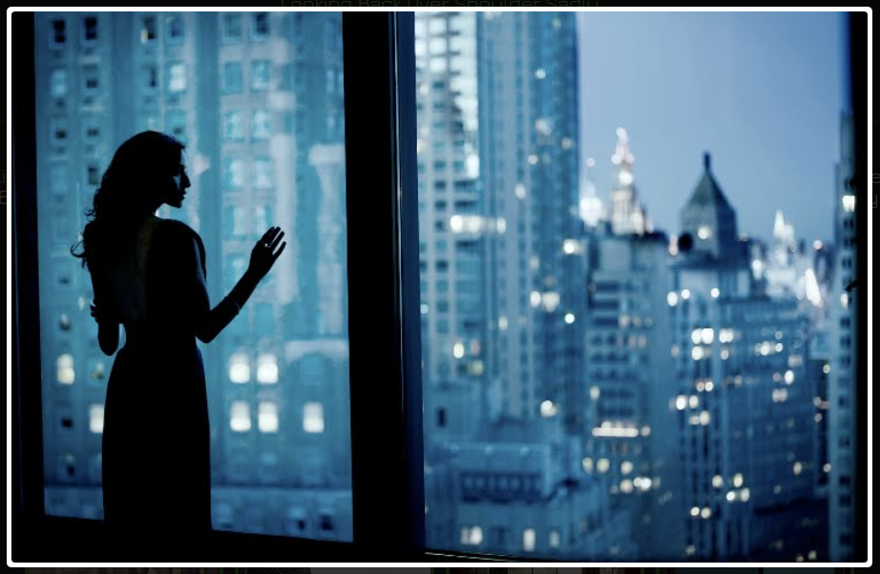
T_{out} 13 °C
H 57%
W 5 m/s
T_{fl} 8 °C
00 03 06 09 12 15 18 21 00 03
S
E
W
N
Summary of GPD – 2015, J.Vitkala
Source: www.gpd.fi © Gerald Smid
Beneq Products Oy

Slide 31
THIN GLASS & PROCESSING
Notes:
CLOSING SLIDE

Slide 32
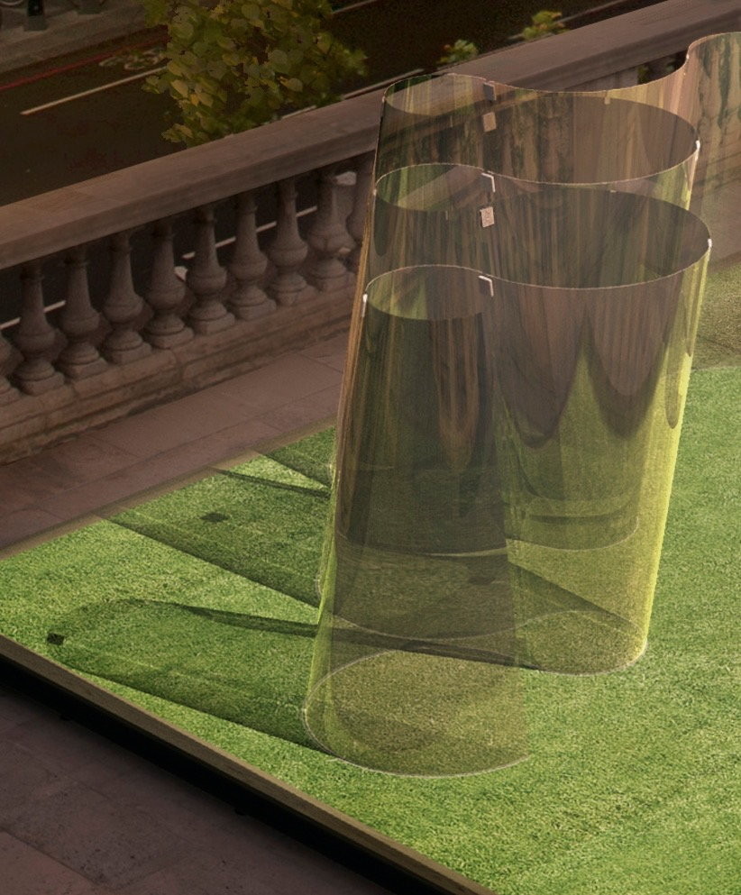
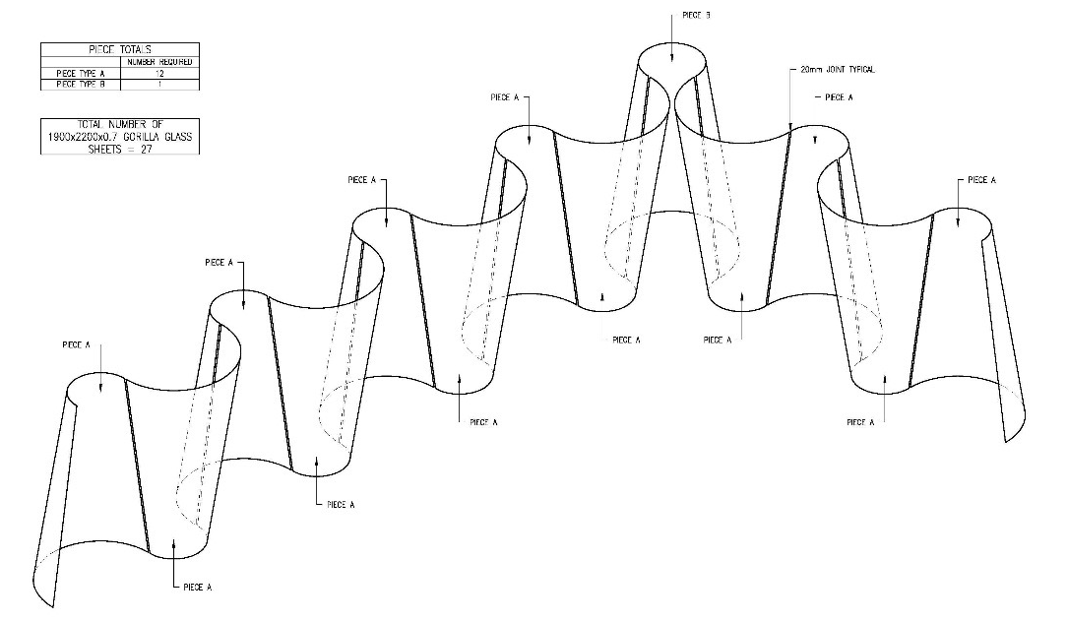
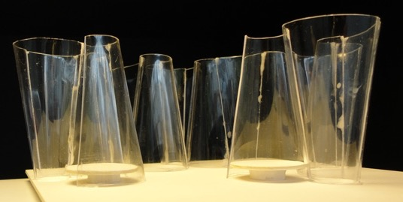
Summary of GPD – 2015, J.Vitkala
Source: www.gpd.fi ©Carpenter / Lowings Architecture & Design

Slide 33
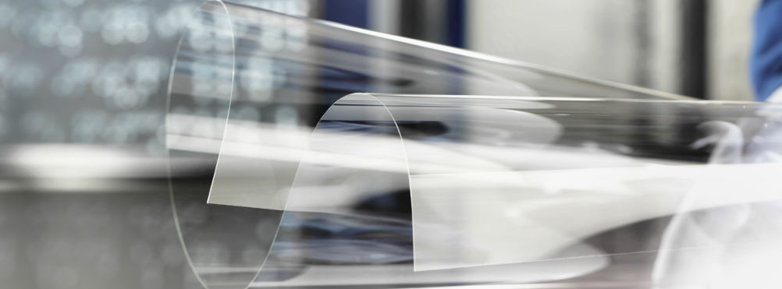
Thin Glass
Summary of GPD – 2015, J.Vitkala | Source: www.gpd.fi ©Jurgen Neugebaur | University of Applied Sciences, FH-Joanneum

Slide 34
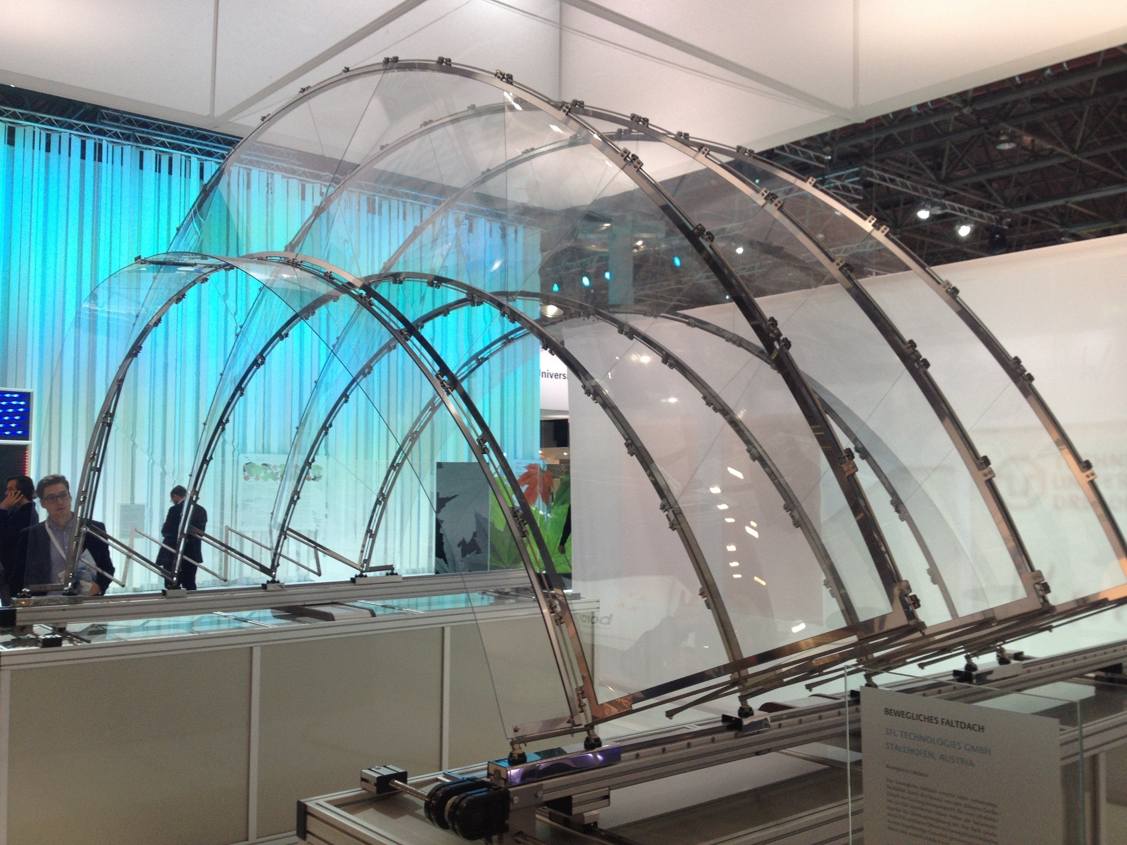
Summary of GPD – 2015, J.Vitkala
Source: www.gpd.fi ©Jurgen Neugebauer
FH-Joanneun
Glasstech 2014

Slide 35
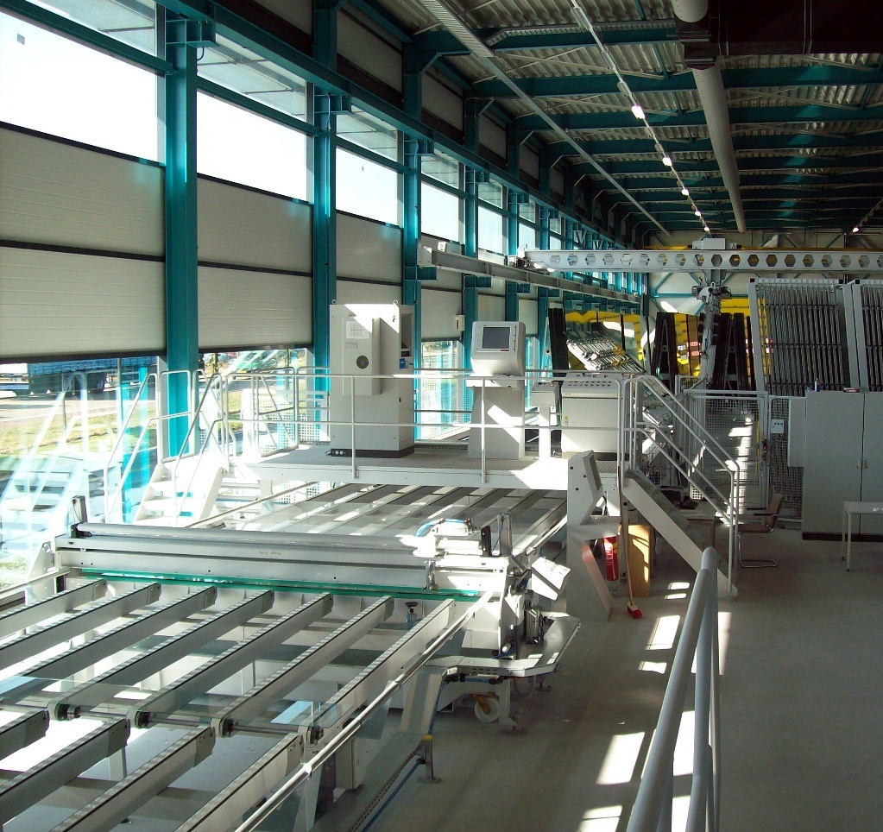
THIN GLASS
- what is it?
It needs to be avaliable for glass
units spanning floor to floor
The processor must be able to strengthen and laminate the glass,- with an aceptable visual quality
The glass product shall meet the requiremnts of product standards
1 ≤ 3 mm
Summary of GPD – 2015, J.Vitkala
Source: www.gpd.fi ©Hannes Spiss, Facade Engineering Arup
Notes:
Thin glass within the construction industry 1- 3mm.
WHY DO WE TALK ABOUT THIS NOW?

Slide 36
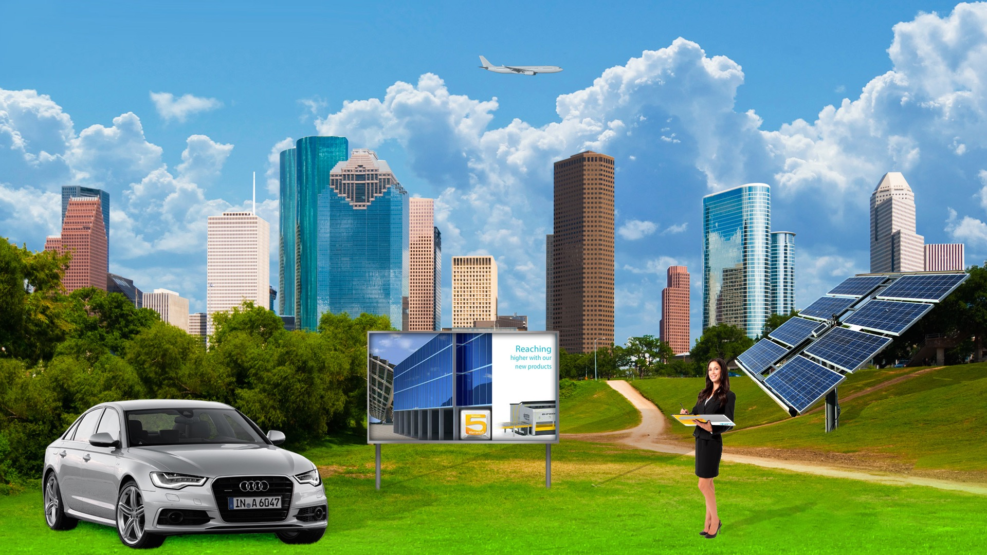
Lower transportation costs with thin glass
Switchable glazings
Thin cold-bend glass for more flexible shapes
Thinner and lighter fire resitant glasses (FRG)
Vacuum IG
Thin glass laminates
Thin IGs in e.g. cooler doors
Thin sidelites (2mm or 1,6mm+1,6mm): passanger + bus
2mm cover/back glasses
Summary of GPD – 2015, J.Vitkala | Source: www.gpd.fi ©Miika Äppelqvist, Glaston

Slide 37
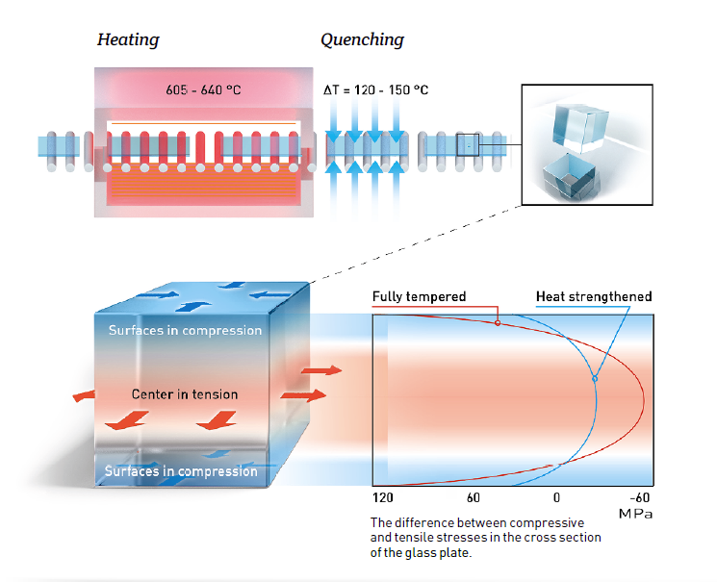
Challenge of thin glass tempering - Basics
Temperature difference between surface and the mid-part is about 120˚C and temperature of midplate is still over 610˚C
  The thinner the glass, the faster and more efficient the surface cooling has to be
  To create ovet 15pcs fragmentation in 5cmx5cm area the surface compression level should be over 120MPa.
Summary of GPD – 2015, J.Vitkala | Source: www.gpd.fi ©Miika Äppelqvist, Glaston

Slide 38
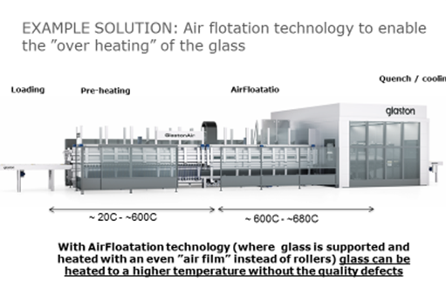
Summary of GPD – 2015, J.Vitkala | Source: www.gpd.fi ©Miika Äppelqvist, Glaston

Slide 39
THICK AND LARGE GLASS
Notes:
CLOSING SLIDE

Slide 40
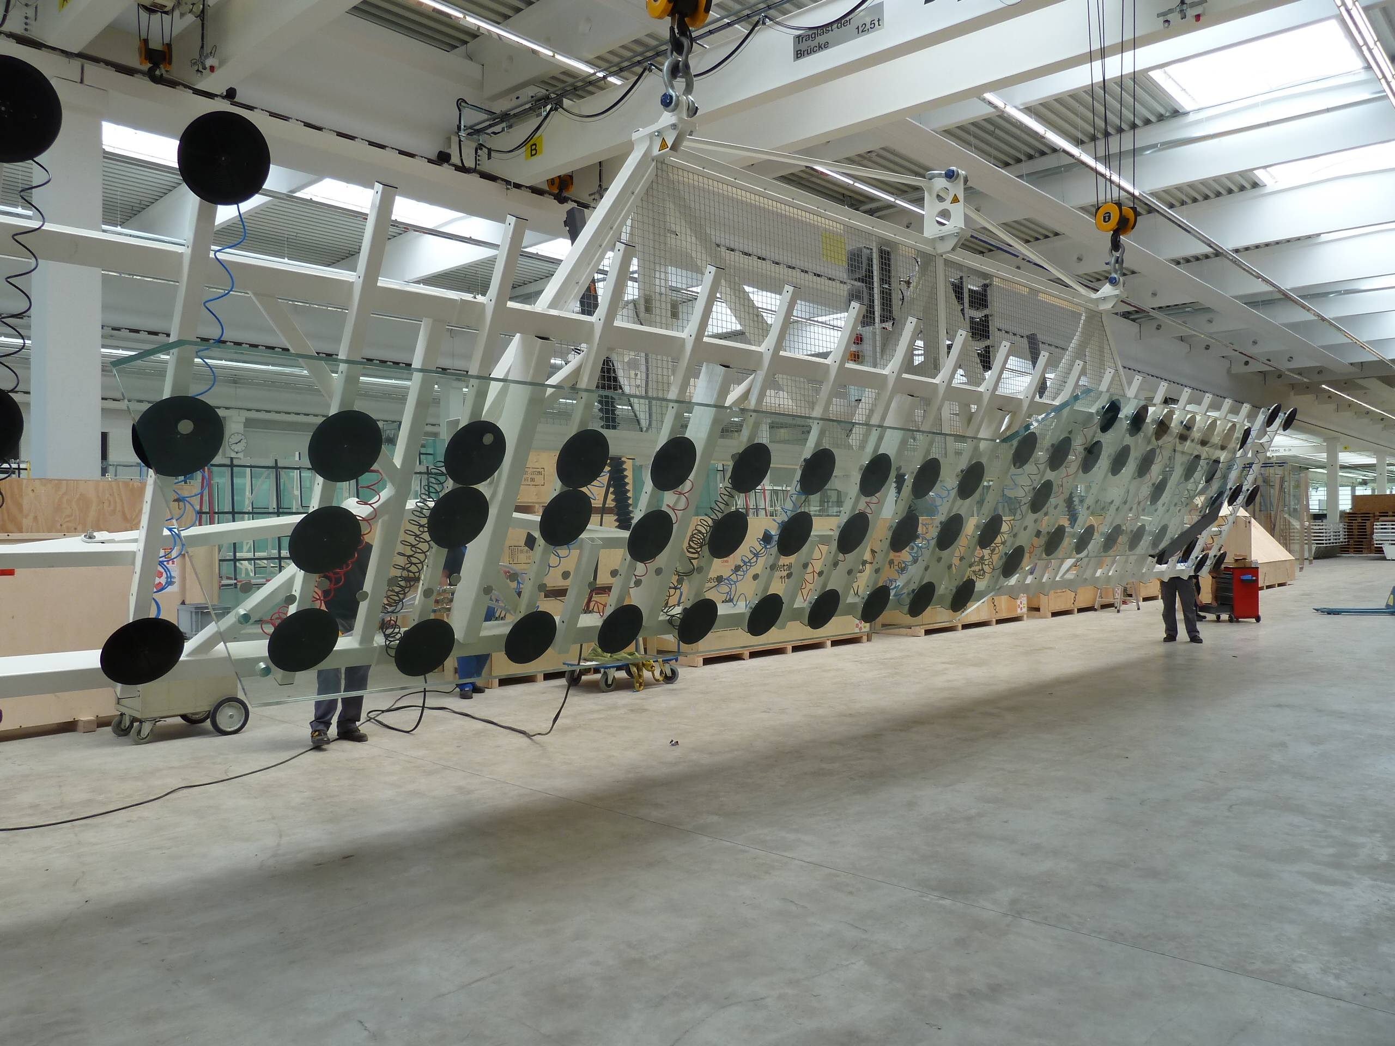
When Glass Becomes Bigger, Handling Requires Special Attention
Summary of GPD – 2015, J.Vitkala
Source: www.gpd.fi ©James Ocallaghan,
Eckersley O’Callaghan

Slide 41
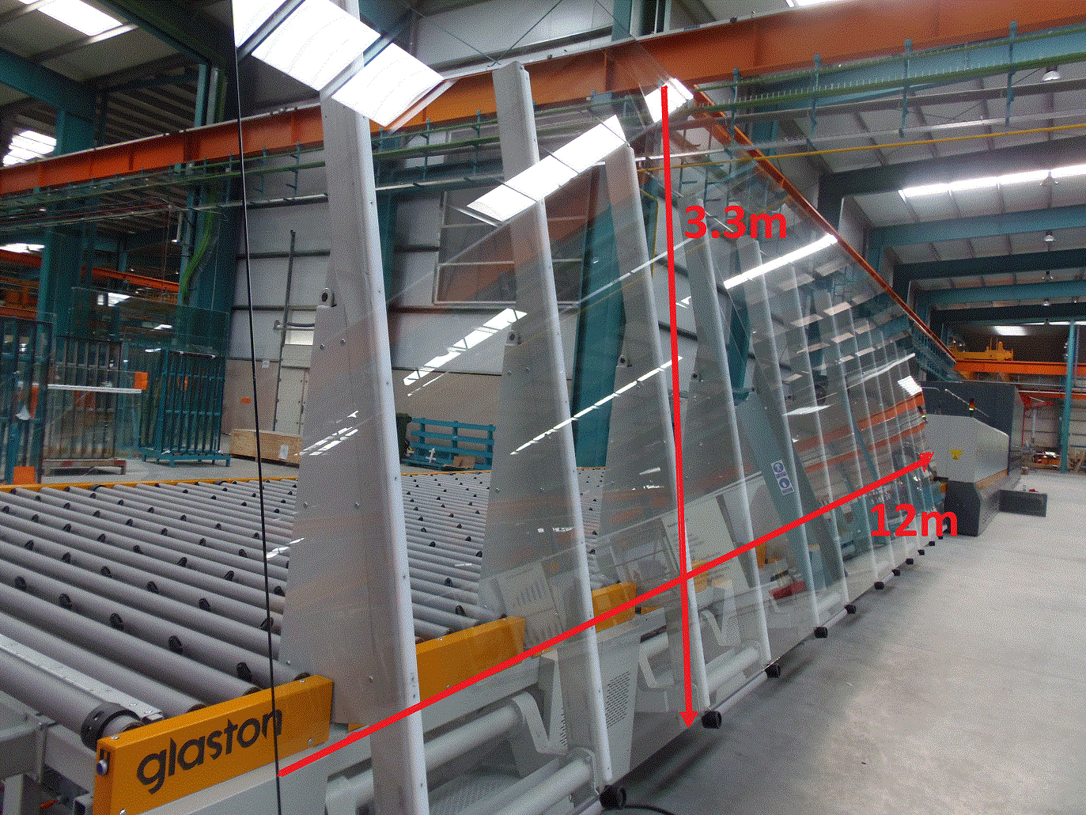
Large glass needs special handling equipment -
Tvitec Spain
Summary of GPD – 2015, J.Vitkala
Source: www.gpd.fi ©Tvitec

Slide 42
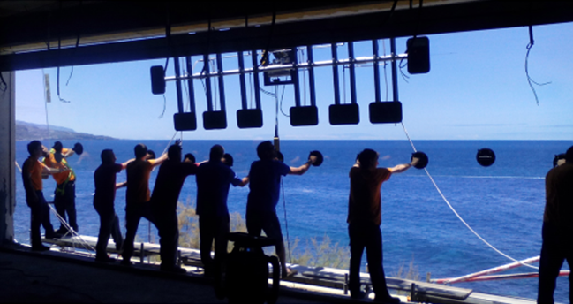
Handling large glass is especially challenging
Summary of GPD – 2015, J.Vitkala
Source: www.gpd.fi ©Tvitec

Slide 43
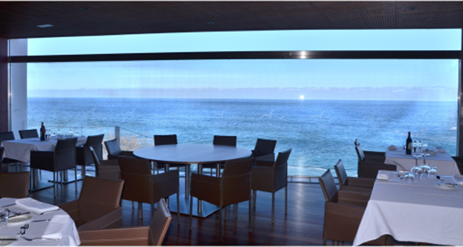
But once done, large uniform glass offers
uncomparable views
Summary of GPD – 2015, J.Vitkala
Source: www.gpd.fi ©Tvitec

Slide 44
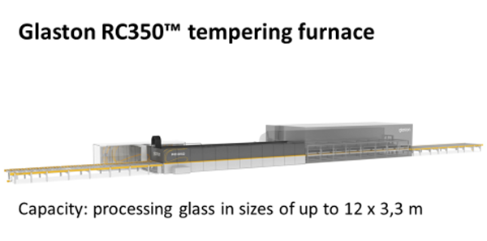
Summary of GPD – 2015, J.Vitkala | Source: www.gpd.fi ©Miika Äppelqvist, Glaston

Slide 45
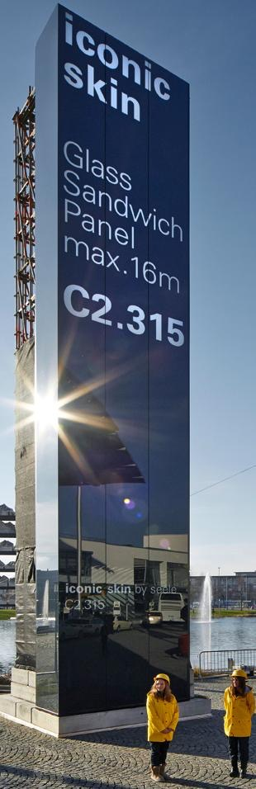
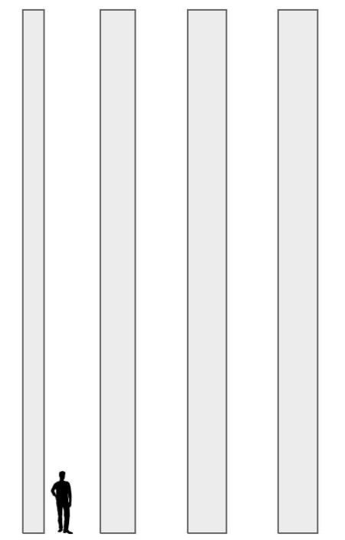
Introduction
… A new facade system
iconic skin glass sandwich panel
pre-fabricated building component
cost-efficient glass façade
coated HS glass
flush surface
up to 15 m long
600, 1000, 1100, 1150 mm wide
vertical or horizontal
openings / windows
invisible fixings
shadow gap
max 15 m
Summary of GPD – 2015, J.Vitkala
Source: www.gpd.fi © Dr. –Ing. Martien Teich, Seele GmbH

Slide 46

The Ion-Exchange Process
ION SOURCE
Glass Matrix
Kinetic transport in glass matrix
Surface Thermodynamic Equilibrium
Process t >> τ
Summary of GPD – 2015, J.Vitkala | Source: www.gpd.fi ©Guglielmo Macrelli, Isoclima SpA

Slide 47

Summary of GPD – 2015, J.Vitkala | Source: www.gpd.fi ©Guglielmo Macrelli, Isoclima SpA

Slide 48
SOLAR
Notes:
CLOSING SLIDE

Slide 49

Ballasted system
Summary of GPD – 2015, J.Vitkala
Source: www.gpd.fi ©Jim Gulnick, McGrory Glass, Inc.

Slide 50

Actual view
Summary of GPD – 2015, J.Vitkala
Source: www.gpd.fi ©Jim Gulnick, McGrory Glass, Inc.

Slide 51

Monitoring Solar Project
Summary of GPD – 2015, J.Vitkala
Source: www.gpd.fi ©Jim Gulnick, McGrory Glass, Inc.

Slide 52





WELDED GLASS CONNECTIONS
Fully transparent glass connections
To simulate the automated process manually, glass is manually welded in layers
Summary of GPD – 2015, J.Vitkala
Source: www.gpd.fi ©James Ocallaghan, Eckersley O’Callaghan
AM glass, PhD research at Facade Research Group,TU Delft, Lisa Rammig

Slide 53

Redirecting the light
Lightdistribution
Source: GPD.fi © Frank Schneider, Okalux

Slide 54
Function of reflective blinds
Type O: intro-reflective
Type U: retro-reflective
Source: GPD.fi © Frank Schneider, Okalux
Notes:
Check also Place!
Daylight?

Slide 55


Slide 56
WWW.GPD.FI
Jorma.vitkala@gpd.fi +358 40 553 2042

