Slide 1

2026 Check list for posters
The poster presentation
A short, max 1-min introduction pitch
A physical poster at the venue size A0 (84 x 119 cm), portrait orientation
The poster should contain
FINMARI logo (if possible)
Information on the research infrastructure, which has been used for the work
Collaboration with FINMARI institutes (if any)
For the poster pitching session, please send us a one-slide PP of your poster, using the model template slide attached here, to be presented in a 1-min poster pitch, no later than Tuesday 17.3. 2026 12:00 o´clock to finmari@utu.fi. Please, name the file as “poster_your lastname_your first name.pptx”

Slide 2
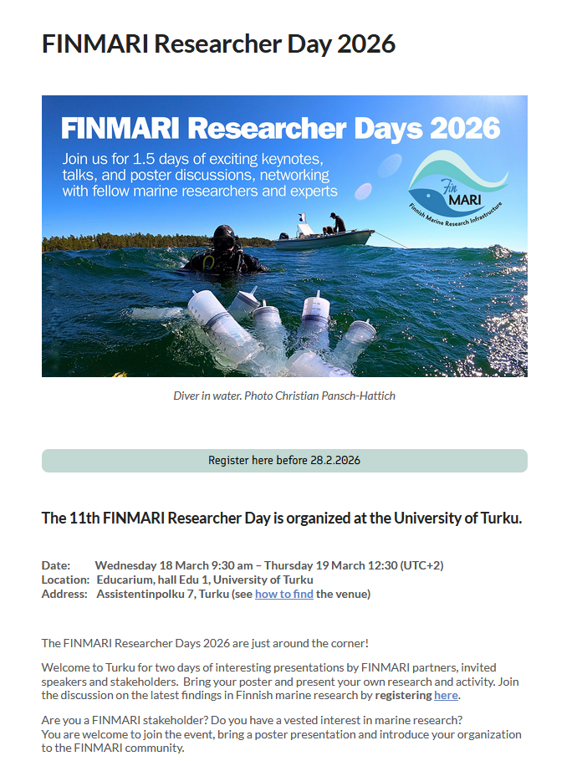
Poster title
Authors
Institution(s)
put here the main
points and the
message of
your poster
…
…
…
…
…
Add here a picture of your poster

