Slide 1
Matti Väänänen, Patrik Wikström | 23.05.2019
Showcasing DigiaFramework Web UI

Slide 2
Content of the presentation
DevOps Culture in Digia
DigiaFramework Web UI
Web UI Features
Web UI Components
Frontend Architecture
Mobile Support
Demo 1
Backend Architecture
Backend Implementation
DatasetModel
DevOps Tools
Infrastructure as Code
Cloud Delivery
Demo 2

Slide 3
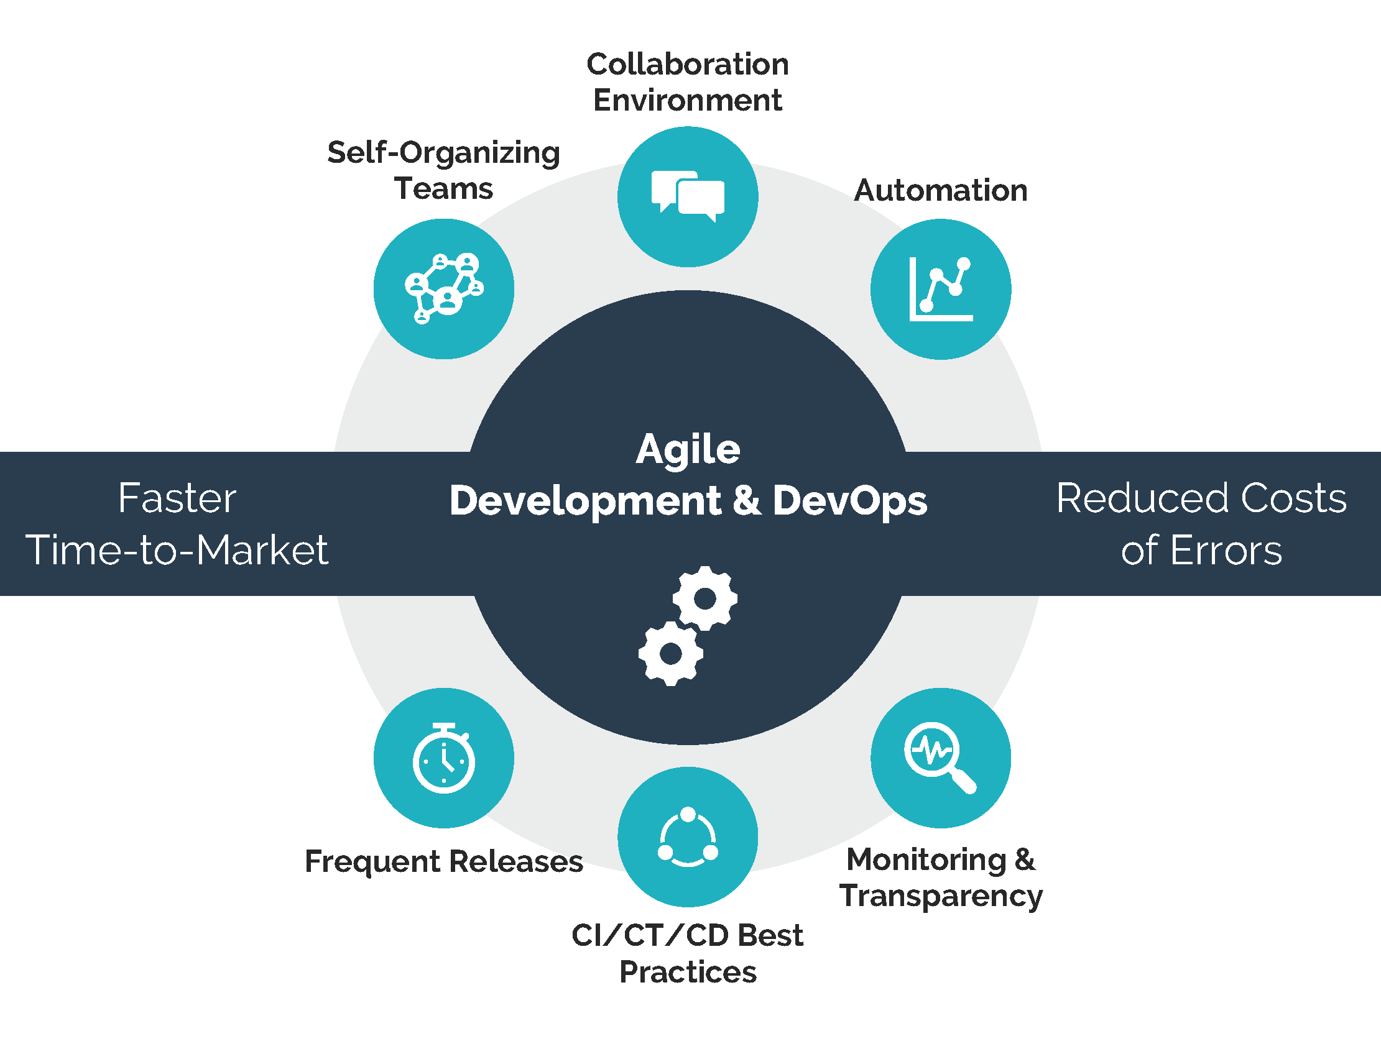
DevOps Culture in Digia
Previously
Development
Large teams, big releases, bug fixing, manual deployment and manual testing
Operations
Manual installations, maintenance, react to problems after they occur
Today - DevOps in Digia
DASA DevOps Fundamentals certifications
Smaller teams. Work as autonomous teams
Many smaller releases. Can release anytime
Emphasize on testing features. Test early
Build and deployment automation
Unit & robot tests
Infrastructure as code
Aim for continuous improvement. Monitor everything
Notes:
- Development
- Formerly separate dedicated teams for developing application features and handling servers and installations
- Manual testing late in the development cycle.
Today
DASA: DevOps Agile Skills Association
End to end responsibility
Autonomous teams:
Multi-talent members. Platforms as own team
Scrum, sprints, sprint demo
Hackathons
Many smaller releases instead of larger release. Testing. Test features not releases (test early)
Build & deployment automation
Better pipelines
Test coverage, code quality (SonarQube/Sonarlint)
Unit & robot tests
Test early and less manual testing
Infrastructure as code
Aim for continuous improvement
Aim for preemptive (monitoring etc.)

Slide 4
DigiaFramework Web UI
DigiaFramework
Web UI
Provides a platform for implementing application business services
Serves Menus, Views, Users/Roles/Security and session data for any frontend
Serves files of any type to any frontend
Reuse of existing functionality
Provides User Interface which automatically reflects to changes
Connects to backend via APIs
Set of reusable Components which can be used in any View via parameterization
Views are described in JSON format
Components get data from Data Sources
Notes:
DigiaFramework (DF):
Serves business services through a service interface layer. Business services consists of Business Entities, Business Tasks and Business Workflows.
The menu structure data, view structure data and files of any type are served for any frontend capable of calling REST-services
The DigiaFramework stores user information like user roles and authorization rules in its Tools database
Makes it possible to reuse existing functionality by using wrapping and other methodologies. Reuse of our 20+ years on Enterprise Tools framework code.
Web UI:
Makes it possible to represent various different kind of use cases with the same Web UI framework via parameterization
All Web UI features are made generic so they can be reused by different customers and use cases
Makes it possible to create a reusable View and Data Sources for the View and its Components
Work is done only once in frontend, less coding

Slide 5
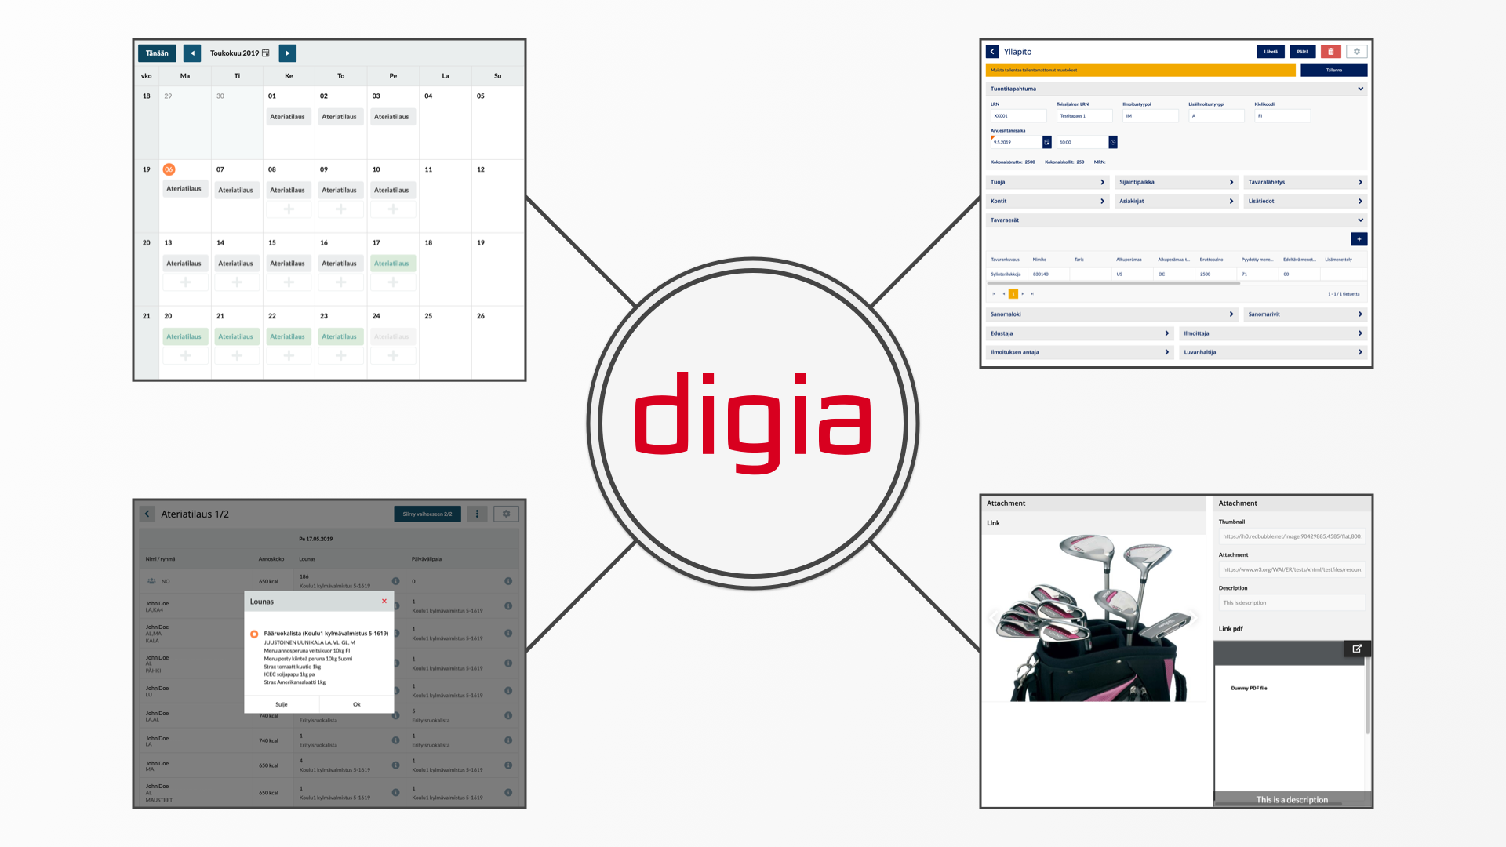
DigiaFramework Web UI
Notes:
Showcasing some of the different views Frontend can already handle.
From top row to bottom:
Scheduler view
Complex maintenance view with dynamic data
Modals with selections and dynamic data
Attachments

Slide 6
Web UI Features
Customer specific themes and styles
Localization
Views
Menus
Micro components
CRUD functionality
Custom (invokable) methods
Lookups and modals
Data Sources
JSDO
Business Entities
Business Tasks
REST support
Custom endpoints
JSON Web Token
Attachments
Automatically tested web browsers
UI Debugger
View Designer
View Maintenance
Responsive web design
OWASP mapping done in 2018
Notes:
The JSDO is a client side typescript library for Progress Data Object Services published by Progress Software Corporation. Its purpose is to provide an easy to understand API for querying, creating, updating and deleting Progress Data Objects as well as invoke server side business logic. The JSDO is a free and open-source full-featured implementation that can be used in web, mobile web and hybrid mobile apps.
JSON Web Tokens are an open, industry standard RFC 7519 method for representing claims securely between two parties.
The Open Web Application Security Project (OWASP) is an online community that produces freely-available articles, methodologies, documentation, tools, and technologies in the field of web application security

Slide 7
Web UI Components
Layout
Micro Component - Button Group
Micro Component - Stack Layout
Micro Component - Tab
Micro Component - Tab Group
Complex
Micro Component - Barcode Reader
Micro Component - Dynamic Frame
Micro Component - Grid
Micro Component - Grid Group
Micro Component - Link
Micro Component - List View
Micro Component - Scheduler
Micro Component - Tree View
Micro Component - Upload
Input
Micro Component - Action Button
Micro Component - Checkbox Group
Micro Component - Datepicker
Micro Component - Dropdown
Micro Component - Multi-select
Micro Component - Number Input
Micro Component - Radiobutton Group
Micro Component - Text Area
Micro Component - Text Input
Micro Component - Text Label
Micro Component - Typeahead
Notes:
Based on Kendo UI for Angular library
Reusable

Slide 8
Frontend - Architecture
Customers
Browser
Mobile
User Interface
Git, Gitlab, CI/CD pipeline, TsLint, Typescript
JSDO / REST
Angular
Kendo
Docker
Backend services
Notes:
High-level architecture view of Frontend.
Docker container is build and tested in GitLab CI pipeline, same container goes to production
Containers are run either on Docker Swarm or in Kubernetes Container Platform
Kendo UI for Angular is used as the UI Component library
Frontend uses JSDO and REST Data Sources to communicate with backend services
Also other JavaScript libraries are used, like RxJS.
RxJS is a library for reactive programming using Observables, to make it easier to compose asynchronous or callback-based code.

Slide 9
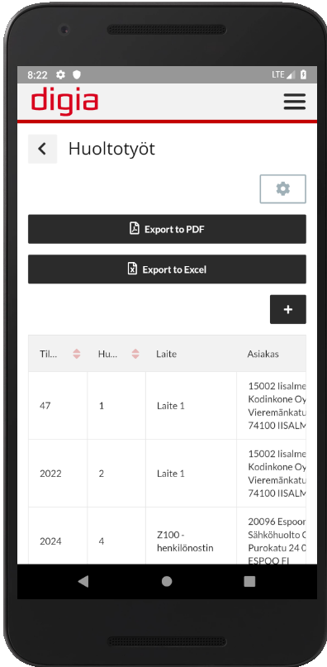
Mobile Support
Progressive Web App (PWA)
https://developers.google.com/web/progressive-web-apps/
Web application which imitates native app
Installed to Home screen
Enables limited hardware support and functionality like offline support
Uses Service Workers
Uses same codebase
Designed for touch screen
Scalability
Notes:
- Progressive Web App
Progressive web applications (PWAs) are web applications that load like regular web pages or websites but can offer the user functionality such as working offline, push notifications, and device hardware access traditionally available only to native applications. PWAs combine the flexibility of the web with the experience of a native application.
- A service worker is a script that your browser runs in the background, separate from a web page, opening the door to features that don't need a web page or user interaction, like push notifications.

Slide 10
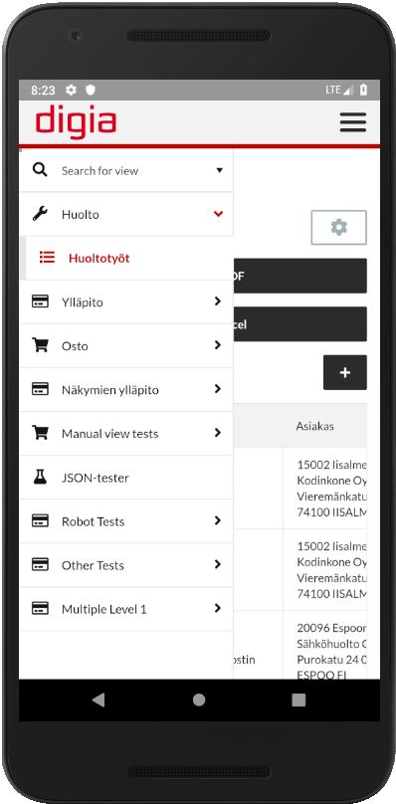
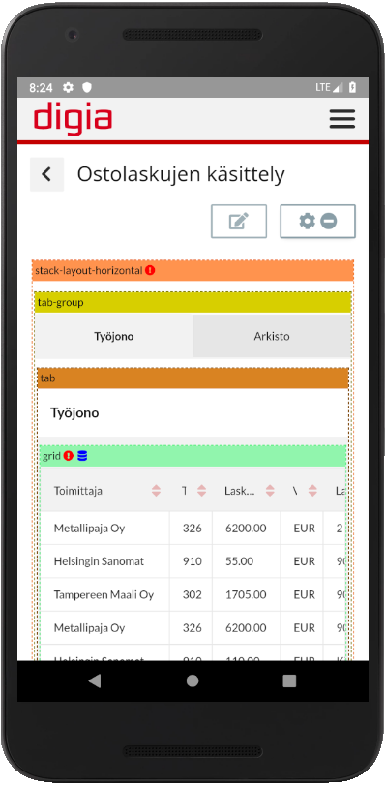
Mobile Examples
Notes:
Different mobile Views

Slide 11
Demo 1

Slide 12
Backend - Architecture
Customers
Browser
Mobile
Analytics
3. Party system
Service Interface
Digia Framework (including Smart Component Library)
Business Entity (BE) -
Business Logic
Application Logic
Data Access (DA) – Datasource Interface
Database – Cloud / MS SQL / OpenEdge / REST services / …
Notes:
The DigiaFramework is based on the OpenEdge Reference Architecture (OERA)
The architecture makes it possible to combine services from many of our application into new services and products.
We can, on the other hand, more easily develop parts of our application

Slide 13
Frontend – backend communication (JSDO & REST)
Service interface
Data transformation
Browser
JSDO
Service Adapter
JSON
ProDataSet
Mobile
RESTful
Service Adapter
JSON
Notes:
Picture
The frontend talks to the backend through different service adapters like JSDO and RESTful
The data is in JSON format and the backend service interface is transforming the data into ProDataSet format for the backend business components
Authorization is also handled for every call

Slide 14
Backend implementation

Slide 15
Backend implementation
The Digia backend service platform is called DigiaFramework
DigiaFramework conforms to OERA and builds on top of the SmartComponentLibrary and Enterprise Tools
The framework can be separately delivered when building/modernizing any Progress application
The services are exposed through Webhandler implementations (the Service Interface layer)
Common infrastructure services are serving all the applications layers
Notes:
DigiaFramework (DF)
Utilizes SmartComponentLibrary
Integration of Enterprise Tools features like inheritance, automation chains and validations etc.
Webhandlers serves UI/service consumers with View & menu data, Reports (PDF/HTML etc.)
Common infrastructure: Translation Manager, Helper classes (Object creation, JSON, ProDataSet/Buffer handling, Configuration etc.)
These can be mentioned
- We are, of course, also using Service Adapters and Service Interfaces etc. But not all are presented on these slides

Slide 16
Business entity – general info
Business data object defining the data using a logical schema
Represents the data in the way best suited for the service consumer needs
Stateless – performs every call in a single transaction
Mainly includes CRUD (create, read, update, delete) operations
DigiaFramework features
New record initialization routine
Data inheritance support
Automation chain operations support
Query language enhancements (find some father records filtering by child field values)
Notes:
Business Entity
The Business Entity defines the data using a logical schema, typically defined as a ProDataSet with one or more ABL temp-tables, which represents the data in the way best suited to the needs of the business logic, and to the user interface and other Service Requesters, regardless of how the data happens to be stored in a database or other source
Should be stateless, perform every call in a single transaction
The Business Entity should mainly be about the data model and the CRUD operations with very few (invokable) methods
Business Entity enhancements made in DigiaFramework. For example:
Common Initialize-method for initializing new temp-table records before saving them into the DB. The initial values of the record can be fetched from the database/by other means or using the Tools inheritance feature
Support for some of the Enterprise Tools main features
Calling inheritance methods
Calling automation chain events
Validations during update/save
Query enhancements (own ABLFilter syntax) for child table level filters on father table records in multi-level Business Entity table structures hierarchies

Slide 17
Business entity – best practices
Small enough business entities. Less tables is probably a better choice
Focus on the data that the business entity manages. Don’t create dependencies
Add additional tables needed by the consumer (read-only!) or call other business entities to fetch data into calculated fields
Do not update data through other business entities. Use business tasks to separate the concerns (SOLID)
Be aware of possible performance issues when calling into other business entities
Notes:
BE best practices
Keep the BE’s small enough. As a starting point, only add tables that can’t function without a parent record like sales order & order lines and invoice & invoice lines.
Only add methods handling exactly the data the BE is holding. Use Business Tasks in other cases
Use Business Tasks to separate the concerns (SOLID principles).
Add read-only temp-tables or call other BE’s to retrieve data into calculated fields BUT never update data using another BE!
Be aware of possible performance issues when using other BE’s to fetch additional read-only data

Slide 18
Business task
Handles complex business logic concerning several business entities. Serves the special needs of the service consumer (UI/some other)
The “use case” object
Represents the data in the way best suited for the service consumer needs
Stateless – performs every call in a single transaction
Should probably only contain a few methods to call
Best practices
Keep it simple and small, extract code to child classes to keep the program logically structured and easy to maintain
Don’t try to replicate all CRUD methods using a business task
Only one reason to change (by a person from financial, production, DBA etc.)
Notes:
Business Task
If complex business logic needs to access data in multiple Business Entities, you can represent this as a Business Task, a higher-level Business Component that can access and update data through other components
Should be stateless, perform every call in a single transaction
Like the BE also has a logically defined schema
This is often called a “use case” object
Used to serve a very special need for the client, be it UI or some other consumer of the service
Should have very few methods, often one or two
BT best practices
Keep it simple and small, extract the code into child classes to keep the program logically structured and easy to maintain
Don’t try to replicate all CRUD methods using a BT, use a BE to do CRUD.
Only one role of people (financial, DBA etc.) should have a change request made concerning a single BT. This keeps the module maintainable and more clean. Feel free to duplicate code if that requirement is not met(!)

Slide 19
Business workflow
Handles long-running business processes
Stateful. A workflow doesn’t have the same requirement as the BE and BT to complete in one single transaction
Could be implemented like a business task (technically)
Notes:
Business workflow
If you need to represent a long-running business process that may be executed in a series of independent transactions, and that must maintain its own state information in between those steps, you can build this as a Business Workflow
Stateful. A workflow doesn’t have the same requirement as the BE and BT to complete in one single transaction
The technical implementation might be the same as the one for the Business Task

Slide 20
DatasetModel coding interface
Notes:
We have a static temp-table and ProDataSet.
The problem with this is that it has a too large scope and isn’t encapsulated in any way by default.

Slide 21
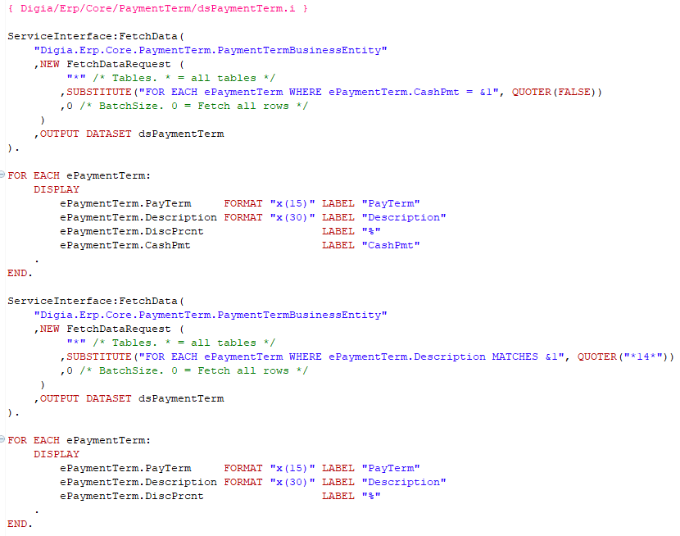
DatasetModel - continued
Notes:
We call the BE through the service interface. The challenge with this one is the static ProDataSet & Temp-table definitions.
Notice that the second FetchData call empties the data from the first call.

Slide 22
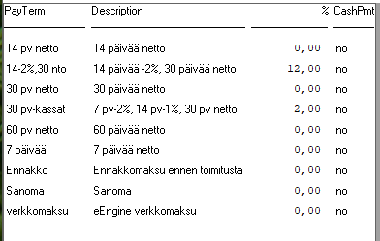
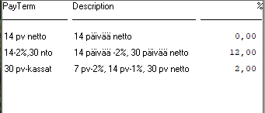
DatasetModel - continued
Notes:
The result using the different techniques is the same.

Slide 23
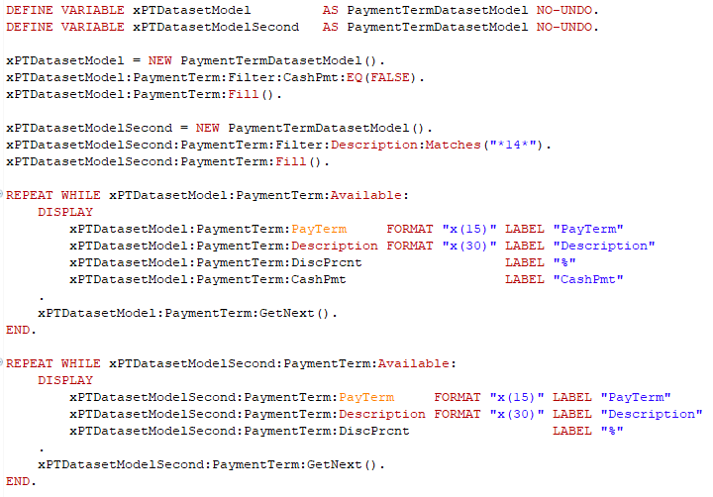
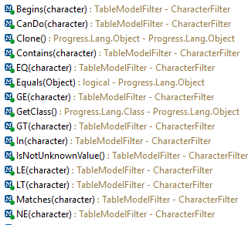
DatasetModel - continued
Notes:
We call the BE through the DatasetModel interface. In this case we have encapsulated the static ProDataSet & Temp-table definitions into the Model and have a nice interface for the developer to use and we can also help the user when he/she is using the DatasetModel (Code completion = Ctrl + Space).

Slide 24
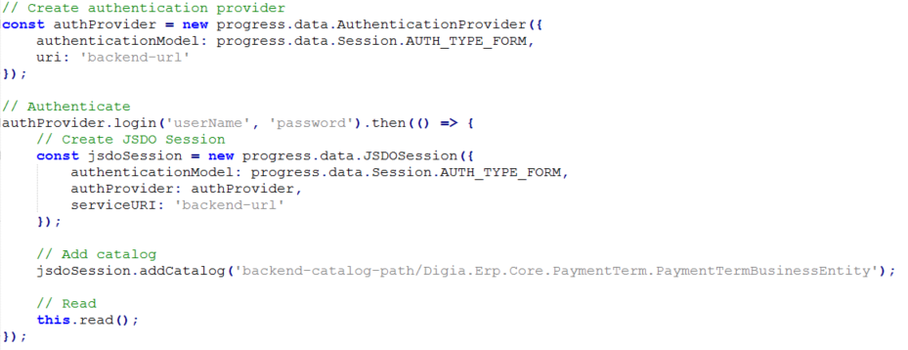
JSDO Read Code Example 1/2
Notes:
TypeScript example of using JSDO to read data from backend.
Assuming a JSDOSession has been created and user is authorized.
A catalog can be added and a Data Object resource accessed via JSDO instance.
The Progress Data Service Catalog is a JSON file that describes the schema for one or more Data Object resources and the operations that can be invoked on these resources by the client.

Slide 25
JSDO Read Code Example 2/2
Notes:
Read operation.
Calling fill method in JSDO has a callback to afterFill method.
Fill is executed asynchronously and returns results in callbacks that you register using methods of a Promise object returned as the method value.

Slide 26
DevOps Tools
Git & GitLab & Jenkins
Developer Studio & OEDT-plugin & SonarLint-plugin & Business Entity designer, PASOE Application Server
Ant
SonarQube, Robot Framework
Docker
Angular 7+
JSDO
Notes:
Pipeline / Tools
We develop every task in own feature branches in Git / Gitlab
We try to arrange every task as a fully testable entity, not too small, but also not too big
We have OEDT editor plugin that helps us with the code writing
We have SonarLint plugin, with our own selection of coding rules, for the Developer Studio that checks out code as we type
We have the Business Entity designer from the SmartComponentLibrary which we use to design our Business Entities
On every push of a Git feature branch we execute (in Jenkins/Ant or Gitlab CI) the build, run the unit tests, run the robot framework tests and build the api-documentation (depending on branch)
We can have, on need basis, a separate environment with databases and PASOE generated for a feature branch for Web UI testing
The backend build results in DB’s, Progress library files, help-documentation and the frontend build results in a docker container file
Backend build
Ant is used by the Jenkins to perform the build steps
Frontend build
Gitlab CI is performing the build steps
More tools
SonarQube is used for our code quality. It can report test coverage, duplicate code, code smells, bugs, can analyze the progress we’ve made on our code quality etc.
JSDO is used by our frontend to connect to the business components of the DigiaFramework
Ansible is used to deploy our frontend
Robot Photo by Franck V. on Unsplash

Slide 27
Infrastructure as Code
Jenkins and GitLab pipelines
Installation and maintenance scripts
Frontend Docker container installation
On-premise
Installation scripts (SSH)
Ansible
Docker Swarm
Cloud
Terraform
Configuration tool for cloud environments (”infrastructure”)
Supports multiple cloud providers
Kubernetes
Container orchestration platform
Google Kubernetes Engine
Azure Kubernetes Service
Notes:
Frontend Docker container is built to Docker registry from where it can be shared.
Infrastructure as code is the process of managing and provisioning computer data centers through machine-readable definition files, rather than physical hardware configuration or interactive
configuration tools.
Ansible is an open-source software provisioning, configuration management, and application-deployment tool. By RedHat.
Docker Swarm is an open-source container orchestration platform and is the native clustering engine for and by Docker.
Terraform is a tool for building, changing, and versioning infrastructure safely and efficiently. Terraform can manage existing and popular service providers as well as custom in-house solutions. Created by HashiCorp.
Kubernetes is an open-source container-orchestration system for automating application deployment, scaling, and management across the clusters of hosts. Created by Google.
Code Photo by Markus Spiske on Unsplash

Slide 28
Demo 2

Slide 29
Questions?
Thank you.

