Slide 1
Towards a Nordic User Gene Bank?
Annette Hägnefelt
Jan T. Svensson

Slide 2
AGROBIODIVERSITY
Since the 1900s, ~75 percent of plant genetic diversity has been lost as farmers worldwide have left their multiple local varieties and landraces for genetically uniform, high-yielding varieties.
Today only 150 to 200 edible plants species are used by humans. Historically ~7000 species of plants have been cultivated for consumption in human history
95% of the world’s food is generated from only 30 plants
Four plants - rice, maize, wheat and potato - contribute nearly 60 percent of calories and proteins obtained by humans from plants.
Notes:
bout 7,000 species of plants have been cultivated for consumption in human history. The great diversity of varieties resulting from human and ecosystem interaction guaranteed food for the survival and development of human populations throughout the world in spite of pests, diseases, climate fluctuations, droughts and other unexpected environmental events.
Presently, only about 30 crops provide 95% of human food energy needs, four of which (rice, wheat, maize and potato) are responsible for more than 60% of our energy intake. Due to the dependency on this relatively small number of crops for global food security, it will be crucial to maintain a high genetic diversity within these crops to deal with increasing environmental stress and to provide farmers and researchers with opportunities to breed for crops that can be cultivated under unfavorable conditions, such as drought, salinity, flooding, poor soils and extreme temperatures.
The conservation and sustainable use of PGRFA is necessary to ensure crop production and meet growing environmental challenges and climate change.
Plant genetic resources are the basis of food security and consist of diversity of seeds and planting material of traditional varieties and modern cultivars, crop wild relatives and other wild plant species. These resources are used as food, feed for domesticated animals, fibre, clothing, shelter and energy. The conservation and sustainable use of PGRFA is necessary to ensure crop production and meet growing environmental challenges and climate change. The loss of these resources or a lack of adequate linkages between conservation and their use poses a severe threat to the world’s food security in the long term.The potential of plant genetic resources for food security, sustainable livelihoods, adequate nutrition and adaptation to climate change is enormous, if managed in a sustainable manner.
FAO is dedicated to improve knowledge and conservation of plant genetic resources to ensure the sustainable provision of food in the long term, and contributing to make full use of the genetic resources available, including wild relatives of main crops currently used.

Slide 3
X

Slide 4
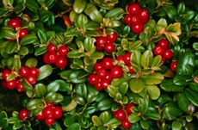
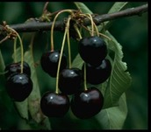
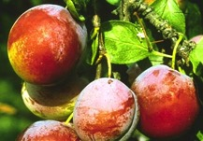
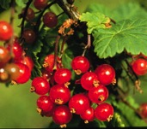
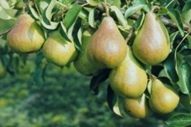
Conservation of genetic diversity
in seed genebanks
A major goal is to preserve natural patterns of genetic diversity to the extent possible to preserve options for future “evolutionary” change
Active use of genebank material is conservation
Note: not everything can be preserved in a gene bank!!

Slide 5
Nordic seed collection

Slide 6
Nordic Seed Collection
The collection includes 513 species and varieties of cultivated crops and their wild relatives, with 35,700 registered accessions (20,000 unregistered)
The Gene Bank is working with material of Nordic origin and/or relevance

Slide 7
29.000 ACC/PEN
6.700 TEM
+ INCOMING

Slide 8
Cereal collection
Regeneration 2015 and 2016
-> 3000 accessions
-> € 700.000
Cost to recreate the cereal collection
Estimated at > €5 million

Slide 9
User gene bank(s)
Regulatory framework
Conservation and traditional varieties listed

Slide 10
EU Directives
Directive 2008/62/EC
agricultural landraces and varieties naturally adapted to local conditions …
no limits regarding package size
Bevaringssort (DK)
Alkuperäiskasvilajikkeet (FI)
Bevaringsverdige sorter (NO)
Bevarandesorter (SE)
Conservation varieties (EN)
Directive 2009/145/EC
vegetable landraces and varieties traditionally grown in certain regions…
only small package
Amatørsorter (DK)
n/a (FI)
Tradisjonssorter (NO)
Amatörsorter (SE)
Others (EN)
Notes:
772 amateurvarieties

Slide 11
Nordic Conservation varieties
 | DK | FI | IS | NO | SE
Wheat | 1 |  |  | 4 | 14
Oat |  | 1 |  |  | 5
Barley |  | 2 |  | 1 | 7
Rye |  | 9 |  | 1
Potato |  |  |  | 3 | 14
Pea |  |  |  |  | 16
clover |  | 8
Swede |  | 2 |  |  | 1
Buckwheat |  | 1
Soy bean |  |  |  |  | 1
French bean |  |  |  |  | 1
Broad bean

Slide 12
Nordic traditonal varieties
 | DK | FI | IS | NO | SE
Garden pea |  |  |  | 1
Tomato |  |  |  | 2
French bean |  |  |  |  | 3
Wrinkled pea |  |  |  |  | 1
Sugar pea |  |  |  |  | 1

Slide 13
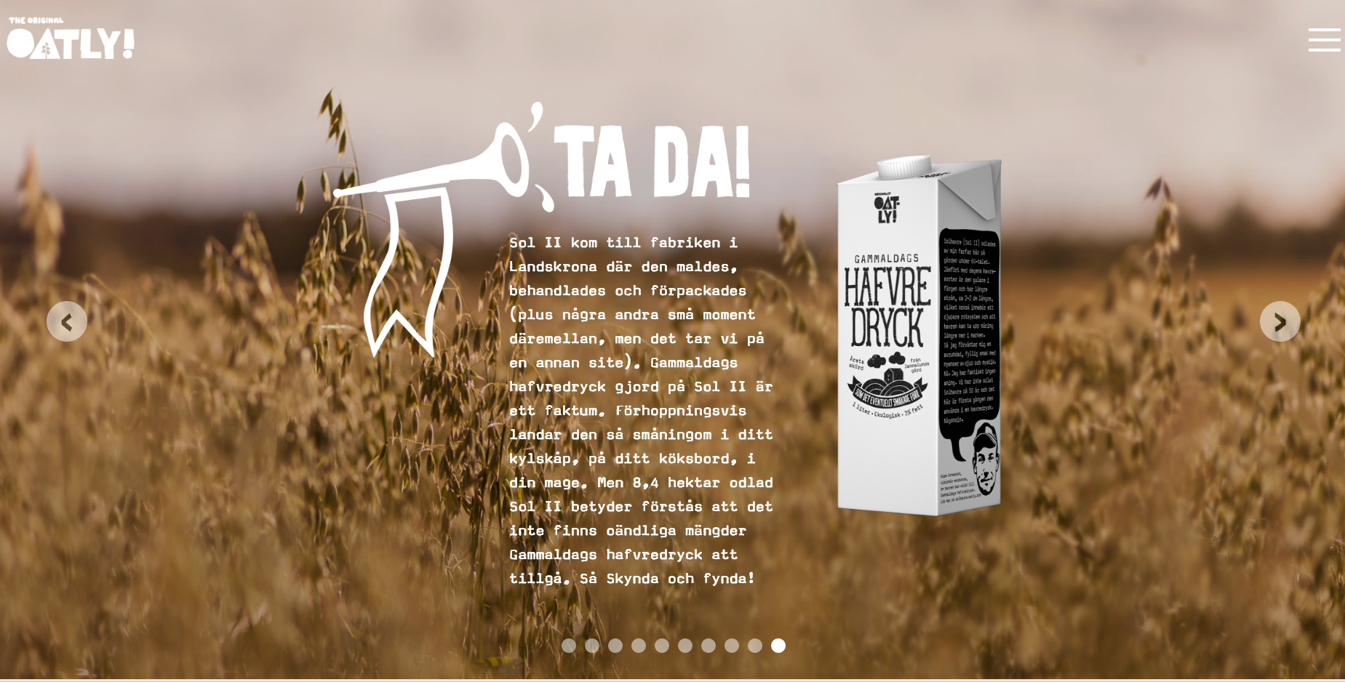
Oat drink from Sol II

Slide 14
Towards a user gene bank

Slide 15
Seed requests 2010 - 2016

Slide 16
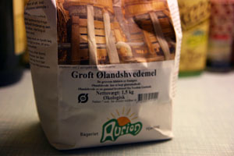
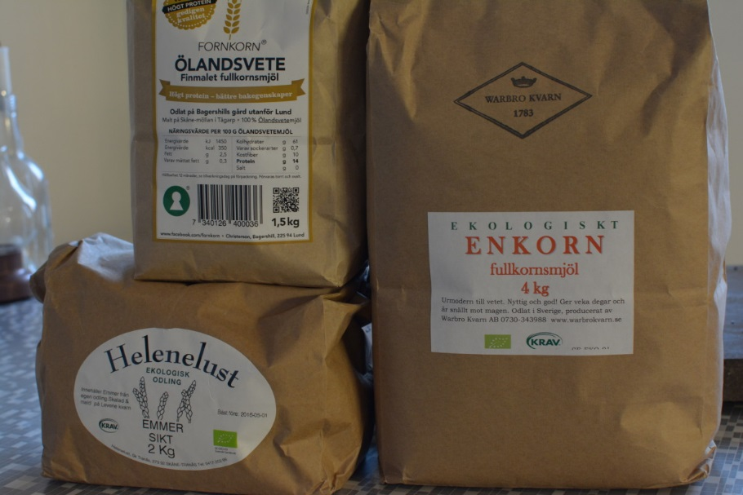
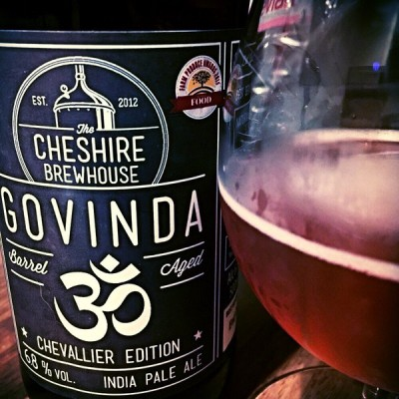
Group work on agrobiodiversity in legislation
16.00 – 17.00 User Genebank - interaction with end users
-give your views on a user genebank(s)

Slide 17
Towards a ”user genebank” 1) define end-users (hobby, SMB) 2) driven by end-users with support from NordGen -organization? -role of NordGen? -National or Nordic? 3) create a trademark ”grönt kulturarv” 4) legislation 5) funding
Notes:
NordGen will have an extra cost for harvesting, threshing and cleaning the surplus. Today NordGen only harvest, thresh and clean the amount decided at NordGen, normally 22000 seeds.
NOTE! Conservation varieties (bevarandesorter) shall be multiplied in its region of origin.
This implies that only Swedish varieties can be multiplied at Alnarp as conservation varieties (bevarandesorter)
Decisions to be taken:
Shall the seed be sold or given away?
What seed amounts for different species/cultivars

Slide 18
Towards a ”user genebank” Annual surplus of seeds 1) suitable for hobby growers 2) included in NordGen’s hobby collection NordGen as an active partner 1) End-users and NordGen defines accessions of interest for use in Nordic countries 2) NordGen ”assists” with 1st regeneration (cereals) National hubs (”user gene banks”) 1) Driven by end users in Nordic countries 2) NordGen assists in selection of material
Notes:
NordGen will have an extra cost for harvesting, threshing and cleaning the surplus. Today NordGen only harvest, thresh and clean the amount decided at NordGen, normally 22000 seeds.
NOTE! Conservation varieties (bevarandesorter) shall be multiplied in its region of origin.
This implies that only Swedish varieties can be multiplied at Alnarp as conservation varieties (bevarandesorter)
Decisions to be taken:
Shall the seed be sold or given away?
What seed amounts for different species/cultivars

Slide 19
NordGen today
Conservation
Utilization
Regeneration
sMTA
Breeders
Researchers
Hobby
10-250 seeds
Stored
Stored
Surplus seeds – often discarded
Cereals
Vegetables
Notes:
We also multiply herbs, medicinal plants, ornamentals and potato. All these groups seldom gives a surplus.

Slide 20
NordGen distributes surplus seeds to hobby
NordGen
NordGen
User Gene
Bank
Conservation
Storing/Packing/Distribution
Regen & Multipl
Long Storage
Utilization
Hobby growers
Hobby MTA
Surplus
Surplus
Cereals
Vegetables

Slide 21
NordGen as an active partner
Seed quality
Germination
Purity
Disease free
NordGene
User Gene
Bank(s)
sMTA
Multiplication/Storing
Packing/Distribution
Marketing & Sales
Trademark/Logotype
Exclusivity
Distribution territory
Reclaims
Seed legislation for conservation varieties
Max acreage/crop
Labelling
Species
Weight
Person resp. for labelling
Etc.
sMTA
Farmer’s shops
Restaurants
Museums
Hobby gardeners
Notes:
Questions
Where? A user gene bank
To/for whom?
How many?
What? Conservation varieties or ”unique” NordGen material?
Why?
How?

Slide 22
Group work on agrobiodiversity in legislation
16.00 – 17.00 User Genebank - interaction with end users
-give your view(s) on user genebank(s)

Slide 23
Thank you for your attention!

