Slide 1
Farm Saved Seed – How it is done in Finland
Finnish Seed Trade Association

Slide 2


















Member companies of Finnish Seed Trade Association

Slide 3
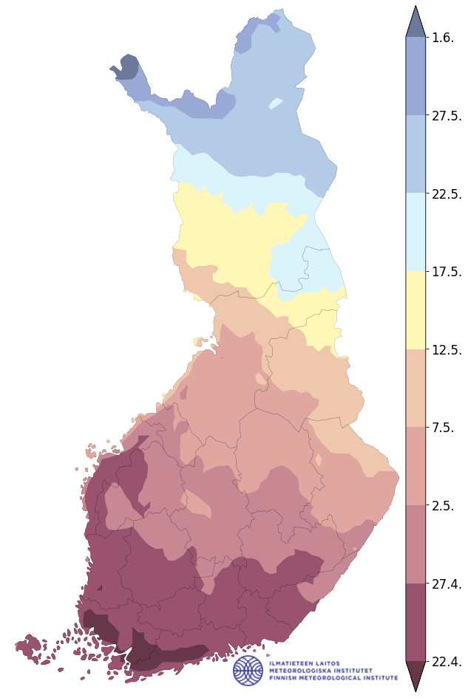
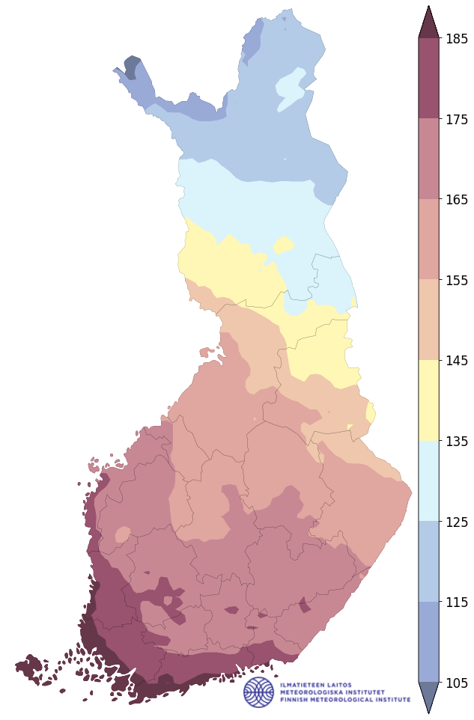
Latitudes – in sense of thermal growing season
Starting days Lenght (days)
ARCTIC CIRCLE

Slide 4
Finnish Seed Trade Association (FSTA)
Member companies are organised into sections.
Plant Breeding
Seed Potato
Section Plant Breeding compiles data on Farm Saved Seed use and collects the plant variety right remuneration by invoicing farmers.
Most FSTA members participate in the payment collection. In volume, they represent > 95 % of protected varieties cultivated in Finland.
Field Crops
Horticultural Species

Slide 5
Objectives and Challenges
Use of certified seed is relatively low in Finland. For spring barley, oat and wheat certified seed use is around 25 - 35 % per year and depending on the crop. Objective is to increase the use of certified seed.
Popularity of Farm Saved Seed is the sum of different reasons.
Most of the farms have equipment for drying and storing seed. There is a tradition for storing seed in case of bad harvest or weather conditions.
In the north, higher seeding rates are needed to produce an equal harvest compared to southern latitudes. Low ‘seed multiplication rate’ is one factor that increases the cost of certified seed.

Slide 6
Farm Saved Seed use in Finland
Country totals in 2025
~ 40 000 farms
~ 1 000 000 ha cereals
~ 45 000 ha legumes
~ 19 000 ha potatoes
Around 10-15 % of the farmers are exempted from the invoicing process on the basis of growing unprotected or otherwise not invoiced varieties.
Farm Saved Seed use in 2025
~ 16 500 invoiced farms
~ 572 000 ha cereals
~ 31 000 ha legumes
~ 6 000 ha potatoes

Slide 7
What is ment by variety protection?
Plant breeder protects a variety with a Plant Breeder's Right (PBR).
It is a patent like immaterial property right which is applied to plant varieties.
PBR gives the breeder the right to decide on the variety’s professional use. An exemption to the rule is that a farmer can, by paying a renumeration to the breeder, use the produced harvest as seed or seed potato on his/her own holding.
Plant Breeder's Right is applied either nationally or it is applicaple for the whole EU region.
National protection is, in general, in force for 30 years and EU protection for 25 years (except for potatoes 30 years).

Slide 8
Right to cultivate a protected variety
Finnish Plant Breeder’s Right Act: Section 6, subsection 1
Subject to payment of remuneration, a farmer has the right to use or produce propagating material of protected varieties for propagation purposes on his or her own holding.
This right concerns, except for hybrids, the varieties of the following species:
oat, barley, rye, wheat, triticale, turnip rape, rape seed, flax, pea, field bean, potato, buckwheat
In practice, royalties for use of FSS are collected from a more limited number of species than legislation permits:
oat, barley, rye, wheat, tritcale, pea, field bean, potato

Slide 9

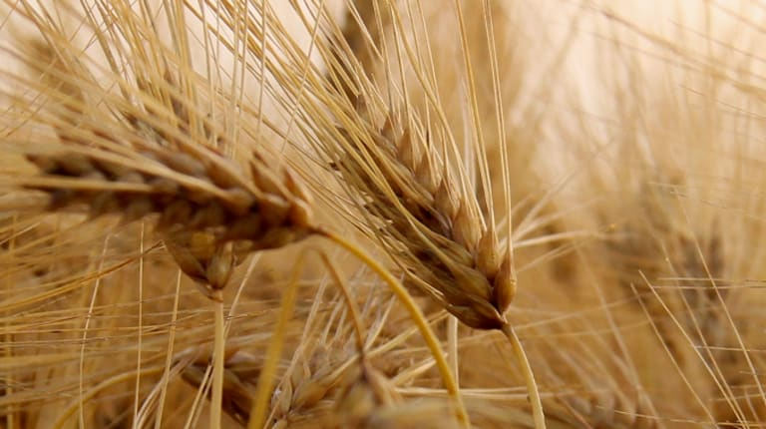
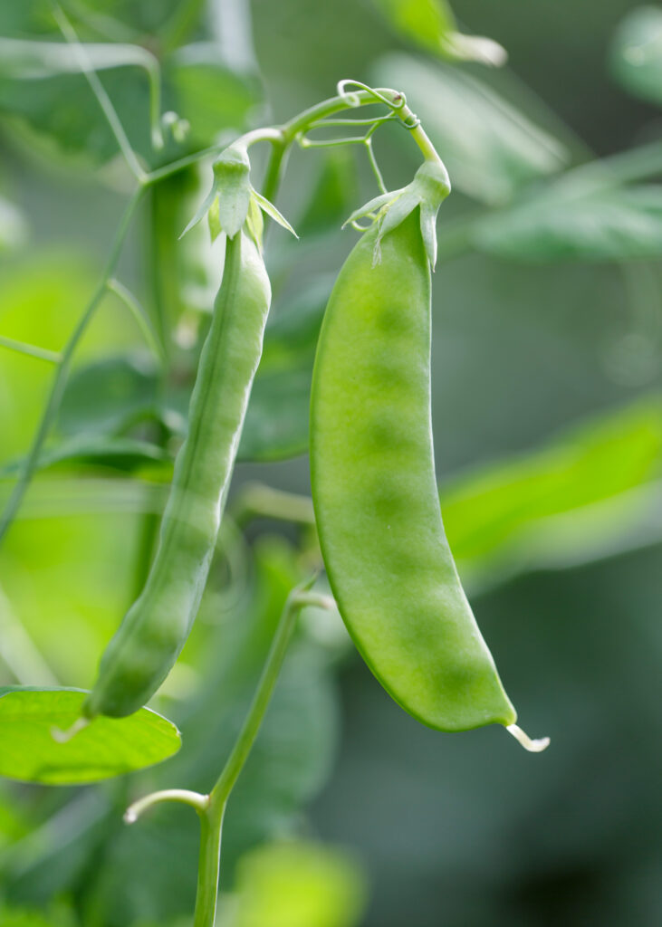
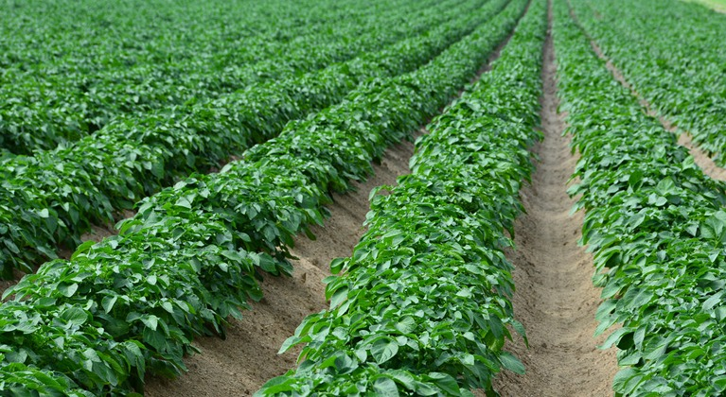
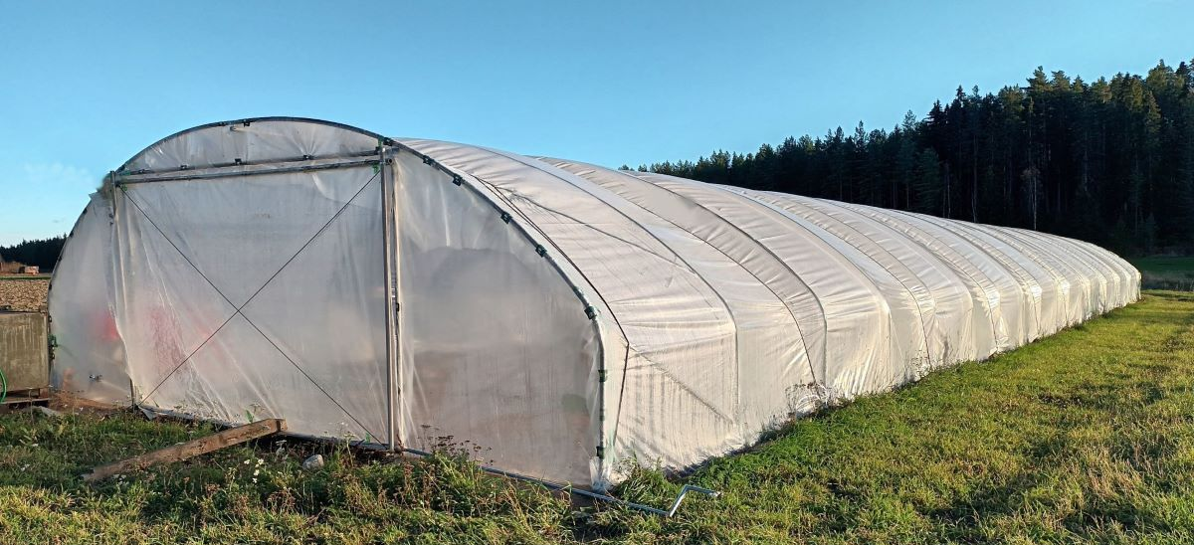
Obligation to pay royalties for use of FSS in case of Finnish National PBR
Finnish Plant Breeder’s Right Act: Section 6, subsection 3
Farmers are obliged to pay remuneration for using FSS of protected variety when
arable land area held by the farmer is 10 hectares or more.
However, in the case of potato cultivation, obligation for remuneration originates when cultivation area is no less than
two hectares in open field, or
one hectare under covering,
even if the arable land area held by the farmer would be less than 10 ha.
10 ha
2 ha
1 ha

Slide 10

Obligation to pay royalties for use of FSS in case of European Community PBR
Farmers are obliged to pay remuneration for using FSS of variety protected by a plant variety right of the European Community when their cultivation area exceeds
the calculated area needed for the production of 92 tonnes of cereal
OR
7 hectares in the case of potato cultivation

Slide 11
From which farms is the fee collected?
FIN protected
For nationally protected varieties, farms with more than 10 hectares of arable land are obliged to pay.

Slide 12
From which farms is the fee collected?
FIN protected
For nationally protected varieties, farms with more than 10 hectares of arable land are obliged to pay.
For EU-protected varieties, the payment obligation applies to farms producing more than 92 tonnes of calculated yield. In practice, the 92-tonne limit means farms with 30.67 ha in subsidy area A (south), 41.82 ha in subsidy areas B-C1 (south) and 70.77 ha in subsidy areas C2-C4 (north).
EU protected

Slide 13
From which farms is the fee collected?
FIN protected
For nationally protected varieties, farms with more than 10 hectares of arable land are obliged to pay.
For EU-protected varieties, the payment obligation applies to farms producing more than 92 tonnes of calculated yield. In practice, the 92-tonne limit means farms with 30.67 ha in subsidy area A (south), 41.82 ha in subsidy areas B-C1 (south) and 70.77 ha in subsidy areas C2-C4 (north).
For potato, the payment obligation is based on the potato cultivation area. For nationally protected varieties, the payment obligation applies to farms with more than 2 ha of potatoes or more than 1 ha of early potatoes under covering. For EU-protected varieties, farms having at least 7 ha of potatoes.
EU protected
Potato

Slide 14
Why is the payment collected?
The fee is collected to help fund plant breeding activities. Royalties on certified seed are another important source of income for breeders.
Aim is that plant breeding is able to introduce new varieties suitable for Finnish conditions and that the varieties produce a good quality harvest.
FSTA forwards the payments to plant breeders and their representatives in relation to the hectares on which the varieties are cultivated.
Farmers are allowed to use FSS of protected varieties against a payment.

Slide 15
Variety owner’s right for information
Finnish Plant Breeder’s Right Act: Section 7, subsection 1
For the enforcement of the payment obligation laid down in section 6, the plant breeder's right holder is entitled to access the following information from the information system referred to in the Act of the Information System of the Rural Business Authorities (284/2008):
…

Slide 16
Variety owner’s right for information
Finnish Plant Breeder’s Right Act: Section 7, subsection 2, points 1-3
…the following information…
Name and contact information of the farmer;
Code number of the farm;
Arable land area held by the farmer if it is more
than two hectares in the case of a protected potato variety,
one hectare in the case of early potato cultivated under covering,
and 10 hectares in the case of other varieties;

Slide 17
Variety owner’s right for information
Finnish Plant Breeder’s Right Act: Section 7, subsection 2, points 1-3
…the following information…
Cultivation area of varieties protected by a plant variety right of the European Community (2100/94)
if this exceeds
the calculated area needed for the production of 92 tonnes of cereal
7 hectares of potato
Cultivation areas by variety sown with seed of varieties protected under this Act produced on farmer’s own holding.

Slide 18
Farmers obligation to provide information
Finnish Plant Breeder’s Right Act: Section 6, subsection 4
A farmer is obliged to provide, upon request, the authority and the plant breeder’s right holder with the necessary information for establishing the payment obligation.

Slide 19
How is the invoicing done?
The used variety and how much it was sown is asked from farmers in the subsidy application submitted to the Finnish Food Authority in spring.
In the autumn, the Finnish Food Authority provides the necessary information to FSTA for the purpose of collecting the remuneration.
Plant breeders and their representatives in Finland have authorised FSTA to carry out the invoicing of farmers. Invoices are sent in December.
The association forwards the received payments to breeders and their representatives in relation to their variety hectares.

Slide 20

Confidentiality and destruction of the information
Finnish Plant Breeder’s Right Act: Section 7, subsection 3
A plant breeder’s right holder may use information disclosed under subsection 1
only for the enforcement of the right to receive payment referred to in section 6.
The plant breeder’s right holder is not entitled to disclose the information to another party.
Finnish Plant Breeder’s Right Act: Section 8
A plant breeder’s right holder shall destroy the information within one year from the end of the calendar year concerned in the enforcement of the payment obligation.

Slide 21

Setting the level of royalties for use of FSS
Finnish Plant Breeder’s Right Act: Section 6, subsection 2
A contract may be concluded between
the plant breeder’s right holder and the farmer OR
between organisations representing them
on a reasonable amount of remuneration payable to the plant breeder’s right holder.
In practice agreement of remuneration is negotiated between Farmers Union and Finnish Seed Trade Association (FSTA).
Agreement on level of remuneration is also a condition for the disclosure of information concerning FSS use.

Slide 22
Setting the level of royalties for use of FSS in the case no agreement exist
Finnish Plant Breeder’s Right Act: Section 6, subsection 2
When there is no existing agreement the farmer has the obligation to pay to the plant breeder’s right holder a remuneration of 50 % of the royalty fee.
It is difficult to identify the 50 % limit, because seeding rate (kg / ha) varies and royalty (€ / t) per variety varies.
In practice the Farmers Union and Finnish Seed Trade Association (FSTA) have had existing agreement from the very beginning.
50 %

Slide 23
Farmers need information – ”What?”
” What is this invoice? I haven’t bought anything from you! ”
“ Where do you get the invoicing data from? ”
“ Who decides on the level, €/ha? ”
Communication on Plant Breeder’s Rights (PBR) and Farm Saved Seed
Scheme which needs to be communicated
Legal base and enforceability
Collected cost-efficiently by FSTA, paid to owners of PBR in relation to how much (ha) each variety is used for FSS

Slide 24
Refrences and more information
PowerPoint presentation by Finnish Food Authority
https://cpvo.europa.eu/en/news-and-events/conferences-and-events/farm-saved-seed-seminar-4-march-2020-tartu-estonia
Finnish Plant Breeder’s Right Act
https://www.finlex.fi/api/media/statute-foreign-language-translation/688157/mainPdf/main.pdf?timestamp=2009-12-21T22%3A00%3A00.000Z
Finnish Seed Trade Association homepage
https://www.siemenkauppiaat.fi/

Slide 25
Thank You for Your attention!

