Slide 1


Template for school visits

Slide 2


Agenda
z
Safer space principles
What are EU programs? Erasmus+ Youth & ESC
EuroPeers network
My experience
Where to find different projects? Everyone can do research
Q&A
1

Slide 3


Safer Space principles
Have an open mind
Respect each other
Give space
Active listening
Be mindful - listen and learn
No discrimination or bullying
Be curious, there’s no dumb questions!

Slide 4

What are EU youth programs?

Slide 5

What are EU youth programs?
EU youth programs include Erasmus+ Youth and European Solidarity Corps volunteering programs.
Not only in EU, but there are also partner countries involved.
Aim was originally to reduce youth unemployment and create equal opportunities to all young people.
Now they also support education, mobilities, encourage solidarity and civic engagement.

Slide 6

Erasmus+ Youth Exchanges
EU grant includes support for travel costs (maximum sum), accommodation and meals, so usually it’s free for participants
Youth exchanges allow groups of young people from different countries to meet, live together and cooperate on shared projects for short periods.
Possible variety of topics: sustainability, local food production…
Possibility to join in planning the program
Youth exchanges take place outside the school environment. On a youth exchange, you can expect to participate in activities such as workshops, exercises, debates, role-plays, outdoor activities and more.
Ages of 13 and 30. To be a group leader in a youth exchange, you must be at least 18 years-old.
5-21 days

Slide 7

Erasmus+ training courses
Helps young people and youth workers to develop their skills in leadership, project management and social inclusion
Focus on non-fomral education methods, (“learning by doing”)
18+ years olds
Duration about one week
EU grant includes support for travel costs (maximum sum), accommodation and meals, so usually it’s free for participants
1

Slide 8

European Solidarity Corps (ESC)
EU funded volunteering program for 18-30 year-olds
Topics: environment, social work, culture…
You can do short-term (2wk-2months) or long-term (2-12 months) project
Volunteering teams (2wk-2months) are group volunteering projects
EU grant includes support for travel costs (maximum sum), accommodation and meals, travel to workplace, pocket money, insurance, and support for language learning (online tool) so usually it’s free for participants

Slide 9
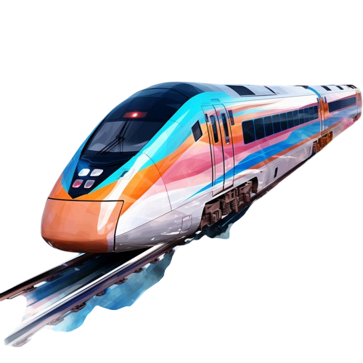
DiscoverEU
Open to 18-year-olds from EU and Erasmus+ countries.
Selected participants get a pass to explore Europe by train.
Encourages learning about different countries and cultures.
Travel alone or with up to four friends.
Extra support is available for those with special needs.
Calls for applications open twice a year.
1

Slide 10
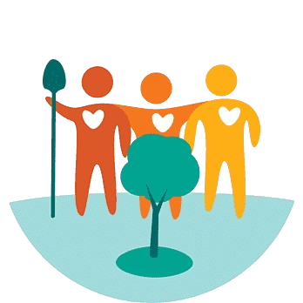
Solidarity projects
Participants aged 18-30 create and run the project.
Positive Community Impact – Projects address local challenges and bring change.
Projects last between 2 to 12 months.
Funding is provided to cover project costs.
Guidance Available – A coach can offer support if needed.
No Organization Required – A group of at least five people can apply independently.

Slide 11
EuroPeers network
What is Europeer Network?
A youth-led network of former participants in EU programs like Erasmus + and European Solidarity Corps
Promotes youth mobility, active citizenship and European opportunities
Operates in multiple European and partner countries - each with its own activities but with a shared mission.
What do Europeers do?
Peer-to-Peer Engagement: Schools and youth centres visits and public events to share their experiences.
How to become an Europeer?
Participate in Erasmus+ or European Solidarity Corps project.
For more info, check Europeers Official Website: https://europeers.org/

Slide 12
My experience
Add pictures from your project here!

Slide 13

Where to find current projects?
ESC: European Youth Portal, different (sending) organisations like Allianssin nuorisovaihto, Maailmanvaihto, KVT
Training courses: SALTO
Youth exchanges: Different youth organisations/youth centers like Vamos, Allianssin nuorisovaihto, Metsäkartano, Marttinen
DiscoverEU: call is shared twice a year
Solidarity project: you can apply yourself
Social media: europeanyouthfinland, eurodeskfinland

Slide 14
^{Q&A}
You can do this for example by post-its, creating a padlet, or just a regular Q&A!

