Slide 1
Informing and engaging citizens ahead of the European elections (6-9 June 2024) Presentation for external use by staff, communicators and networks of the European Commission Version of 29 April 2024
Notes:
This standard presentation has been prepared by the European Commission, DG Communication, COMM.B.2.
Contact: COMM-TOGETHER@ec.europa.eu
It draws on corporate steer and information available from various sources, including Commission and EP materials and the main elections web page https://elections.europa.eu/
The presentation aims to provide arguments and information about various aspects of democracy and the European elections for Commission staff as ambassadors and for the Commission’s communicators and networks.
It complements the achievements communication materials available at
The story of the von der Leyen Commission - European Commission (europa.eu) and
The EU in 2023 - General Report (europa.eu)
It serves the purpose to inform and engage with citizens and empower them to make informed decisions when they take to the polls.
It can be used in an external context in a modular way and should be adapted to the respective target audience and local context.
The accompanying notes can be used as speaking points and useful background.
The presentation is available on DG HR’s internal web page on the European elections: https://eceuropaeu.sharepoint.com/sites/european-elections.

Slide 2
A very precious thing called…democracy
The European elections – why vote ?
How to vote ?
What and who to vote for ?
How does the EU ensure free and fair elections ?
How to counter disinformation and interference ?
What happens after the elections ?
How to stay in touch with the EU ?

Slide 3
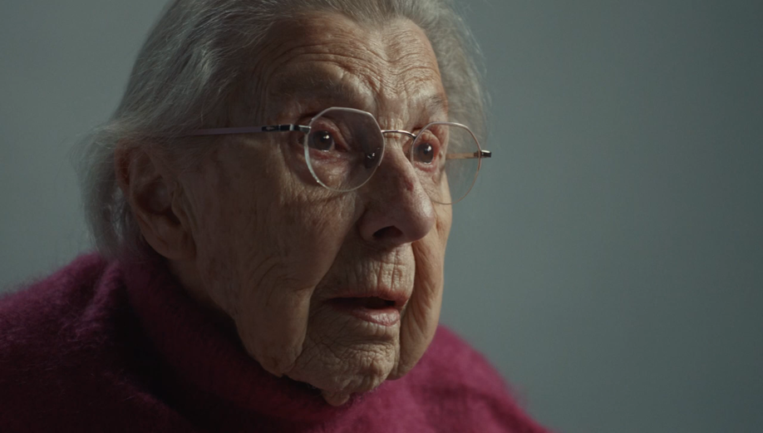
EP 'use-your-vote' campaign video hosted on the European elections website and on YouTube. ​ Other formats and languages available in the EP Multimedia Center. ​​​
Notes:
The European Parliament is in the lead for the call to vote.
The main phase of the EP's ‘go-to-vote’ campaign started on 29 April.
The message is ‘Use your vote. Or others will decide for you’.
The central element is a four-minute ‘hero movie’/documentary that also exists in shorter versions, different formats and languages. It is accompanied by a wide range of other campaign assets.
The campaign movie has a strong intergenerational dimension, involving elderly citizens sharing their life experience about moments when democracy was trampled, passing it on to the younger generations and urging them to vote and preserve democracy.
As of 29 April, as part of an interinstitutional effort to generate momentum for a viral impact, the Commission supports and amplifies the ‘hero movie’ and the go-to-vote campaign through all its channels and networks at a similar level as in 2019.
We use the hashtags #UseYourVote (other language versions here) and #EUelections2024 (other language versions here).
The hero movie/documentary is hosted on the European elections website and on YouTube.
All movie formats and languages are available for download in the EP Multimedia Center.
Practical guidance and technical information about the campaign assets are available here.
Commission staff is encouraged to share the EP’s go-to-vote ‘hero movie’ and related assets.
DG COMM advises against using the EP’s campaign email signature for staff.

Slide 4
A very precious thing called…democracy
The European elections – why vote ?
How to vote ?
What and who to vote for ?
How does the EU ensure free and fair elections ?
How to counter disinformation and interference ?
What happens after the elections ?
How to stay in touch with the EU ?

Slide 5
2019 European elections – turnout by country
Source: European Parliament/Kantar 2019
Notes:
Turnout in the 2019 European elections
The official and final turnout of the 2019 European Elections is set at 50.66% (up 8.06 pp on 2014), following the publication all 28 final national turnout data. Through the link on the slide you can also access further information about turnout by country, socio-economic backgrounds, reasons to vote or not to vote in 2019 etc.
The 2019 European elections were shaped by the significant increase in voter turnout:
50.66% is the highest turnout since 1994 European elections and represents a striking increase by 8.06 percentage points from 2014 (when the turnout was 42.60%).
20 Member States reported increase in national turnout, with significant increases compared to 2014 recorded in Poland, Romania, Spain, Austria, Hungary and Germany. Also countries with a traditional low or very low turnout in European elections, such as Slovakia and Czechia, showed substantial increases. On the other hand, turnout decreased in eight countries, but by no more than 3 percentage points in any of them.
Despite the average increase in turnout, large differences remain between Member States, ranging from 88.47% in Belgium to 22.74% in Slovakia.
Youth participation
Socio-demographic analysis shows that there has been an increase in turnout for all groups of the population, although this is higher for some groups, with a much larger turnout among younger people and first-time voters. Although older people remain more likely to vote, the increase between 2014 and 2019 is larger among young people aged under 25 (42%, +14 pp) and aged 25–39 (47%, +12pp), when compared with those aged 55 or over (54%, +3 pp). Overall, this means that the differences between age groups have narrowed when comparing 2019 with 2014 (see page 24 of the report).
Reasons for voting A greater sense of civic duty boosted the overall turnout, alongside increasingly positive support for the EU and its impact on Europeans. The most common reason for voting was because people felt it was their duty as a citizen (52%). Other main reasons were because the respondent always votes (35%), because they are in favour of the EU (25%), to support the political party they feel close to (22%) and because voting in the elections can ‘make things change’ (18%) (see page 44 of the report).
Issues behind the vote
There are five issues mentioned by at least a third of respondents as reasons to go to vote: economy and growth (44%), combating climate change and protecting the environment (37%), promoting human rights and democracy (37%), the way the EU should be working in the future (36%) and immigration (34%).
At least a quarter of respondents mentioned a number of other issues: social protection of EU citizens (29%), the fight against terrorism (26%), combatting youth unemployment (25%) and security and defense policy (25%). Also mentioned are the protection of external borders (21%), consumer protection and food safety (20%) and protection of personal data (12%) (see page 50 of the report).

Slide 6
The European elections – why vote?
It’s about you and your future!
It’s also about Europe in this record year of world elections!
It’s also about our democracy!
Sign up now to get voting reminders and ensure you don’t forget to use your vote: https://elections.europa.eu/en/use-your-vote/
Notes:
It’s about you and your future!
Have a say on topics you care about
The EU provides solutions to issues that cannot be solved by one country alone: the economy, environment, energy, climate change, security, migration, agriculture, data protection, artificial intelligence, disinformation.
The EU also supports farmers, researchers, towns, cities and regions, NGOs, SMEs, young people, the unemployed and teachers through different funding programmes.
The EU upholds values like human rights, freedom, democracy, equality and the rule of law.
Today, every important national topic also has a European angle.
By voting, you decide how Europe tackles these issue in the future.
You can choose the way you want to live in Europe…
…instead of letting others decide for you!
It’s also about Europe in this record year of world elections!
In 2024, about half of the world’s population is voting (not all of them in free and fair elections however!).
It’s the ‘world championship of elections’.
With almost 360 million eligible voters in the EU (358,861,608 according to latest information by DG JUST and Eurostat) the EU is the second biggest democracy in the world after India.
Let’s show that Europe is a ‘global champion of democracy’.
It’s also about our democracy!
The EU adopts laws democratically:
Following a proposal by the European Commission, these laws are normally discussed and adopted by the European Parliament – that you elect directly - and the Council, representing member states governments that came into power democratically.
This is how democracy works at EU level.
By voting you strengthen our democracy and institutions.
Democracy should never be taken for granted. It is a collective achievement.
It’s a collective responsibility in which we all have a role.
Voting in the European elections is a very important way to support democracy in Europe.
Because the more people vote, the stronger our democracy becomes.
Sign up now to get voting reminders and ensure you don’t forget to use your vote: https://elections.europa.eu/en/use-your-vote/

Slide 7
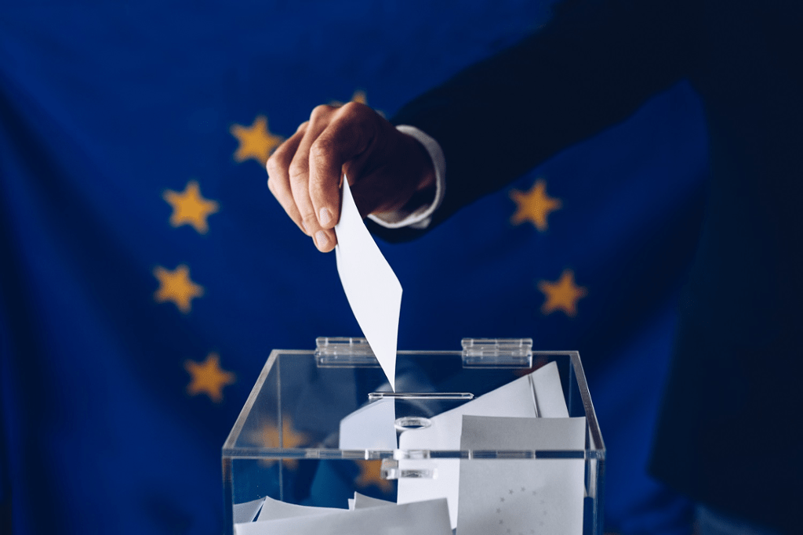
Does my vote really change anything?
Yes! By voting you directly choose the members of the European Parliament (MEPs).
They make EU laws – together with the Council of the European Union (member states).
They hold the Council and the Commission accountable.
They elect the President of the European Commission, scrutinise Commissioners-designate and approve the new Commission.
They decide how the EU’s money is spent, together with the Council.
Your vote will influence Europe's future course!
Notes:
Does my vote really change anything?
Yes! By voting you directly choose the women and men that represent you in the European Parliament.
They have important powers: They make EU laws in most areas – together with the Council of the European Union (member states).
They hold the Council and the Commission accountable.
They elect the President of the European Commission, scrutinise Commissioners-designate and approve the new Commission.
They decide on how the EU’s money is spent.
By voting you can change things and influence Europe’s future course!
In more detail: the powers of the European Parliament
Source: https://european-union.europa.eu/institutions-law-budget/institutions-and-bodies/search-all-eu-institutions-and-bodies/european-parliament_en
Legislative
Passing EU laws, together with the Council of the EU, based on European Commission proposals
Deciding on international agreements
Deciding on enlargements
Reviewing the Commission’s work programme and asking it to propose legislation
Supervisory
Democratic scrutiny of all EU institutions
Electing the Commission President and approving the Commission as a body. Possibility of voting a motion of censure, obliging the Commission to resign
Granting discharge, i.e. approving the way EU budgets have been spent
Examining citizens' petitions and setting up inquiries
Discussing monetary policy with the European Central Bank
Questioning Commission and Council
Election observations
Budgetary
Establishing the EU budget, together with the Council
Approving the EU's long-term budget, the "Multiannual Financial Framework"

Slide 8
Young people matter!
In the past, many young people did not vote in the European elections – compared to the older generations.
Even if there was a strong increase of the youth vote between 2014 and 2019 (+14 p.p. to 42%), it remained below the average turnout of 51%.
In some countries (Austria, Belgium, Germany, Malta) 16- and 17-year-old now have the right to vote. In Greece, 17-year-old can vote. In others you can vote when you are 18.
Use your right to vote! Don’t let others decide your future for you!
More information in this youth leaflet GET READY! The countdown to the 2024 European elections has begun.
Notes:
Young people matter!
Voting in the elections is particularly important for young people.
They are the ones who will live longest in the Europe we choose today.
If they start engaging democratically today, it is more likely that they will do so in the future, too. This will strengthen our democracy.
In the past, many young people did not vote in the European elections – compared to the older generations:
Even if there was a strong increase of the youth vote between 2014 and 2019 (+14 p.p. to 42%), the youth vote remained below the average turnout of 51%.
In 2024, in some countries (Austria, Belgium, Germany, Malta) people aged 16 and 17 years have already the right to vote.
In Greece, 17-year-old can vote.
In all other countries you can vote when you are 18.
Use your right to vote! Do not let others decide your future for you!

Slide 9
A very precious thing called…democracy
The European elections – why vote ?
How to vote ?
What and who to vote for?
How does the EU ensure free and fair elections ?
How to counter disinformation and interference ?
What happens after the elections ?
How to stay in touch with the EU ?

Slide 10
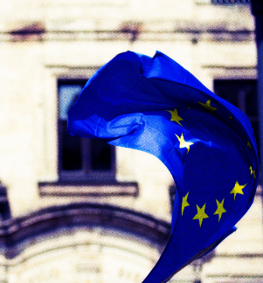
How do European elections work?
European elections are held every 5 years.
Election dates this year: Thursday 6 June – Sunday 9 June 2024.
720 Members of the European Parliament (MEPs) to be elected in 2024.
The number of MEPs varies between a minimum of 6 (Malta, Cyprus, Luxembourg) and a maximum of 96 (Germany).
Each MEP from a larger country represents more people than an MEP from a smaller country ( = degressive proportionality).
Find out How the European elections are organised in your country.
Infographic: National voting rules (dates, minimum age , voting modalities, possibilities for postal vote, etc.)
Notes:
European elections are held every five years. The last European elections took place in May 2019.
In 2024, our rendez-vous with European democracy will take place across the 27 EU member states from Thursday 6 June to Sunday 9 June.
Pending formal announcements by some national authorities, the vote will kick-off in the Netherlands on Thursday 6 June, followed by Ireland on Friday 7 June, and Latvia, Malta and Slovakia on Saturday 8 June.
In Czechia the ballots will be open Friday and Saturday, while in Italy the vote will take place on Saturday and Sunday.
The other 20 EU countries (Austria, Belgium, Bulgaria, Croatia, Cyprus, Denmark, Estonia, Finland, France, Germany, Greece, Hungary, Lithuania, Luxembourg, Poland, Portugal, Romania, Slovenia, Spain and Sweden) will hold their elections on Sunday 9 June.
Provisional results will be published on Sunday evening at https://results.elections.europa.eu/en/
As a general rule, the number of MEPs is decided before each election. The total cannot exceed 750 plus the president.
A total of 720 Members of the European Parliament will be elected in June 2024. This was decided by the European Council and approved by the EP in 2023.
It is 15 more compared to the previous elections in order to take into account demographic developments.
The 15 additional seats go to 12 countries: two additional seats for France, Spain and Netherlands respectively. One seat each for Austria, Denmark, Belgium,, Poland, Finland, Slovakia, Ireland, Slovenia and Latvia.
The minimum number of any country is 6 (Malta, Cyprus, Luxembourg), the maximum number is 96 (Germany).
Each MEP from a larger country represents more people than an MEP from a smaller country. This is called degressive proportionality.
Seats per country in the 2024-2029 legislature:
Germany: 96
France: 81 (includes +2)
Italy: 76
Spain: 61 (includes +2)
Poland: 53 (includes +1)
Romania: 33
Netherlands: 31 (includes +2)
Belgium: 22 (includes +1)
Greece: 21
Czechia: 21
Sweden: 21
Portugal: 21
Hungary: 21
Austria: 20 (includes +1)
Bulgaria: 17
Denmark: 15 (includes +1)
Finland: 15 (includes +1)
Slovakia: 15 (includes +1)
Ireland: 14 (includes +1)
Croatia: 12
Lithuania: 11
Slovenia: 9 (includes +1)
Latvia: 9 (includes +1)
Estonia: 7
Cyprus: 6
Luxembourg: 6
Malta: 6
Elections are contested by national political parties but once MEPs are elected, most opt to become part of transnational political groups.
Most national parties are affiliated to a European-wide political party.
MEPs sit in political groups based on shared ideals. Each group has a minimum of 23 MEPs from at least a quarter of EU countries. There were seven groups in the Parliament during the 2019-2024 legislature.

Slide 11
How to vote?
The national rules vary from country to country. On the European elections website you can see how to vote in each member state.
There are some common principles:
Elections take place during a four-day period, from Thursday to Sunday. The exact date depends on the country.
The number of MEPs elected from a political party is proportional to the number of votes it receives.
EU citizens resident in another EU country can vote and stand for election there.
Each citizen can vote only once.
Infographic: National voting rules (dates, minimum age, voting modalities, postal vote, etc.)
Notes:
It is up to each country to manage the election.
The national rules on dates, minimum age, voting modalities etc. vary from country to country.
There are some common principles:
Elections take place during a four-day period, from Thursday to Sunday. The exact date depends on the country.
The number of MEPs elected from a political party is proportional to the number of votes it receives.
EU citizens resident in another EU country can vote and stand for election there.
Each citizen can vote only once.
On the European elections website you can see exactly how to vote in each member state, whether you are a citizen of the country and residing there, or whether you are a citizen of another EU country. The rules of the member state in which you are registered to vote apply.
You find there plenty of practical information, e.g.:
What is the date of the elections in the country in which you will vote.
If you can vote by mail
If you can vote online
If you can ask somebody to vote for you
If there is an obligation to vote
Where you can vote
If and how to register and by when
What kind of support exists for people with a disability
Where to find easy-to-read information
If your country gives you the right to vote when you live outside the European Union.
Etc.

Slide 12
A very precious thing called…democracy
The European elections – why vote ?
How to vote ?
What and who to vote for ?
How does the EU ensure free and fair elections ?
j
How to counter disinformation and interference ?
What happens after the elections ?
How to stay in touch with the EU ?

Slide 13
What and who to vote for ?
It’s your choice!
Get informed about how the EU has delivered on its promises.
Have a look at what the EU does for you, for your region/city and your life.
Check out these interactive maps of cohesion funding and NextGenerationEU funding close to you.
Check out what the candidates and political parties are proposing for the future: https://elections.europa.eu/en/.
Based on this, you can make informed decisions when you take to the polls.
Notes:
As Commission we do not give any recommendation as to which candidate or party you could vote for.
The Commission defends the European interest and democracy, explains how the EU delivers and informs about the elections and their importance.
It’s therefore up to you to decide what and who to vote for.
It is your choice!
The EU has delivered on important policies in key priorities and tackled several crises heads on. This impacts directly on you. We encourage you to inform yourself about how the EU has delivered on its promises.
And to have a look at what the EU does for you concretely, for your region/city and your life.
Check also out the interactive maps of cohesion funding and NextGenerationEU funding close to you.
If you want to find out more about the candidates and political parties have a look at the elections website https://elections.europa.eu/en/ and/or the websites of the parties and candidates.
On the basis of all this, you can make informed decisions when you take to the polls.

Slide 14
A very precious thing called…democracy
The European elections – why vote ?
How to vote ?
What and who to vote for ?
How does the EU ensure free and fair elections ?
How to counter disinformation and interference ?
What happens after the elections ?
How to stay in touch with the EU ?

Slide 15
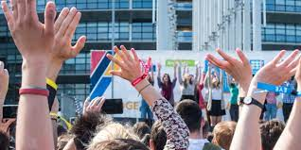
How does the EU ensure free and fair elections ?
Free and fair elections are at the heart of the democratic process.
Voters should be able to make their choice free from interference and manipulation.
The EU is prepared to prevent malign interference, disinformation, cyberattacks and data breaches and to uphold free and fair elections.
Source: Free and fair elections
Notes:
How does the EU ensure free and fair elections ?
Free and fair elections are at the heart of the democratic process.
Voters should be able to make their choice free from interference and manipulation.
The EU is prepared to prevent malign interference, disinformation, cyberattacks and data breaches and to uphold free and fair elections.
Who is in charge of ensuring that the European elections are free and fair?
National election authorities work to ensure that the European elections are fair and free from interference and manipulation. They do this in accordance with European and national law and with the support of EU institutions.
This work includes defending the elections against potential attempts at information manipulation, cyberattacks, data breaches and hybrid threats.
When citizens vote in the European elections, the way they vote will differ from country to country. In some countries citizens vote using ballot papers, in others they can vote electronically or online.
There are established routines in place for double-checking the counting of the ballots, regardless how the vote is cast. Systems are also in place nationally to report, check and correct possible technical errors, as small irregularities and human errors may occur in every election.
The European cooperation network on elections brings together member state authorities in charge of electoral matters. Find here your country’s authorities responsible for ensuring election integrity: Austria, Belgium, Bulgaria, Croatia, Cyprus, Czech Republic, Denmark, Estonia, Finland, France, Germany, Greece, Hungary, Ireland, Italy, Latvia, Lithuania, Luxembourg, Malta, Netherlands, Poland, Portugal, Romania, Slovakia, Slovenia, Spain, Sweden.
How is the cybersecurity of elections ensured?
Ensuring the cybersecurity of the European elections is the responsibility of each EU country.
This means protecting networks and information systems relating to the elections, as well as their users, against cyber threats that could negatively affect them, with disrupting effects for the electoral process and the voters. This could for example be hacks or cyberattacks.
Ahead of the European elections, EU countries cooperate to prepare for potential cyber threats. They are supported by EU institutions, bodies and agencies, such as the EU Agency for Cybersecurity or The Computer Emergency Response Team for the EU institutions, bodies and agencies.
How is data protection ensured during elections?
Organising safe elections means handling personal data, such as name, address, date of birth or ID number of the voters.
National election authorities follow EU and national rules to ensure a high level of data protection during the European elections. This includes protection of personal data against unauthorised or unlawful processing and accidental loss.
Find your country’s authority overseeing data protection.
Important recent developments:
On 9 April 2024, Vice-President Jourová hosted a signing ceremony of the Code of Conduct for the 2024 European Parliament Elections. With their signature, European political parties committed to upholding ethical and fair campaign practices. Against the backdrop of growing concerns about protecting the integrity of elections in Europe from internal and external threats, this commitment by political parties carries great importance. Source: Vice-President Jourová hosts signing ceremony (europa.eu)
On 9 April 2024, the new Regulation on the transparency and targeting of political advertising, to reinforce democracy and protect the integrity of elections, entered into force. The Regulation aims to ensure that the provision of political advertising is in full respect of fundamental rights and that voters are better placed to make well informed choices. Source: Democracy and electoral rights - European Commission (europa.eu).
On 26 March 2024, the Commission has published guidelines under the Digital Services Act on recommended measures to Very Large Online Platforms and Search Engines to mitigate systemic risks online that may impact the integrity of elections, with specific guidance for the upcoming European Parliament elections in June. Source: Commission publishes guidelines under the DSA (europa.eu)
Overview of what the EU is doing "to make sure that voters can cast their ballots as free from manipulation and interference as possible. That they can decide based on their own believes and opinions, rather than being manipulated or lied to by foreign interference" by Vice-President Jourová at the Democracy Tour Event on 21 March 2024: The Eleventh Hour to Strengthen Democracy in the EU? Source: Democracy Tour Event (europa.eu)
Digital Services Act starts applying to all online platforms in the EU as of 17 February. Source: press release of 16 February 2024: DSA starts applying to all online platforms in the EU (europa.eu)
Defence of Democracy – Commission proposes to shed light on covert foreign influence, 12 December 2023. Source: Defence of Democracy (europa.eu)

Slide 16
A very precious thing called…democracy
The European elections – why vote ?
How to vote ?
What and who to vote for ?
How does the EU ensure free and fair elections ?
How to counter disinformation and interference ?
What happens after the elections ?
How to stay in touch with the EU ?

Slide 17
This is what we expect:
Narratives that
claim wrongly that voting makes no difference and accuse the EU of not being a democracy,
confuse voters by spreading wrong information about election dates, rights and procedures,
question the integrity of elections or candidates, e.g. by pretending that the elections are stolen or pre-determined; use of deep fake videos etc.
Hijacking of ‘hot topics’, like Russia’s war of aggression against Ukraine, health, environment/climate, migration or equality issues and to increase polarisation in society;
Hybrid incidents that want to prevent and deter people from casting their vote.
Notes:
The threat is real. The EU institutions and member states have a good sense of what might come our way, based on thorough analysis of what happened in national elections and continued monitoring and exchange.
We expect for example narratives that
claim wrongly that voting makes no difference and accuse the EU of not being a democracy
confuse voters by spreading wrong information about election dates, procedures and electoral rights.
question the integrity of elections or candidates, e.g. by pretending that the elections are stolen or pre-determined; in this context deep fake videos could also be used, notably very shortly before the elections.
In addition, we expect disinformation that is also spread by hijacking ‘hot topics’, like Russia’s war of aggression against Ukraine, health, environment/climate, migration or equality issues and to increase polarisation in society;
Finally, we expect hybrid incidents that want prevent and deter people from casting their vote.
The EU is prepared to prevent malign interference, disinformation, cyberattacks and data breaches and to uphold free and fair elections.
Definitions
Disinformation is content that is deliberately manipulated and disseminated with the intention to deceive or fool an audience in order to achieve certain strategic, political or economic goals. This could for example be to undermine trust in democratic institutions, processes or elections or to influence election results.
Its origin can come from actors inside the EU or from foreign actors in the shape of Foreign Information Manipulation and Interference (FIMI).
Disinformation does not need to be completely fake or fabricated. Manipulation can take many forms. Often it relies on presenting information or content out of context, accompanying them with a misleading headline or photo or presenting real content as something it is not.
Disinformation can be a threat to society because it can undermine democracy, distort democratic debate, polarise society and make it difficult for citizens to make their democratic choice free from interference and manipulation.
Disinformation is distinct from the expression of opinions which is at the heart of our democratic societies.
Disinformation is also distinct from mere misinformation where false or misleading content is shared without harmful intent, even if the effects can still be harmful.

Slide 18
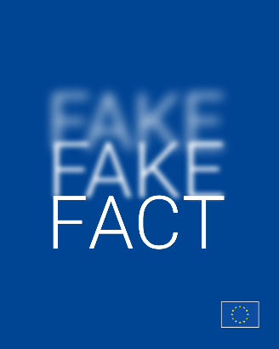
What is the EU doing against disinformation ?
Legal framework and regulation.
Monitoring and close cooperation.
Resilience building & awareness raising.
Communication.
Notes:
We have a legal framework and regulation in place and are using it (Digital Services Act, Code of Practice on Disinformation, etc.). For details see the notes of slide "How does the EU ensure free and fair elections".
We are working closely with social media platforms to ensure that they take their responsibility and obligations seriously.
The EU institutions and member states have established tools and structures that allow us to monitor, detect and fight disinformation and foreign interference and information manipulation.
We do not hesitate to act against Foreign Information Manipulation and Interference (FIMI),
For example by exposing the underlying mechanisms and over 16 k cases, by suspending the Russia Today/Sputnik and other outlets that Russia uses in its war against Ukraine; we are exchanging information and act through the European External Action Service’s Rapid Alert System; we cooperate with international partners, etc.)
We are building resilience and raise awareness through media literacy initiatives, work with fact-checkers, the European Digital Media Observatory and put out materials for pupils and teachers.
We are communicating upfront with factual communication and debunk false information about the EU and EU policies.

Slide 19
What can you do against disinformation?
Disinformation is fuelled by people pushing the share or like button too fast and maybe without having even read what they are about to share. Therefore:
Think before you share
Question your own biases
Check the entire content, the media outlet, the URL, the author
Look at the context (publication date, sources).
Keep yourself informed about the elections and the EU through reliable and verified sources.
Notes:
What can you do against disinformation?
Think before you share!
Disinformation is fuelled by people pushing the share or like button too fast and maybe without having even read what they are about to share.
Disinformation often relies on one of these techniques to convince people to share it:
it triggers strong feelings - such as anger, outrage, fear or greed;
it is very polarising;
it seems ”too good or too bad to be true”.
Therefore, before you share anything:
question your own biases,
check the entire content, the media outlet, the URL, the author
Look at the context (publication date, sources)
And keep yourself informed about the elections and the EU through reliable and verified sources.

Slide 20
A very precious thing called…democracy
The European elections – why vote ?
How to vote ?
What and who to vote for ?
j
How does the EU ensure free and fair elections ?
How to counter disinformation and interference ?
What happens after the elections ?
How to stay in touch with the EU ?

Slide 21
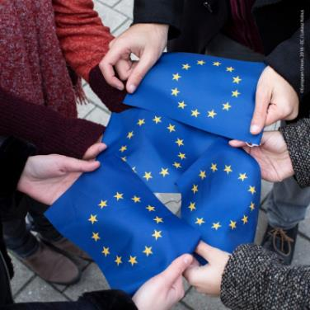
What happens after the elections ?
The elected MEPs will form political groups. At its first plenary session (mid-July), the new Parliament elects its President.
The European Council proposes a candidate for Commission President, taking into account the elections and after having held the appropriate consultations.
EP elects the new Commission President.
EP will examine the Commissioners-designate and approve the new Commission.
Sources: Elections and appointments - institutions | European Union (europa.eu)
After the European elections | News | European Parliament (europa.eu)
Notes:
What happens after the elections ?
The elected MEPs will form political groups.
At its first plenary session (mid-July), the new Parliament elects its President.
The European Council proposes a candidate for Commission President, taking into account the elections and after having held the appropriate consultations.
EP elects the new Commission President. The calendar is decided by the future Conference of Presidents of the political groups.
EP examines Commissioners-designate in so-called 'hearings' and approves the new Commission.
In more detail:
Election of the Commission President
Article 17(7) of the Treaty on the European Union stipulates: "Taking into account the elections to the European Parliament and after having held the appropriate consultations, the European Council, acting by a qualified majority, shall propose to the European Parliament a candidate for President of the Commission. This candidate shall be elected by the European Parliament by a majority of its component members. If he does not obtain the required majority, the European Council, acting by a qualified majority, shall within one month propose a new candidate who shall be elected by the European Parliament following the same procedure."
Article 14 of the Treaty of the European Union provides that the EP “shall elect the President of the Commission.” In practice, based on the rule 124 of the Rules of Procedure, the candidate proposed by the European Council will present their political guidelines to Parliament, followed by a debate. Parliament will elect the President of the Commission by a majority of its component MEPs (361, in a Parliament of 720 Members). The vote is by secret ballot.
On the subsequent hearings of Commissioners-designate:
Under current procedures, together with the (newly) elected Commission President, the Council appoints the Commissioners-designate.
Each Commissioner-designate is assigned responsibility for a specific policy area by the Commission President.
The relevant EP committees assess each of the Commissioners-designate, before a plenary vote on the appointment of the College of Commissioners (i.e. the Commission) as a whole.
On the EP vote of investiture of the new College of Commissioners:
The Commission President takes the results of the hearings, as well as consultations with Parliament's political groups, into account.
S/he then presents her/his team and political priorities during a plenary session.
After a debate, MEPs will decide, by a majority of votes cast, whether to invest the new College of Commissioners for a mandate of five years.
Sources:
Elections and appointments - institutions | European Union (europa.eu)
After the European elections | News | European Parliament (europa.eu)

Slide 22
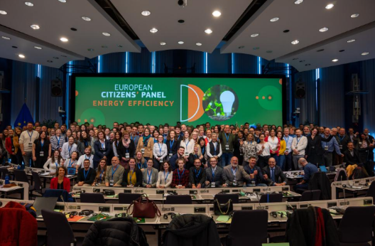
How does the EU engage with citizens between elections?
Europe delivers policies for and with citizens. e.g. through:
the new Citizens’ Engagement Platform,
European Citizens' Panels, which fully embed citizens (including young people) in the EU’s policy-making process,
Public Consultations and feedback,
European Citizens’ Initiative,
Youth dialogues, the European Youth Week, the European Youth Event, education and youth programmes, etc.
manifold activities in member states
Sources: Citizens’ Engagement Platform and European Youth Portal
Notes:
How does the EU engage with citizens between elections?
Europe delivers policies for and with citizens.
Europe listens to people. And acts upon what it hears.
Beyond the European elections, the EU engages with citizens in many ways, for example by:
Discussing ideas and future policies on the new Citizens’ Engagement Platform, launched by the Commission in February 2024, as a follow-up to the Conference on the Future of Europe.
Inviting randomly selected citizens to European Citizens' Panels, which fully embed citizens in the EU’s policy-making process. One third of participants are young people between 15-26 years. Citizens panels since December 2022 addressed the issues of food waste, virtual worlds, learning mobility, energy efficiency and tackling hatred in society (ongoing).
Consulting citizens on upcoming EU policies and simplifying existing laws.
Encouraging the introduction of a European Citizens’ Initiative: EU citizens can call on the European Commission to propose legislation on topics within its competences. An initiative needs to collect at least one million valid signatures. Since its introduction in 2012, over 100 initiatives have been launched and around 18 million EU citizens have supported an initiative. Successful initiatives influenced Commission legislative proposals on matters such as access to drinking water or setting mandatory targets for reducing the use of chemical pesticides.
Holding youth dialogues, the European Youth Week and offering opporunities through education and youth programmes like Erasmus+, DiscoverEU, etc.
Organising manifold activities in member states through Commission Representations, EUROPE DIRECT centres or other networks.

Slide 23
A very precious thing called…democracy
The European elections – why vote ?
How to vote ?
What and who to vote for ?
j
How does the EU ensure free and fair elections ?
How to counter disinformation and interference ?
What happens after the elections ?
How to stay in touch with the EU ?

Slide 24
How to stay in touch with the EU ?
The EU is close to you. You can stay informed about the European Union, engage with it, ask your questions or make your suggestions in many ways:
Information on the achievements of the current Commission, see brochure and timeline and links to 12 thematic webpages
The EU in 2023 – General Report on the EU’s activities
European elections website
European Commission website
European Citizens’ Engagement Platform
European Youth Portal
The EU around you
The EU’s contact centre - free phone 00800 6 7 8 9 10 11

Slide 25
The European Commission on social media
europeancommission
Pinterest
@EuropeanCommission
Mastodon
@EuropeanCommission
EUTube
@EU_Commission
Giphy
EU Spotify
Threads
European Commission
Bluesky

Slide 26
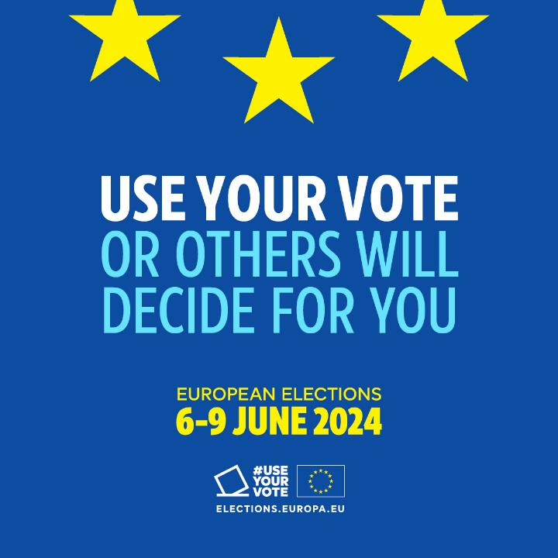
Notes:
The European Parliament is in the lead for the call to vote.
The main phase of the EP's ‘go-to-vote’ campaign started on 29 April.
The message is ‘Use your vote. Or others will decide for you’.
The central element is a four-minute ‘hero movie’/documentary that also exists in shorter versions, different formats and languages. It is accompanied by a wide range of other campaign assets.
The campaign movie has a strong intergenerational dimension, involving elderly citizens sharing their life experience about moments when democracy was trampled, passing it on to the younger generations and urging them to vote and preserve democracy.
As of 29 April, as part of an interinstitutional effort to generate momentum for a viral impact, the Commission supports and amplifies the ‘hero movie’ and the go-to-vote campaign through all its channels and networks at a similar level as in 2019.
We use the hashtags #UseYourVote (other language versions here) and #EUelections2024 (other language versions here).
The hero movie/documentary is hosted on the European elections website and on YouTube.
All movie formats and languages are available for download in the EP Multimedia Center.
Practical guidance and technical information about the campaign assets are available here.
Commission staff is encouraged to share the EP’s go-to-vote ‘hero movie’ and related assets.
DG COMM advises against using the EP’s campaign email signature for staff.

Slide 27
Thank you!

