Slide 1
The Effect of Age-Specific Social Distancing Recommendation on Healthcare Utilization
Jukka Laaksonen (THL, UTU) (with Mika Kortelainen and Henri Salokangas)
31.1.2025
Terveystaloustieteen päivä Helsinki
Social distancing and healthcare utilization

Slide 2
Introduction
In March 2020, the World Health Organization (WHO) declared COVID-19 a global pandemic
▶ Reports indicated that older individuals, particularly those with pre-existing medical conditions, faced higher case-fatality rates
▶ Age-specific stay-at-home recommendations were implemented in many countries
In Finland, the government declared a state of emergency on March 16, 2020
▶ Individuals aged 70 and older were instructed to remain in quarantine-like conditions until June 23, 2020.
▶ Individuals with underlying health conditions were also considered as part of the risk group
We apply regression discontinuity (RD) design to study the effect of the Finnish
age-specific social distancing recommendation on healthcare utilization, using extensive Finnish register data.
Social distancing and healthcare utilization

Slide 3
Main results
We found a decline of
▶ 1.0 percentage points in the probability of private dental care visits (-11.8 %) and
▶ 1.1 percentage points in the probability of non-acute specialized care visits (-7.9 %)
Additionally, we found that the reduction in private dental care was partly compensated after the lockdown was lifted
▶ 0.6 percentage point increase during the post period (+5.4 %)
Social distancing and healthcare utilization

Slide 4
Previous literature
Reductions in healthcare utilization have been observed during the pandemic, especially among individuals with no severe health issues (Moynihan et al., 2021)
▶ Both in the context of emergency and outpatient care visits (Hartnett et al., 2020; Sim and Nam, 2022)
▶ Potentially increased risk of preventable hospitalization when appropriate treatment in primary care is not received (Gibson et al., 2013; Loyd et al., 2023)
Do social distancing or other non-pharmaceutical interventios (NPIs) explain the declines in health care use during the first wave?
Social distancing and healthcare utilization

Slide 5
Previous literature
Our study is most closely related to recent studies from Turkey and Sweden (Altindag et al., 2022; Bonander et al., 2022) which investigated the effects of age-specific social distancing using RD design
Altindag et al. (2022) found that a strict curfew on adults aged over 65 led to reduced mobility
▶ Deteriorating effect on self-reported mental health
Bonander et al. (2022) found that a non-mandatory social distancing recommendation directed at ages 70 and older reduced severe COVID-19 cases
▶ Based on survey data (one question for "Weekly visits to healthcare provider"), no impacts on overall healthcare visits
Social distancing and healthcare utilization

Slide 6
Our contribution
Our study complements previous knowledge on the decline in healthcare service use in response to social distancing measures during the COVID-19 pandemic.
▶ Prior evidence on age-specific effects relies on survey data and provide only rough estimates on healthcare use (Altindag et al., 2022; Bonander et al., 2022)
Our contribution lies particularly in the detailed analysis of various service types across different sectors of healthcare system.
We shed light on which particular types of services may be most sensitive to distancing measures among elderly (+70 years old)
Social distancing and healthcare utilization

Slide 7
Data
Nationwide Finnish administrative data sources compiled by Statistics Finland (INVEST)
▶ The Finnish Institute for Health and Welfare (THL)
⋆ Care Register for (specialized) Health Care and Register of Primary Health Care Visits
▶ The Finnish Social Insurance Institution
⋆ Drug prescriptions, visits in private dental care
▶ FOLK-longitudinal data modules
⋆ Basic individual characteristics such as age, gender, education, residential information etc.
▶ Causes of death register
Analytical sample
▶ Individuals aged 60–80 living in Finland at the time of the lockdown
▶ We consider individuals born in March 1950 or before to be over 70 years old at the start of the lockdown
▶ We exclude individuals who turned 70 during the lockdown (born in the second quarter of
1950) as their treatment status cannot be unambiguously determined.
▶ Separate analyses for individuals with and without a health risk factor
Social distancing and healthcare utilization

Slide 8
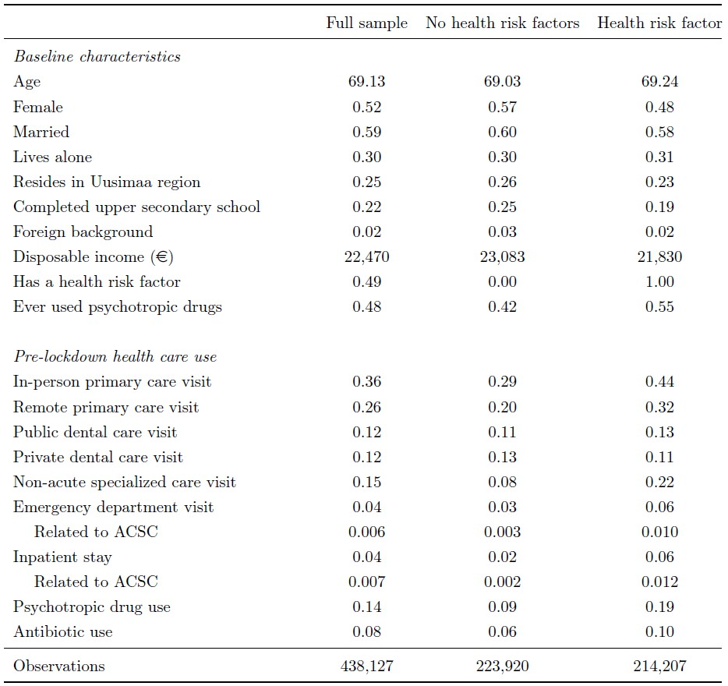
Descriptive statistics for individuals aged 67-73
Social distancing and healthcare utilization

Slide 9
Methods
We apply RD design, considering age as the running variable and the age of 70 at the start of the lockdown as the cutoff in the running variable:
Y_{i} = α + τ D_{i} + f (X_{i} ) + ϵ_{i} , (1)
where Y_{i} is the outcome for individual i , D_{i} is the treatment indicator which gets the value of 1 for individuals who were at least 70 years old in March 2020 (i.e. born in March 1950 or before) and 0 otherwise. The running variable age is represented by X_{i} and f (X_{i} ) is a linear function of age fitted separately on both sides of the cutoff. The error term is represented by ϵ_{i} .
For each outcome, we apply the mean squared error (MSE) optimal bandwidth selection method by Calonico et al. (2014) and report robust confidence intervals using this optimal bandwidth.
Social distancing and healthcare utilization

Slide 10
Preliminary checks
The baseline characteristics are balanced across the threshold (Appendix 1)
We find no evidence on remarkable differences in healthcare utilization between the treatment and control group during the three-months pre-lockdown period (Dec 2019 - Feb 2020) (Appendix 2, Appendix 3, and Appendix 4)
Social distancing and healthcare utilization

Slide 11
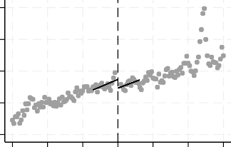
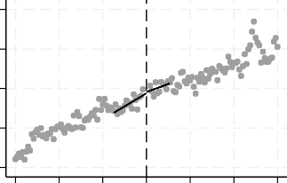
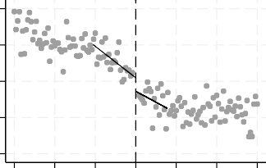
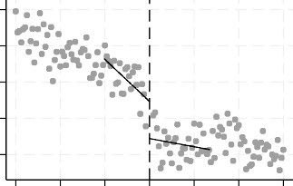
Impact of lockdown on primary and dental care visits
In-person primary care visit
Remote primary care visit
.4
.4
.35
.35
P(Visit)
P(Visit)
.3
.3
.25
.25
.2
.2
64 66 68 70 72 74 76
Age at the start of the lockdown
64 66 68 70 72 74 76
Age at the start of the lockdown
Public dental care visit
Private dental care visit
.09
.11
.08
.1
P(Visit)
P(Visit)
.09
.07
.06
.08
.07
.05
64 66 68 70 72 74 76
Age at the start of the lockdown
64 66 68 70 72 74 76
Age at the start of the lockdown
Social distancing and healthcare utilization

Slide 12
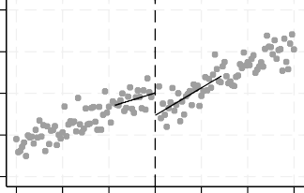
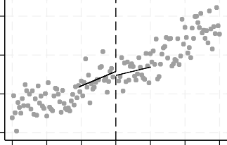
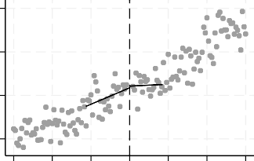
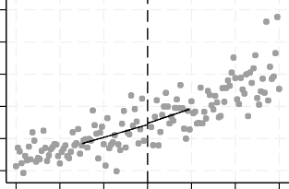
Impact of lockdown on specialized care use and mortality
Non-acute specialized care visit
Emergency department visit
.18
.06
.16
P(Visit)
P(Visit)
.05
.14
.12
.04
.1
.03
64 66 68 70 72 74 76
Age at the start of the lockdown
64 66 68 70 72 74 76
Age at the start of the lockdown
Inpatient stay
Death during the lockdown
.06
.012
P(Inpatient stay)
.01
.05
P(Death)
.008
.006
.004
.002
.04
.03
64 66 68 70 72 74 76
Age at the start of the lockdown
64 66 68 70 72 74 76
Age at the start of the lockdown
Social distancing and healthcare utilization

Slide 13
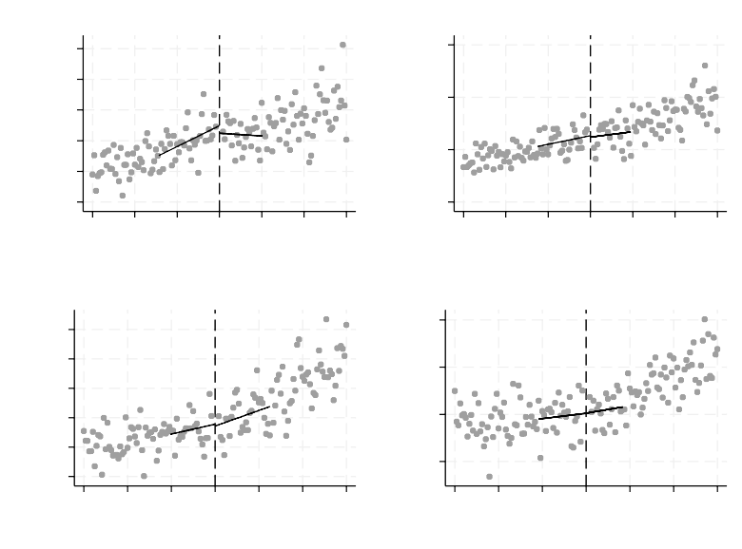
Impact of lockdown on ACSC related specialized care use and drug consumption
Emergency department visit (ACSC)
Inpatient stay (ACSC)
.012
.015
.01
.008
.006
.004
.002
P(Visit)
P(Visit)
.01
.005
0
64 66 68 70 72 74 76
Age at the start of the lockdown
64 66 68 70 72 74 76
Age at the start of the lockdown
Psychotropic drug use
Antiobiotic use
.18
.17
.16
.15
.14
.13
.1
P(Drug purchase)
P(Drug purchase)
.09
.08
.07
64 66 68 70 72 74 76
Age at the start of the lockdown
64 66 68 70 72 74 76
Age at the start of the lockdown
Social distancing and healthcare utilization

Slide 14
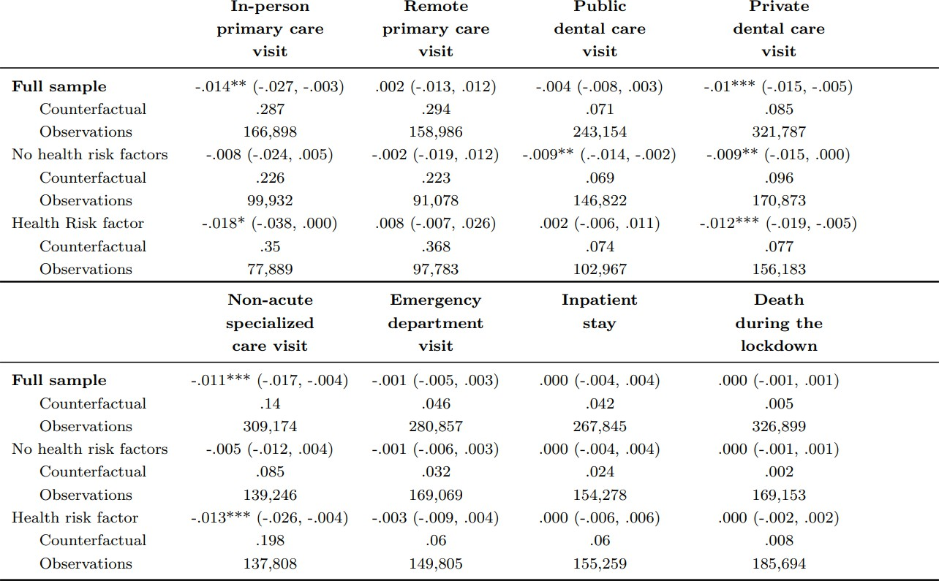
Impact of lockdown on healthcare use and mortality
Social distancing and healthcare utilization

Slide 15
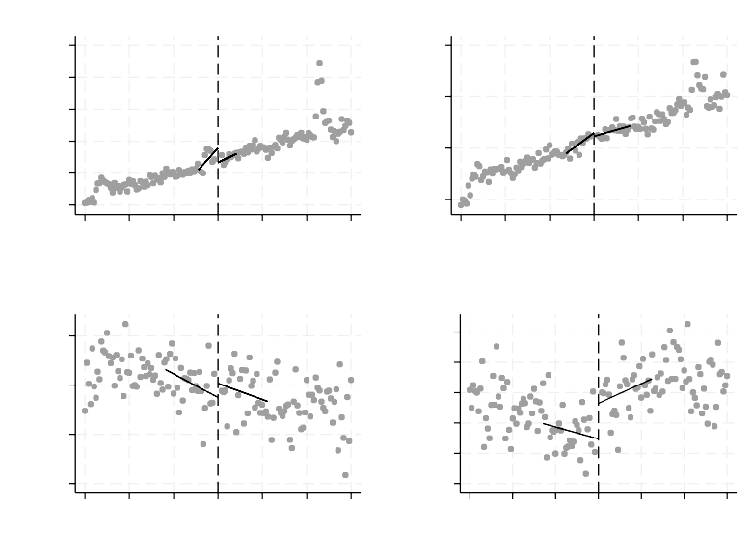
Primary and dental care use during the three-months post-period (Jul 2020–Sep 2020)
In-person primary care visit
Remote primary care visit
.5
.45
.35
P(Visit)
.4
.35
P(Visit)
.3
.25
.3
.25
.2
64 66 68 70 72 74 76
Age at the start of the lockdown
64 66 68 70 72 74 76
Age at the start of the lockdown
Public dental care visit
Private dental care visit
.12
.13
.125
.12
.115
.11
.105
P(Visit)
.11
P(Visit)
.1
.09
64 66 68 70 72 74 76
Age at the start of the lockdown
64 66 68 70 72 74 76
Age at the start of the lockdown
Social distancing and healthcare utilization

Slide 16
Conclusions
The Finnish age-specific recommendation during the COVID-19 pandemic resulted in modest delays in non-acute care
▶ The declines took place in services which can likely be postponed without creating costly healthcare burden at a later phase
▶ The lockdown did not hinder access to acute healthcare services or create substantial healthcare burdens within the observation periods
An age-specific distancing recommendation may to some extent reduce immediate healthcare demand during pandemics but is unlikely to strain public health in the medium term
▶ Even longer post-period could still be examined
Social distancing and healthcare utilization

Slide 17
Literature
Altindag, O., Erten, B., and Keskin, P. (2022). Mental health costs of lockdowns: Evidence from age-specific curfews in Turkey. Am. Econ. J. - Appl. Econ., 14(2):320–343.
Bonander, C., Stranges, D., Gustavsson, J., Almgren, M., Inghammar, M., Moghaddassi, M., Nilsson, A., Capdevila Pujol, J., Steves, C., Franks, P., Gomez, M., Fall, T., Björk, J., Sweden, C. S. S., Chan, A., Ourselin, S., Spector, T., Wolf, J., Kennedy, B., Fitipaldi, H., Hammar, U., Maziarz, M., Tsereteli, N., Oskolkov, N., Varotsis, G., and Spiliopoulos, L. (2022). A regression discontinuity analysis of the social distancing recommendations for older adults in Sweden during COVID-19. Eur. J. Public Health, 32(5):799–806.
Calonico, S., Cattaneo, M. D., and Titiunik, R. (2014). Robust nonparametric confidence intervals for regression-discontinuity designs.
Econometric Theory, 30(3):546–557.
Gibson, O. R., Segal, L., and McDermott, R. A. (2013). A systematic review of evidence on the association between hospitalisation for chronic disease related ambulatory care sensitive conditions and primary health care resourcing. BMC Health Serv. Res., 13(1).
Hartnett, K., Kite-Powell, A., DeVies, J., Coletta, M., Boehmer, T., Adjemian, J., Gundlapalli, A., and of Practice, N. S. S. P. C. (2020). Impact of the covid-19 pandemic on emergency department visits — United States, January 1, 2019–may 30, 2020. Morb. Mortal. Wkly. Rep., 69(23):699–704.
Loyd, C., Blue, K., Turner, L., Weber, A., Guy, A., Zhang, Y., Martin, R. C., Kennedy, R. E., and Brown, C. (2023). National norms for hospitalizations due to ambulatory care sensitive conditions among adults in the us. J. Gen. Intern. Med., 38(13):2953–2959.
Moynihan, R., Sanders, S., Michaleff, Z., Scott, A., Clark, J., To, E., Jones, M., Kitchener, E., Fox, M., Johansson, M., Lang, E., Duggan, A., Scott, I., and Albarqouni, L. (2021). Impact of COVID-19 pandemic on utilisation of healthcare services: a systematic review. BMJ Open, 11(3):e045343.
Sim, B. and Nam, E. (2022). The impact of COVID-19 pandemic on outpatient visits for all-cause and chronic diseases in Korea: A nationwide population-based study. Intern. J. Environ. Res. Pub. Health, 19(9):5674.
Social distancing and healthcare utilization

Slide 18
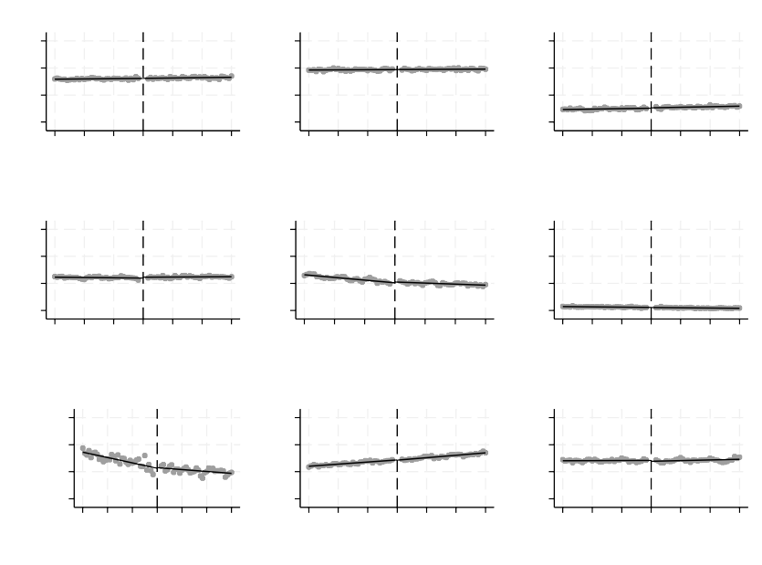
Preliminary checks: balanced covariates
Female
Married
Lives alone
.8
.6
.4
.2
.8
.6
.4
.2
.8
.6
.4
.2
67 68 69 70 71 72 73
Age at the start of the lockdown
67 68 69 70 71 72 73
Age at the start of the lockdown
67 68 69 70 71 72 73
Age at the start of the lockdown
Resides in Uusimaa region
Completed upper secondary school
.6
.4
.2
0
67 68 69 70 71 72 73
Age at the start of the lockdown
Foreign background
.6
.4
.2
0
.6
.4
.2
0
67 68 69 70 71 72 73
Age at the start of the lockdown
67 68 69 70 71 72 73
Age at the start of the lockdown
Disposable income (€)
Has a health risk factor
Ever used psychotropic drugs
26000 | .8 |  | .8
24000 | .6 |  | .6
22000 | .4 |  | .4
20000 | .2 |  | .2
67 68 69 70 71 72 73 Age at the start of the lockdown |  | 67 68 69 70 71 72 73 Age at the start of the lockdown |  | 67 68 69 70 71 72 73 Age at the start of the lockdown
Social distancing and healthcare utilization

Slide 19
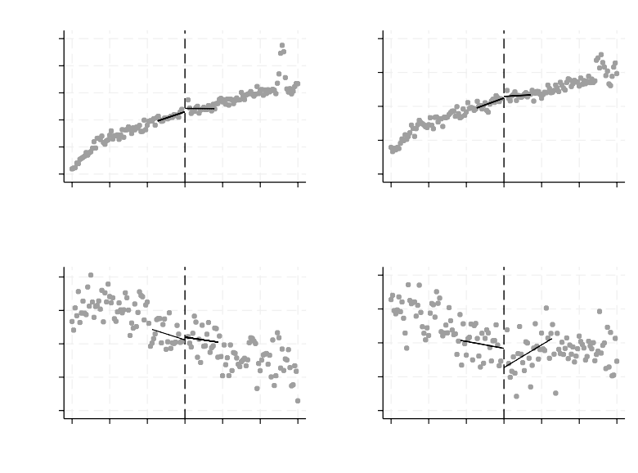
Preliminary checks: Primary and dental care visits during the three-months pre-period (Dec 2019–Feb 2020)
In-person primary care visit
Remote primary care visit
.5
.45
.35
.3
P(Visit)
.4
.35
P(Visit)
.25
.3
.25
.2
.15
64 66 68 70 72 74 76
Age at the start of the lockdown
64 66 68 70 72 74 76
Age at the start of the lockdown
Public dental care visit
Private dental care visit
.14
.14
.13
.13
P(Visit)
P(Visit)
.12
.12
.11
.11
.1
.1
64 66 68 70 72 74 76
Age at the start of the lockdown
64 66 68 70 72 74 76
Age at the start of the lockdown
Social distancing and healthcare utilization

Slide 20
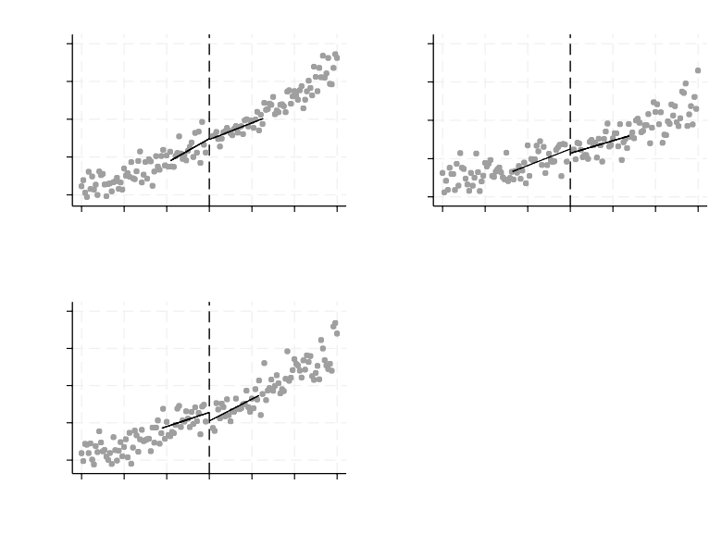
Preliminary checks: Specialized care use during the three-months pre-period (Dec 2019–Feb 2020)
Non-acute specialized care visit
Emergency department visit
.2
.07
.18
.06
P(Visit)
.16
P(Visit)
.05
.14
.04
.12
.03
64 66 68 70 72 74 76
Age at the start of the lockdown
64 66 68 70 72 74 76
Age at the start of the lockdown
Inpatient stay
.07
.06
.05
.04
.03
64 66 68 70 72 74 76
Age at the start of the lockdown
P(Inpatient stay)
Social distancing and healthcare utilization
20 / 17

Slide 21
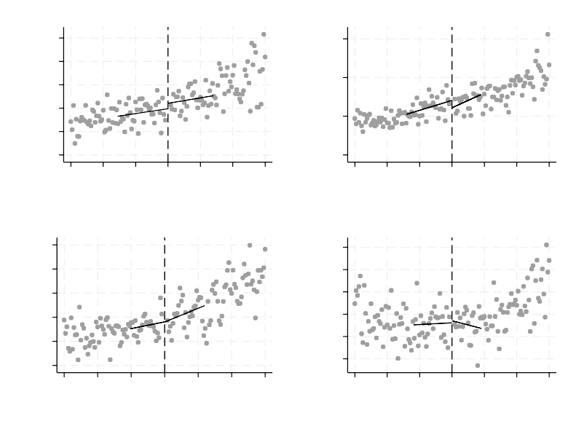
Preliminary checks: ACSC related specialized care use and drug consumption during the three-months pre-period (Dec 2019–Feb 2020)
Emergency department visit (ACSC)
Inpatient stay (ACSC)
.012
.01
.008
.006
.004
.002
.015
P(Visit)
P(Visit)
.01
.005
0
64 66 68 70 72 74 76
Age at the start of the lockdown
64 66 68 70 72 74 76
Age at the start of the lockdown
Psychotropic drug use
Antiobiotic use
.17
.095
.09
.085
.08
.075
.07
P(Drug purchase)
.16
.15
P(Drug purchase)
.14
.13
.12
64 66 68 70 72 74 76
Age at the start of the lockdown
64 66 68 70 72 74 76
Age at the start of the lockdown
Social distancing and healthcare utilization
21 / 17

Slide 22
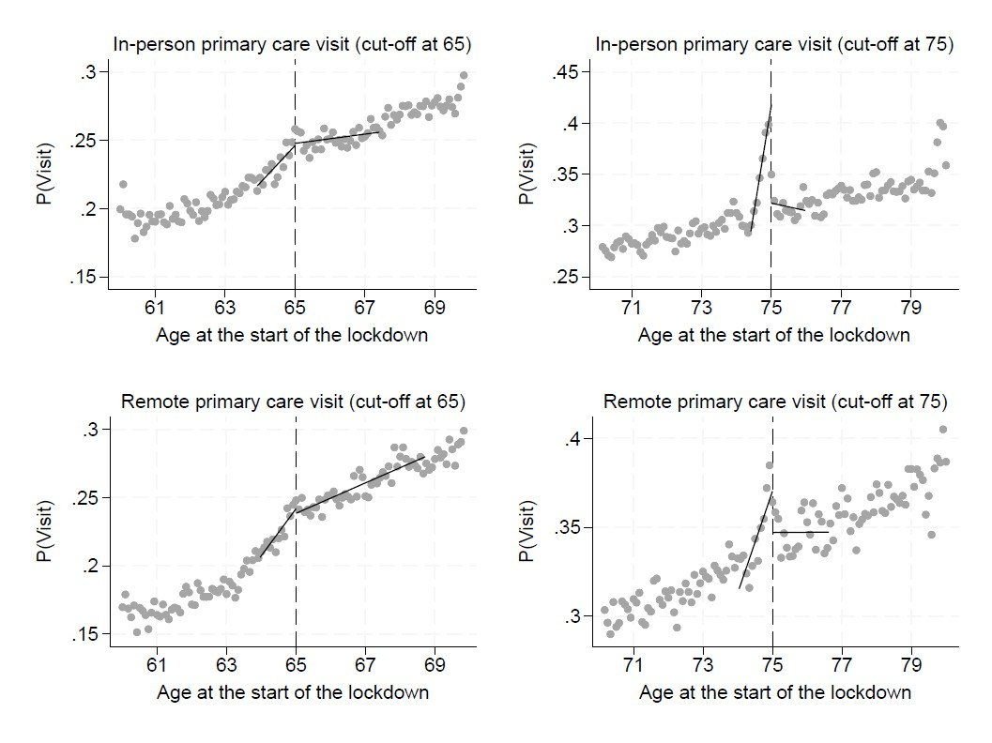
Primary care visits at the ages of 65 and 75
Social distancing and healthcare utilization
22 / 17

Slide 23
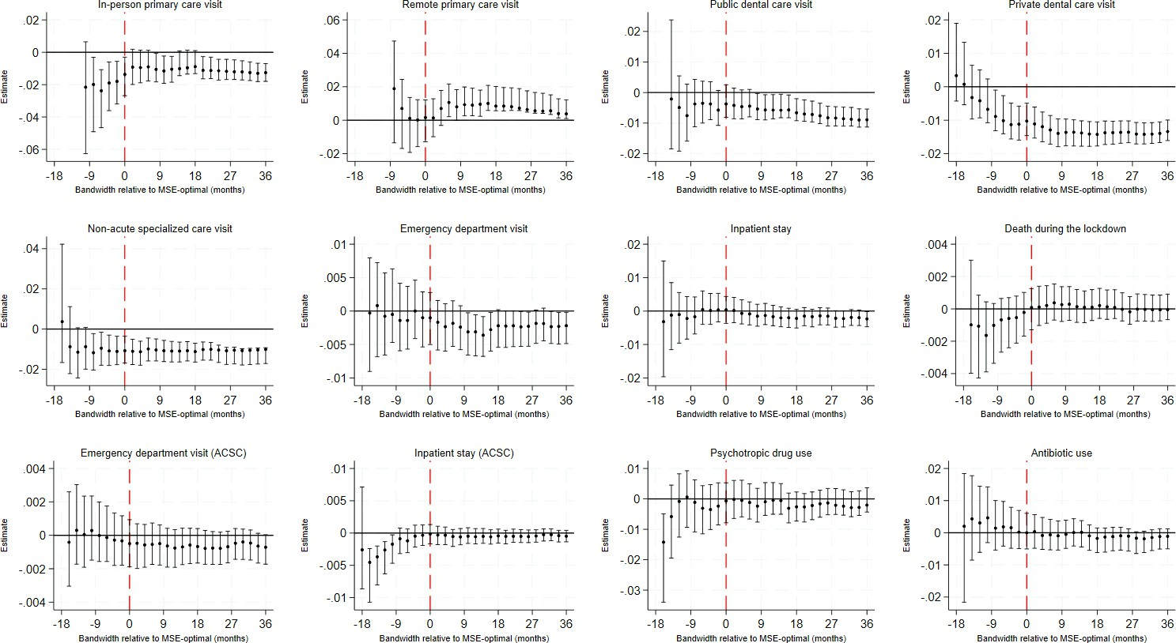
Main estimates with alternative windows
Social distancing and healthcare utilization
23 / 17

