Slide 1
Need-adjusted formula funding for wellbeing services counties
Update 2025
Tuukka Holster and the project team

Slide 2
Funding of wellbeing services counties (WSCs)
Determinants of the allocation | %
Social and health services (total) | 97,727
Need for social and healthcare services | 79,156
Population count | 13,046
Population density | 1,458
Share of foreign languege speakers | 1,944
Share of Swedish speakers | 0,486
Share of Sámi speakers | 0,013
Non-continental land area | 0,11
University hospital supplement | 0,543
Health and welfare promotion | 0,972
Rescue services (total) | 2,273
Population count | 1,477
Population density | 0,114
Risk factors | 0,682
Since 2023, WSCs have been responsible for proving all public social and healthcare services in Finland and their funding comes from the government
The baseline level of the total funding (2023) for WSCs was based on municipalities’ social and healthcare costs in 2022
Nearly 80% of the funding is allocated to WSCs based on social and healthcare service needs (see figure)
Need-adjustment models are updated (at least) every four years, the need multipliers annually
Notes:
The annual changes in the funding level take into account the wellbeing services area index, anticipated changes in service needs (the so-called SOME model), and task changes.
The actual cost level from 2023 will be accounted for retrospectively in the 2025 funding.
A transition adjustment mechanism allows regions time to adapt to the upcoming calculated funding level.

Slide 3
The starting point for need-adjustment
The aim is to predict the service need (in euros) for each financing year and every WSC
A statistical model is implemented that provides ”the best guess” for service need in 2025 using data available in 2024
SOME-model: How much will the need for services, financed by the regions, increase nationally? (~1 % annually)
Need factors: What will be the relative service need between WSCs? The natural starting point is to estimate an individual level prospective model and aggregate the results to a regional mean

Slide 4
Social and Health Care Service Need is based on a statistical model
Linear regression is used to predict costs of service use at the person level, using disease indicators and socioeconomic and demographic variables as predictors
The model gives person-level predictions for future service use: the predictions are averaged to the county level to get predictions of average need in the county
Variables that the policy maker does not want to compensate for are ”neutralized” by setting them to country average
The publicly funded National Health Service in England uses similar models for regional allocations (Chaplin et al. 2016; NHS England, 2022), and similar statistical models are used in health plan risk adjustment (Ellis et al. 2018)

Slide 5
Need factors are based on predicted values from individual level linear model
We predict individual’s future (t+1) service use and costs based on the information from current year (t) ( = prospective model)
Potential predictive variables/factors
Demand
Need factors: morbidity, functional capability, age, sex, the availability of services in other sectors (occupational and private healthcare).
Preferences: the patient’s preferences regarding treatment intensity
Supply: the availability of services, treatment intensity
Aim is that the predictions reflect only the service need → the control variables (i.e. all variables except the need factors) are fixed to a national mean (i.e. neutralized)
Predictions are transformed to regional indices: predicted values are first (i) aggregated to regional mean and then (ii) the regional means are divided by the national mean
Measure of relative service need

Slide 6
(1) Search registers for information on people’s illnesses and background
(2) Calculate the cost of service use
👴
👧
👴
👧
👴
👧
Pertti
Ilona
Age 65
Diabetes
Reflux
Separated
3 GP visits (à 87€)
7 nurse visits (à 41€)
⋮
Total = 5548€
1 GP visit (à 87€)
Total = 87€
Age 22
No diseases
Student
👩👨‍🦲👵👨‍🦰
🧒👨👩‍🦳👶
(5) Calculate the proportional need in the county (the need multiplier)
(4) Calculate the predicted cost (=need) per person
👧
(3) Estimate the association between (1) and (2) (with a linear regression in a dataset including Pertti, Ilona and every other resident of Finland)
👴
The need in the wellbeing services county divided by the country average (for example, 2300€):
2564,75 / 2300 ≈ 1,12
1703,9 + 1068,0 + 677,2 + 89,0 = 3538,1€
1703,9 – 112,5 = 1591,4€
Constant 1703,9***
⋮ ⋮
Diabetes 1068,0***
Reflux 677,2***
Separated 89,0***
Student -112,5***
⋮ ⋮
Per person:
(3538,1 + 1591,4) / 2 = 2564,75€

Slide 7
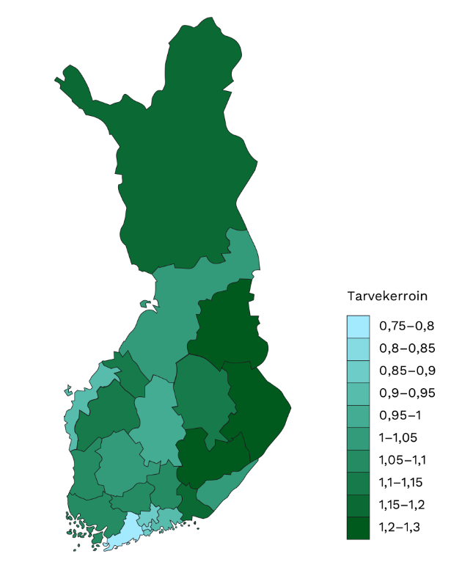
Service need varies considerably between wellbeing services counties
Need multipliers for 2025
Need multiplier measures the average need in the county relative to the average in Finland
The smaller the number, the lower the average need in the county (relative to the rest of the country)

Slide 8
We aim to identify credible predictive variables and to report the associated uncertainty
The decision to include any varible is based on the variable’s assumed predictive statistical power and on the assumed mechanism, by which the variable explains the predicted variable
Not a pure predictive model, because some variables are included only as controls → need to make assumptions about the mechanism
Necessary to form an opinion on whether (i) the variable reflects need or other sources of variation (ii) whether the inclusion of the variable could lead to adverse incentives
We have tried using same variables in multiple versions: simple vs. complex
For example, country of origin being other than Finland vs. indicators for the exact country of origin
The simple version is preferred for transparency
If the the most complex version of the variable does not increase the predictive power, it is better to pick the simpler version
For transparency, we report both the predictive power and the impact on need multipliers for all versions of a single variable

Slide 9
Data
Service use costs (the predicted variable): Care registry, child wellfare registry and outpatient social care registry from a few regions. To get total costs, we multiply the number of service visits by the average national unit costs.
Morbidity: Care registry (primary and secondary diagnosis, which are the reason for the visit; long term diagnosis; information on benefits and pensions from Kela and ETK (work disability pensions, sickness benefit, disability benefit, rehabilitation), prescription drug reimbursement registry (diagnosis or reimbursement codes), cancer registry, childbirth registry, visual impairment registry
Other information: Statistics Finland’s FOLK modules

Slide 10
Following general practice, we estimate the model and calculate the residuals using different samples
We estimate the model using data from one year and then validate the results using data from another year (i.e., estimation sample 2021→2022, validation sample 2022→2023)
This allows us to compare models that include different predictor variables
A model may perform well in estimation sample but predict poorly out of sample (overfitting)
This does not matter much with current number of predictive variables: in-sample and out-of-sample performance are similar

Slide 11
Contents in the next model update
Data update (2018/2019 → 2021/2022)
Disease classification update
The classification has been developed with clinical experts
Both predictive performance and incentives are important:
A more detailed classification of diseases improves predictive performance (up to some point)
On the other hand, each group should include sufficiently similar diagnoses and ambiguous diagnoses should be avoided
We try some new predictive variables:
Broader set of supply factors (number of doctors and nurses in municipality per 1000 inhabitants, waiting time to primary care and specialized care services, the number of incoming referrals in specialized care)
Information about the parents
The use of services in occupational and private care
Other: more precise information on labor market status (i.e. company size) and country of origin

Slide 12
Because the objective is to predict county-level service need, model evaluation should be done at the county level
County population changes over time, and costs of acute diseases are difficult to predict at the person level
It is possible to predict the service use of a cancer patient, but not the likelihood of pneumonia or childbirth (random pandemics are particularly difficult)
One possibility is to combine prospective and concurrent models so that the same regression includes data from both the year preceding service use and the same year (Dudley et al. 2003)
It is assumed that concurrent variables remain stable at the regional level over a short period
The current funding model includes such elements: childbirths and premature births
However, it is not meaningful to compare such a model with a pure predictive model based on individual-level criteria
County-level assessment enables the comparisons of the current model and structurally different models

Slide 13
Preliminary results
The impact of the updates on predictive ability is moderate in healthcare and elderly care, but there is a significant improvement in social services.
Perhaps not surprisingly, identification of diseases beyond public healthcare (i.e., from private and occupational care) weakens predictive ability.
Despite of the low person-level predictive performance, one may expect county-level prediction errors to be smaller

Slide 14
Uncertainty related to variable selection, regression coefficients, and the annual values of predictors
With slightly different variable sets, it is possible to achieve practically the same predictive power, and then the predictions of the models should also ideally be very close to each other
Prediction intervals caused by model specification uncertainty have been published before.
The impact of model uncertainty arising from the standard errors of regression coefficients – is it possible to evaluate the distribution using bootstrapping?
The impact of uncertainty related to the annual values of predictors – bootstrapping?
Since annual fluctuations in need calculations cause significant challenges, this would be highly policy-relevant.

Slide 15
Bootstrapping of the need calculations
Uncertainty caused by annual values of need factors:
Repeat many (~1000) times:
a. For the specified county, draw a sample with replacement from the annual observations (residents) for the county equal to the county population size (e.g., for Helsinki, ~660,000 observations sampled with replacement). b. Run the regression model on the entire national population, replacing the actual observations of the welfare area with the sample drawn in step (a). c. Calculate the service need for the county.
Generate a distribution of need estimates for the county
Uncertainty Caused by the Standard Errors of Regression Coefficients: Follow the same process, but sample with replacement at the national level.

Slide 16
Next steps
Self-assessed health and preferences from Finsote and TerveSuomi datasets
Testing disease classifications of other countries: The English classification (Chaplin et al., 2016) has already been tested earlier (Holster et al., 2022); the next step could be the American Diagnostic Items Classification System, which includes approximately 3,000 categories (Ellis et al., 2022).
Recent registry data:
RAI functional ability data in elderly care (2025).
Emergency care registry (2025).
Social welfare monitoring registry (2027).
Kanta - patient data archive.

Slide 17
Literature
Chaplin, M., Beatson, S., Yiu-Shing, L., Davies, C., Smyth, C., Burrows, J., Weir, R. & Tatarek-Gintowt, R. (2016). Refreshing the Formulae for CCG Allocations. For allocations to Clinical Commissioning Groups from 2016-2017. Report on the methods and modelling. ANHS England, Analytical Services (Finance).
NHS England (2022). Update of the formula for general and acute hospital services for 2022/23 allocations.
Dudley, R. A., Medlin, C. A., Hammann, L. B., Cisternas, M. G., Brand, R., Rennie, D. J., & Luft, H. S. (2003). The best of both worlds? Potential of hybrid prospective/concurrent risk adjustment. Medical Care, 41(1), 56-69.
Ellis, R. P., Hsu, H. E., Siracuse, J. J., Walkey, A. J., Lasser, K. E., Jacobson, B. C., ... & Ash, A. S. (2022). Development and assessment of a new framework for disease surveillance, prediction, and risk adjustment: the diagnostic items classification system. In JAMA Health Forum (Vol. 3, No. 3, pp. e220276-e220276). American Medical Association.
Ellis, R. P., Martins, B. & Rose, S. (2017). Risk Adjustment for Health Plan Payment. In McGuire, T.G. & van Kleef, R. (eds.) Risk Adjustment, Risk Sharing and Premium Regulation in Health Insurance Markets: Theory and Practice. 1-45. Elsevier Press.
Holster, T., Haula, T. & Korajoki, M. (2022). Sote-rahoituksen tarvevakiointi: Päivitys 2022. THL-työpaperi 26/2022.
Holster, T., Ji, S., & Marttinen, P. (2024). Risk adjustment for regional healthcare funding allocations with ensemble methods: an empirical study and interpretation. The European Journal of Health Economics, 1–15.

