Slide 1
Medical labour under low powered financial incentives
Carol Propper
Imperial College London, Monash University and IFS

Slide 2
Some facts
Healthcare production is an important part of the economy in rich – and less rich – countries
Sector is labour intensive
Large variation in productivity across - and within - firms

Slide 3
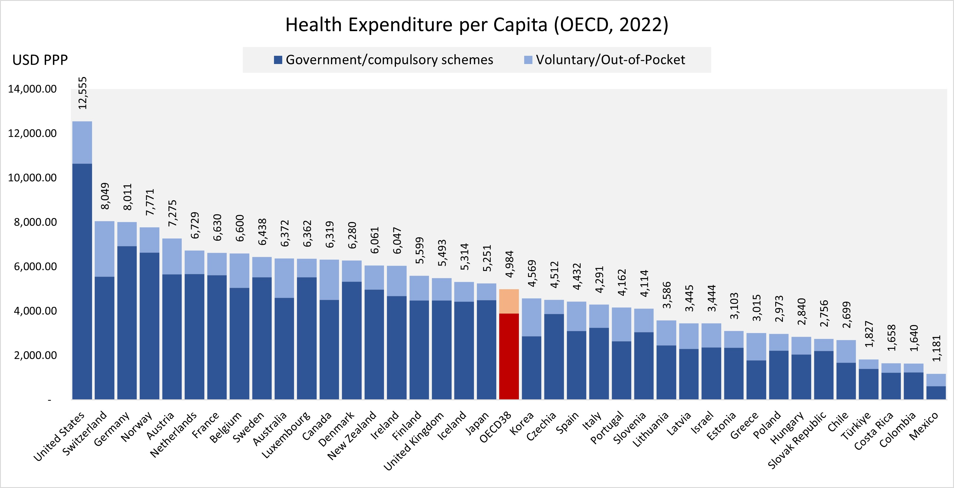
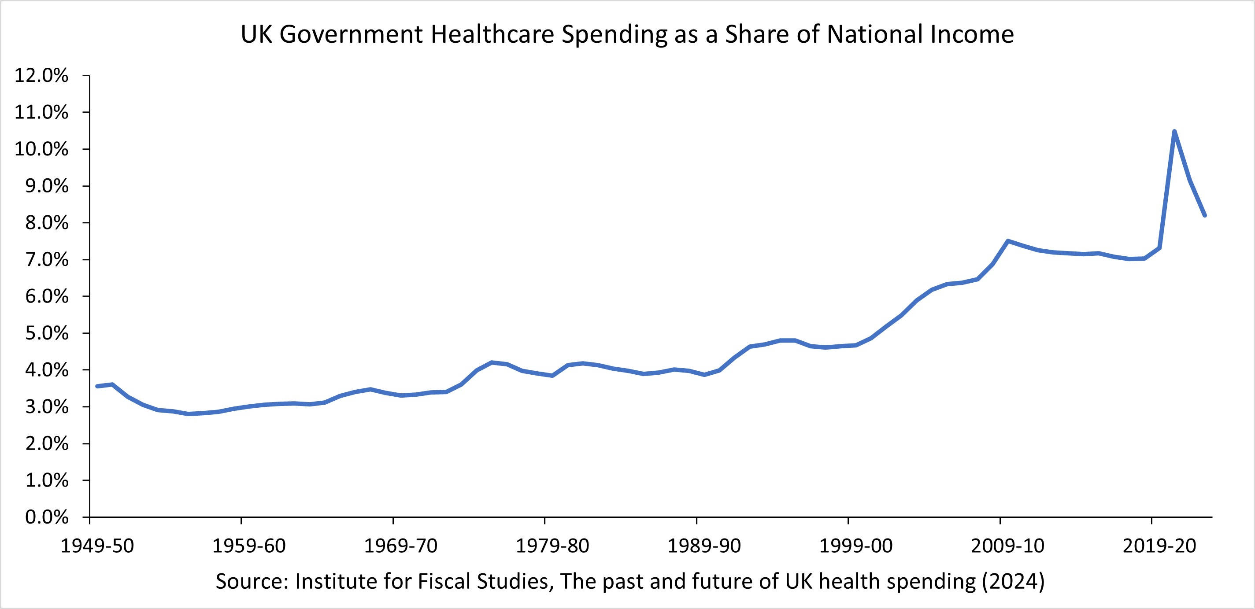
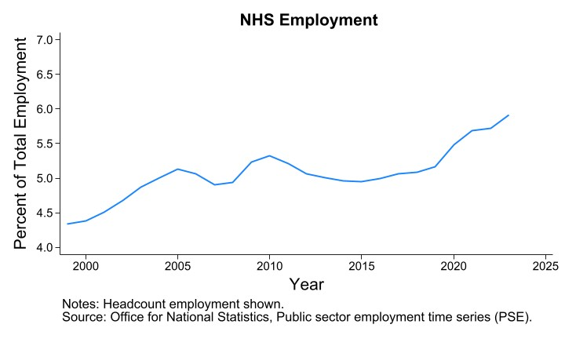
More facts …

Slide 4
More facts…..
Regional variation
Large variations in healthcare utilization (unrelated to outcomes) across regions after adjustments for prices and patients' characteristics (Skinner, 2012)
Variation in spending at physician level (within ER)
Physicians at 75th percentile of spending distribution consume 20% more resources than those at the 25th percentile (Van Parys 2016)
Variation in outcomes at physician level (within ER)
Moving between a doctor at 10th to 90th percentile reduces mortality by 29% of the mean mortality rate (Stoye 2023)

Slide 5
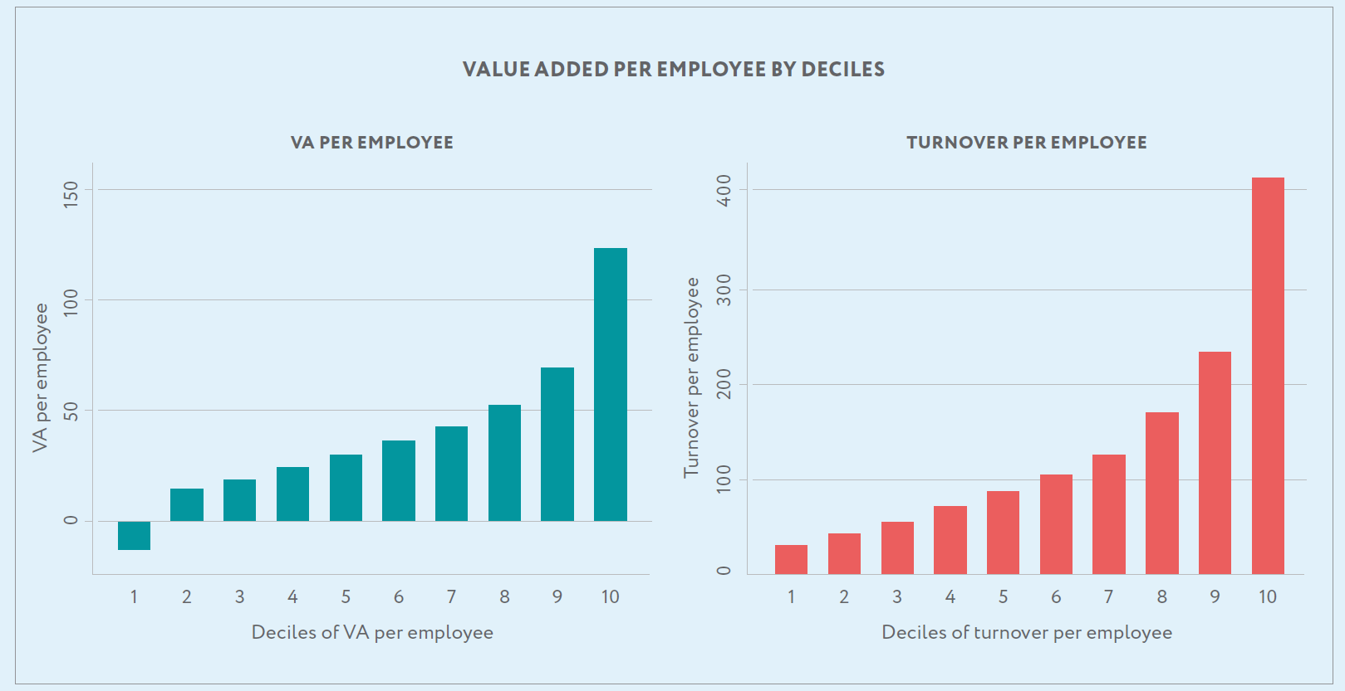
Productivity dispersion not unique to healthcare
Persistent heterogeneity in firm productivity (and other dimensions of performance) in narrowly defined industries in many countries and time periods (e.g. Foster, Haltiwanger, Syverson 2008; Bartelsman & Dhrymes 1998)
Productivity institute 2023

Slide 6
Healthcare production is an important part of the economy in rich – and less rich – countries
Sector is labour intensive
Large variation in productivity within the sector
=> Need to understand what drives productivity within the firm

Slide 7
One way of increasing productivity: financial incentives
Piece rates, performance related pay (individual or groups), career concerns, ……
More widely used in private sector than in public sector
Examples of their successful (and unsuccessful) use in public sector (e.g. teachers, bureaucrats)

Slide 8
Using financial incentives in healthcare: Theory
High powered incentives for public services providers not needed or counter-productive (Besley Ghatak 2005; Benabou Tirole 2006)

Slide 9
Using financial incentives in healthcare: Practice
Increase remuneration
Short-run elasticities for physicians relatively small (Nicolson and Propper 2012; Lee et al 2019; Propper et al. 2024)
Career concerns – less studied in healthcare settings
Pay for performance for individuals and groups
Substantial variation in effectiveness in both rich and less rich countries
Issues of enforcement particularly problematic in LMICs (Mullen et al. 2012; Banerjee, Glennerster, Duflo 2008; Kovacs et al 2020)

Slide 10
Using financial incentives in healthcare
Large component of variation in utilisation and outcomes in healthcare maybe unrelated to physician financial incentives
Supply-side factors important determinants of observed geographical variations (Finkelstein et al., 2016; Godøy & Huitfeldt, 2019)
Differences in health care utilization more pronounced within than across regions and among physicians within than across hospitals (Tsugawa et al., 2017)
Financial strain on healthcare systems worldwide implies widespread use of high-powered financial incentives unlikely to be of practical value to policy makers

Slide 11
Non-financial incentives/work organisation as driver of productivity
Distribution of decision rights between managers and workers (autonomy/decentralisation), job design (flexibility), team working (who works with whom), information provision
Management (Bloom and Van Reenen 2008, Fenizia 2022; Rasul and Rogger 2018; Munez and Otero 2024, Janke et al 2022)
Teams (75% employment in US in occupations where team work very/extremely important) (Lindbeck and Snower 2000, Hamilton, Nickerson, Owen 2003)
Peers (Kandel and Lazear 1992, Mas and Moretti 2009) + Social Networks (Bandiera, Barnakay, Rasul 2009)

Slide 12
Physician practice style focuses on non-financial incentives
Physicians exhibit systematic differences in their treatment decisions for similar patients after allowing for common incentives and constraints (e.g., financial considerations, litigation risks, infrastructure)
Approximately 50% of the variation in medical practice can be attributed to individual physicians (Spinola 2024)

Slide 13
Non-financial factors associated with practice style
Preferences and beliefs (Cutler et al 2019, Chan et al 2022)
Physician quality
Diagnostic skill + procedural skill (Currie and Macleod 2020, Currie et al 2016, Simeonova et al 2022)
Interact e.g. less skilled order more tests => neg corr between physician quality and costs (Gowrisankaran et al 2022, Silver 2021)
Access to, and use of, information (e.g. use of guidelines)
Learning by doing
Practice environment (Molitor 2018; Avdic et al 2023)
Peers, management, local systems….

Slide 14
Three examples of physician behaviour and outcomes where financial incentives are low powered
Impact of peers on the adoption of innovation
Responses to news and patient outcomes
Nursing teams and patient outcomes
Context – UK/Swedish NHS
Single payor system, similar financial incentives for hospitals, widespread use of regulated wages + limited patient choice

Slide 15
Impact of peers on innovation diffusion
Barrenho, Gautier, Miraldo, Propper, Rose
(Mgmnt Sci 2024)

Slide 16
Impact of peers on innovation diffusion
Interactions amongst co-workers important for innovation
Difficult to study within skilled workers
Innovation in healthcare important but often slowly adopted
Physician networks likely to be important because of length of on-the-job training, extensive team working and the existence of tacit knowledge
Relatively little robust evidence on networks and innovation adoption outside pharma (Agha and Molitor 2018)

Slide 17
What we do
Use admin data on to construct firm-worker-task panel for 15 years
Coworkers are docs who routinely treat same patients
Use moves between hospitals – when coworkers change – to estimate (jointly) three effects coworkers may have on take-up of innovation
Extent to which individual is connected to other workers (network size)
Exposure to ‘key players’ or ‘influencers’ in network
Peer take-up
Surgical innovation - keyhole surgery in cancer treatment

Slide 18
In this setting
Expect social interactions to play an important role in innovation diffusion
OJT primary way of learning new technique, so observability of peer behaviour is likely to matter (peer effect)
Learning from a wider group of peers mitigates level of uncertainty in applicability of uncodified knowledge (network size)
Heterogeneity in peer effects (importance of opinion leaders, pioneers, peers who connect otherwise unconnected communities)

Slide 19
What we find
Significant effect of all three channels:
Largest effect is peer use of innovation
Effect also of key players in network (larger than effect of network size)
Use estimates to examine two counterfactuals designed to increase take-up (i) training programme for small group of physicians (ii) job rotation programme

Slide 20
Some qual evidence on the role of peers and networks
“…probably the most frequent way [ to adopt an innovation] is attending meetings, and I do go to quite a lot of scientific meetings, and I organize quite a few myself. So you do get to hear about innovations and new research on these things, and that’s very valuable. So that’s probably the commonest way, word of mouth, obviously. We’re a relatively friendly community in surgery, so we do tend to talk to each other about innovations and new techniques”
“I would say the majority of surgeons would learn about new tech, they hear about it by word of mouth, by discussing with colleagues and go ahead. Colleagues within the same institutions and in other hospitals.”
“Peer pressure, not wanting to look a dinosaur…”
“It’s difficult to learn a new technique, and, establish new things. You need your colleagues input. […] There was one person […] I followed his footsteps and was very influenced by him. […] I told him about my experience. And he told me about various experiences he’s had, and I thought, my God, I've done much better than him. So he had worse experience than I had in developing his technique, and he encouraged me and he really was very influential and just driving me into not really giving up.”
“…conversations with colleagues plays a big role. Well, but you wouldn’t innovate on the basis of talking to one or two people. You’ve certainly got to have more evidence than that.”
“… It’s usual from the people who are actually doing the procedure, from the papers that have come out from the practice, from the innovators, and either meeting with people, listening to these people, …”
Professional networks
Peer pressure
Info and experience
Size of network and behaviour
Source: Barrenho E, Miraldo M, Propper C (2018)

Slide 21
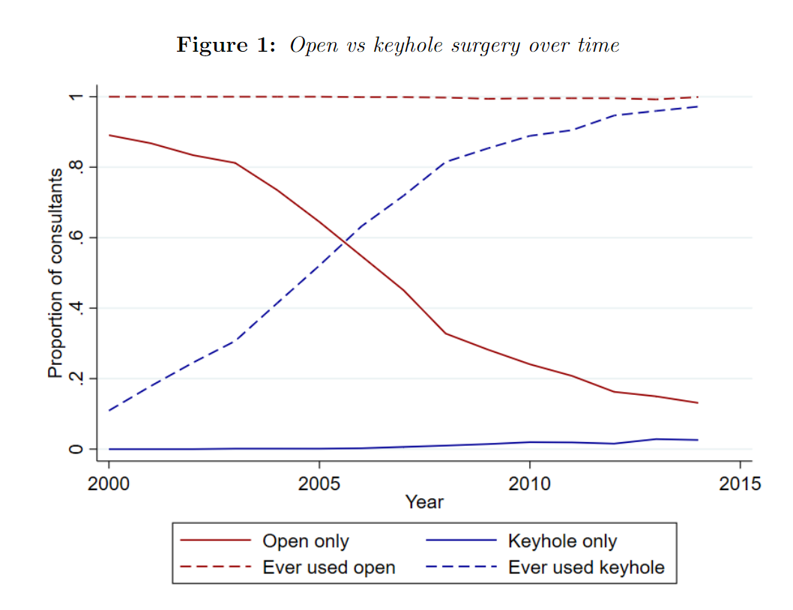
Diffusion of the innovation
11% consultants performed at least one keyhole surgery in 2005, 97% by 2014
By 2005 median consultant performed 0
By 2014 median consultant performed 52% surgeries by keyhole
Consultants do not switch discretely from doing all open to all keyhole

Slide 22
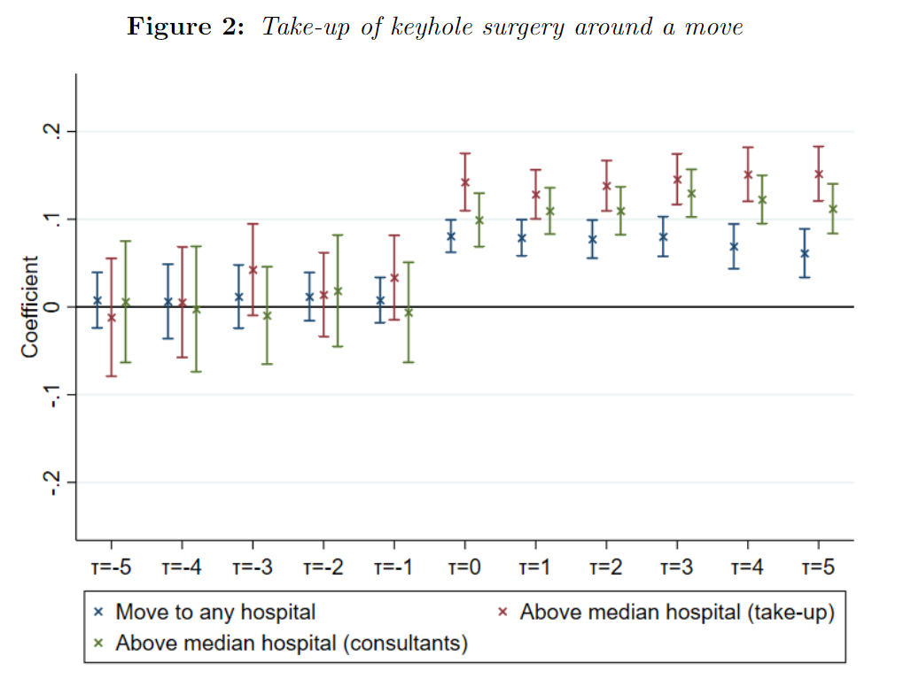
Innovation diffusion around a move

Slide 23
Empirical approach
Seek to identify coworker exposure (network centrality), key agents and peer effects
But maybe correlated effects, endogenous mobility, reflection
Need to assume
Exogenous mobility across hospitals (conditional on fixed effects for years-until-next–move and hospital-in- previous-year fixed effects)
Matrix of key agents is sparse (identification follows from consultants’ differential trajectories of mobility across hospitals)
Use IV which exploits network structure to address reflection (uses exogenous shocks to peer-of-peers who are not peers of the focal consultant)

Slide 24
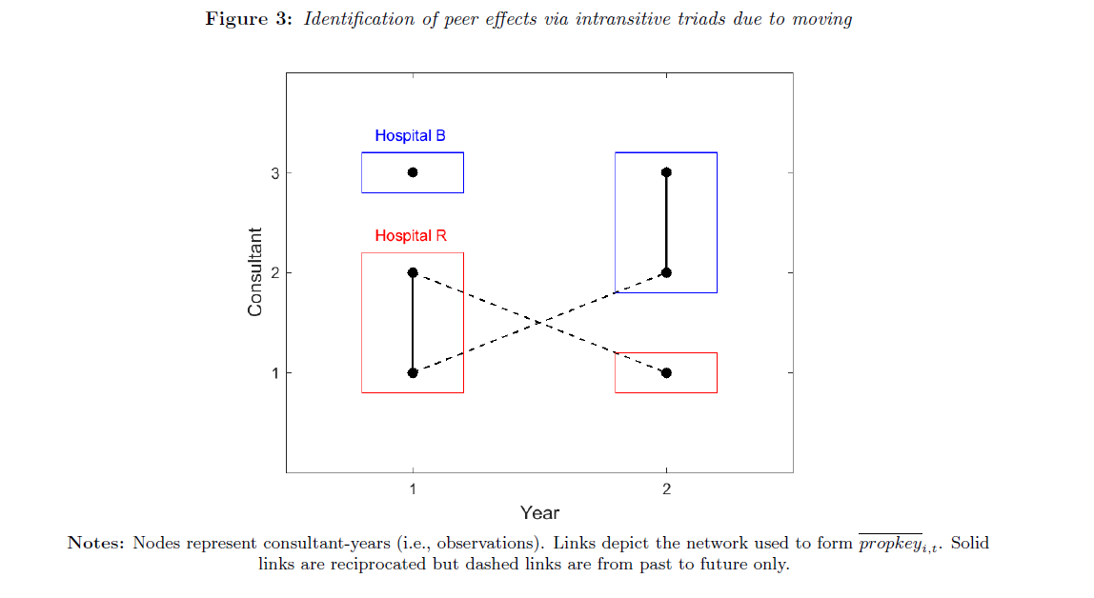
Identification of peer effects via intransitive triads due to moving
Notes:
Our identification strategy uses two key arguments. The first is that the network is
exogenously formed, which implies that consultant mobility between hospitals is not
driven by take-up of laparoscopic resection. This, along with the network’s dynamic
nature, identifies the network effects (degree and pioneer proximity). To identify the peereffects
we must also deal with the endogeneity arising from simultaneity of take-up. We
follow an instrumental variables approach which exploits variation in the characteristics
of inter-hospital peers (i.e. those practicing in different hospitals).
We treat consultant and patient characteristics as exogenous. Due to capacity based
allocation of patients to consultants and the two week waiting time guarantee, we expect
that sorting of more suitable patients to high take-up consultants be limited. Moreover,
due to the consultant fixed effect, only sorting based on annual take-up shocks would be
problematic, further limiting its potential. For these reasons we take patient suitability as
exogenous, focusing instead on endogeneity of peer take-up.
We also treat the network as exogenous. Network exogeneity is a standard assumption
in the literature on identification of peer-effects (e.g. Bramoullé et al. 2009). In our context,
it requires exogenous mobility of consultants between hospitals. We do not expect that
mobility be driven by take-up conditional on age, experience and patient characteristics,
time-invariant consultant and hospital heterogeneity and community-year heterogeneity.
All hospitals in our sample have the requisite technology for the procedure, hence there
are no incentives to move hospital for technological reasons. The consultants in our
sample also perform a range of other procedures, making it is unlikely that laparoscopic
take-up for colorectal cancer surgery plays a major role in mobility. Goldacre et al.
(2013) show that geographical considerations play a crucial role, finding that UK-trained
consultants’ tend to be located in close proximity to their pre-medical school family
home, medical school, place of training and place of first career post. These associations
are more pronounced among more recent cohorts. Goldacre et al. (2013) also document
limited mobility between regions, which we show in Figure 1 and Table 1. This suggests
that mobility is largely driven by geographical factors.
To test exogenous mobility, we estimate a linear probability model in which the dependent
variable is an indicator for moving hospitals between years t and t+1 (moveit).15
The covariates of interest are take-up in year t (yit), the proportion of laparoscopic
colorectal cancer surgeries conducted in years 00, ..., t 􀀀 1 (yi,00!t􀀀1), the proportion of
laparoscopic colorectal cancer surgeries in year t in hospital h(i, t) minus the proportion
15We use a linear probability model due to the large number of fixed effects.
12
An exogenous and dynamic network does not suffice to identify the peer-effects. This
is because peer take-up is endogenous due to simultaneity of take-up and correlated
unobservables (Manski, 1993). For example, intra-hospital peers share the same facilities
and management. To allow for contextual effects at the hospital-year level, we control for
the characteristics of intra-hospital peers (exit). In doing so, we allow for some hospitals
to have more suitable patients than others (e.g. due to differing local demographics) and
for these differences to vary over time. We also control for differing experience and age
profiles of consultants between hospitals. We include hospital and community-year fixed
effects to account for other sources of heterogeneity common to a consultant and their
peers. Due to the regional overlap documented in Figure 1, community-year effects also
largely control for unobserved regional heterogeneity. We Despite conditioning on sources of common heterogeneity, simultaneity at the
consultant-year level implies that we need at least two strictly exogenous excluded
instruments for yit and yi,00!t􀀀1.17 Instruments can be constructed using the exogenous
characteristics of peers, or even peers-of-peers (Bramoullé et al. 2009). We use peer
characteristics (xit, xi,00!t􀀀1). The exclusion restriction is that, conditional on consultant
characteristics, the characteristics of intra-hospital peers, and consultant, hospital and
community-year fixed effects, peer characteristics do not directly determine take-up. The
intuition is that we do not expect contextual effects common to consultants practicing in
different hospitals. Hence, we can exclude the characteristics of inter-hospital peers. This
aspect of our identification strategy also hinges on a dynamic network. In the absence of
mobility there are no inter-hospital peers, implying xit = exit, and hence that the excluded
instruments are collinear with the included exogenous regressors.
To present our identification strategy more formally, we can
‘key players’. For the moment we loosely define
key players to be consultants, the proximity to whom impacts upon take-up above and
beyond their contribution to the peer and network effects in our baseline model. A
formal definition is given below. Key players thus play particularly influential roles in
the diffusion process. They could, for example, be well respected in the profession, or
contribute to others’ training. As explained below, we are agnostic as to which consultants
are key players. We estimate their identities and effects on others jointly, and compare
their observables with other consultants. Key players are differentiated from pioneers
because the latter are defined based on their own take-up, rather than their impact on
others’ take-up. Pioneer identities are directly observed from the data.
In this setting, standard instrumental variables based
estimators such as TSLS or GMM are not appropriate. This is because the linear systems
on which they are based are close to rank deficient. To reduce the dimensionality, we
suppose that the parameter vectors b3, b4 are sparse. Sparsity means that the vectors have
many entries equal to zero, though we do not specify which ones. Equivalently, it means
that there are relatively few key players compared to the total number of consultants,
but we do not know their identities. In this way, we formally define key players as

Slide 25
Key findings
One sd increase in peer connections boost innovation by 16%.
Key players can either amplify or dampen diffusion
Peer adoption has a greater impact on less experienced individuals.
Key players more degree central, higher takeup and use keyhole surgery at lower levels of experience and patient suitability
Highlights value of targeting training to high impact network members to speed up diffusion
Notes:
We consider an intervention which targeted one consultant in 2001, the effect of which was to increase their residual take-up by 0.05 in years 2001-2014. An example of such an intervention could be an individual training program.
We then solve the resulting linear system to obtain the implied take-up of all consultants in all years.
This yields one counterfactual data-set for each consultant observed in 2000.
We denote the mean take-up in year t under counterfactual i by earlyit.
The solid red line plots the most effective intervention (that with largest earlyi,14), which we estimate would have increased average take-up in 2014 by 13 percentage points relative to no intervention.
Of course, this
intervention could not have been implemented in 2001 because the identity of the optimal
consultant is determined by data from 2000 to 2014. To address this, and with a view to
informing future policy, we now consider which types of consultant would best have been
targeted.

Slide 26
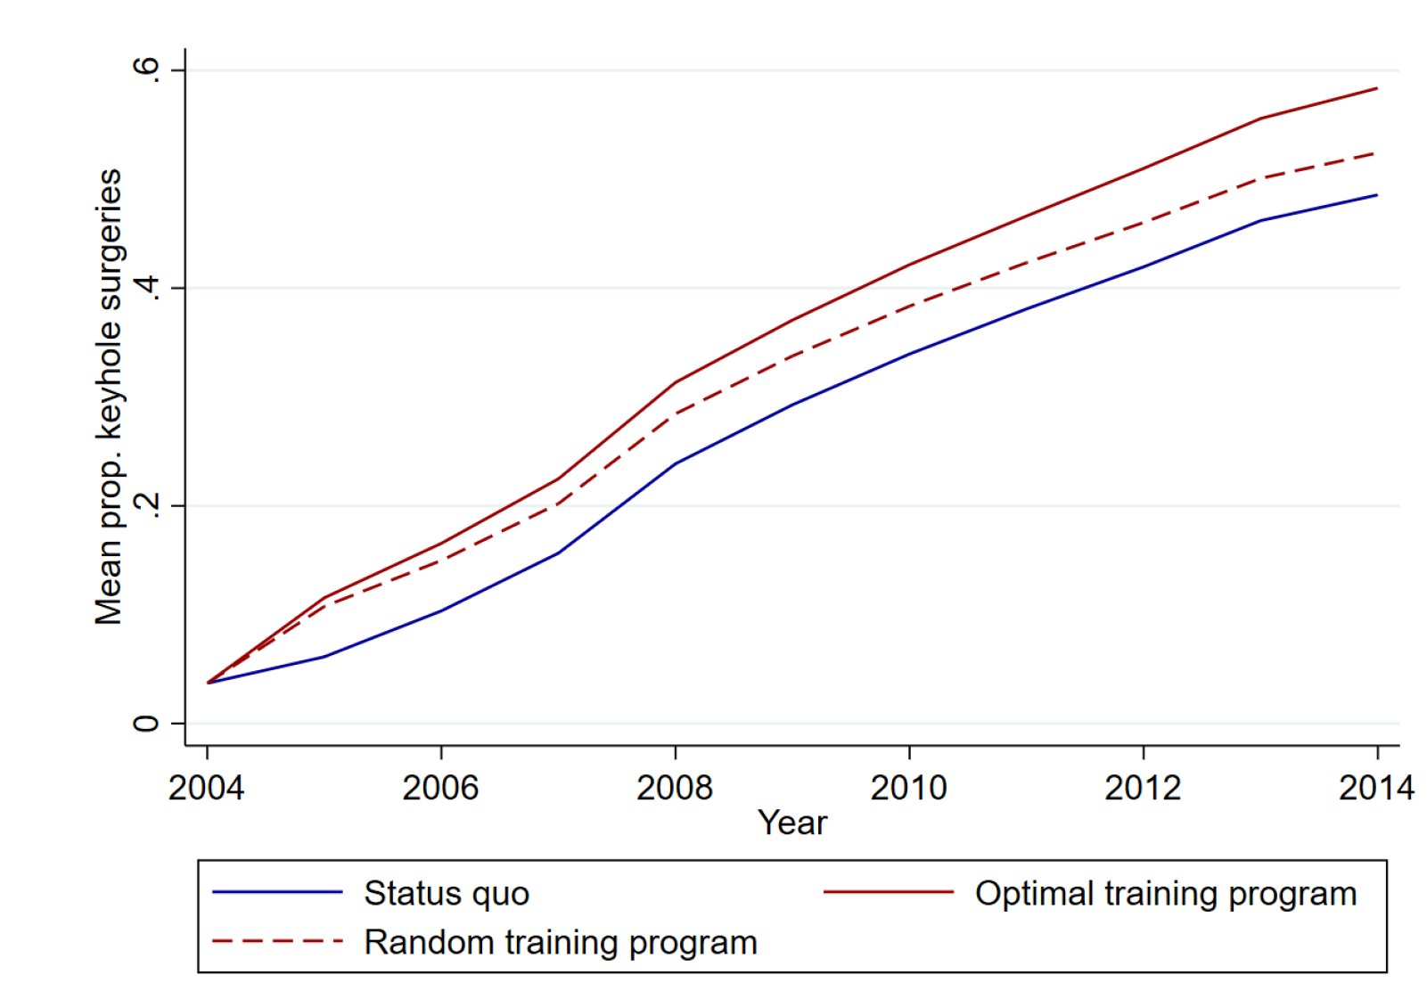
Policy
Notes:
We consider an intervention which targeted one consultant in 2001, the effect of which was to increase their residual take-up by 0.05 in years 2001-2014. An example of such an intervention could be an individual training program.
We then solve the resulting linear system to obtain the implied take-up of all consultants in all years.
This yields one counterfactual data-set for each consultant observed in 2000.
We denote the mean take-up in year t under counterfactual i by earlyit.
The solid red line plots the most effective intervention (that with largest earlyi,14), which we estimate would have increased average take-up in 2014 by 13 percentage points relative to no intervention.
Of course, this
intervention could not have been implemented in 2001 because the identity of the optimal
consultant is determined by data from 2000 to 2014. To address this, and with a view to
informing future policy, we now consider which types of consultant would best have been
targeted.

Slide 27
Key findings
Commensurate with peer learning and/or imitation, and information transmission due to inter-hospital mobility of clinicians
Notes:
We consider an intervention which targeted one consultant in 2001, the effect of which was to increase their residual take-up by 0.05 in years 2001-2014. An example of such an intervention could be an individual training program.
We then solve the resulting linear system to obtain the implied take-up of all consultants in all years.
This yields one counterfactual data-set for each consultant observed in 2000.
We denote the mean take-up in year t under counterfactual i by earlyit.
The solid red line plots the most effective intervention (that with largest earlyi,14), which we estimate would have increased average take-up in 2014 by 13 percentage points relative to no intervention.
Of course, this
intervention could not have been implemented in 2001 because the identity of the optimal
consultant is determined by data from 2000 to 2014. To address this, and with a view to
informing future policy, we now consider which types of consultant would best have been
targeted.

Slide 29
Information shocks, physician responses and patient outcomes
Is there variation in responses to common news shocks and how does this affect patient outcomes?
Exploit worldwide common news shock in introduction of DES stents

Slide 30
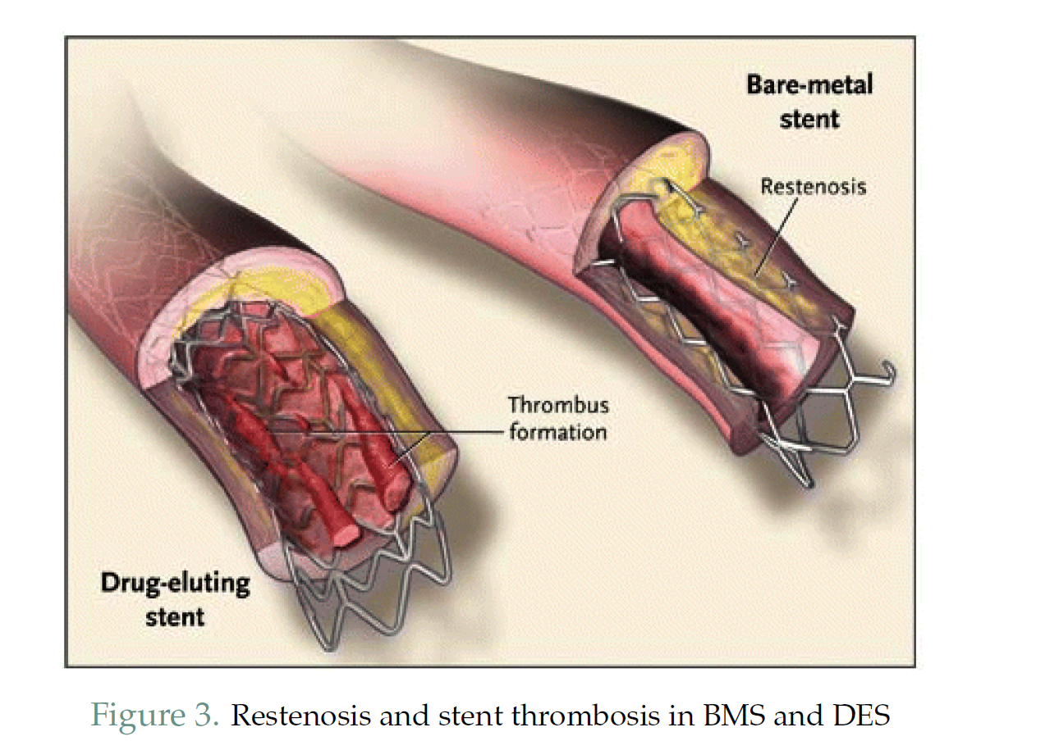

Slide 31
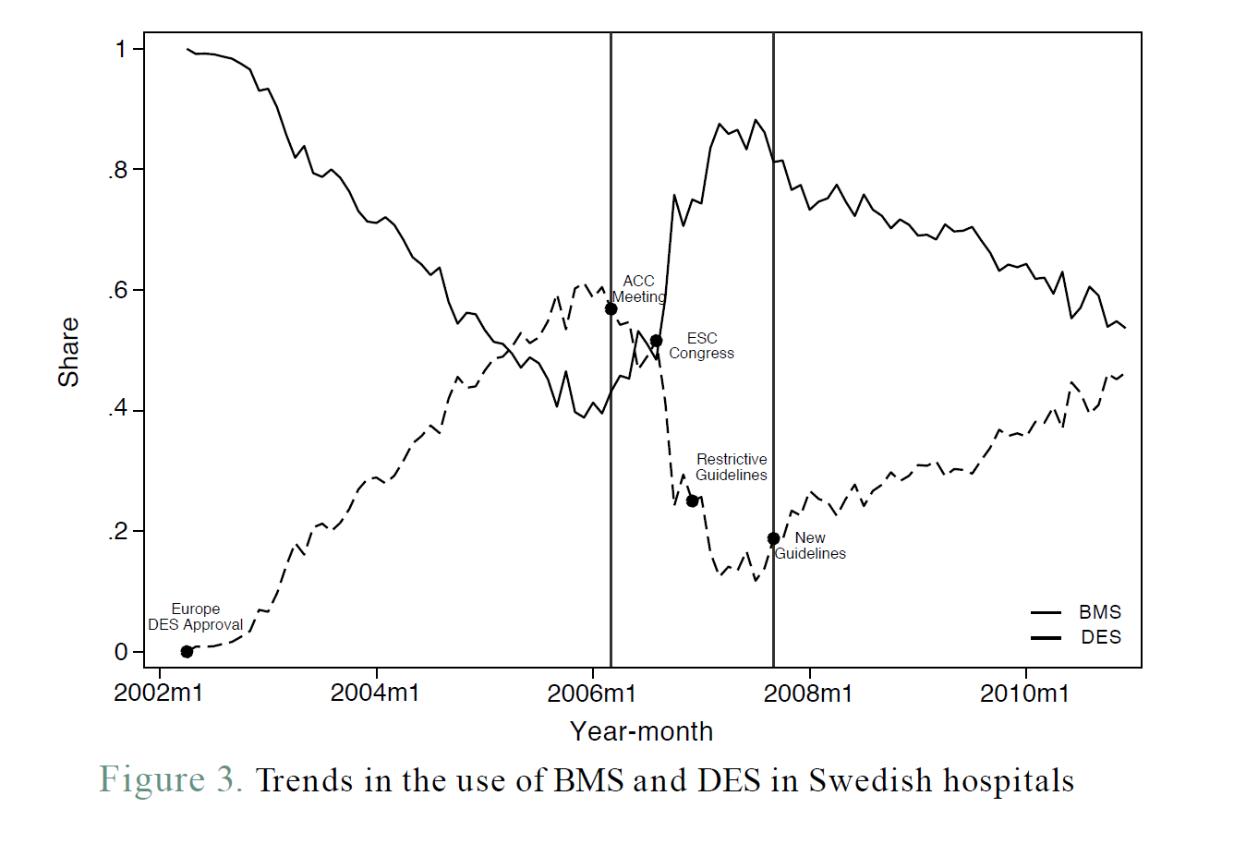

Slide 32
What we did
Examine response of universe of Swedish cardiologists, characterised by response to initial good news
Did those who responded more slowly than their peers to initial good news have better subsequent outcomes for patient?
Examine whether this was due to patient or treatment selection
Swedish healthcare setting allows us to interpret variation in responsiveness as arising from individual discretion

Slide 33
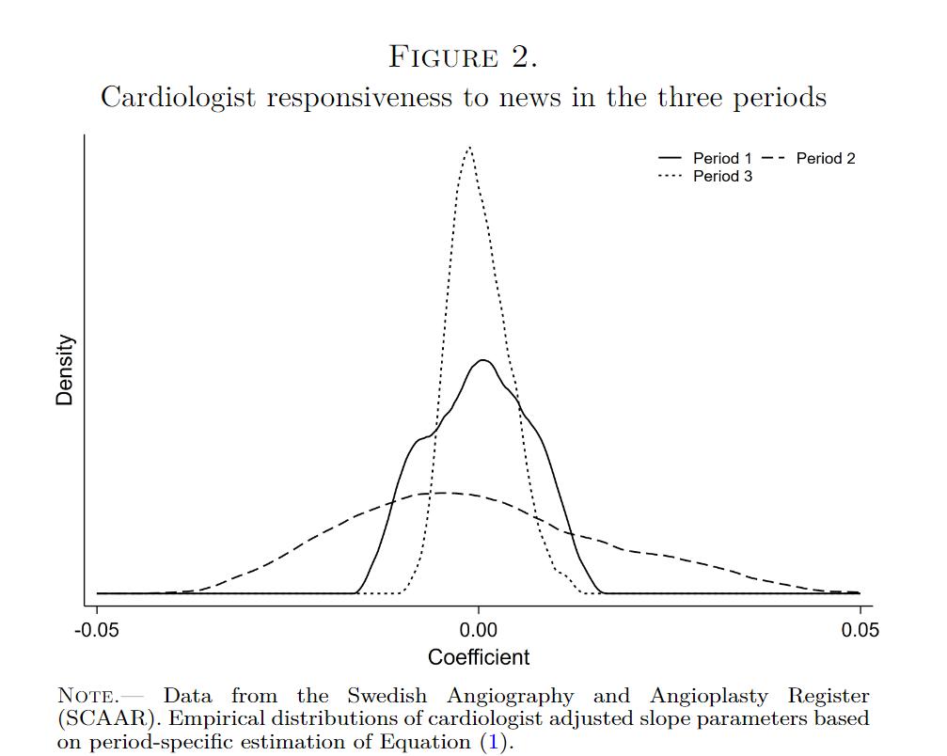
What we found
Less heterogeneity in news response post-guidelines

Slide 34
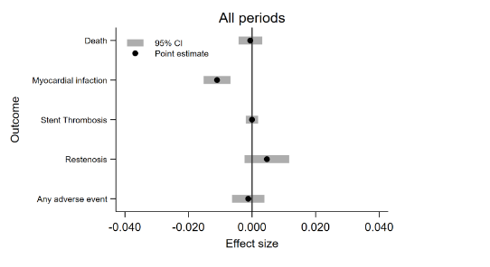
What we found
Those who reacted more slowly to good news had better patient outcomes

Slide 35
What we found
Not due to patient selection
Fewer decision errors by fast responders
Less off-label use by slow responders
Slow responders more likely to be in teaching hospitals – commensurate with access to private information to help decision making

Slide 36
Nursing teams and patient outcomes (Kelly, Propper, Zaranko)

Slide 37
Why might we be interested?
Nurses 50% clinical staff in hospital
World wide staff shortages
What happens to patients when wards are understaffed/certain individuals are missing?
Examine this in a setting where financial incentives play little role

Slide 38
What we do
Exploit variation in staffing from
Absences relative to hospital designated safe staffing
Rotation of staff due to need to provide care 24/7
Study absence of more or less qualified workers (general human capital)
Effect of familiarity with the firm (hospital), location (ward) and team members
Outcomes: inpatient mortality and other outcomes related to quality of nursing care
Data
19,000 teams, 4500 unique staff, 44,000 patients (av. 20 nurses, 40 patients)

Slide 39
Team production in nursing
Widespread shortage of nurses: account for 25% of staff by >40% vacancies
Nursing teams composed of 2 types of worker: degree trained and those without degree level qualifications
Within each type there are different grades
Paid according to seniority by nationally regulated wages
In out context, teams are on average 20 people caring for 40 patients

Slide 40
What we do
Use detailed data from one large NHS hospital containing three sites
Match nurse rosters at ward-day level to patient outcomes
Construct measures of staff shortage of each type of staff at team level derived from difference between planned (3 months in advance) and actual on day
Construct measures of hospital-, location(task)- and team-member familiarity of team
Estimate probability of a death on a ward-day as function of shortages of different levels of general human capital and different types of familiarity of team members (split by human capital levels)
Battery of tests for assumption that patient severity is exogenous to staffing

Slide 41
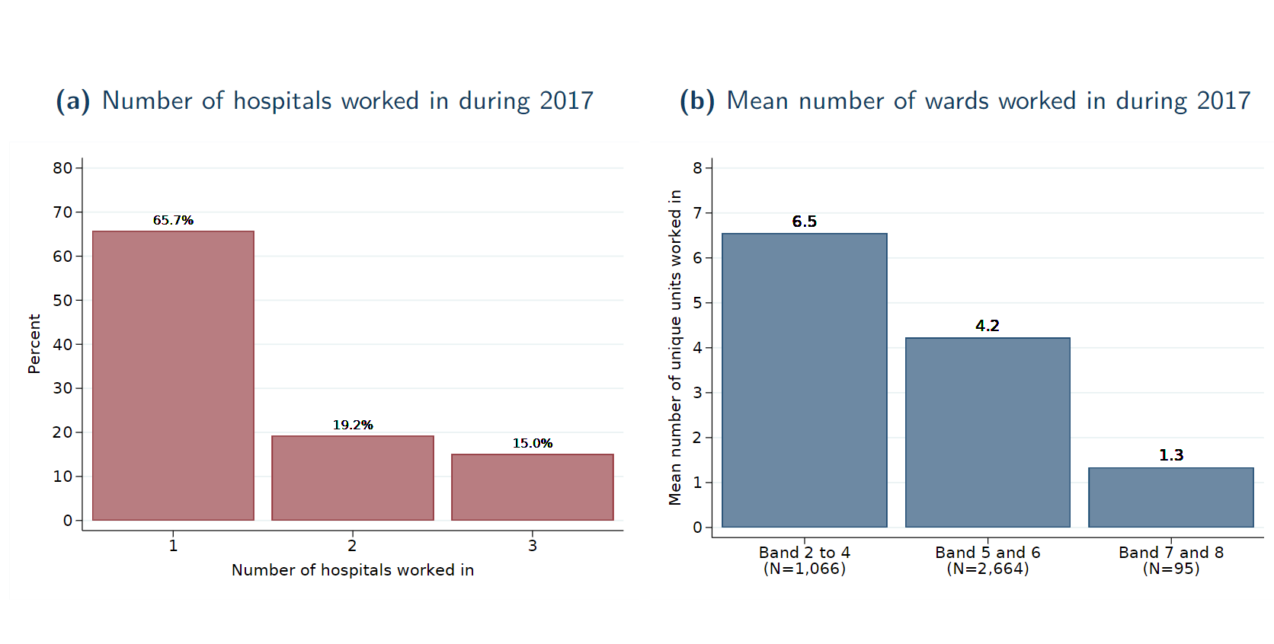
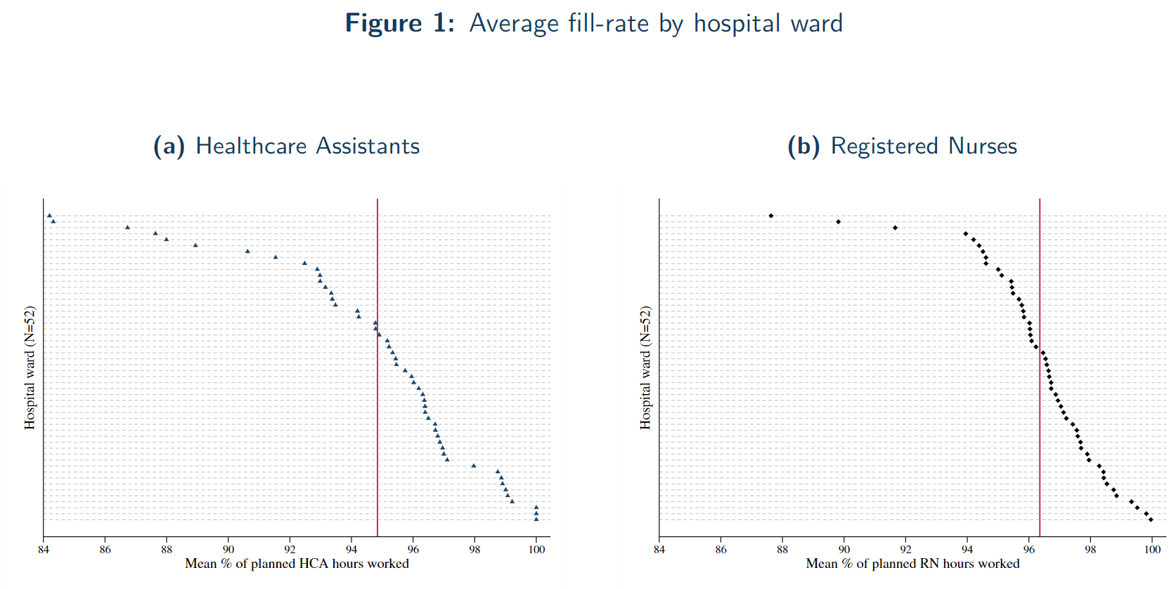
Mobility and shortages

Slide 42
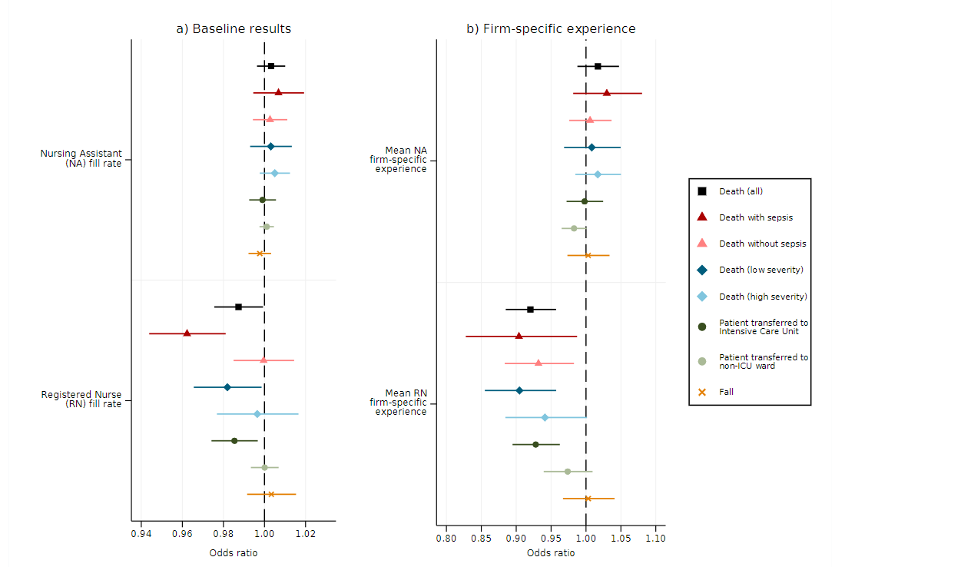
Impact of nurse absences on outcomes

Slide 43
Key findings
Unplanned reductions of qualified staff associated with higher probability of patient death
Losing a 12-hour shift from a RN increases odds of a patient death by 10% /effect is non-linear in absence
No effect of shortage of less qualified nurses/agency staff
Low severity patients most at risk and most impact is on sepsis deaths
Hospital (firm) experience of RNs associated with reduction in the odds of a patient death; no effect of ward or team familiarity

Slide 44
Policy implications
Increasing nursing labour force by use of unqualified and agency staff not a short-term solution

Slide 45
My conclusions
Healthcare is a great lab to examine impact of non-financial incentives on the performance of individuals, teams and firms
More evidence from diverse range of settings enables move from series of ‘case-studies’ to more general understanding of what improves patient outcomes, reduces cost (growth) and increases productivity

Slide 46
Thank you

