Slide 1
Applicability of NURES® ion exchange materials for holistic radioactive liquid waste treatment
Weronika Wojnicka / Sales Engineer / Nuclear Services
22.10.2025

Slide 2
Table of Contents
Introduction & Aim
Background
  Previous NURES Projects at Fortum
  Sources of Liquid Waste
  Ion Exchange Materials
Materials & Methods
  Choice of Elements & Batch Experiments
  Chemical Speciation
  Measurements
Results
Conclusion

Slide 3
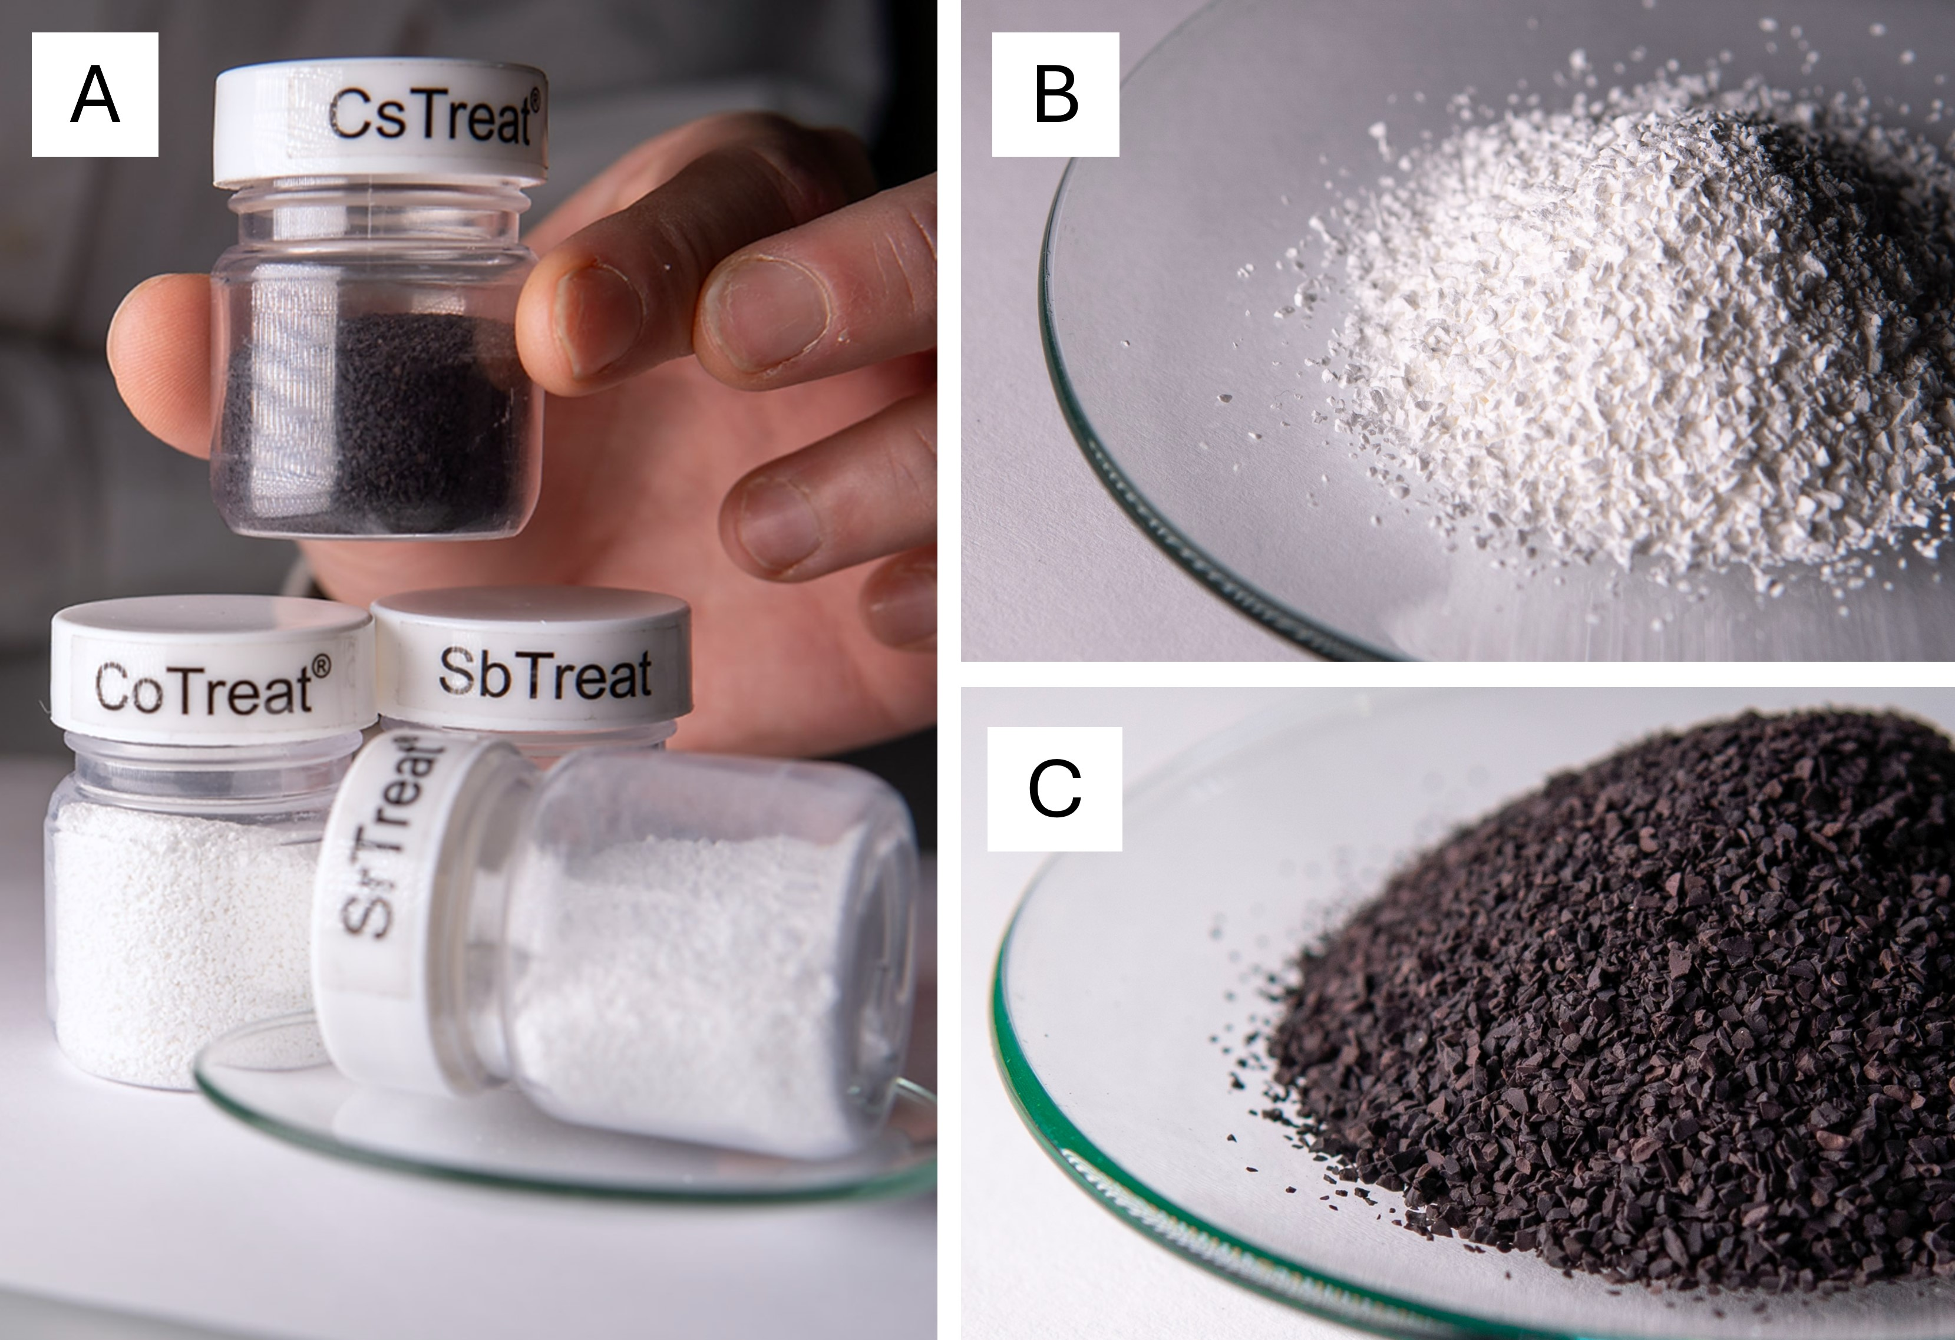
Introduction & Aim
Importance of waste management
  Environmental and human safety
  Affects public opinion towards a solution/technology
  Cost reduction
Liquid waste can be treated with ion exchange technology → NURES
Aim:
  Expand application scope of NURES
  Optimized waste management
    Safe and stable final state of waste
    Volume reduction for easier and cheaper disposal
Collaboration with University of Helsinki and VTT Technical Research Center of Finland
Fortum’s NURES products:
SbTreat, CoTreat, CsTreat, SrTreat

Slide 4
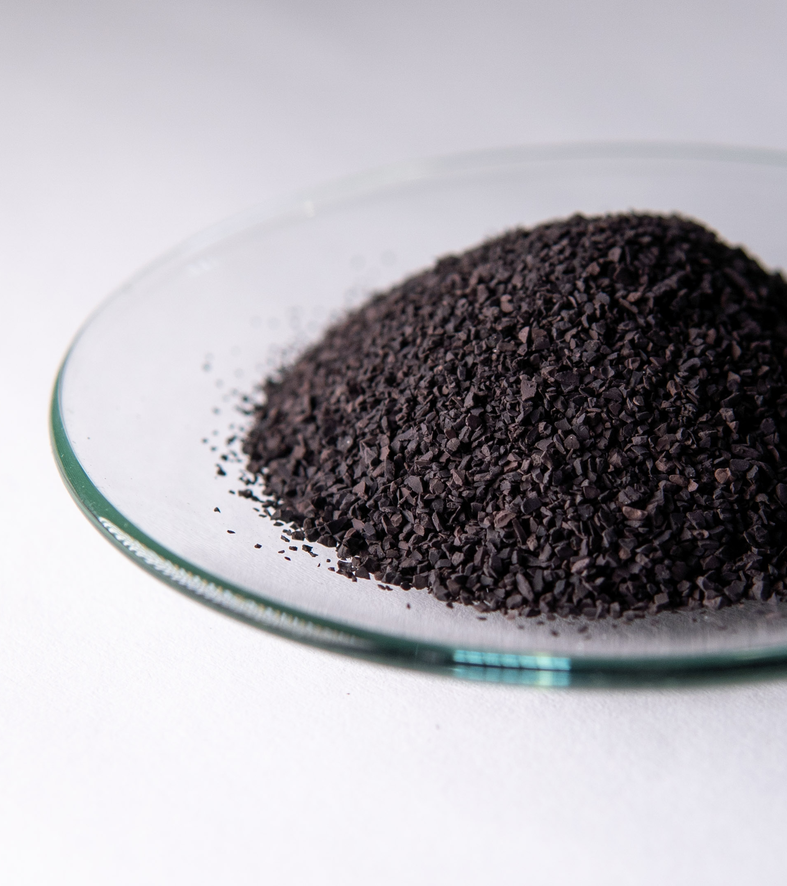
Introduction to NURES®
NURES® purifies liquid radioactive waste to a fraction of the original volume
Originally developed in the 1980s for the cesium removal at the Loviisa NPP
Fortum’s NURES® technology is based on patented, 100% inorganic, highly selective ion exchange materials, fitted for radioactive waste treatment
NURES® technology has been used for over 30 years and reached over 100 customers worldwide.
CsTreat®
SrTreat®
CoTreat®
SbTreat®

Slide 5
Background

Slide 6
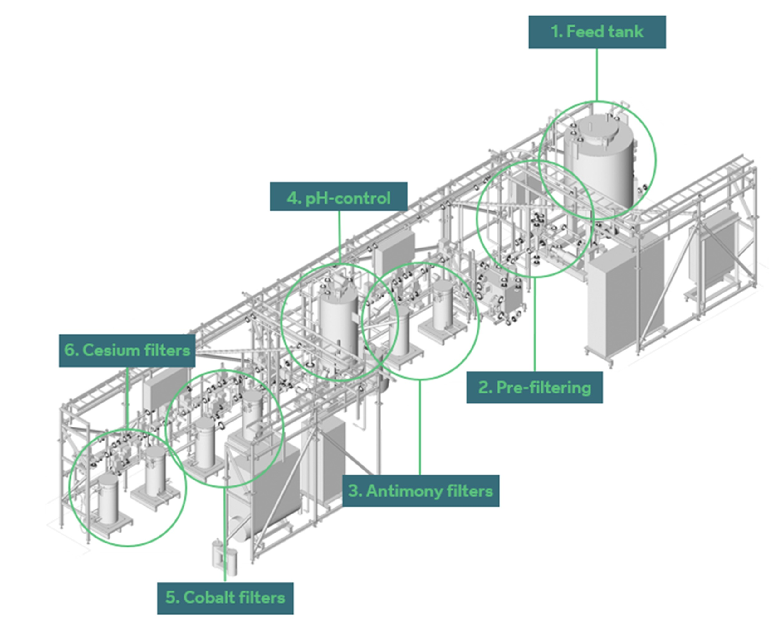
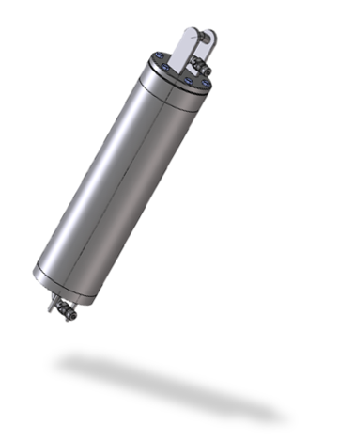
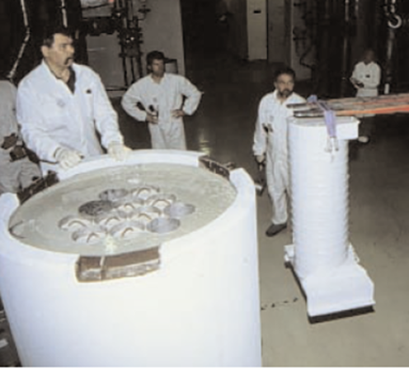
Previous NURES Projects at Fortum
NURES used in over 50 locations around the world
Examples:
  Loviisa nuclear power plant, Finland
  Fukushima Daiichi nuclear power plant, Japan
  Grafenrheinfeld nuclear power plant, Germany
  Duferco La Louvière steel plant, Belgium
A NURES purification system used for treating liquid waste at the Grafen-rheinfeld nuclear power plant in Germany. The system includes three NURES modules, a pre-filter, a feed tank, a chemical station, and a mixer tank.
6
NURES column
Loviisa final disposal waste container

Slide 7
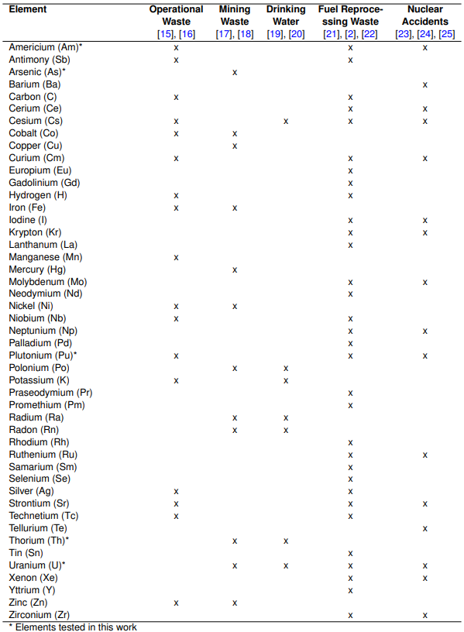
Sources of Liquid Waste and Harmful Elements
Nuclear operational waste
Nuclear fuel reprocessing waste
Nuclear accidents waste
  Fukushima, Japan 2011
  Chernobyl, Ukraine 1986
Mining waste

Slide 8
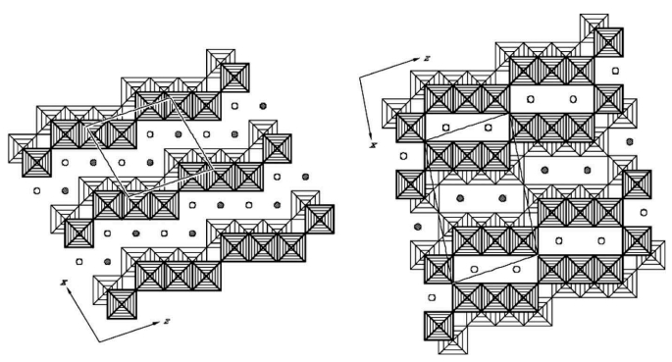
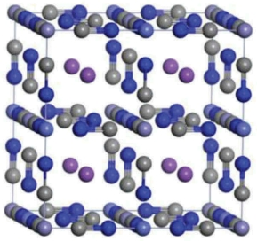
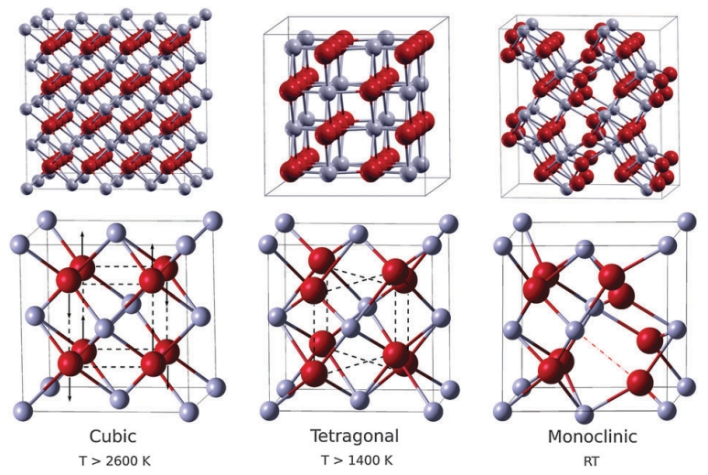
NURES Ion Exchange Materials
Hexacyanoferrate – CsTreat Titanate – CoTreat & SrTreat
Zirconium Oxide - SbTreat

Slide 9
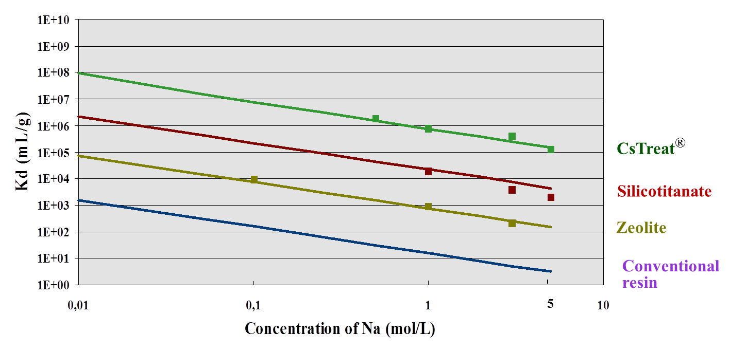
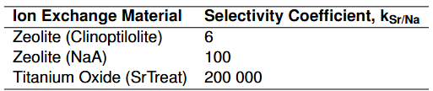
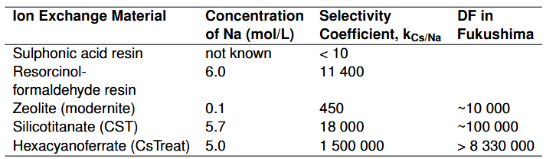
Ion Exchange Materials - Comparison
Organic:
  Majority of ion exchangers in radiochemical analysis are organic resins
  Focus more on operating power plants
  Cheaper, but less selective → more material needed, and more waste remains
Inorganic:
  Focus more on waste treatment and volume reduction
  Advantages:
    High selectivity
    Radiation tolerance
    Thermal resistance
    Mechanical and chemical stability
    Minimizes disposal space, costs, and environmental burden
Best available technology for Cs removal in high salt liquid
9

Slide 10
Materials & Methods

Slide 11
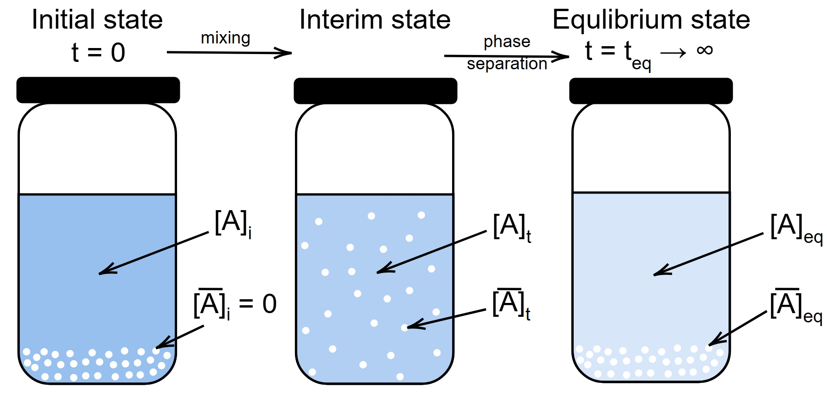
Choice of Elements & Batch Experiments
Chosen elements:
  Arsenic
  Thorium
  Uranium
  Plutonium
  Americium
Choice based on:
  NURES capabilities
  Market needs & client inquiries
  Abundance in:
    Nuclear fuel reprocessing waste
    Nuclear operational waste
    Nuclear accidents
    Mining waste
Batch Experiments

Slide 12
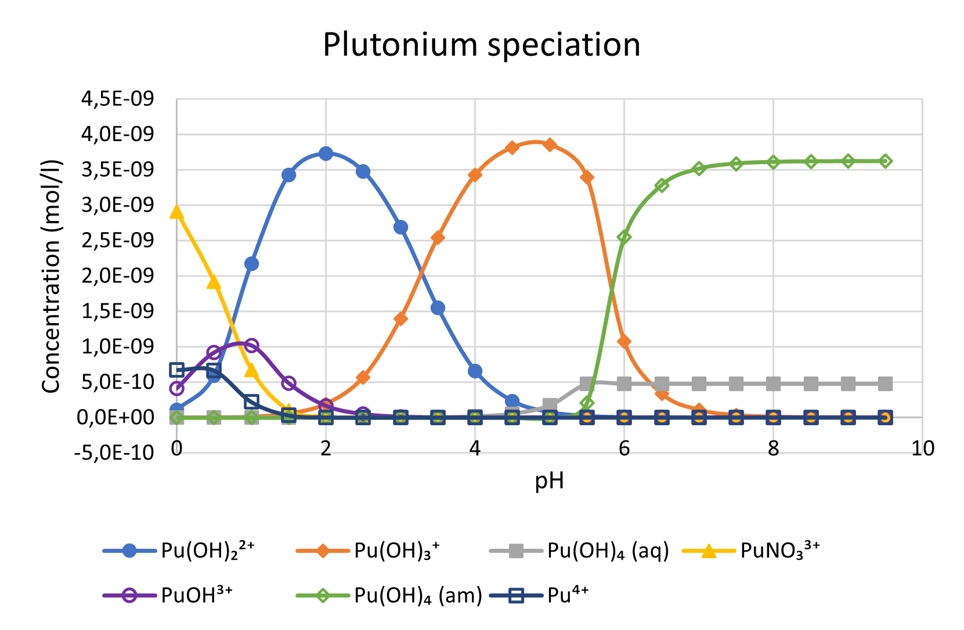
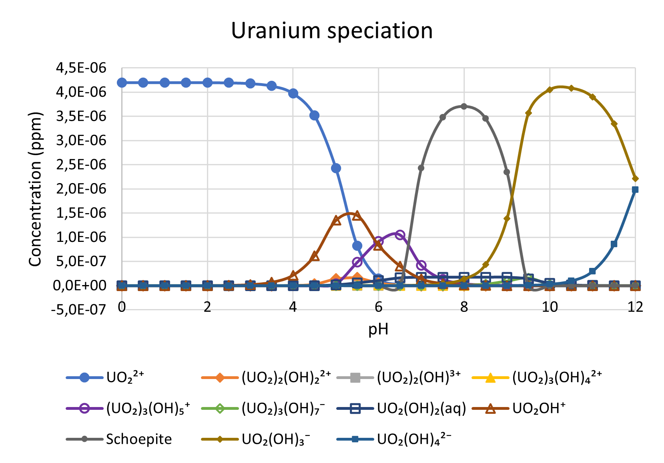
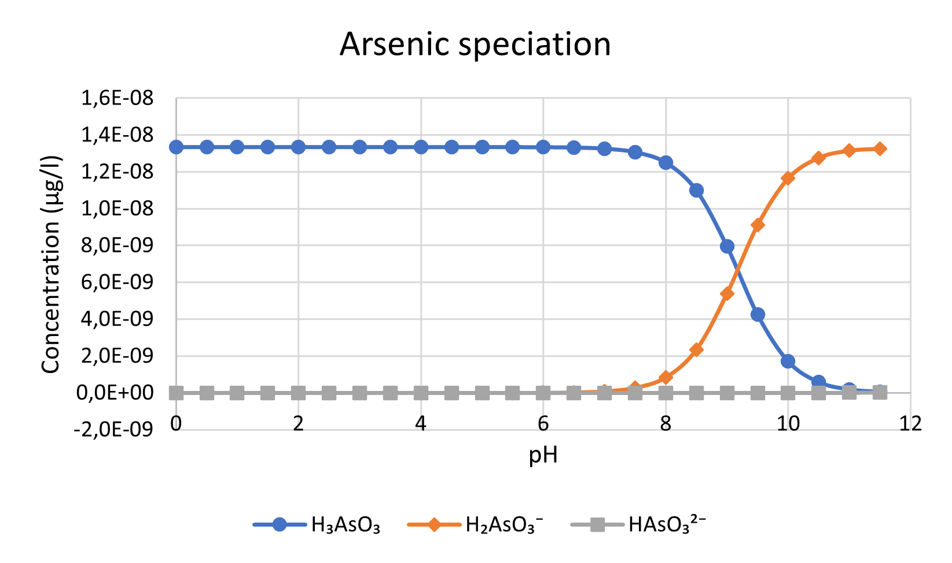
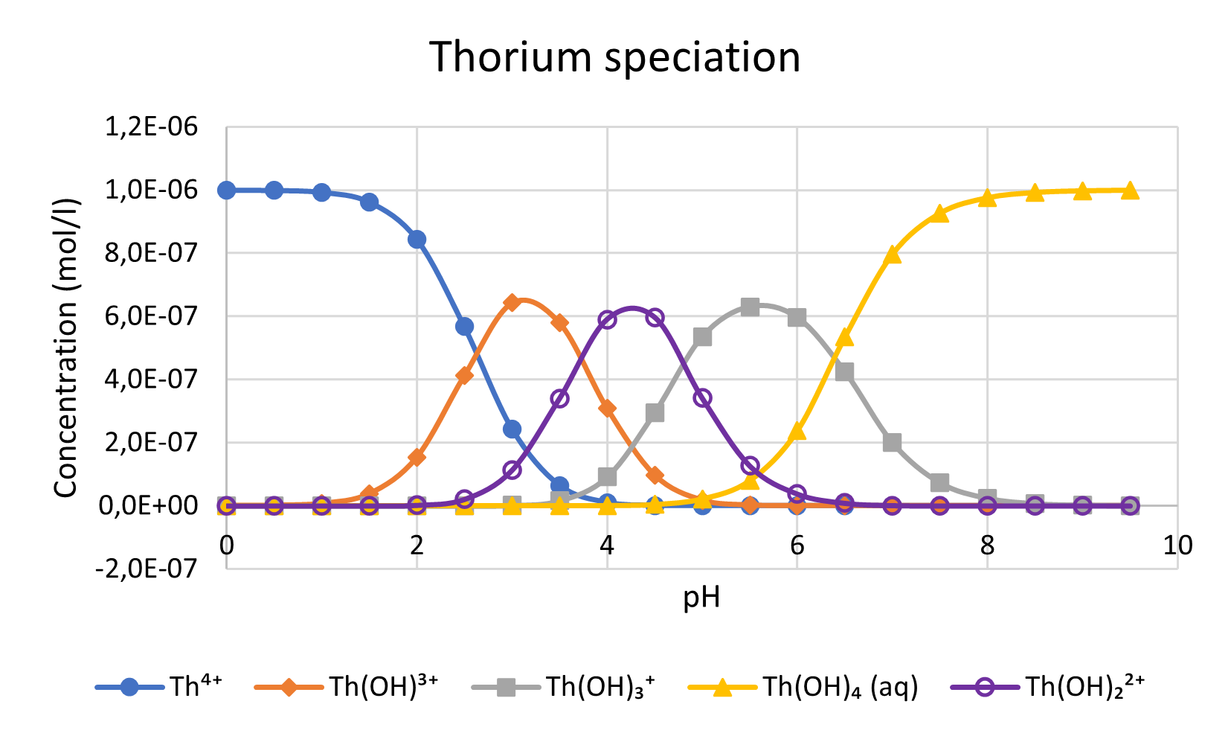
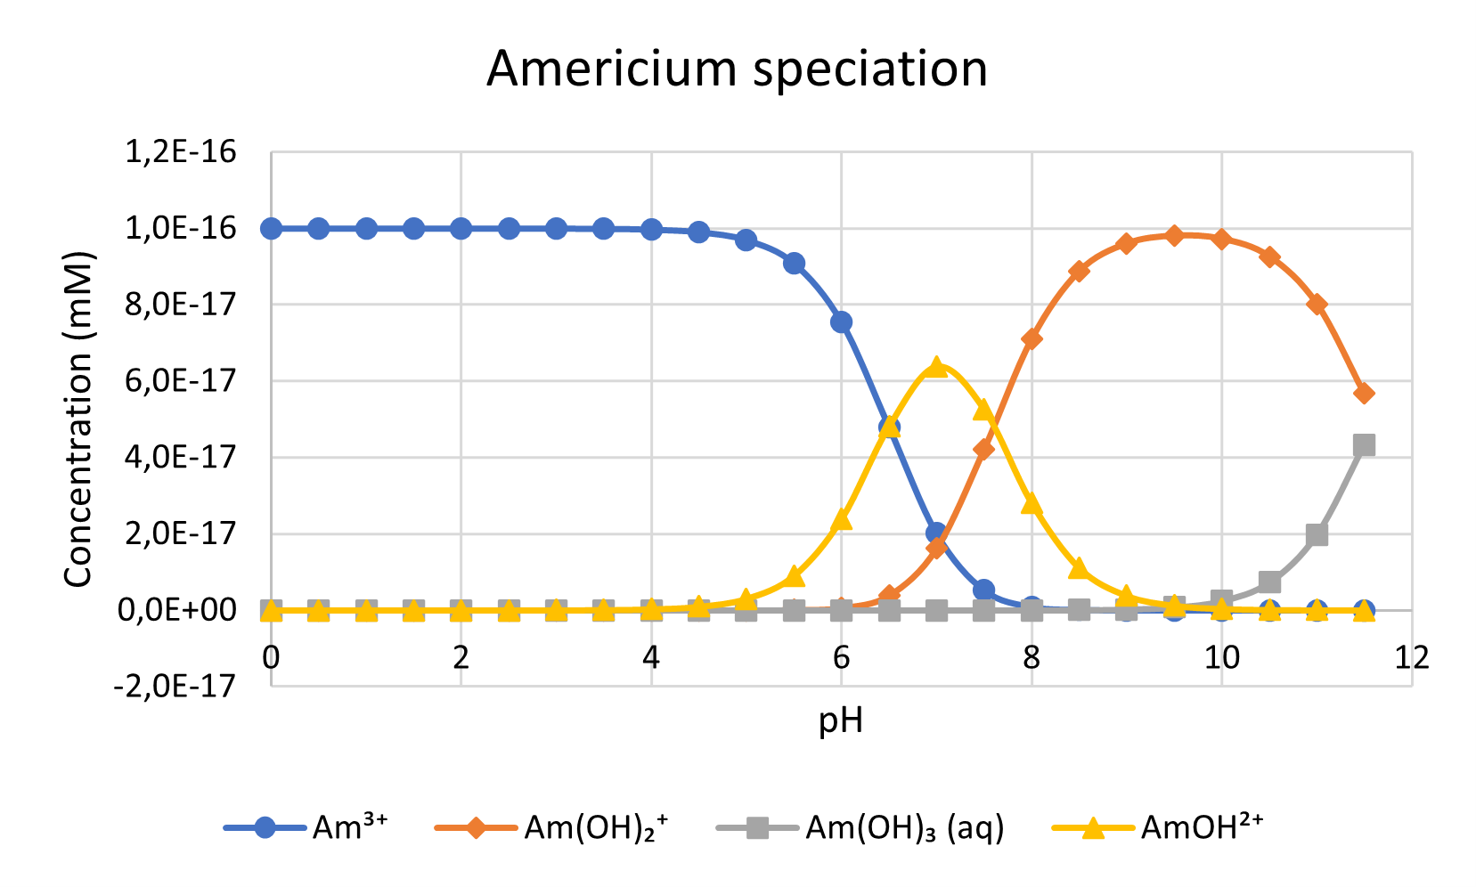
Chemical Speciation

Slide 13
Measurements
Based on detectable activities and type of radiation
Microwave Plasma Atomic Emission Spectrometry: Arsenic
  Detects trace elements
Gamma Spectrometry: Americium
  Emission of gamma rays
High Resolution Inductively Coupled Plasma Mass Spectrometry: Thorium, Uranium, Plutonium
  Emission of alpha particles and weak gamma rays

Slide 14
Results

Slide 15
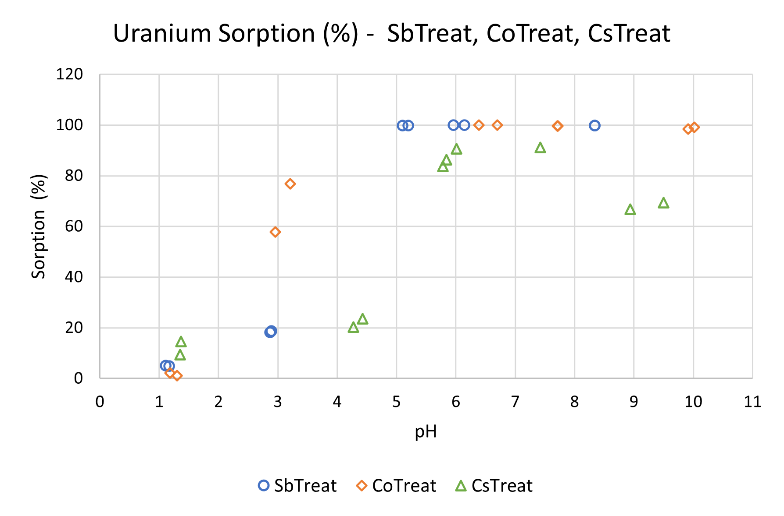
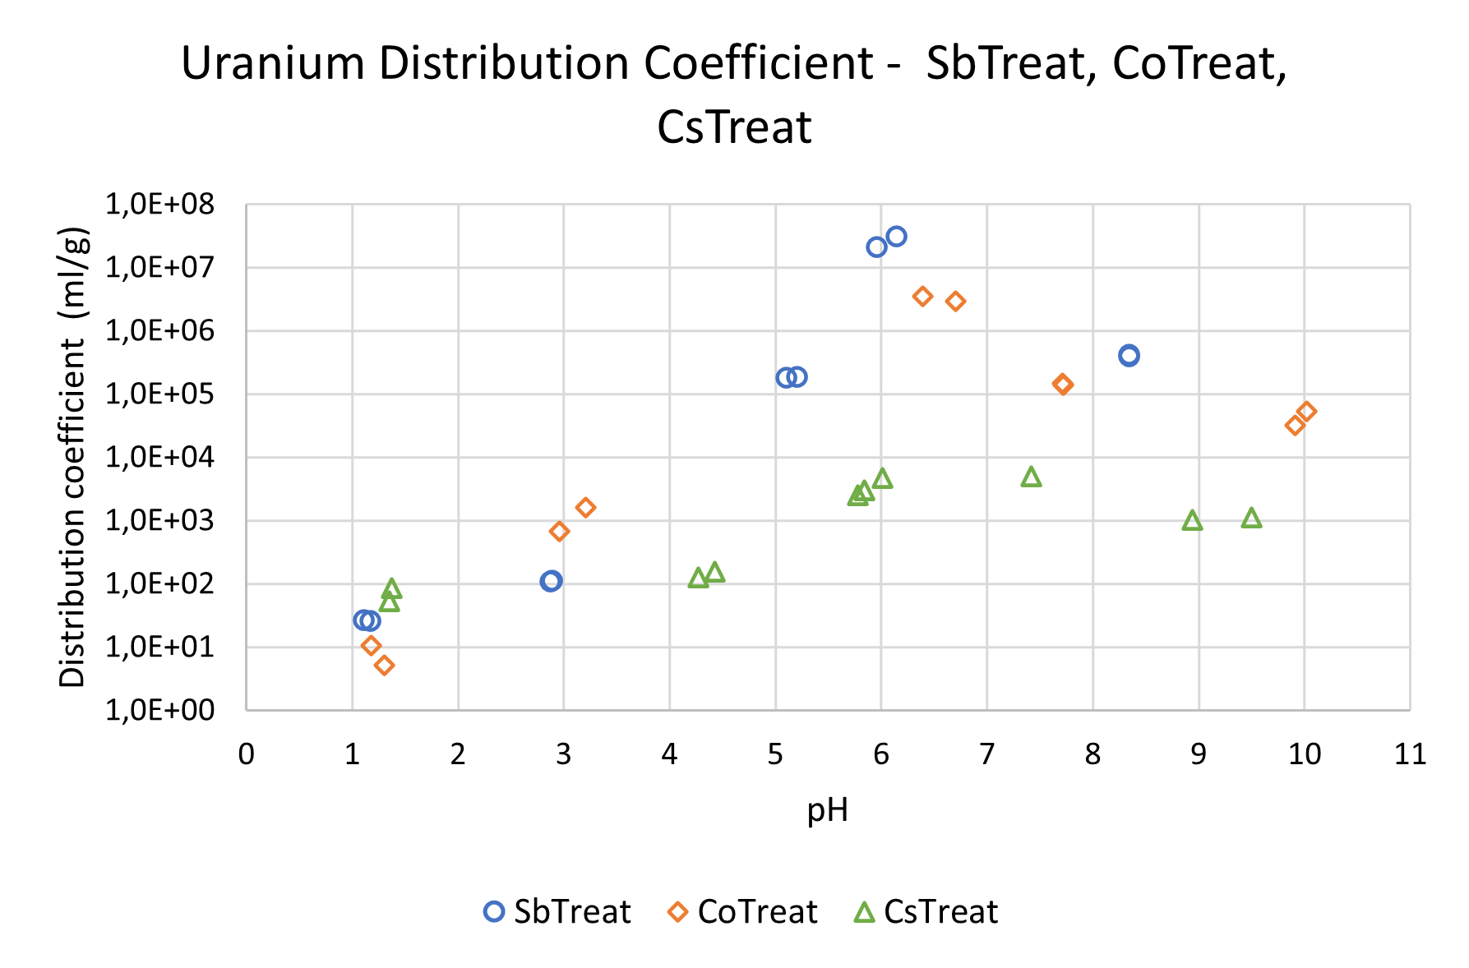
Distribution Coefficient and Sorption (%)

Slide 16
Distribution Coefficient and Sorption (%)
The best removal results for each tested nuclide.
Nuclide | Material | pH | Sorption (%) | Distribution Coefficient (ml/g)
Arsenic-75 | SbTreat | 7,3 | 98,75 | 4,0E+04
Plutonium-242 | CoTreat | 6,6 | 99,86 | 3,1E+05
Americium-241 | CoTreat | 6,7 | 99,95 | 1,1E+06
Uranium-238 | SbTreat | 6,1 | 99,99 | 3,1E+07
Thorium-232 | SbTreat | 6,2 | 99,99 | 1,5E+07

Slide 17
Conclusion
What: Testing effectiveness of SbTreat, CoTreat, and CsTreat for removing arsenic, thorium, uranium, americium, and plutonium from liquids at various pH levels
Why: Expanding applicability scope of NURES for an improved waste treatment
How: Batch experiments and concentration measurements
Result:
  NURES has potential for removing tested elements
  Most optimal pH depending on the element speciation and NURES material
Further research ideas:
  Testing other conditions besides pH
    E.g. salt concentrations and competing elements
  More repeats per condition
    To increase accuracy, reliability, and reproductability

Slide 18

Thank you!
Questions?
Weronika Wojnicka
weronika.wojnicka@fortum.com

Slide 19
Selected Partners & References
GUNDREMMINGEN IN GERMANY (2024-2025)
Liquid treatment feasibility study for spent fuel pool water
STUDSVIK IN SWEDEN (2024)
Laboratory scale liquid waste treatment system delivery
DUFERCO IN BELGIUM (2018-PRESENT)
Cs removal from contaminated metal steel ash
GRAFENREHINFELD GERMANY (2020– 2022)
Treatment of liquid from plant evaporator treatment system with CsTreat® and CoTreat® & SbTreat®
IAERI, Japan (1997 – 1998)
70 m3 of reprocessing liquid with 7 GBq/l of Sr and 7 GBq/l of Cs purified to lower activity enabling cheaper further treatment
FUKUSHIMA, JAPAN (2011 – 2012)
Cleaning of spent fuel pools
FUKUSHIMA, JAPAN (2012 – PRESENT)
Cleaning of cooling water reverse osmosis reject. CsTreat® and SrTreat® are used in ALPS to reach non-detectable level of Cs and Sr.
PAKS NPP, HUNGARY (2003 – PRESENT)
Cs removal and boron recovery from evaporator concentrates
DOUNREAY, UK (2002 – PRESENT)
Cleaning of sodium coolant from PFR and DFR with CsTreat®
BRADWELL MAGNOX NPP, UK (2013– 2017)
Treatment of liquid from a Fuel Element Debris (FED) treatment system with CsTreat® and CoTreat®
SELLAFIELD THORP, UK (2005 – 2007)
THORP Feed Pond decontamination with CoTreat®
CALLAWAY, USA (1996 – 1999)
3000 m3 of floor drain wastewater was purified with 250 liters of CsTreat®
SAVANNAH RIVER, USA (1999 – 2000)
Demonstration to remove cesium from R-Reactor Disassembly Basin. 24 000 m3 was treated.
LOVIISA, FINLAND (1991 – PRESENT)
1310 m3 of evaporator concentrates have been purified by 2009 with 232 litres of CsTreat®. Savings compared to cementation are over 50 million euros.
ATOMFLOT, RUSSIA (1996 - 1997)
Cs and Sr purification of liquids from nuclear ice breakers with mobile unit
PALDISKI, ESTONIA (1995)
Cleaning of 760 m3 of liquid waste in the Paldiski Naval Base (former Soviet Naval Training Centre) with only 12 litres of CsTreat®

