Slide 1
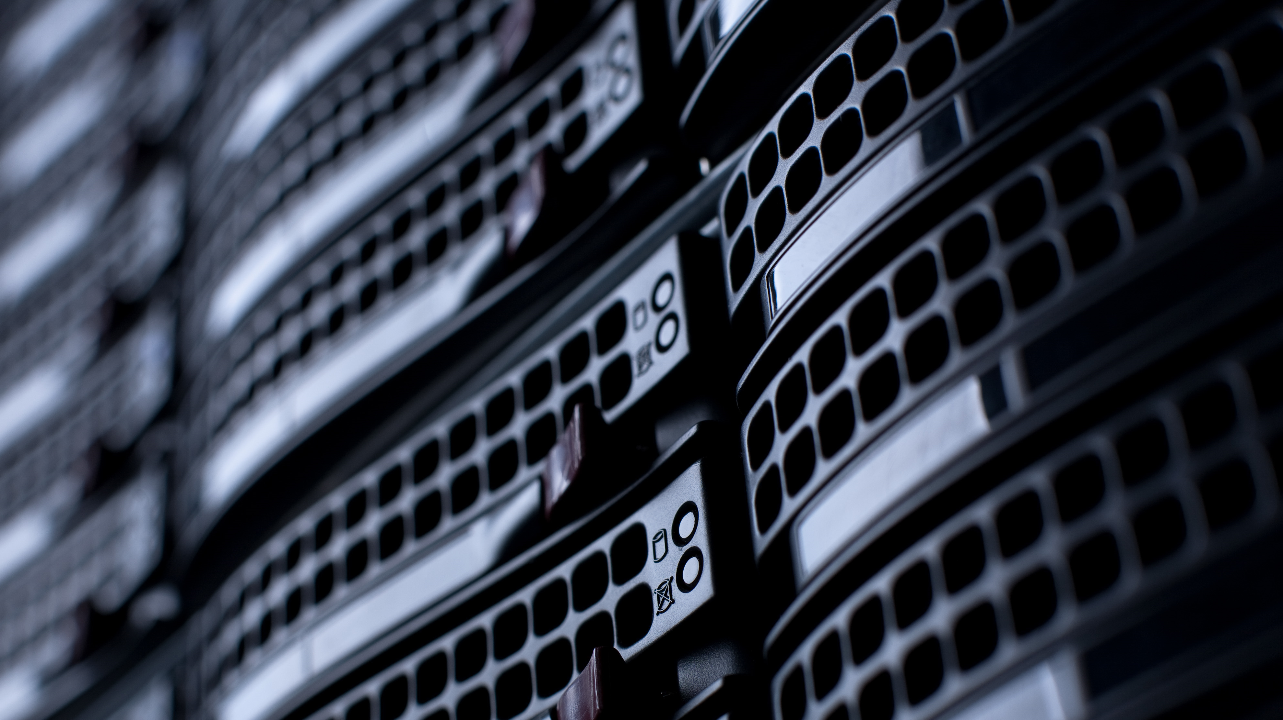
The Potential Impact of Nuclear Energy on Data Centers
M.Sc. (Tech.) Jussi-Pekka Ikonen, Research Scientist

Slide 2



Jussi-Pekka Ikonen
Research Scientist, VTT
Educational background
LUT University
    2017-2020: B. Sc. (Tech) in Energy Technology
    2020-2022: M. Sc. (Tech) in Nuclear Engineering
  Aalto University
      2023-; PhD in Energy Technology, SMR Economics and Safety
Expertise
Techno-economic modelling
Decarbonization of Helsinki metropolitan area with small modular reactors
Nuclear thermal hydraulics modelling
Safety analysis of NuScale
Code coupling between reactor neutronics and computational fluid dynamics
Notes:
Safety analysis of NuScale Small Modular Reactor (SMR)
Nuclear thermal hydraulic modelling
Creating code coupling in Kraken to reactor neutronics code and computational fluid dynamics model of the SMR
Techno-economic modelling
Modelling VTT developed LDR-50 SMR and E-SMR to a energy system model of Helsinki metropolitan area with Backbone.

Slide 3
Content of the presentation
Artificial Intelligence and data centers
  Efficiency gains
  Data center operation profile
Future electricity demand of datacenters
  Challenges, potential of nuclear and future projections
Nuclear Energy Deals
  United States &Europe
Conclusions

Slide 4
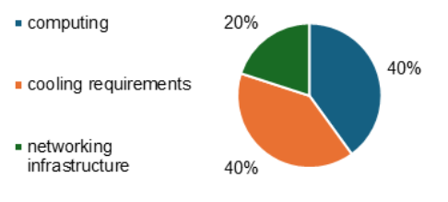
Data Centers, shortly
Data centers play a central role in our digital age:
  E-commerce websites
  Mobile phone apps
  Online banks
  Cloud services
  Email
  Social media
The electricity consumption of data centers can be split into three categories:
Computing which accounts for 40 %
Cooling, another 40 %
The networking infrastructure, 20 %

Slide 5
What does AI mean for data centers?

Slide 6
Emergence of Artificial Intelligence and Large Language models in Data Center industry
Artificial Intelligence (AI) applications are central to modern data center operations.
Training large language models (LLMs) like ChatGPT requires vast computational resources.
Inference phase (using trained models) consumes more electricity than training.
    Training: 20–40% of energy use
    Inference: 60–70% of energy use
GPT-4 training required over 50 GWh of energy: 50x more than GPT-3.
Training GPT-3 evaporated 700,000 liters of clean freshwater.
Inference is also energy-intensive:
  ChatGPT-powered Google search: 2.19 Wh
  Traditional search: 0.3 Wh

Slide 7
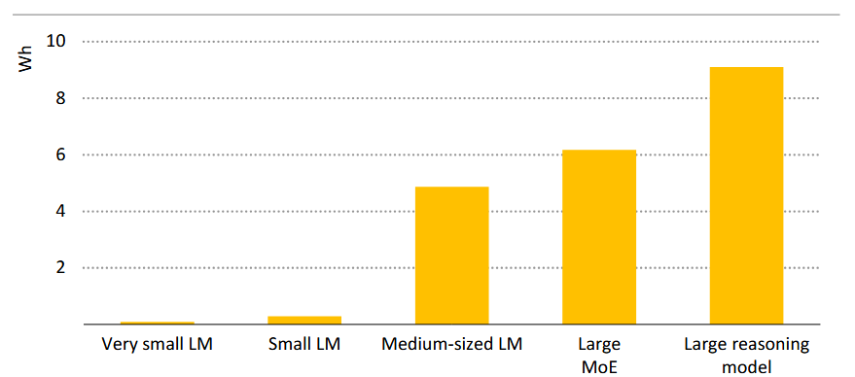
Figure 1. Estimated inference electricity consumption across different model types for text generation tasks. Note that only the GPU electricity consumption is shown. (IEA 2025)

Slide 8
DeepSeek and efficiency gains in data center industry
DeepSeek trained a ChatGPT-level model with far fewer resources.
  DeepSeek-V3: 2.788M H800 GPU hours
  GPT-4: ~60M A100 GPU hours
Efficiency driven by limited access to US chips and open-source innovation.
  “Chain of thought reasoning”
Potential to reduce global electricity consumption.
Lower entry barriers may increase AI market competition.
  Leading to increased electricity demand
Key question: Is AI growth constrained by budget, compute, or unconstrained?
  Corporations optimistic about AI-driven efficiencies
  But efficiency gains unlikely to reduce the electricity demand
  AI demand likely to remain unconstrained in the near term.

Slide 9
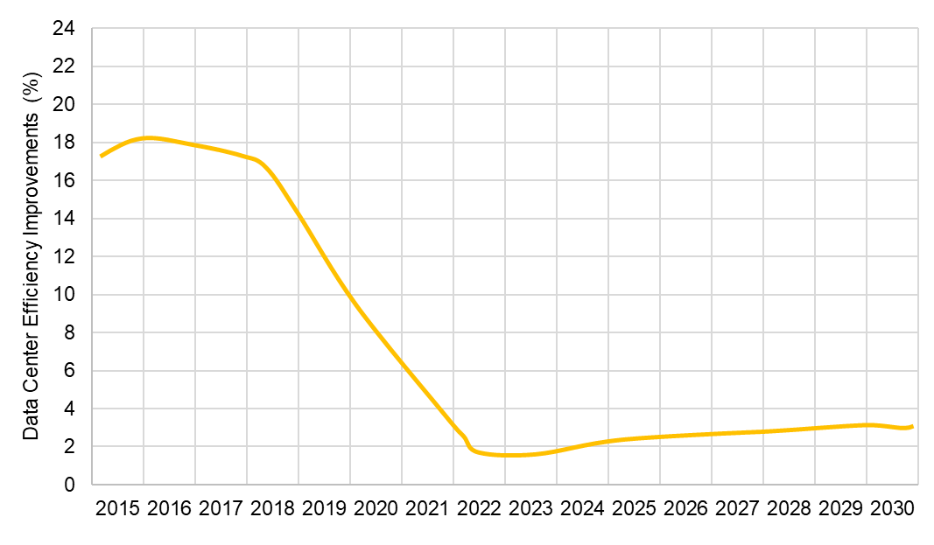
Figure 2. Data center efficiency gains as a function of time. (Singer, Davenport, Chang et al. 2024)
Notes:
Efficiency gains come from the shift to bigger data centers (economies of scale), more servers can be handled with the same infrastructure.

Slide 10
Figure 5. Data center sizes by power demand (L. Gynther, T. Kiuru, and J. Meetter 2022)
Figure 3. Shares of data center types by electricity use in 2010 and 2018. (E. Masanet, A. Shehabi, N. Lei, S. Smith, and J. Koomey 2020)

Slide 11
Data center operation profiles
Data center power demand ranges:
  Small: ~2 MW
  Colocation/Cloud: up to 50 MW
  Hyperscale: 50–300 MW
Hyperscale/AI data centers require 24/7 power reliability.
AI data centers are capital-intensive infrastructures that require load factors to maximize return on investments.
Study by Nøland et al. states that continuous and reliable power production is extremely valuable for competitiveness of data center operations, contrary to other power-intensive industries that are sensitive to electricity price.
The study reveal that AI and data center expansion could drive significant baseload power demand in the future energy systems.

Slide 12
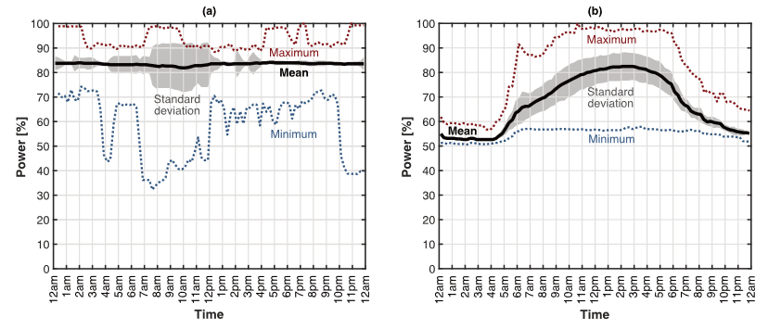
Figure 4. Whole-year-averaged load profiles for (a) Flat and (b) mixed-use US data centers. (Nøland & Hjelmeland & Korpås 2024)

Slide 13
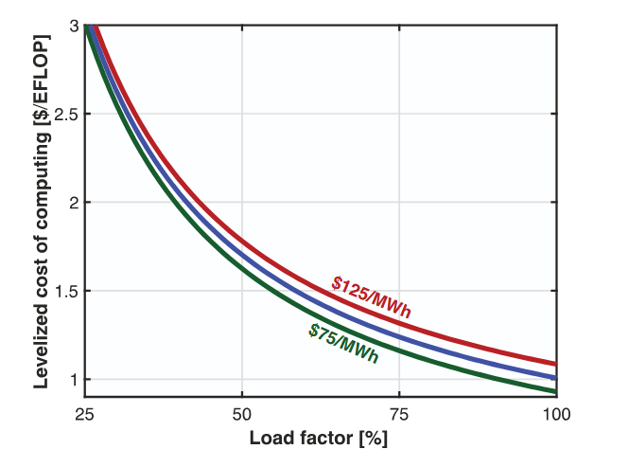
Figure 5. Sensitivity to load factor and electricity price on the levelized
cost of computing (LCOC). (Nøland & Hjelmeland & Korpås 2024)
Notes:
Formulation of LCOC includes capital expenditure, operating expenditure, power consumption, and the total amount of computation during the lifetime of the infrastructure.
The lower the LCOC, more efficient the data center is!
Load factor must be maximized from the data center operator point of view.

Slide 14
Future electricity demand of data centers

Slide 15



Challenges of data center expansion
Huge Energy Demand and CO2 emissions:
    Data centers are growing in size and housing more power-hungry, high-density servers while energy efficiency gains are slowing at the same time
Lack of Baseload Power:
    Natural gas is currently used but needs to be replaced in the long term.
    A combination of renewables and battery storage is an alternative
      But intermittent and location-dependent
Insufficient Transmission Infrastructure:
    Data centers are being built close to power production facilities
    Or data center operators are building their own power capacity

Slide 16
Potential of nuclear power
Baseload Power, Energy security & Emissions:
  Data centers seek dispatchable carbon-free power: nuclear power is a key candidate!
Scalability and Flexibility:
  AI training allows data centers to be located in remote areas with energy abundance
  Small Modular Reactors offer a flexible and scalable solution that is not reliant on specific geographical placement
But not forgetting the challenges:
  Nuclear power plants have long construction times and they’re notorious for delays
    SMRs attempt to reduce construction times by reducing size and modularity
    but what happens to the total costs?
Notes:
when you need reliable electricity around the clock, few other generation sources compare.

Slide 17
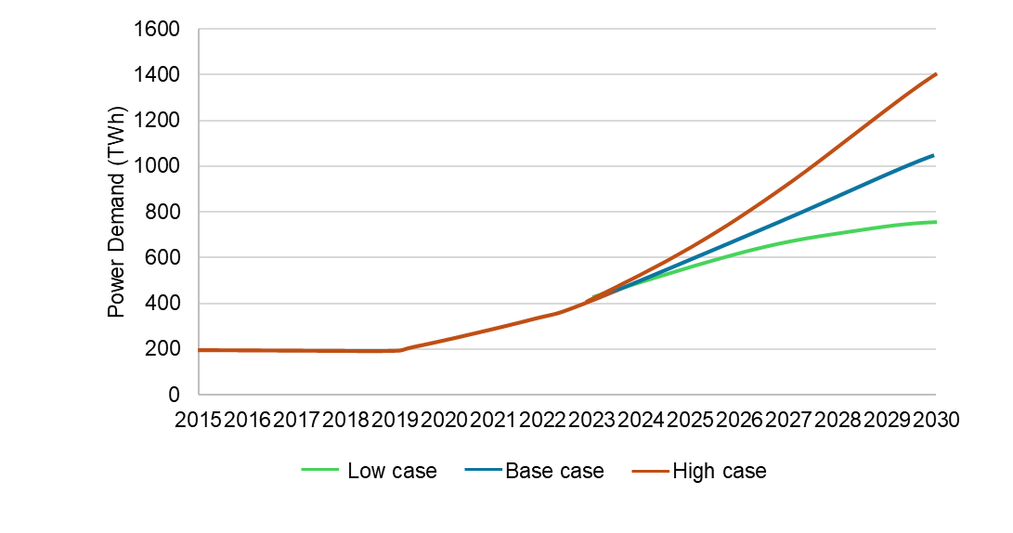
Figure 6. Goldman Sachs estimation of global electricity demand of data centers. Note that years after 2022 are projections of power demand. (Singer et al. 2025)

Slide 18
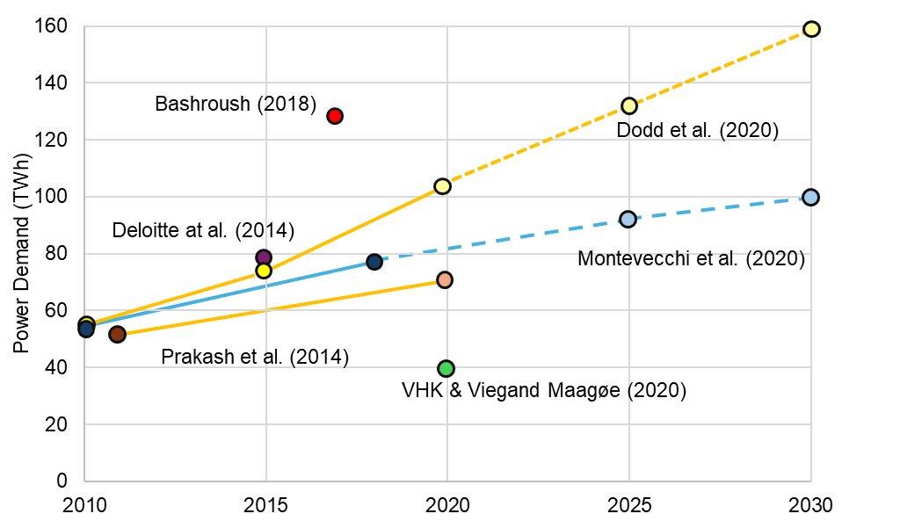
Figure 7. Summary of studies on electricity demand growth in European data centers. Note that the darker circles indicate estimates while lighter circles and dotted lines indicate projections. (Kamiya & Bertoldi 2024)

Slide 19
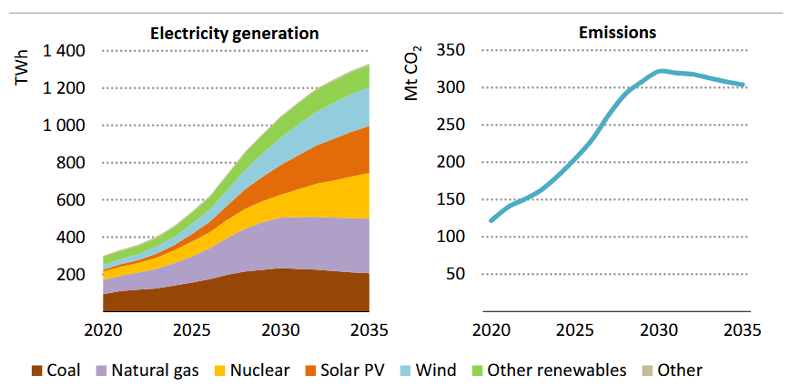
Figure 8. Global electricity generation for data centers and the associated CO2 emissions in the IEA base case scenario. (IEA 2025)
Notes:
In the US, the Goldman Sachs study estimates that the added generation capacity will be around 40% natural gas combined-cycle gas turbines, 20% natural gas peakers, 25% solar and 15% wind. This would result in about 47 GW of incremental generation capacity in the US through 2030. On the long term, nuclear capacity is expected to increase in the 2030s.

Slide 20
Nuclear Energy Deals in Data Center Industry

Slide 21

The effect of AI’s insatiable appetite for baseload power
What’s happening in
the United States?
Notes:
Amazon Web Services (AWS) is investing over $500 million in nuclear power projects.
AWS signed an agreement with Dominion Energy to develop SMRs, adding 300 MW of power to Virginia
AWS partnered with Energy Northwest to fund, license, and construct four SMRs in Washington State with an option to build up to eight additional SMR modules
Amazon’s Climate Pledge Fund is the lead anchor in a 500 million dollar financing round for SMR and nuclear fuel developer X-energy
Three Mile Island nuclear power plant is planned to restart through a 20-year agreement to power Microsoft’s data centers.
Constellation Energy plans to invest 1.6 billion dollars in restarting the plant through 2027, stating that the agreement with Microsoft as largest power purchase agreement that nuclear power plant operator has ever signed.
Google made an agreement with the SMR developer Kairos Power to purchase power from a fleet of SMRs which is estimated to add 500 MW to the grid
The first reactor is expected to come online by 2030, with more reactors going live through 2035

Slide 22
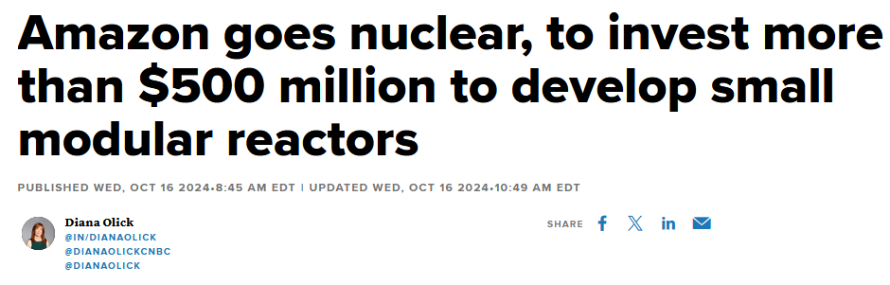
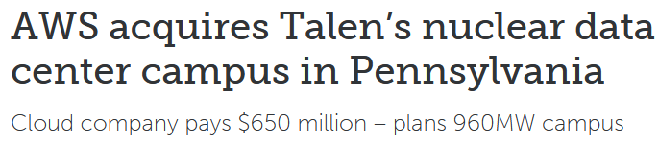
The effect of AI’s insatiable appetite for baseload power
Notes:
Amazon Web Services (AWS) is investing over $500 million in nuclear power projects.
AWS signed an agreement with Dominion Energy to develop SMRs, adding 300 MW of power to Virginia
AWS partnered with Energy Northwest to fund, license, and construct four SMRs in Washington State with an option to build up to eight additional SMR modules
Amazon’s Climate Pledge Fund is the lead anchor in a 500 million dollar financing round for SMR and nuclear fuel developer X-energy
Three Mile Island nuclear power plant is planned to restart through a 20-year agreement to power Microsoft’s data centers.
Constellation Energy plans to invest 1.6 billion dollars in restarting the plant through 2027, stating that the agreement with Microsoft as largest power purchase agreement that nuclear power plant operator has ever signed.
Google made an agreement with the SMR developer Kairos Power to purchase power from a fleet of SMRs which is estimated to add 500 MW to the grid
The first reactor is expected to come online by 2030, with more reactors going live through 2035

Slide 23
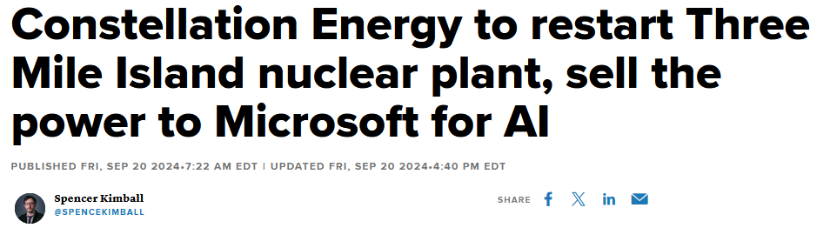
The effect of AI’s insatiable appetite for baseload power
Notes:
Amazon Web Services (AWS) is investing over $500 million in nuclear power projects.
AWS signed an agreement with Dominion Energy to develop SMRs, adding 300 MW of power to Virginia
AWS partnered with Energy Northwest to fund, license, and construct four SMRs in Washington State with an option to build up to eight additional SMR modules
Amazon’s Climate Pledge Fund is the lead anchor in a 500 million dollar financing round for SMR and nuclear fuel developer X-energy
Three Mile Island nuclear power plant is planned to restart through a 20-year agreement to power Microsoft’s data centers.
Constellation Energy plans to invest 1.6 billion dollars in restarting the plant through 2027, stating that the agreement with Microsoft as largest power purchase agreement that nuclear power plant operator has ever signed.
Google made an agreement with the SMR developer Kairos Power to purchase power from a fleet of SMRs which is estimated to add 500 MW to the grid
The first reactor is expected to come online by 2030, with more reactors going live through 2035

Slide 24
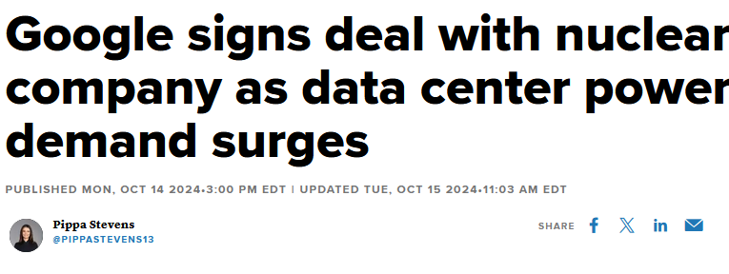
The effect of AI’s insatiable appetite for baseload power
Notes:
Amazon Web Services (AWS) is investing over $500 million in nuclear power projects.
AWS signed an agreement with Dominion Energy to develop SMRs, adding 300 MW of power to Virginia
AWS partnered with Energy Northwest to fund, license, and construct four SMRs in Washington State with an option to build up to eight additional SMR modules
Amazon’s Climate Pledge Fund is the lead anchor in a 500 million dollar financing round for SMR and nuclear fuel developer X-energy
Three Mile Island nuclear power plant is planned to restart through a 20-year agreement to power Microsoft’s data centers.
Constellation Energy plans to invest 1.6 billion dollars in restarting the plant through 2027, stating that the agreement with Microsoft as largest power purchase agreement that nuclear power plant operator has ever signed.
Google made an agreement with the SMR developer Kairos Power to purchase power from a fleet of SMRs which is estimated to add 500 MW to the grid
The first reactor is expected to come online by 2030, with more reactors going live through 2035

Slide 25
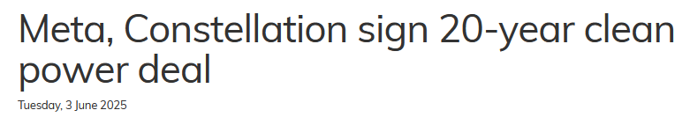
The effect of AI’s insatiable appetite for baseload power:
The Big Tech have all signed long-term PPAs to offtake power from NPPs
Notes:
Amazon Web Services (AWS) is investing over $500 million in nuclear power projects.
AWS signed an agreement with Dominion Energy to develop SMRs, adding 300 MW of power to Virginia
AWS partnered with Energy Northwest to fund, license, and construct four SMRs in Washington State with an option to build up to eight additional SMR modules
Amazon’s Climate Pledge Fund is the lead anchor in a 500 million dollar financing round for SMR and nuclear fuel developer X-energy
Three Mile Island nuclear power plant is planned to restart through a 20-year agreement to power Microsoft’s data centers.
Constellation Energy plans to invest 1.6 billion dollars in restarting the plant through 2027, stating that the agreement with Microsoft as largest power purchase agreement that nuclear power plant operator has ever signed.
Google made an agreement with the SMR developer Kairos Power to purchase power from a fleet of SMRs which is estimated to add 500 MW to the grid
The first reactor is expected to come online by 2030, with more reactors going live through 2035

Slide 26
The effect of AI’s insatiable appetite for baseload power:
What’s happening in
the Europe?
Notes:
In Europe, data center industry has started to warm up for nuclear power in 2025
European data center firm Data4 has signed a nuclear power supply agreement with French electric utility EDF to power its French data center portfolio.
Westinghouse Electric Company and Data4, signed a memorandum of understanding (MoU) to explore the use of AP300 SMR to power future data centers in Europe.
Out of the three deals by Equinix, two are related to Europe. The second agreement saw Equinix sign a Letter of Intent with ULC-Energy for a Power Purchase Agreement of up to 250MWe to power its data centers in the Netherlands. ULC-Energy has selected Rolls Royce SMR as its preferred technology in 2022.
Equinix’s third deal was a pre-order power agreement with Stellaria, a French nuclear company, for 500MWe to supply data centers across Europe. Stellaria is developing the world’s first molten salt Breed & Burn reactor, Stellaria was founded in 2023 by CEA and Schneider Electric.

Slide 27
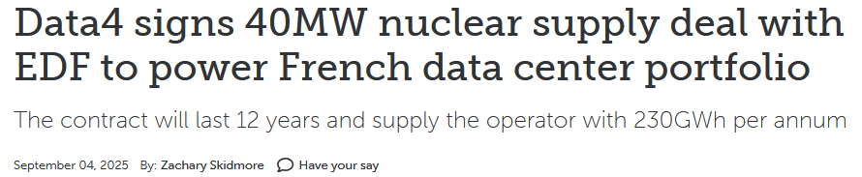
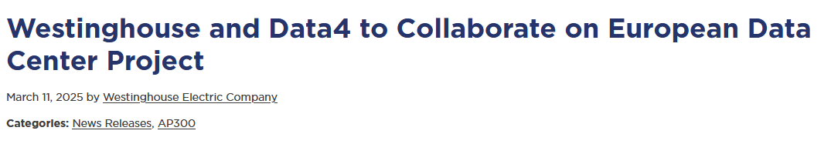
The effect of AI’s insatiable appetite for baseload power:
Notes:
In Europe, data center industry has started to warm up for nuclear power in 2025
European data center firm Data4 has signed a nuclear power supply agreement with French electric utility EDF to power its French data center portfolio.
Westinghouse Electric Company and Data4, signed a memorandum of understanding (MoU) to explore the use of AP300 SMR to power future data centers in Europe.
Out of the three deals by Equinix, two are related to Europe. The second agreement saw Equinix sign a Letter of Intent with ULC-Energy for a Power Purchase Agreement of up to 250MWe to power its data centers in the Netherlands. ULC-Energy has selected Rolls Royce SMR as its preferred technology in 2022.
Equinix’s third deal was a pre-order power agreement with Stellaria, a French nuclear company, for 500MWe to supply data centers across Europe. Stellaria is developing the world’s first molten salt Breed & Burn reactor, Stellaria was founded in 2023 by CEA and Schneider Electric.

Slide 28
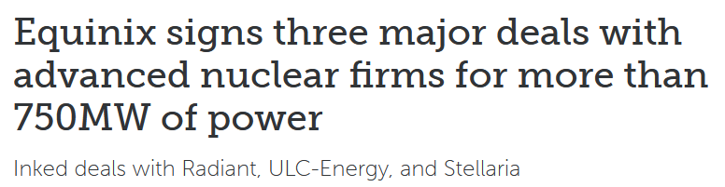
The effect of AI’s insatiable appetite for baseload power:
First deals being made in 2025
Notes:
In Europe, data center industry has started to warm up for nuclear power in 2025
European data center firm Data4 has signed a nuclear power supply agreement with French electric utility EDF to power its French data center portfolio.
Westinghouse Electric Company and Data4, signed a memorandum of understanding (MoU) to explore the use of AP300 SMR to power future data centers in Europe.
Out of the three deals by Equinix, two are related to Europe. The second agreement saw Equinix sign a Letter of Intent with ULC-Energy for a Power Purchase Agreement of up to 250MWe to power its data centers in the Netherlands. ULC-Energy has selected Rolls Royce SMR as its preferred technology in 2022.
Equinix’s third deal was a pre-order power agreement with Stellaria, a French nuclear company, for 500MWe to supply data centers across Europe. Stellaria is developing the world’s first molten salt Breed & Burn reactor, Stellaria was founded in 2023 by CEA and Schneider Electric.

Slide 29
Conclusions
Major companies such as Microsoft, Google, and Amazon are entering long-term agreements and investing significant capital into both traditional nuclear power plant and SMR projects.
  These projects will prove if SMRs can overcome their challenges
This trend is supported with the studies indicating that data centers are more sensitive to load shifting rather than by fluctuations in electricity prices.
  Nuclear power plants and data centers both want to operate on a 24/7 basis
Datacenters specialized in cryptocurrency were not mentioned, but they could prove to be flexible.
    Cryptocurrency mining is prioritized when the electricity prices are low
Notes:
when you need reliable electricity around the clock, few other generation sources compare.

Slide 30

Thank you!
Jussi-Pekka Ikonen,
Research Scientist VTT
jussi-pekka.Ikonen@vtt.fi
+358505606522

Slide 31
References
Gynther L.,Kiuru T., and Meetter J., (2020), “Energy Efficiency of Data Centers in Finland,” 2022. Accessed: Mar. 14, 2025. [Online]. Available: https://www.motiva.fi/files/20768/Energy_Efficiency_of_Data_Centers_in_Finland_-_November_2022.pdf
IEA (2024), “Electricity 2024”, IEA, Paris https://www.iea.org/reports/electricity-2024, Licence: CC BY 4.0
IEA (2025), “Energy and AI”, IEA, Paris https://www.iea.org/reports/energy-and-ai, Licence: CC BY 4.0
Kamiya, G. and Bertoldi, P., (2024) “Energy Consumption in Data Centres and Broadband Communication Networks in the EU, Publications Office of the European Union”, Luxembourg, doi:10.2760/706491, JRC135926.
Masanet E.,Shehabi A., Lei N., Smith S., and Koomey J., (2020) Recalibrating global data center energy-use estimates.Science367,984-986.DOI:10.1126/science.aba3758
Nøland, J.K, & Hjelmeland M., & Korpås M., (2024a) “Will Energy-Hungry AI Create a Baseload Power Demand Boom?” IEEE Access. PP. 1-1. 10.1109/ACCESS.2024.3440217. [Accessed 21 March 2025].
Singer, B., Bingham D, et al., and (2024) “AI/data centers' global power surge and the Sustainability impact”, Goldman Sachs [Online]. Available at: https://www.goldmansachs.com/images/migrated/insights/pages/gs-research/gs-sustain-generational-growth-ai-data-centers-global-power-surge-and-the-sustainability-impact/sustain-data-center-redaction.pdf (Accessed: 5 February 2025)
Singer, B., Corbett, B., Davenport, C., et al., (2025) “AI/data centers’ global power surge and the Sustainability impact”. [Online]. Available at: https://www.goldmansachs.com/pdfs/insights/goldman-sachs-research/five-drivers/FinalReport.pdf [Accessed 26 February 2025].

Slide 32
More research:
SANE (The Safety Assessment of Non-Electric uses of Nuclear Energy)
https://www.sane-euratom.eu/
  Possibility to join as End User
  Data center study is going to be published this year
TANDEM (Small Modular Reactor for a European safe and Decarbonised Energy Mix) https://tandemproject.eu/
  Economic and operational studies about integration of small modular reactors to hybrid energy systems
EASI-SMR (Ensuring Assessment of Safety Innovation for SMR) https://easi-smr.eu/
  Safety assessments of small modular reactors

Slide 33
Thank you!
Jussi-Pekka Ikonen,
Research Scientist VTT
jussi-pekka.Ikonen@vtt.fi
+358505606522
Sini Huhtinen,
Research Scientist VTT
sini.huhtinen@vtt.fi
+358504775386

