Slide 1
Load Follow Operation Capability of Olkiluoto 1 & 2
A Fuel Performance Perspective
SYP 2025
Joona Saira
Reactor Engineer
TVO | Reactor Analysis & Core Supervision

Slide 2
Background: Load Follow Operation of NPPs
Electricity generation capacity of Finland has increased.
This is due to growth wind and nuclear.
Wind, hydro, and nuclear combined, made up almost 80 % of total generation in 2023.
Volatility in electricity prices
As the remaining major generation method with reliable, steady load follow capability, pressure mounts on NPPs to operate more flexibly.
This involves control of reactor thermal power through reactivity control.
Fuel conditions must remain acceptable both locally and globally within the reactor core → technical limitations
 | Energy [TWh] | Share of total [%]
Wind | 14.5 | 19.2
Hydro | 15.0 | 18.5
Nuclear | 32.8 | 41.8
Total | 78.3
(StatFin: 11sr - Production of electricity 2023)

Slide 3
BWR Load Following: Pellet Cladding Interaction
BWR reactor power manoeuvring in high power ranges (above 70 %):
Primarily through coolant flow control. (boiling → moderator density → reactivity effect)
Effects are more spatially distributed within the core
Operation below this requires more control rod movement.
Effects are more localised to fuel near the moving control rods
High localised power ramps give rise to a fuel failure mechanism: pellet cladding interaction (PCI)
Within the operating cycle of a reactor core, the periods with the highest PCI risk are:
Beginning of cycle, during startup
Late into the cycle, as All Rods Out (ARO) operation is approached

Slide 4
Pellet Cladding Interaction (PCI)
Fuel failure mechanism linked to local power ramps, which can potentially progress into a fuel leak
Gas gap between fuel pellet and cladding closes, physical contact
Tensile stress
Stress corrosion cracking (SCC) of pellet and cladding
Fuel leak, worsening as the crack propagates
A result of multiple contributing phenomena
Thermal expansion of fuel and cladding
Swelling of irradiated fuel
Cladding creep down
Chemical corrosion by fission products
Delayed hydride cracking

Slide 5

Modelling of PCI in Core Calculations at TVO
SIMULATE5 neutronic solution → fuel pin powers
Linear heat generation rate (LHGR) [W/cm] for 25 equally divided axial nodes of each fuel rod
Tracking of threshold and conditioning levels
The most limiting location restricts core operation
PCI limit
PCI limit
Maximum step
LHGR
Conditioning
Conditioning
PCI step
LHGR
$${PCI}_{step}=LHGR−max⁡({LHGR}_{conditioning},{LHGR}_{threshold})$$
Conditioning rate: 3 W/cm / h
Deconditioning rate: 50 W/cm/MWd/kgU
Unit | Max PCI step [W/cm]
OL1 | 24
OL2 | 28
$${PCI}_{marg}=P_{th}\left(\frac{{PCI}_{limit}}{LHGR}−1\right)$$

Slide 6
Categories of PCI
Classic PCI
High step change in local power to a level above conditioning
Typically contributed to by local releases of gaseous fission products (SCC)
Typically, in fuel rods located near control rod. Bundles with 1.5 to 3 years of core operation behind them
High residence time PCI
Slow increase of power and mechanical stress, not as easily avoidable through conservative ramp rates
Internal chemistry contribution not as significant
Typically, in higher burnup fuel rods, located away from moving control rods

Slide 7
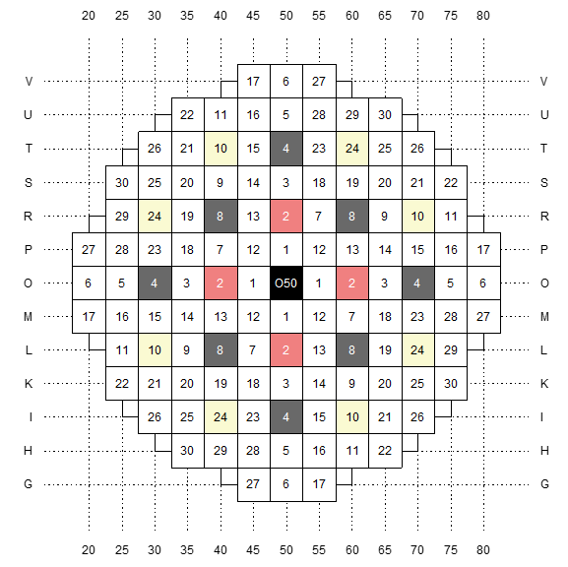
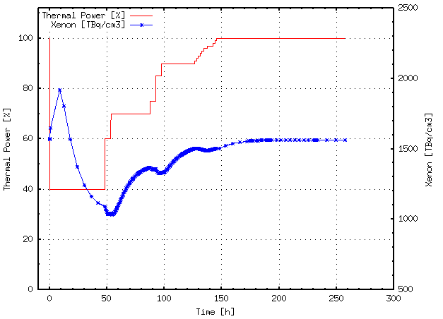
Example: axial power profile of a fuel rod
Theoretical case of 40 % relative thermal power operation for a period of 48 hours by OL1/2 calculated with SIMULATE5
Starting point from a depletion calculation of a past cycle
Fuel rod of a bundle in a control rod group 2 super cell
During the case group 2 rods go from fully withdrawn (100 %) to fully inserted (4 %) and back to fully withdrawn.

Slide 8
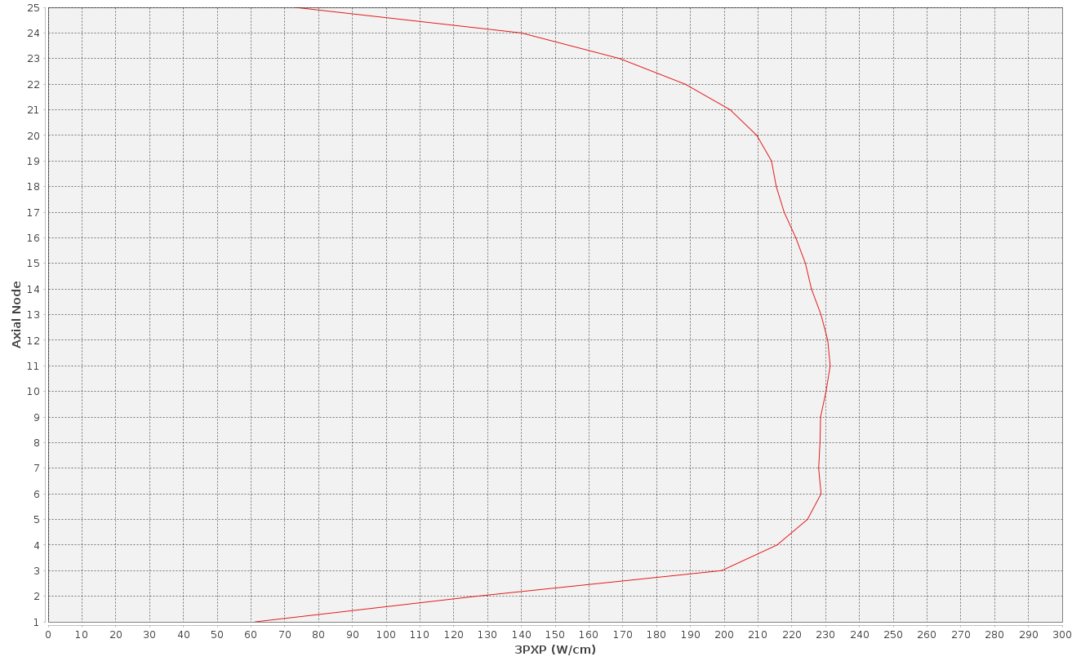
Example: axial power profile of a fuel rod
000.00 Hours 100.00 % Thermal power 100 % G2 Withdrawal

Slide 9
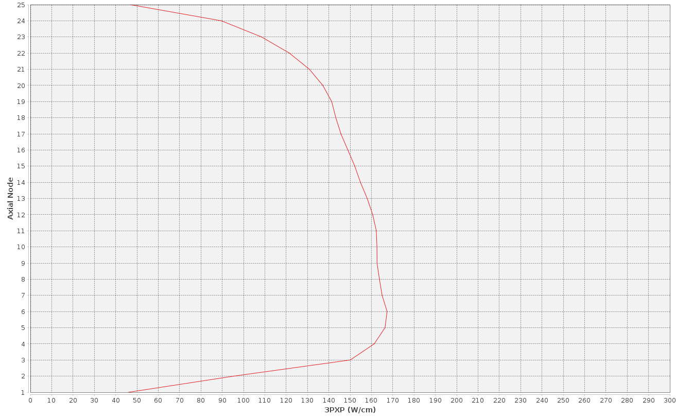
Example: axial power profile of a fuel rod
000.04 Hours 70.00 % Thermal power 100 % G2 Withdrawal

Slide 10
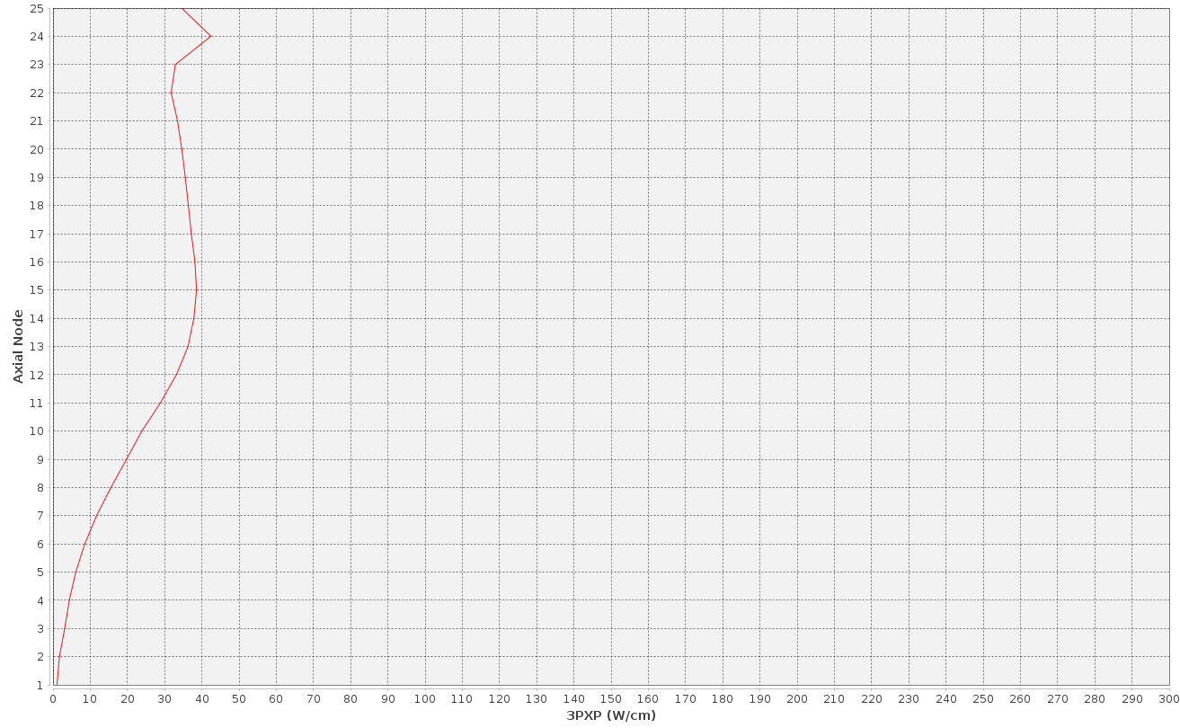
Example: axial power profile of a fuel rod
012.08 Hours 40.00 % Thermal power 60 % G2 Withdrawal

Slide 11
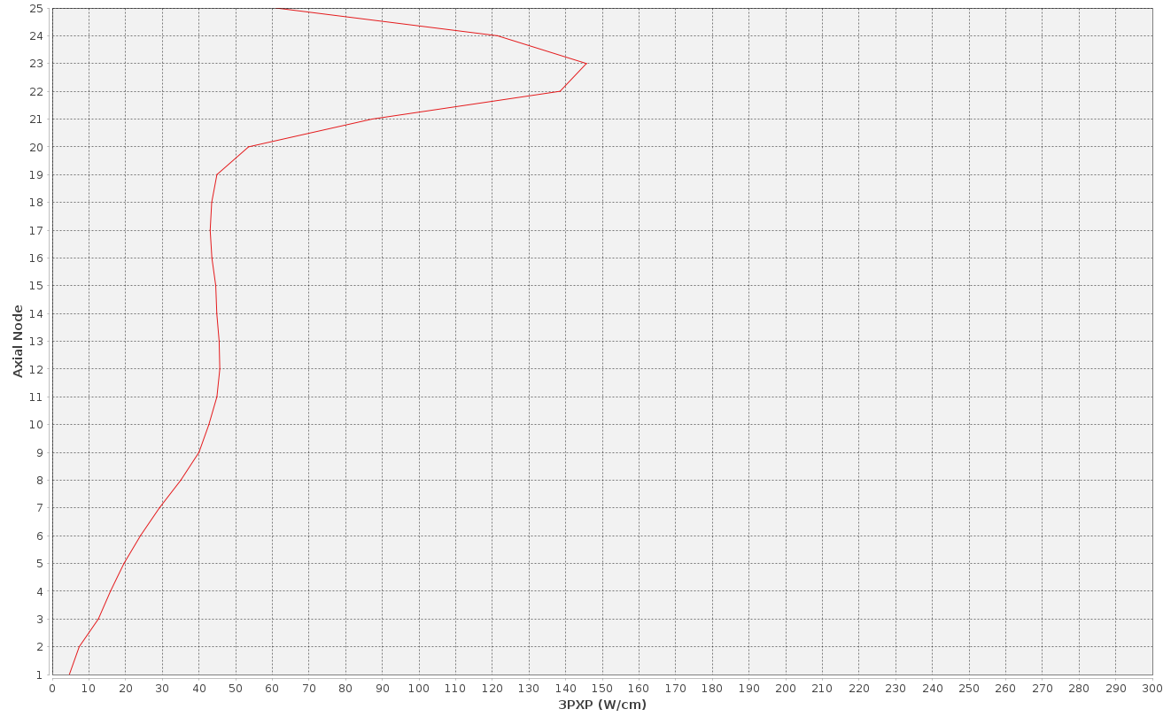
Example: axial power profile of a fuel rod
048.12 Hours 55.00 % Thermal power 18 % G2 Withdrawal

Slide 12
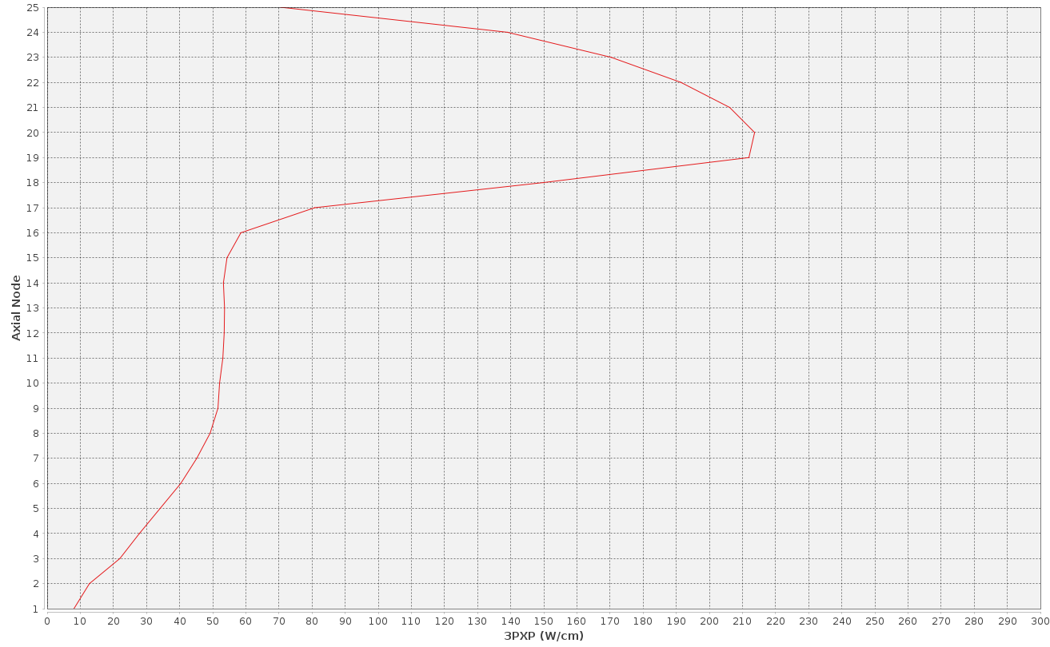
Example: axial power profile of a fuel rod
054.33 Hours 70.00 % Thermal power 32 % G2 Withdrawal

Slide 13
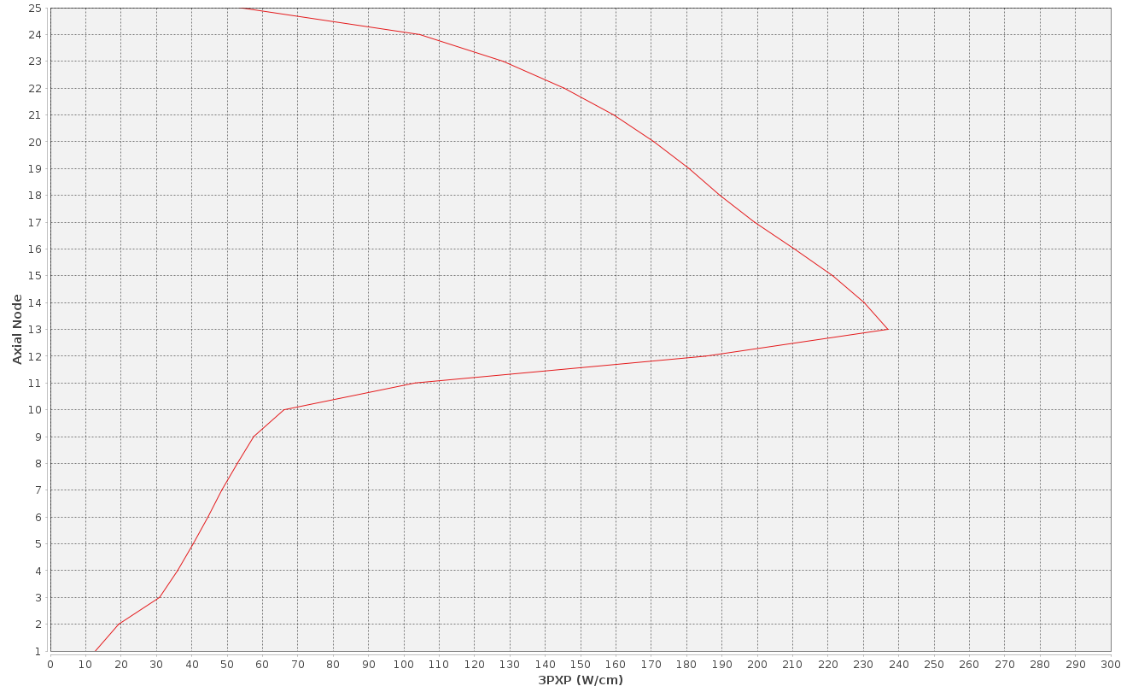
Example: axial power profile of a fuel rod
070.90 Hours 75.00 % Thermal power 57 % G2 Withdrawal

Slide 14
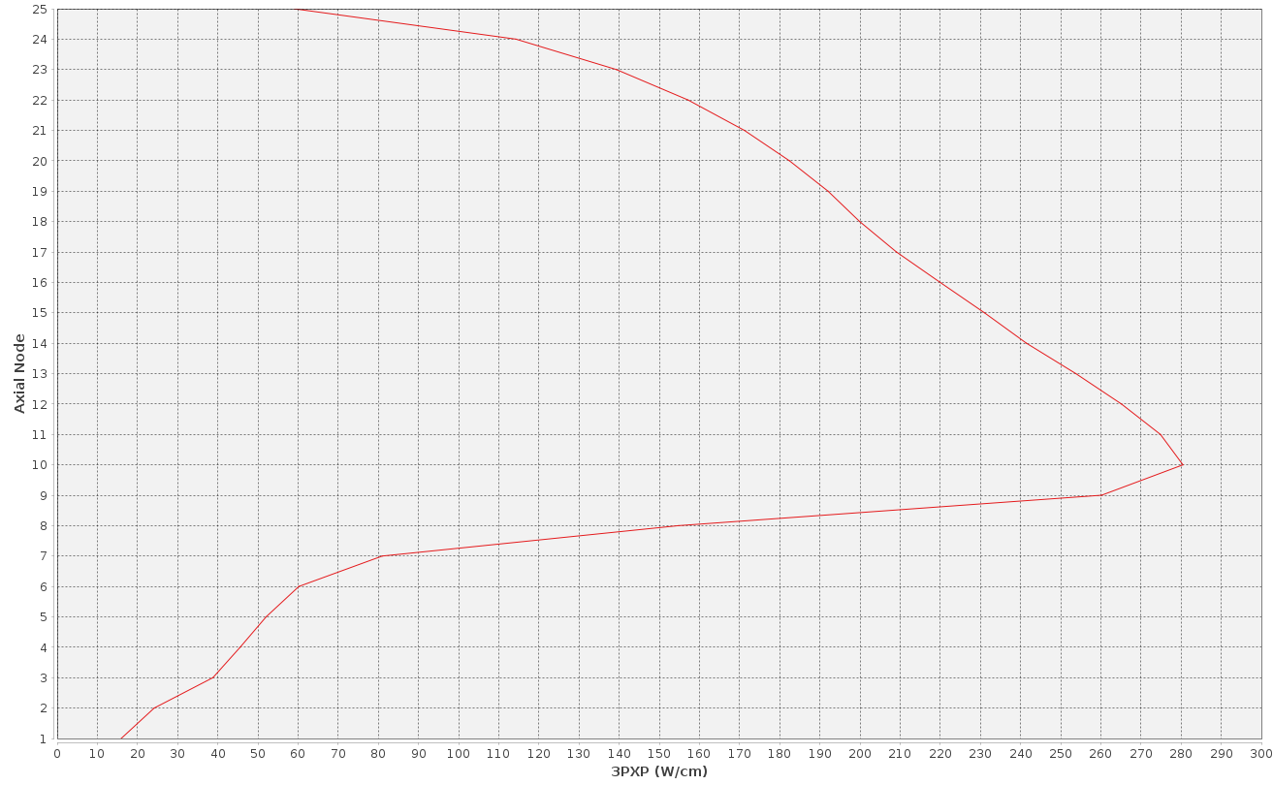
Example: axial power profile of a fuel rod
078.02 Hours 90.00 % Thermal power 71 % G2 Withdrawal

Slide 15
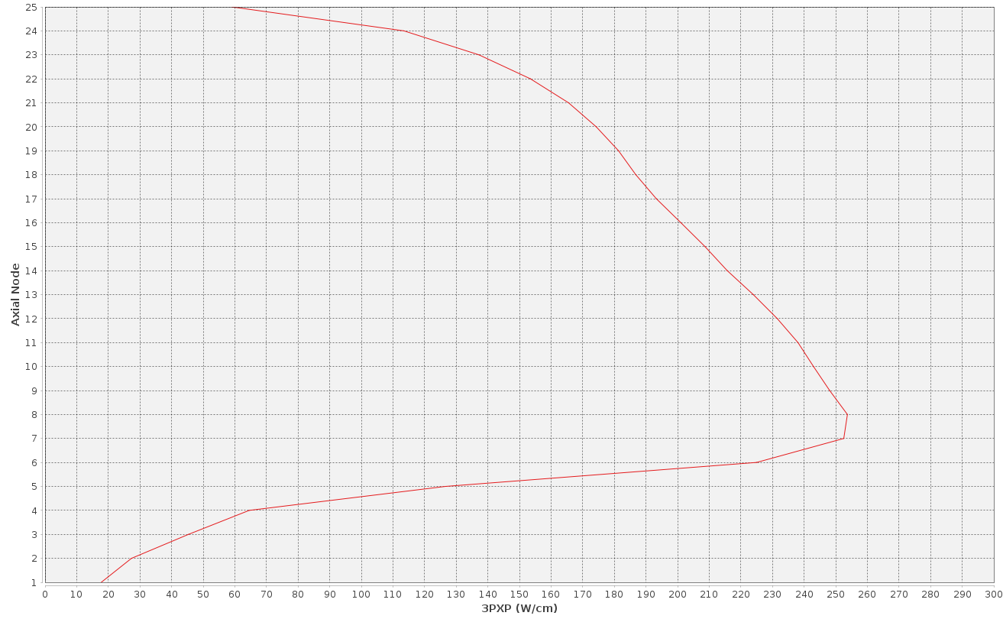
Example: axial power profile of a fuel rod
084.52 Hours 90.00 % Thermal power 83 % G2 Withdrawal

Slide 16
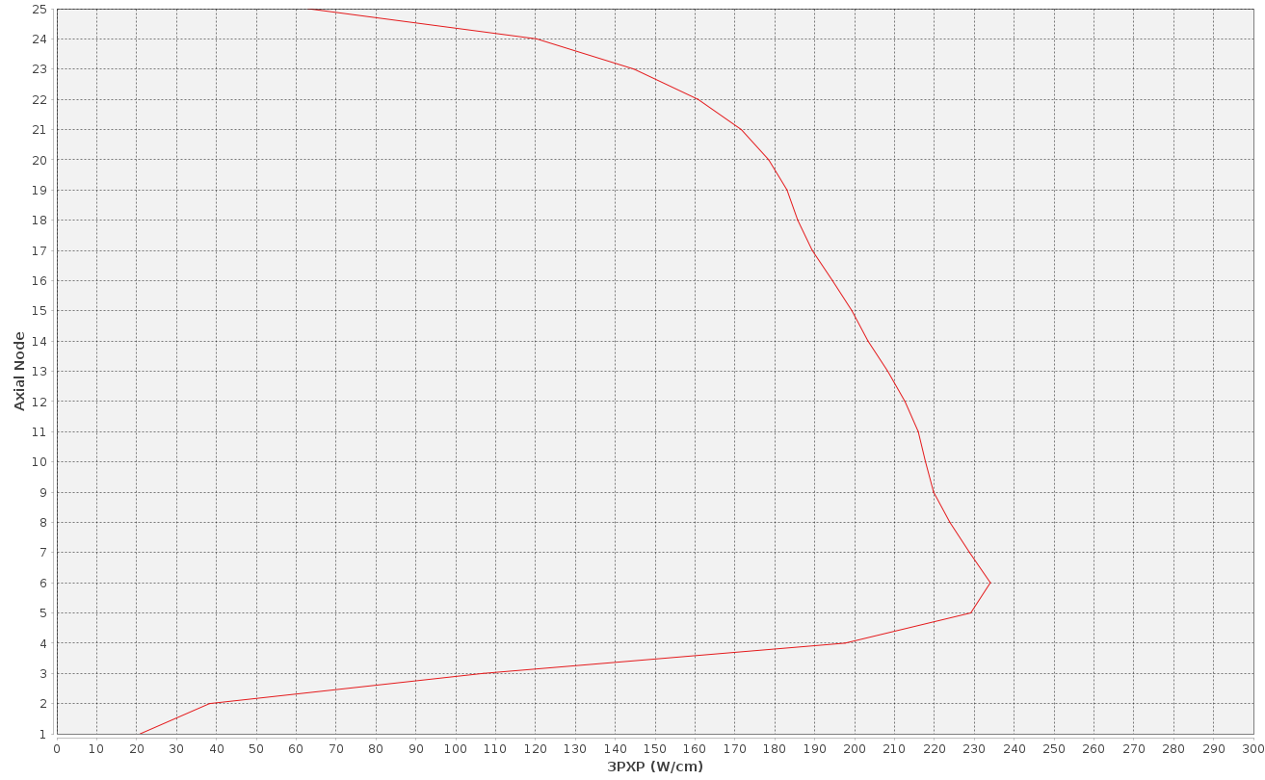
Example: axial power profile of a fuel rod
089.02 Hours 90.00 % Thermal power 91 % G2 Withdrawal

Slide 17
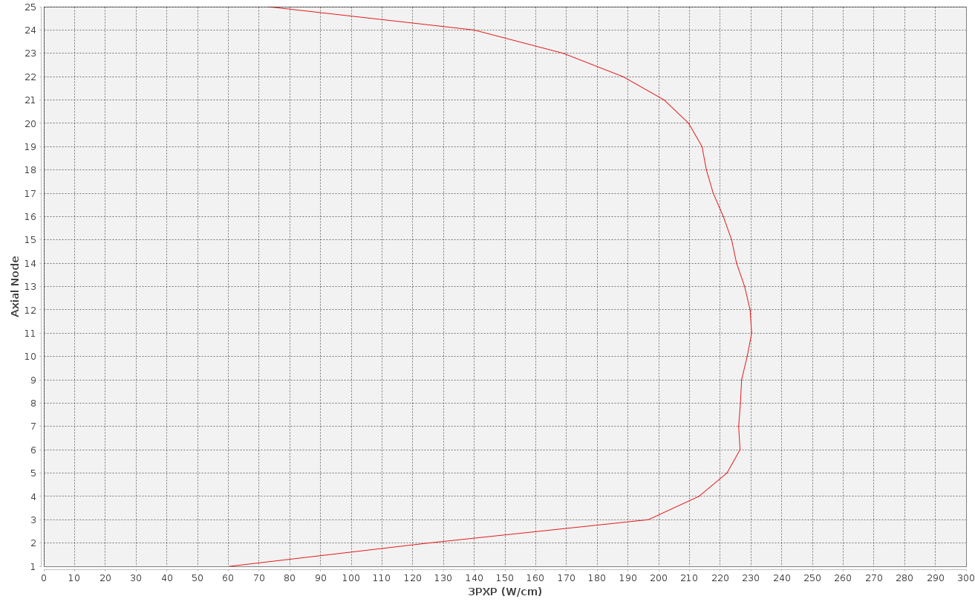
Example: axial power profile of a fuel rod
198.50 Hours 100.00 % Thermal power 100 % G2 Withdrawal

Slide 18
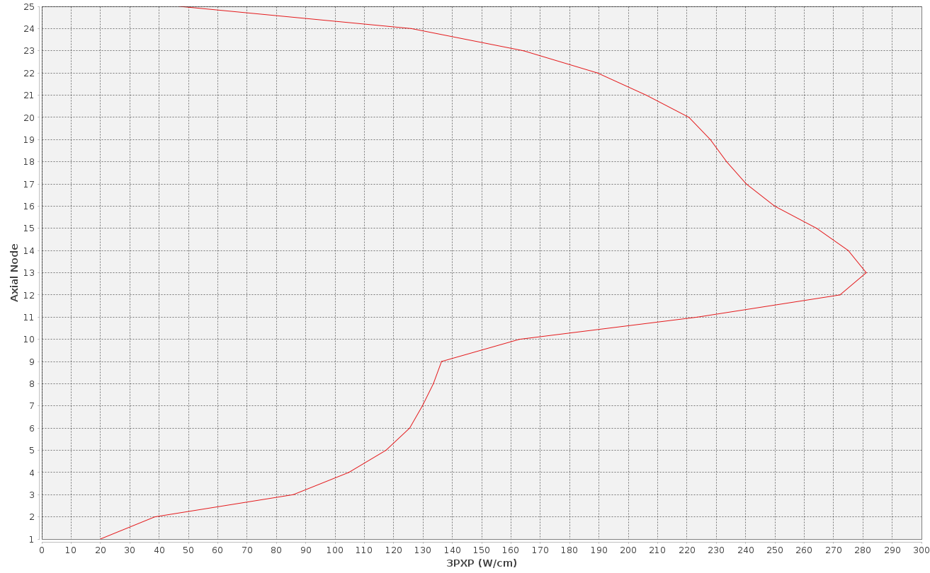
Example: effect of single rod step on axial power profile
Before a 1 % withdrawal step (58 % → 59 %)
Node | LHGR0 [W/cm] | LHGR1 [W/cm] | ΔLHGR [W/cm]
14 | 275.02
13 | 281.16
12 | 272.20
11 | 223.63

Slide 19
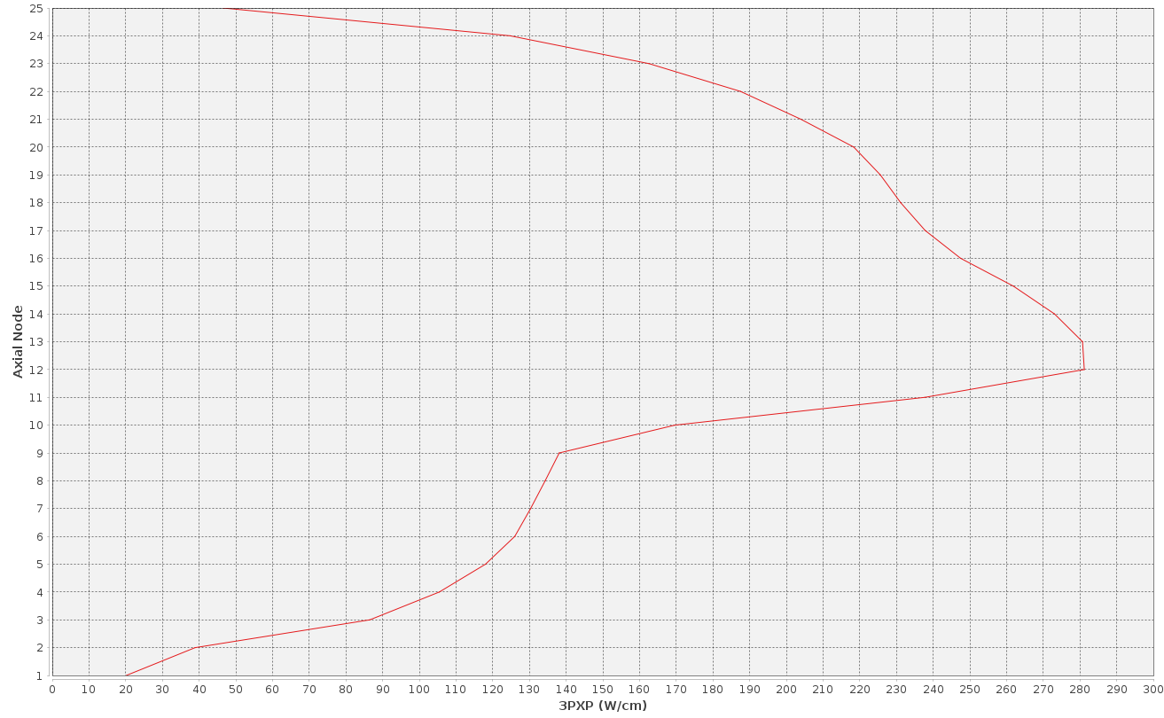
Example: effect of single rod step on axial power profile
After a 1 % withdrawal step (58 % → 59 %)
Unit | Max PCI step [W/cm]
OL1 | 24
OL2 | 28
Node | LHGR0 [W/cm] | LHGR1 [W/cm] | ΔLHGR [W/cm]
14 | 275.02 | 273.05 | -1.97
13 | 281.16 | 280.70 | -0.46
12 | 272.20 | 281.18 | +8.98
11 | 223.63 | 237.75 | +14.12

Slide 20
Example: effect of single rod step on axial power profile
After a 1 % withdrawal step (58 % → 59 %)
Unit | Max PCI step [W/cm]
OL1 | 24
OL2 | 28
Node | LHGR0 [W/cm] | LHGR1 [W/cm] | ΔLHGR [W/cm]
14 | 275.02 | 273.05 | -1.97
13 | 281.16 | 280.70 | -0.46
12 | 272.20 | 281.18 | +8.98
11 | 223.63 | 237.75 | +14.12
PCI limiting location in node 12.
Threshold of 279.04 W/cm and conditioning of 258.06 W/cm → PCI step is 2.14 W/cm

Slide 21
What is TVO doing on this matter?
Operational guidelines
Investigation of control rod sequences
Goal of more even distribution of changes in thermal power during reactor power manoeuvring (core level)
Lower localised peaking → increased margins
Higher reactivity effect of control rod sequence steps
Flexible operation capability vs. fuel economics
Investigation of fuel enrichment design
Goal of more even distribution of changes in thermal power during reactor power manoeuvring (bundle level)
Lower localised peaking → increased margins

Slide 22
What is TVO doing on this matter?
Fuel performance code PCI analyses of flexible operation cases and startups in co-operation with external parties
We provide case design, core calculation, power histories and other data using our calculation systems.
Our partners provide cladding stress results generated using fuel performance codes.

Slide 23
Fuel performance analyses so far
We observe differences in the most PCI limiting location at some periods of power history.
Bundles of control group super cells are prominent in results of our PCI model. Fuel performance code results occasionally point towards the outer core.
This seems to indicate that the current PCI model used in core supervision doesn’t capture high residence time PCI as well as it does classic PCI.
This is understandable and to be expected due to the simplicity of the model.
It should also be noted that we haven’t had PCI issues outside of control groups lately.

Slide 24
In Closing
If you wish to know more about some of the topics discussed in presentation. You can read my master’s thesis, which is publicly available online at the publication repository of LUT University lutpub.lut.fi
Saira, J. 2024. Optimising Boiling Water Reactor Cores for PCI Margins and Load Follow Operation Capability.
Or feel free to come and talk to me!

