Slide 1
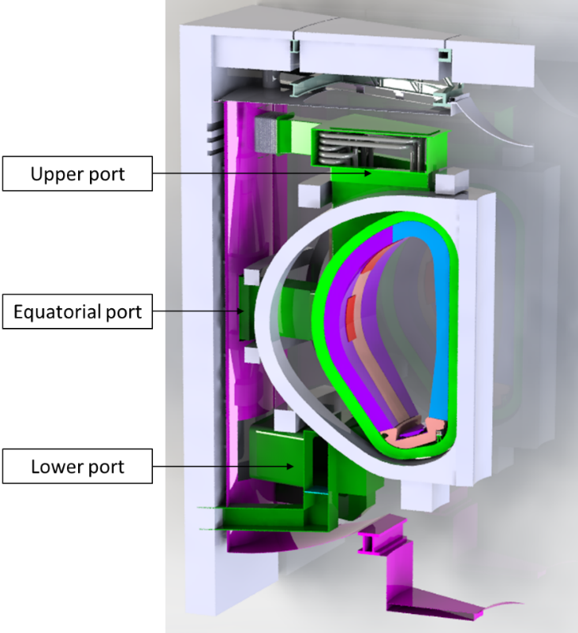
Remote Maintenance Strategies and Equipment for
DEMO Port Systems
Syp2025, October 21st
Nuclear Fusion Technology
Changyang Li*, Huapeng Wu, Pradeep Gaudel, Peng Shang, William Brace
Changyang Li, D.Sc. (Tech)
Department of Mechanical Engineering, School of Energy Systems
Li.Changyang@lut.fi

Slide 2
Table of content
Activities in Upper Port (UP)
Activities in Equatorial Port (EP)
Activities in Lower Port (LP)
Methodology
Li.Changyang@lut.fi
2 / 14

Slide 3
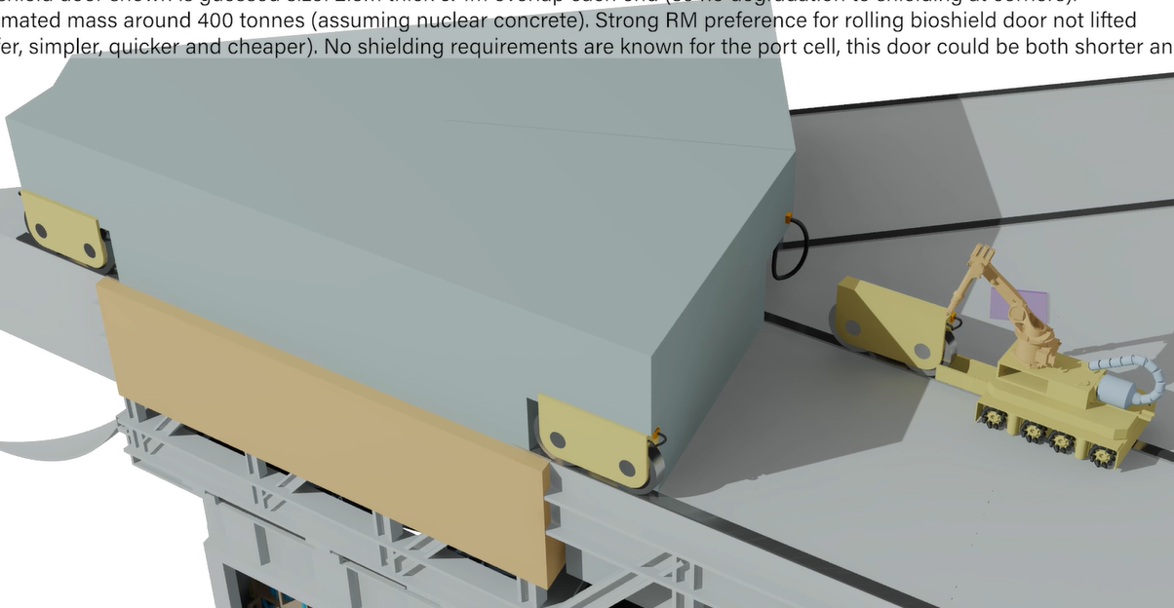
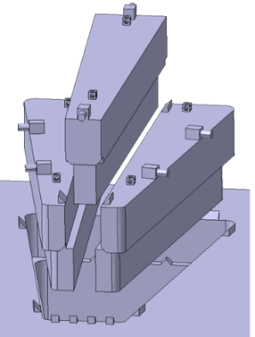
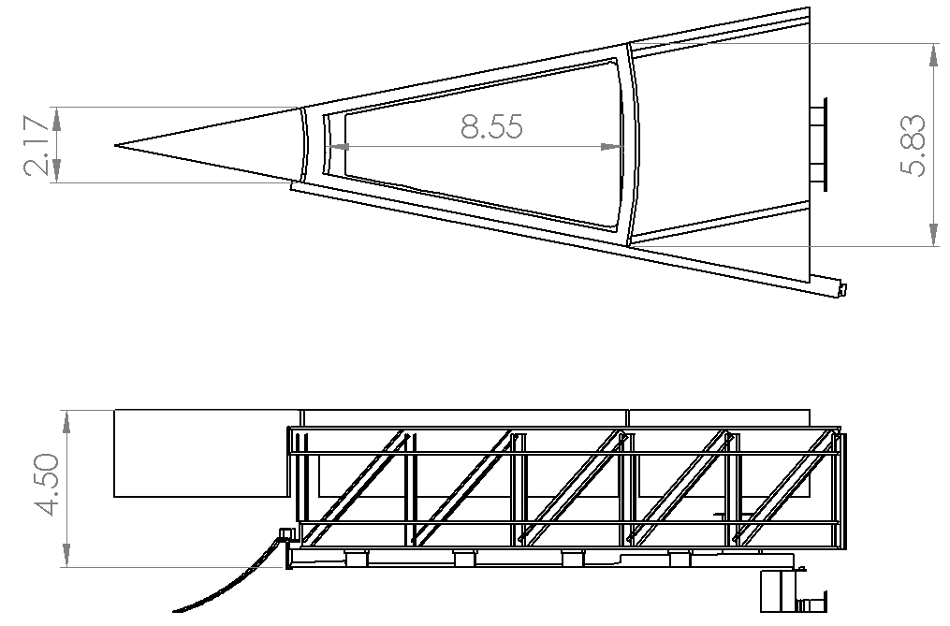
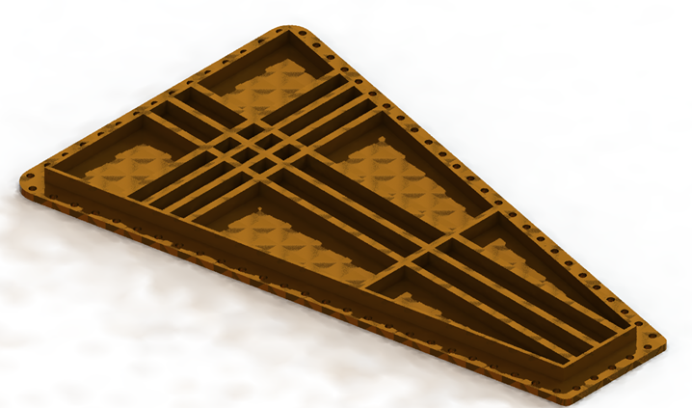
Bioshield door
Bioshield plug
Port closure plate
Li.Changyang@lut.fi
3 / 14

Slide 4
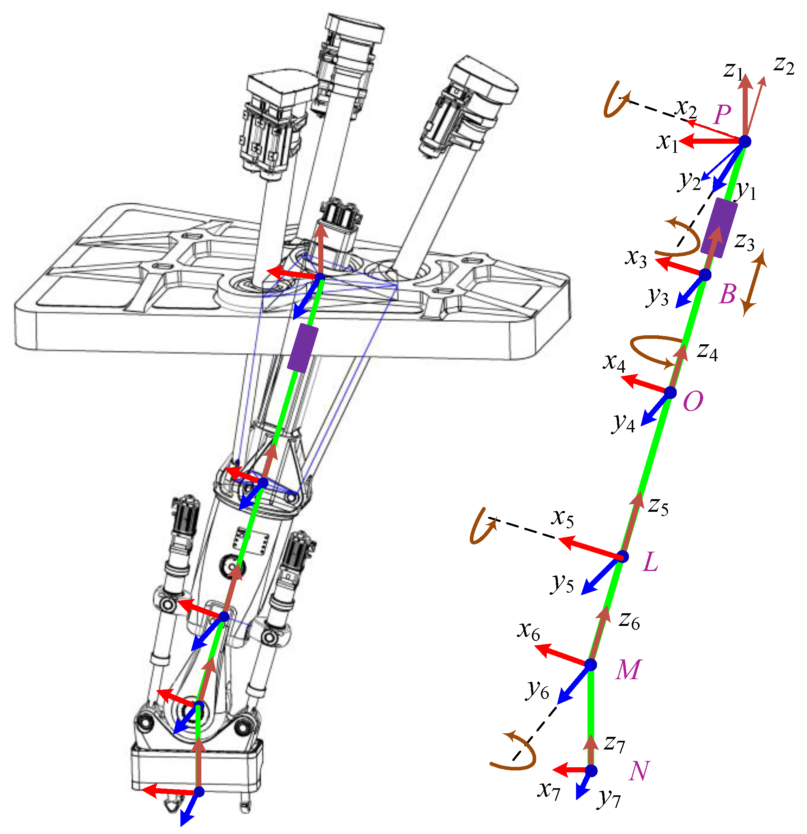
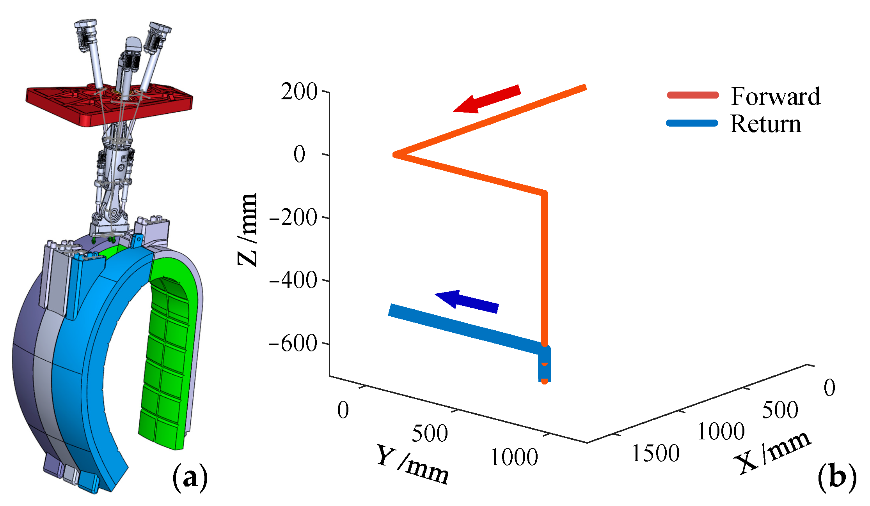
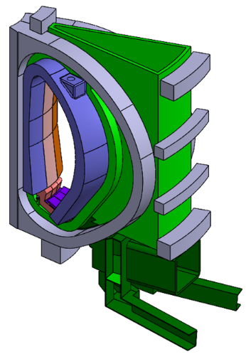
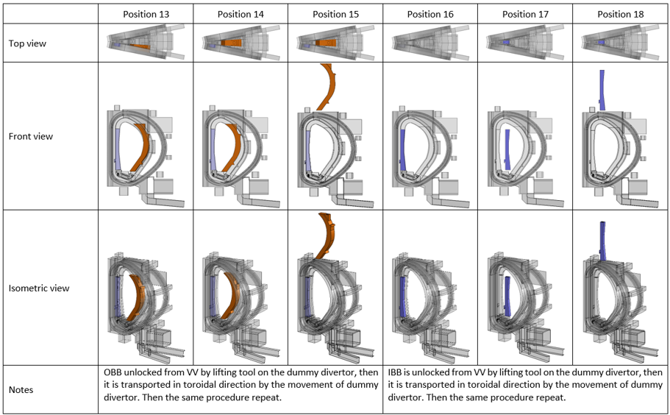
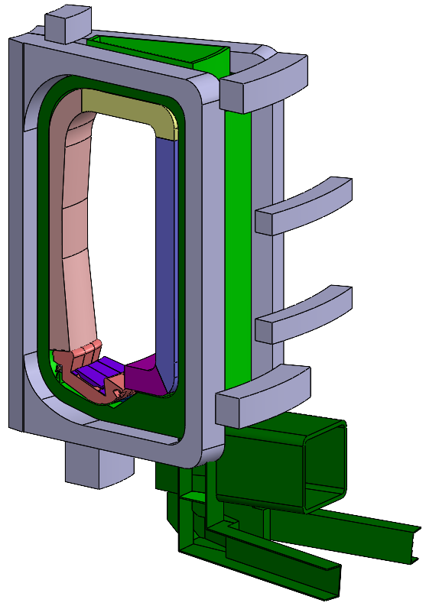
Activities in uP
Remote maintenance of the breeding blanket
Architecture study of the breeding blanket, which will be beneficial for the remote maintenance
Bluemira study of the breeding blanket, multi-objective optimization
Checking piping
Li.Changyang@lut.fi
4 / 14

Slide 5
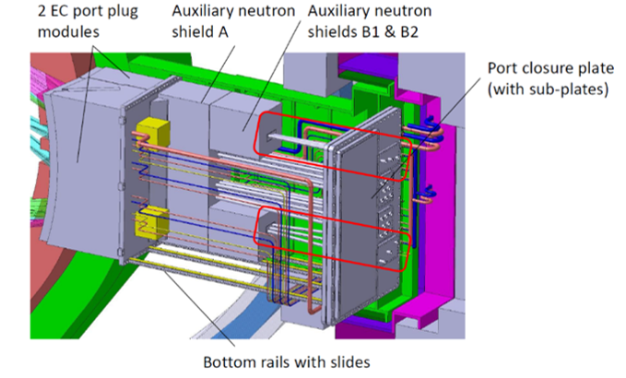
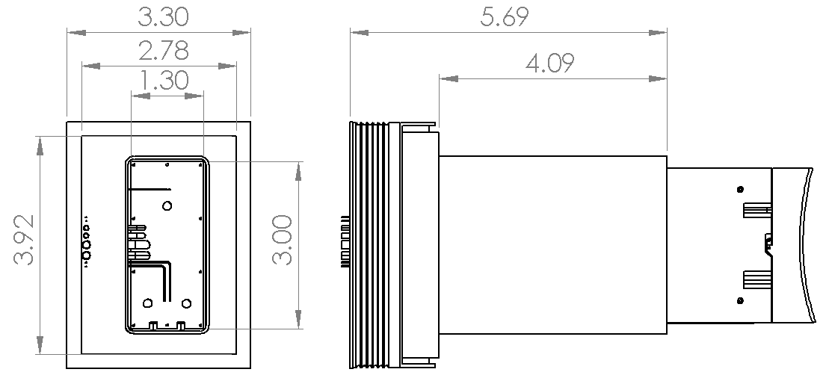
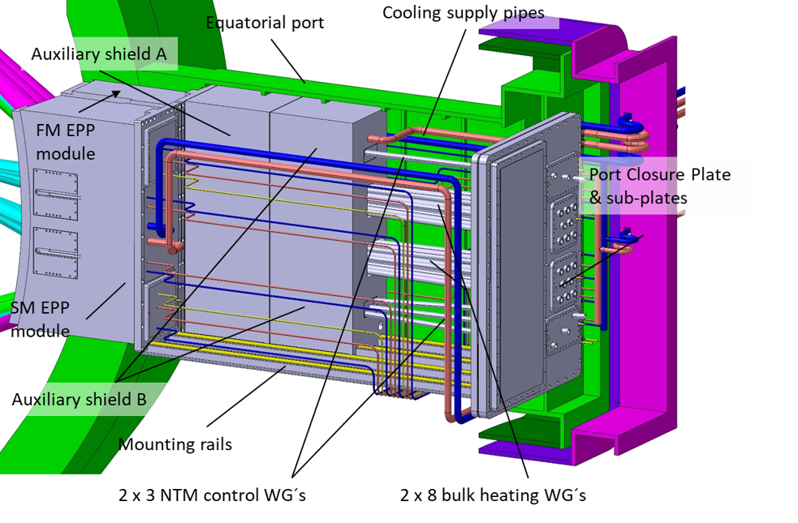
Configuration 1
Configuration 2
Li.Changyang@lut.fi
5 / 14

Slide 6
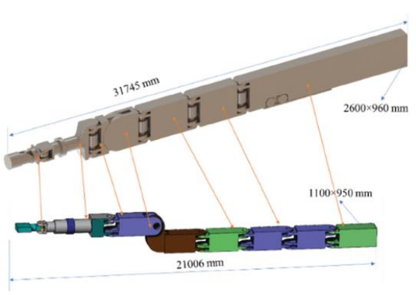
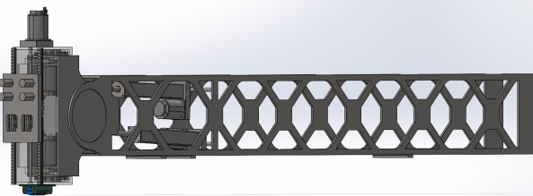
Activities in EP
Multi-Purpose Deployer (MPD) study
Remote maintenance of the plasma facing component – 3D printing possibility
Study on the current design
Remote maintenance of limiter (6-20 tonnes)
Remote maintenance of components in EC launcher
Li.Changyang@lut.fi
6 / 14

Slide 7
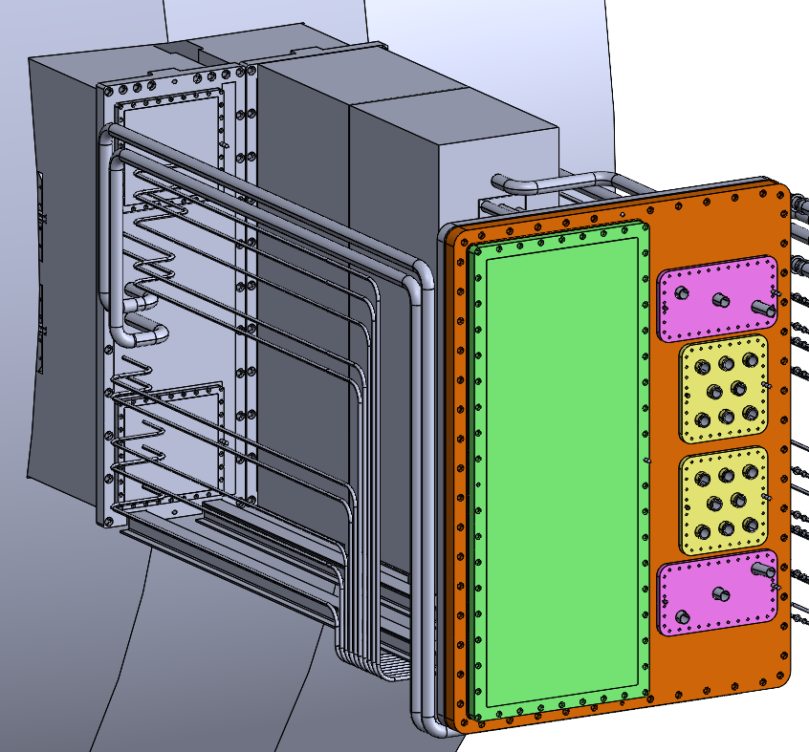
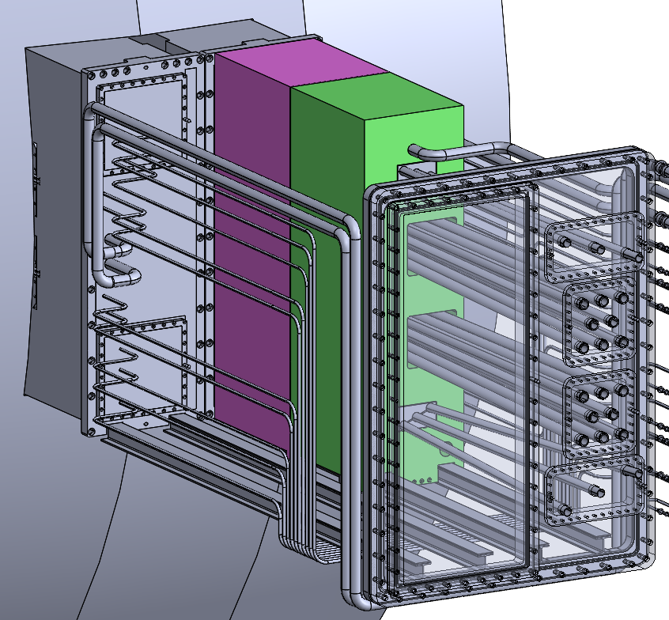
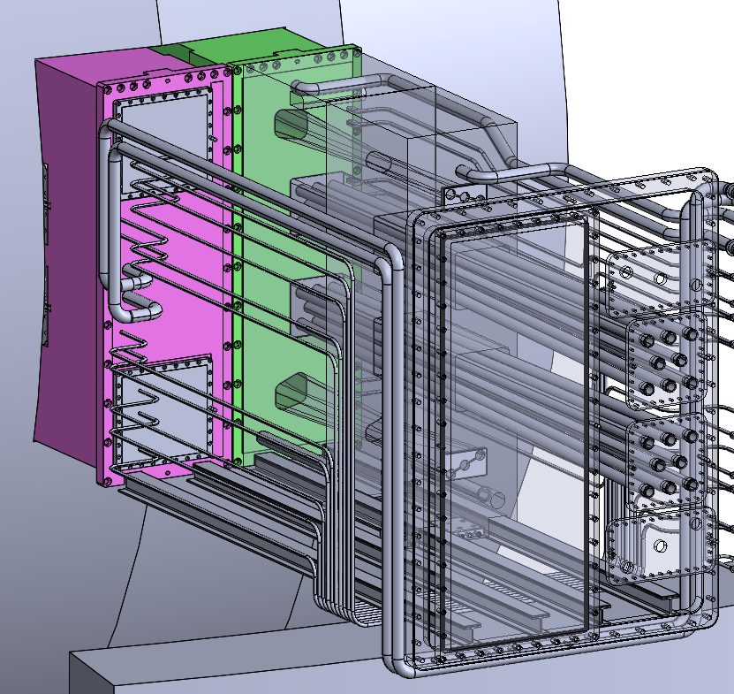
Port closure plate
Configuration 1
Port plug
Neutron shield
Configuration 2
Li.Changyang@lut.fi
7 / 14

Slide 8
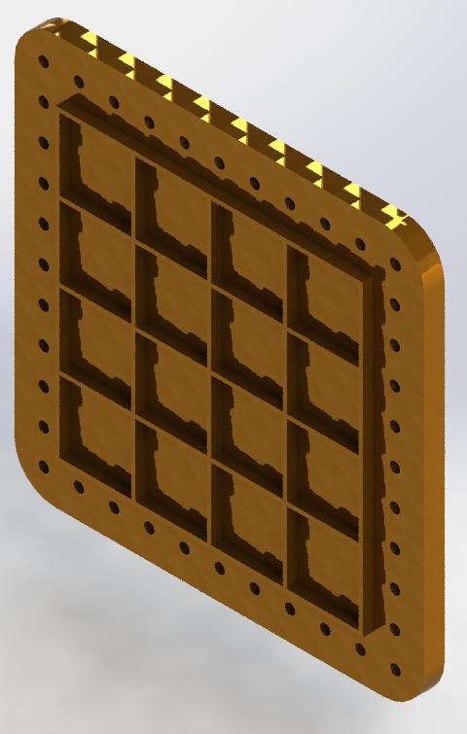
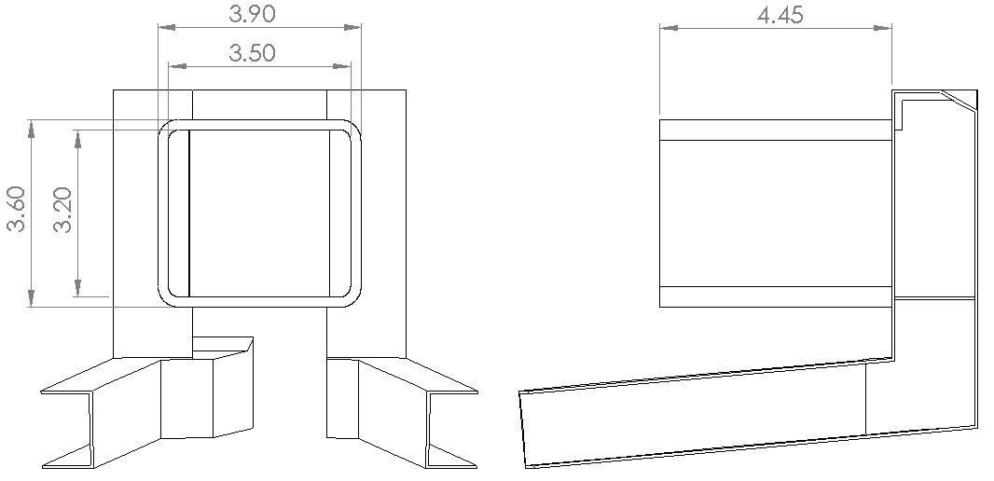
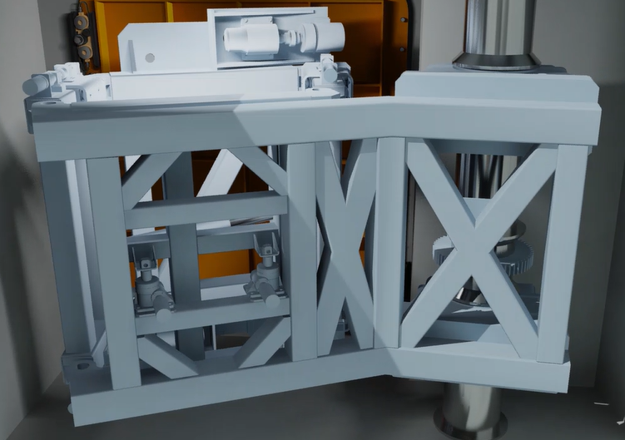
Port closure plate
Port closure plate RM tool
Li.Changyang@lut.fi
8 / 14

Slide 9
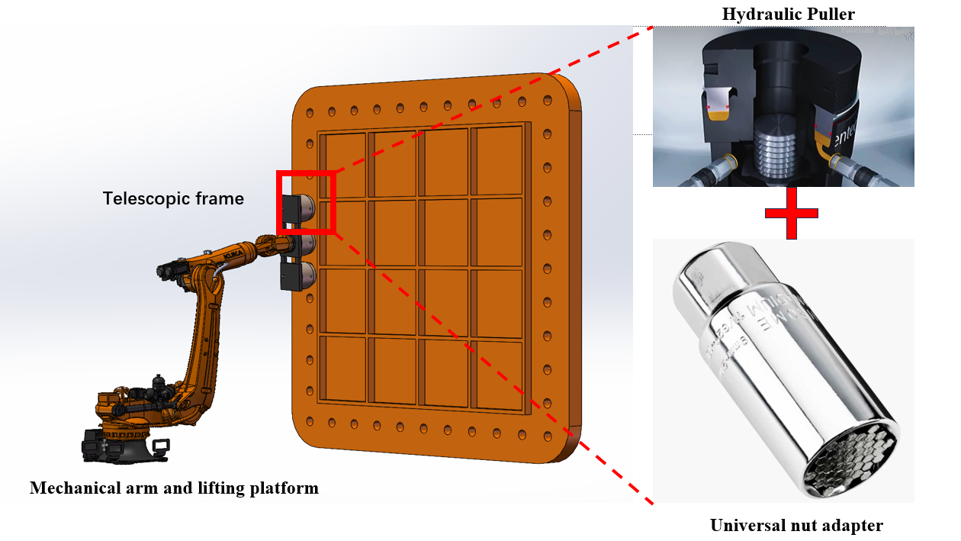
Activities in LP
Main focus: Remote maintenance of the PCP in horizontal direction (14 tonnes)
Autonomous nut runners
Remote maintenance of other components, which is similar as the EP
Li.Changyang@lut.fi
9 / 14

Slide 10
Parameters of components
Component | Height [mm] | Width [mm] | Length [mm] | Mass [tonnes]
Neutron Shield (Configuration 1)
NS A (Conf.1) | 3160 | 900 | 1200 | 20*
NS B1 (Conf.1) | 950 | 900 | 1170 | 8**, 5.2*
NS B2 (Conf.1) | 950 | 900 | 1170 | 8**, 5.2*
Neutron Shield (Configuration 2)
NS A (Conf.2) | 3000 | 910 | 1195 | 17
NS B (Conf.2) | 3000 | 910 | 1170 | 17
Port Plug
SM EPP | 2840 | 910 | 1900 | 20 – 25***
FM EPP | 2840 | 910 | 1800 | 23***
Port Closure Plate
UP PCP | 200 | 4000 (widest) | 7600 | 25
EP PCP 1 | 110 | 3420 | 2550 | 3.9
EP PCP 2 | 80 | 3220 | 1325 | 2.65
EP PCP 3 (NTM) | 40 | 890 | 485 | 0.13
EP PCP 3 (Heating) | 40 | 670 | 650 | 0.13
LP PCP | 300 | 3400 | 3800 | 14
Bio-shield door/plug
UP BSD | 1000-3000**** | 5800 (widest) | 9200 | 179-436
EP BSD | 2000 | 3000 | 5000 | 120
LP BSD | 2000 | 4700 | 5985 | 215
*With cooling
**Without cooling
***Including mirrors
****The thickness depends on the radiation limitation requirement
Li.Changyang@lut.fi
10 / 14

Slide 11
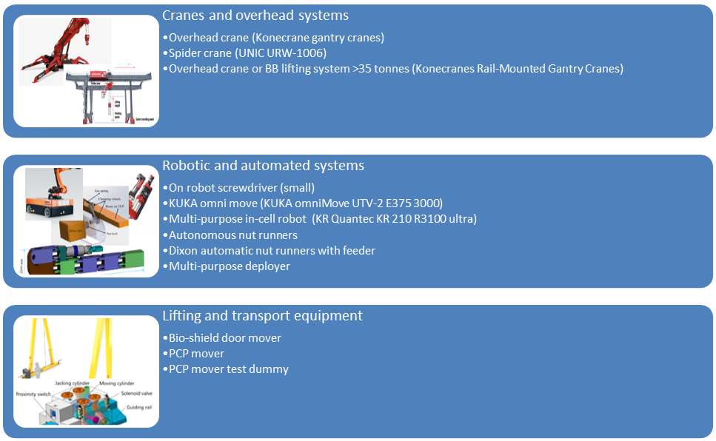
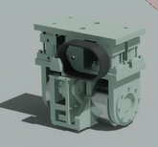
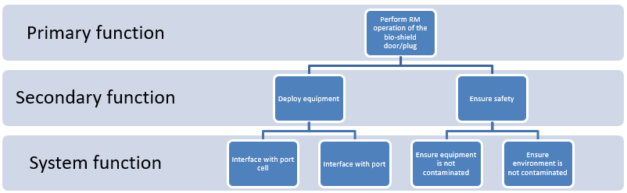
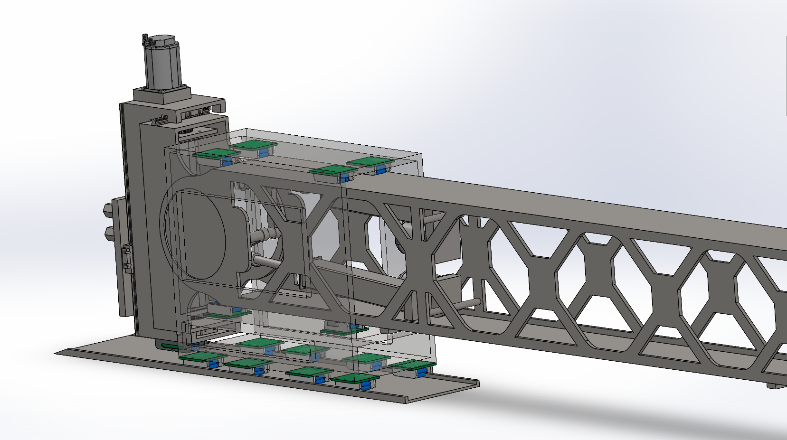
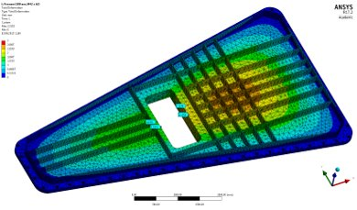
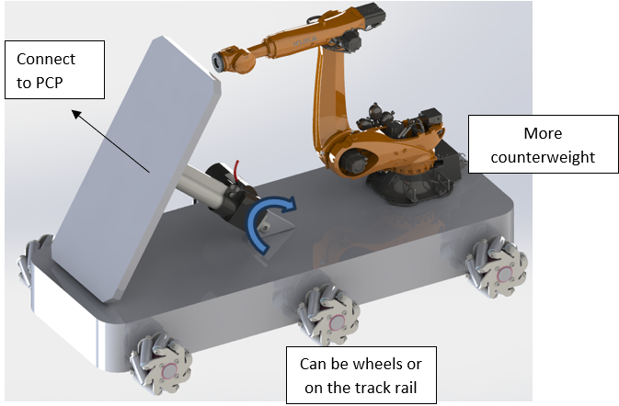
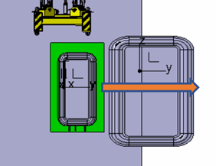
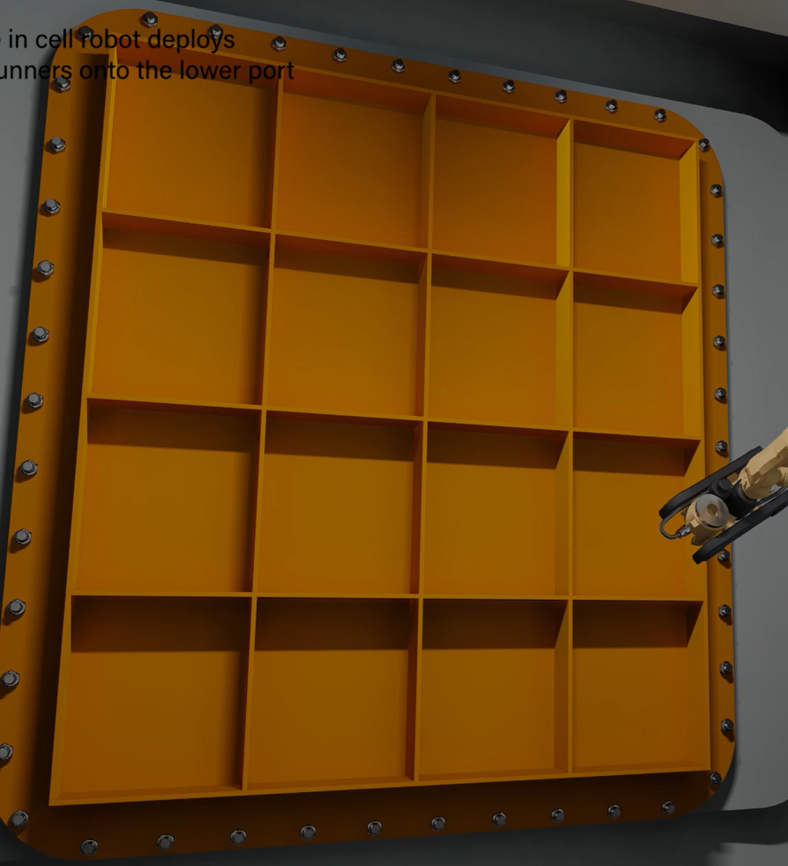
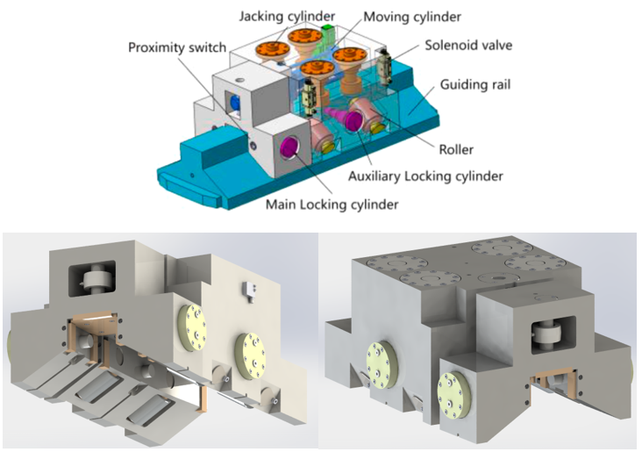
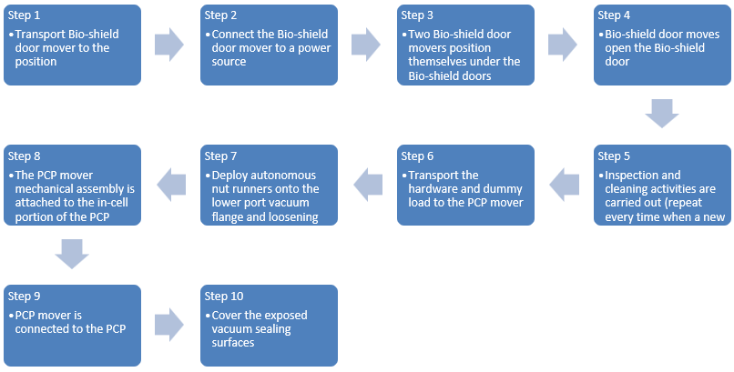
Methodology
Study the RM components
Define the RM operation
Search the commercial products / Concepts
Make design
Li.Changyang@lut.fi
11 / 14

Slide 12
Methodology
Ability > Expectiation
Focus on using current technology
Technical data sheet
Ability
What can the machine do?
(From products)
Size
Readliness level
Sources
Category
Status
Figure
System requirement document
Context definition document
Engineering bill of materials
Expectiation > Ability
Focus on design/research
Expectation
What do we want the machine to do?
(From RM tasks)
Li.Changyang@lut.fi
12 / 14

Slide 13
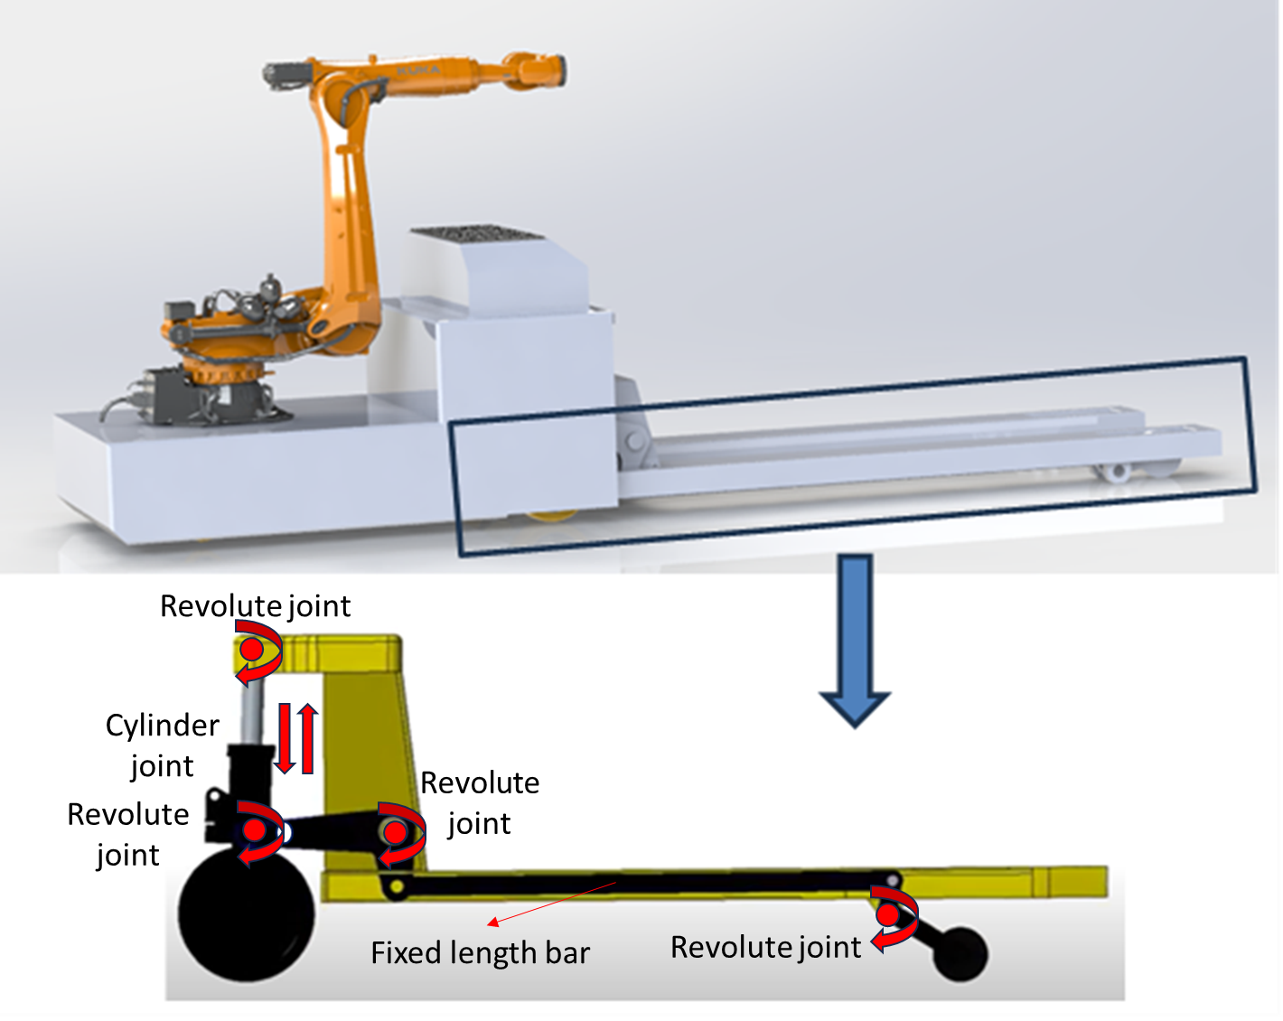
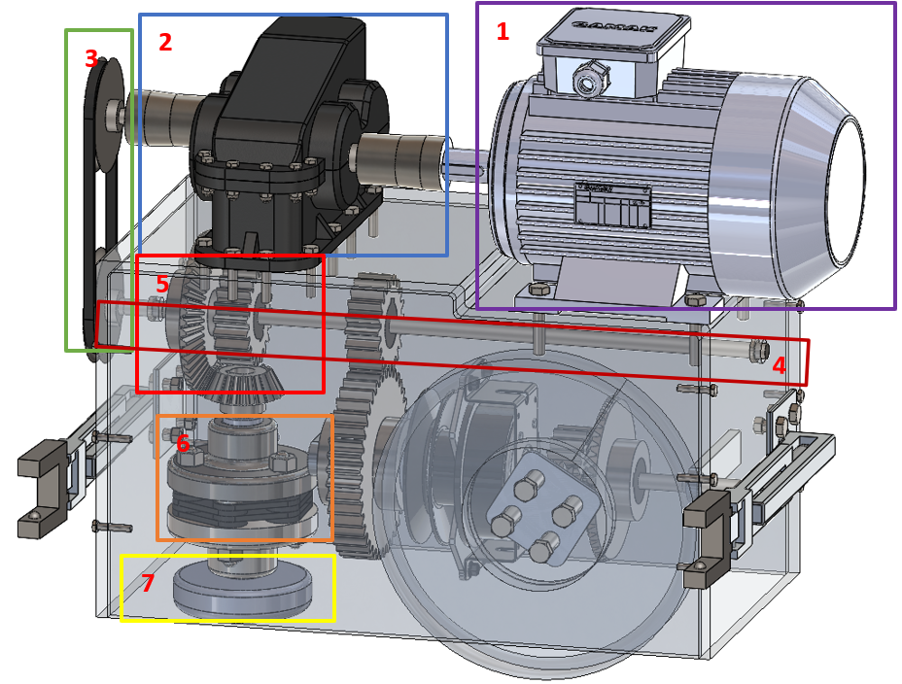
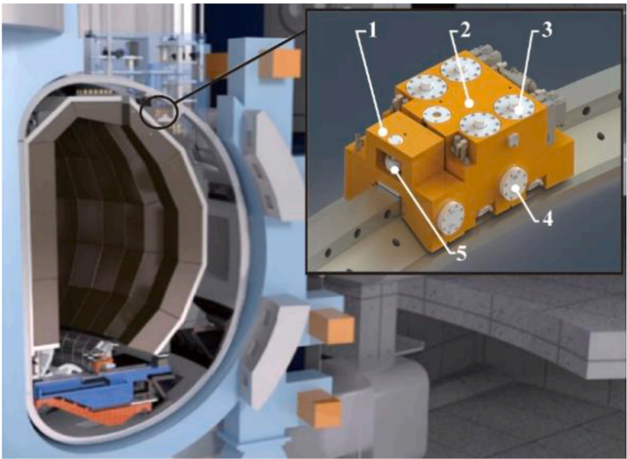
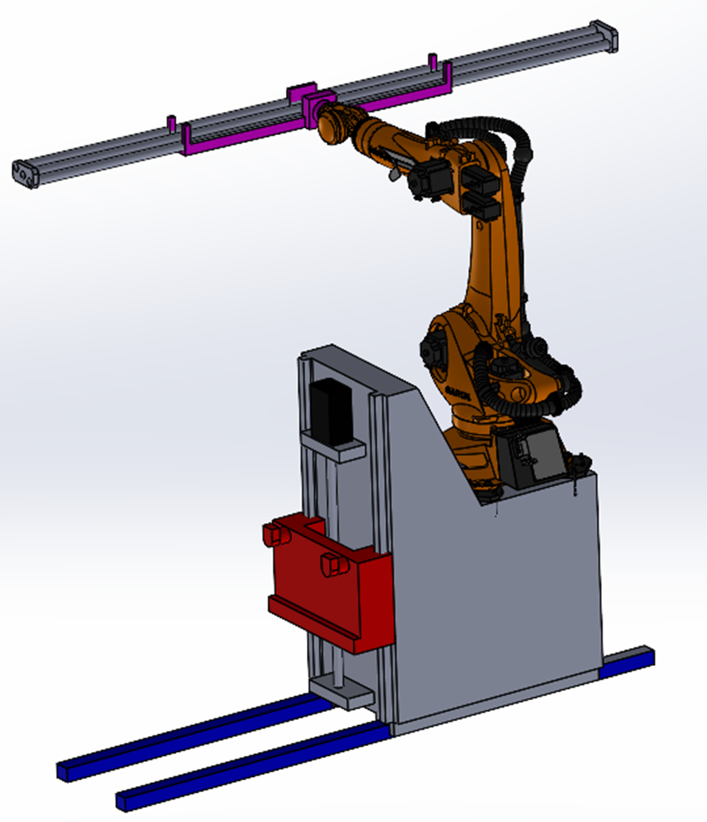
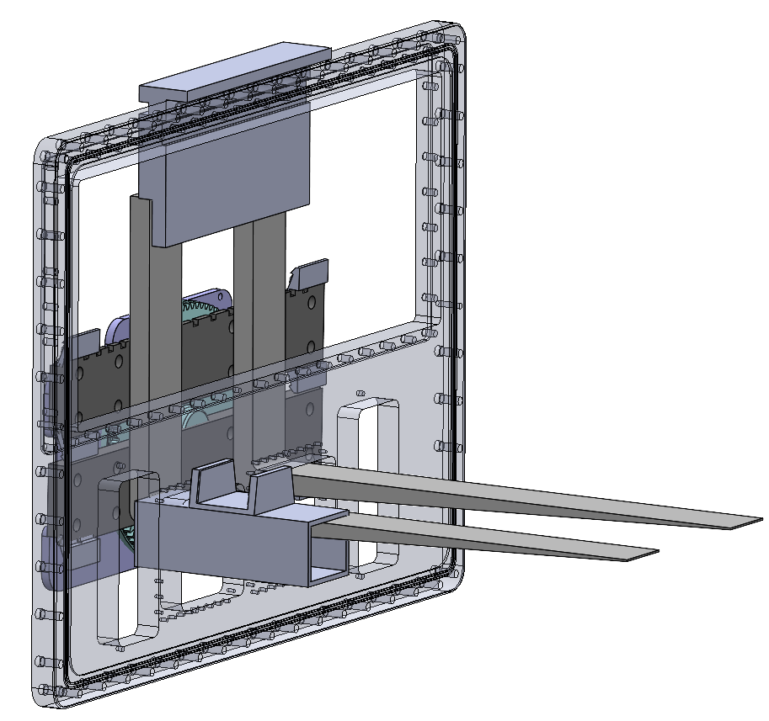
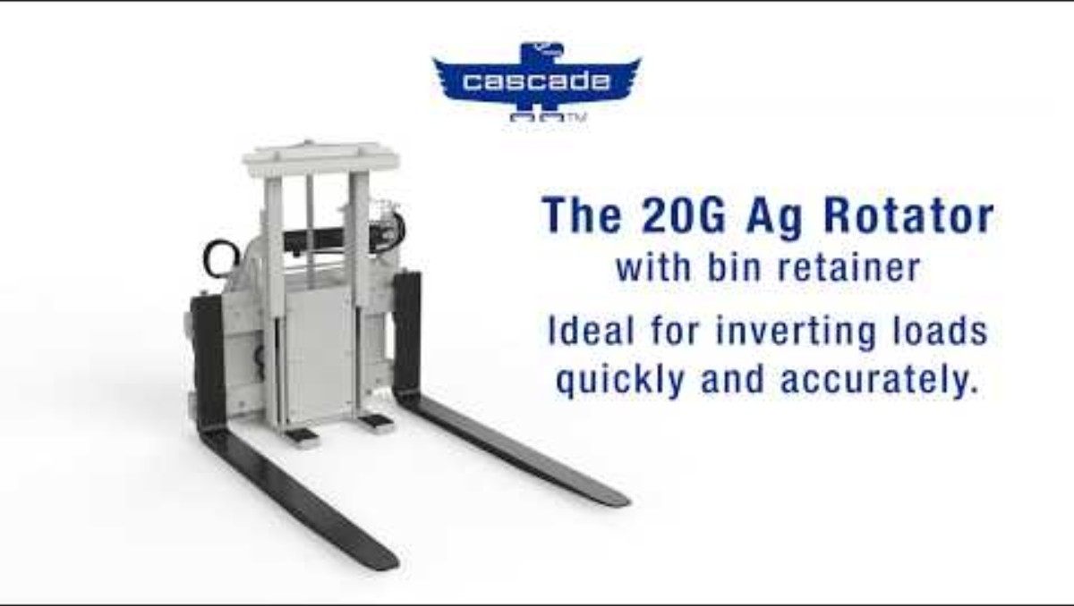
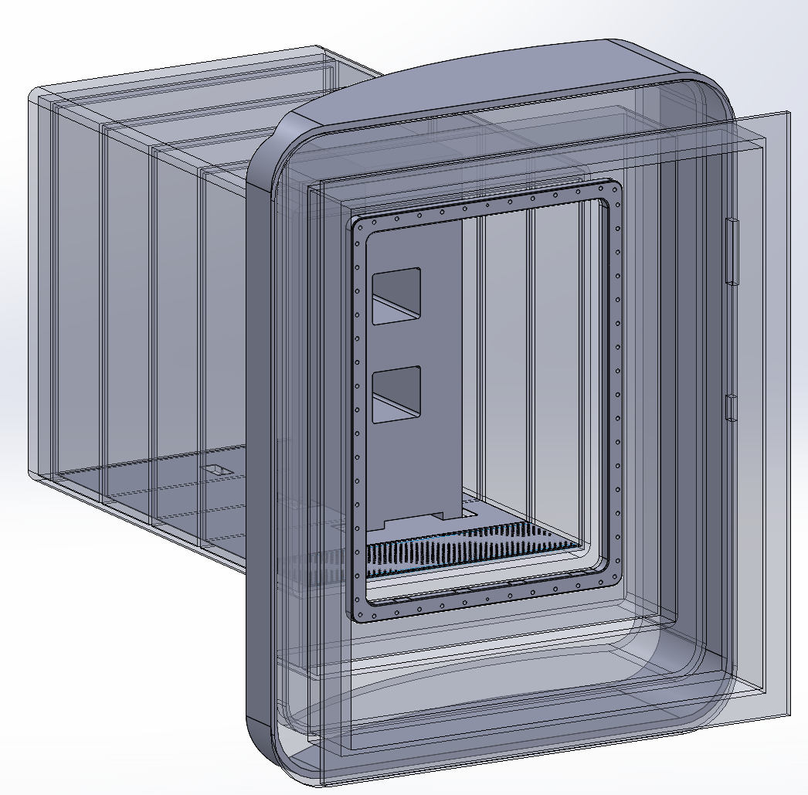
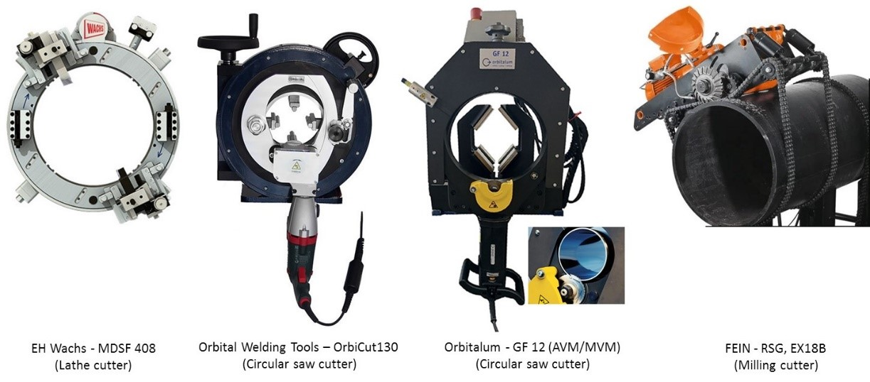
Li.Changyang@lut.fi
13 / 14

