Slide 1
Master’s thesis: Operational maturity of gen IV Reactor designs
Pyry-Pekka Koistinen / SYP 2025 Presentation / Fortum New Nuclear Strategy and R&D
Notes:
Intro:
Pyry-Pekka Koistinen
Master’s thesis worker at Fortum New Nuclear Strategy and R&D team
Master student at LUT Nuclear Engineering

Slide 2
Research goals
Current focus of attention in new nuclear projects is mainly in licensed, constructed and operated current designs and evolutionary designs needing only confirmatory testing or engineering
These are sometimes called GEN III and GEN III+ nuclear reactors
Going further the GEN IV, or innovative designs, bring major conceptual changes to the existing practice
What are the main operability-related issues to these reactors?
What is the technological readiness to solutions of these issues
Which issues from the historical predecessors of these reactors remain relevant?
What is the current state and timeline of GEN IV reactor development?

Slide 3
Technological overview

Slide 4
Six GEN IV reactor designs
The current development of the GEN IV nuclear reactors is coordinated by the Generation IV International Forum (GIF)
In the early 2000s GIF selected six general reactor designs to be further developed among its member countries and parties
Very-High Temperature Reactor (VHTR)
Sodium-Cooled Fast Reactor (SFR)
Lead-Cooled Fast Reactor (LFR)
Molten Salt Reactor (MSR)
Supercritical Water Reactor (SCWR)
Gas-Cooled Fast Reactor (GFR)

Slide 5
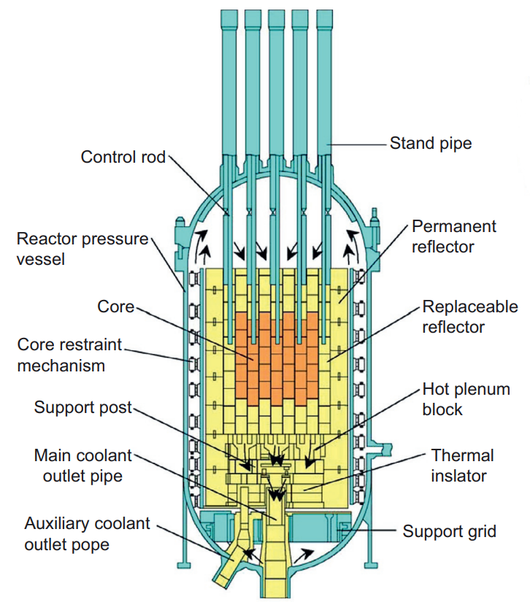
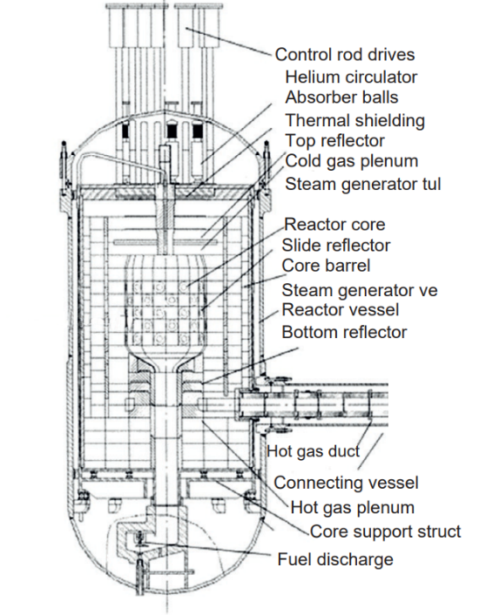
VHTR overview
Spectrum | Thermal
Moderator | Graphite
Coolant | Helium
Fuel type | TRISO UO₂
Fuel enrichment [%] | 8-20
Power density [W/cm³] | 2-8
Core outlet temperature [°C] | 700-1000
Operating pressure [Bar] | 40-100
Thermodynamic efficiency [%] | 45-55
Power conversion process | Brayton/Rankine
Gas-cooled, thermal reactor with high core outlet temperatures
Historical operations from 8 operating reactors
4 prismatic core type and 4 pebble bed type
Average operation factors of 60% and capacity factors of 43%
Issues with air and water ingress, online refuelling issues and graphite dust
Low power density limits the maximum size
High temperatures allow vast possibilities
Hydrogen production
Steel production
High-efficiency power generation
The HTTR (left) and the HTR-10 (right) (Yan, 2023)
Notes:
Design and fuel:
-VHTR is a gas-cooled, graphite-moderated reactor with a high core outlet temperature in the range of 700-850°C, with the target design temperatures reaching 900-1000°C. This corresponds thermodynamic efficiency of 45-55%.
-The two main design lines of the VHTR are the prismatic type and the pebble bed type. Both utilize the same tri-structural isotropic (TRISO) fuel.
Historical operations:
-4 Prismatic core reactors and 4 pebble bed reactors have been operated
-Currently 1 demonstrator operating (HTR-PM) along with 2 experimental reactors in China and Japan
-Both reactors have a low power density due to the limited heat transfer by gas the aim to utilize passive residual heat removal, favouring a tall and thin core.
Power conversion:
-The main driver for this technology is the high core outlet temperature, allowing vastly better thermodynamic efficiency compared to LWRs (45-55%), as well as heightened possibilities for use in cogeneration for industrial purposes

Slide 6
VHTR ranking results
Phenomena | # | Failure mode / Scenario | Importance ranking |  |  |  | State of knowledge
 |  |  | S | O | D | IL | TRL | DA | UL
Graphite dust | 1.4 | Maintenance difficulty, loss of efficiency | 3 | 5 | 4 | 3.91 | 4 | 3 | 3.46
Pressure vessel materials for COT above 800°C | 3.3 | Structural material failure | 5 | 3 | 3 | 3.56 | 5 | 3 | 3.87
Heat exchanger materials for COT above 800°C | 3.4 | Structural material failure | 5 | 3 | 3 | 3.56 | 5 | 3 | 3.87
Moisture removal from coolant and fresh fuel | 4.3 | Corrosion | 3 | 5 | 3 | 3.56 | 4 | 3 | 3.46
Graphite dust
Formed via the wear of graphite components in the core
Contains radioactive fission- and activation products
Issues with maintenance actions
Recurring issue in German pebble-bed reactors
Materials
Contemporary pressure vessel materials, combined with vessel cooling allow core outlet temperatures below 750°C
Alloy steels used in fossil plant applications, such as 9Cr-1Mo, are currently unsuitable for forging large pressure vessels
Advanced heat exchanger materials, such as Inconel 617, Haynes 230 or Hastelloy X would require more research and testing to be qualified
Moisture
Helium is chemically inert, but coolant impurities have degrading effects
Small moisture ingress possible via leaking welds, seals and fuel pebbles during online refuelling
Complete avoidance difficult, so the functioning of the coolant purification system is important
Notes:
1. PIRT explanation
Goal of this method is the identification of the most important operability-related phenomena
Ranking the phenomena is based on their importance and the state of knowledge
Here the importance ranking is defined with parameters severity, occurrence and detection, such as in the failure modes and effects analysis
The state of knowledge (or uncertainty) is defined with parameters technological readiness level and data availability.
The identified phenomena with the highest levels of importance and uncertainty are presented in this table
2. Table and risk matrix explanation
The risk matrix displays all the identified phenomena graphically, with colors representing the effect of importance and uncertainty
X – Axis displays the importance level, going from low to high
Y – Axis displays the uncertainty level, going from low to high
The phenomena on the upper right part are the most important
3.VHTR Phenomena:
Graphite dust
- Present in both prismatic and pebble bed cores
Formed by mechanical interaction of fuel pebbles with surrounding pebbles and online refuelling system and the by the graphite reflector
The dust is transported via the coolant and deposits on the primary system surfaces. The graphite dust contains various radioactive activation and fission products.
Cleaning of graphite dust is difficult, and it causes problems with maintenance actions on radiation protection and safety issues in the case of a coolant leakage
Pressure vessel and heat exchanger materials
High temperatures and coolant impurities make the VHTR structural materials susceptible to degradation
In temperatures below 750°C, when the pressure vessel is cooled, the use of standard PWR pressure vessel steels such is possible.
If cooling is not possible, alloy steels with good creep resistance, such as 9Cr-1Mo alloys is needed, these are currently not suitable for forging large pressure vessels
Advanced heat exchanger materials are nickel-based alloys, such as Inconel, or Hastelloy X. These materials would require more thorough research and testing to be qualified for use
Moisture
The phenomenon of moisture in the VHTR reactors is a problem due to corrosivity.
Sources of a small moisture ingress to the reactor coolant can be leaking welds, seals or fuel pebbles during online refuelling.
The phenomenon of moisture in the VHTR coolant is inevitable, so functioning of the coolant purification system is extremely important

Slide 7
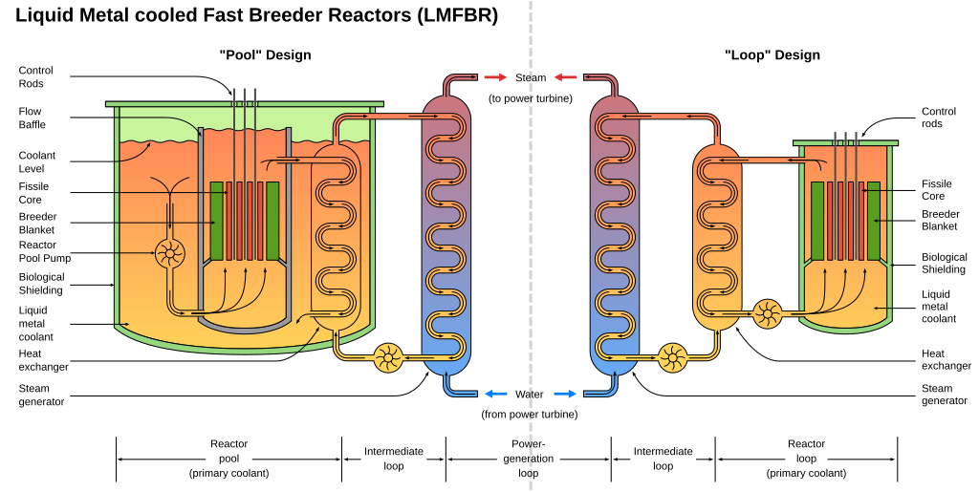
SFR overview
Spectrum | Fast
Moderator | -
Coolant | Sodium
Fuel type | Steel-cladded UO₂/MOX
Fuel enrichment [%] | 15-30
Power density [W/cm³] | 300-500
Core outlet temperature [°C] | 500-550
Operating pressure [Bar] | 1
Thermodynamic efficiency [%] | 45
Power conversion process | Rankine
Sodium-cooled reactor with moderately high core outlet temperatures
Most developed GEN IV reactor type with over 20 reactors operated historically
Much variance in performance. Average operation factors of 45% and capacity factors of 40%
Currently operating BN-reactors have the best record with average 60-80% capacity factors
SFR uses liquid sodium, which allows operation at atmospheric pressure
Sodium reacts violently with air and water
Maintenance is complex due to the need for remote operations in sodium-filled environments
Two designs of the sodium-cooled fast reactor (Dunlap, 2025)
Notes:
Design and fuel:
Sodium has a good thermal conductivity allowing COT of around 500-550°C, corresponding to thermodynamic efficiency of around 45%
To main design lines are the pool type and loop-type reactor. Pool type has been favored historically due to simplicity.
Historical operations:
Most developed GEN IV reactor type.
Over 20 reactors operated historically, extensive operational data.
Much variance in SFR performance factors, quite low on average.
Long-operated BN-reactors show OK performance with capacity factors of 60-80%. This is mainly affected by the long refueling outages lasting approximately 40 days per year.
Power Conversion and operations:
Sodium has a high boiling point, which allows operations at atmospheric pressures
As a downside sodium is highly reactive with air and water. This is why the SFR uses a large non-radioactive secondary sodium circuit.
Maintenance is complex due to remote operations

Slide 8
SFR ranking results
Phenomena | # | Failure mode / Scenario | Importance ranking |  |  |  | State of knowledge
 |  |  | S | O | D | IL | TRL | DA | UL
Remote operations inside reactor vessel | 2.1 | Failure of remotely operated machinery | 5 | 4 | 3 | 3.91 | 3 | 4 | 3.46
Inspections and maintenance of in-sodium equipment | 2.2 | Fires, failure of remotely operated machinery | 4 | 4 | 3 | 3.63 | 3 | 4 | 3.46
Large secondary sodium leaks | 5.5 | Large leakage causing fires and loss of a cooling loop | 5 | 4 | 2 | 3.42 | 4 | 3 | 3.46
Remote operations
Due to the need of system leak tightness, the SFR must be refuelled and maintained without opening the reactor vessel.
A complex reactor refuelling and maintenance system is needed
Multiple failures of these systems have been recorded in history, and they are also the main cause of low maximum performance factors
Inspections and maintenance of in-sodium equipment
The reliability of in-sodium systems and their handling components need to be high
Repairing or replacing in-sodium equipment is difficult and time-consuming
Secondary sodium leaks
Sodium leaks from the secondary sodium circuit are the likely to occur and to cause interruptions to operations.
The secondary sodium circuit of the SFR is large and not as isolated as the primary circuit
Multiple incidents like these have occurred in the past, causing notable downtime
Notes:
SFR Phenomena
Remote operations
-Due to the need of system leak tightness, the SFR must be refuelled and maintained without opening the reactor vessel.
-The complex reactor refuelling and maintenance system often consists of a rotating plug vessel head, in-sodium manipulators, fuel transferring machine and a sodium-filled fuel storage tank.
-Multiple failures of these systems have been recorded in history.
Inspections and maintenance of in-sodium equipment
The reliability requirements for in-vessel handling components need to be high, since repairing or replacing in-sodium equipment is difficult and time-consuming.
With the current and historically operated SFRs, the refuelling and maintenance actions are notably slower than with LWRs
Secondary sodium leaks
From the SFR anticipated operational occurrences, sodium leaks from the secondary sodium circuit are the likely to occur and to cause interruptions to operations.
The secondary sodium circuit of the SFR is large and not as isolated as the primary circuit.
A large sodium leak from the secondary circuit might be difficult to contain, and it has potential for serious structural damage.
Multiple incidents recorded

Slide 9
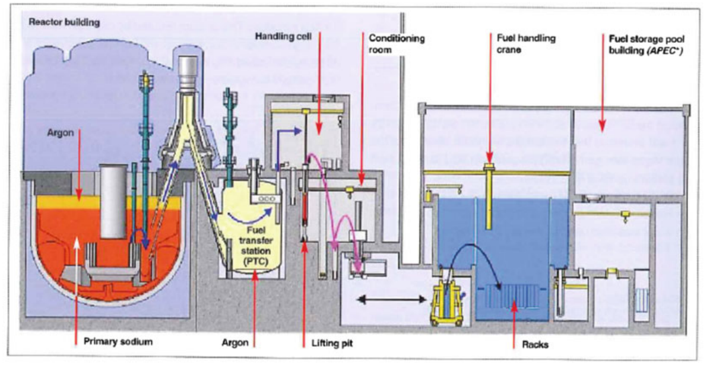
SFR Superphenix refuelling systems
Spent fuel handling path in the Superphenix (Guidez, J. et al, 2017)
Notes:
Superphenix refueling example
Path:
Reactor
In-vessel fuel manipulator
In-vessel storage area
Rotating transfer machine
Fuel storage drum (in-sodium storage)
Fuel handling cell (under nitrogen, inspections and removal of residual sodium)
Transfer to a regular water storage pool

Slide 10
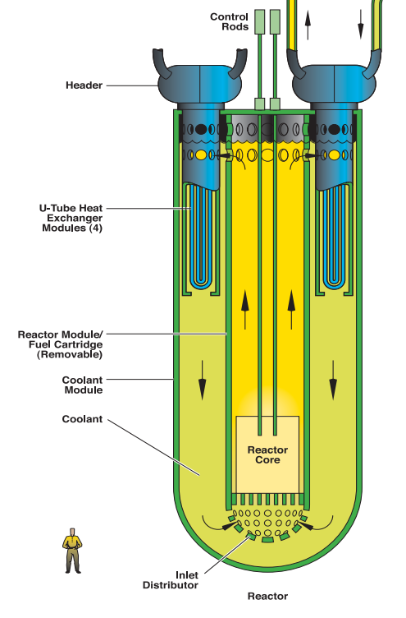
LFR overview
Spectrum | Fast
Moderator | -
Coolant | Lead / LBE
Fuel type | UN,PuN/MOX
Fuel enrichment [%] | 15-30
Power density [W/cm³] | 100-300
Core outlet temperature [°C] | 480-540
Operating pressure [Bar] | 1
Thermodynamic efficiency [%] | 40-45
Power conversion process | Rankine
A fast reactor sharing similarities with the SFR.
Only historical experience comes form the operation of Soviet submarines (8 units) and their land prototypes (2 units)
Technical viability proven, but major issues regarding operations exist
LFR uses liquid lead or lead-bismuth eutectic (LBE) as coolant
Operates at atmospheric pressures
Operating temperatures around 500°C, yielding 40–45% efficiency.
Typically, a pool-type design, loop-type is less viable due to challenges with pressure losses and corrosion
Lead is chemically inert with air and water, no intermediate circuit needed. Air ingress to reactor must still be avoided
Lead is highly corrosive, necessitating advanced materials or protective coatings
LBE coolant causes a radiation hazard due to the formation of polonium
Overview of the lead-cooled fast reactor (GIF, 2002)
Notes:
Historical operations
LFR shares many similarities with the SFR.
Only historical operating experience comes from Soviet submarines, not directly applicable to power reactors
Design and power conversion
-Uses liquid lead or lead-bismuth eutectic (LBE) as coolant.
-Operates at atmospheric pressure. Operating temperature around 500°C, yielding 40–45% efficiency.
-Typically a pool-type design. Loop-type designs are less viable due to corrosion and pressure loss challenges.
Safety and Operational Challenges:
Lead is chemically inert with air and water, reducing risks compared to sodium. / no intermediate circuit needed
As a downside, lead is highly corrosive, requiring advanced materials or coatings.
Polonium contamination (if LBE is used) poses serious radiation hazards.

Slide 11
LFR ranking results
Phenomena | # | Failure mode / Scenario | Importance ranking |  |  |  | State of knowledge
 |  |  | S | O | D | IL | TRL | DA | UL
Fuel handling mechanism | 1.2 | Failure of handling machinery | 4 | 5 | 3 | 3.91 | 4 | 4 | 4.00
Fuel integrity | 1.4 | Corrosion of fuel cladding | 4 | 3 | 4 | 3.63 | 4 | 4 | 4.00
Remote operations inside reactor vessel | 2.1 | Failure of remotely operated machinery | 4 | 4 | 3 | 3.63 | 4 | 5 | 4.47
Structural materials for COT below 500°C | 3.1 | Corrosion by coolant, structural material failure | 5 | 4 | 3 | 3.91 | 4 | 3 | 3.46
Structural materials for COT above 500°C | 3.2 | Corrosion by coolant, structural material failure | 5 | 4 | 3 | 3.91 | 5 | 4 | 4.47
Functioning of coolant purification system | 4.1 | Coolant oxidization resulting in corrosion and oxide formation | 4 | 5 | 4 | 4.31 | 5 | 3 | 3.87
Coolant leakages | 5.5 | Lead leakage causing contamination and need of repair | 4 | 4 | 3 | 3.63 | 4 | 4 | 4.00
Fuel handling and remote operations
Similarly to the SFR, the refuelling and maintenance actions on the LFR need to be conducted remotely
A minor benefit in using lead coolant is the inertness with air, but air ingress to the reactor should be avoided
High shutdown temperatures due to avoidance of coolant solidification will bring problems (lead melting temperature is 327.5°C and LBE 123.5°C)
Structural materials
Lead coolant is notably corrosive, requirements for structural materials and fuel cladding are strict
In a suitable temperature range of 400-550°C it is possible that a protective oxide layer forms on the steel surface, working as a corrosion inhibitor
Suitable oxygen content in the coolant needs to be maintained and kept at levels that do not cause a formation of oxide blockages (slagging)
Notes:
LFR Phenomena
Fuel handling and remote operations:
The issues related to fuel handling and remote operations inside the reactor vessel are similar as in the SFR; complex and leak-tight equipment for fuel handling and maintenance are needed
Air ingress to the reactor should be avoided, as this can lead to formation of lead-oxide blockages
Compared to the SFR, the high shutdown temperatures due to avoidance of coolant solidification will bring problems as well; maintenance tools need to withstand high temperatures
Structural materials and fuel integrity
Since lead coolant is notably corrosive, requirements for structural materials and fuel cladding are strict.
Typical materials for LFR fuel cladding are ferritic/martensitic steels. Structural materials for reactor vessels are austenitic steels.
In a suitable temperature range of 400-550°C it is possible that a protective oxide layer forms on the steel surface, working as a corrosion inhibitor.
This requires that a suitable oxygen content in the coolant is maintained and kept at levels that do not cause a formation of blockages.
Corrosion can be also inhibited by using different coatings such as aluminium on the steels; this is not yet demonstrated.
Leaks
Lead leakages from the primary circuit do not cause fires, but are a serious personnel protection challenge
Lead is notably toxic, and if LBE is used instead of pure lead the polonium contamination must be considered in maintenance activities

Slide 12
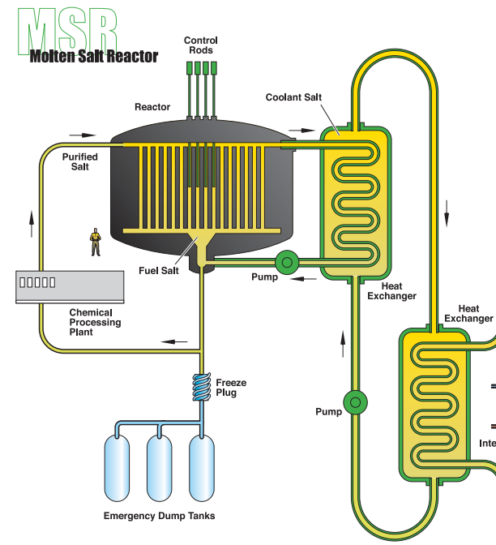
MSR overview
Spectrum | Thermal/Fast
Moderator | Graphite / None
Coolant | Molten salt LiF₄/BeF₄/ZrF₄/NaF
Fuel type | Fuel salt UF₄,PuF₄
Fuel enrichment [%] | 20
Power density [W/cm³] | 20-300
Core outlet temperature [°C] | 600-700
Operating pressure [Bar] | 1
Thermodynamic efficiency [%] | 45-50
Power conversion process | Rankine / Brayton
The MSR is a fast or thermal reactor cooled by molten salts and operated at high temperatures
Three experimental MSRs have been operated in history (ARE, MSRE, TMSR-LF1)
The MSR can be divided to three main designs
The circulating fuel type
The static fuel type
The salt-cooled HTR (or TRISO-fuelled MSR)
Molten salt creates challenging operating conditions
Molten salts are extremely corrosive, structural materials must resist corrosion and radiation damage
Complex chemistry of coolant and fuel salts requires continuous monitoring
Coolant and fuel salt processing has been demonstrated, but not yet on a commercial scale
Overview of the molten salt reactor (GIF, 2002)
Notes:
Overview
The MSR is a fast or thermal reactor cooled by molten salts and operated at high temperatures of around 700°C, yielding a high 45–50% efficiency.
Three experimental MSRs have been operated in history, Chinese TMSR being the latest, commissioned in 2023.
Design and fuel:
Uses molten fluoride or chloride salts as coolant.
Three main types are circulating fuel, static fuel and salt-cooled HTR type reactors.
In all but the last one, fuel is dissolved in the salt, enabling online refueling and fuel processing.
Safety and Operational Challenges:
Molten salts are corrosive, especially at high temperatures. Structural materials must resist corrosion and radiation damage
Complex chemistry of molten salts requires continuous monitoring.
Coolant and fuel salt processing have been demonstrated, but not yet on a commercial scale

Slide 13
MSR ranking results
Phenomena | # | Failure mode / Scenario | Importance ranking |  |  |  | State of knowledge
 |  |  | S | O | D | IL | TRL | DA | UL
Fuel handling mechanism | 1.2 | Failure of handling machinery | 4 | 5 | 3 | 3.91 | 4 | 4 | 4.00
Fuel integrity | 1.4 | Corrosion of fuel cladding | 4 | 3 | 4 | 3.63 | 4 | 4 | 4.00
Remote operations inside reactor vessel | 2.1 | Failure of remotely operated machinery | 4 | 4 | 3 | 3.63 | 4 | 5 | 4.47
Structural materials for COT below 500°C | 3.1 | Corrosion by coolant, structural material failure | 5 | 4 | 3 | 3.91 | 4 | 3 | 3.46
Structural materials for COT above 500°C | 3.2 | Corrosion by coolant, structural material failure | 5 | 4 | 3 | 3.91 | 5 | 4 | 4.47
Functioning of coolant purification system | 4.1 | Coolant oxidization resulting in corrosion and oxide formation | 4 | 5 | 4 | 4.31 | 5 | 3 | 3.87
Coolant leakage | 5.5 | Lead leakage causing contamination and need of repair | 4 | 4 | 3 | 3.63 | 4 | 4 | 4.00
Salt processing
Salt impurities and fission products cause issues with corrosion
Failures in the salt processing system severely affect reactor operability, as failures in refuelling or salt corrosivity control can cause long unavailability
While some processes (e.g. fluorination, off-gas systems) have been demonstrated in experiments like MSRE, others (e.g. helium sparging, pyrochemical separation) remain untested at full reactor scale.
Structural materials
The tested nickel-based alloys, such as Hastelloy-N suffer from irradiation damage and salt penetration.
Coatings, salt chemistry control systems and new alloys are proposed to mitigate corrosion.
Maintenance challenges
Due to the circulation of fuel salts, the environment around the primary circuits is challenging
High shutdown temperatures and significant radiation dose rates create a need for utilizing remote maintenance technologies
Equipment contaminated with fission products need to be remotely removed and decontaminated prior to in-person maintenance
Notes:
LFR Phenomena
Salt processing
The phenomena related to fuel salt processing are of large importance and uncertainty in the liquid-fuelled MSRs.
The MSRE experiment demonstrated online refuelling and the and the removal of gaseous fission products trough an off-gas system.
Processes for removal of fission products, such as helium sparging and pyrochemical separation are less technologically mature
Structural materials
The corrosion structural materials by fluoride salts and fission products is a major concern.
Tested nickel-based alloys, such as Hastelloy-N suffer from issues such as irradiation damage and salt penetration.
Preventing structural material failures is planned to be conducted by the salt chemical control systems, and possibly by coating the alloys with dissolution-resistant materials.
Maintenance challenges
The most important maintenance-related phenomena with the MSRs are caused by the difficult environment around the primary salt circuits.
The high shutdown temperatures and major radiation dose rates caused by the circulation of fuel salts create a need for utilizing remote maintenance technologies.
When irradiated equipment in the MSR primary circuit need to be repaired or replaced, they most likely need to be remotely removed and decontaminated before such maintenance can be conducted.
No relevant operating experience yet exists on the subject. Similar issues are faced when dealing with possible salt spillages and leaks.

Slide 14
Vendors and timeline

Slide 15
Vendors and Timeline
Notes:
Demo to deployment
The time it takes to reach commercial maturity is dependent on the success of constructing and operating the demonstrator units.
If using the HTR-PM as an example, the detailed design was completed and construction began in 2012, and full power was reached in 2022.
If the commercial demonstrator HTR-PM600 is finished in 2032, this would mean a 20-year long development from the end of detailed design to ready commercial deployment.
Estimation
This is my estimation based on the current GEN IV vendor development status and goals
The VHTR and SFR are the most developed among the six technologies and the closest to possible commercial deployment
The development and interest towards the MSR and LFR in coming years dictates their rate of development, possibly becoming available in the 2040s or 2050s
The SCWR and GFR are currently the least developed, and only a few major projects currently exist

Slide 16
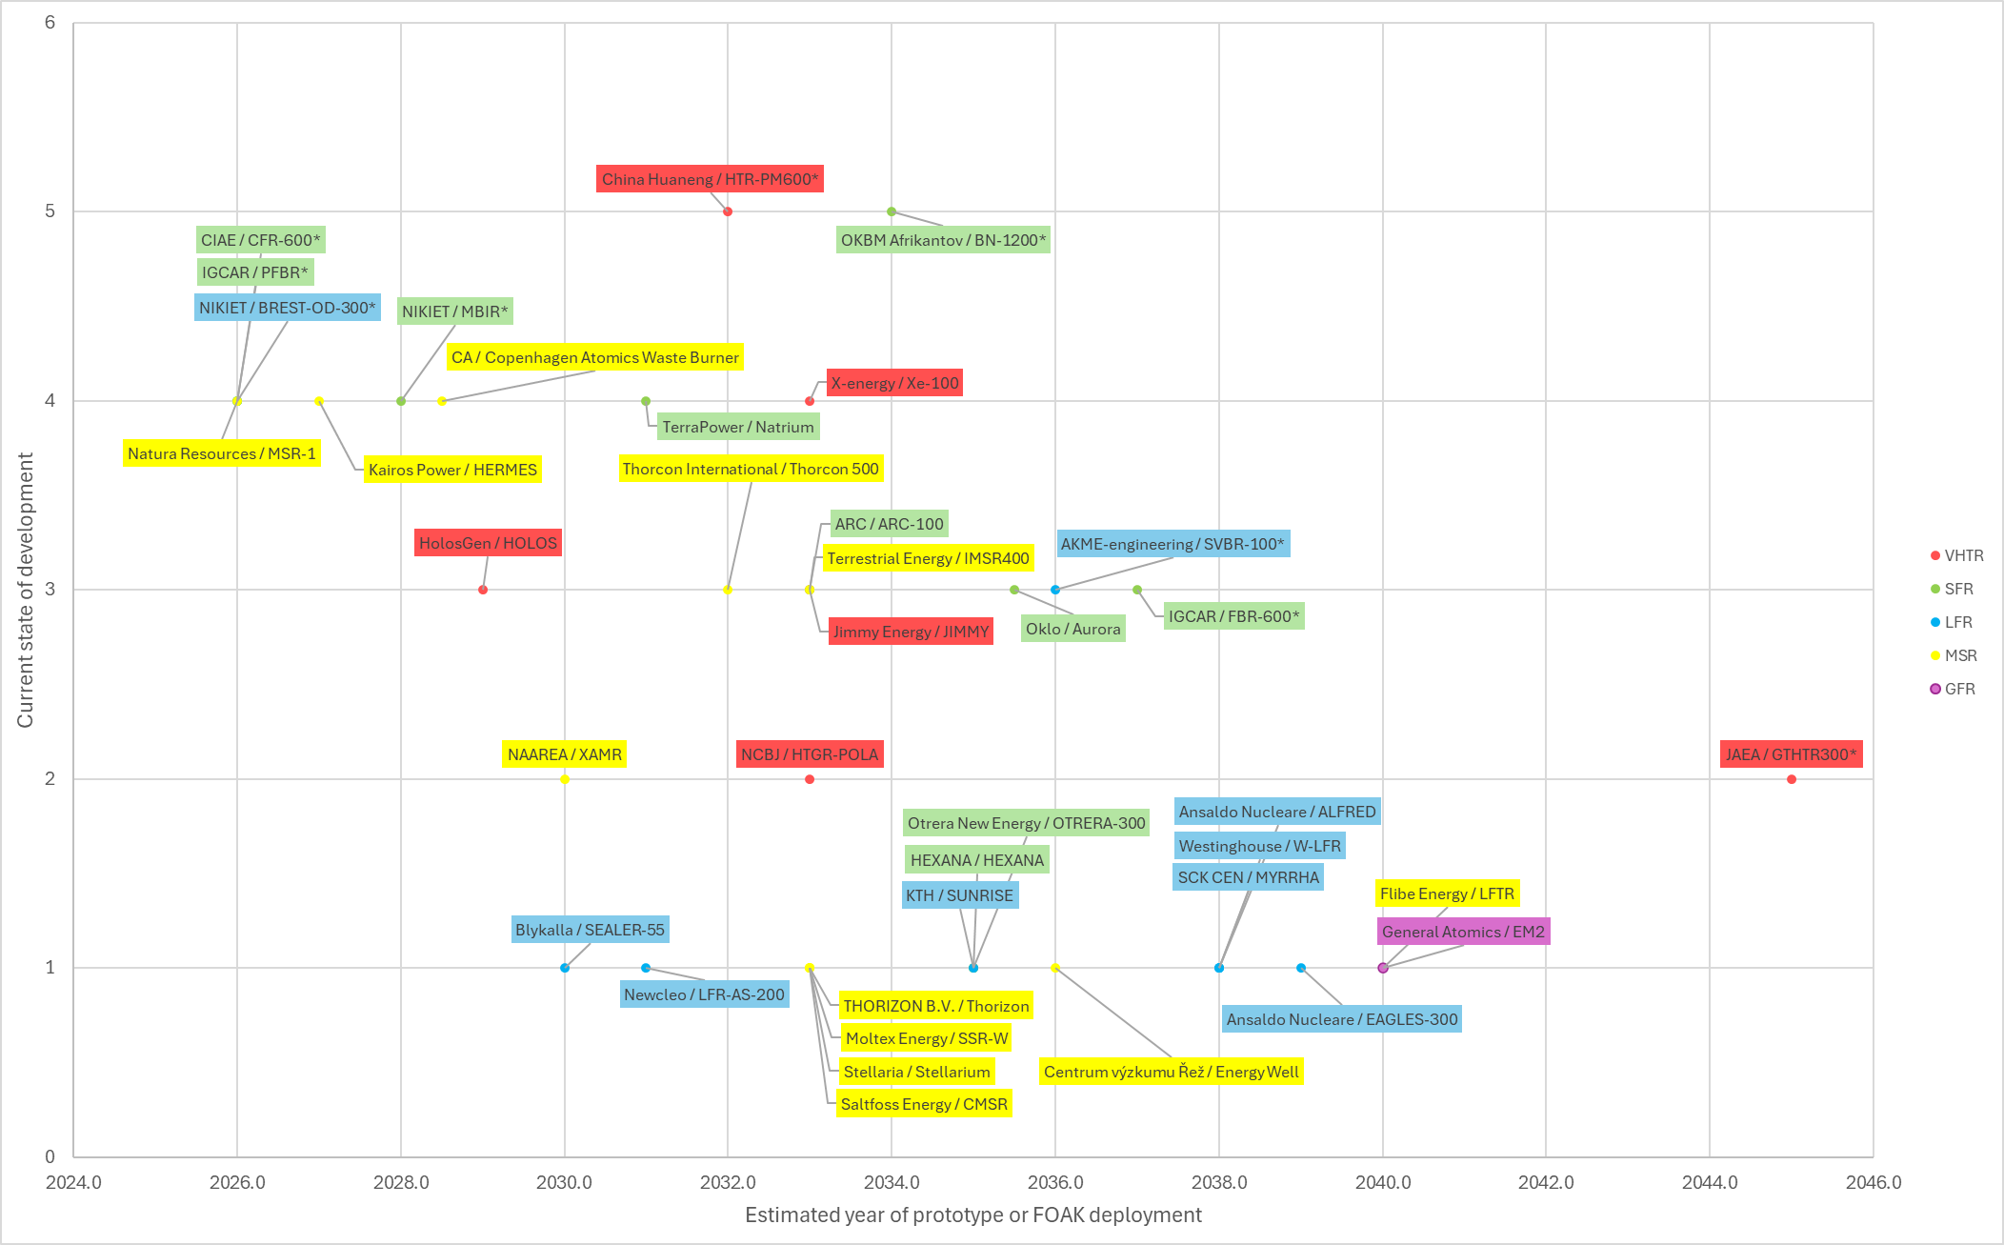
Vendors and Timeline
Stage of development | Description | Projects
5. Commercial demonstration | Construction of a first of a kind, full-scale plant | 2
4. Engineering Demonstration | Construction or planning of a nuclear demonstrator/prototype plant. Gain of operating experience. | 9
3. Detailed design | System descriptions, safety analyses and licensing documents are available. Itemized cost estimate and master schedule for the construction phase have been prepared. | 10
2. Basic design | Brief descriptions of key components and systems are provided | 5
1. Conceptual design | Key components, layout drawings, single line diagrams are available | 31
Notes:
Overview
A collection of currently ongoing GEN IV projects
The x-axis displays developer estimates for the year of first prototype or commercial unit deployment
The y-axis displays the state of development
Accuracy
The accuracy of the estimated year of deployment is low, since the data is supplied by the reactor developers and is part of their marketing
Majority of the designs are still in the early stages of development, so it is understandably difficult to estimate when the design is ready to be licensed and demonstrated
Future
Now, the HTR-PM600 and the BN-1200 are in the most advanced stage of development. Both these reactors have “demonstrator” units currently in operation (HTR-PM, BN-800).
In the next few years, the Russian demonstrators LFR BREST-OD-300 and SFR MBIR are planned to enter operation along with a Chinese double-unit SFR CFR-600 and the Indian SFR PFBR.
In the western countries, multiple demonstration reactors are planned for the coming years. The molten salt reactors Natura Resources MSR-1 and Kairos power KP-FHR demo HERMES have been granted construction permits by the NRC
Other demonstrators planned are the SFR TerraPower Natrium, VHTR X-energy Xe-100, and the MSR Copenhagen atomics waste burner

Slide 17
Questions?

Slide 18
Thank you!
Contact information
Email: pyry-pekka.koistinen@fortum.com
LinkedIn: Pyry-Pekka Koistinen

Slide 19
References
Dunlap, R. A (2025) Generation IV Nuclear Reactors: Design, Operation and Prospects for Future Energy Production. 1st edition.
Generation IV International Forum. (2002). A Technology Roadmap for Generation IV Nuclear Energy Systems. Washington, D.C.: U.S. Department of Energy.
Guidez, J. et al. (2017) Superphenix Technical and Scientific Achievements. [Online]. Paris: Atlantis Press.
Yan XL (2023) Chapter 3 - Very High Temperature Reactor In: Pioro IL (ed) Handbook of Generation IV Nuclear Reactors (Second Edition). Woodhead Publishing, 133–165.

