Slide 2
Advancing the understanding of non-condensable gases
(NCgs) in nuclear reactor coolant sytems
Sharandeet Singh*, Giteshkumar Patel, Lauri Pyy, Juhani Hyvärinen
SYP october 21-22, 2025
Presented by - Sharandeet Singh
Nuclear Engineering, LUT School of Energy Systems, LUT University, Finland

Slide 3
Advancing the understanding of non-condensable gases
(NCgs) in nuclear reactor coolant sytems
Sharandeet Singh*, Lauri Pyy, Giteshkumar Patel, Juhani Hyvärinen
Nuclear Engineering, LUT School of Energy Systems, LUT University, Finland
Presenting by Sharandeet Singh
Nuclear Engineering, LUT School of Energy Systems, LUT University, Finland
SYP october 21-22, 2025

Slide 4
content
Motivation
Introduction to NCGs – Definition, safety impact & key challenges.
Research Motivation & Gaps – Limitation of current SYS-TH codes.
Key Experimental Findings – Nitrogen problem, time constant issue.
Numerical Modeling – Henry´s Law, two-fluid model.
Bubble Dynamics & Modified R-P Equation – Physics, R-P modification.
Analogy to Boiling & Cavitation – Comparative mechanism.
NCGDENSE Program – Objectives, methods & innovations.
Conclusion & Future Work – Summary and next steps.
SYP october 21-22, 2025

Slide 5
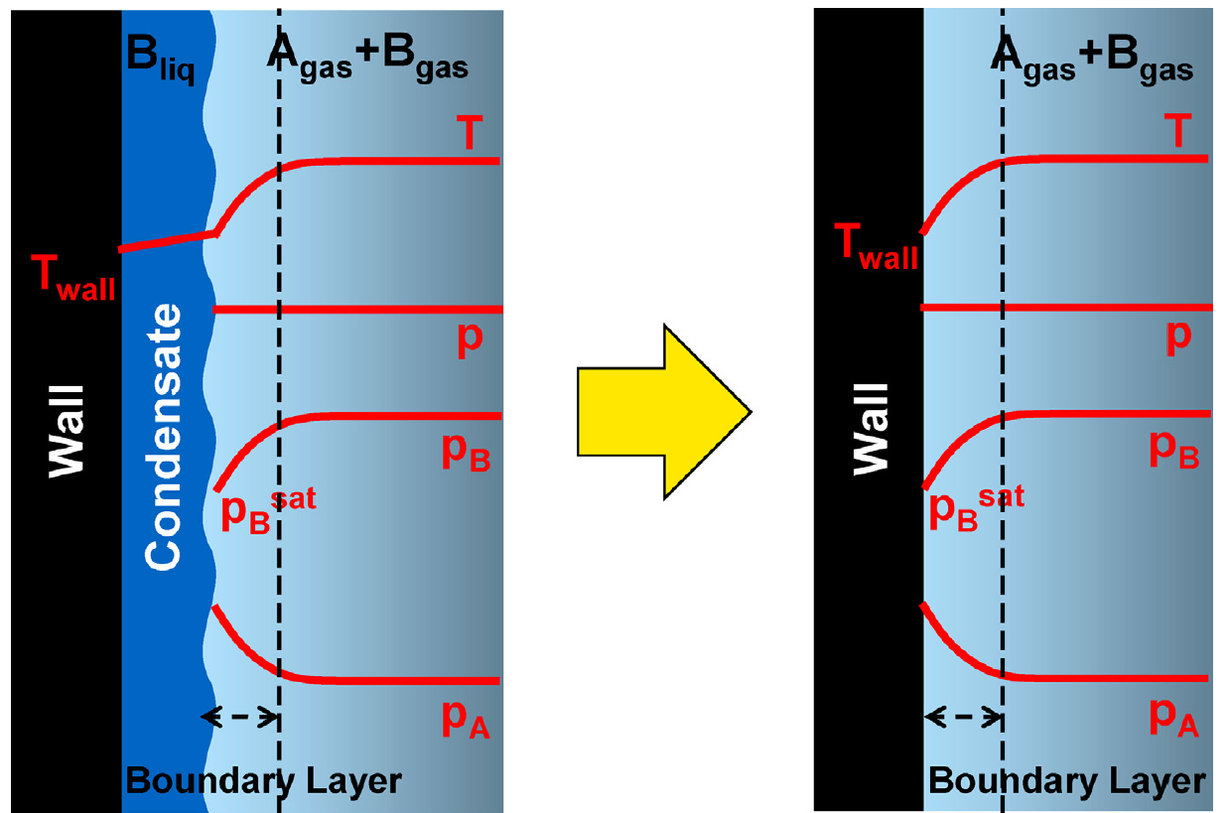

Introduction to Non-Condensable Gases (NCGs) in Nuclear Reactor Safety
Motivation - Understanding the Hidden Challenge in Light Water Reactors
What Are NCGs?
  Gases like N₂, H₂, He, air that do not condense under reactor operating conditions.
  Sources: Dissolved in coolant, released from accumulators.
Why Do NCGs Matter?
  Heat Transfer Degradation:
    Accumulate at vapor-liquid interfaces, creating a diffusion barrier (Fig. 1).
    50% reduction in HTC with just 0.5% air (Othmer, 1929).
  Safety Risks:
    Exacerbate LOCA, MSLB, and long-term cooling by disrupting natural circulation.
    Hydrogen buildup → explosion hazards (e.g., Fukushima).
*QR Code for the image and paper reference
SYP october 21-22, 2025

Slide 6
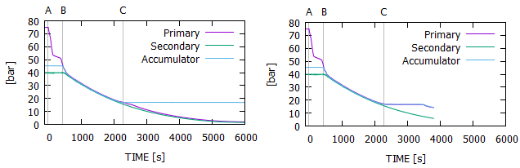
Introduction to Non-Condensable Gases (NCGs) in Nuclear Reactor Safety
Motivation - Understanding the Hidden Challenge in Light Water Reactors
An example of importance to Nuclear Safety: The presence of NCGs, especially during transients or accidents, can reduce or impede core cooling by blocking coolant flow and/or heat removal from the primary system
No NCG
NCG
NCG prevents primary system depressurisation down to Low Pressure Safety Injection range
SYP october 21-22, 2025

Slide 7
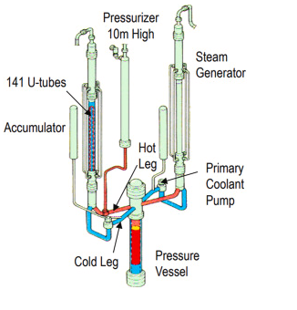

Source of ncg
Why is it important to know
The accumulator is a key part of the Emergency Core Cooling System (ECCS) in a Pressurized Water Reactor (PWR).
Its job is to rapidly inject a large volume of borated water into the reactor core during a specific type of accident—a large Loss-of-Coolant Accident (LOCA).
Here’s how it works:
Normally: It is filled with cold water and pressurized with nitrogen gas.
During a large LOCA: The reactor pressure drops drastically.
Activation: When the system pressure falls below the nitrogen pressure, the nitrogen gas pushes the water quickly and forcefully into the reactor core to prevent it from overheating.
In short: The accumulator is a passive, high-pressure emergency water tank designed to flood the core immediately after a pipe break.
*QR Code for the image and paper reference
SYP october 21-22, 2025

Slide 8
Source of ncg
LOCA Occurs –
Rapid Pressure Drop
Accumulator Discharges, High Pressure $N_{2}$ Saturated Water, enters Low-Pressure Environment
Accumulator Discharges, High Pressure 𝑁_2 Saturated Water, enters Low-Pressure Environment
Water Becomes Supersaturated, $c_{∞}>c_{sat}$
Water Becomes Supersaturated, 𝑐_∞>𝑐_𝑠𝑎𝑡
Driving Force for Degassing
Rapid Formation of $N_{2}$ Bubbles
Rapid Formation of 𝑁_2 Bubbles
Two-Phase Coolant Flow with $N_{2}$ Bubbles
Two-Phase Coolant Flow with 𝑁_2 Bubbles
Reduces Heat Transfer
Two-Phase Coolant Flow with $N_{2}$ Bubbles
Two-Phase Coolant Flow with 𝑁_2 Bubbles
Two-Phase Coolant Flow with $N_{2}$ Bubbles
Two-Phase Coolant Flow with 𝑁_2 Bubbles
Why is it important to know
Risk of inadequate Core Coolong
SYP october 21-22, 2025

Slide 9

Key Experimental Insights into NCG Behavior
Empirical Evidence Revealing System-Level Impacts
The Nitrogen Accumulation Problem (LSTF Tests)
Setup:
  JAERI's 1/24-scale PWR model (Tsuruga-II) simulating SBLOCA.
  SB-PV tests: Nitrogen release from accumulators → primary circuit.
Critical Findings:
  Cold Leg Stratification: N₂ gas pockets in U-bends reduced steam generator heat transfer by ~30% (Lorduy-Alós et al.).
  Asymmetric Flow: Uneven N₂ distribution disrupted natural circulation, delaying LPIS activation.
Code Limitation:
  TRACE assumed uniform gas distribution → underpredicted stagnation by 40%.
Time Constant Dynamics (VTT/LUT Experiments)
Setup:
  PACTEL facility simulating PWR depressurization.
Key Results:
  Flashing Phase: τ ≈ 10–20 s (rapid interfacial area expansion).
  Coalescence Phase: τ ↑ to 80–100 s (bubble mergers slow mass transfer).
Implication:
  Fixed τ = 50 s (codes) ignores nonlinear degassing kinetics → unsafe transient predictions.
SYP october 21-22, 2025

Slide 10
Research Motivation & Gaps – Limitation of current SYS-TH codes
Why Current Approaches Fall Short
1. Oversimplified Mass Transfer (Key Issue)
Problem:
  SYS-TH codes use fixed time constants (τ = 50 s) for NCG release/dissolution (Purhonen et al).
  Reality: τ varies nonlinearly during transients (e.g., flashing → rapid interfacial area change → τ ↓; coalescence → τ ↑).
Impact: Underestimates transient gas accumulation.
2. Liquid-Phase Neglects NCG (in most SYS-TH Codes)
Code Limitations:
  TRACE/RELAP5: Model NCGs only in steam phase.
  Mass dissolution dynamics (e.g., N₂ degassing from ECCS water during LOCA).
Consequence: Incorrect prediction of:
  Core cooling delays (LSTF tests).
3. Interfacial Area Oversimplification
Assumption: Uniform bubble distribution.
Reality: Flow regimes (bubbly/slug/churn) drastically alter interfacial area.
Example: Bubble coalescence in cold legs → local NCG accumulation → asymmetric natural circulation.
4. Lack of High-Fidelity Experimental Data
Scalability Issues: SETFs (1/24th scale) struggle to replicate full-system thermodynamics.
Instrumentation Gaps: Indirect measurements (pressure/temperature) miss real-time NCG dynamics.
SYP october 21-22, 2025

Slide 11

Bubble Dynamics & the Modified R-P Equation
Physics-Driven Modeling of NCG Release and Dissolution
Classical Rayleigh-Plesset (R-P) Limitations – The R-P equation describes the dynamics related to a spherical bubble inside a liquid and is given as:
$r_{B}\frac{d^{2}r_{B}}{dt^{2}}+\frac{3}{2}{\left(\frac{dr_{B}}{dt}\right)}^{2}=\left(\frac{P_{B}−P_{∞}}{ρ_{l}}\right)−\frac{4v_{l}}{r_{B}}\frac{dr_{B}}{dt}−\frac{2σ}{ρ_{l}r_{B}}$ (1)
Shortcomings for NCGs:
❌ No mass transfer (dissolution/release of gases)
❌ Ignores concentration gradients (Henry’s Law coupling)
❌ Assumes spherical bubbles (invalid in turbulent flows)
SYP october 21-22, 2025

Slide 12


Bubble Dynamics & the Modified R-P Equation
Physics-Driven Modeling of NCG Release and Dissolution
NCG-Specific Modifications, Key Additions –
Interfacial Mass Exchange (mass flux term (J))
Momentum balance at the interface
Jump condition for dissolution and release of the NCGs
Interfacial Mass Exchange (mass flux term (J(t)))
Where, from Fick´s Law, $J\left(t\right)=\left(\dot{R}−U_{l}\right) C\left(R,t\right)+D\frac{∂C}{∂r}$ (3), C represents the mass-based concentration field and D is the gas diffusion coefficient in the liquid.
2. From Ideal Gas Law, PV = nRT ; where, $\frac{dn}{dt}=4πR^{2}J(t)$
We get –
$\frac{{dP}_{B}}{dt}$ = $\frac{3}{R}\left[RTJ\left(t\right)−P_{B}\dot{R}\right]$,
Where, $J\left(t\right)=D\frac{∂C}{∂r}$
and $C=H(T)P_{B}$(t)
*QR Code for paper reference
SYP october 21-22, 2025

Slide 13

Bubble Dynamics & the Modified R-P Equation
Physics-Driven Modeling of NCG Release and Dissolution
The modified R-P equations is derived as:
$r_{B}\frac{d^{2}r_{B}}{dt^{2}}+\frac{3}{2}{\left(\frac{dr_{B}}{dt}\right)}^{2}−\frac{J}{⍴_{l}}\left[\left(2\frac{dr_{B}}{dt}+\frac{J}{ρ_{0}}−\frac{J}{ρ_{l}}\right)\text{=}\text{​}\frac{1}{⍴_{l}}\text{​}\left[P_{B}\text{​}−P_{∞}\text{​}−\frac{2σ}{r_{B}}\text{+}3\int_{R}^{∞}{\frac{τ_{rr}}{r}ⅆr}\right]\right]$(2)
Where, from Fick´s Law, $J\left(t\right)=\left(\dot{R}−U_{l}\right) C\left(R,t\right)+D\frac{∂C}{∂r}$ (3), C represents the mass-based concentration field and D is the gas diffusion coefficient in the liquid.
*QR Code for paper reference
SYP october 21-22, 2025

Slide 14


Leveraging Physical Analogies: Boiling and Cavitation
Adapting Established Theories to Model NCG Bubble Dynamics
Core Concept : Analogical Reasoning
Why Use Analogies?
Basis: The underlying physics of phase change (vapor) and gas release (NCG) are governed by similar conservation laws and interfacial interactions.
$$Q_{cond}=−kA\frac{dt}{dx}$$
$$m_{diff}=−DA\frac{dc}{dx}$$
Feature | Boiling (Vapor Bubble) | NCG Release (Gas Bubble)
Driving Force | Saturation temperature and latent heat of vaporization | Supersaturation due to pressure drop or temperature change
Nucleation Sites | Heated surfaces, micro-cavities | Surfaces/cavities, impurities, fluid turbulence
BubbleGrowth Mechanism | Heat conduction and evaporation | Mass diffusion and interfacial gas transport
Collapse/Reabsorption | Condensation if subcooled liquid is present | Re-dissolution if pressure increases
SYP october 21-22, 2025

Slide 15
The NCGDENSE Program: An Integrated Research Framework
Bridging Experiments, Theory, and Code Improvement to Solve the NCG Challenge
Experimental Campaign (The Foundation)
Direct Code Implementation & Validation (The Application)
Theoretical & Numerical Model Development (The Bridge)
Vision & Objective
Core Problem: Current SYS-TH codes use oversimplified models for NCG behavior, leading to significant uncertainties in safety analysis.
NCGDENSE Mission: To develop, validate, and implement high-fidelity, physics-based models for NCG release and dissolution into system-level codes.
Methodology: Integrated approach combining high-resolution experiments, theoretical model development, and direct code enhancement.
The Three-Step Methodology – Analytical, Experimental & Numerical
SYP october 21-22, 2025

Slide 16
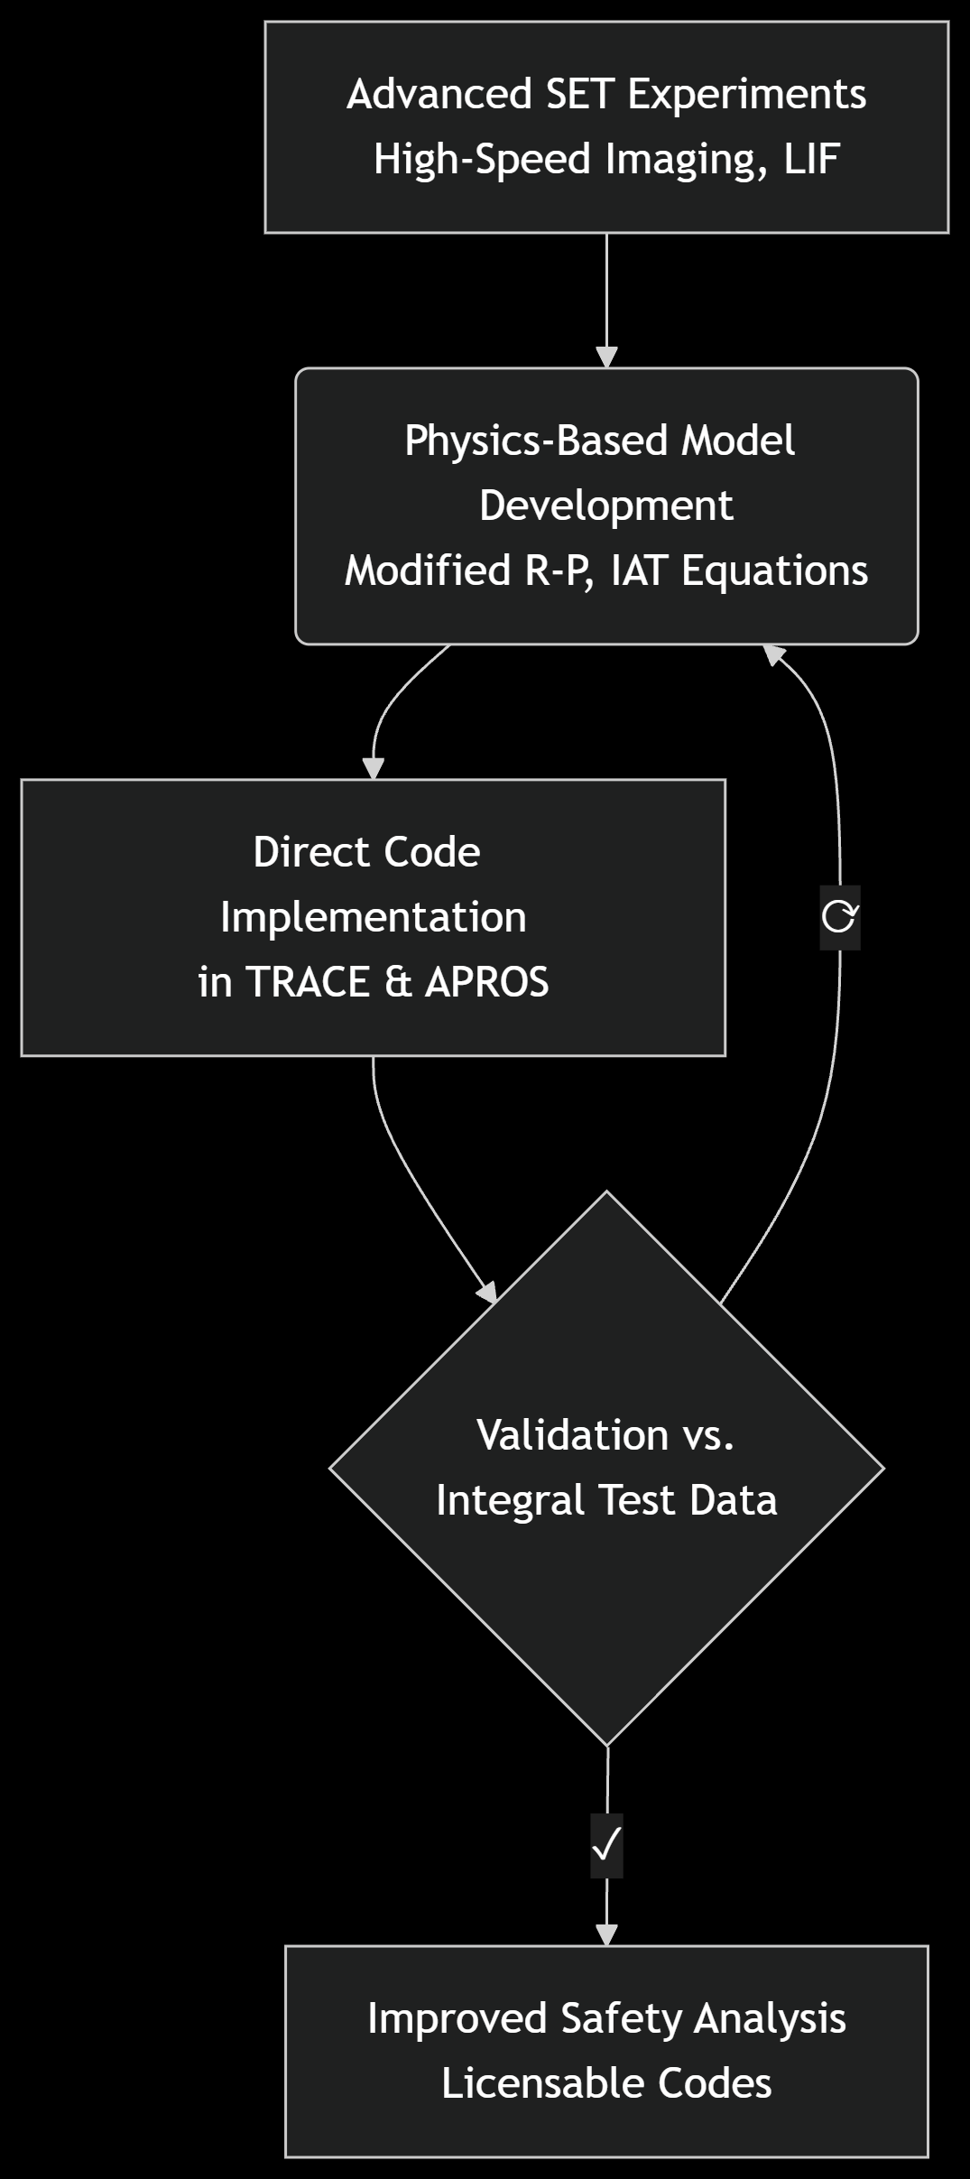
The NCGDENSE Program: An Integrated Research Framework
Bridging Experiments, Theory, and Code Improvement to Solve the NCG Challenge
Gap in Existing Model | NCGDENSE Contribution
Oversimplified dissolution models based on time constants | High-fidelity experimental quantification of gas-liquid interfacial transport
No coupling between bubble formation & mass transfer | Incorporation of mass transfer term in R-P equation
Lack of validated models for system codes | Improving the SYS-TH codes using experimentation validation
Why This Approach is Novel & Critical?
2. Expected Delivarables and Impacts.
SYP october 21-22, 2025

Slide 17
Conclusions & Future Horizons
Paving the Way for Predictive NCG Management in Nuclear Energy
Med-Term: Commissioning SET facility; initial experiments on N₂ and model development TRACE/APROS.
Long-Term: Implement NCG models into SYS-TH codes; Experimentation Validation; Application to Gen-IV reactors; and finalize a PhD dissertation.
Short-Term: Developing the physics from first principles, R-P equation, initial work on a SET Facility
Conclusions
NCGs are a critical, yet poorly modeled, challenge to nuclear safety, with current SYS-TH codes relying on oversimplified empiricism.
The NCGDENSE program's integrated approach—combining advanced experiments, theoretical development, and direct code improvement—is the necessary path to transition NCG modeling into a predictive science.
This will directly enable more accurate safety analyses and the design of more robust passive safety systems for future reactors.
Future Work
Final Vision
This work moves NCG modeling from a simplifying assumption to a quantified reality, enhancing the safety and economic viability of nuclear power.
SYP october 21-22, 2025

Slide 18




QUESTIONS?
Don’t hesitate to contact us!
Sharandeet Singh (M.Sc)
Sharandeet.Singh@lut.fi
Giteshkumar Patel, D.Sc. (Tech.)
CFD (OpenFOAM)
Giteshkumar.Patel@lut.fi
Thank You
Lauri Pyy, M.Sc. (Tech.)
Advanced measurement techniques
Lauri.Pyy@lut.fi
Juhani Hyvärinen, D.Sc. (Tech.)
Professor
Juhani.Hyvarinen@lut.fi
SYP october 21-22, 2025

