Slide 1
Strategic Optionality and Flexibility in SMR Investments:
Scenario and Real Options Approach
Finnish Nuclear Science and Technology Symposium 2025
Authors
Jyri
Rökman
Juuli
Huuhanmäki
This work has been enabled by VTT´s internal SMR project funded by the Government of Finland
Reserach Scientist, VTT; Doctoral student, LUT
Research Scientist, VTT
Maaria
Nuutinen
Senior Principal Scientist, VTT
Tapani
Ryynänen
Senior Scientist, VTT

Slide 2
Reconnecting the field of foresight & strategy in business.
Doctoral studies in LUT Business School:
How Do Incumbent Capital-Intensive Firms Develop Strategic Real Options for Sustainability Transformation?

Slide 3
How can strategic decision-making be enhanced in highly uncertain future energy and SMR markets?
WHY
Capital-intensive, high-uncertainty environments drive “wait & see” behavior
SMR value realization held back by regulatory, technological, and market risks
Traditional DCF methods ignore timing flexibility and deep uncertainty
Business cases and deployment pathways for SMRs remain untested
Scenario Planning + Real Options Analysis to enable adaptive choices

Slide 4
83% of firms in EU state uncertainty as barrier for new investments
EIB Investment Survey 2025
TOP 3 obstacles
Uncertainty about the future
Availability of skilled staff
Energy costs

Slide 5
“Ideas are cheap, execution is expensive”
Jani Halinen, PhD, VP Nuclear Energy VTT
”The business case [for SMR] is purely a project finance exercise”
Interviewee, process industry
“Finance is not about math…
To figure out what the right assumptions are is the whole game.”
Stephen A. Schwarzman
co-founder & CEO, Blackstone

Slide 6
Combined approach for decision-making in capital-intensive industries facing complex, uncertain business environment
(Cornelius et al., 2005; Mathews et al., 2007; Vecchiato, 2012)
Miller & Waller, 2003
“Strategic planning and capital budgeting processes should force managers to be explicit about their assumptions”
“…unlike NPV analysis, the real option perspective assumes managers can intervene in ways that add value over time.”
“…a framework for evaluating environmental effects and management influences on the values of strategic investments.”

Slide 7


Scenario planning
provides decision-makers with the tools for systematic identification of the sources of uncertainty and means for creation of sets of alternative assumptions and outcomes regarding the future.
Real options analysis
is a way of thinking, mapping and analyzing investment opportunities and managerial flexibity within the opportunities: identify strategic and tactical level rights, not obligations to act.

Slide 8
Scanning for uncertainties in our research
Sources
Journals, news
Workshops
Field
Desk study on SMR future developments / uncertainties
VTT technology expert workshops
SMR Business Day findings / SYP / Field notes
Interviews
Case industry stakeholders

Slide 9
Scenario method for improved understanding on uncertain SMR future markets
Long list of uncertainties and emerging trends in the SMR market
Impact and uncertainty evaluation of the recognized uncertainties
Cross-impact analysis of the selected uncertainties
SMR scenarios for future outlook and strategic decision-making
Level of uncertainty:
General business environment and industry

Slide 10
Real options methods for identifying and valuing managerial flexibility in risky projects
Discovery of shadow options in uncertain business environment: Real options ”on projects” – what flexibilities and opportunities exist
Acquire or develop real options ”in projects”: Defer, stage, grow, alter scale, switch
Exercise: For example, staged approach to SMR investment and decision / valuation points when new information arrives
Level of uncertainty:
Firm and project level
Adopted from Trigeorgis & Reuer 2017. Real Options Theory in Strategic Management

Slide 11
Map uncertainties
General Environmental | Complex licensing and lack of EU harmonization
 | High capital costs and unclear financing models
 | Unclear risk-sharing models
 | Technology maturity and lack of commercial SMRs
 | Public acceptance and political cycles
 | Waste handling unresolved and costly
 | Geopolitical and supply chain risks
Industry Level | Utilities/District Heating | Process Industry | Data Centers
 | Heat demand predictability and price volatility | Site-specific constraints and cooling water availability | Integration challenges and redundancy requirements
 | Competition from heat pumps and biomass | Long investment cycles vs. SMR readiness | Uncertain demand growth
 | Dependency on municipal partnerships and public acceptance. | Regulatory complexity for industrial integration | Competing solutions like waste heat recovery and renewable PPAs
 | Uncertainty about scale and module availability | Alternative technologies like renewables and hydrogen | Location competition / siting
Firm / organization level | Political cycles | Electricity price stability is critical | Need for feasibility studies and scenario planning
 | Limited familiarity with nuclear integration among operators | Cautious approach due to regulatory hurdles
Categorization adopted from: Miller, K. D. (1992). A Framework for Integrated Risk Management in International Business. Journal of International Business Studies, 23(2).

Slide 12
Identify most pressing ones, and how might they play out
 |  | Scenario 1 | Scenario 2 | Scenario 3
General Environmental | GE 1
 | GE 2
 | GE 3
Industry Level | IL 1
 | IL 2
 | IL 3
Firm / organization level | FL 1
 | FL 2
 | FL 3

Slide 13
“Managers can influence the values of the underlying resources through their strategic actions”
 | Scenario 1 |  | Impact on Option
General Environmental |  |  | Switch
Industry Level |  |  | Expand
Firm / organization level |  |  | Exit
Adopted from Miller & Waller, 2003

Slide 14
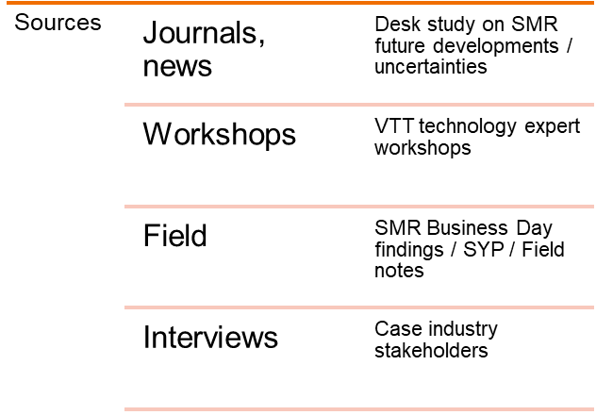
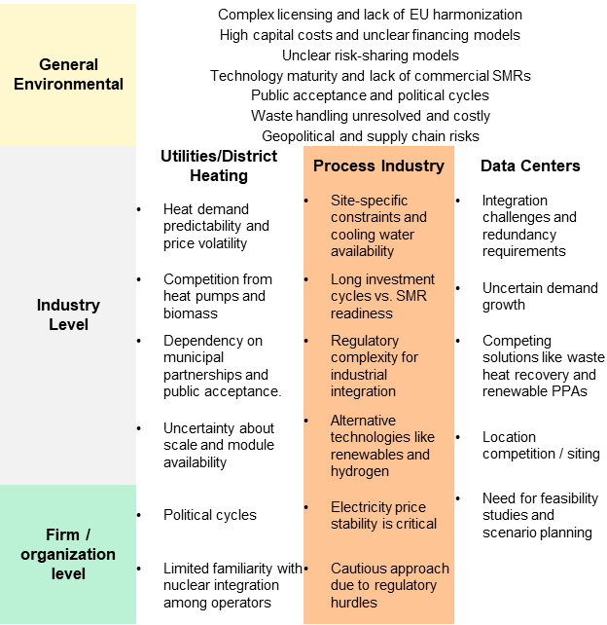
Next steps
Fill interview gap: Data centers
Synthesize findings from all sources
Sanity/cross check most impactful uncertainties to TCO / DCF models
Theoretical scenario + real option mapping for use cases
Article publication
Continue work towards quantitative analysis

Slide 15
Thank you!
Contact:
Jyri Rökman, firstname.lastname@vtt.fi

