Slide 1
Determination of Recovery Time Distributions for Water Supply Systems for Level 2 PRA
The Finnish Nuclear Science and Technology Symposium 2025
October 21-22, 2025, Espoo, Finland

Slide 2
1. Introduction
Objective: Accurate determination of recovery times for water supply systems in different Plant Damage States (PDSs) in Level 2 PRA.
Focus: Olkiluoto 1 and Olkiluoto 2 Boiling Water Reactors (BWR) at Olkiluoto Nuclear Power Plant (NPP).
Systems Analyzed:
Containment Spray (CS) System
Low-Pressure Reactor Core Spray (LPRCS) System
Auxiliary Feedwater (AFW) System
The full paper can be accessed via the link provided in reference [5].

Slide 3
2. Research Questions
How can the recovery times for different systems in different PDSs in a nuclear power plant be determined?
How well does the log-normal distribution model the recovery times in different PDSs?

Slide 4
Procedure

Slide 5
3. Nine PDS were considered in the analysis (underlined)
Table 1. Abbreviations and descriptions for each PDS.

Slide 6
4. Identify MCSs
Identify the 100 or more most significant Minimal Cut Sets (MCSs) for each PDS from Level 1 PRA.
For each PDS, obtain all MCSs, i.e. fault combinations, that lead to the loss of safety function for the water supply systems.
If a combination disables required number of trains, consider it for recovery time determination.
Search MCSs of PDSs for combinations of faults affecting water supply systems.

Slide 7
5. Recovery time sources
Obtain recovery time for each basic event from PRA model input data.
In the case of common cause failures (CCF), the recovery time of a single basic event is multiplied by two.*
Estimate recovery time if not defined, e.g., 48 hours for severe seismic events.
*The rationale behind this is, that if we simply used the recovery time of a single basic event for the CCF, it might underestimate the complexity and coordination required to address multiple simultaneous failures. In contrast, multiplying the repair time by the number of basic events included in the CCF could overestimate the time needed, as some recovery activities might overlap or be streamlined. Therefore, multiplying the recovery time by two provides a more balanced estimate.

Slide 8
6. Determine recovery times
Blue minimal cut set: Contains an MCS causing the containment spray (CS) system’s safety function to fail (outlined in yellow).
One out of four trains must be restored to regain the CS system’s safety function.
Common cause failure of three pumps is faster to restore than the maintenance package, with a recovery time of 8 hours, so the recovery time is recorded for it.
Red minimal cut set: Contains no MCS that causes the CS system’s safety functions to fail (outlined in black), so zero is recorded for the last event.

Slide 9
7. Calculate cumulative share
Collect all unique recovery times in a table.
Determine the cumulative share of the total frequency for each recovery time.
This represents the proportion of total frequency of each recovery time.
Use the cumulative share data to create an initial value matrix (table 2).
Table 2. Example initial values.

Slide 10
8. Process initial values
Calculate what is the cumulative share of other recovery times from the total share, from which the cumulative share of zero has been subtracted (table 3).
Table 2. Example initial values with zero.
Table 3. Example initial values without zero.

Slide 11
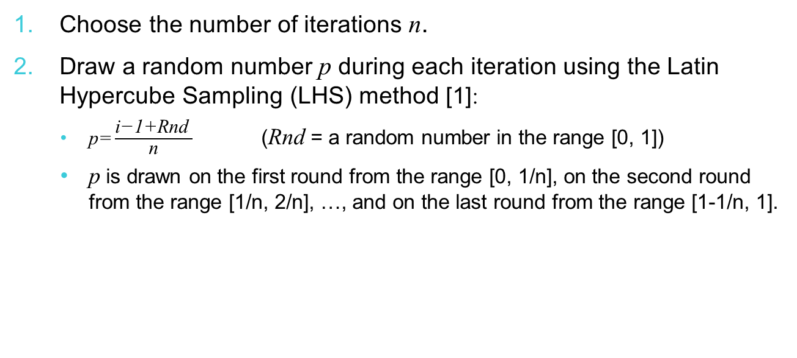
9. Create a random sample (part 1)
Choose the number of iterations $\text{n}$.
Draw a random number $\text{p}$ during each iteration using the Latin Hypercube Sampling (LHS) method $\text{[1]}\text{:}$
$\text{p}\text{=}\frac{\text{i}\text{−1+}\text{Rnd} }{\text{n}}$ ($\text{Rnd}$ = a random number in the range [0, 1])
$\text{p}$ is drawn on the first round from the range [0, 1/n], on the second round from the range [1/n, 2/n], …, and on the last round from the range [1-1/n, 1].
Notes:
LHS method ensures that the random sample represents the actual variation of the data set.

Slide 12

9. Create a random sample (part 2)
Compare $\text{p}$(see previous slide) to cumulative proportions in table 3, as shown below in table 4, and choose β based on that.
Use the chosen β to calculate the current iteration’s recovery time $\text{x}$ [h] using exponential distribution’s quantile function with probability $\text{Rnd} \text{[2]}\text{:}$
$\text{x}\text{=}\frac{\text{ln}{\text{(1−}\text{Rnd}\text{)}}}{\text{1/}\text{β}}$ ($\text{Rnd}$ = a random number in the range [0, 1])
Table 4. Example initial values without zero compared to $\text{p}$.
Notes:
The exponential distribution is used here because the recovery times are not assumed to be constant, as in the initial values, but they vary due to various reasons, such as the type of components affected, the cause of the fault, and the repair method.

Slide 13

10. Calculate the log-normal distribution parameters
The parameters of the log-normal distribution, i.e. the mean μ, variance $σ^{2}$, error factor EF, expected value E, and standard deviation σ, are calculated from the random sample using the following equations [3, 4]:
Table 5. Example results.

Slide 14
Evaluation of the results

Slide 15
11. Calculate the statistical probability
Divide random sample into 5-minute sections for 48 hours.
Calculate the number of data points for each interval ((0, 0.08], (0.08, 0.17], etc.).
Calculate statistical probability for each interval.
Example: 100 000 iterations, 5 476 values in (0, 0.08] range, so probability s = 100 000 / 5 476​ = 5.48E−2.

Slide 16
12. Comparison
Compare statistical value s (see previous slide) to numerical integral of log-normal density function (lognp).
Table 6. Comparison between lognp and s.
Only small
differences in
this case.

Slide 17
13. Comparison using R-squared (R²) value
Calculated as follows:
Three water supply systems were analyzed across nine different PDSs, resulting in a total of 27 figures. Regarding the fits,
16 of them had an R² value above 0.9 (indicating a good fit)
4 had an R² value less than 0.9 but greater than 0 (indicating a poor fit)
4 had an R² value less than 0 (indicating that the data was completely non-log-normal)
3 had an R² value of NaN (indicating that the system is always available in the PDS).

Slide 18
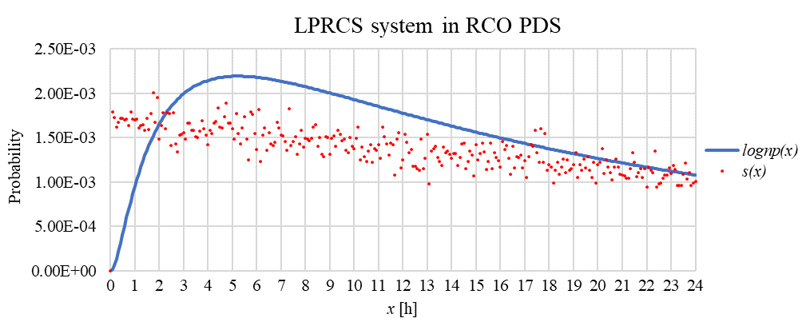
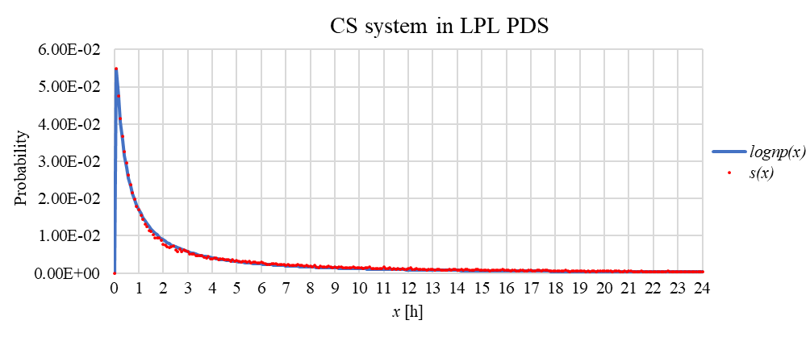
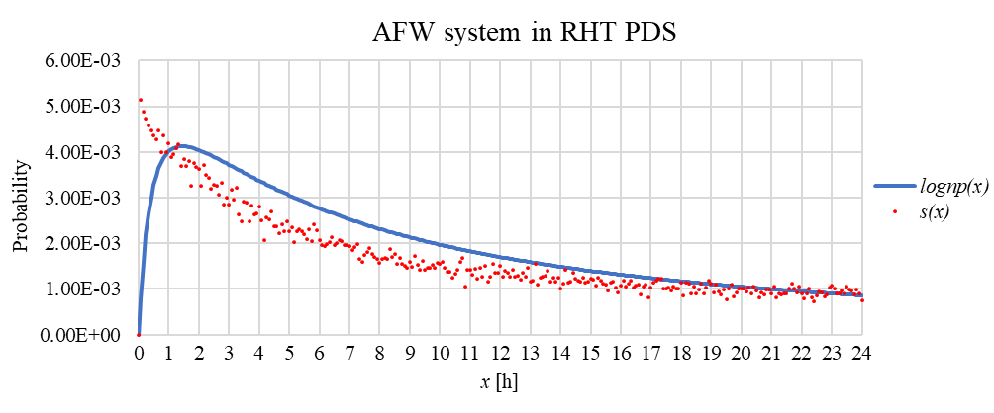
14. Visual inspection
R² = -0.07 (completely non-log-normal)
R² = 0.74 (poor fit)
R² = 0.99 (good fit)

Slide 19
RECAP

Slide 20
15. Procedure
Identify the 100 most significant Minimal Cut Sets (MCSs) for each PDS from Level 1 PRA.
Obtain all the MCSs that lead to the loss of the safety function of the water supply systems in each PDS.
Determine recovery times for the water supply systems’ fault combinations within PDS MCSs.
Collect unique recovery times and calculate their cumulative share of the total frequency.
Create an initial value matrix for each system in each PDS.
Generate a random sample based on the initial values.
Calculate the parameters of the log-normal distribution.
Evaluate accuracy by comparing the random sample to log-normal distribution values.

Slide 21
Conclusions

Slide 22
16. Conclusions
Log-normal distribution is useful for modeling recovery times in different PDS.
It has limitations and may not always be the best fit.
The difference between fits is due to what kind of MCSs there are in the PDS and what is their proportion of the PDS’s total frequency.
Further research could explore other goodness-of-fit measures (e.g., Akaike Information Criterion (AIC) or Bayesian Information Criterion (BIC)) to find alternative distribution models that might be better than log-normal in some scenarios.
Dependencies and system availability could be analyzed further. These are explained in more detail in the paper.

Slide 23
References
[1] Cheng, J., & Druzdzel, M. (2000). Latin Hypercube Sampling in Bayesian Networks. Proceedings of FLAIRS-2000. 287-292.
[2] Joram, S. (2022). Proof: Quantile function of the exponential distribution. The Book of Statistical Proofs. Available at: https://statproofbook.github.io/P/exp-qf.html (Accessed: 31 May 2024). DOI: 10.5281/zenodo.4305949.
[3] Evans, M., Hastings, N., & Peacock, B. (1993). Statistical Distributions (2nd ed.). Hoboken, NJ: John Wiley & Sons, Inc.
[4] Britton, P., Mohammad, A. H., & Robert, R. (2023). Uncertainty Estimation Cheat Sheet for Probabilistic Risk Assessment. Available at: https://ntrs.nasa.gov/api/citations/20170012415/downloads/20170012415.pdf (Accessed: 17 October 2023).
[5] Wallius, M. (2024) Determination of Recovery Time Distributions for Water Supply Systems for Level 2 PRA. Available at: https://iapsam.org/PSAM17/program/Papers/PSAM17&ASRAM2024-1405.pdf (Accessed: 19 May 2025).

Slide 24
Contact:
Miika Wallius
miika.wallius@tvo.fi

