Slide 1
Final disposal of nuclear and radioactive waste
Ville Oinonen / Senior Expert / Fortum Nuclear Service
22.10.2025

Slide 2
Agenda
01 | Final Disposal Facilities & Waste Origins
02 | Loviisa LILW repository & NPP operational waste
03 | Complex waste from Loviisa decommissioning
04 | Complex waste from research, medical and industrial use
05 | Final disposal of external waste

Slide 3
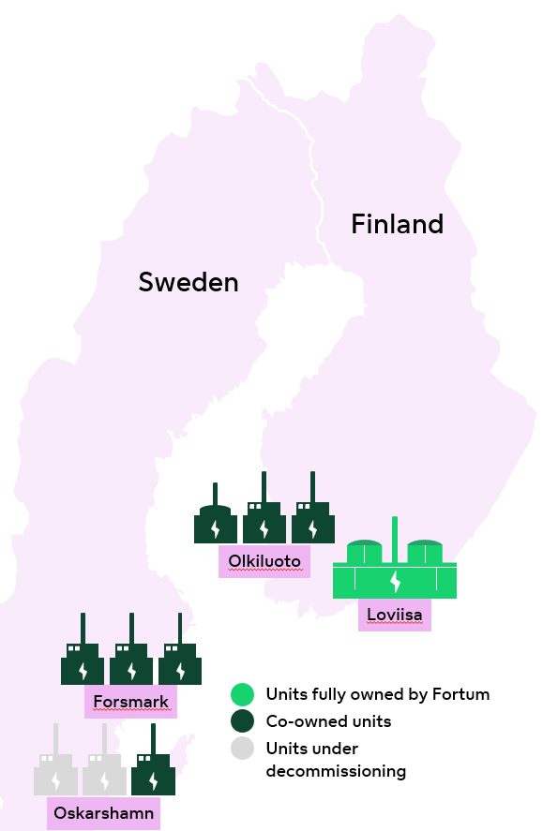
Final Disposal Facilities & Waste Origins
Majority of waste originates from Nuclear Power Plants
  During operation 2000 – 5000 m³ (per Unit)
  During decommissioning 10 000 – 20 000 m³(per Unit)
Finland has soon 3 operational disposal facilities
  Loviisa LILW repository
  Olkiluoto LILW repository
  Posiva DGR (for Spent Nuclear Fuel)
  TVO also has landfill type VLLW facility under commission
Facilities are focus on serving license holder's own waste

Slide 4
Final Disposal Facilities & Waste Origins
 | Industry and Research |  | Health Care
Other than High Active Sources | Radionuclide | Number | Radionuclide | Number
 | Cs-137 | 3705 | Co-57 | 139
 | Co-60 | 513 | Ge-68 | 101
 | Kr-85 | 272 | Cs-137 | 37
 | Am-241 (gamma sources) | 196 | Gd-153 | 36
 | Fe-55 | 94 | Sr-90 | 24
 | Am-241 (AmBe-neutron sources) | 68 | Ba-133 | 17
 | Ni-63 | 68 | Co-60 | 10
 | Sr-90 | 64
 | Pm-147 | 60
High activer sources | Radionuclide | Number | Radionuclide | Number
 | Cs-137 | 27 | Ir-192 | 7
 | Ir-192 | 11 | Co-60 | 2
 | Co-60 | 10
 | Am-241 (AmBe-neutron source) | 4
 | Am-241 (gamma source) | 3
 | Se-75 | 2
Besides the Nuclear Power Plants, part of the National waste will accumulate from:
  Research: Material research of activated materials
  Medical: Use of medical Isotopes for treatment
  Industry: Radiation sources for measurements
Used sources and material samples are returned for the original owner for future treatment
  Some sources cannot be returned
  Destructive analyzing methods for material samples will produce contamination that is categorized as operational waste from research
STUK Radiation practices Annual Report 2024

Slide 5
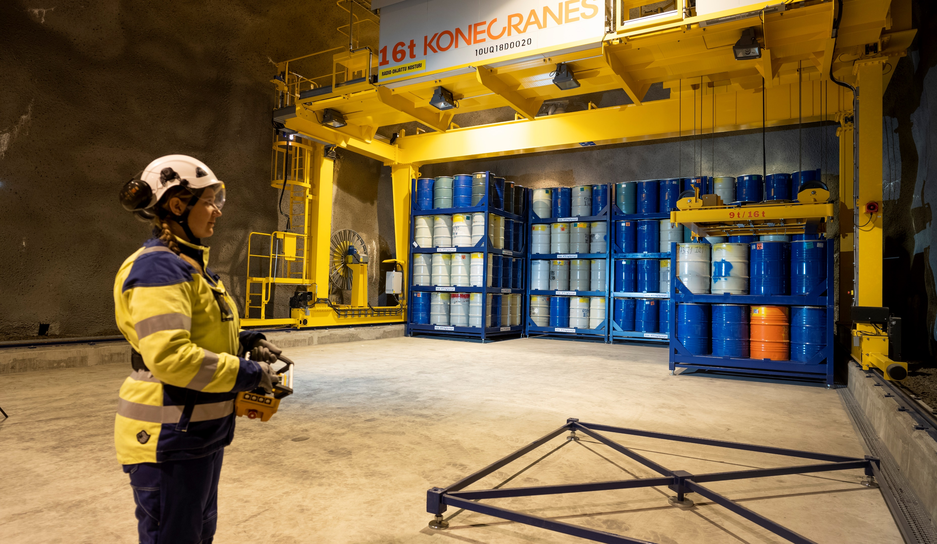
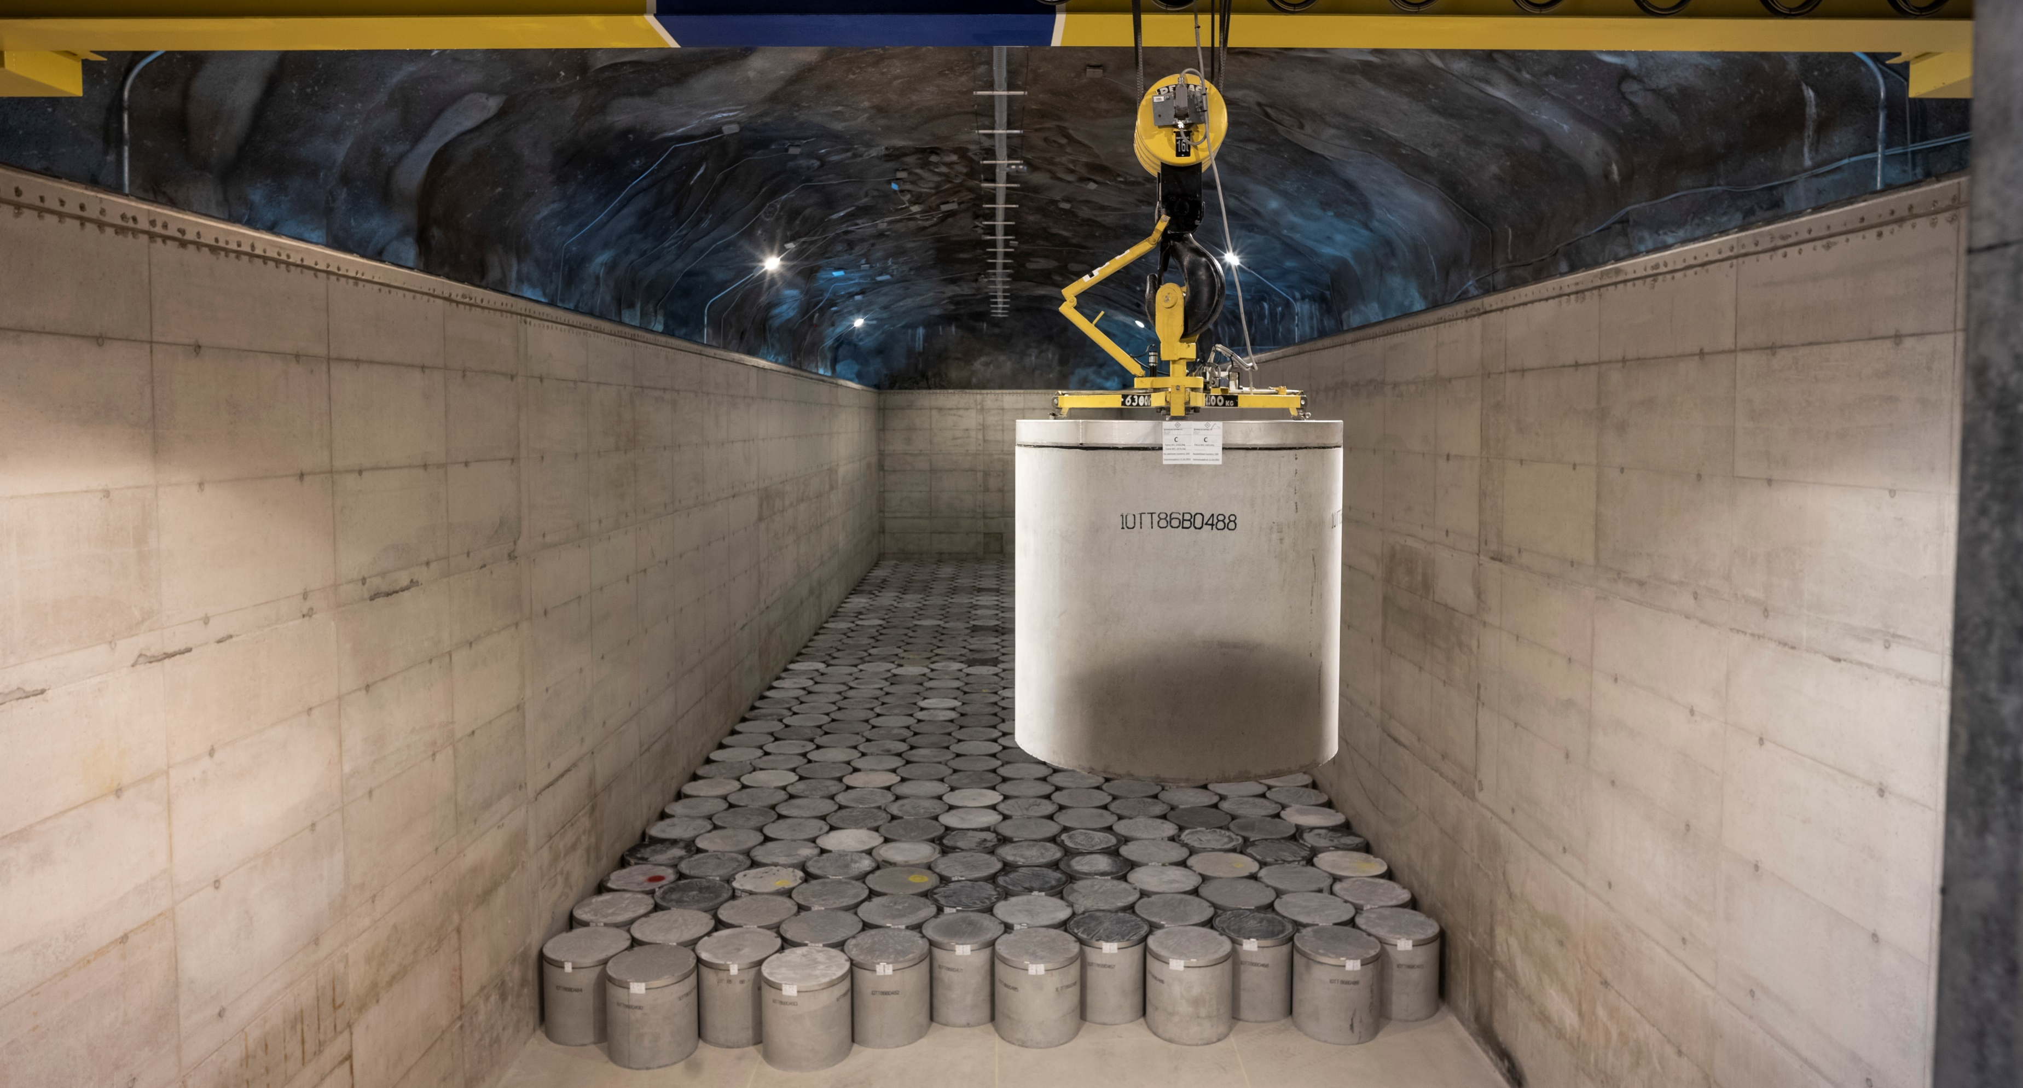
Loviisa LILW repository & NPP operational waste
Operational waste origins from Power Plant RCA
  Activity is created at reactor core and spread to primary circuit and auxiliary systems
  Opening the circuit during the yearly maintenance breaks (outage) allows nuclides to spread materials and tools at working areas.
  All contaminated components, materials and tools will end up as waste
Solid waste is packed to barrels
  Sorting, compressing, characterization
Liquid waste is treated and solidified to concrete container
  Treatment (NURES), solidification (LOKIT)
Packages are transported to Final Disposal Facility

Slide 6
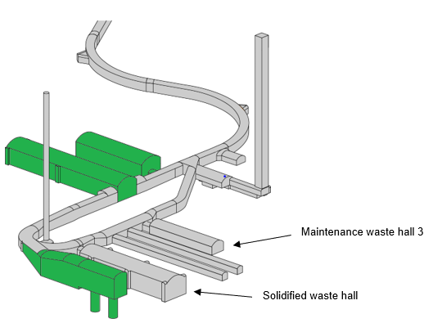
Loviisa LILW repository & NPP operational waste
Disposal Facility consists of separate disposal halls
Operational waste is disposed for HJT1,2,3 & KJT (Maintenance waste halls 1-3 and solidified waste hall)
Some halls will be constructed later to serve decommissioning needs

Slide 7
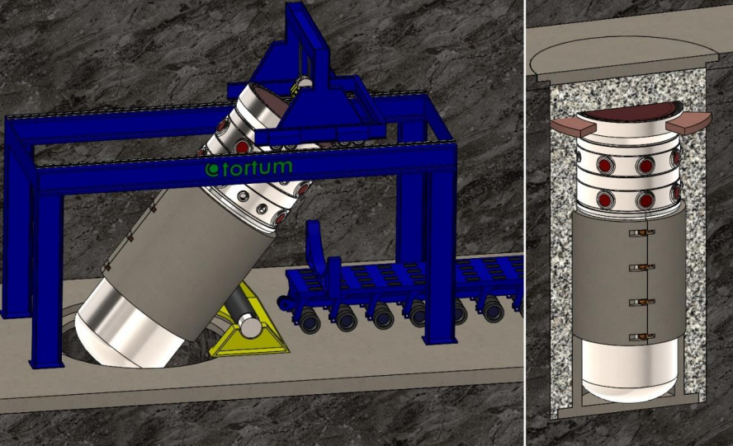
Complex waste from Loviisa decommissioning
Majority of the activity inventory is at Reactor components
  Reactor pressure vessel (RPV)
  Reactor pressure vessel internals (RPVI)
  Shield Elements
Primary strategy is to dispose RPV at one-piece.
  Concrete Vault is done before hand
  RPV works as container for Internals

Slide 8
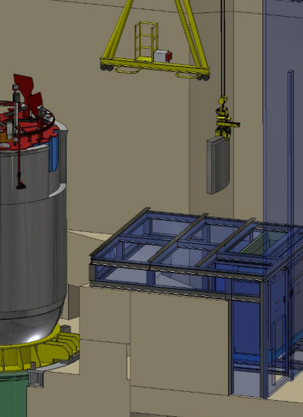
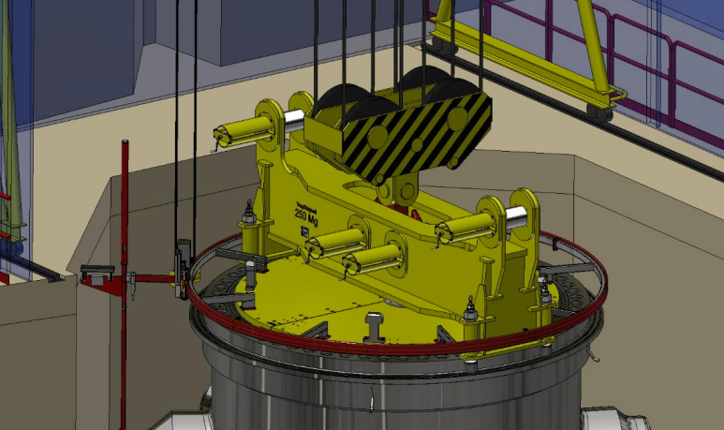
Complex waste from Loviisa decommissioning
Secondary methods is to segment RPV

Slide 9
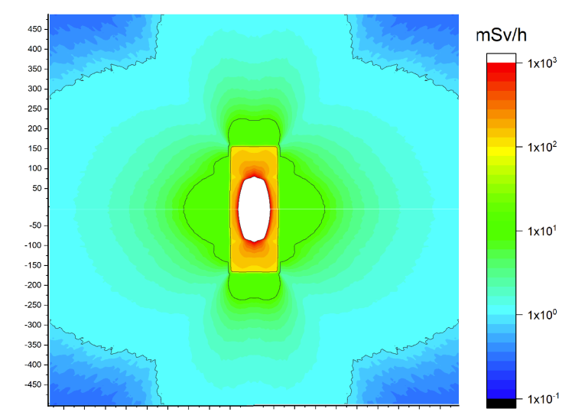
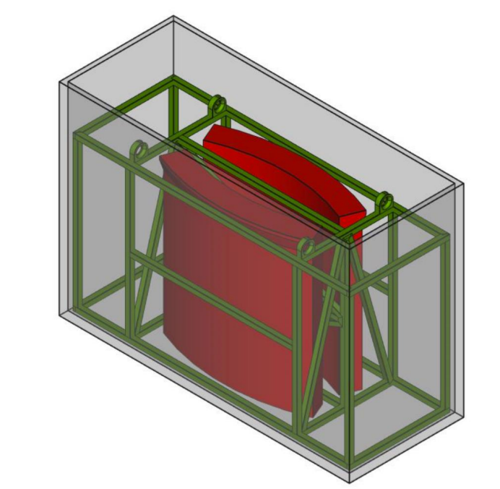
Complex waste from Loviisa decommissioning

Slide 10
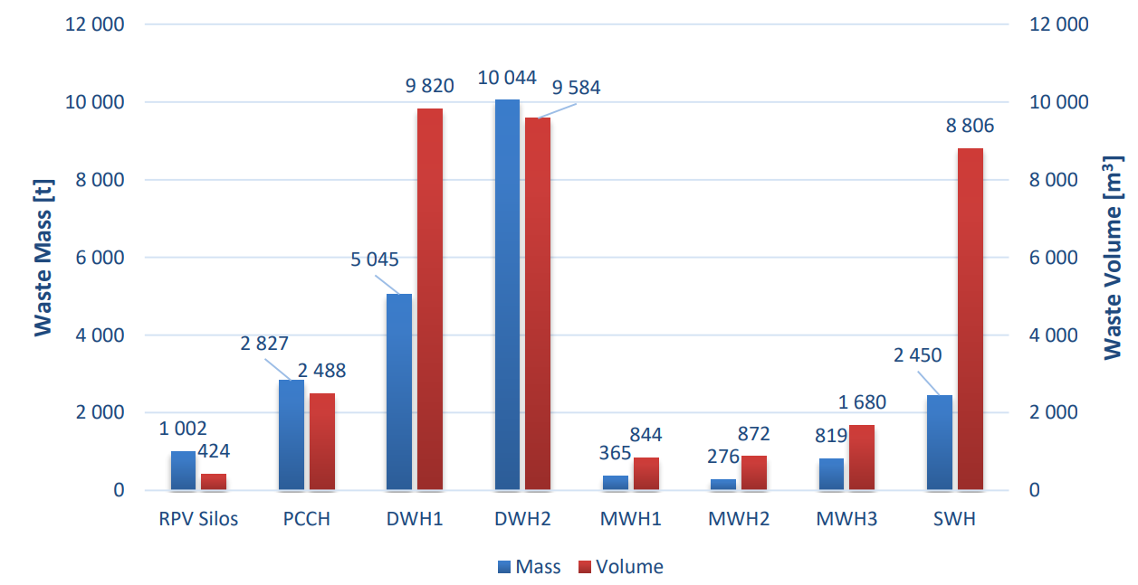
Total mass and volume of Final Disposal Facility (Loviisa NPP own inventory)

Slide 11
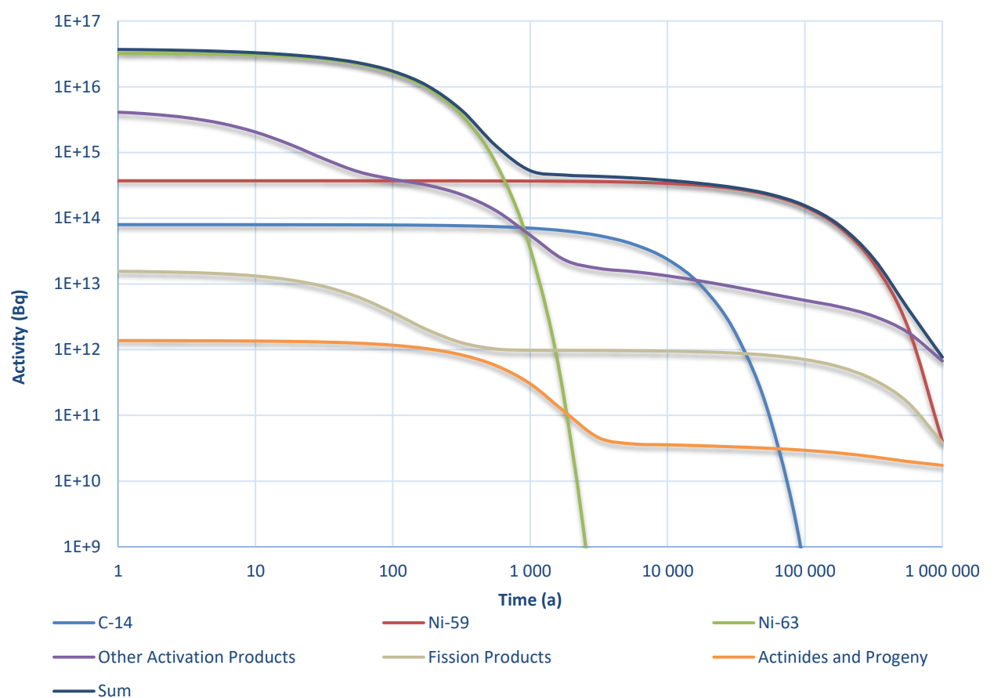
Total activity of Final Disposal Facility (Loviisa NPP own inventory)
Total activity at closure of Final Disposal Facility is about 1 000 TBq (1E17 Bq)
Majority is consists of short-lived nuclides
Ni-63 and Ni-59 dominates the inventory. After 1 000 000 years only Actinides and fissions products are left (less than 1 TBq)
Long-term-safety analyses models radiation doses for environment and people
  Besides total activity, also concentration and nuclide specific transferring capabilities (K_{diff}) and nuclide conversion factors will affect to radiation dose.
  Even small amounts (1-100 MBq) of long-lived nuclide could be significant (e.g. FiR1 reflector Cl-36)

Slide 12
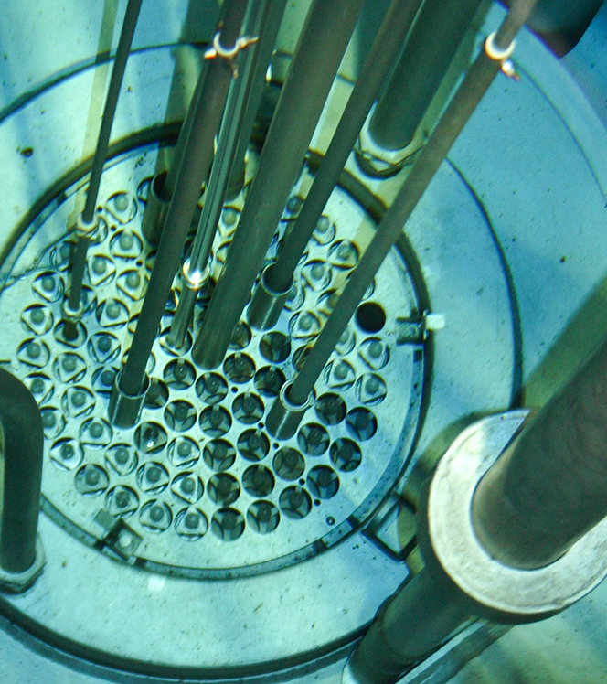
Complex waste from research, medical and industrial use
Radioactive waste from research, medical and industrial use is mainly stored for the later treatment and disposal
Following projects has been completed so far
  FiR1 research reactor decommissioning (treatment and disposal)
  OK3 laboratory dismantling waste (Disposal)
  TVO has also disposed some radiation sources from Industrial use

Slide 13
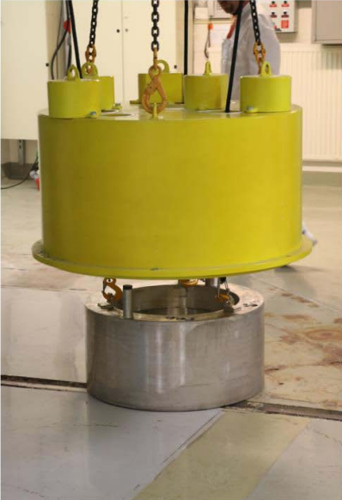
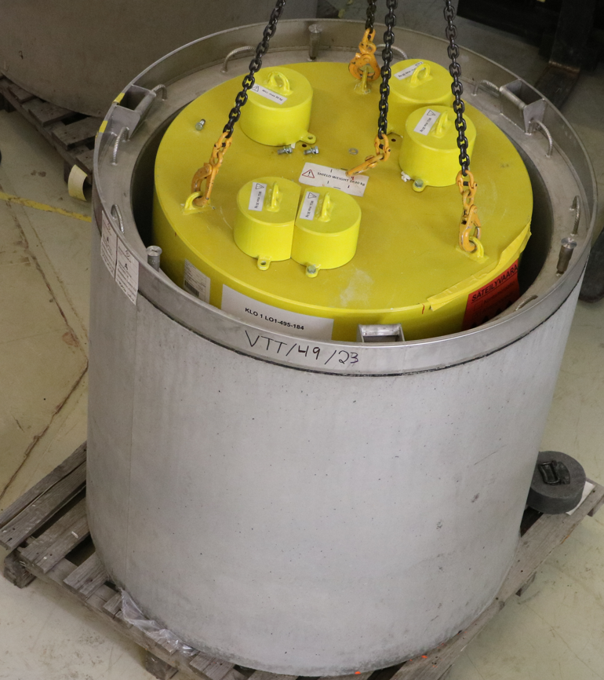
Complex waste from research, medical and industrial use
- Case example FiR1

Slide 14
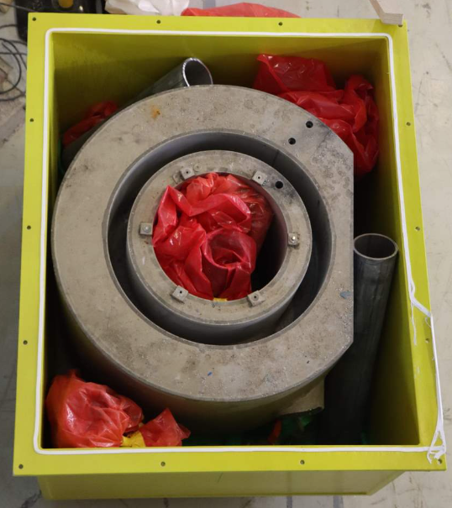
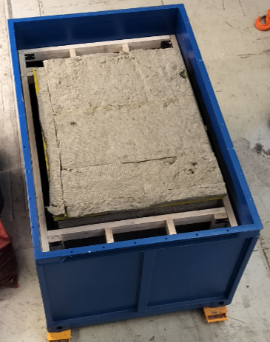
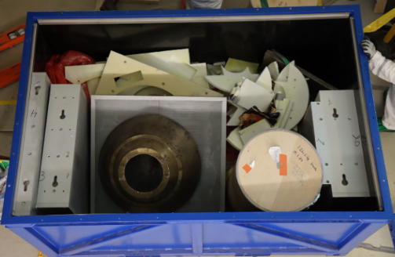
Complex waste from research, medical and industrial use
- Case example FiR1
Graphite reflector (radiation shield)
Graphite reflector (Disposal Container)
BNCT station (Disposal Container)

Slide 15
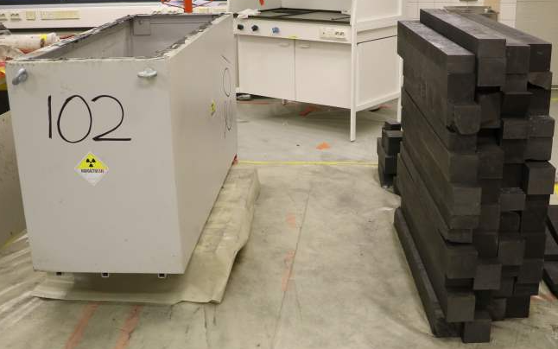
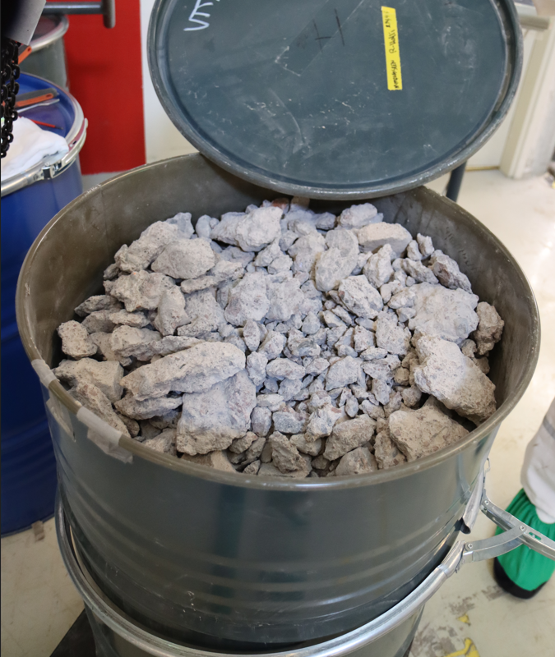
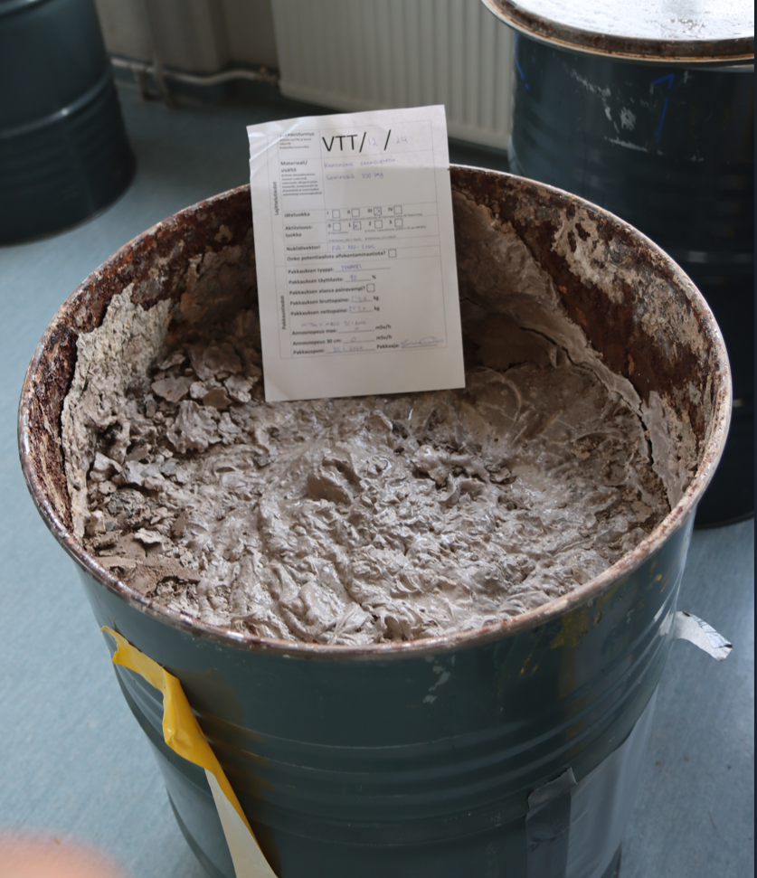
Complex waste from research, medical and industrial use
- Case example FiR1
Activated Graphite elements
Concrete from BIO shield
Solidified concrete sludge from BIO shield

Slide 16
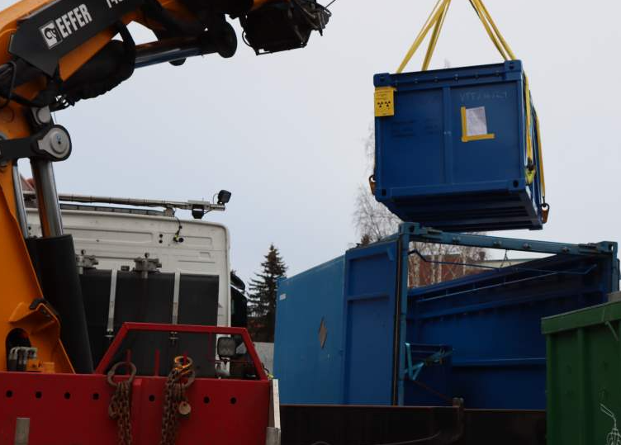
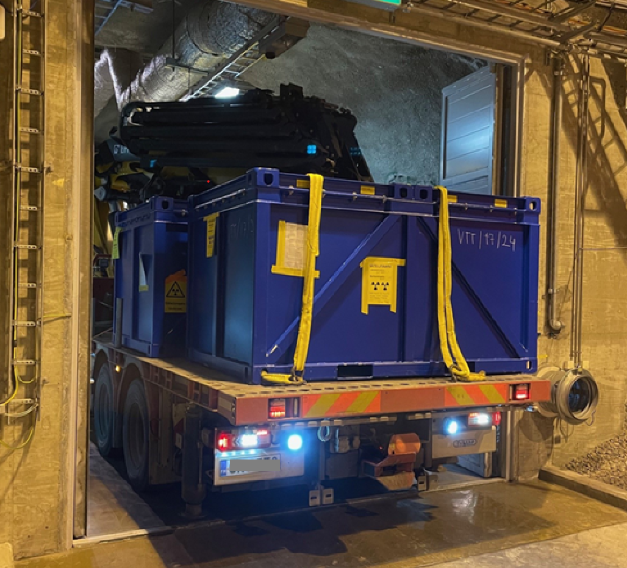
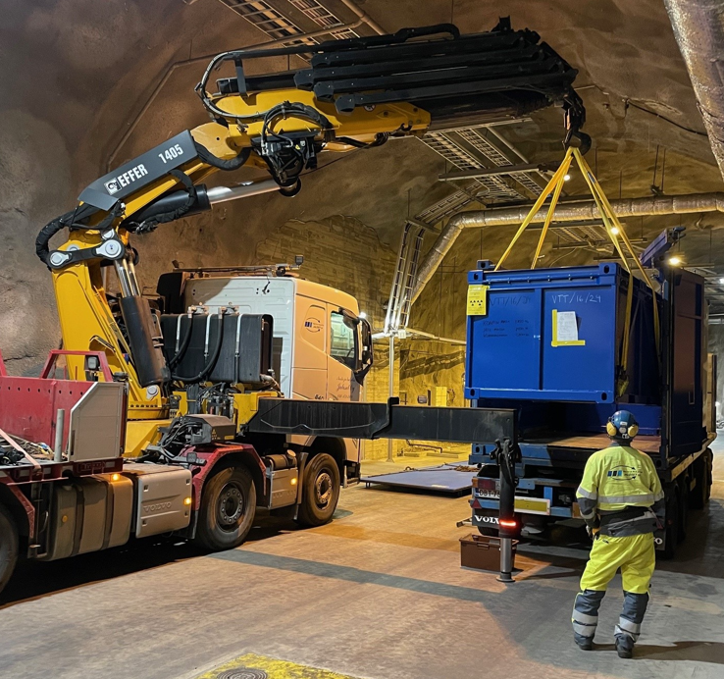
Complex waste from research, medical and industrial use
- Case example FiR1
Packing for transport
Transport
Unloading

Slide 17
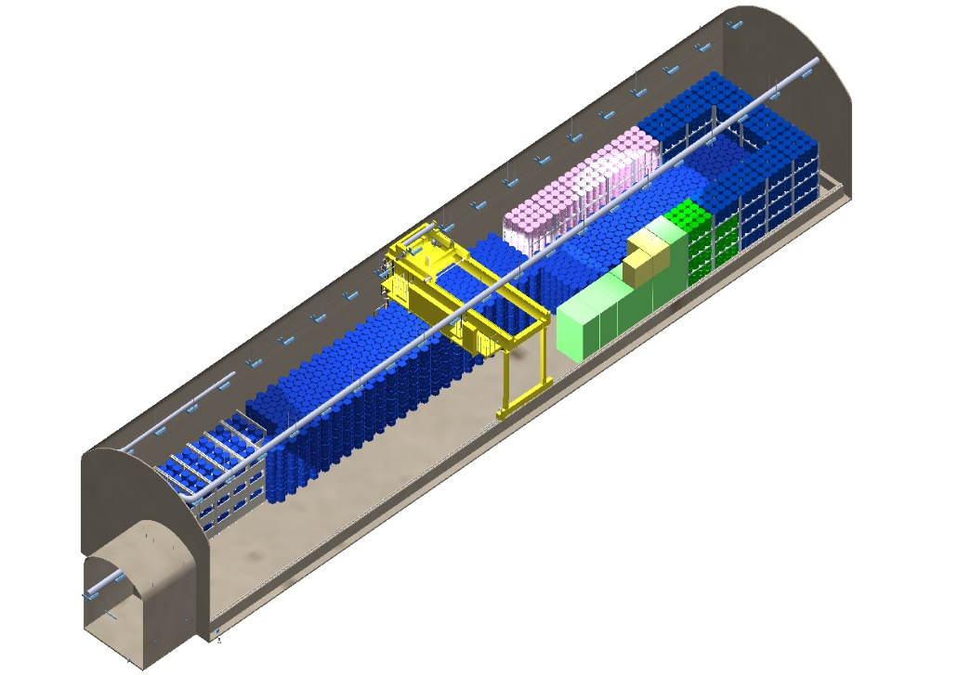
Final disposal of external waste
Currently Loviisa LILW repository license covers NPP own waste
FiR1, OK3 and YTT (VTT) has been done case by case principle
  Each project had specific waste inventory (Type, Activity, Mass, Volume)
  Long-term-safety analyses, characterization principles, WAC (waste acceptance criteria), radiation dose analyses
In future, plan is to create continuous process for small patches of radiation sources.
  License is applied for specific nuclide inventory and waste types
  WAC criteria is made public and generic format. WAC describes to external party how to characterize, pack and document waste to full fill Loviisa LILW requirements.

Slide 18
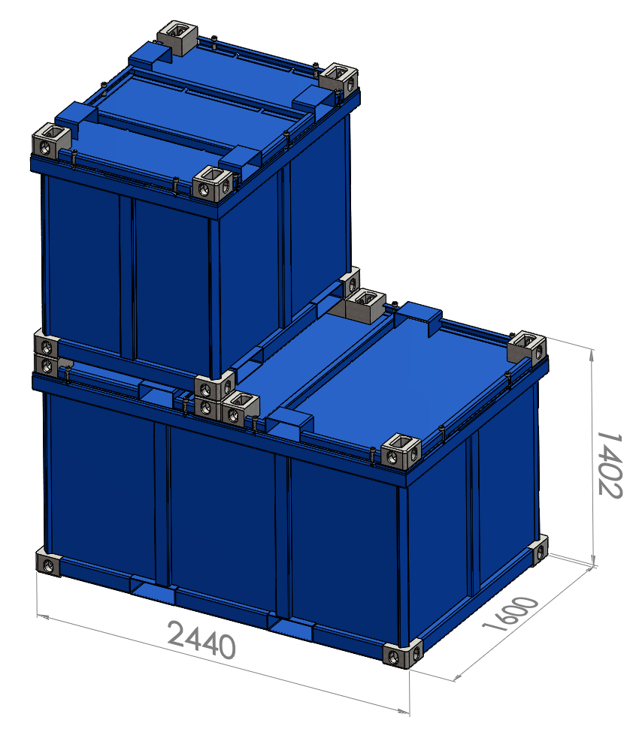
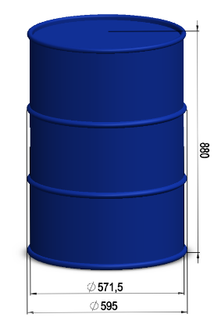
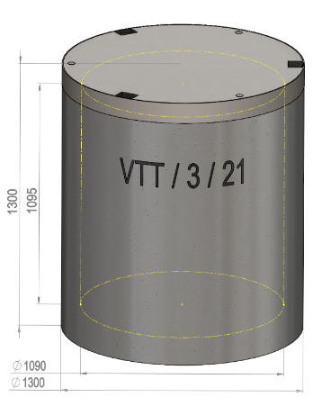
Final disposal of external waste
The most important aspects for external party to consider during radioactive material lifecycle
  Original high quality records about activity, reference date, material, place of origin, manufacturer
  Disposal cost to be considered during the procurement
  Proper storage after decommissioning.
    Important for safety of upcoming packing work. E.g. glass ampoules might break, high active source handling should be avoided

Slide 19
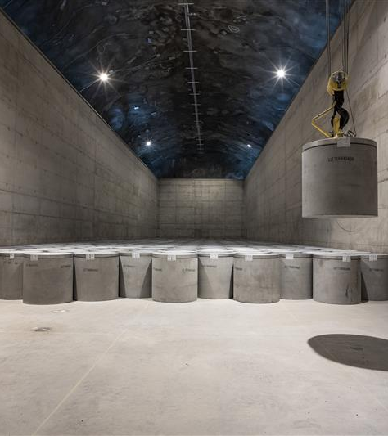
Thank you!
Final Disposal, decommissioning and waste management aspects contact:
ville.oinonen@fortum.com
+358400 829465
Senior Expert, Decommissioning & Disposal
Fortum Nuclear Service

