Slide 1
Characterisation and Radionuclide Transport Modelling of SNF from LWR SMRs
Sami Naumer, Miiko Pöyhönen, Veli-Matti Pulkkanen, Pirjo Hellä, Anniina Seppälä

Slide 2
Background
LWR SMRs employ similar technology as conventional nuclear power plants
SMRs fuel has similar characteristics, burnups and enrichment comparable to fuel from conventional NPPs
However, LWR SMRs have large variation in fuel enrichment and burnup [1]
How variations in burnup and enrichment affect disposal?
Rolls-Royce SMR
STAR
Current NPPs
LDR-50
Named SMRs
Other SMRs
Finnish nuclear power plants

Slide 3
Objectives of this study
This study
How does SNF from LWR SMRs with different burnups, and slightly varying enrichments differ? Selected reactors:
Rolls-Royce SMR: up to 65 MWd/kgU and 4.95% ²³⁵U [1]
LDR lite: 20–25 MWd/kgU and 2–3% ²³⁵U [2]
Characterisation of SNF for both reactors
Radionuclide transport modelling from the repository near-field using SNF inventories specified for the two SMRs
SNF characterisation
Output: Radionuclide inventory
Fuel
Cladding
Other structural parts
Near-field model
Output: Near-field release rate
for each radionuclide
To geosphere

Slide 4
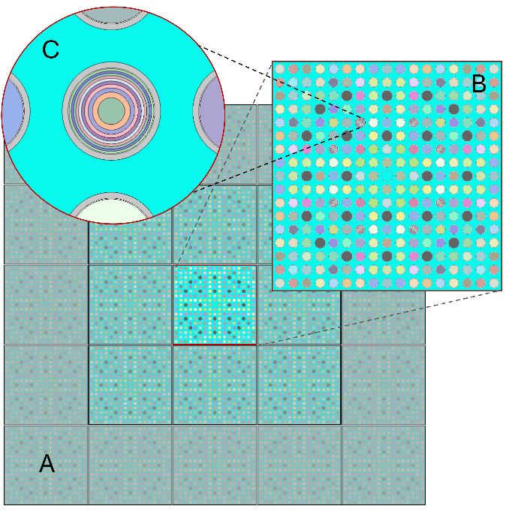
SNF Characterisation
Characterisation carried out with Serpent version 2.2.2 [3]
17x17 square LWR fuel assembly in an infinite 2D lattice geometry
Based on LDR lite, “extended” assembly for Rolls Royce (more U)
Reflective boundary conditions
Full power operation on three cycles
Three different assemblies modelled for LDR lite
One for Rolls-Royce SMR
No impurities in materials
A) Infinite lattice geometry
B) Single assembly
C) Fuel rod in an assembly

Slide 5
SNF Characterisation

Slide 6

Canister loading
No new criticality calculations carried out
Assumption: similar canister as used for the fuel from EPR (OL3) [4], four assemblies in each canister for both SMRs. This canister is used as a reference canister.
Earlier studies show that LDR lite fuel could be disposed with a fresh fuel assumption [5]
Rolls Royce has higher discharge burnup than EPR fuel, so assumed that it also can be disposed in a similar canister. Needs to be reassessed with canister criticality calculations
LDR lite:
4 x assembly
139 kgU
556 kgU
Rolls-Royce SMR:
4 x assembly
389 kgU
1 557 kgU
2.8 x to LDR lite

Slide 7
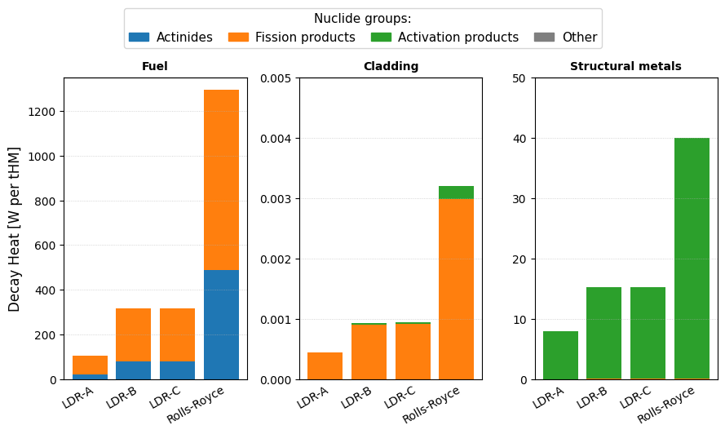
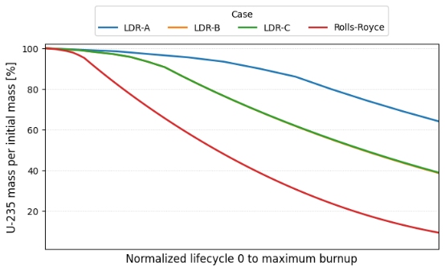
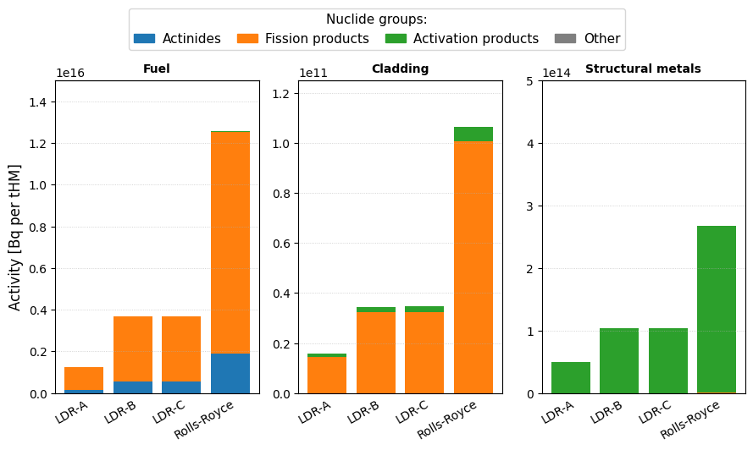
Results
Higher burnup leads into a greater depletion of fissile materials into fission products
Higher activity and decay heat
For certain LDR-lite assemblies, a substantial amount of fissile material is left over
Real operation could aim for higher burnup?
Notes:
Briefly explain that three different LDR assemblies were modelled
Explain that the right-side image is normalised so that the timescale is from beginning until removal from reactor

Slide 8
Radionuclide Transport Modelling

Slide 9
Radionuclide transport modelling
Tunnel backfill (bentonite)
Release through an advective fracture intersecting the tunnel
Similar approach as applied by Posiva [6] (with newly built models)
GoldSim software
Modelling assumptions:
A hole appears in the reference canister after 1000 years and fuel starts to dissolve
Stable groundwater conditions
Diffusion through the EBS into the excavation damage zone
Sorption and solubility limits retard release
Advection out of the near-field
Inventory:
Separate models for LDR lite and Rolls-Royce SMR
Inventory divided into fuel, cladding and other structural parts
All with separate degradation rates
Results compared to reference fuel [6]
Note: in this study Calculated without IRF
Release through the excavation damage zone
Release through an advective fracture intersecting the buffer
“F route”
Bedrock with fractures
Bentonite buffer
9

Slide 10
Release rates from the near-field
Posiva reference fuel [6]
Total release: 6.8 GBq
Peak annual release 50 200 Bq/yr
Time of peak release rate: 3 300 a
¹⁴C largest contributor to release

Slide 11
Release rates from the near-field
Posiva reference fuel [6]
Total release: 6.8 GBq
Peak annual release 50 200 Bq/yr
Time of peak release rate: 3 300 a
¹²C largest contributor to release
LDR lite
Total release: 2.9 GBq
Peak annual release 8 670 Bq/yr
Time of peak release rate: 140 000 a
⁵⁹Ni largest contributor to release

Slide 12
Release rates from the near-field
Rolls-Royce SMR
Total release: 8.9 GBq
Peak annual release 9 880 Bq/yr
Time of peak release rate: 350 000 a
⁵⁹Ni largest contributor to release
LDR lite
Total release: 2.9 GBq
Peak annual release 8 670 Bq/yr
Time of peak release rate: 140 000 a
⁵⁹Ni largest contributor to release

Slide 13
What do the results mean?
¹⁴C largest in reference fuel ⁵⁹Ni in SMRs
Impurities were not included in the SMR characterisation. Activation of impurities leads into ¹⁴C formation.
SMR metal parts contain more nickel that is activated. Also, other nuclides such as ⁹³Mo
Delays time of peak release!
Other radionuclides such as ¹²⁵Cs and ¹²⁹I have smaller differences, mainly from burnup and mass in the reference canister
Despite lack of activated impurities, the total release from RR is the highest
Mass in a disposal canister varies between the reactors.
→ In the future, it would be useful to compare canisters with normalised loading.
High burnup leads to a larger inventory of fission products.
Effect of high burnup on degradation rates not considered

Slide 14
Conclusions
A framework from reactor to repository for SMR SNF assessments was created
Post-irradiation activities, decay heat and radionuclide inventories determined for two SMRs.
With a lower burnup, less fissile material is converted into fission products when comparing LDR lite to Rolls-Royce SMR
The radionuclide release rates differed significantly between the SMRs and the reference fuel
Highlights importance of including impurities during characterisation. Do the vendors take this into account, especially for advanced SMRs?
Reactor materials also affect the releases. Could the materials be optimised during design phase of SMRs to minimise activation of mobile radionuclides?
Need for normalised canister loading or radionuclide releases per unit of energy produced!
Characterisation and canister loading was done with a lot of assumptions
More data needed from the vendors for detailed analysis!

Slide 15
References
International Atomic Energy Agency, “Small Modular Reactor Technology Catalogue 2024 Edition”, 2024. [Online]. Available: https://aris.iaea.org/Publications/SMR_catalogue_2024.pdf
R. Komu, R. Tuominen. "LDR lite benchmark specifications." LDR design document, LDR-PUB-VTT-10002-R4, VTT Technical Research Centre of Finland, 2024.
J. Leppänen, V. Valtavirta, A. Rintala and R. Tuominen, ”Status of the Serpent Monte Carlo code in 2024”, EPJ Nuclear Sciences & Technologies, vol 11, 2025. [Online]. Available: https://doi.org/10.1051/epjn/2024031
Posiva, “Käyttölupahakemus Käytetyn Ydinpolttoaineen Kapselointi- ja loppusijoituslaitos” 2021. [Online]. Available: https://tem.fi/documents/1410877/176068401/Kayttolupahakemus.pdf/885eff79-131c-93c3-9b36-afb5f763837c/Kayttolupahakemus.pdf?t=1697608133858
S. Naumer, P. Keto, N. Gotcheva, M. Kojo, P. Juutilainen, N. Kiviluoma, V. Rinta-Hiiro, S. Tornberg, T. Schatz, A. Vainio, M. Airola M. Lehtonen, T. Litmanen, M. Kari, ”SMRSiMa: SMR Waste Management and Siting, Waste Management and Societal Engagement”, 2024, VTT-R-00084-24
A. Poteri, H. Nordman, V-M. Pulkkanen, P. Smith, ”Radionuclide Transport in the Repository Near-Field and Far-Field”, 2014, Posiva 2014-02

