Slide 1
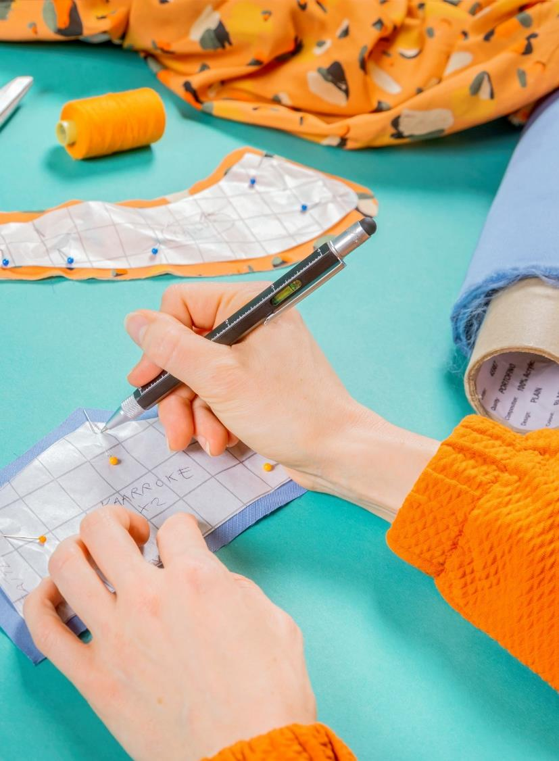
Research results on product life extension, why it is important? Piia Nurmi 25.4.2024

Slide 2
Presentation today
Background
Some research results
Summary of the research findings
Final words

Slide 3
Background

Slide 4
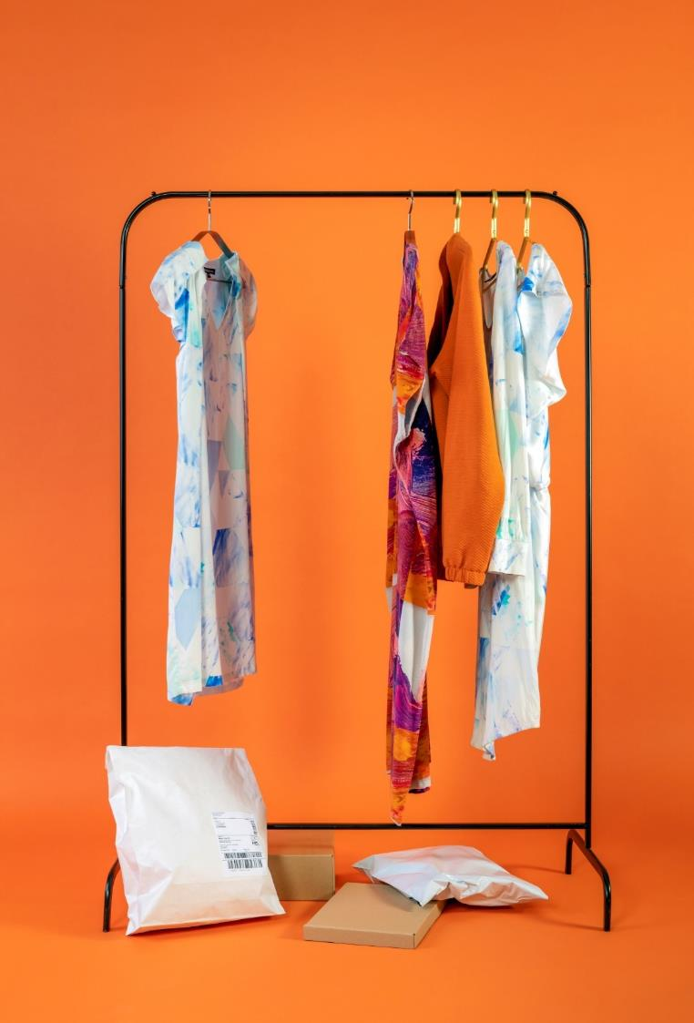
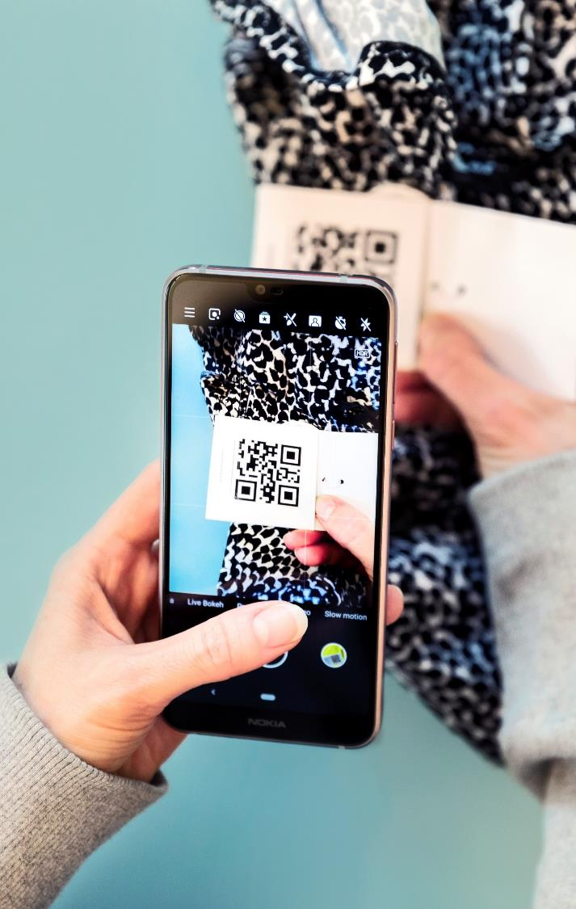
What is happening here?

Slide 5
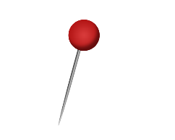
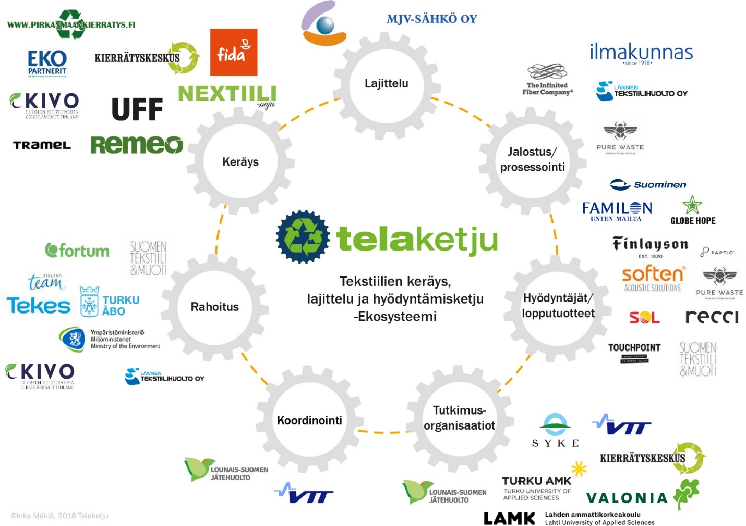
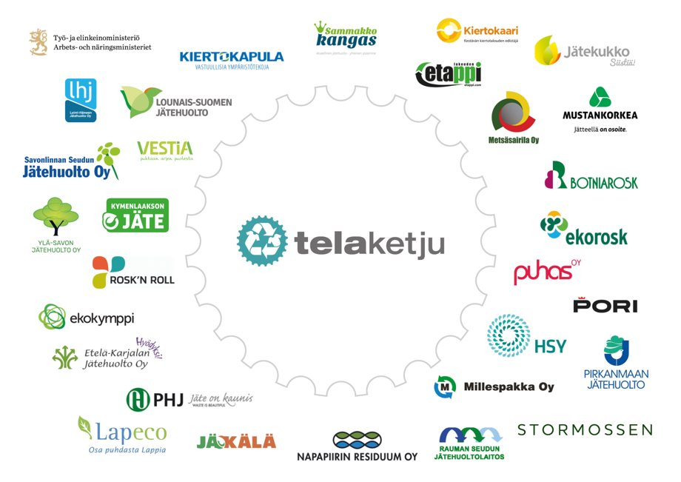
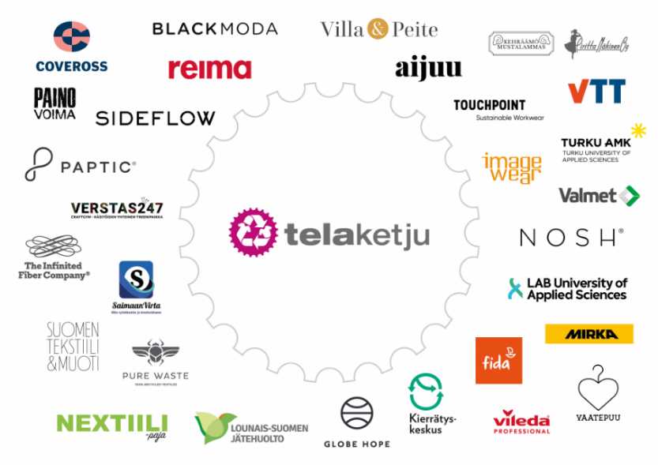
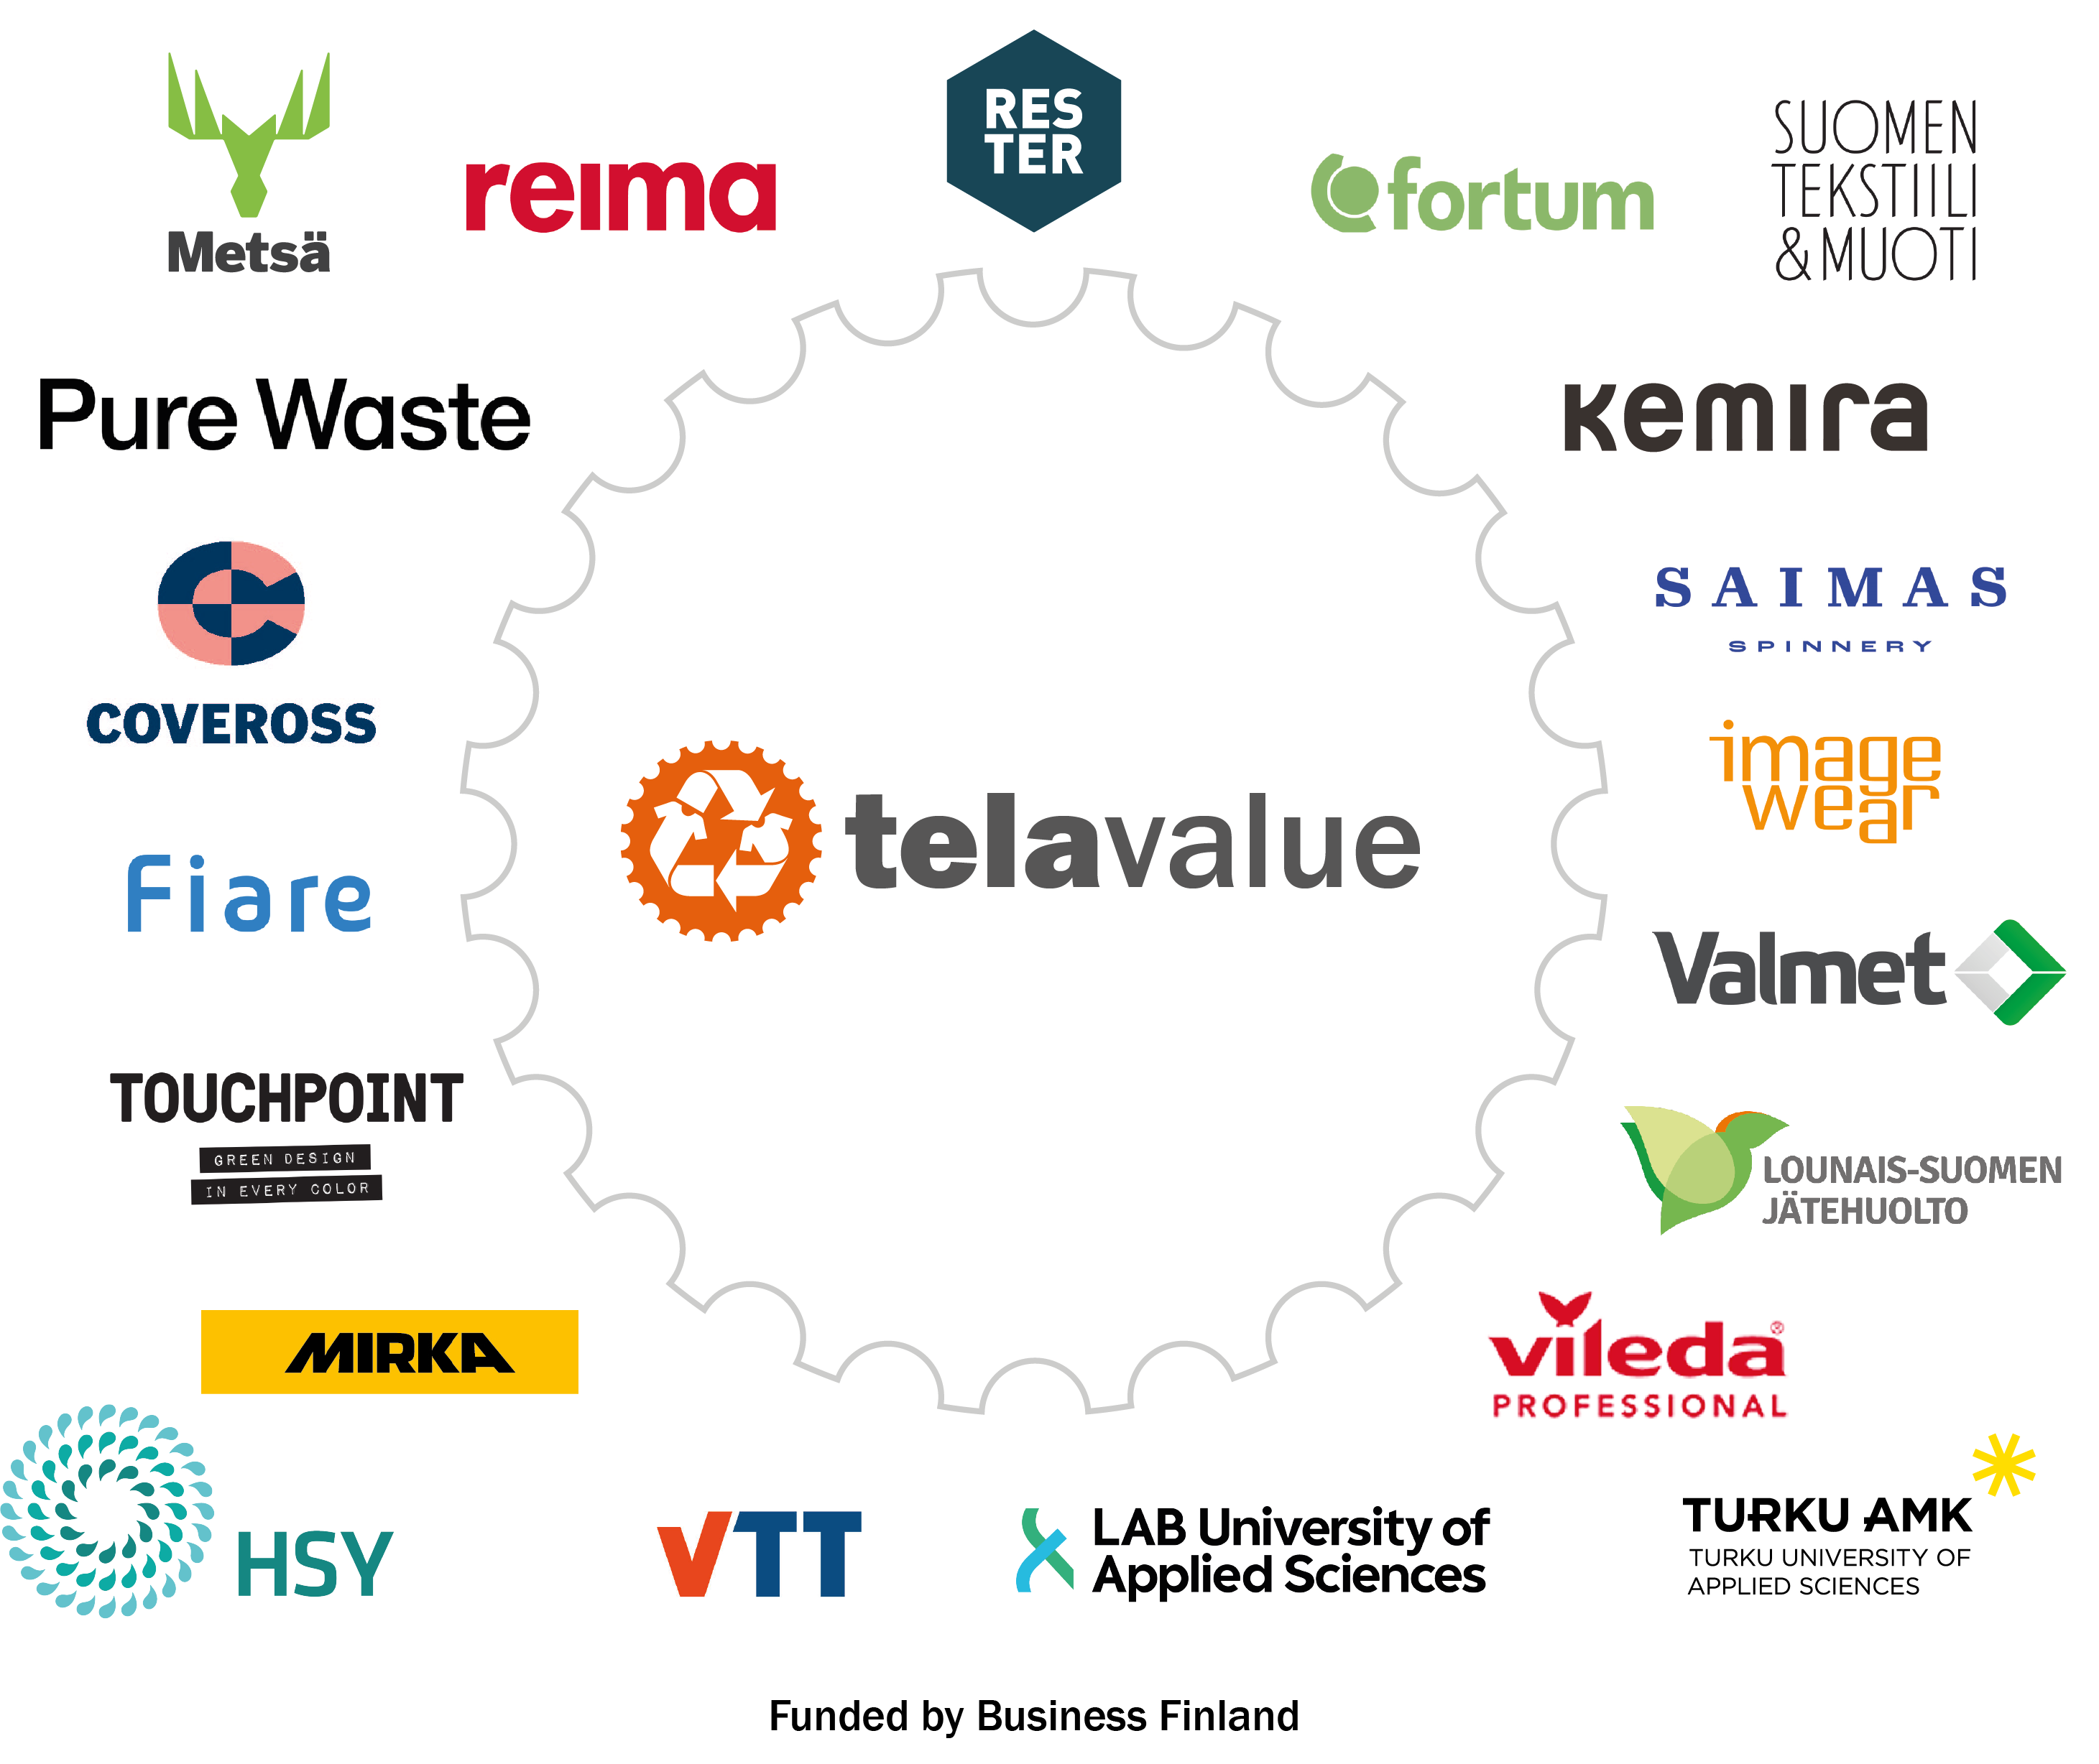
Active Research Continuum
No more landfilling
Separate collecting starting in Finland …and in EU
2015
2016
2017
2018
2019
2020
2021
2022
2023
2024
2025
Relooping Fashion (Tekes)
Telaketju YM & Tekes
Telaketju 2 BF
Telavalue BF
Textile 2.0
Telaketju TEM & AIKO
PaaS Pilots
NordicBio (FI/BF-SE/Vinnova)
CircDNet (SA)
Sustafit (BF)
NeoCel (EU)
FINIX (SA)
Trash-2-Cash (EU)
tExtended (EU)
Baltic2Hand
Telaketju …

Slide 6
Some research results of Telavalue

Slide 7
ONE OF TELAVALUE’S OBJECTIVES
Obtain competence for implementation of new circular business models in companies.
-> Multifactor Study on Business Models

Slide 8
Social, consumer, environmental, economic, data and design aspects

Slide 9
Research results
Social aspects/ https://telaketju.turkuamk.fi/en/yleinen-en/how-to-evaluate-social-responsibility-of-novel-business-models/
Consumers / to be published before summer 2024 on www.telaketju.fi
Environmental aspects / https://telaketju.turkuamk.fi/en/telavalue-results/environmental-impacts-of-circular-textile-models/
Economic aspects / https://telaketju.turkuamk.fi/en/telavalue-results/the-economic-aspects-of-new-ce-business-models/
Data / to be published before summer 2024 on www.telaketju.fi
Design / 1. Design in novel business models https://urn.fi/URN:ISBN:978-951-827-472-1 2. https://blogit.lab.fi/labfocus/tuotesuunnittelun-rooli-kiertotalouden-liiketoimintamalleissa-edellyttaa-muotoiluajattelua/
Summary of the Multifactor Study findings / to be published before summer 2024 on www.telaketju.fi

Slide 10
Social Aspects
Eerika Heinonen, Turku UAS

Slide 11
Social aspects
We started with outlining how would the hypothetical case look like in terms of the business model and its service model – from ordering to end-of-life treatment.
Then we evaluated the potential social risks throughout the service model. This evaluation was based on the UNEP’s Guidelines for Social Life Cycle Assessment of Products and Organisations (2020).
To conclude the results, a visualisation was made. It includes the social pain points of the hypothetical business models, on which each company could base their social responsibility evaluation.
The company could focus on just one variable for implementation, but in the best-case scenario, they would take into consideration all the variables and aim to implement them all excellently.
The outcome of this research gives viewpoints on social sustainability, not just taking one point of view of working conditions but trying to consider all different stakeholders in the service model. For the novel business to be truly a sustainable choice, all the different points of views need to be considered.

Slide 12
Social responsibility stages in circular business of textiles
 | IMPLEMENTATION OF VARIABLES
NAME OF THE VARIABLE | OK | GOOD | VERY GOOD | EXCELLENT
Code of Conduct | Code of conduct in effect | CoC followed | Implementation evaluated (possibly via 3rd party) | Results reported publicly
Internal feedback | Grievance mechanism | Measuring and monitoring | Interference with problems | Changes in company policies and operation
External feedback | Grievance mechanism | Reaction to feedback | Procedure | Changes in company policies and operation
Remuneration | Employees with employment contract | Living wage | Equal pay | Employment of locals
Stakeholders | Transparent and public value chain | Established partnerships | Partners involved in development work | Economically viable business ecosystem
Product as a service | The product is sustainable, comfortable and safe | Repairable and refurbishable | Sustainable material | Closed loop system
Reusable product | The product is sustainable, comfortable and safe | Remains its value (even repaired) | Recyclable material | Closed loop system
Accessibility in reuse | Promise of product durability | Platform supporting reuse | Product used up | Valuable material returns to the company
Transparency of product data | Internal trackability of products | Link to up-to-date product data within the product | Product data includes scope 3 | Product data during use-phase collected
Business model | Test | Pilot | Established part of business | Decreases the production of new products
Sustainability communications | Communication on the current situation | Communication on the development | Communication on the future | Communication on the results and reaching the targets set

Slide 13
Environmental aspects
Erika Raitala, Turku UAS

Slide 14
Environmental impacts of circular textile model
The goal was to determine the environmental impacts of two different business models
The work started by making a process diagram and defining the delimitation of the research
Soon after starting we noticed that both models consist of similar main processes:
washing
repairs storage
maintaining the sales platform
transportations
end of life treatment for unusable items
Notes:
1,5 min

Slide 15
Product as a Service
Customer/renter
Use of the product
Maintenance and washing during the rental period
Is the product usable?
Yes
Storage of products
New procurement
Service purchase/
order
Telavalue–hanke. Turku AMK / Erika Raitala ja Mitja Hokkanen 2023
Maintenance times and method
End-of-Life
No
Washing times and methods
Transport between operators
Notes:
1 min

Slide 16
Results
One process at a time, it was started to list which factors affect the environmental load of the business model.
Out of the examined product life cycles, a total of 29 environmentally relevant factors were found. Some of them may also multiply, depending on the total amount of use periods during life cycle.
Most of the factors (17) are quantitative, and the tables suggest suitable measurement units for them. The rest of the factors (12) are qualitative, related to the choice of energy form, among others.
These factors determine what the result of the environmental impact assessment is
Notes:
1,5 min

Slide 17
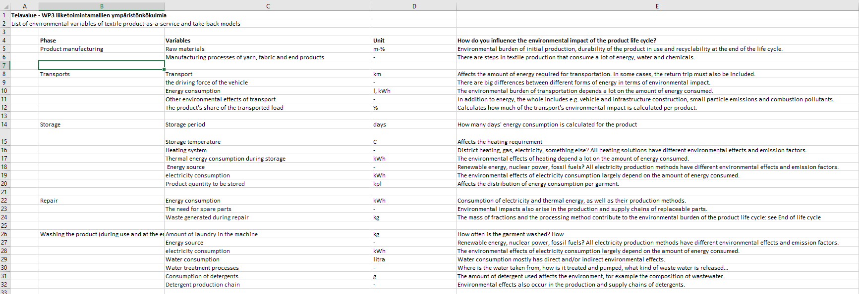
Instead of the most significant emission sources, the factors affecting the result were found
the variable monitoring during the entire life cycle is tools for that
The list of variables and those affecting them has been published.
For example, the importance of storage in relation to the environmental impact:
Notes:
1 min

Slide 18
Economic aspects
Marjaana Launonen, Turku UAS

Slide 19
Economic aspects, literature review
Project included a literature review, considering the economic aspect of circular economy business models
The aim was to find out, how much literature is available in the databases that takes into account the economic aspects
The search was conducted mainly from the central databases of business administration and sales
Only articles available online that are not related to previous studies or publications in the Telaketju project were taken into account in this search
A total of five articles were found in the searches
The result of the literature review is that there are only a few articles on economic perspectives to be found, and the need for this kind of material clearly exists

Slide 20
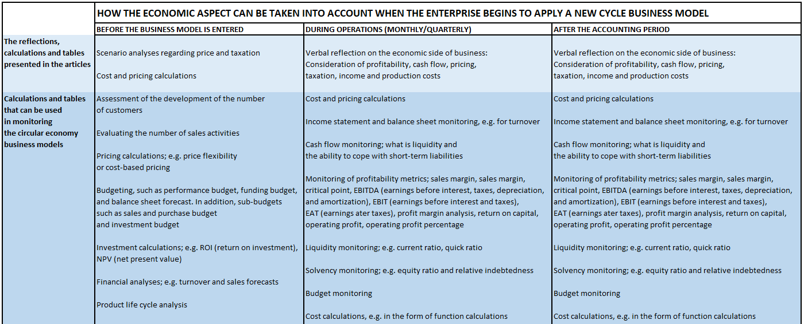

Slide 21
Research results
Social aspects/ https://telaketju.turkuamk.fi/en/yleinen-en/how-to-evaluate-social-responsibility-of-novel-business-models/
Consumers / to be published before summer 2024 on www.telaketju.fi
Environmental aspects / https://telaketju.turkuamk.fi/en/telavalue-results/environmental-impacts-of-circular-textile-models/
Economic aspects / https://telaketju.turkuamk.fi/en/telavalue-results/the-economic-aspects-of-new-ce-business-models/
Data / to be published before summer 2024 on www.telaketju.fi
Design / 1. Design in novel business models https://urn.fi/URN:ISBN:978-951-827-472-1 2. https://blogit.lab.fi/labfocus/tuotesuunnittelun-rooli-kiertotalouden-liiketoimintamalleissa-edellyttaa-muotoiluajattelua/
Summary of the Multifactor Study findings / to be published before summer 2024 on www.telaketju.fi

Slide 22
Summary of the findings

Slide 23
Multifactor Study on Business Models published before summer 2024 www.telaketju.fi

Slide 24
1. The phenomena is wide and important

Slide 25
2. We need to do the change together

Slide 26
3. We need to decrease consumption

Slide 27
4. Consumers have a leading role

Slide 28
5. All aspects need to be developed separately and together

Slide 29
Product life extension, why it is important?

Slide 30
Thank you! Piia Nurmi @turkuamk.fi
www.telaketju.fi

