Slide 1
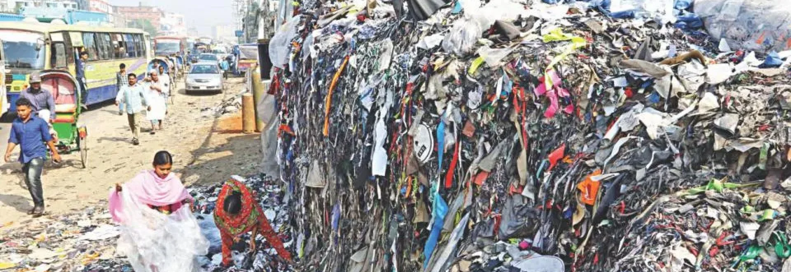
Sustainable supply chain of textiles - Experiences shared from South-Asia

Slide 2
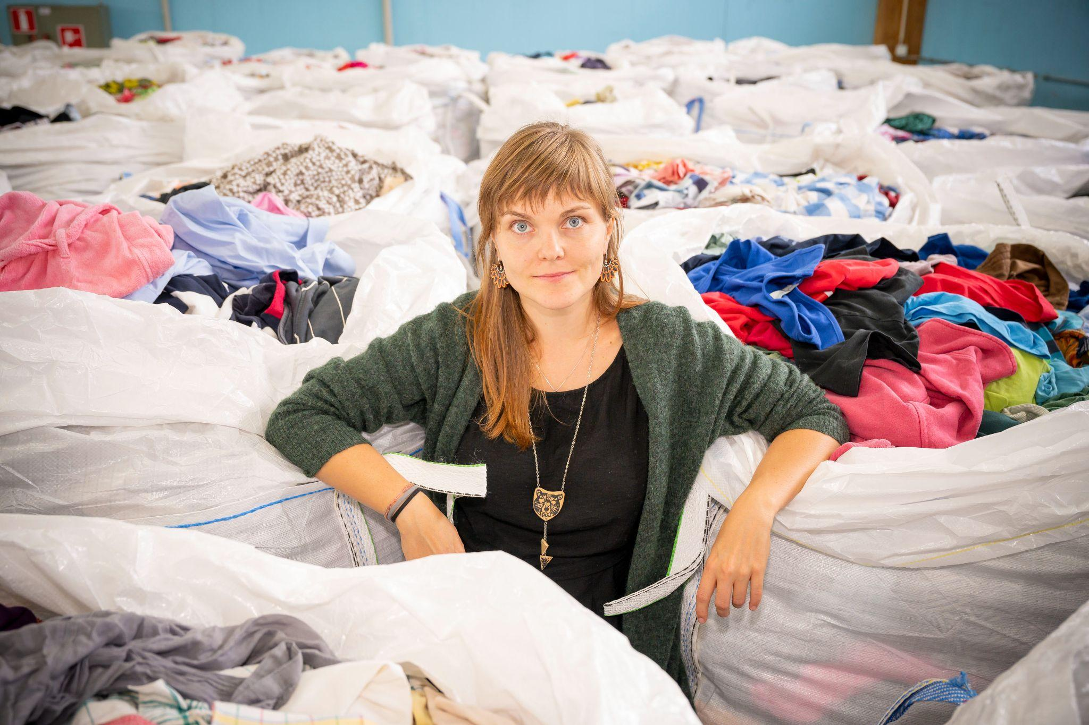
Tanzida Islam
Impact-driven sustainability professional with 11+ years of experience on Social and Environmental issues in textile industry mainly with H&M Group across Bangladesh, Pakistan & Africa.
Led programs connected to supply chain sustainability, climate, water, chemicals and circularity for textile waste, with a focus to create an environmentally resilient supply chain.
Drove social program connected to Wage management system to secure transparency and fairness, Inclusion and Diversity to create a balance in gender ration in the all level, Industrial Relation to support freedom of association among workers to strengthen workers and management relation.
Sini Ilmonen
With over a decade of professional experience in sustainable practices, I have consistently driven positive change and sought solutions to enhance circularity in senior and managerial roles.
I have played a key role in developing textile collection and sorting practices at the national level in Finland, collaborating with municipal waste management companies, cities, ministries, and other stakeholders in the textile recycling value chain.
I have worked in the mechanical recycling plant and currently I'm working for chemical recycling field by building a sustainable and circular supply chains of textile waste for next gen fiber production.

Slide 3
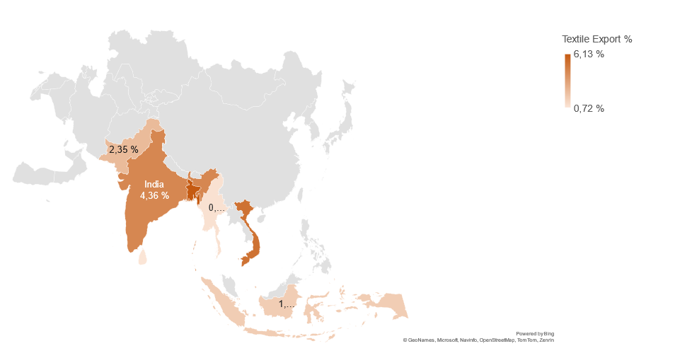
In 2022, Textiles were the world's 7th most traded product, with a total trade of $941B . Year on year growth was 6.8%.
Trade in Textiles represent 3.97% of total world trade
Country | Textile Export %
Bangladesh | 6,13 %
Vietnam | 5,18 %
India | 4,36 %
Pakistan | 2,35 %
Cambodia | 1,70 %
Indonesia | 1,65 %
Myanmar | 0,85 %
Thailand | 0,82 %
Sri Lanka | 0,72 %

Slide 4
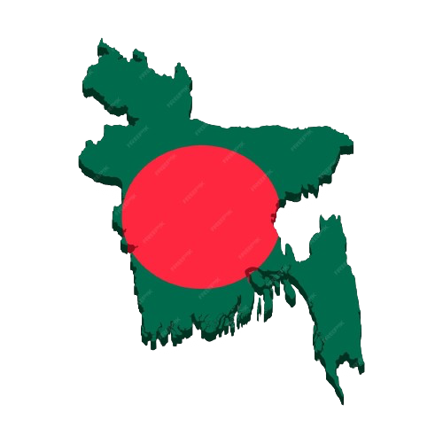
Bangladesh in textile numbers
Bangladesh is the 8th-most populated country in the world with almost 2.2% of the world's population. As per the final results of the 2022 Census of Bangladesh, the country's population is 171.2 million
In the last twenty years, Bangladesh's CO2 emissions have been going up by about 8% each year, mostly because of the RMG sector.
Apparel exports from Bangladesh hit a milestone in 2023 fetching an all-time high of nearly $47 billion¹
Garments accounted for about 85% of all export in ¹
Bangladesh could eventually retain USD 1 billion locally If the country manage 100% of cotton-based waste recycling ¹
Bangladesh stands top as garment exporter in terms of volume
~ 500,000 tonnes of textile waste generates yearly ³
1 https://www.thedailystar.net/business/news/garment-exports-earned-record-4738b-2023-3512736#
2. https://thefinancialexpress.com.bd/trade/stop-garment-waste-export-to-ensure-supply-for-local-recycling-units-1671161568
3. https://www.lightcastlebd.com/insights/2023/08/textile-waste-opportunity/

Slide 5
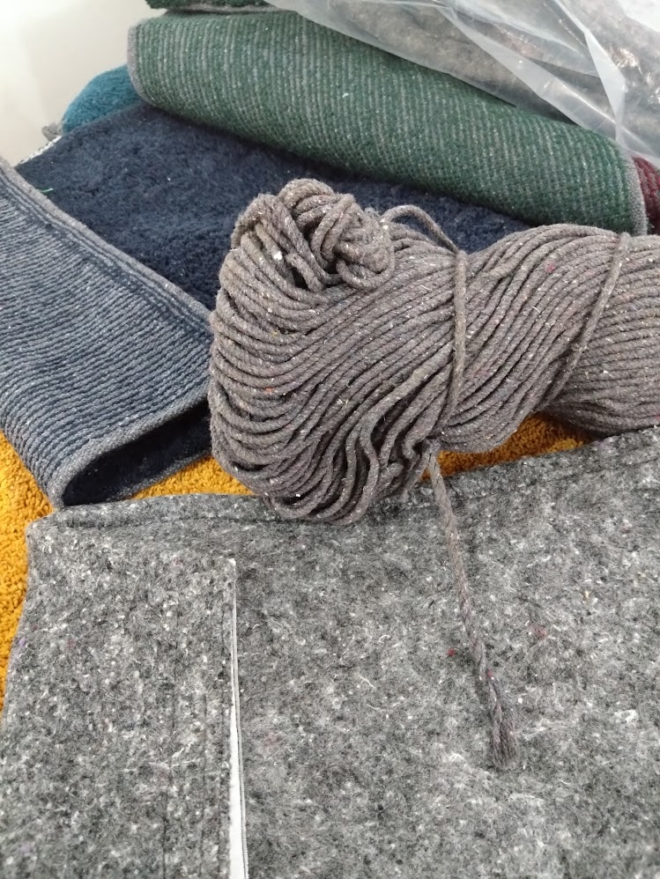
Post Industrial Textile Waste – Current practices
Local recycling capacity is approx. 80kt which can only cover 15% of the total produced wastage.
5% back to yarn production
Fuel to produce energy
35% through fabric incineration boiler or some cases landfill
Export to India, Hong Kong and other countries for recycling - approx. 60%
No Post Consumer waste
75% of the fabric waste are cotton
No regulation in place on using fabric scrap for onsite incineration
Recycling technology is available only for cotton fabric waste
Technology not available for blended textile waste locally
Waste Handling sector is informal so traceability, child labour, correct wages are big concerns
Strong need of formalizing the recycling value chain and strengthening their connection
Inclusive policies are needed for informal sector to be formal
Investment support for new technology is a must
References : 1. https://thefinancialexpress.com.bd/trade/stop-garment-waste-export-to-ensure-supply-for-local-recycling-units-1671161568

Slide 6
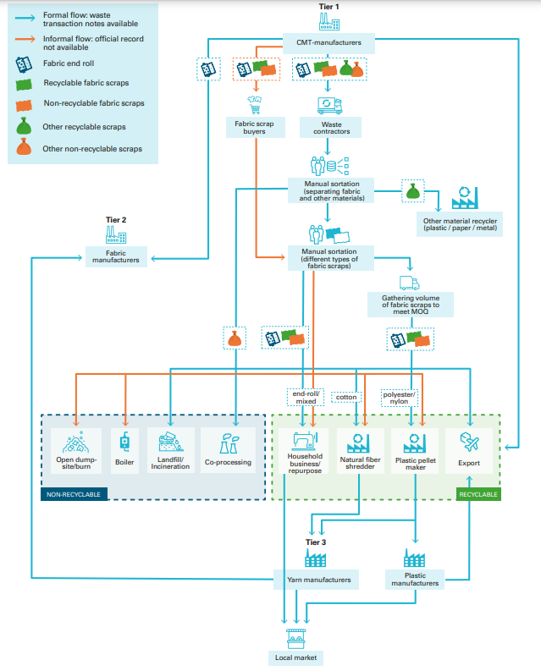
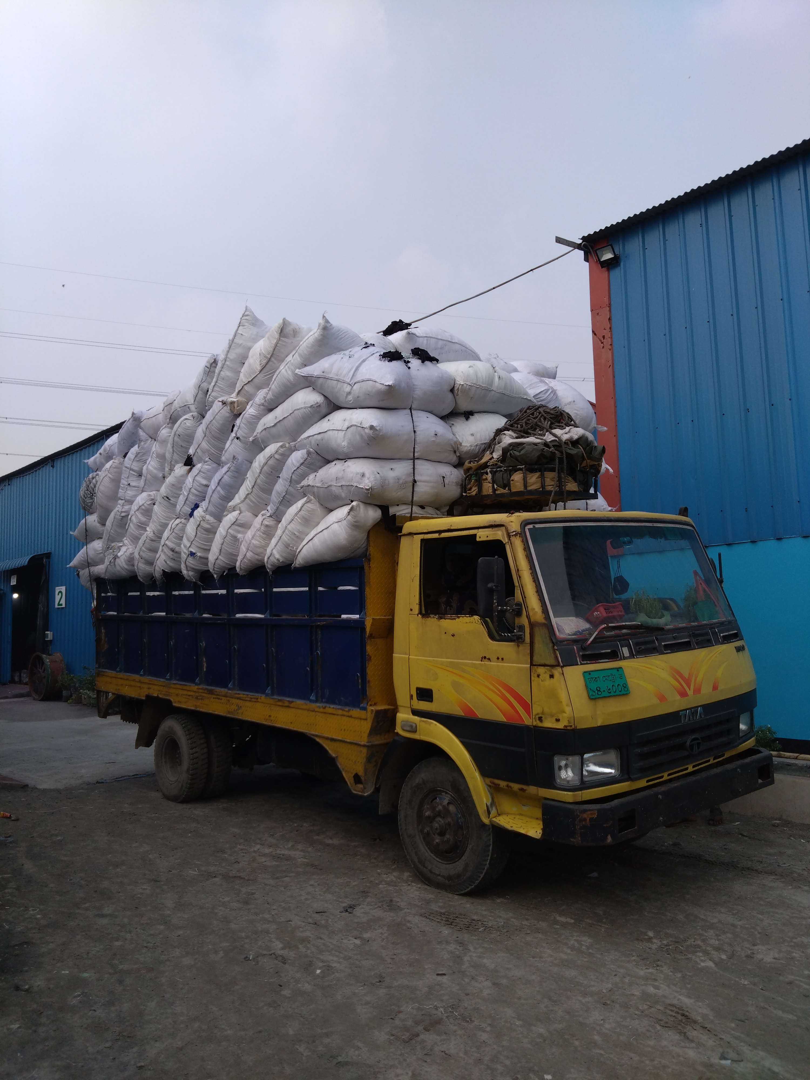
Collection and sorting
Source: Industrial Fabric Waste Flow A tentative Analysis for Vietnam

Slide 7
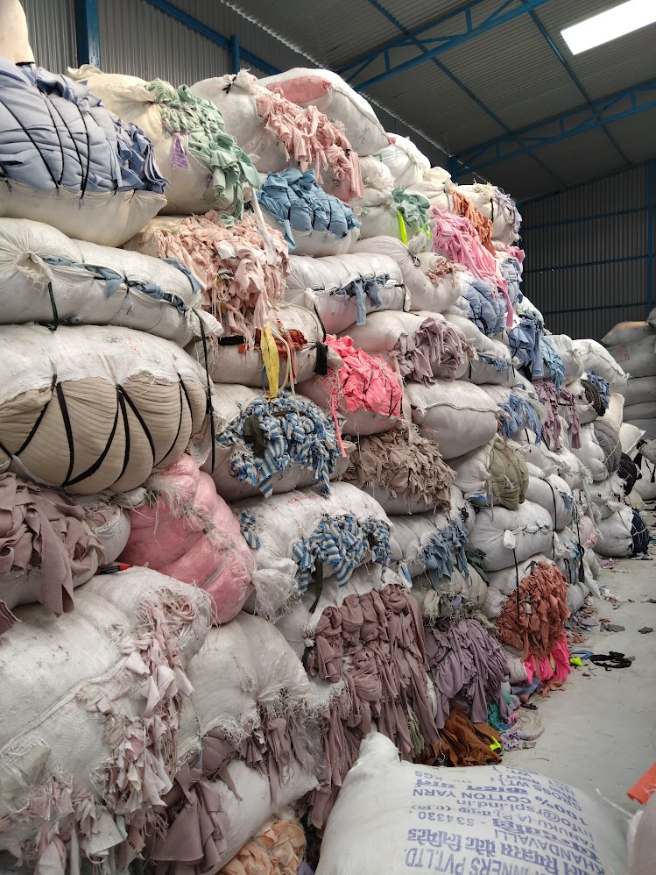
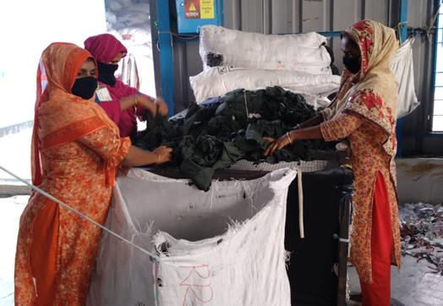
Sorting of post-industrial textiles

Slide 8
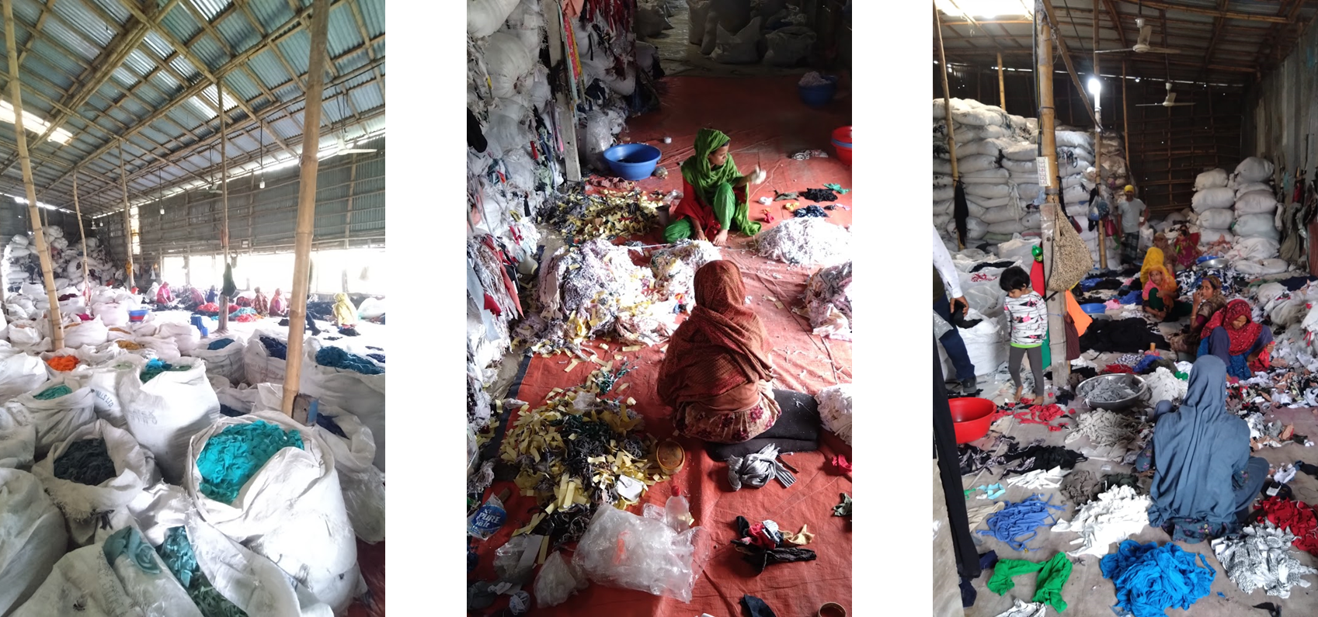
Sorting of post-industrial textiles (informal)

Slide 9
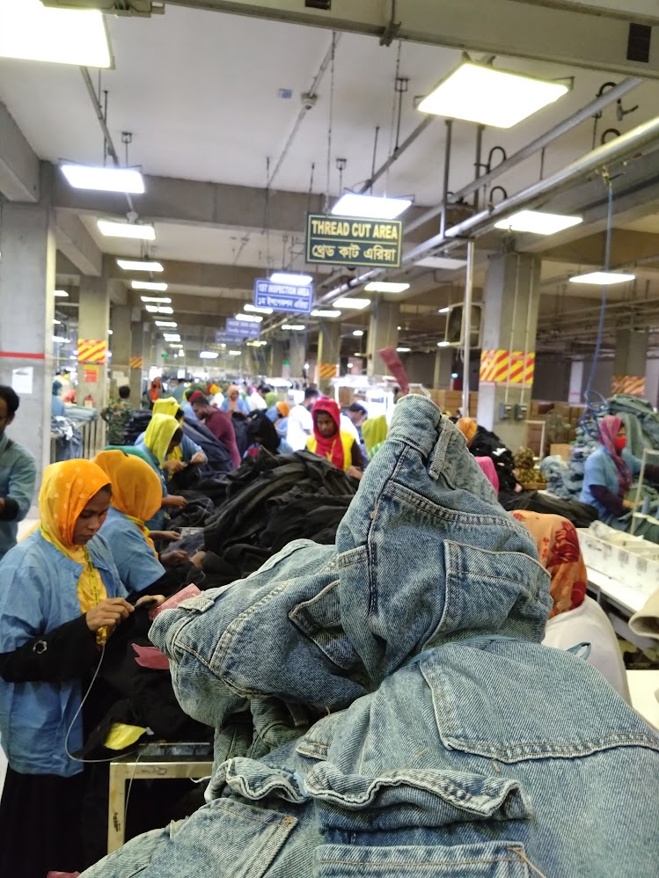
Brands taking action
Reputational risk mitigation
Due diligence & Voluntary disclosure through Sustainability
To secure business
Upcoming legal / mandatory requirements
Support Environmental causes
(climate and circularity)
EU CSRD & CSDD
Other EU legislation

Slide 10
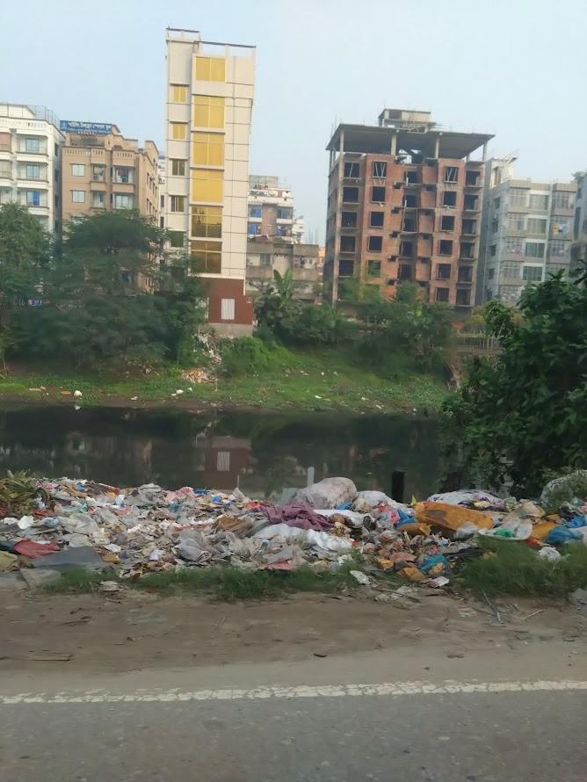
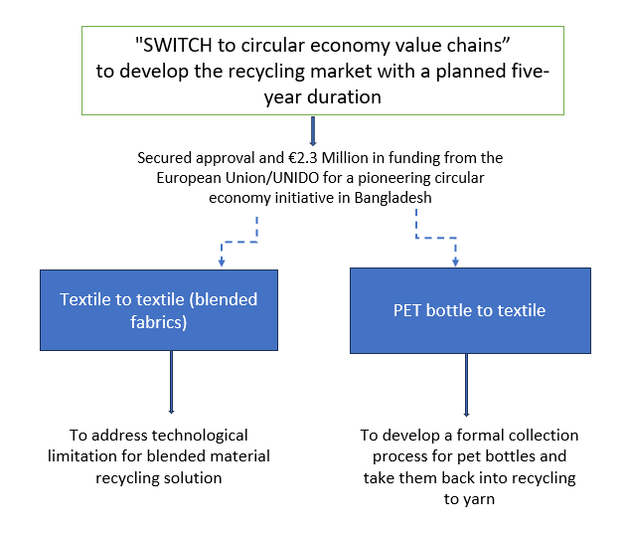
Brands Initiative - recycling

Slide 11
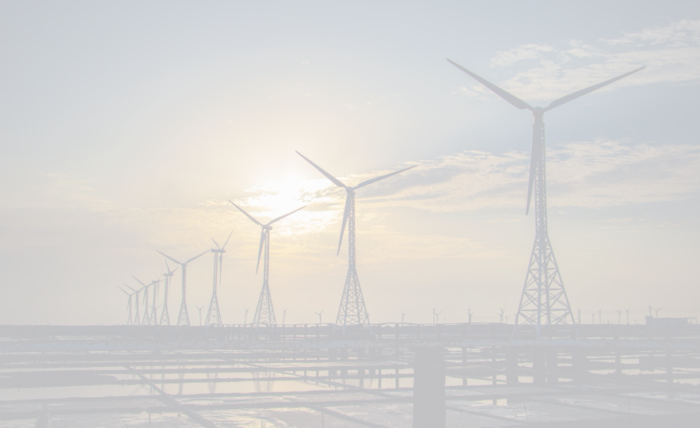
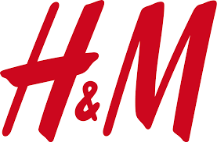
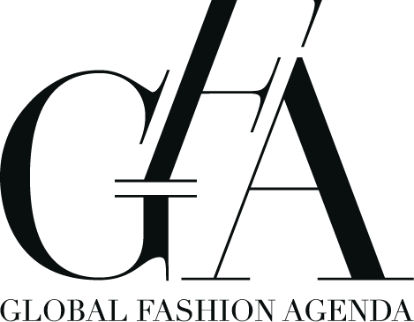
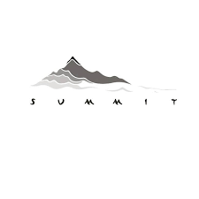
Brands Initiative – Enabling Decarbonization by Collective investment to wind power
Bestseller and H&M Group made the pledge at COP28 to support the first ever utility scale large offshore wind power project in Bangladesh
The wind project would have an approximate capacity of 500 megawatts
Project proposal valued at USD 1.3 billion
Bestseller will invest up to $100 million as a co-investor
The project is likely to support Bangladesh renewable energy goal of supplying 40 per cent of the nation's power demand from renewable sources by 2041
The project has received government approval to carry out a detailed feasibility study and implement the first phase of development with site exclusivity in the next three years.
If development is successful, operations are expected to commence in 2028
Co-Investment partner : H&M
Project development partner : Copenhagen Infrastructure Partners (CIP
Co-Investment partner : Bestseller
Advocacy partner :
Global Fashion Agenda
Local Partner : Summit power

Slide 12
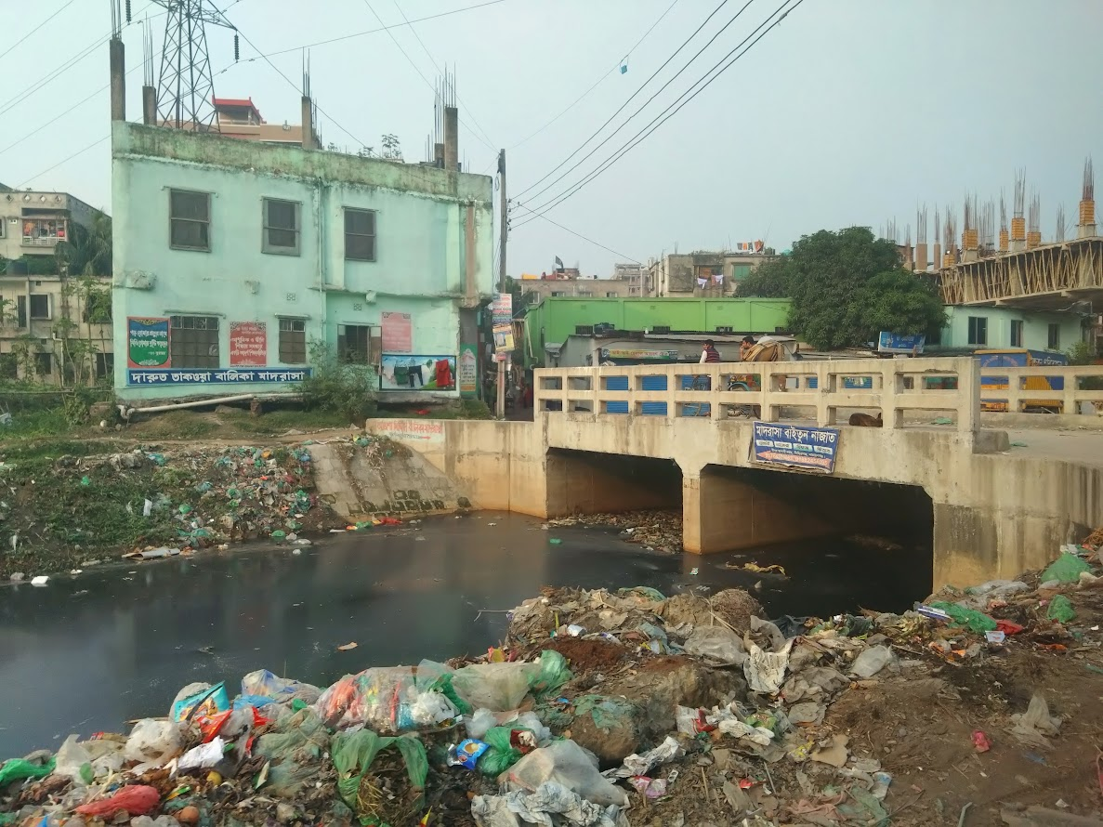
Ground Water Depletion & Pollution : Greater Dhaka
Major Ground Water (GW) consuming sectors are agriculture, domestic use & industry.
Withdrawal in some regions exceed the groundwater recharge rate, resulting in falling groundwater.
It likely affects water availability in industrial zones at Savar, Ashulia, Tongi & Narayanganj.
Ground water level around greater Dhaka is declining by 3 meters/year due to over-extraction.
Sources: Rapid Assessment of Greater Dhaka Groundwater Sustainability , 2030 Water Resources Group, Bangladesh Water Partnership, 2019
BAU means Business As Usual which assumed steady state growth in industrial expansion & considered industrial growth rate 8.9% in 2018.
BAU Plus means Business As Usual Plus which assumed industrial growth rate will not be steady & considered 9.6% & 11% growth rate for year 2021 & 2030 respectively.

Slide 13
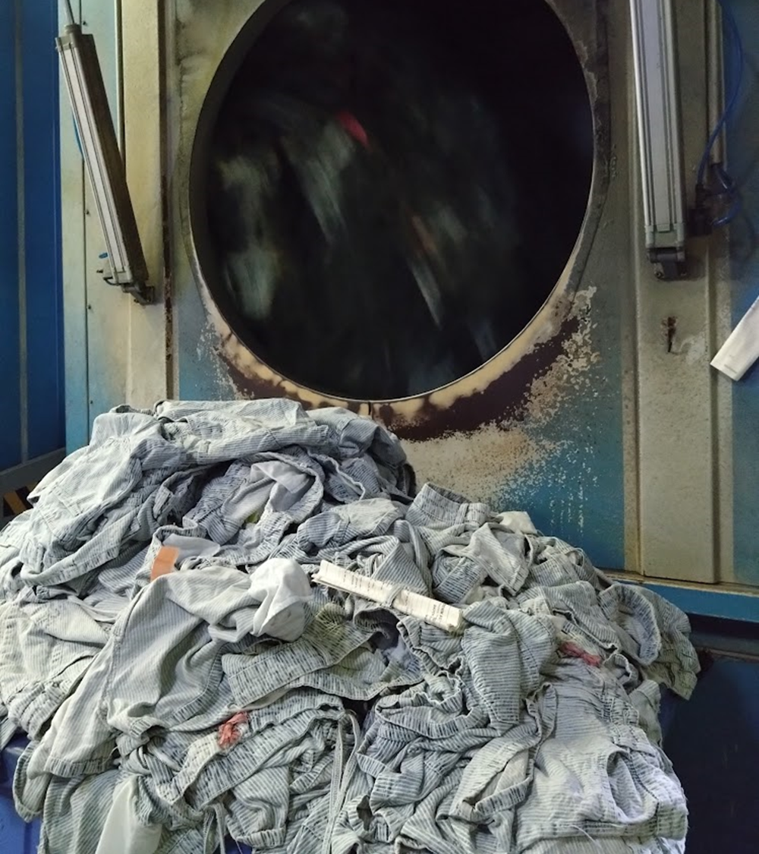
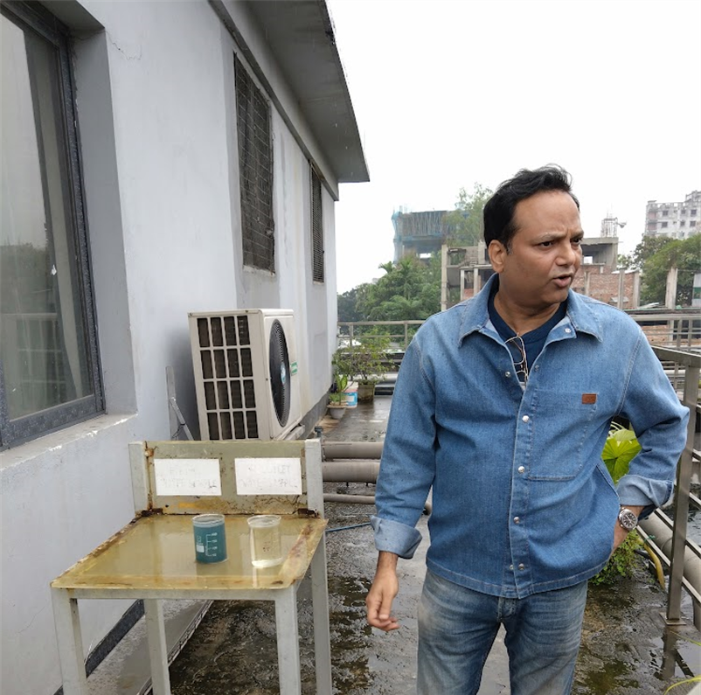
Manufacturers initiative – water treatment & recycling

Slide 14
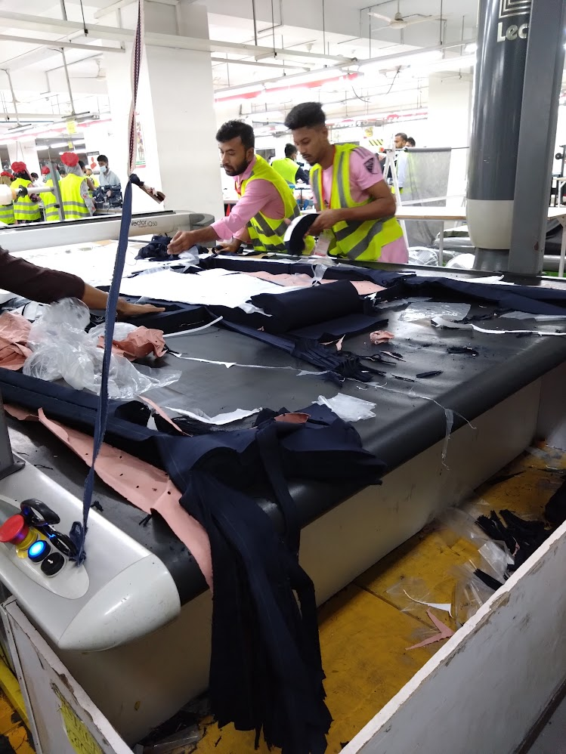
Why the change takes so long?
Systemic Change:
Holistic approach to viewing the world. Interrelationships between things. Networks of different actors that interact with each other directly or indirectly. It is necessary to observe how a system functions in order to intervene in it. Find the best points of leverage. Systemic change refers to the simultaneous reform of operational models, structures and their interactions.
Supply chains are complex and global, making systemic change challenging.
Differing regulations in various countries create chaos.
Consumers are unwilling to pay the true costs.
Corruption is prevalent in production, especially in developing countries.
Innovation and research efforts are lacking.
Legislation and its enforcement is behind.
While sustainability is important for most stakeholders, profit remains the primary factor.
Notes:
Why this is so slow?

Slide 15
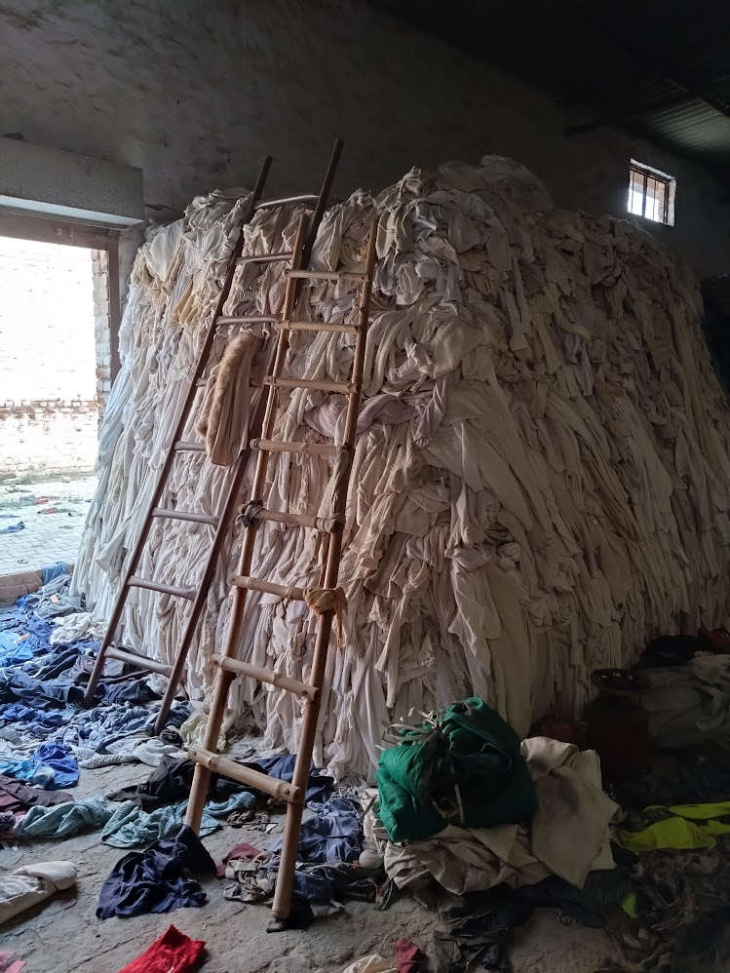
QUESTIONS?

